Slide 1
With apologies to Wiley Publishing…
ITIL
for
Dr Malcolm Murray Durham University

Slide 2
Learning Outcomes
Understand what ITIL is
High level view of the key parts
Know the interface between ITIL and
Change Management
Project Management
Service Level Management
Share the experience of the group

Slide 3
What is ITIL?

Slide 4
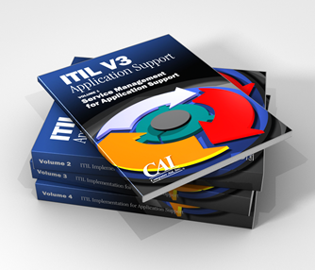
Define thyself...
ITIL® is the only consistent and comprehensive documentation of best practice for IT Service Management
ITIL consists of a series of books giving guidance on the provision of quality IT services, and on the accommodation and environmental facilities needed to support IT.
http://www.itil-officialsite.com/AboutITIL/WhatisITIL.asp
Notes:
The Office of Government Commerce (OGC) is an independent office of HM Treasury, established to help Government deliver best value from its spending.

Slide 5
A framework
ITIL provides a systematic and professional approach to the management of IT service provision.
http://www.itil-officialsite.com/AboutITIL/WhatisITIL.asp
ITIL is the most widely accepted approach to IT service management in the world. ITIL provides a cohesive set of best practice, drawn from the public and private sectors internationally.
http://www.itil-officialsite.com/home/home.asp

Slide 6
ITIL in plain English
A series of books…
The IT Infrastructure Library
…and badges
Supporting Professional Qualification Scheme
http://upload.wikimedia.org/wikipedia/commons/thumb/f/f9/Wearer_of_an_ITIL_Foundation_Certificate_pin.jpg/220px-Wearer_of_an_ITIL_Foundation_Certificate_pin.jpg

Slide 7
Claimed Benefits of ITIL
Reduced costs
Improved IT services through the use of proven best practice processes
Improved customer satisfaction through a more professional approach to service delivery, standards and guidance
Improved productivity
Improved use of skills and experience
Improved delivery of third party services through the specification of ITIL or ISO 20000 as the standard for service delivery in services procurements.
http://www.itil-officialsite.com/AboutITIL/WhatisITIL.asp

Slide 8
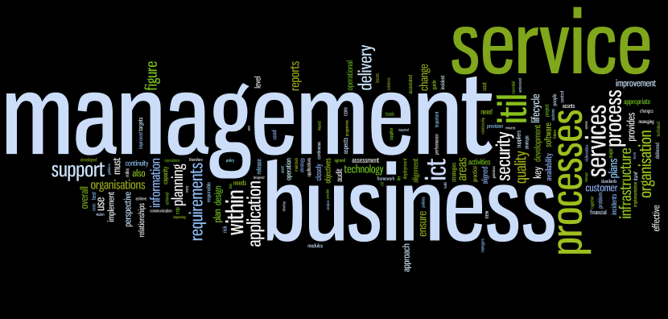
-ing murdering? ITIL v2
The IT Infrastructure Library An Introductory Overview of ITIL® Version 2.0
Colin Rudd
ISBN 0-9543521-9-X
published in the UK by the IT Service Management Forum Limited
9 780954 352196
http://www.wordle.net/create

Slide 9
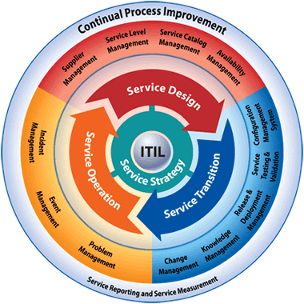
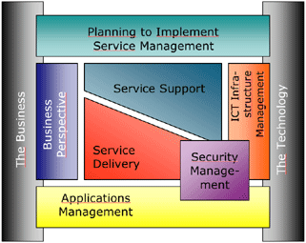
Which Version?
ITIL started in the 1980s ITIL v3 released in 2009
Many still using ITIL v2
Notes:
OGC withdrawing support for ITIL v2, process to complete by 30th June 2011 http://www.ogc.gov.uk/itil_ogc_withdrawal_of_itil_version2.asp

Slide 10
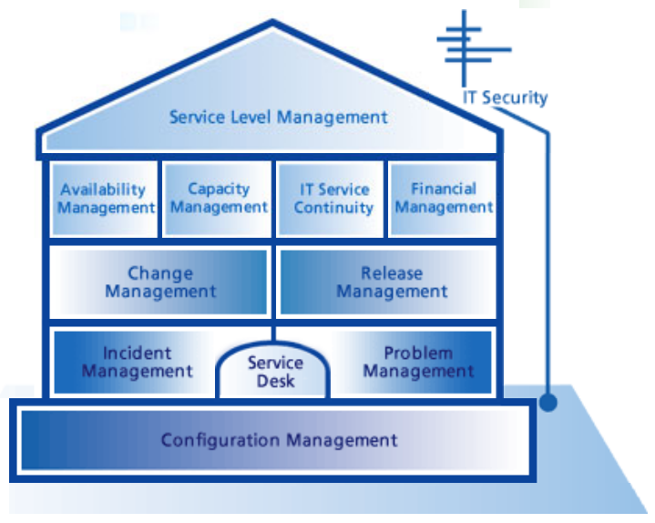
The House of ITIL v2
Image Source: Basel Consulting Group http://p13957.typo3server.info/fileadmin/media/microsite/engl/itil/itil_startframe.htm

Slide 11
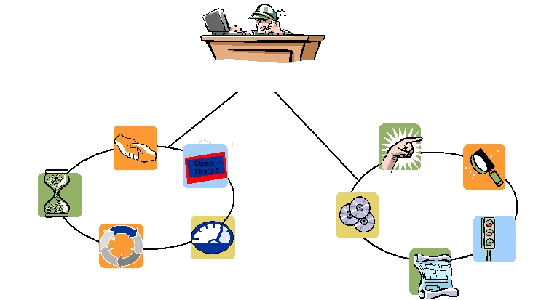
Version 2
Service Desk
Service Level Mgmt
Incident
Mgmt
Problem Mgmt
Availability Mgmt
Service Delivery
Service Support
Financial Mgmt
Release
Mgmt
Capacity Mgmt
Change
Mgmt
Service Continuity Mgmt
Configuration
Mgmt
After: http://www.securityfocus.com/foundations/images/itil-figure1.jpg

Slide 12
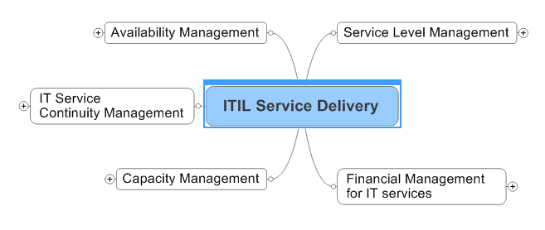
ITIL v2 Service Delivery Mind Map
http://itsmdoc.googlepages.com/ITIL_Service_Delivery.mmap

Slide 13
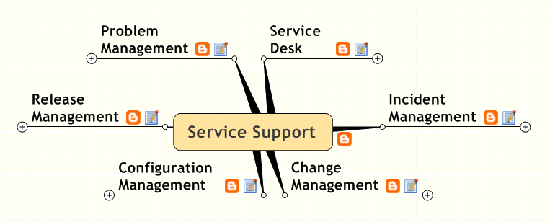
ITIL v2 Service Support Mind Map
http://itsmdoc.googlepages.com/ITIL_Service_Support.mmap

Slide 14
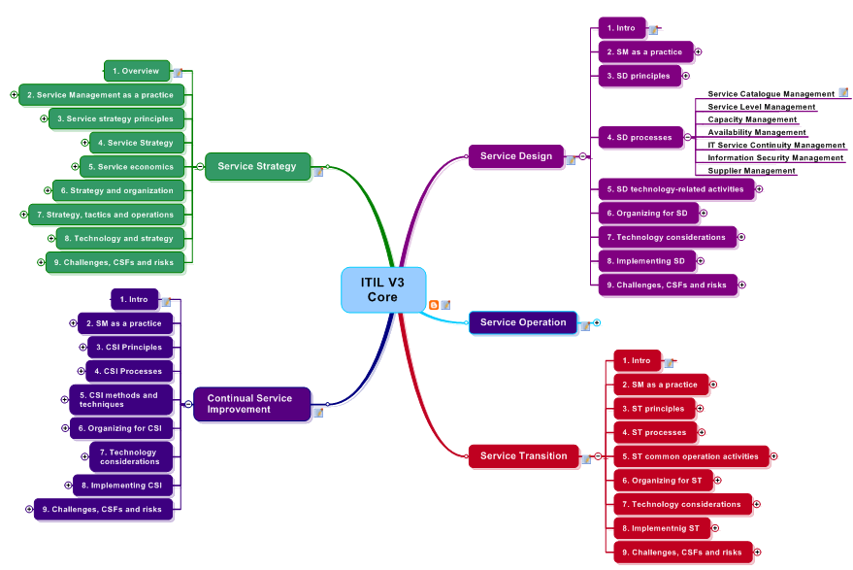
ITIL v3 as a Mind Map
http://itsmdoc.googlepages.com/ITILV3.mmap

Slide 15
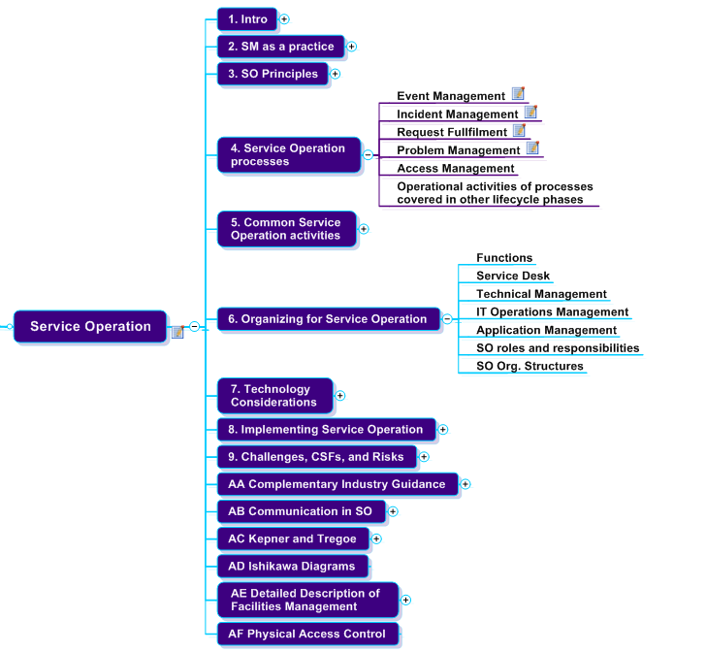
ITIL v3 Service Operation

Slide 16
Dangers
ITIL generates a lot of acronyms...
http://www.best-management-practice.com/gempdf/ITIL_Glossary_V3_1_24.pdf

Slide 17
ITIL & Change

Slide 18
Where Change Happenz in ITIL v2
Incident Management
RFC as an output from a user’s Service Desk call
Business Relationship Management
Customers make a RFC
Problem Management
Trigger a RFC as an output
Change Management
Process for RFCs
Trigger a RFC as an output
Release Management
May be required whilst making a change
Notes:
Users via SD, Customer via BRM

Slide 19
Change Management
Aim
Minimise the adverse impacts of change
Ensure standard methods and procedures are used
Assess the benefit of change vs. risk and cost

Slide 20
Change Management Process
Raise (record) a change
Assess the impact, benefit, cost & risk
Develop business case
Obtain approval (CAB)
Manage change implementation
Monitor and report
Close and review

Slide 21
Software
Roll your own with SharePoint
Part of a full solution – Remedy
“other solutions are available”
ITIL is a framework, a set of ‘Best Practice’ guidelines. It is not a standard. Consequently no company, tool, project or person could be ‘certified ITIL compliant’.
Brooks (2009)
ITIL Software Scheme Report available at http://www.itil-officialsite.com/nmsruntime/saveasdialog.asp?lID=769&sID=212

Slide 23
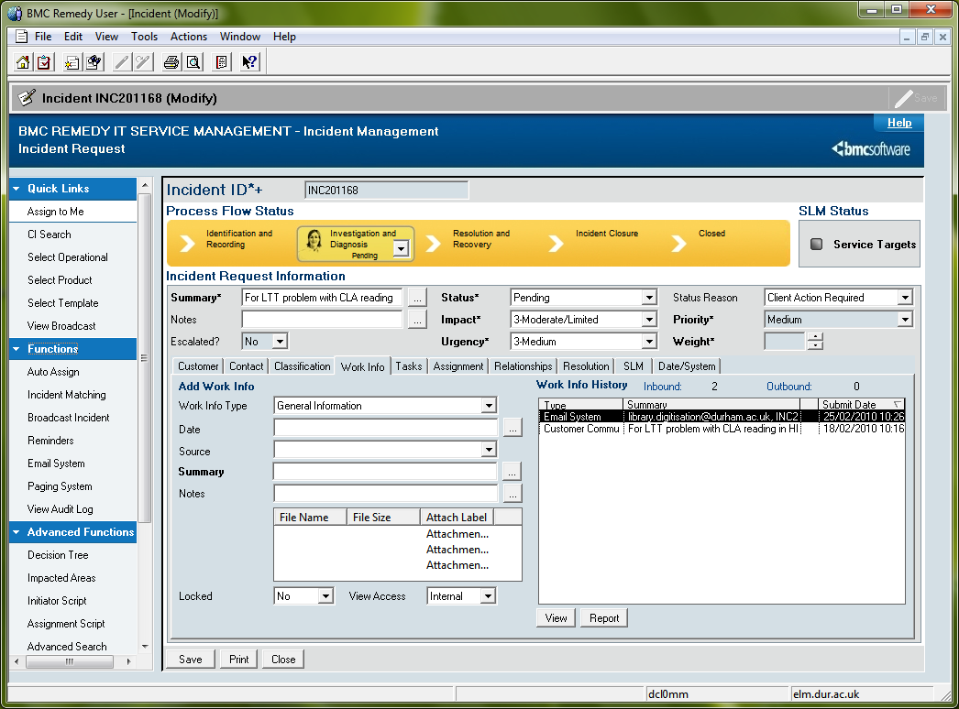

Slide 24
ITIL & Projects

Slide 25
Project Management
Not part of the ITIL framework
ITIL can’t ensure that your project will succeed...
...but ITIL change management might stop it inadvertently breaking something (everything) else

Slide 26
ITIL & Service Level Management

Slide 27
Service Level Management
Aims
Maintain & gradually improve IT service quality
Constant agreed cycle of monitoring & reporting achievement
Action to eradicate poor service

Slide 28
Service Level Management Process
Establish Function of the Service
Compile Service Catalogue (incl. Owners)
Establish Service Level Requirements
Draft, Agree & Implement SLAs
Manage the Ongoing Process
Periodic Review

Slide 29
Service Level Agreements
Agreed between
Service Owner
Customer Representative
Where to start
Internal service targets?
Build SLAs from these

Slide 30
Measuring e-Learning
Developing metrics for assessing the performance of a Learning Environment
This will form the substance of the ITIL discussion this afternoon

Slide 31
Wisdom of the crowd

Slide 32
Experiences from the group
Anything you’d like to share?

Slide 33
Picture from Durham
What are we doing?
A lot of talking
A lot of training
Considerable investment
upfront
long term: new staff; v2 to v3; v4 etc...
Refining processes
Service Improvement Projects
Talking to customers
Talking to IT Staff

Slide 34
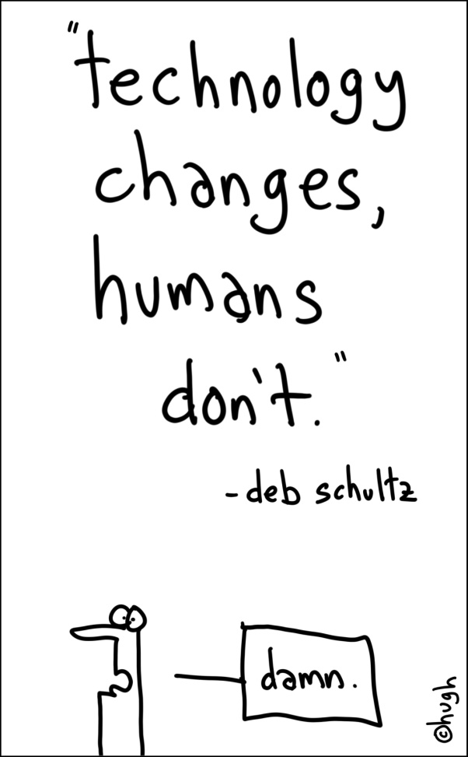
Cultural Change
“Restore service as quickly as possible” vs. “Find and fix the root cause”
Most IT staff prefer technology over process
Initially about as popular as documentation
http://gapingvoid.com/2007/05/19/technology-changes/

Slide 35
Conclusion
ITIL is
A framework for IT service provision
Books & badges
ITIL has processes for many aspects, including
Change Management
Service Level Management
but not
Project Management

Slide 36
Further Information
Official ITIL website:
http://www.itil-officialsite.com/home/home.asp
IT Service Management Forum
http://www.itsmf.co.uk/
ITIL v3 Pocket Book
http://www.best-management-practice.com/gempdf/itSMF_An_Introductory_Overview_of_ITIL_V3.pdf
One of many blogs
http://itservicemngmt.blogspot.com

Slide 37
Thanks. Any further questions?

Slide 38
Dr Malcolm Murray FRGS FHEA CMALT
Learning Technologies Team Leader
IT Service
Durham University
Email: malcolm.murray@durham.ac.uk
bye

