Slide 1
Introduction to Web Page Design
Instructional Support Services (ISS)
Short Course, Fall 2012
UMSL

Slide 2
An Overview…
Know Uniform Resource Locator (URL), Web Browsers/Servers
Web Design Software
Designing a Simple Web Page:
  Add font and size to enhance text appearance.
  Create unnumbered and numbered lists.
  How to create tables and its advantages & disadvantages
  Placing images in your webpage
  Helpful web designing tips

Slide 3
Browsers, HTML, and URL
Purpose of a Browser:
  It must be able to communicate to the server using the specific language of that server. Ex: HTTP protocol, FTP
Hyper Text Markup Language (HTML) – contains the basic structure of a web page, including all text, background colors, links to other pages, images, etc.
Popular Browsers: Internet Explorer, Firefox, Safari, etc.
Uniform Resource Locator (URL) – a pointer location to data on a webpage. Ex: http://umsl.edu/

Slide 4
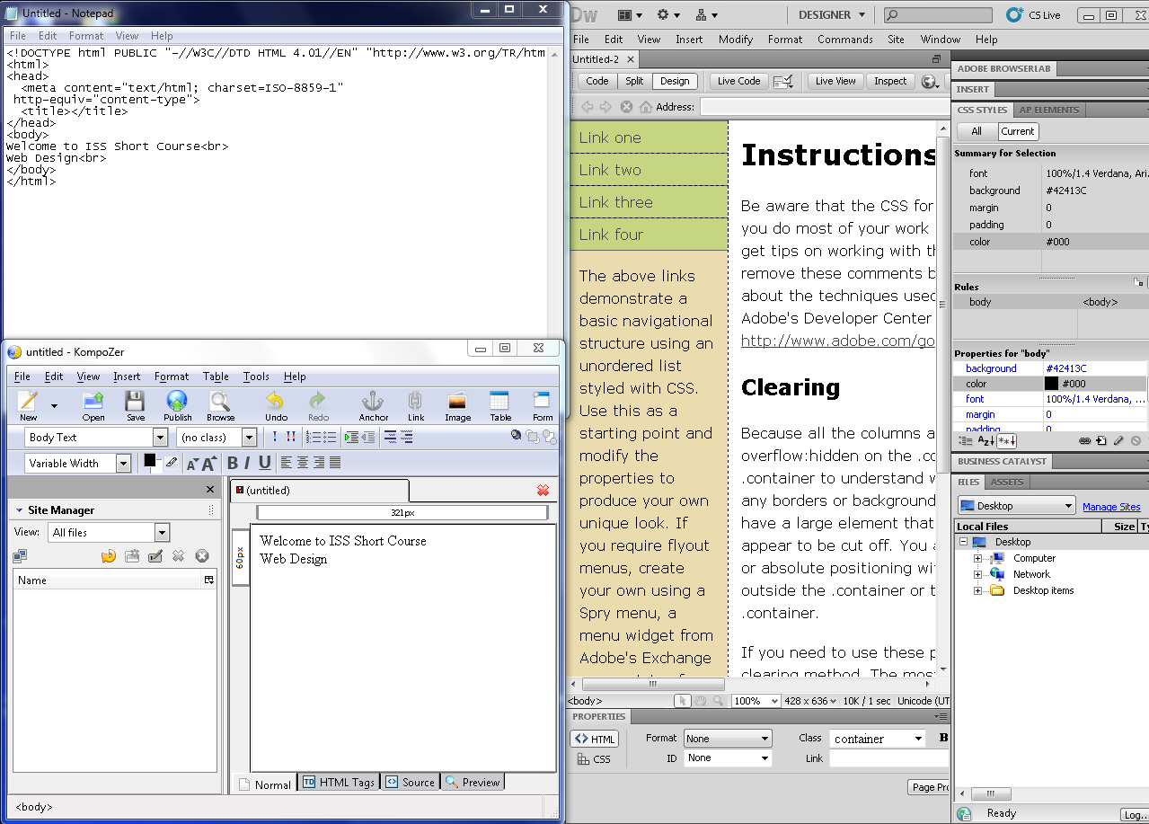
Applications
Applications Available at UMSL:
  Notepad
  Microsoft Word
  Microsoft PowerPoint
  Kompozer
  Dreamweaver CS5

Slide 5
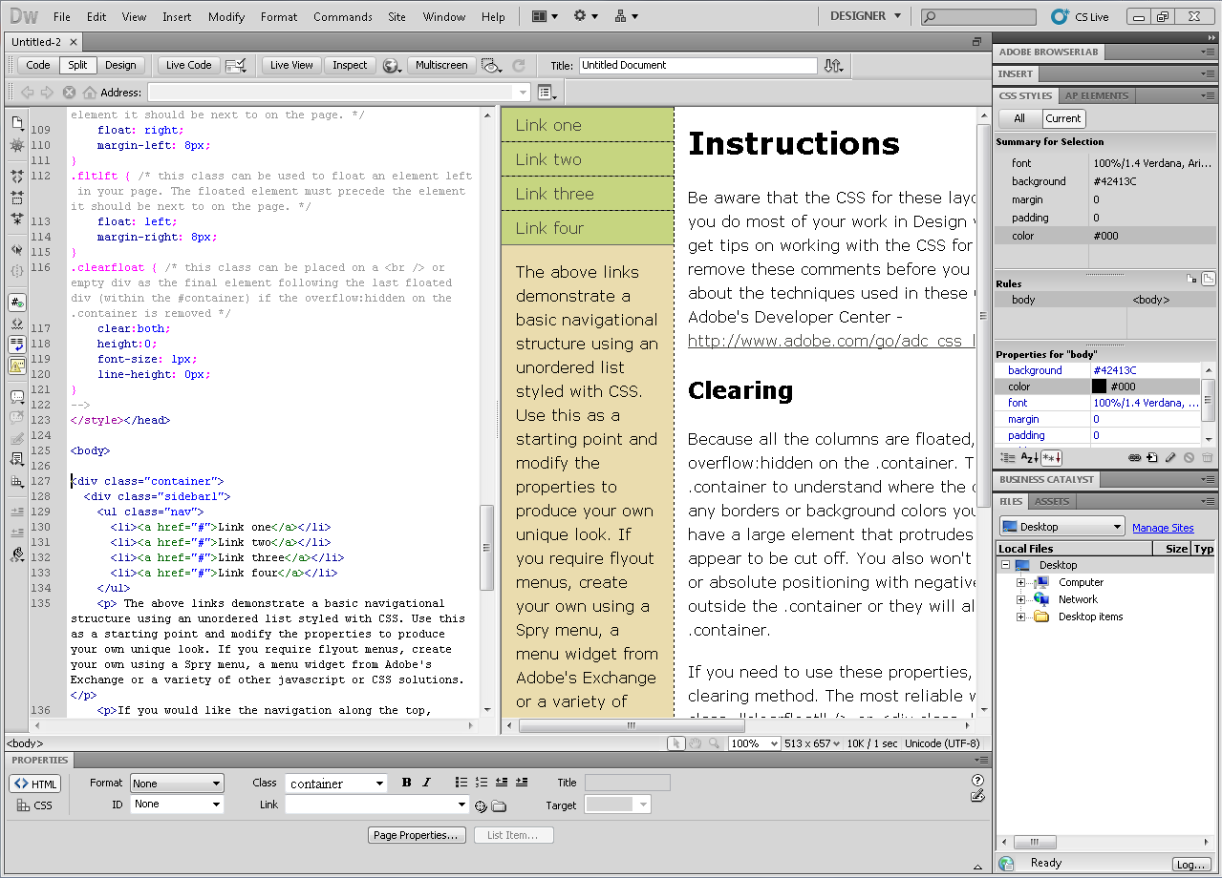
Dreamweaver CS5
The majority of today’s course will cover web designing using Adobe Dreamweaver CS5.

Slide 6
Steps to Creating Your First Web Page
Creating Folders
Location of Dreamweaver
Naming a Site & Home Page File
Creating the Web Page

Slide 7
Steps to Creating Your First Web Page
Creating Folders:
  Create a central folder to contain all your files related to this webpage.
  Create a sub-folder titled “Assets” to contain all picture and other media files.
Where is Dreamweaver located?
  Start (task bar) → All Programs → Internet & Web Publishing → Dream Weaver → Adobe Dreamweaver CS5
  …Start (task bar) → just type in “Dreamweaver” in the search box!

Slide 8
Steps to Creating Your First Web Page Cont…
Naming a Site and Home Page File
  After launching Dreamweaver, choose the “HTML” option under “Create New”.
  Under the “Site” menu, choose “New Site”.
  In the site tab, name your site and choose the local site folder.
  “Advanced Settings” tab → “Local Info” → Default Images Folder.
  Name your new file as “index.html”.

Slide 9
Creating the Web Page
Choose a Background Color:
  Click “Page Properties” on the Properties bar on the bottom of your screen.
  In the appearance category, choose a background color/image of your choice.
Make a Heading & Set Size:
  Type the text “All About Web Design!”
Add a Horizontal Rule:
  Start this on a new line.
  Go to “Insert Menu” → “HTML” → “Horizontal Line”
  Double click the horizontal line.
  Under the “<hr>” properties, adjust the width, height, and alignment according to your preference.

Slide 10
Using Cascading Style Sheets
What is CSS?
Cascading Style Sheets – styles that describe how HTML elements should be displayed.
Saves a whole lot of work for web developers.
External style sheets – edit only one file, which enables the developer to alter the layout of the web site.
Files saved as .css.
Info from Learn CSS with w3schools

Slide 11
Text and CSS
Copy and Paste all the text from the notepad file onto Dreamweaver on the design mode (under the hr rule).
We’ll use CSS to style the main heading, subheading, body paragraphs/bullet points, and other text.

Slide 12
Styling with CSS
Main Heading “All About Web Design”
Highlight the text "All About Web Design!"
Ensure that "<p>" is selected.
Under the properties bar, select "CSS".
Click "Edit Rule"
Name this "Main_heading" and click "Ok".
Under the type category, choose any font family, font size, style, and text decoration of your choice.
In the border category, choose any border of your choice.
Click Ok.

Slide 13
Styling with CSS Cont…
Subheading:
Highlight "What is a website?"
In the "Targeted Rule" drop down box, make sure that "<New CSS Rule>" is selected.
Click "Edit Rule".
Name this new rule as "Subheading".
Click ok.
In the type category, choose font-family, font size, style, and decoration of your choice. For this example, let's choose a smaller font than 24.
For the following text "What can you do with Dreamweaver" and "Dreamweaver" layouts, select "Subheading" in the "Targeted Rule" drop down box.

Slide 14
Styling with CSS Cont…
Body/Bullet Points:
Highlight the entire text starting from "Create..." to "...manipulation"
Make sure that "<New CSS Rule> is selected in the "Targeted Rule" drop-down box.
Click "Edit Rule".
Name this "Bullet Points".
Click Ok.
In the type category, choose font-family, font size, style, and decoration of your choice. Let's use an even smaller font for this one.
In the list category, choose a style type/position of your choice.
For the next set of bullet points under "Dreamweaver Layouts", choose "Bullet Points" css style.

Slide 15
Styling with CSS Cont…
Regular Text
Highlight the entire text under "What is a website" subheading.
Make sure that "<new CSS Rule>" is selected.
Click "Edit Rule".
Name this one "Regular Text".
In the type category, choose any font family that you want.
Select Ok.

Slide 16
Inserting Images
Image:
Insert an image after “What Can You Do with Dreamweaver” text.
Insert Menu → Image
Browse the assets folder, and choose the image “Dreamweaver.jpg”.
In the “Image Tag Accessibility Attributes”, give a 1-3 word description of the image in the Alternative Text.
Click on the image in design view.
Under properties, choose any alignment of your choice under the Align drop down menu.

Slide 17
Creating a Table
Insert → Table → choose 5 rows x 2 columns.
Add the tags text in the left column and the description on the right.
Name this page “tags.html”.

Slide 18
External Hyperlinks
Add this sentence below the image: "For more information..."
Highlight "W3Schools".
Under the properties bar, ensure that "HTML" is selected.
Copy and paste the site's url on the link drop down menu and press ENTER.
Under the target drop down menu, click "_new"

Slide 19
Internal Hyperlinks
Links the main home page to another page internally, within the same site.
Copy and paste the text: “Click here for some insightful HTML…” below the external hyperlink + text.
Highlight “here”.
In the HTML properties, click on the browse icon (looks like a folder”.
Browse for the file “tags.html” and choose Ok.
Save and check your work on the browser.

Slide 20
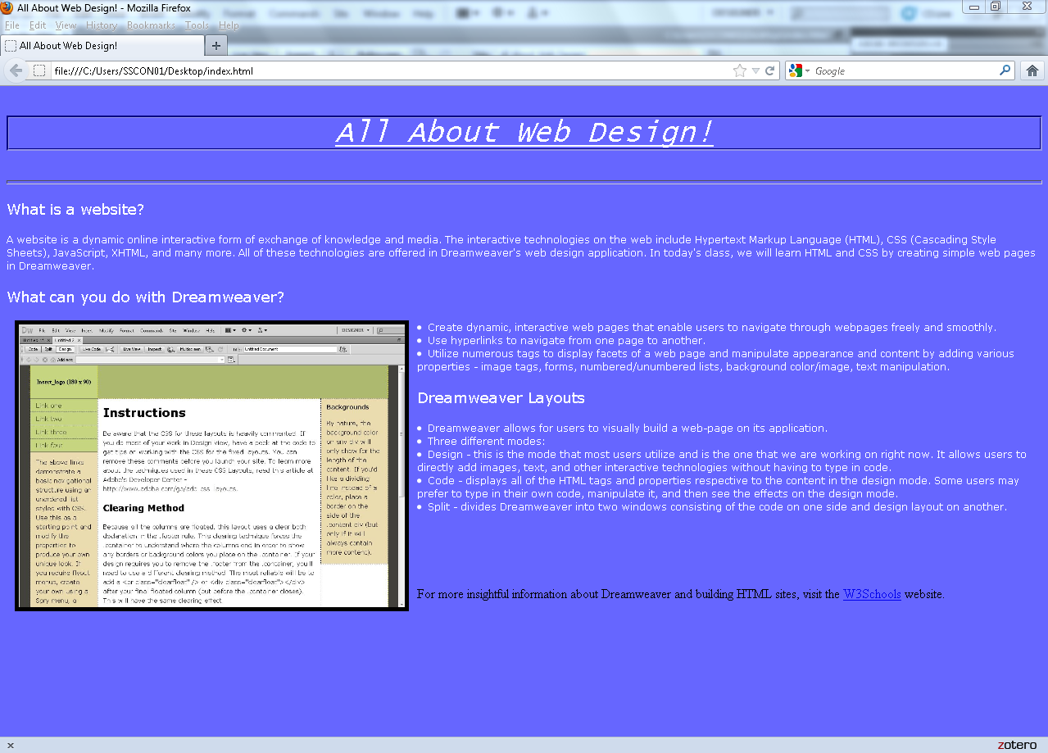
Your simple web page would look similar to…

Slide 21
Other Ways to Create Web Pages through Dreamweaver…
Tables
Frames
Dreamweaver’s Templates (consists of .div tags).

Slide 22
Helpful Resources for Web Designing
http://w3schools.com/

Slide 23
Sources:
Teach Yourself Web Publishing with HTML 3.0
Dreamweaver CS4: The Missing Manual
Learn CSS with w3schools

