Slide 1
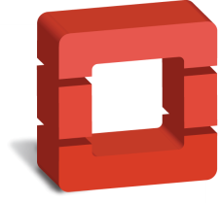
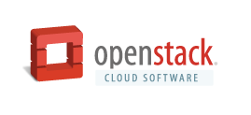

OpenStack Cloud Platform for the Hosting Industry
“OpenStack has won the race to become the standard, and it has done it rapidly.”
Ann Winblad
Hummer Winblad Ventures
Superior scalability, availability, economics and support
Hundreds of public and private cloud hosting companies bet their businesses on OpenStack software
Leadership and support from industry notables such as AT&T, Cisco, HP, IBM, Red Hat and SUSE
Vibrant community over 8,000 strong; 170+ companies contributing and driving fast-paced innovation
www. OpenStack.org

Slide 2

eNovance uses OpenStack
“We launched eNocloud: the 1st OpenStack Public Cloud in Europe. Our main goal was to have full control over infrastructures and hardware, ensure compatibility with other Public Clouds and deliver a high-performance cloud.”
Raphaël Ferreira
CEO, eNovance
Web, Cloud & Big Data expert
Top 10 contributor to the OpenStack project
Running OpenStack Public Clouds in France & Canada
Design, Build & Manage OpenStack Private Clouds
Provides consulting & training around OpenStack
Headquartered in Paris, France
www.enovance.com

Slide 3
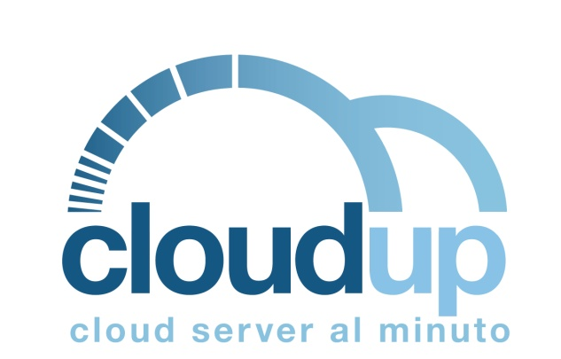
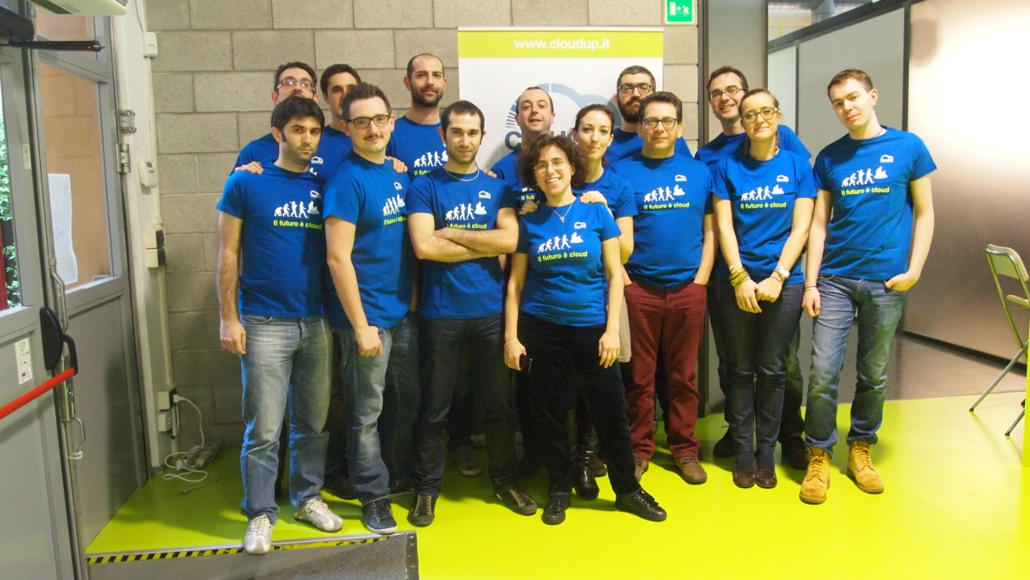
Cloudup uses OpenStack
“We had a dream: being the first Italian cloud service provider to offer a true on demand, scalable, pay-as-you go IaaS cloud service based on OpenStack's open infrastructure.”
Martina Casani
Marketing Manager at Cloudup
1st pay-by-the-minute Italian public cloud service
More than 4.000 subscriptions from launch in May 2012 up to now
Infrastructure’s growth: from 4 nodes to more than 20 nodes in less than a year
Datacenter recently integrated into a 10 GbE ring linking European data centers in Amsterdam, Frankfurt, London and Paris
Headquartered in Milano, Italy
www.cloudup.it
www.cloudup.it/cloud-server/index-en.php

Slide 4


Cloudwatt uses OpenStack
“OpenStack emerges as the leading Cloud OS standard for next decennia. Comparison with DOS situation for emerging PCs in 1982 is obvious. Cloudwatt is willing to be part of this on-going new frontier.”
Pierre Paperon
CSMO
Target is to become among Cloud Provider leaders in Europe
Using OpenStack to propose Compute and Storage offers to all professional companies (10 million potential users) with distinctive and unique features
Extensive hiring in progress of 50 OpenStack developers to complement the 15 of eNovance (OpenStack partner)
Headquartered in Boulogne, Paris area, France
www.cloudwatt.com

Slide 5


DreamHost uses OpenStack
“With OpenStack virtual machine management, reliable and resilient Ceph block storage, and software-defined networking that truly isolates each instance in the infrastructure, DreamCompute sets a new standard for compute-as-a-service.”
Simon Anderson
CEO of DreamHost
15 years expertise in engineering and deploying open source web infrastructure.
OpenStack founding member with a seat on the Board of Directors. Top 10 contributor of lines changed to “core” projects.
DreamCompute deploys KVM hypervisors, Ceph block storage integrated with Cinder, and delivered through Quantum as enhanced with DreamHost’s own Akanda layer 3 open source software.
Headquartered in Los Angeles, California.
www. dreamhost.com

Slide 6
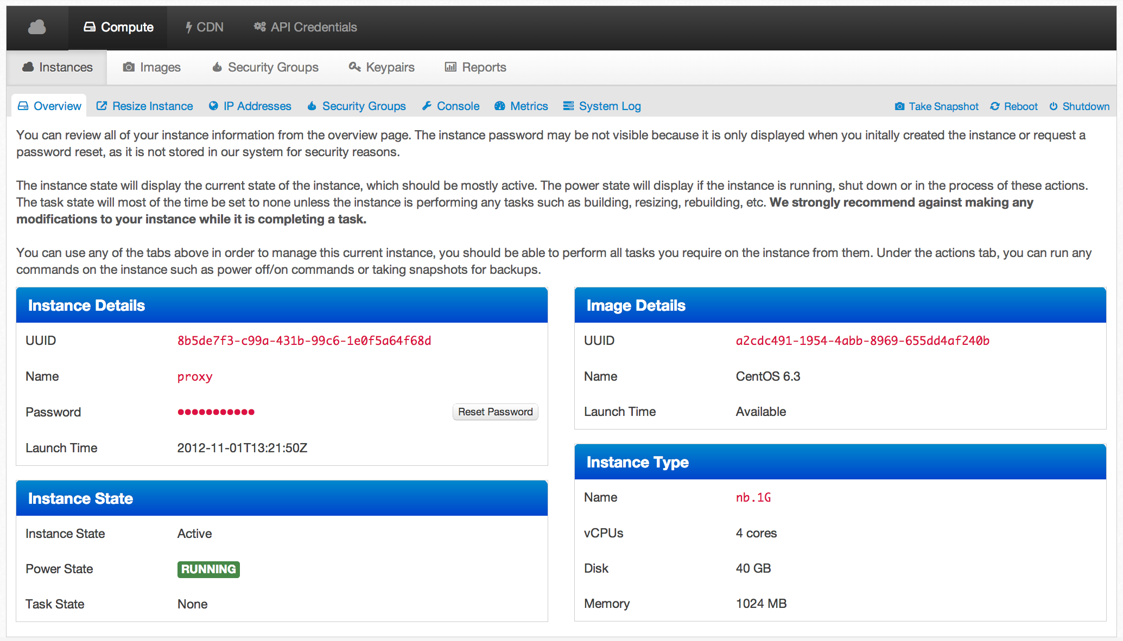
VEXXHOST, Inc. uses OpenStack
“With the power of OpenStack and the open source ecosystem that surrounds it, we are able to fully revolutionize the way that online hosting works, while helping businesses reduce their costs.”
Mohammed Naser
Chief Executive Officer
First Public OpenStack Cloud in Canada
Developed full OpenStack management portal, featuring security groups, key pairs and full reports.
Migrated multiple large busy online e-commerce sites from typical dedicated server deployments to fully managed, auto scaling OpenStack clusters.
Headquartered in Montreal, Quebec, Canada
www.vexxhost.com

Slide 7

Stackscale uses OpenStack
“OpenStack is a once in a lifetime opportunity we could not miss. Combining it with the most financial and energy efficient hardware support allows our customers to benefit from a competitive price for fully featured private clouds.”
David Sanchez
Founder & CEO, Stackscale
Private Cloud Provider meaning predictable performance
Using OpenStack to power 4 interconnected infrastructures in different international locations
Based on StackOps with fully automated provisioning and highly skilled and efficient customer support
Headquartered in Amsterdam, The Netherlands. Founded by 15 year experienced hosting entrepreneurs
www.stackscale.com

Slide 8
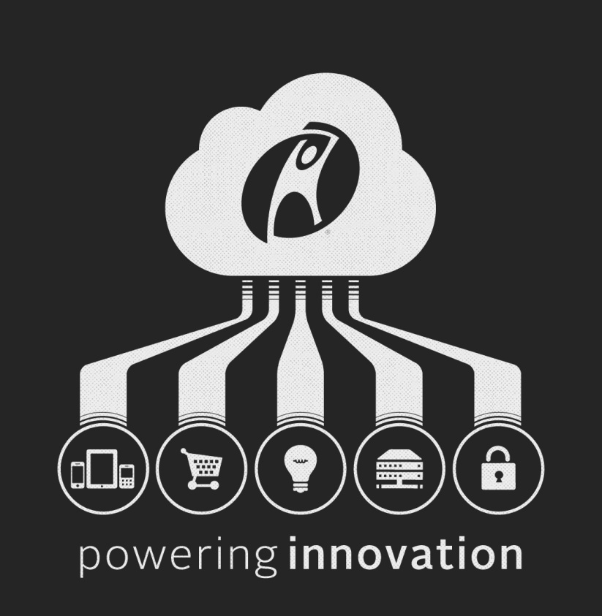
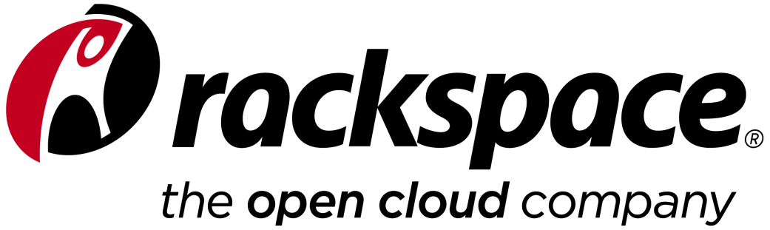
Rackspace uses OpenStack
“We’re moving into a world of open standards where a million clouds will soar—where each business customer can find the right cloud for its unique needs, along with the reliability and flexibility that everyone deserves.”
Lanham Napier
Rackspace CEO
Co-founder of OpenStack with NASA in 2010
#1 hosting provider for the top 100,000 websites in the world
Tens of thousands of OpenStack-powered production servers in the public cloud
Rackspace provides training, support and operations expertise on our Private Cloud powered by OpenStack to over 100 organizations, including 22% of the FORTUNE100
Rackspace Private Cloud software downloaded in over 150 countries around the globe
Nine data centers around the world and over 200K customers
www.Rackspace.com
www.Rackspace.co.uk

Slide 9


HP Public Cloud uses OpenStack
“HP is providing an open, enterprise-grade cloud platform based on OpenStack® technology, combining the best of OpenStack and HP innovation to enable enterprises to adopt hybrid delivery models across private, managed and public cloud services.”
Eileen Evans
HP Vice President & OpenStack Board Member
Enterprise-grade public cloud with industry-leading SLAs, security and support
Storage, Compute and Advanced Networking Services
Part of a Converged Cloud platform by HP, the world’s largest IT company
OpenStack Leadership:
  Founding Platinum member of Foundation; Top 5 Code Contributor; Lead and staff OpenStack Continuous Integration (CI) project
HP Public Cloud
www.hpcloud.com

Slide 10


Deutsche Telekom uses OpenStack
“TelekomCloud Business Marketplace makes finding, buying, managing and using cloud-based business applications easy and secure for small and medium-sized businesses. We’ve built the hosting platform on top of OpenStack.”
Kurt Garloff
VP of Engineering, Cloud Services
Telekom
Cloud
Offering SaaS business applications from software partners (ISVs) to SMBs
  OpenStack standard APIs result in faster partner onboarding
Deutsche Telekom addresses SMB IT challenges and cloud concerns by taking end-to-end responsibility for the offerings for a per month per user payment
OpenStack IaaS adopted for scalability, lower cost, vibrant community, and widespread industry adoption
https://portal.telekomcloud.com/

