Slide 1


From infrastructure to applications
building and managing an application optimised private cloud

Slide 2
Session Timeline
Time (min) | Presenter | What? | How long (min)
0 | Microsoft | Slide 1 – Welcome / Intro Session | 2 mins
2 | HP | Slides 3 – 10 | 12 mins
14 | Microsoft | Slides 11 – 19 | 17 mins
31 | Microsoft | Slide 20 – Introduce panel | 2 mins
33 | Microsoft / HP / Intel | Slides 20 – Panel Discussion / Q&A | 20 mins
53 | HP | Introduce HP Cloud Discovery Workshop Offer | 2 mins
55 | Microsoft | Summarise and close session | 5 mins
Hidden Slide

Slide 3

agenda
Customer Challenges
Starting the journey to the cloud with HP BladeSystem Matrix
Accelerating the journey to the cloud
  Infrastructure to Applications
  Hyper-V Cloud Fast Track
  HP Cloud Foundation for Hyper-V
Panel Discussion –

Slide 4
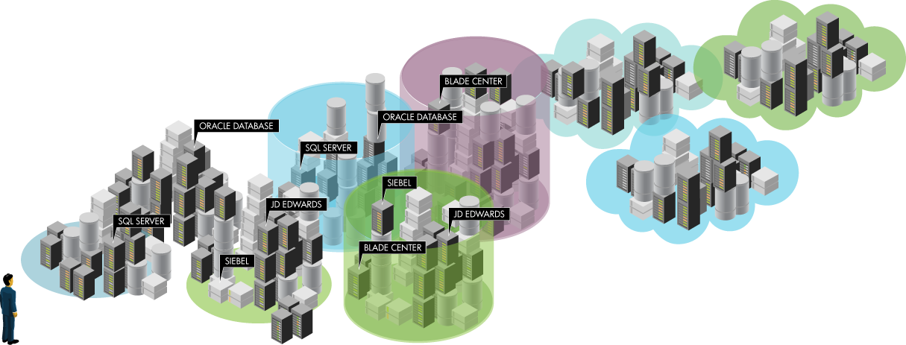
What’s driving the move to cloud?
>70% of businesses considering or using private clouds ⁽¹⁾
Business drivers: Speed, flexibility and economics
Business is adopting cloud 5x faster
than IT operations ⁽²⁾
IT challenges: Sprawl, control and integration
70% of IT resources captive in maintenance and operations ⁽³⁾
IDC Survey, Cloud Computing Attitudes, Doc.#223077, April 2010
You're Not Ready For Internal Cloud, Forrester Research, Inc., July 2010
2009 InformationWeek Analytics Survey

Slide 5
Transition to the cloud will happened at different speeds
Transformation
Private cloud candidates
Modular building blocks
Fully-automated environment
Consolidate & modernize applications
Standardize management tools, processes
Build-in resiliency, continuity, security
Standardize consolidate, and virtualize
High-cost islands
Low-cost, pooled assets
Data center of the future
On-premises, Outsourced, Cloud, or Hybrid

Slide 6
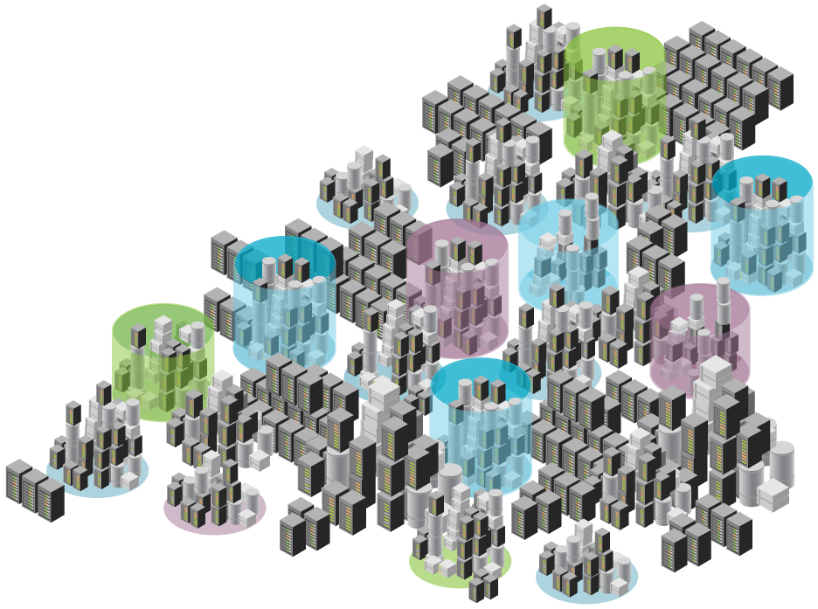




The misalignment of business and IT
Outsourcing
Public Cloud offerings
Business users want better service at lower cost
Anytime, anyplace
Easy to use
Faster
Flexible
IT still provides only technology
Slow
Inflexible, Complex
Expensive
Stuck in maintenance with little innovation
Force.com
MS Azure
Google Apps
Shadow IT is made easier via Public Cloud
Notes:
What do business users want from their IT organization?
Now Business is looking at alternative ways
Public Cloud is the alternative
It only takes a credit card
More Shadow IT
We will get a cloud sprawl.
For many years, businesses are asking for better user experience with intuitive user interface, access to data and their business processes anytime, anywhere. They want access fast at Internet speed now and last but not least they want a flexible model that adapts to the business changes.
These requirements have been around for a long time. IT organizations managed to cut the cost through better technology, consolidation, virtualization but did they really provide what users were asking for?
But more important question “ Will business user wait for months and years for IT organization to gather requirements and come back with a solution? What if they can get their service using their credit card now?
26 November 2010
HP Confidential
6

Slide 7
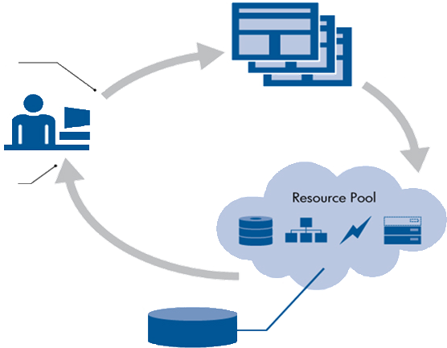


The private cloud concept
Delivering IT as a service
Catalogue of Services
Application or Infrastructure
Service Definition and SLA
Cost & Lease
Request Service
Service Delivered
Resource Pool
Pool of Server Storage Network
Virtualized and abstracted
Automated
Capacity and Automation
Scalable, Failover, Metered
Notes:
The Private Cloud concept follows a simple premise….. service request should produce a delivered service in as timely manner as much as possible
Templates
Develop templates for virtually any workload, including:
Enterprise Resource Planning
Customer Relationship Planning
Data Warehouse
Database
Mail & Messaging
File, Print, Infrastructure
Resource Pool
Pools of network, storage, compute and power capacity can be managed as one environment and dynamically provisioned to run applications on up to 2500 managed systems
Inventory Capacity
Integrated spare capacity simplifies resource utilization so you can shift workloads, consolidate servers, save space and cut energy consumption

Slide 8

agenda
Customer Challenges
Starting the journey to the cloud with HP BladeSystem Matrix
Accelerating the journey to the cloud
  Hyper-V Cloud Fast Track
  HP Cloud Foundation for Hyper-V
  Infrastructure to Applications

Slide 9

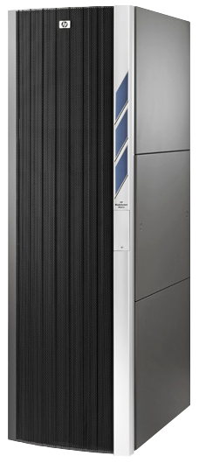




HP BladeSystem Matrix:
The Foundation for your Private Cloud
Matrix
Service Catalog
Matrix
Resource Pool
HP-UX
Windows
Linux
Personalize
your Cloud
Billing/chargeback
Approval flows
Other processes
HP
Converged Infrastructure
Matrix
Cloud APIs
Matrix
Self Service Portal
Matrix
Cloud APIs
Matrix
Service Delivery
Matrix Capacity & Management
NDA Until 22 June 2010

Slide 10












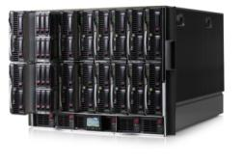


Matrix Operating Environment
How does it work?
Portals
Catalog
Infrastructure
templates
c-Class Blade Provisioning
custom
workflows
Process Workflow Automation
Design
Designer
Virtual Machine Provisioning
Library
vm
templates
rdp
folders
Custom pre and post provisioning scripts
Self Service
Provision &
Operate
Resource management
Administer
Virtual Connect
Resource
Pools
Optimize & Protect
virtual
machines
Network
Storage
c-class blades

Slide 11
agenda
Customer Challenges
Starting the journey to the cloud with HP BladeSystem Matrix
Accelerating the journey to the cloud
  Infrastructure to Applications
  Hyper-V Cloud Fast Track
  HP Cloud Foundation for Hyper-V

Slide 12










Hp converged infrastructure
Storage
Servers
HP
Converged Infrastructure
Power & cooling
Network
Management software

Slide 13








Integrating Virtualization, Infrastructure, and Application Management
Data Protection
& Recovery
Design, Configure
& Deploy
IT Service Management
Storage
HP
Converged Infrastructure
Servers
Monitor & Manage
Service End to End
Virtualize, Deploy
& Manage
IT Process Automation
Power & cooling
Network
Management software
Converged Infrastructure
Notes:
Lower cost. Less energy. Less space.
As space, power, and cooling capacities become limited, maximizing efficiency plays a critical role in preparing for the cloud. Intel technology drives efficiency across multiple areas, including leading silicon power optimization and performance, advanced data center power management, and improved virtualization capabilities. For example, advanced technologies like Intel® Intelligent Power Node Manager and Intel® Data Center Manager (Intel® DCM), along with the Intel® Xeon® processor 5600 series, enable significant improvements in data-center efficiency, making the cloud work for you.

Slide 14
Microsoft and hp partnering to deliver the cloud
FROM
Separate offerings from the #1 IT and #1 Software companies
HP
Microsoft
Services
Services
SQL
Server
templates,
sizing
Exchange
templates, sizing
SQL Server
Exchange
HP BTO Enterprise Mgmt
System Center
OS and Virtualization
Windows or other OSs
Windows
Hyper-V or others
Hyper-V
HP Infrastructure
HP Insight and BTO SW
System Center
Servers storage
and networking

Slide 15
Microsoft and hp partnering to deliver the cloud
TO
Most integrated IT stack in the industry
HP, Microsoft, and Partner Services
Infrastructure-to-Application Integration
SQL
Server
Exchange Server
Other Microsoft and 3rd Party Applications
Converged Infrastructure
Interoperable Management
Integrated Virtualization
HP Servers
Storage and
Networking

Slide 16





Hyper-v cloud fast track
A program that will help customers quickly and easily purchase and deploy private cloud infrastructures
Hyper-V Cloud Fast Track is a key building block for private clouds that is a combination of Microsoft software and integrated (compute, storage and networking) infrastructure based on a reference architecture that OEMs have pre-configured and tested for higher reliability
Self-Service & Provisioning
System Center Virtual Machine Manger Self Service Portal 2.0
Integrated Management
Platform
Compute
Network
Storage

Slide 17
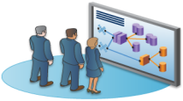
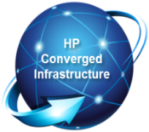

HP Cloud Foundation for Hyper-V
OPTIMIZED
  Provision, flex and recover full application infrastructure in minutes, not months
SIMPLIFIED
  Reduce time to production with reference architecture, step by step implementation guidelines and automated workflows
ACCELERATE
  Modular design enables incremental growth over time from foundation to scalable private cloud
NEW

Slide 18
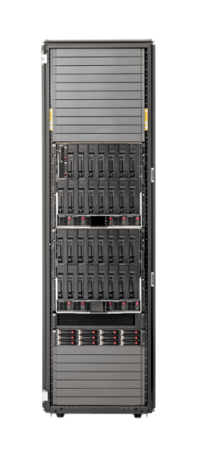




Hp cloud foundation for hyper-v
HP REFERENCE ARCHITECTURE
6 X BL460C’s each with 32GB Ram and 2 sockets
2 DL360C’s
1 EVA4400 FC SAN’s with 6x 1.5GB SAS drives
1 C7000 Blade chassis
2 VC Flex-10 modules
2 8GB fiber channel 24 port modules
INTEL ENABLING TECHNOLOGIES
Intel Xeon 5600
Intel Trusted Execution Technology
Intel Advanced Encryption Standard Instructions
Intel Virtualization Technology
System Center Integration

Slide 19

HP Cloud Foundation for Hyper-V
  Pre-validated HP Matrix + Microsoft System Center environment.
  Reference architecture whitepapers
  Implementation guides
  Standard solutions though HP services organisation and partners
Notes:
When we combine the HP Private Cloud Foundation for Microsoft with HP’s CloudStart solution, HP delivers a true private cloud for a customer, integrated, running and productive within 30 days of hardware installation. No need to wait for development – take advantage of HP’s templates and pre-designed components to be productive right away.
The Private Cloud Foundation for Microsoft, as we discussed, provides the foundation for a private cloud implementation – automated provisioning, catalog/portal, elastic virtualized resources delivered as the Converged Infrastructure.
The HP Cloud Solution for Microsoft Infrastructure take the Private Cloud Foundation for Microsoft and delivers a complete, running, productive “compute” solution, with resource metering and chargeback, integrated into the datacenter security, identity management, backup, DR planning, and can be extended to SLA management and software lifecycle management. Enterprise customers require a private cloud to be a compliant part of the datacenter infrastructure, and that is what this solution delivers.
The HP CloudStart for Microsoft Infrastructure is for customers needing to pilot or start up a private cloud solution quickly, and is a bounded, no options instance of the broader solution. Once the hardware system is installed, HP makes the CloudStart solution ready for production in 30 days.
19

Slide 20
Panel discussion
jonathan hatchuel
specialist sales, Microsoft
TBC
Intel
TBC
HP

Slide 21
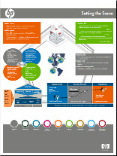
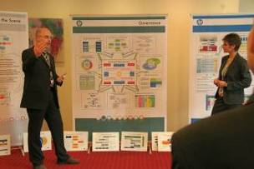

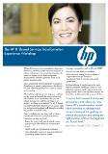

Build the vision and strategy
HP Cloud Discovery Workshop
Duration: 1 day (for CloudStart solution)
Attendees: C-level decision makers, CTOs, chief architects
Register for your interest in one of 10 free workshops now!
Create common cloud understanding
Mobilize teams for fast decision-making
Evaluate cloud opportunity, risks
Share cloud best practices
Determine current capabilities across main domains such as service management, technical architecture, culture & staff, governance etc
Explore HP Converged Infrastructure Architecture and technologies
Layout next steps
Notes:
Overview: 1-day cloud strategy workshop for enterprise customers looking to move beyond data center optimization and like to become infrastructure service provider or consumer through cloud-based models. Workshop is delivered by experienced HP consultants using human-size, highly visual displays.
Please register your interest for the Workshop now through the event feedback form.

Slide 22
Thank you

