Slide 1
“云端”计算时代的位置服务
Location-Based Services on the Cloud
郑宇 博士
微软亚洲研究院 研究员

Slide 2
Location based service (LBS) will become a 13B business by 2013

Slide 3

What is Cloud Computing?
云端计算
Computing as Utility
网云计算
云计算
Grid Computing
Web Services in the Cloud
Understand Cloud Computing and
its Impact on the Future of Location-Based Services

Slide 4
Cloud Computing
Grid Computing
  Refer to resource-pooled environments for running compute jobs (like image processing) rather than long running processes (such as a Web site or e-mail server)
Utility Computing
  Refer to resource-pooled environments for hosting long running processes, and tends to be focused on meeting service levels with the optimal amount of resources necessary to do so
Cloud Computing
  Refer to a variety of services available over the Internet that deliver compute functionality on the service provider's infrastructure
  Its environment (infrastructure) may actually be hosted on either a grid or utility computing environment, but that doesn't matter to a service user
  The data in the cloud, as “Intel inside” (or intelligence inside), is often an important part of the services

Slide 5
Cloud Computing – Simple Definition
Cloud Computing = Software as a Service
+ Platform as a Service
+ Infrastructure as a Service
+ Data as a Service

Slide 6
Cloud Computing – Simple Definition
Cloud Computing = Software as a Service
+ Platform as a Service
+ Infrastructure as a Service
+ Data as a Service
Software as a Service (SaaS)
  From end user’s point of view
  Apps are located in the cloud
  Software experiences are delivered through the Internet

Slide 7
Cloud Computing – Simple Definition
Cloud Computing = Software as a Service
+ Platform as a Service
+ Infrastructure as a Service
+ Data as a Service
Platform as a Service (PaaS)
  From developer’s point of view (i.e. cloud users)
  Cloud providers offer an Internet-based platform to developers who want to create services but don't want to build their own cloud
Notes:
Similar to Windows Platform for ISV developers in the PC ecosystem

Slide 8
Cloud Computing – Simple Definition
Cloud Computing = Software as a Service
+ Platform as a Service
+ Infrastructure as a Service
+ Data as a Service
Infrastructure as a Service (IaaS)
  Cloud providers build datacenters
    Power, scale, hardware, networking, storage, distributed systems, etc
  Datacenter as a service
  Cloud users rent storage, computation, and maintenance from cloud providers (pay-as-you-go; like utility)
Notes:
Similar to Windows Platform for ISV developers in the PC ecosystem

Slide 9
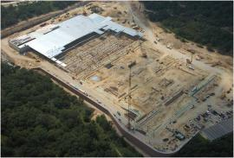
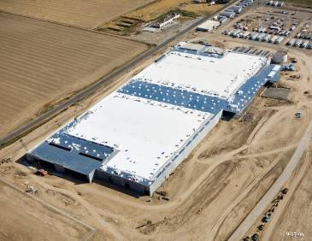
Infrastructure (Mega Datacenters)

Slide 10
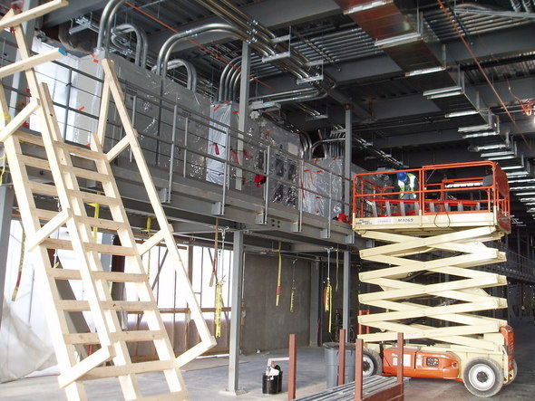
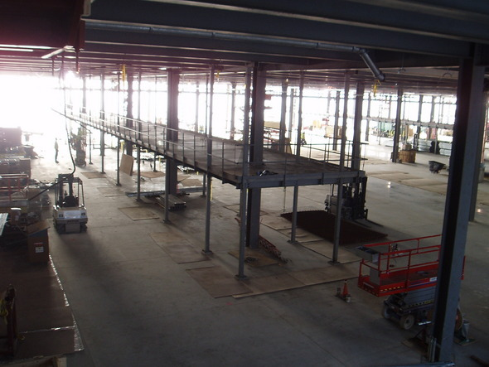
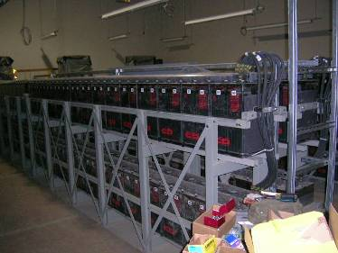

Challenges: Agility, Green, and Smart Growth

Slide 11
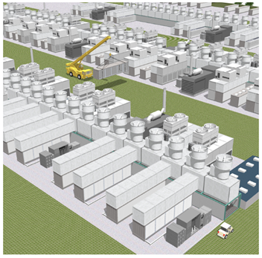
Gen 4 Modular Datacenter
Video link: Generation 4 Modular Data Center
Notes:
Microsoft showed how Gen 4 characteristics could be put in place in both the company's smaller data centers and in its mega-data centers. The portion of the video showing off the Gen 4 mega-data center almost looks like a series of interconnected tiny power plants.

Slide 12
Knowledge & Data Intelligence as a Service
Cloud Computing = Software as a Service
+ Platform as a Service
+ Infrastructure as a Service
+ Data as a Service
Data ➔ Information ➔ Knowledge ➔ Intelligence
  Infrastructure for Web-scale data mining and knowledge discovery
  Empower people with knowledge
  Empower applications and services with intelligence

Slide 13
Benefits of Cloud Computing
Reduce capital and operations costs
  No longer required to make large up-front capital investment on datacenters
  Eliminate the need to plan ahead for provisioning
  Allow companies to start small and increase their resources investment as needed (pay-as-you-go)
  Simplify app deployment & management
  Common programming model across mobile, browser, client, server, cloud
  Access to strong ecosystem of widely deployed applications
  Integration with existing IT assets (Software + Services)
Notes:
Goal: Frame the problems with applications today and the reasons for Cloud Computing / Services.
Speaking Points:
Shift to Cloud Computing
Today there is a shift emerging that we believe will eventually effect virtually every type of organization from small start-ups to large enterprises.
This shift is the use of cloud computing and cloud services.
We are starting to see organizations extend compute, storage, and other workloads to the cloud – where these workloads will be operated and managed by a software vendor.
Some organizations are using the cloud for temporary compute power, as is the case with the New York Times, who needed compute resources to convert their archived library of articles to PDFs – some are more permanent such as data archival.
So what makes the cloud attractive to organizations?
Problems today:
Many of the challenges with building applications today have very little to do with development tools, programming languages, or frameworks.
Rather, many of the challenges that organizations face are related to the infrastructure required to deploy, run, and manage applications.
Startups - For example, imagine you were a startup building the next social networking site or online game
You have to worry about numerous issues that are unrelated to the functionality of the application.
[Capacity]
You have to think about the capacity requirements for the application.
Will it be used by a few thousand users or hundreds of thousands or millions?
How do users translate to bandwidth, storage, and server requirements?
Will the usage be consistent during all times of the year?
Will it be consistent over the lifetime of the application?
Can you handle spikes in demand if there were sudden demands for the app? (Digg Effect)
Ultimately, most organizations end up paying for more capacity then they need.
[Deployment, operations, and versioning]
Then you have to worry about deploying and operating your application
How do you deploy your application over multiple servers?
How do you role out updates to the app without taking it offline?
How do you manage patches?
Enterprise - For established organizations, some of these decisions and problems may have already been addressed through a shared data center or an established staff and processes.
However, in enterprise organizations we often find that apps are silos of their own servers.
Established organizations also still have to spend a significant amount of capital and operations funding.
IT resources are applied to maintaining applications rather than delivering new value and functionality.
ISV - Finally, if you’re an ISV who builds applications for use by other businesses you have to worry about a number of additional problems.
You have to think about your customer’s capacity, which gets factored into the cost of ownership.
Often, your sales opportunities are limited by your customer’s ability to deploy new applications.
Your customers often have existing assets such as order fulfillment systems, ERP systems, multi-terabyte databases, etc. that are running on-premise. You must be able to easily integrate with these assets.
So many things get in the way for building new apps
Infrastructure - Operations, Patching, OS Management
Building and maintaining costly infrastructure
So why are organizations considering or moving to the Cloud?
When we talk with partners and customers, there are 4 general reasons why they’re starting to find the cloud attractive.
1 - First, they view it as a way to reduce their capital and operations costs.
Cloud Services provide a utility-like model to compute and storage resources – where organizations can only pay for what they use.
This is often referred to as a “Pay as you go” model.
2 - Second, the cloud can potentially simplify the deployment and management of applications
By relieving organizations from worrying about infrastructure and capacity.
3 - Cloud Services can improve time to market for new applications.
Instead of spending weeks or months deploying servers and infrastructure to support new applications – organizations can quickly deploy applications to the cloud or use storage in the cloud where vendors provide pre-provisioned data centers.
4 - Finally, Cloud Services can make it much easier to scale up or down as needed.
Instead of building out capacity for peak usage or not having enough capacity to deal with usage spikes, with the cloud the platform vendor manages the capacity and you only use (and pay for) what you need.
Think of this as “Pay as you grow”
Notes:
- Startup - scale and capital
- Enterprise - capacity planning, reducing opex.
Freeing IT resources to focus on delivering new business value
Enable utility-like, “Pay as you go” billing models
Can’t get physical servers quickly.
How do you deploy your app to 200 nodes easily
The Red Dog messaging refers to increased agility as well.
Increase agility
On-the-fly scaling (up & down)
Automated operations
Focus on business logic

Slide 14






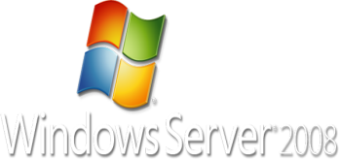




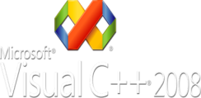
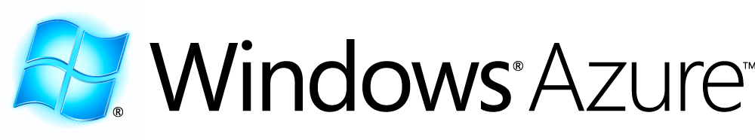
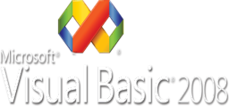
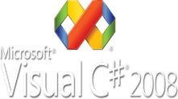

Microsoft’s Cloud Platform
Dev Tools
Finished Services & Solutions
Building Block Services
Cloud Infrastructure Services
Compute
Storage
Management
Global Foundation Services
Hardware
Networking
Deployment
Operations
Notes:
Azure Services Platform
The Azure Services Platform is an internet-scale service-based application platform hosted in Microsoft data centers. Azure includes compute, storage, and application services, all available as elastic resources, and all accessible via standard communication protocols and models. Azure works with the tools, skills, data, and applications customers already have, including .NET, Windows, SQL Server, and more. With Azure, customers will build new connected applications or extend existing ones, quickly and cost-effectively. When launched, Azure will offer guaranteed reliable hosted infrastructure under a pay-as-you-go plan. Suitable for use in a wide variety of application types, and by all types and sizes of organizations and companies, Azure will be able to cut capital and operating expenses and reduce risk.
Components of the Azure Services Platform include:
Windows Azure: Our cloud services operating system that provides flexible and scalable service hosting, data storage, and automated service management.
Windows Azure is Microsoft’s platform for building and deploying cloud based applications, which provides customers with a service hosting and management environment for the Azure Services Platform.
Microsoft .NET Services: A set of higher level developer services like Access Control, Workflow, and Messaging that empower developers to build richer, better connected applications with less code.
.NET Services make developing loosely-coupled on-premises and cloud-based applications easier. .NET Services include a hosted service bus for connecting applications and services across network boundaries, access control for securing applications, and message orchestration. These hosted services allow customers to easily create federated applications that span from on-premises to the cloud.
Microsoft SQL Services delivers on the vision of extending the SQL Server Data Platform capabilities to cloud web-based services. It enables customers to store, process and analyze all types of data - from structured, semi-structured, to unstructured. SQL Data Services (SDS), the first service available within SQL Services, is the relational database. In the future, SQL Services will deliver a comprehensive set of integrated services such as search, reporting, analytics, data integration and data synchronization in the cloud.
Microsoft SQL Services: A set of cloud-based SQL Server capabilities. The first of these capabilities is SQL Data Services, which offers an Internet-facing database service with query capabilities and support for standard protocols.
Microsoft SharePoint Services: Applications available as services today that offer the power of choice to businesses of all sizes and are supported by a set of capabilities unique to the world of hybrid scenarios, such as the ability to federate user identities across the server-service continuum, so a user can authenticate to a portfolio of applications, some on-premises and some consumed as a service.
Live Services provides an easy on ramp for developers to connect with over 460 Million Windows Live users and build web apps with rich social sharing embedded experiences. The Live Framework provides the one uniform way to consume and program Live Services and over time will provide the ability to connect the power and scale of web apps to rich client experiences across a world of digital devices.
Live Services: A set of foundational services and APIs that allows third parties to tap into the massive Windows Live consumer network and its core infrastructure to build rich, engaging applications.
On top of the Azure Services Platform, we offer finished consumer services such as Windows Live, MSN, and Office Live, as well as enterprise-class applications such as Microsoft Exchange Online, Sharepoint Online, and CRM Online. These solutions provide the power of choice for businesses of all sizes and vertical segments and present a set of exciting new opportunities for Microsoft

Slide 15
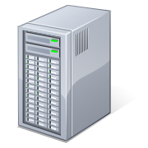

Traditional LBS
Location + Requests
Location + Requests
Services
Services

Slide 16
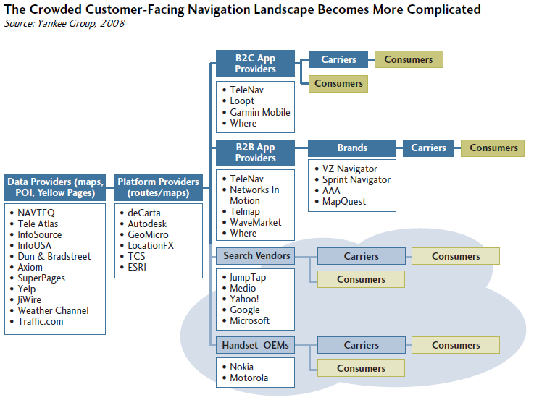
Traditional LBS Value Chain

Slide 17

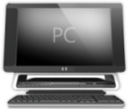


LBS Based on Cloud
End Users
Client Platform (Windows)
Cloud Computing =
Software as a Service +
Platform as a Service +
Infrastructure as a Service +
Data as a Service
Software
+ Services
LBS providers (Cloud Users)
Clients + Cloud
Ecosystem & Dev Tools
Platform as a Service
Infrastructure as a Service
Cloud Providers
Cloud Platform
Notes:
Similar to Windows Platform for ISV developers in the PC ecosystem

Slide 18
LBS Based on Cloud
Software as a service
Platform as a service
Infrastructure as a service
Data as a Service
  LBS provider generated data
    Maps, POIs, road networks
    Search results
    …
  User generated data
    Location history
    Photos, videos
    Search queries
    …

Slide 19




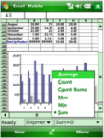
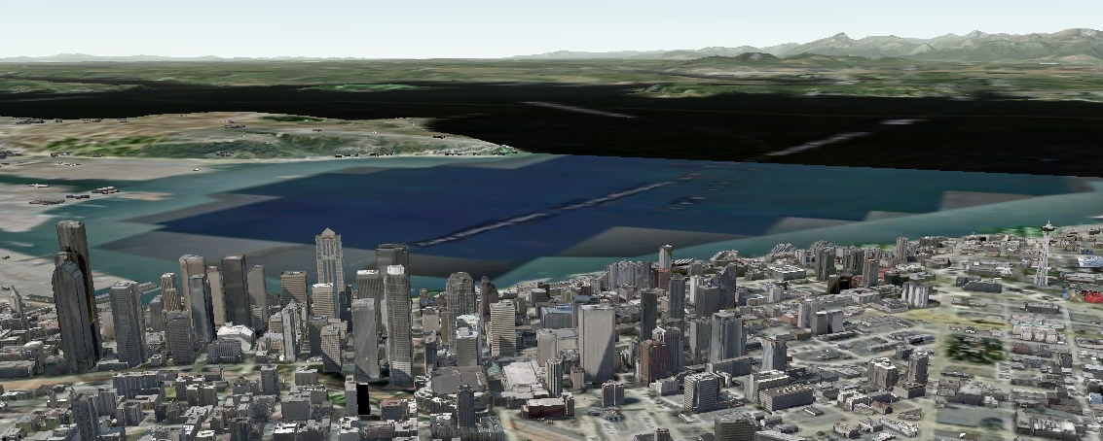

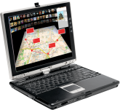

LBS Based on Cloud
Data as a Service
-- sharing
Data +
Intelligence
Microsoft Services
Third Party Services

Slide 20

LBS Based on Cloud
Data as a Service
Data→ Information → Knowledge → Intelligence
Data +
Intelligence
Microsoft Services
Third Party Services

Slide 21
Client: Windows 7 Location Platform
Gadget or script
Application
Location Scripting Interface
Location API
Location and other sensors CPL
Sensor API
Software
Hardware
UMDF sensor driver
Sensor class extension
Sensor MCU
Location
hardware

Slide 22

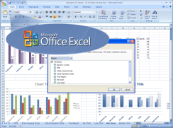
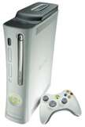

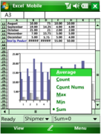
Cloud + Clients (云 + 端) – Life Without Wall
Connect Devices
Connect Data
Connect Apps and Services
Connect People
Connect Businesses
Connect Everything…
Cloud Platform
Notes:
Rich diversity of client devices
Three displays + cloud
Four classes of computers
Seamless user experiences
Connect to NUI

Slide 23


Slide 24
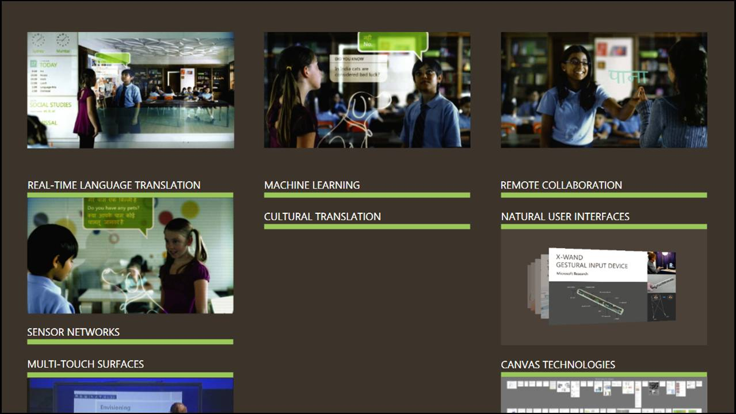

Slide 25
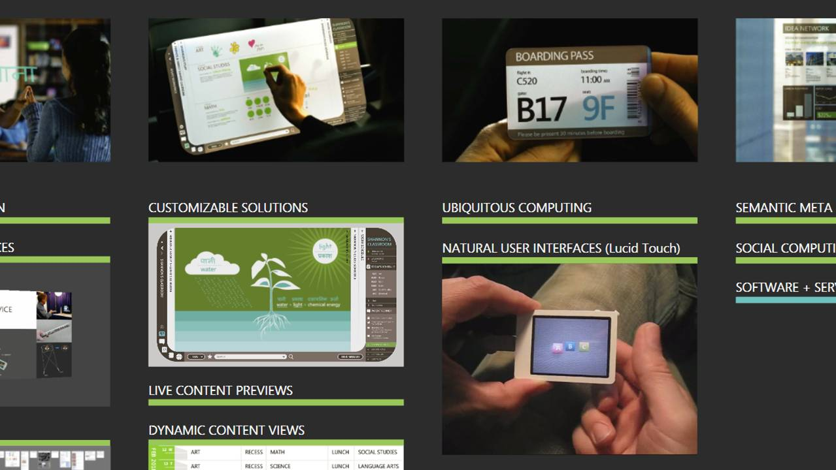

Slide 26
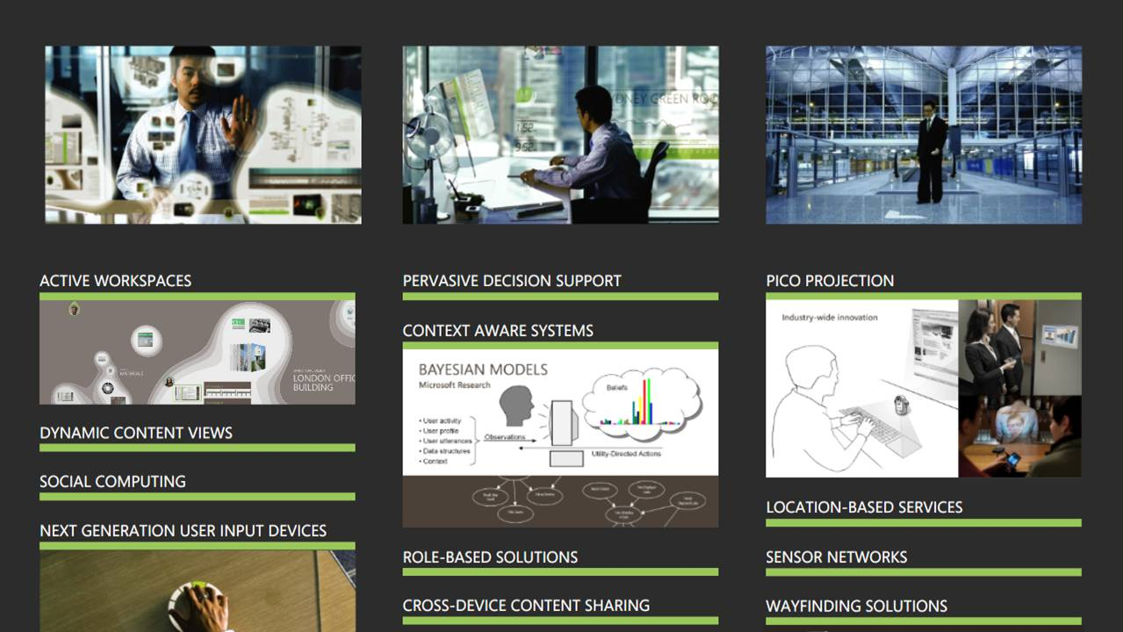

Slide 27
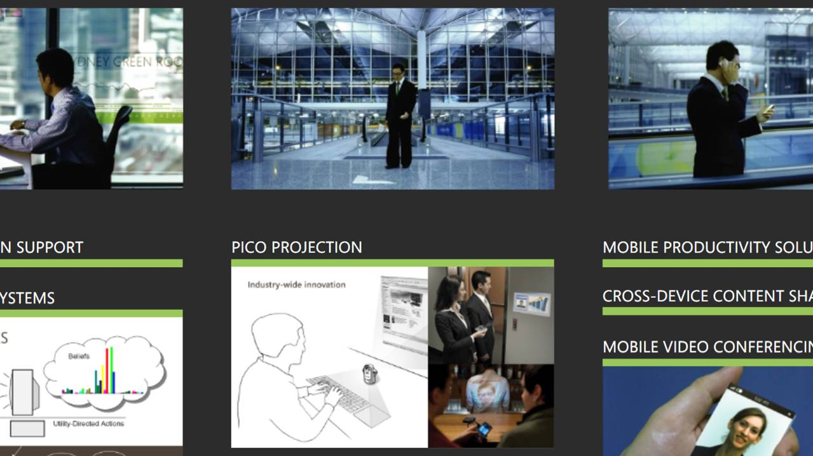

Slide 28
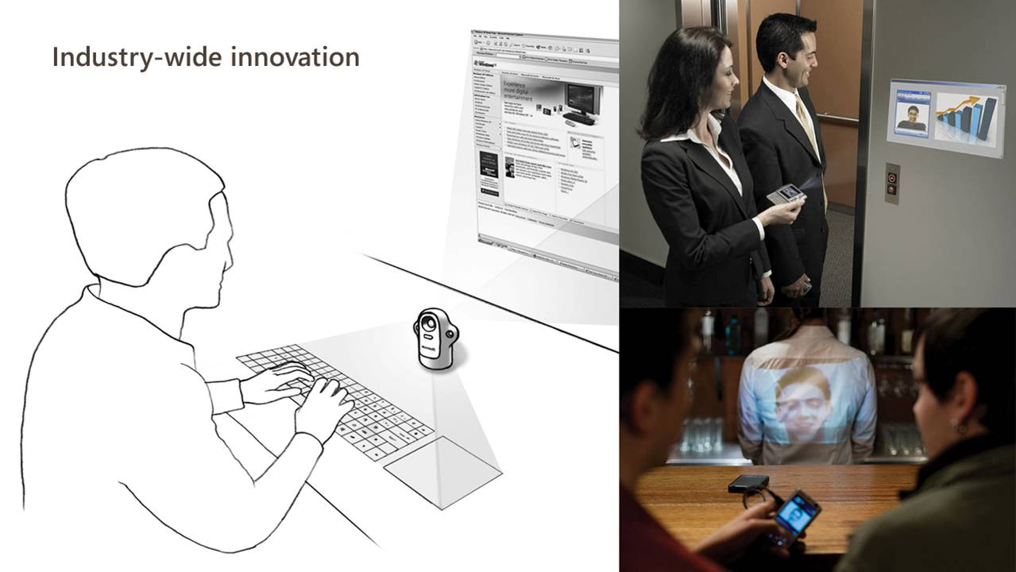

Slide 29
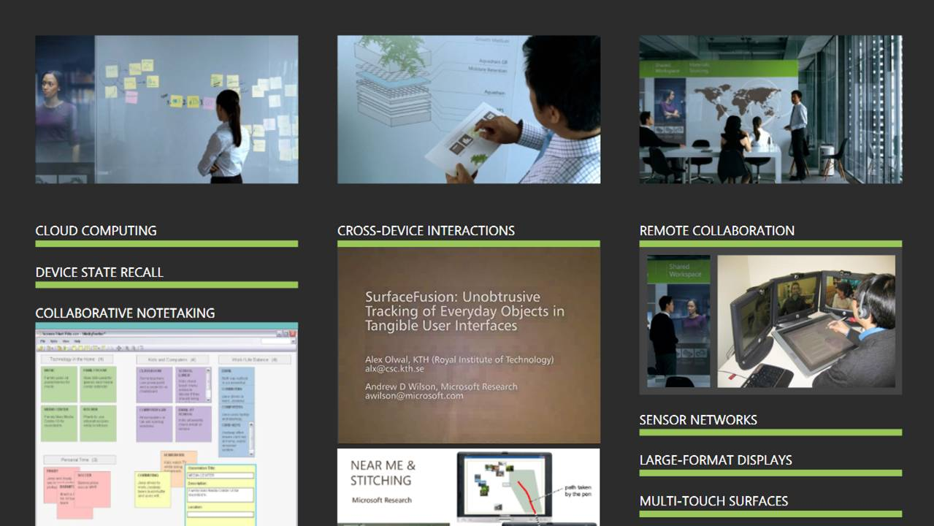

Slide 30
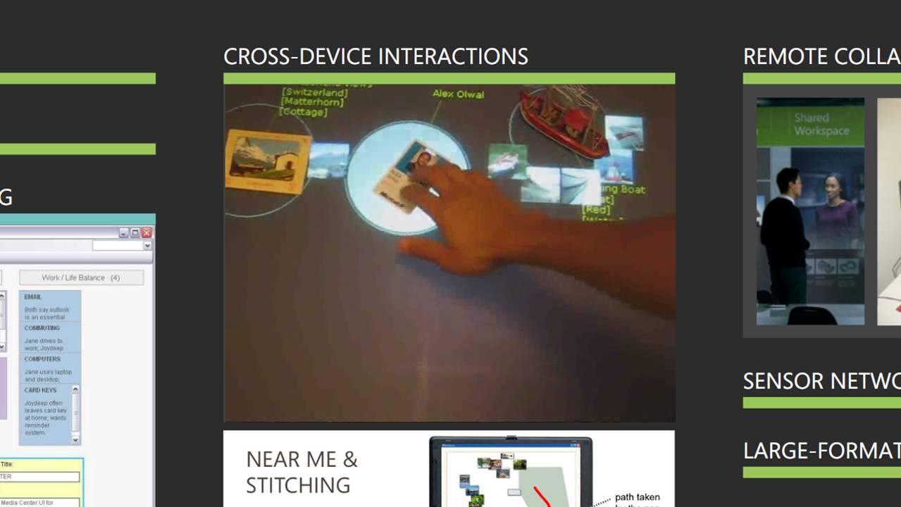

Slide 31
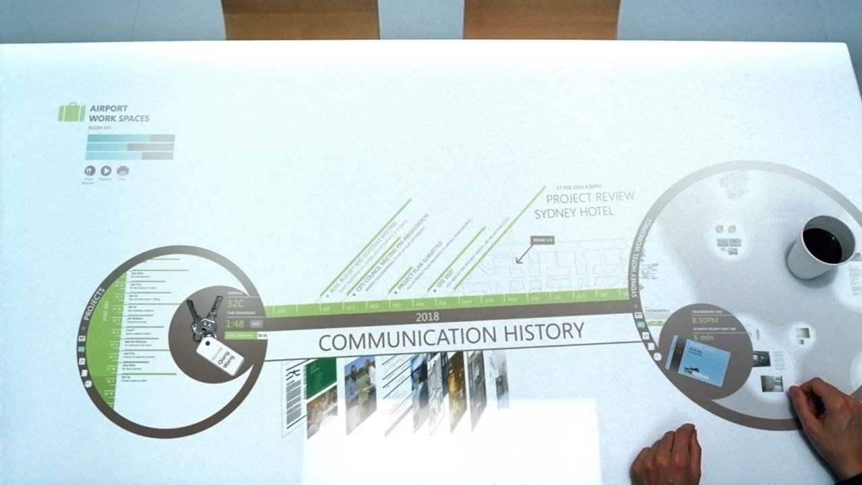

Slide 32
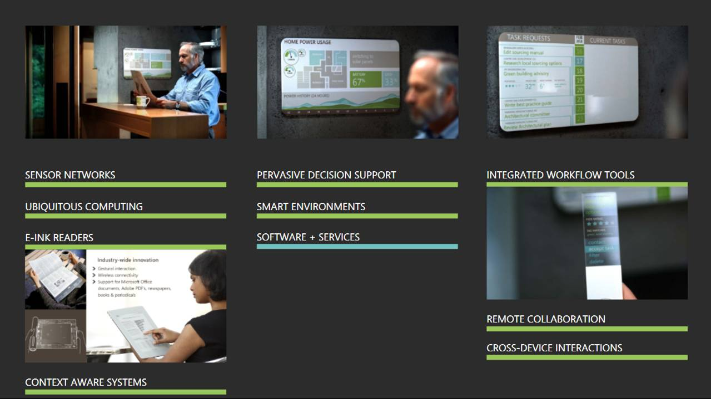

Slide 33
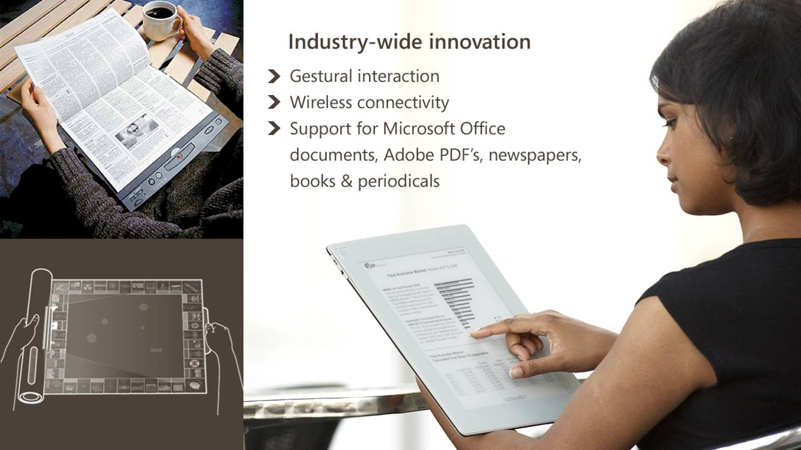

Slide 34
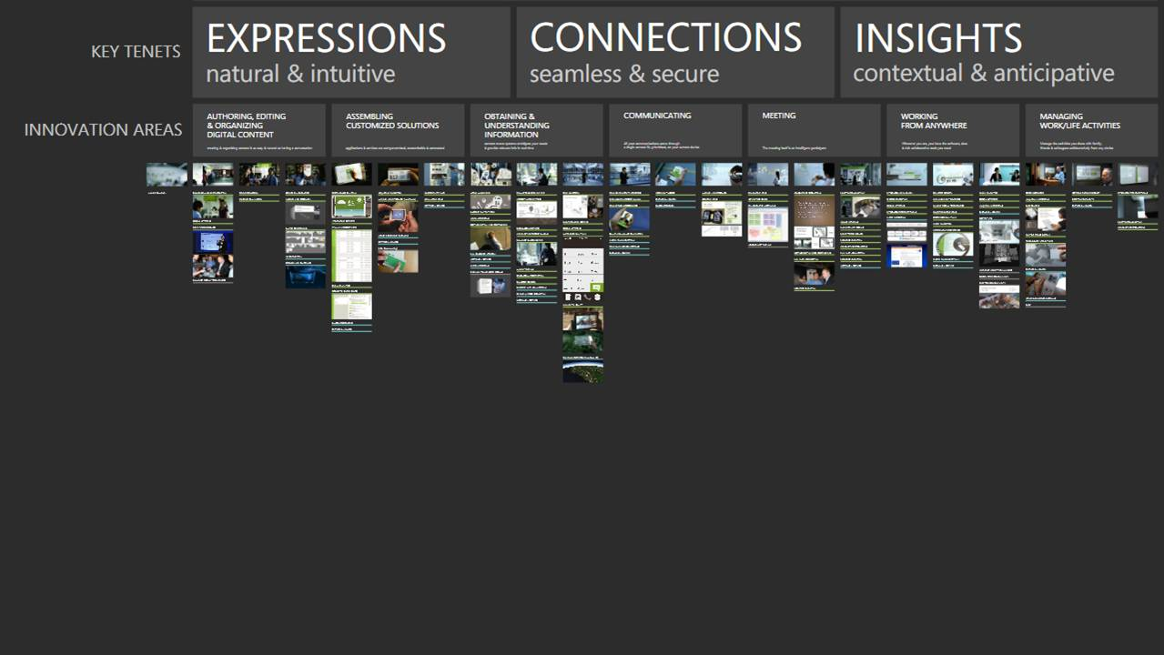

Slide 35
Summary
The real underlying value of “cloud + clients” is that it transparently makes software, data, and computing available everywhere
Be “the Platform”
Lead the revolution of LBS industry

Slide 36

Thank You!
yuzheng@microsoft.com
© Microsoft Corporation. All rights reserved. Microsoft Windows, Windows Vista and other product names are or may be registered trademarks and/or trademarks in the U.S. and/or other countries. The information herein is for informational purposes only and represents the current view of Microsoft Corporation as of the date of this presentation. Because Microsoft must respond to changing market conditions. It should not be interpreted to be a commitment on the part of Microsoft, and Microsoft cannot guarantee the accuracy of any information provided after the date of this presentation. MICROSOFT MAKES NO WARRANTIES, EXPRESS, IMPLIED OR STATUTORY, AS TO THE INFORMATION IN THIS PRESENTATION.

