Slide 1
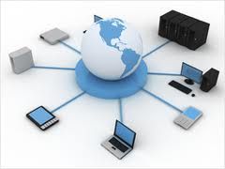
PRESENTATION ON CLOUD COMPUTING
PRESENTED BY–
IRAM KHAN
ISHITA TRIPATHI
GAURAV AGRAWAL
GAURAV SINGH
HIMANSHU AWASTHI
JAISWAR VIJAY KUMAR
JITENDRA KUMAR VERMA
JITENDRA SINGH
KAMAL KUMAR SHARMA
KAUSAL PRATAP

Slide 2
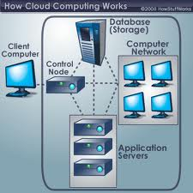
INTRODUCTION
The actual term cloud borrows
from telephony in that
telecommunication companies,
who until the 1990 primarily
offered dedicated point to point
data circuits began offering VIRTUAL
PRIVATE NETWORK(VPN) services
with comparable quality of service
but at a much lower cost.

Slide 3
Cloud Architecture

Slide 4
DEFINITION
CLOUD COMPUTING IS AN EMERGING COMPUTING TECHNOLOGY THAT USES THE INTERNET AND CENTRAL REMOTE SERVERS TO MAINTAIN DATA AND APPLICATION.

Slide 5
CHARACTERISTICS OF CLOUD COMPUTING
Application programming interface.
Device and location independence.
Virtualization .
Reliability.
Maintenance .
Security .
Performance.
Agility.

Slide 6
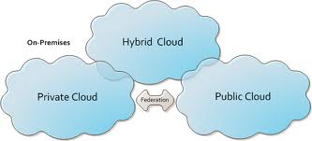
Types of cloud
Public cloud
Private cloud
Community cloud
Hybrid cloud

Slide 7
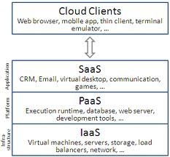
What are Cloud Stacks?
Cloud Services can be dived into *3 stacks:
1. Infrastructure as a Service: IaaS
2. Platform as a Service: PaaS
3. Software as a Service: SaaS

Slide 8
Infrastructure as a Service (IaaS)
This is the base layer of the cloud stack.
It serves as a foundation for the other two layers, for their execution. The keyword behind this stack is Virtualization.
Let us try to understand this using Amazon EC2. In Amazon EC2 (Elastic Compute Cloud) your application will be executed on a virtual computer (instance). You have the choice of virtual computer, where you can select a configuration of CPU, memory & storage that is optimal for your application. The whole cloud infrastructure viz. servers, routers, hardware based load-balancing, firewalls, storage & other network equipments are provided by the IaaS provider. The customer buy these resources as a service on a need basis.

Slide 9
Platform as a Service (PaaS)
Now you don’t need to invest millions of $$$ to get that development foundation ready for your developers. The PaaS provider will deliver the platform on the web, and in most of the cases you can consume the platform using your browser, i.e. no need to download any software.
PaaS Layers
Cloud OS
Cloud Middleware
PaaS Examples
Google App Engine and Windows Azure are examples of Cloud OS. OrangesScape & Wolf PaaS are cloud middleware.

Slide 10
Software as a Service (SaaS)
This is the Top most layer of the cloud computing stack - directly consumed by end user – i.e. SaaS (Software as a Service).
Next generation SaaS promises everything as a service over the internet.
Cloud computing started with a similar premise.
A computing paradigm where there exists a flexible set of computing resources across the internet.

Slide 11
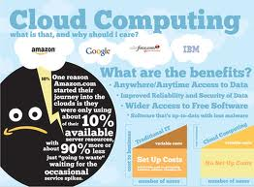
BENEFITS OF CLOUD
Reduce spending on technology
Globalize your work force
on the cheap
Reduce capital cost
Improve accessibility
Improve flexibility
Less personal training is needed
Monitor project more effectively
Achieve economic of scale

Slide 12
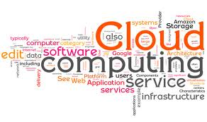
CLOUD SECURITY
SECURITY AND PRIVACY-
Identify management
Physical and personal
security
Availability
Application security
Privacy
Legal issues

Slide 13
USES
Helps to use application without installation.
Access the personal files at any computer with internet
This technology allows much more efficient computation by centralizing storage memory, processing and bandwidth.

Slide 14
CONCLUSION
• Cloud Computing holds some strong promises
– Highly Available
– Dynamically allocate resources
– Pay only for resources that you use
• Cloud Computing is not yet well understood

Slide 15
THANK YOU

