Slide 1
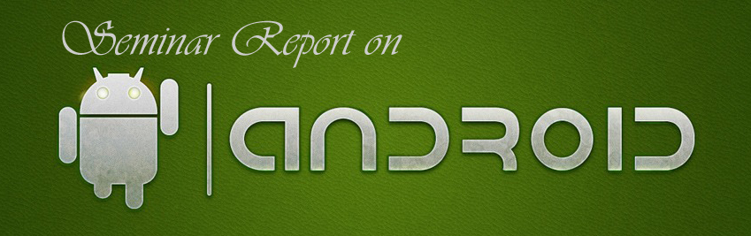
Department Of Computer Science
Gulbarga University Gulbarga
Presented By
Salma Begum
MCA 5th sem
Under the Guidance of
Shrikant G.K

Slide 2
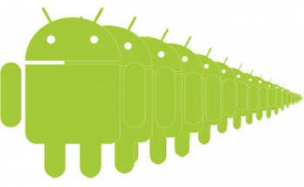
AGENDA
INTRODUCTION
ORGIN OF ANDROID
FEATURES OF ANDROID
ARCHITECHTURE OF ANDROID
VERSIONS OF ANDROID
SOFTWARE DEVELOPMENT
LIMITATIONS
APPLICATION LIFE CYCLE
FUTURE OF ANDROID

Slide 3
Introduction
Android is Linux based operating system for mobile devices.
Android specially developed for applications
There are more than 4,00,000 apps in android market
The andriod is an open source

Slide 4
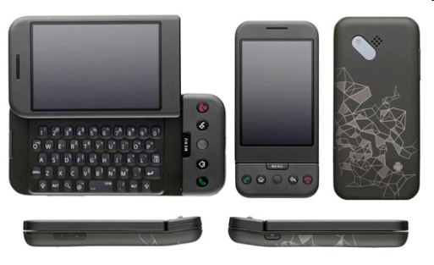
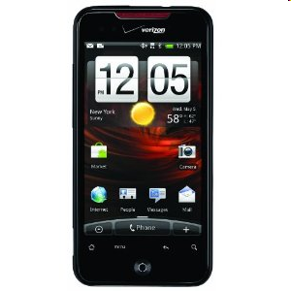
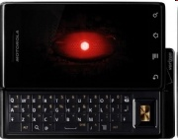
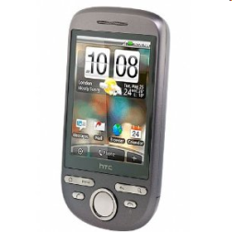
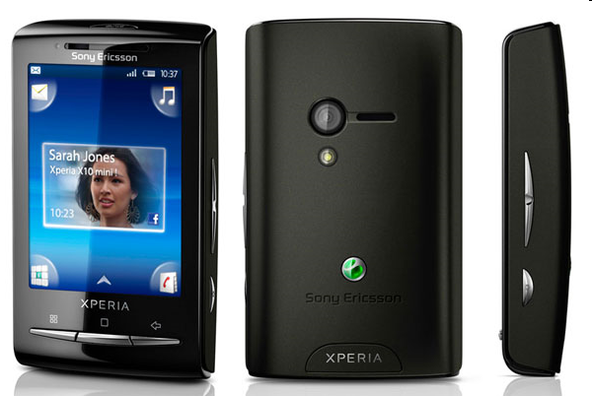
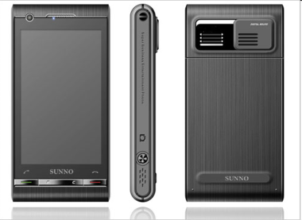
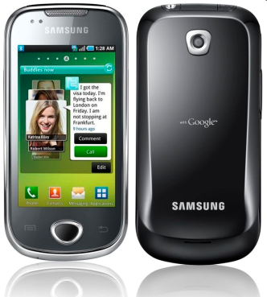
Smart Phones
HTC G1,
Droid,
Tattoo
Motorola Droid (X)
Suno S880
Samsung Galaxy
Sony Ericsson

Slide 5
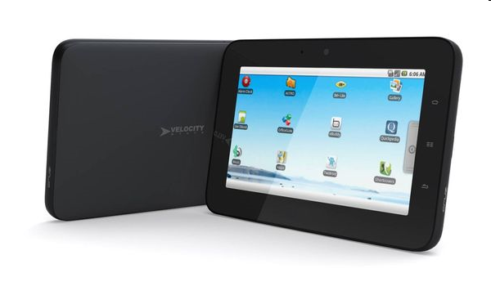
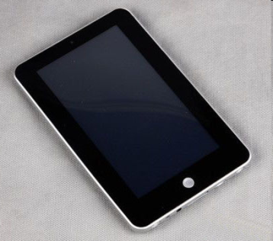
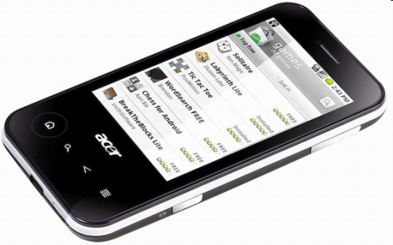
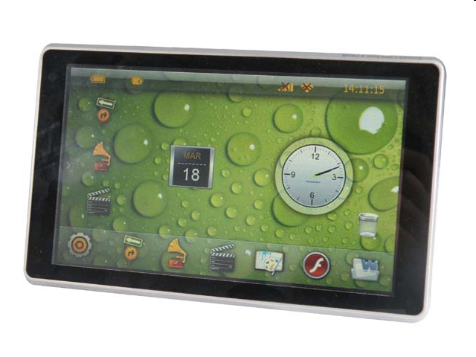
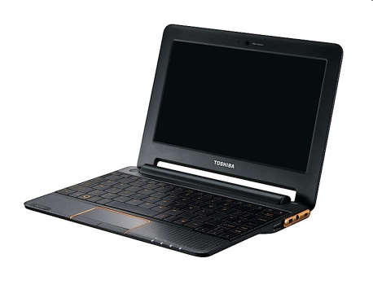
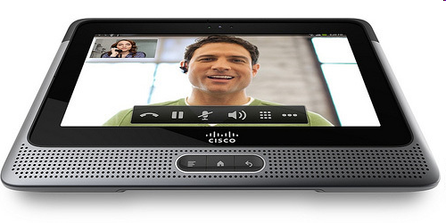
Tablets
Velocity Micro Cruz
Gome FlyTouch
Acer beTouch
Toshiba Android
SmartBook
Cisco Android Tablet
Dawa D7

Slide 6
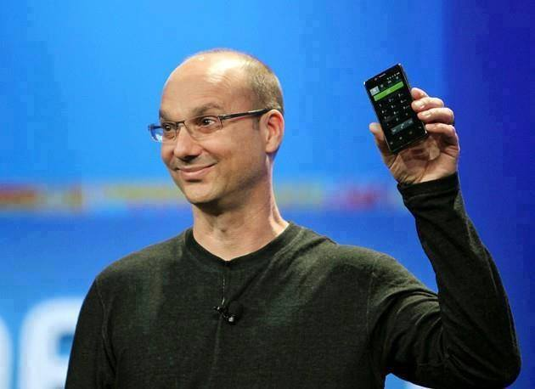
ORIGIN OF ANDROID
Android was founded in Palo Alto, California in October 2003 by Andy Rubin, Rich Miner, Nick Sears and Chris White who work at “Google” to develop.
Andy Rubin

Slide 7
ORIGIN OF ANDROID
Android was purchased by the GOOGLE in AUGUST, 2005 for 50 million $.
The open handset alliance, a group of several companies was formed -5 November 2007
Android beta released-12 November 2007

Slide 8
Open handset alliance(oha)
It’s consortium of several companies.
This group of companies are allowed to use source code of Android and develop applications.

Slide 9
Features of andriod
Andriod can run multiple apps at the same time
Also support optimized graphics VGA, 2D graphics and 3D graphics.
Andriod has better app market.
Andriod lets you change your setting faster.
It gives you more options to fit your budget
Andriod keeps information visible on your home screen.
Android also support java applications.

Slide 10
The Android Software Architecture
Linux kernel
Libraries
Android run time
  core libraries
  Dalvik virtual machine
application layer
application framework

Slide 11
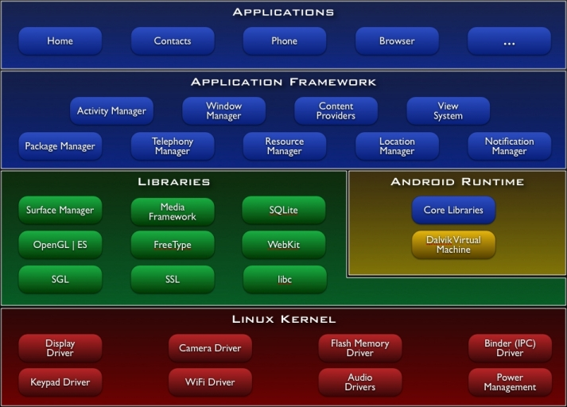
ARCHITECTURE

Slide 12
Linux Kernel
Device drivers
Memory management
Process management
Networking

Slide 13
Libraries
C/C++ libraries
Interface through Java
Surface manager – Handling UI Windows
2D and 3D graphics
Media codes, SQLite, Browser engine

Slide 14
Android Runtime
Dalvik VM.
  Dex files
  Compact and efficient than class files
  Limited memory and battery power
Core Libraries
  Java 5 Std edition
  Collections, I/O etc…
  Providing most of the functionality available in the core libraries of the Java language.

Slide 15
Application Framework
API interface :
Activity manager – manages application life cycle
Android provides a set of core applications:
  Email Client
  SMS Program
  Calendar
  Maps
  Browser
  Contacts,Etc.
All applications are written using the Java language.
  APIs
    Data Structures
    Utilities
    File Access
    Network Access
    Graphics
    Etc

Slide 16
Versions of andriod
Andriod 1.0 23 September 2008
Andriod 1.1 9 February 2009
Andriod 1.5 (Cupcake) 30 April 2009
Andriod 1.6 (Donut) 15 September 2009
Andriod 2.0 (Éclair) 26 October 2009
Andriod 2.2 (Froyo) 20 May 2010
Andriod 2.3 (Gingerbread) 6 December 2010
Andriod 3.0 (Honeycomb) 10 May 2011
Andriod 4.0 19 October 2011
(Ice Cream Sandwich)
Andriod 4.1 ,4.2,4.3 13 July 2012
(Jelly bean)
Andriod 4.4 (Kitkat) 31 October 2013

Slide 17
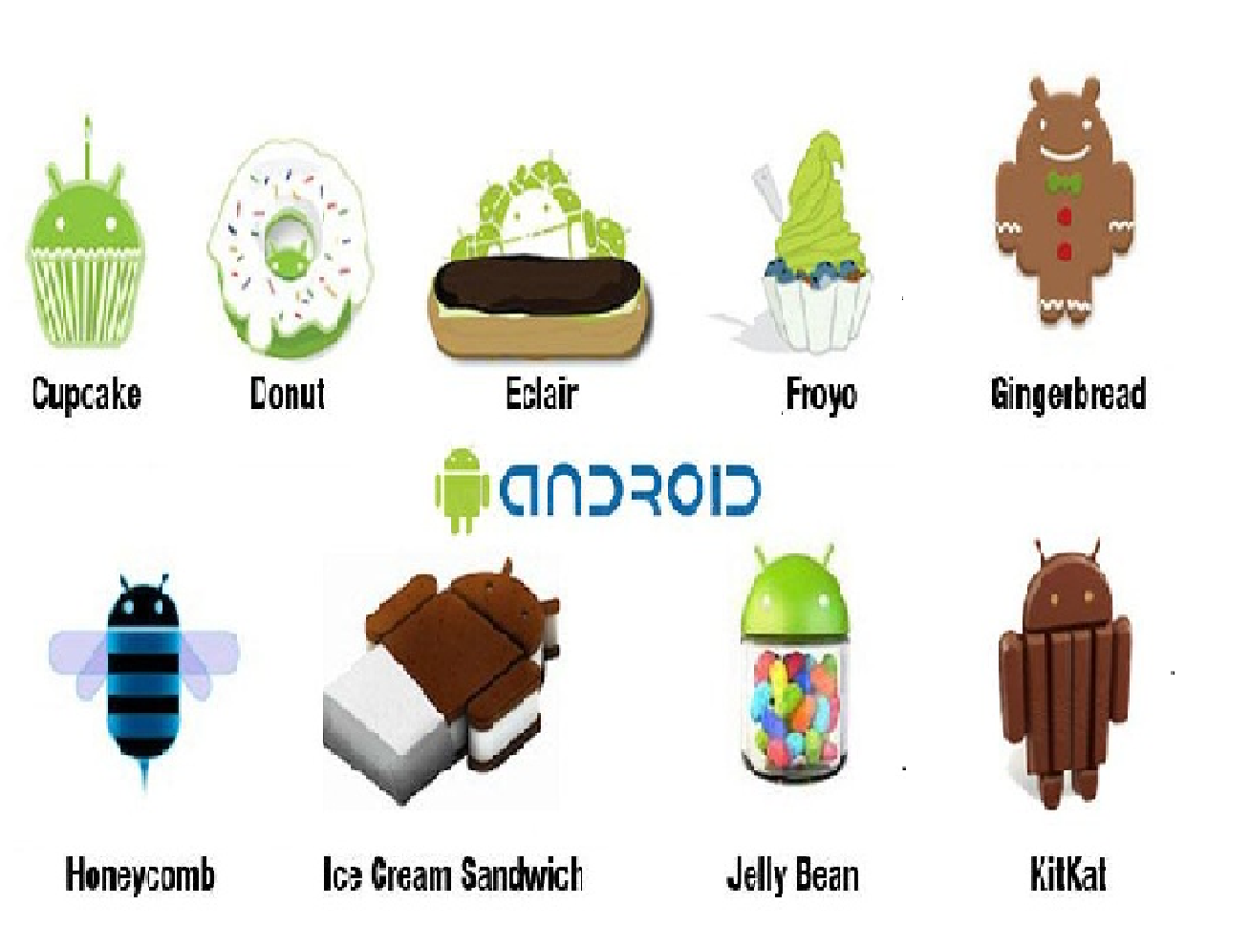

Slide 18
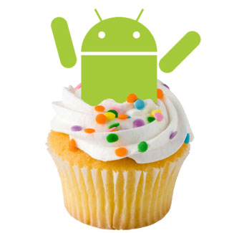
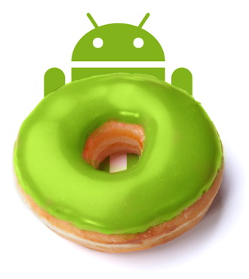
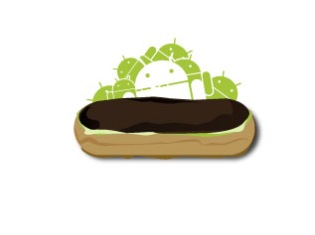
Android Cupcake 1.5
Released on April 30, 2009.
Added auto-rotation option.
Copy and Paste feature added in the web browser.
Increased speed and performance but not upto required level.
Android Donut 1.6
Released on September 15, 2009.
Voice search and Search box were added.
Faster OS boot times and fast web browsing experience.
Android Éclair 2.0/2.1
Released on October 26, 2009.
Bluetooth 2.1 support.
Improved typing speed on virtual keyboard, with smarter dictionary.
no Adobe flash media support.

Slide 19
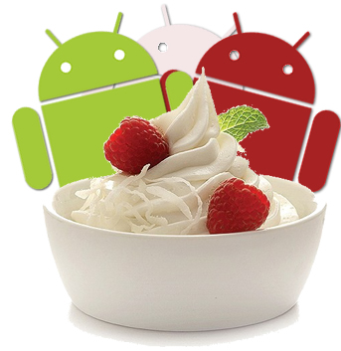


Android Froyo 2.2
Released on May 20, 2010.
Support for Adobe Flash 10.1
Improved Application launcher with better browser
No internet calling.
Android Gingerbread 2.3
Released on December 6, 2010.
Updated User Interface with high efficiency and speed
Internet calling
One touch word selection and copy/paste.
New keyboard for faster word input.
More successful version of Android than previous.
not supports multi-core processors.
Android Honeycomb 3.0
Released on February 22, 2011.
Support for multi-core processors
Ability to encrypt all user data.
This version of android is only available for tablets.

Slide 20
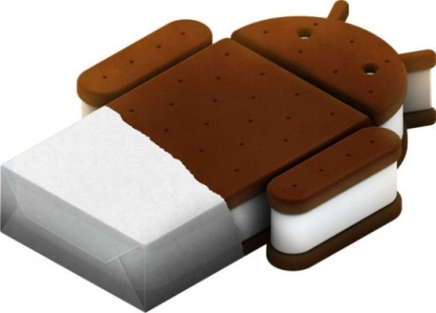
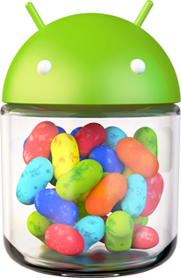
Android IceCreamSandwich(ICS) 4.0
Released on November 14, 2011.
Virtual button in the UI.
A new typeface family for the UI, Roboto.
Ability to shut down apps that are using data in the background.
Android JellyBean 4.1
Released on June 27, 2012.
Improved the features of previous version while improving the graphics quality.
Smoother user interface.

Slide 21
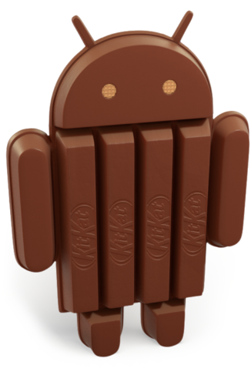
Android JellyBean 4.2,4.3
Released on 13 November 2012
Lock screen improvements
Multiple user accounts (tablets only)
Bug fixes and performance enhancements
Android Kitkat 4.4
Released on 31 October 2013
Ability for applications to trigger translucency
in the navigation and status bars
Wireless printing capability
And even more features are currently being rolled out

Slide 22
Why andriod os is better than iphone os?
Andriod os | Iphone os
We can set any app as a default on android Android just drag and drop for syncing by using USB cable on computer While Google charges for Andriod developer only $5 Andriod os have flash support On Androird,on which you are notified of an email as soon as it arrives | It is impossible on iphone, Have to click manually Iphone syncing only with iTunes Apple charges for the App Developers $100 While the iphone only has html5 support The email system on the iphone is horrible

Slide 23
Android Application Development
Android
SDK
Eclipse IDE
Android
Mobile
Device
Android
Emulator

Slide 24
Android development
Java Source
Android Manifest
Generated Class
Java Compiler
.dex
File
Dalvik
VM
Resource XML
Android Libraries

Slide 25
SOFTWARE FEATURES
Integrated browser based on the open source Web Kit engine
SQLite for relational data storage
Media support for common audio, video, and still image formats
Dalvik Virtual Machine optimized for mobile devices

Slide 26
HARDWARE FEAUTURES
Cellular networking : GSM, EDGE, 3G
LAN : Bluetooth, and Wi-Fi
Graphics Hardware Acceleration
Camera, GPS and Compass
Touch screen and accelerometer for motion sensing

Slide 27
Techniques for saving data
  SQLite Databases: relational database library for storing and managing complex data
  Files: you can create, write, and read files from the local storage or external media (SD Cards)
    FileOutputStream, FileInputStream, and Resources classes.

Slide 28
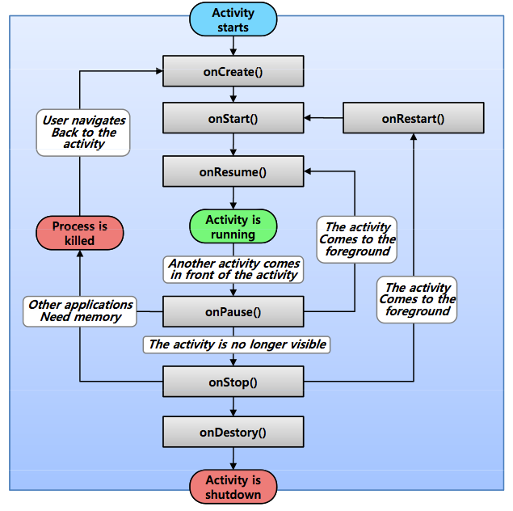
APPLICATION LIFE CYCLE

Slide 29
Life Cycle
Each application runs in its own process.
Each activity of an app is run in the apps process
Processes are started and stopped as needed to run an apps components.
Processes may be killed to reclaim needed resources.
Killed apps may be restored to their last state when requested by the user

Slide 30
Andriod market
Andriod market is the online software store developed by Google for Andriod devices
Users to browse and download apps published by third party developer
As of october 2011 there were more than 4,00,000 apps available for Android
As of dec 2013 there were more than 8,00,000 apps available for Android
Android has several famous apps like voice action, sky map,place directory,GPS,etc..,

Slide 31
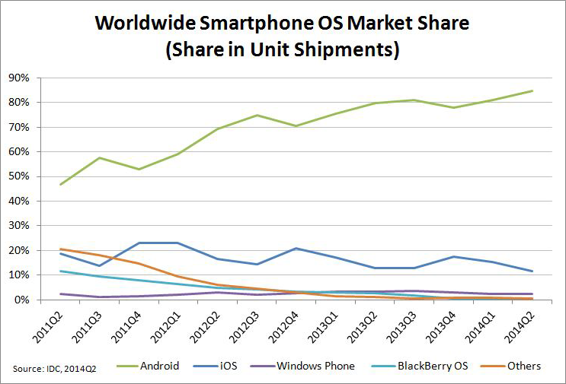
Market Sales Rate for Smartphone devices

Slide 32
Cont…
Period | Android | iOS | Windows Phone | BlackBerry OS | Others
Q2 2014 | 84.7% | 11.7% | 2.5% | 0.5% | 0.7%
Q2 2013 | 79.6% | 13.0% | 3.4% | 2.8% | 1.2%
Q2 2012 | 69.3% | 16.6% | 3.1% | 4.9% | 6.1%
Q2 2011 | 36.1% | 18.3% | 1.2% | 13.6% | 30.8%

Slide 33
WHAT MAKES AN ANDROID SPECIAL?
Open source – Free development platform
Built in components can be improved
Built in services like GPS,SQL Database, browser and maps
Management of process life cycle
High quality graphics and sound
Portability across current and future hardware
Component-based architecture and reusable, replaceable modules
Multi-layer isolation of programs

Slide 34
Where is Android going?
  The Android OS may accelerate the diffusion of smart
  phones by providing a free OS.
  Access to the Android software development kit (SDK) suggests that the number of applications will continue to as well as professional developers provide new offerings.
  Transforming them from consumers of existing applications to creators of apps designed to meet their needs.
  Android, by increasing the user base, might hasten the integration of mobile technology.
  Android is the Biggest selling OS in the World on Mobile Computing.

Slide 35
LIMITATIONS
Android operating system uses more amount of battery as compared to normal java and symbian mobile phones.
It has been seen that it has security related issues.
As we call Android is world of applications we continuously need to connected with the internet which is not possible for all the users.

Slide 36
Android vs windows phones
 | Androidroid | Windows Phone
Company/ Developer | Google | Microsoft
Programmed in | Java, C, C++ | C, C++
OS family | Unix-like | Windows
Initial release | September 23, 2008 | October 21, 2010
Supported platforms | ARM, MIPS, x86, I.MX | x86
License | Apache License 2.0 Linux kernel patches under GNU GPL v2 | Commercial proprietary software
Default user interface | Graphical (Multi-touch) | Graphical (Metro UI)

Slide 37
Cont…
Working state | Current | Current
Source model | Open source software | Closed-source
Updates | Updates are provided by different parties in the consortium. | Updates are only done by Microsoft.
Applications | Applications are created by an open community of developers. | Applications are created by tie up companies and Microsoft.
Touch style | Capacitive technology | Capacitive technology
Offers native support for | Google Sync for Gmail, Contacts, and Google Calendar. | Mail, Exchange, Outlook Contacts, Calendar, Windows Market, etc.
Number of applications | Over 700,000 applications | Limited number of applications.
Language support | Multiple language support | Multiple language support

Slide 38
CONCLUSION AND FUTURE SCOPE
Android is now stepping up in next level of mobile internet.
There are chances of Android Mobile sales in whole world becomes more then iPhone.
There are chances of Android may become the widely used operating system in world as it has found its application in many appliances such as washing machine, microwave ovens, cameras, TVs etc.
Google may launch another version of android that starts L because Google is launching all the android versions in the alphabetical order.

Slide 39


Slide 40

Thank You

