Slide 1

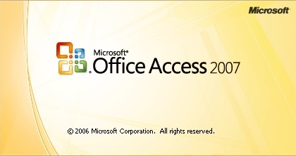
^{MicroSoft Access 2007}
Group Presentation
Computer Based Financial Accounting

Slide 2
Version | Version number | Release Date | Jetversion | Supported OS | Office suite version
Access 1.1 | 1.0 | 1992 | 1.1 | Windows 3.0
Access 2.0 | 2.0 | 1993 | 2.0 | Windows 3.1x | Office 4.3 Pro
Access for Windows 95 | 7.0 | Aug. 24, 1995 | 3.0 | Windows 95 | Office 95 Professional
Access 97 | 8.0 | Jan. 16, 1997 | 3.5 | Windows 95, Windows NT 3.51 SP5, Windows NT 4.0 SP2 | Office 97 Professional and Developer
Access 2000 | 9.0 | June 7, 1999 | 4.0 SP1 | Windows 95, Windows NT 4.0, Windows 98, Windows 2000 | Office 2000 Professional, Premium and Developer
Access 2002 | 10.0 | May 31, 2001 | 4.0 SP1 | Windows NT 4.0 SP6, Windows 98, Windows 2000, Windows Me | Office XP Professional and Developer
Access 2003 | 11.0 | Nov. 27, 2003 | 4.0 SP1 | Windows 2000 SP3 or later, Windows XP, Windows Vista, Windows 7 | Office 2003 Professional and Professional Enterprise
Access 2007 | 12.0 | Jan. 27, 2007 | 12 | Windows XP SP2, Windows Server 2003 SP1, or newer operating system | Office 2007 Professional, Professional Plus, Ultimate and Enterprise
Access 2010 | 14.0 | July 15, 2010 | 14 | Windows XP SP3, Windows Server 2003 SP2, Windows Server 2003 R2, Windows Vista SP1,Windows Server 2008, Windows 7, Windows Server 2008 R2, Windows Server 2012, Windows 8 | Office 2010 Professional, Professional Academic and Professional Plus
Access 2013 | 15.0 | Jan. 29, 2013 | 15 | Windows 7, Windows Server 2008 R2, Windows Server 2012, Windows 8 | Office 2013

Slide 3

Group Members
  Lok Raj Binadi
  Heera Chalaune
  Babita Phulara
  Krishna Raj Pandey
  Ramesh Pant
  Manoj Raj Sharma

Slide 4
CONTENTS
1. Overview
2. Features
3. Areas
4. Differences
5. Some Terms
6. Formation of Tables
7. Advantages
8. Disadvantage

Slide 5

Heera Chalaune
MS-Access 2007
  Overview
  Features

Slide 6
Overview
Microsoft Access, also known as Microsoft Office Access, is a database management system from Microsoft that combines the relational Microsoft Jet Database Engine with a graphical user interface and software-development tools.
It is a member of the Microsoft Office site of applications, included in the Professional and higher editions or sold separately.
Microsoft Access stores data in its own format based on the Access Jet Database Engine. It can also import or link directly to data stored in other applications and databases.

Slide 7
Cont…
A database is a collection of data organized in a manner that allows access, retrieval, and use of that data.
Ex. A Rolodex which keeps track of Names, Addresses, and Phone Numbers, is a simple example of a manual database.
A Database Management System, allows you to use a computer to create a database.
With the computer you can (electronically) create, add, change, and delete data in the database, retrieve data using Queries, and create Forms and Reports.

Slide 8
Cont…
Is known as a desktop database system because its functions are intended to be run from a single computer.
Uses database – a collection of data and objects related to a particular subject, which is organized and categorized by tables
It is a Relational Database Management System (RDBMS), because it stores information in multiple related tables and can be treated as a single storage area and pull information electronically from different tables in whatever order meets your needs; designed primarily for home or small business usage.

Slide 9
Cont…
Previously known as Microsoft Access, is a database management system from Microsoft that combines the relational Microsoft Jet Database Engine with a graphical user interface and software-development tools.

Slide 10
FEATURES OF MS-ACCESS
Users can create tables, queries, forms and reports, and connect them together with Macros .
Macros in Access can be thought of as a simplified programming language which you can use to add functionality to your database. It contains actions that perform tasks, such as opening a report, running a query, or closing the database.
Access also has report creation features that can work with any data sources that Access can “access”.

Slide 11
Cont…
Other features include: the import and export of data to many formats including Excel, Outlook, ASCII, dBase, Paradox, FoxPro, SQL Server, Oracle, ODBC, etc.
It can perform heterogeneous joins between data sets stored across different platforms. It is often used by people downloading data from enterprise level databases for manipulation, analysis, and reporting locally.
Microsoft Access offers parameterized queries. These queries and Access tables can be referenced from other programs like VB6 and .NET through DAO or ADO. From MS Access, VBA can reference parameterized stored procedures via ADO.

Slide 12
Cont…
Microsoft Access is a file server-based database. Unlike client-server relational database management systems, Microsoft Access does not implement database triggers, stored procedures, or transaction logging.
It also has the ability to link to data in its existing location and use it for viewing, querying, editing, and reporting.

Slide 13

Babita Phulara
MS Access 2007
  Areas
  Difference between Access and Excel
  How is it difference from a spreadsheet?

Slide 14
AREAS OF MS-ACCESS
Access as a Development Platform for Small-Business Applications
Access as a Development Platform for Departmental Applications
Access as a Development Platform for Corporation-Wide Applications
Access as a Front End for Enterprisewide Client/Server Applications
Access as a Tool to Develop Web Applications

Slide 15
DIFFERENCES BETWEEN ACCESS AND EXCEL
For the most part, Microsoft Access and Excel are very similar. They are both databases, and have similar functions in terms of inputting data.
However, you would typically use Microsoft Access when compiling data that is either categorical in nature or involves more reading.
A typical project that would be of use in Microsoft Access is a telephone book or a directory.

Slide 16
Cont…
Microsoft Excel typically uses more numerical data than Microsoft Access, and is used to show functions between cells.
As you will see from this Quicktip, Access does use relationships, but can show relationships between databases, as well as cells.

Slide 17
HOW IS IT DIFFERENT FROM A SPREADSHEET?
Spreadsheet Software allows users to add, subtract & perform user defined calculations on rows & columns of numbers.
Spreadsheets are more geared towards numeric data, whereas Databases work with Data that contains info. like Names, Addresses, Soc. Security #’s etc.

Slide 18

Manoj Raj Sharma
(Vatij)
  MS Access 2007
  Points to remember and its definition
  Primary Key

Slide 19
POINTS TO REMEMBER
Tables
Records
Fields
Primary Key

Slide 20
DEFINITIONS
Table
A table is a collection of data about a particular subject. For Ex. a Movie table contains info. about movies like Movie No., Movie Title, Year Made, Movie Type etc.
RECORDS
Records are simply the ROWS in the table.
FIELDS
Fields are the COLUMNS in the table.

Slide 21
Movie Table
Each COLUMN in the table
is a FIELD
Each ROW in the table
is a RECORD

Slide 22
RECORDS
A RECORD in the MOVIE Table contains information about a specific MOVIE.
Ex. Record Number 003 contains specific information on the movie Dancing Duo.

Slide 23
FIELDS
A FIELD contains a specific piece of information within a RECORD.
Ex. The Movie Title field contains specific information about the Title of the Movie.

Slide 24
PRIMARY KEY
The first field in the MOVIE table is the MOVIE NUMBER. This is a code assigned by the owner to each MOVIE.
These numbers are unique; that is no two movies will be assigned the same number.
Such a field can be used as a UNIQUE IDENTIFIER. Ex. Soc-Sec-No.
This is called the PRIMARY KEY.

Slide 25

Lok Raj Binadi (Raazz)
Ramesh Pant

Slide 26

TODAY WE WILL LEARN
How to create a table?
Example:
Movie Table
2. Director Table

Slide 27
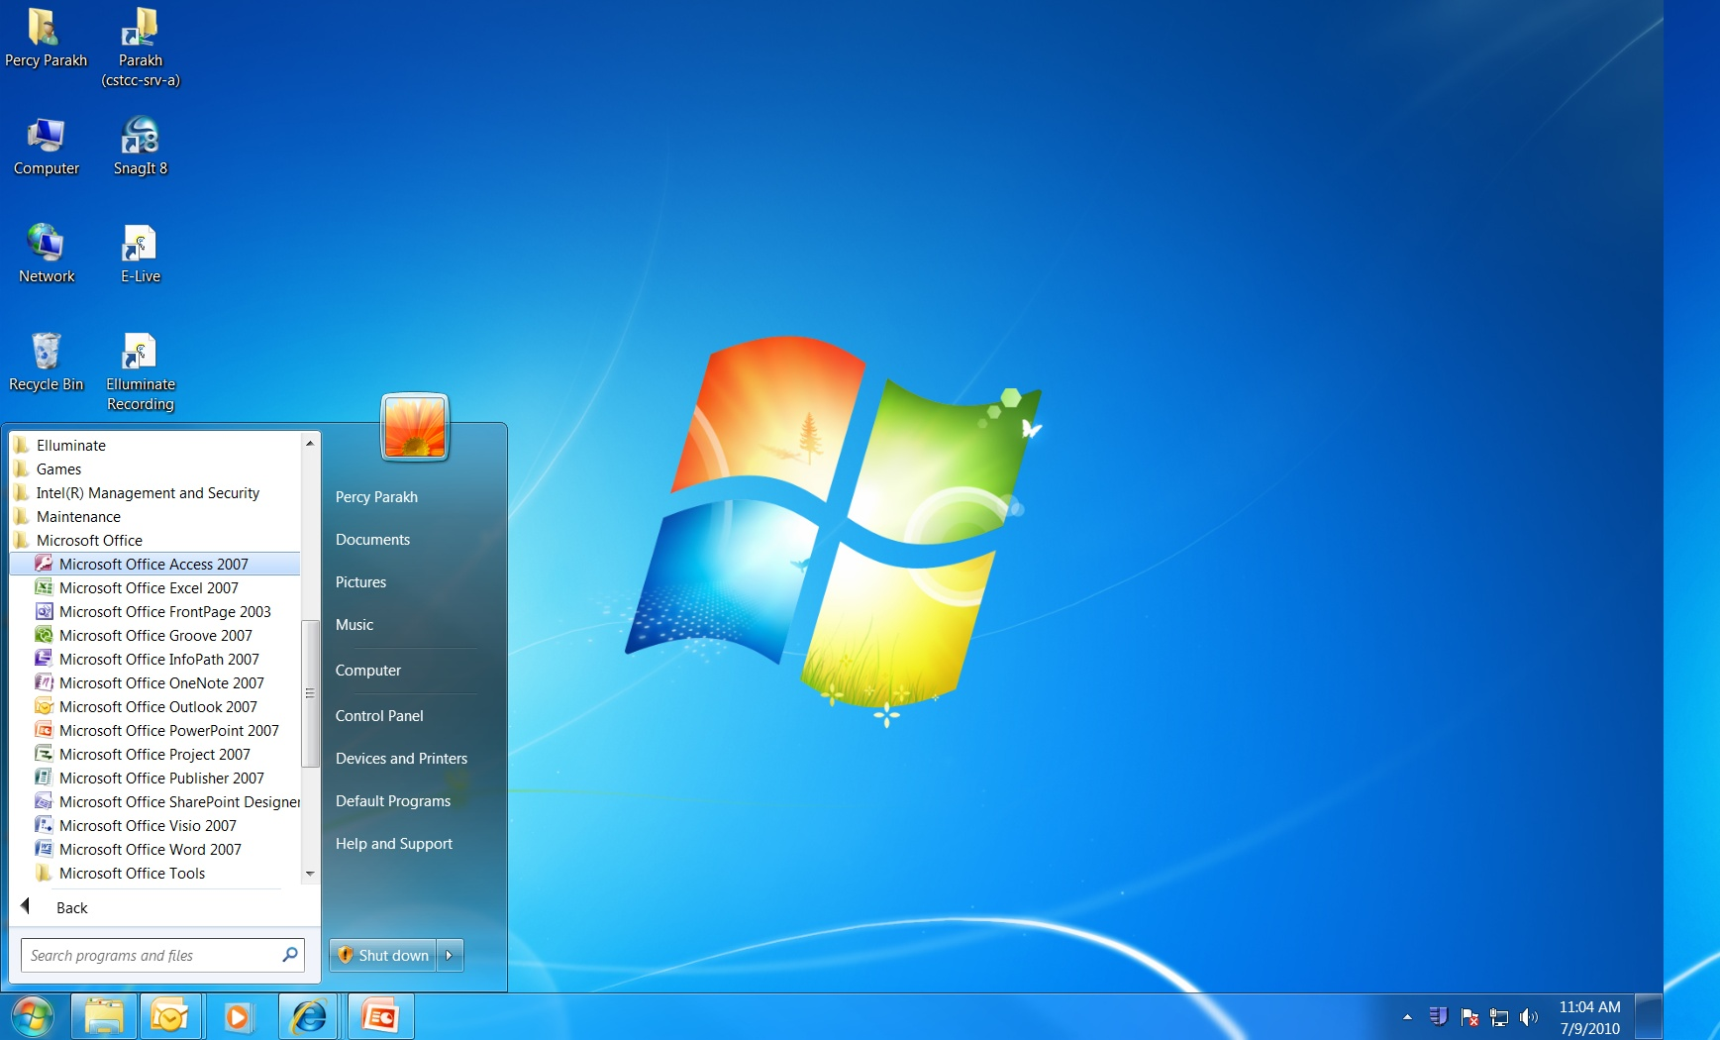
Click on Start, Programs,
Microsoft Office, Microsoft
Office Access 2007

Slide 28
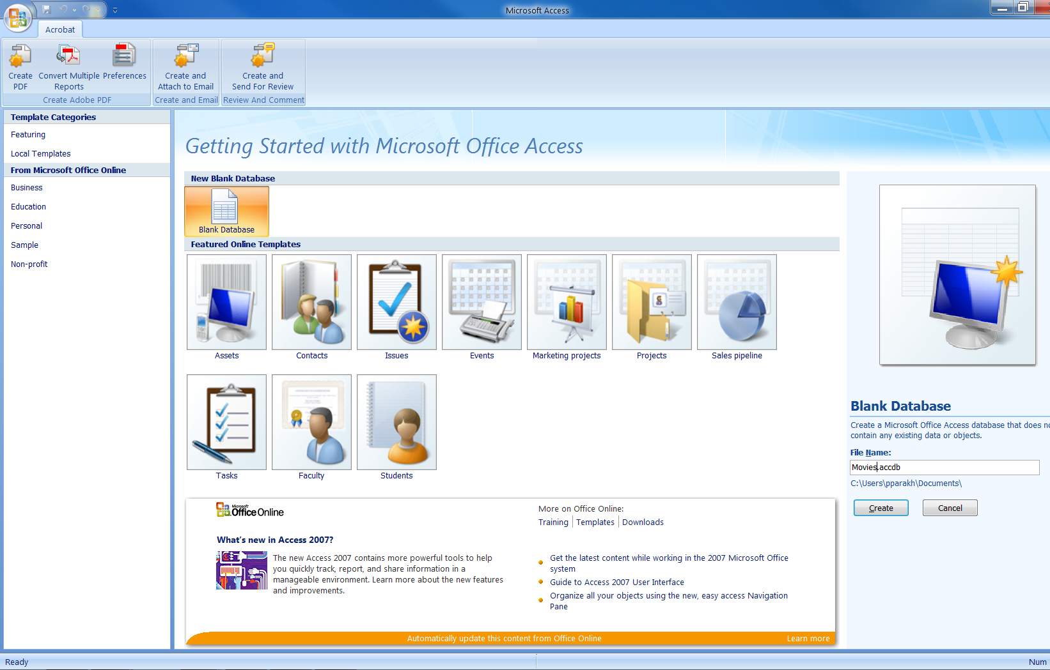
1) Click, Blank
Database
2) Name it
Movies.accdb
3) Click,
Create

Slide 29
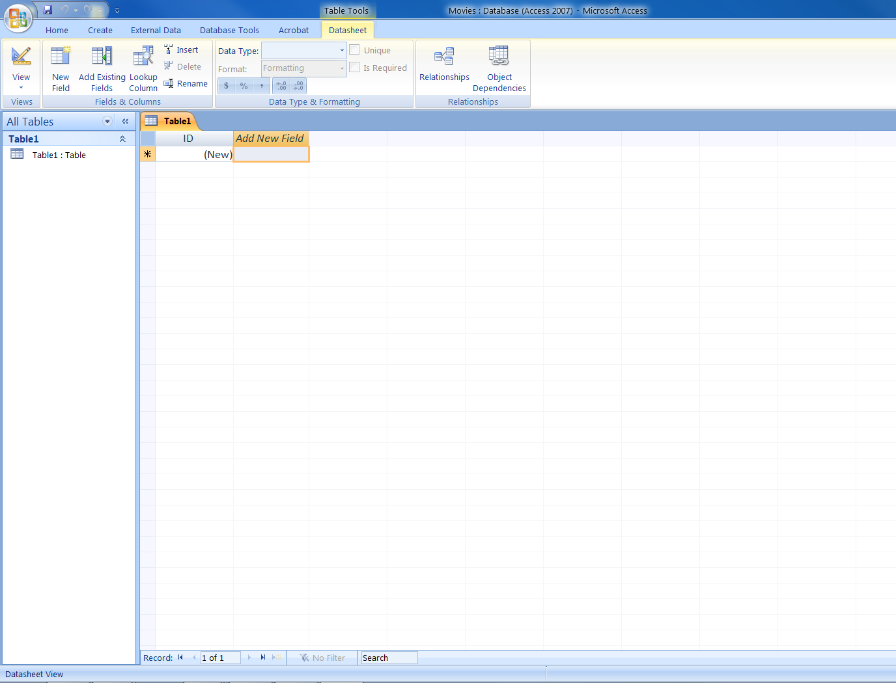

Slide 30
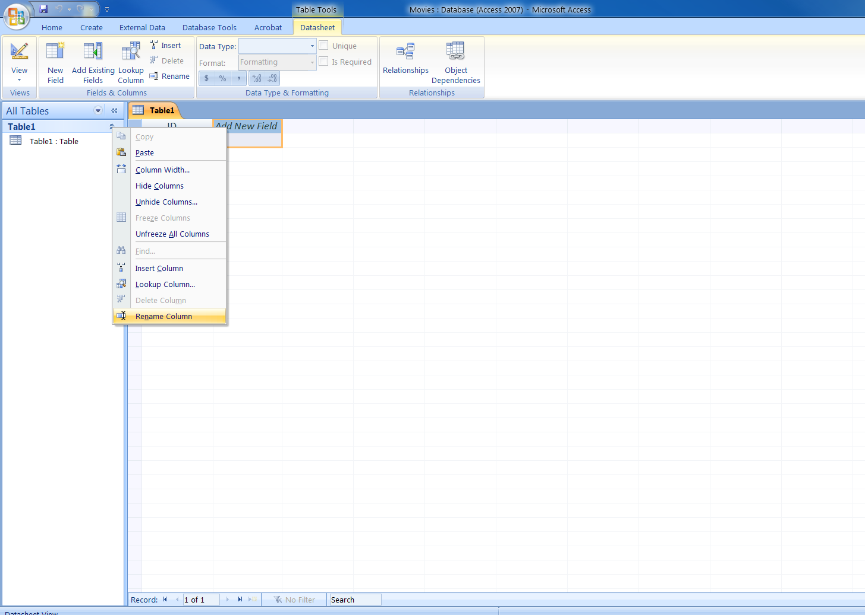
1) Right Click,
select Rename
Column

Slide 31
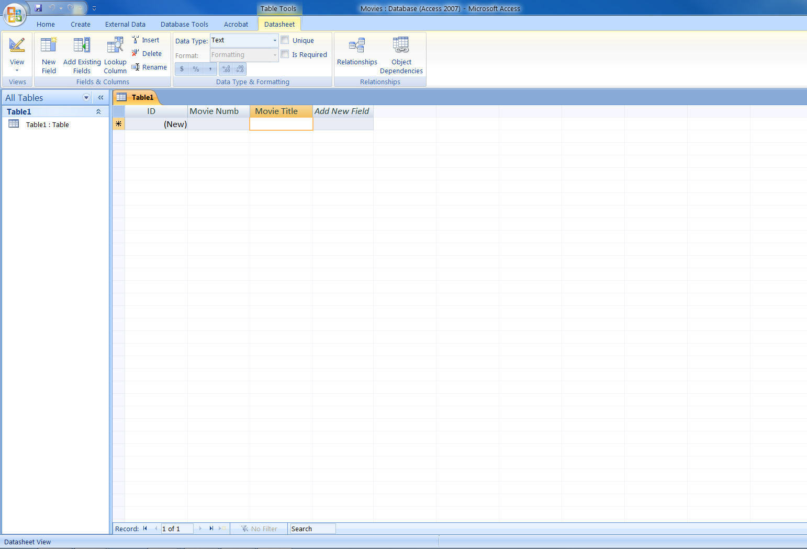
3) Data Type,
Text
4) Type in Movie
Title and so on…..
1) Rename field
as Movie Number
2) Press the
Down Arrow
key

Slide 32
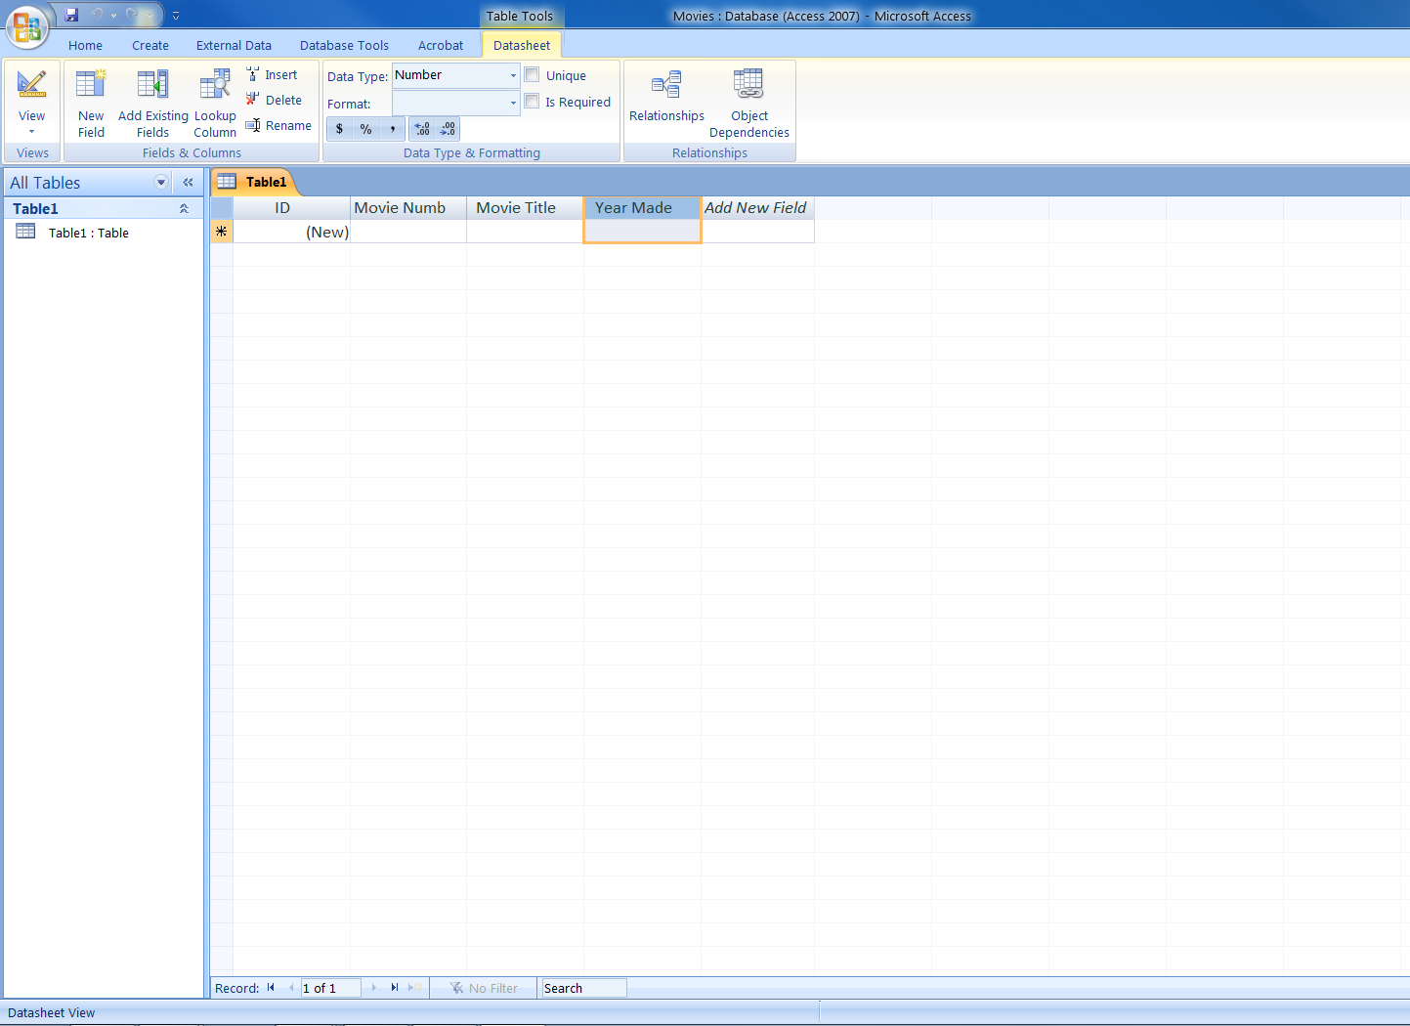
Data Type for
Year Made – Number

Slide 33
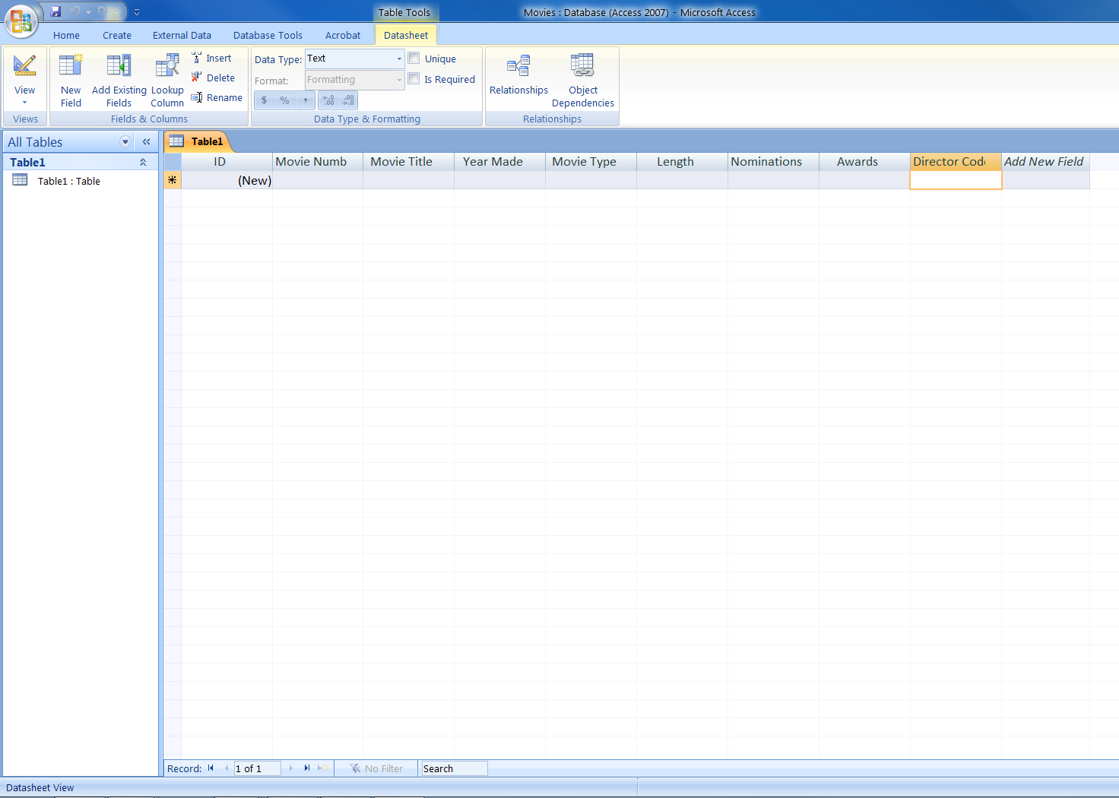
Data Type,
Number
The rest of the fields
Have a Data Type of
Text

Slide 34
How to Save the Table
Save the Table and call it Movies.
The Movies Table will show up in the left pane.

Slide 35
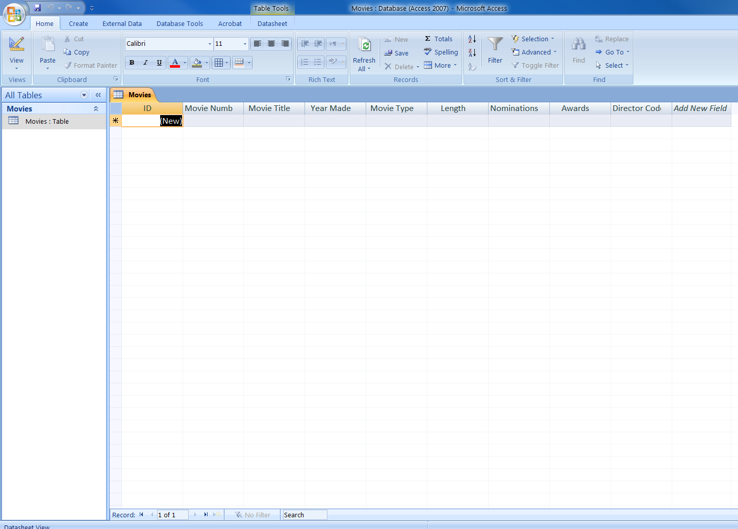
2) Click on View to
Toggle to Design
View
1) Saved as
Movies: Table

Slide 36
CREATING THE PROPER PRIMARY KEY
We will delete the bogus Primary key i.e. the ID #.
We will make the Movie Number the Primary Key, by clicking on the Primary Key Button.

Slide 37
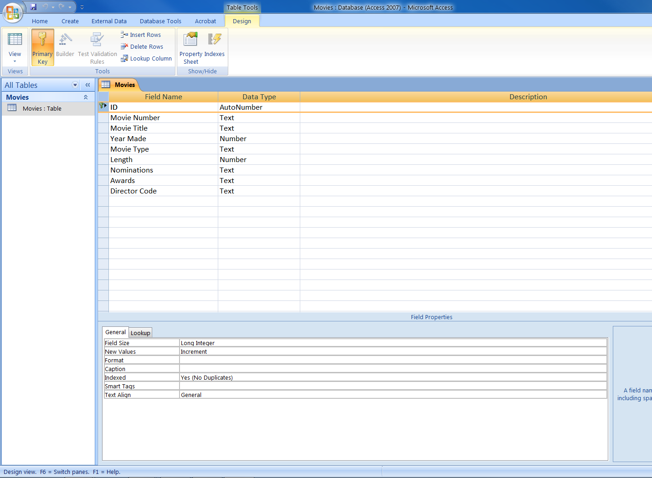
Click on the
Primary Key row,
and press Delete
on the keyboard

Slide 38
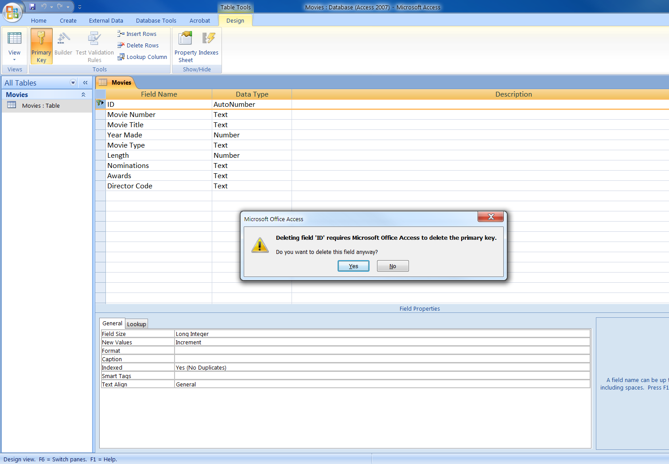
Click on
Yes

Slide 39
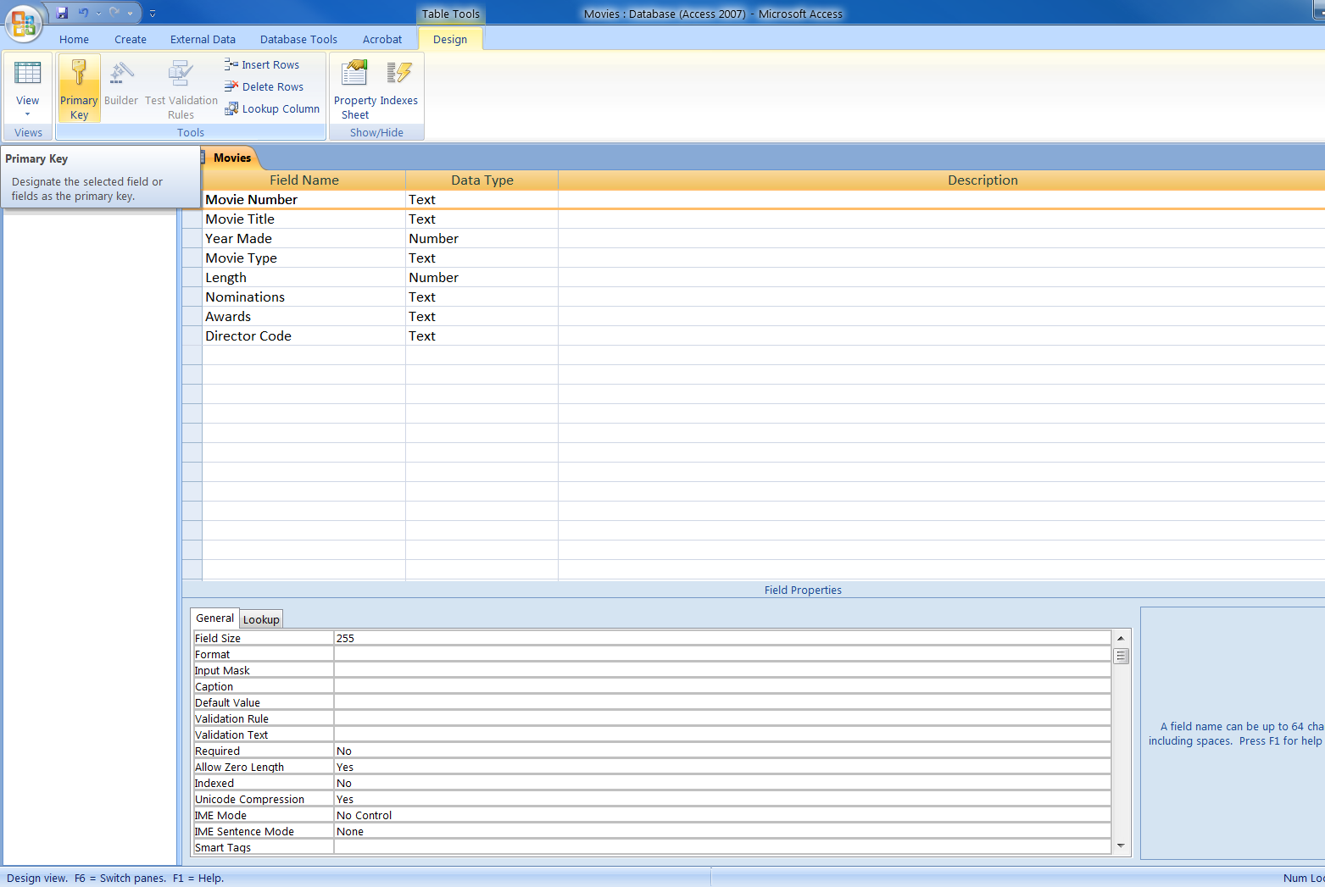
2) Click on
Primary Key
1) Click on
Movie Number
Field

Slide 40
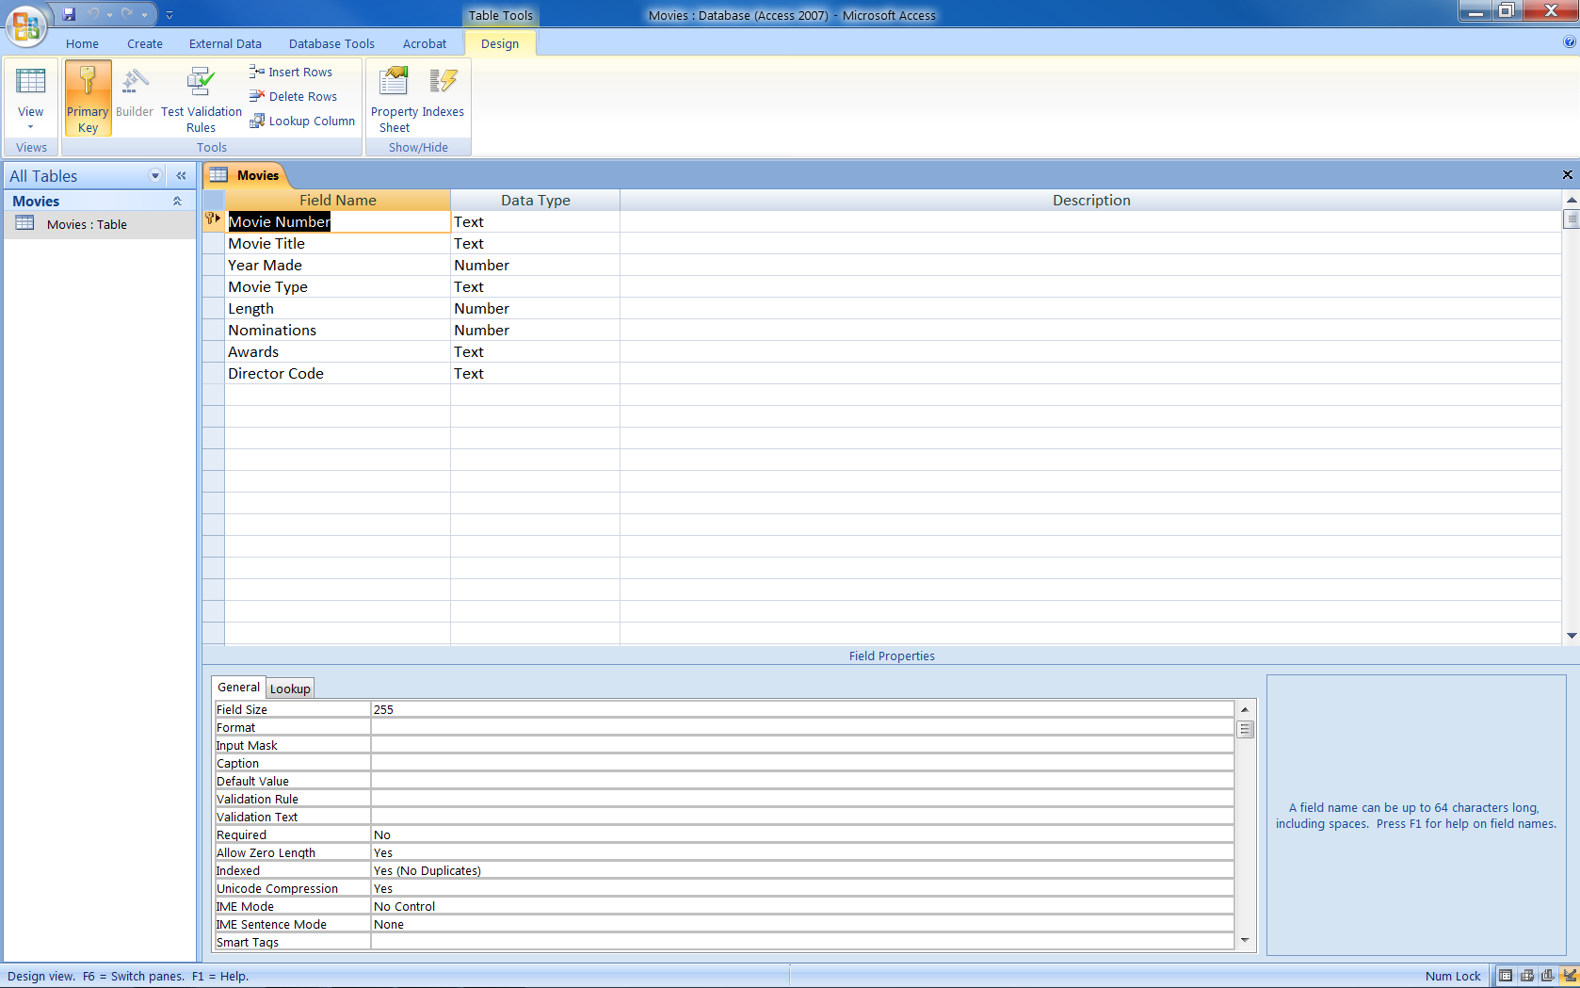
2) Close and
Save the table
1) Movie Number
is now the
Primary Key

Slide 41
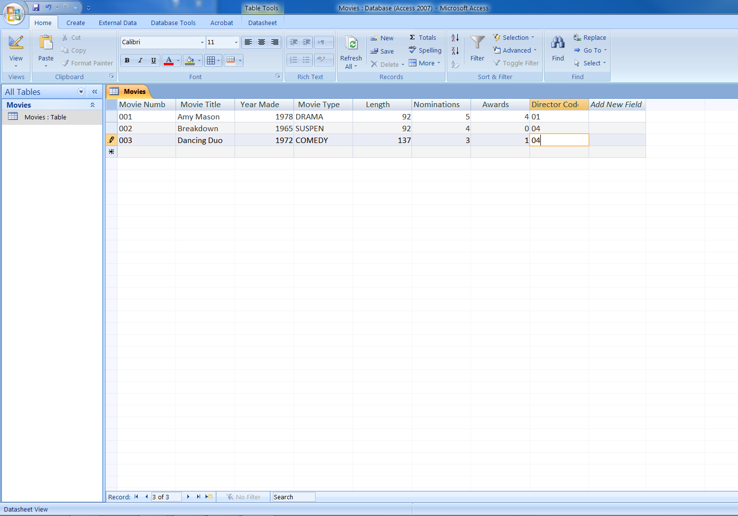
Start entering Records,
use the Tab key to move
from one field to the next,
or click in field with your
mouse and type

Slide 42
ANOTHER EXAMPLE:
CREATE THE DIRECTOR TABLE
Click on the Create tab, click on Table
Create the fields in the Director Table just as before (Movie Table).
Save the Table as Director.
Click on View to flip to Design View.
As before delete the bogus Primary Key.

Slide 43
Cont…
Make the Director Number as the Primary Key
Change the field width to 2.
Save the Table by clicking on Close button on the table.
Type in all the records in the Director Table

Slide 44
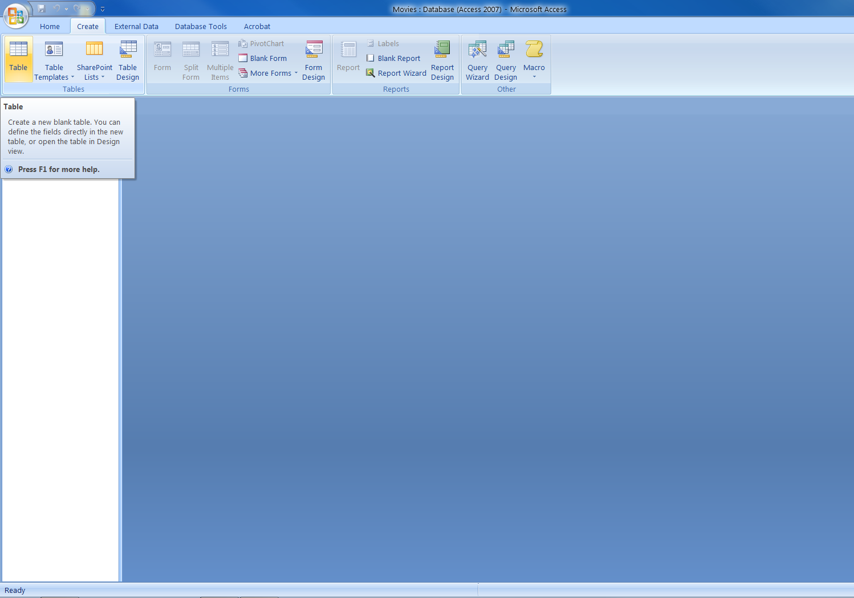
Click on
Create Tab
2) Click on
Table ( to create a
New Table)

Slide 45
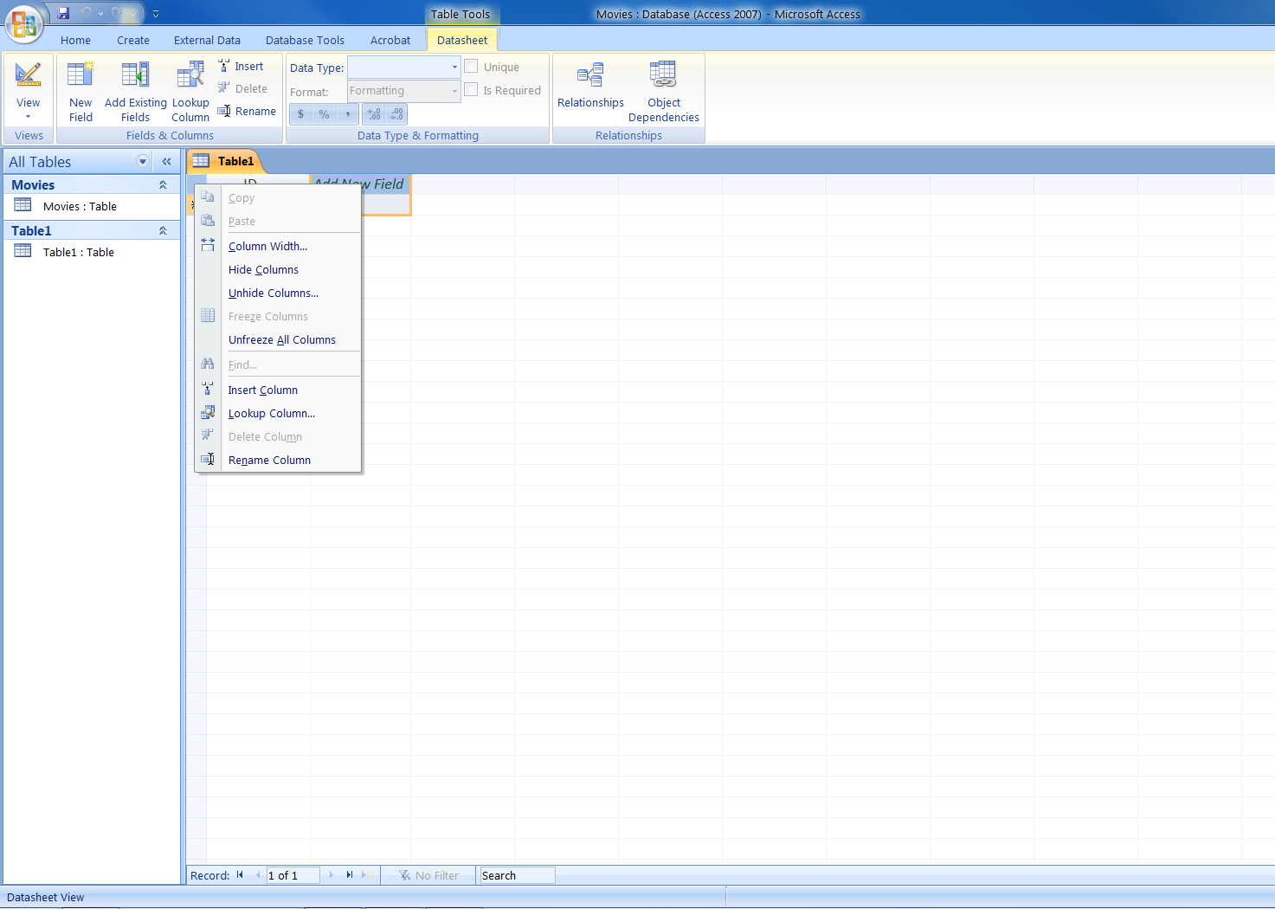
1) Right Click
On Add New
Field
2)Click on
Rename Column

Slide 46
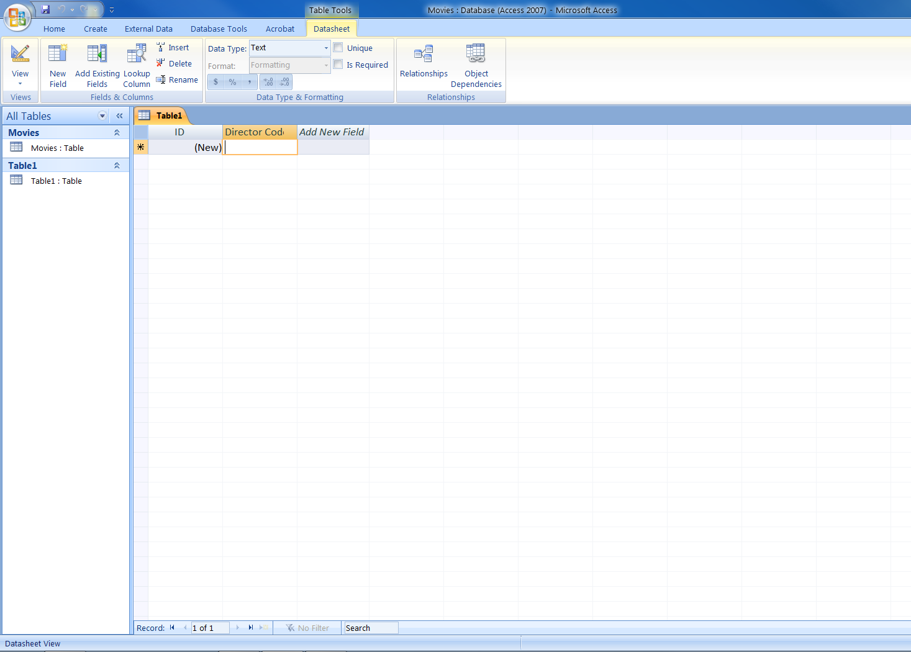
Type in
Director Code

Slide 47
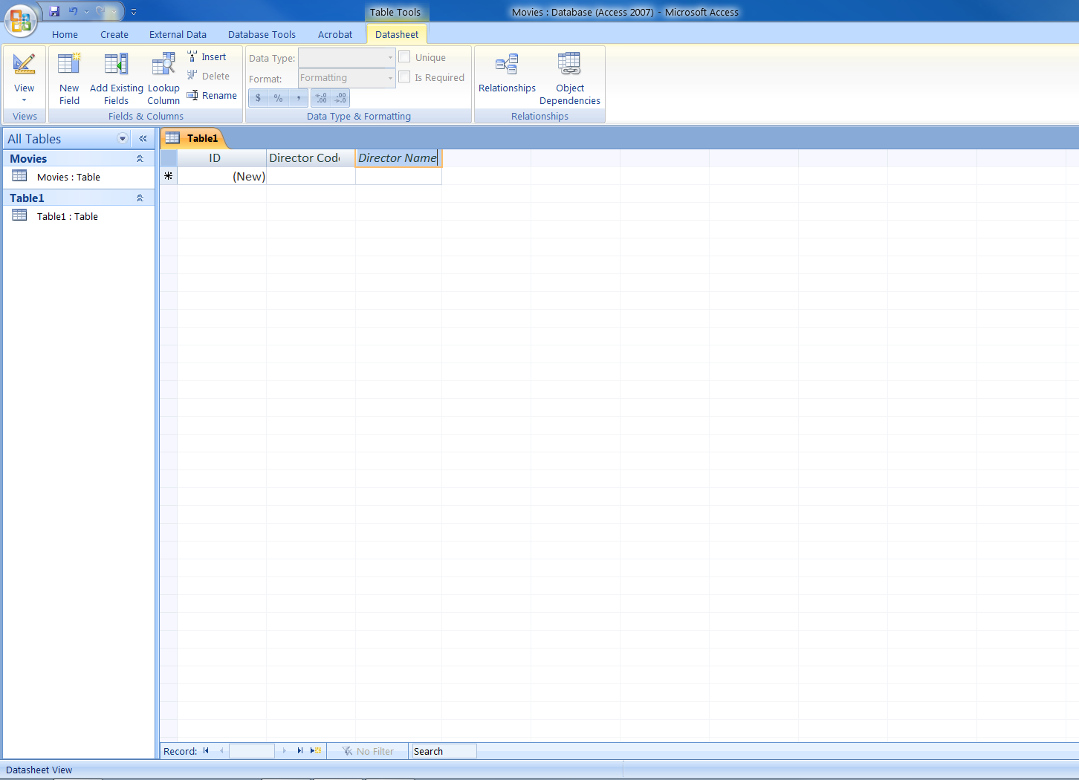

Slide 48
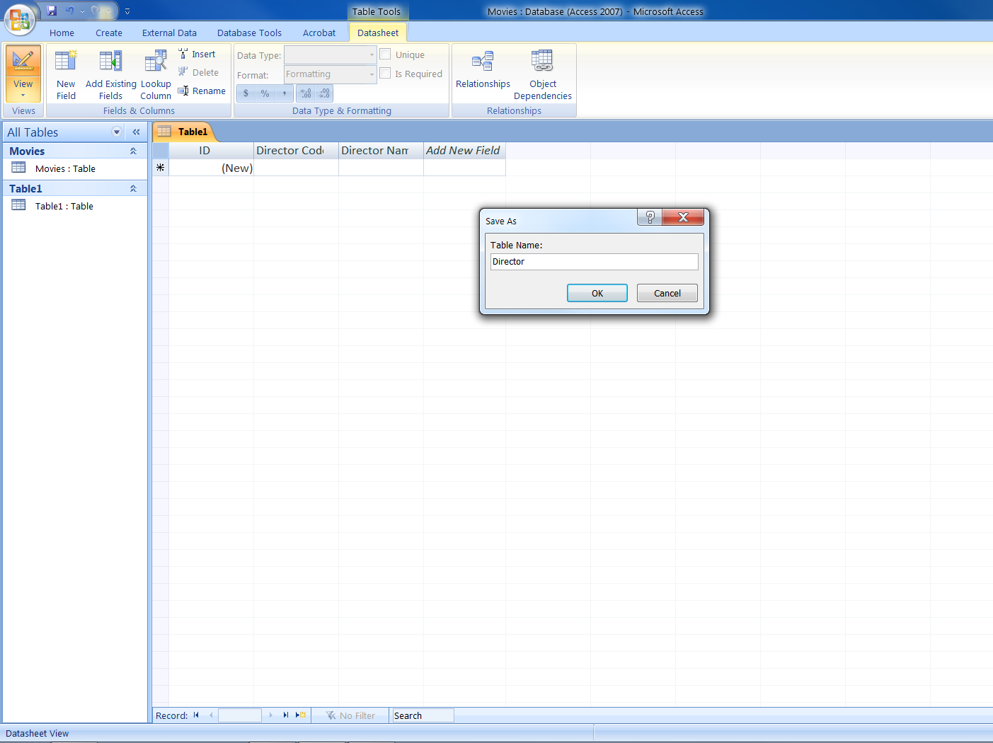
1) Save As
Director
2) Click on
View, to flip
To Design
View

Slide 49
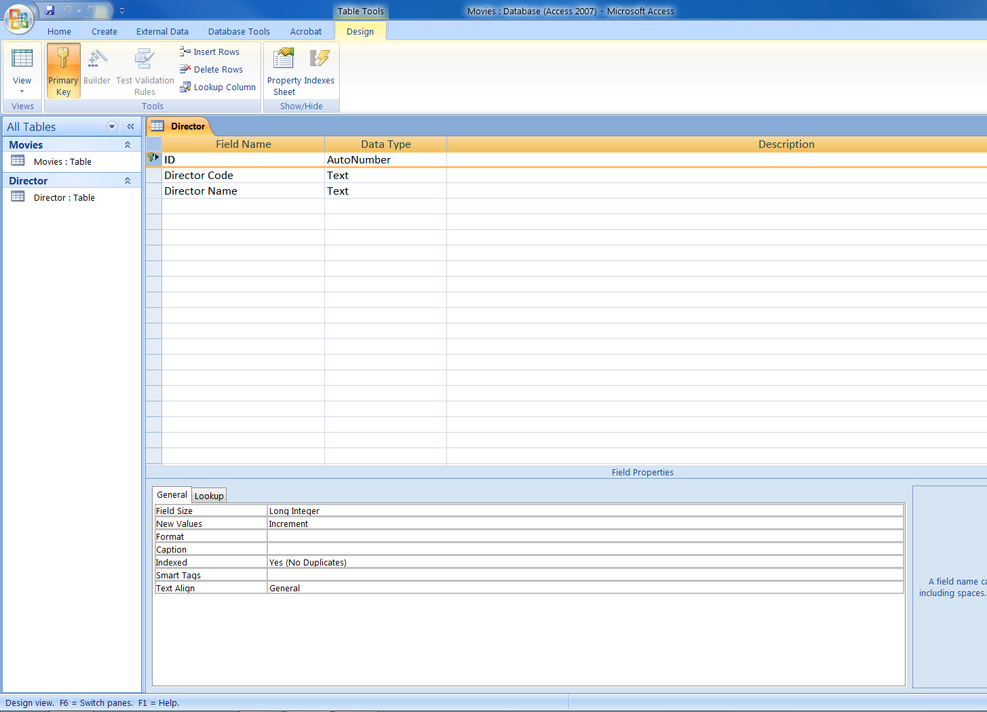
Click and
Press Delete

Slide 50
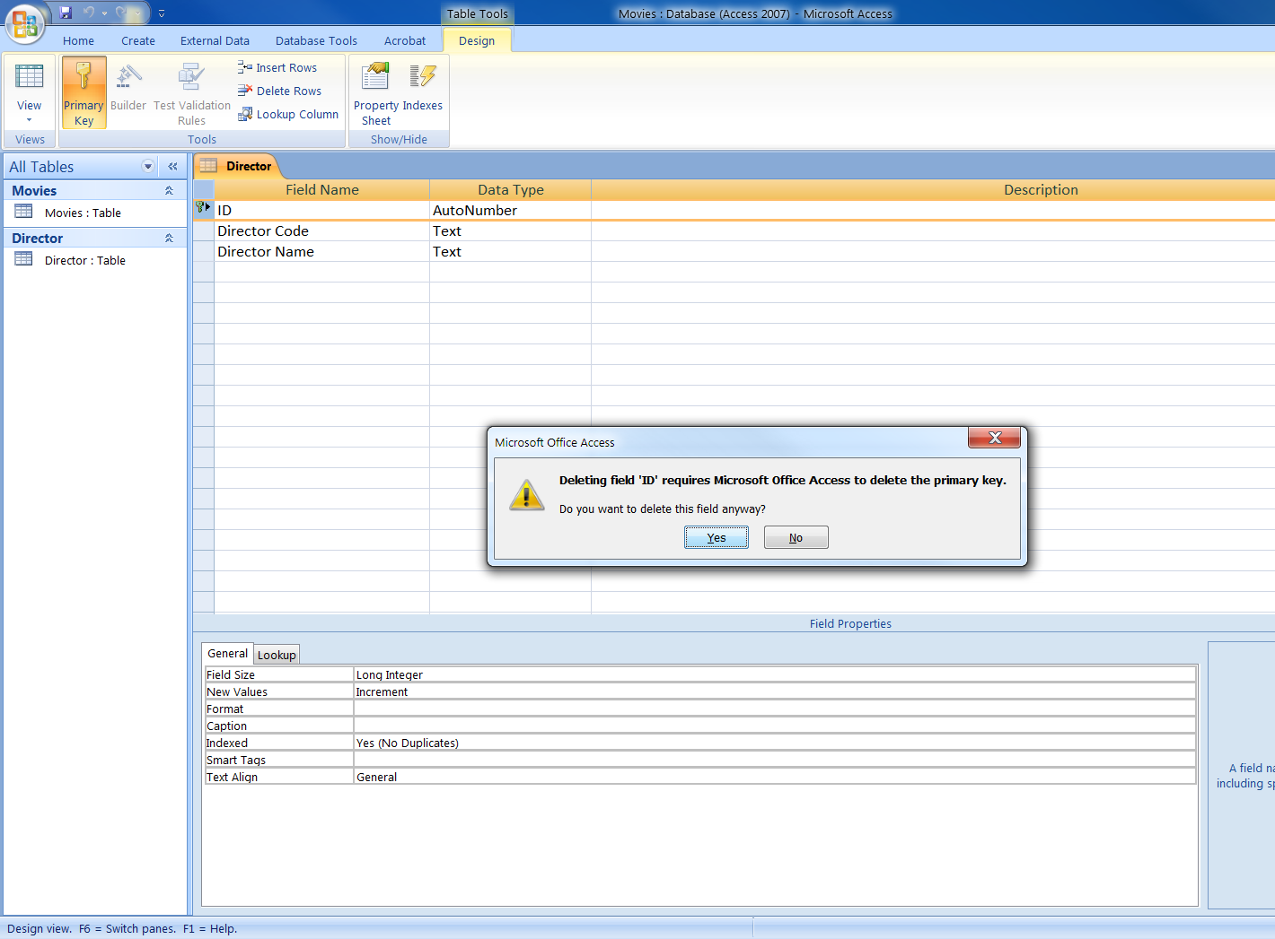

Slide 51
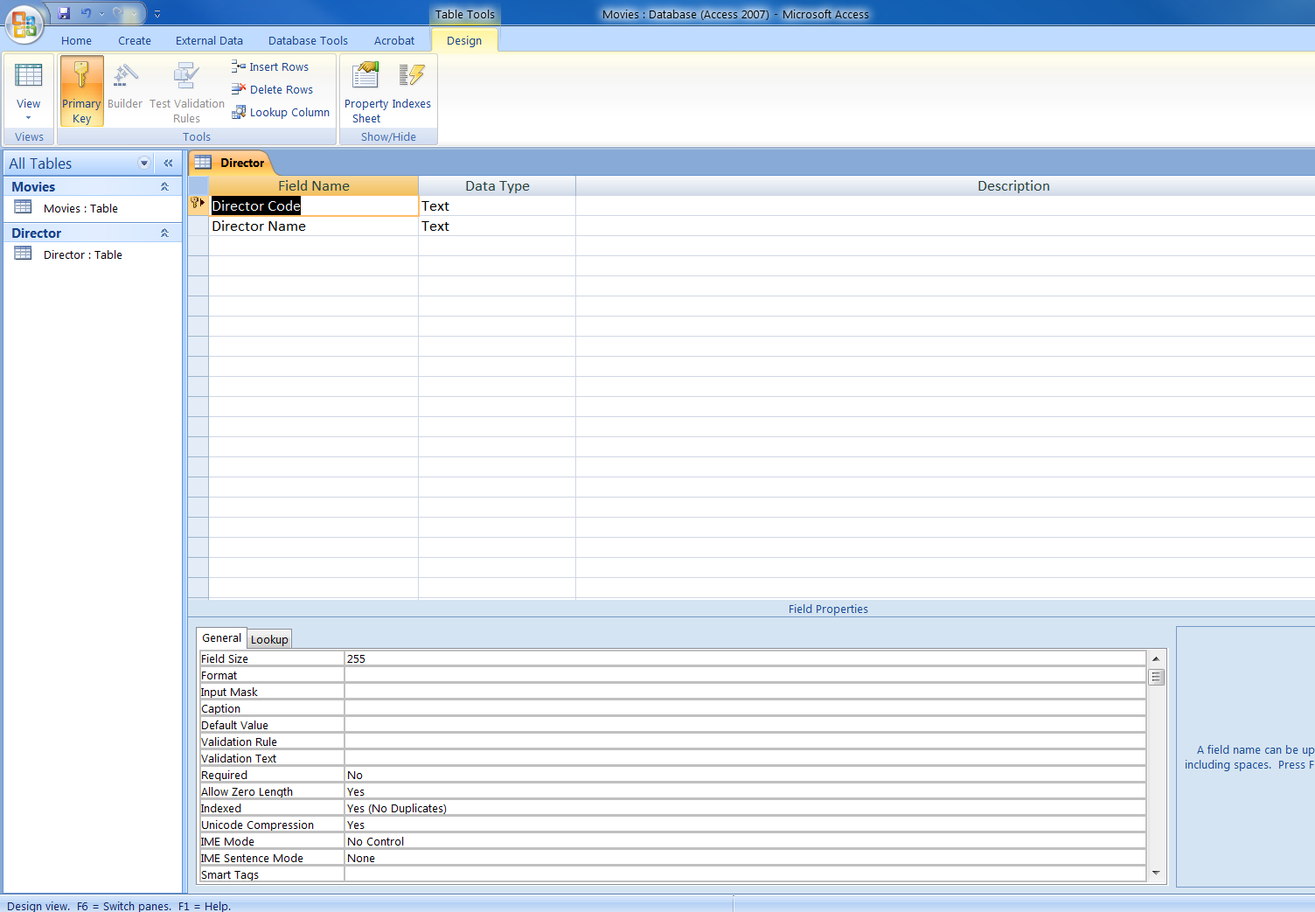
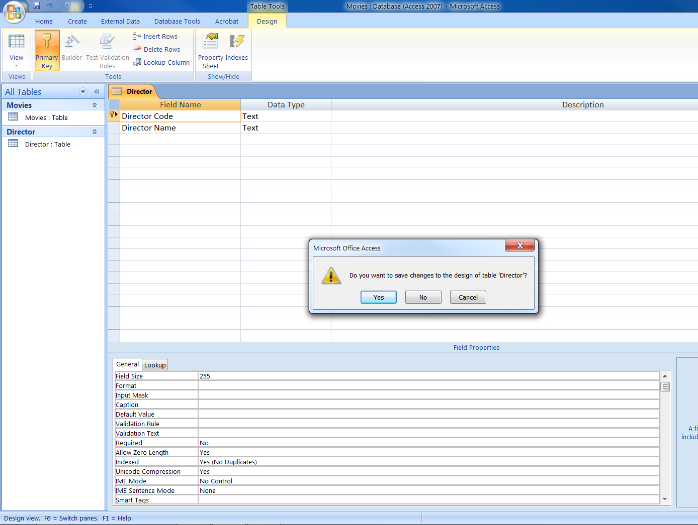
2) Click on
Primary Key
Click in
Row selector

Slide 52
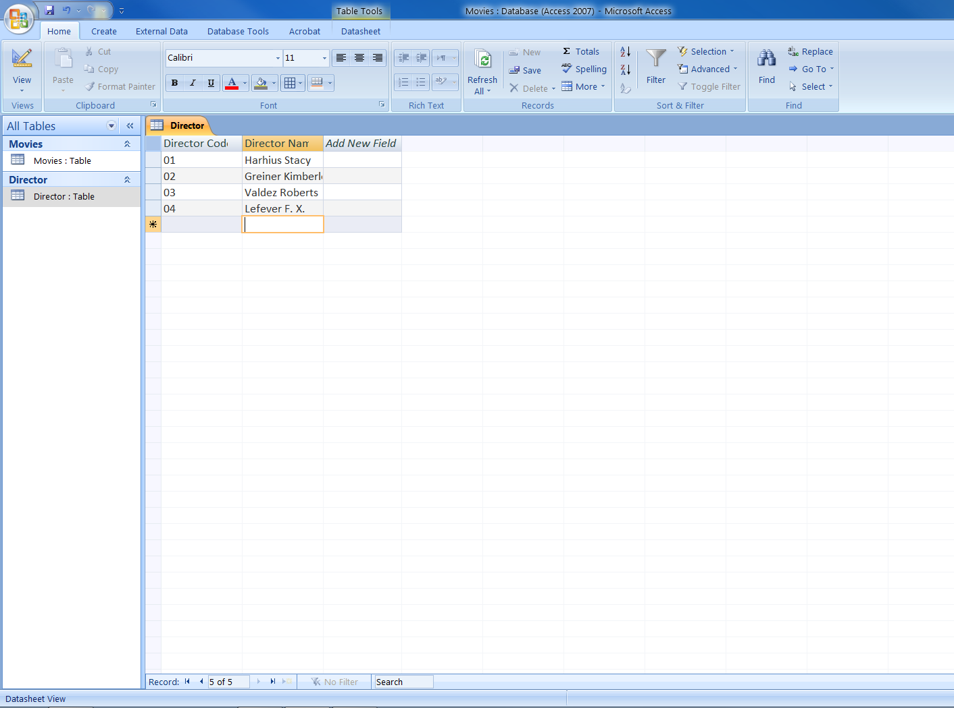
Type in
all the
records

Slide 53
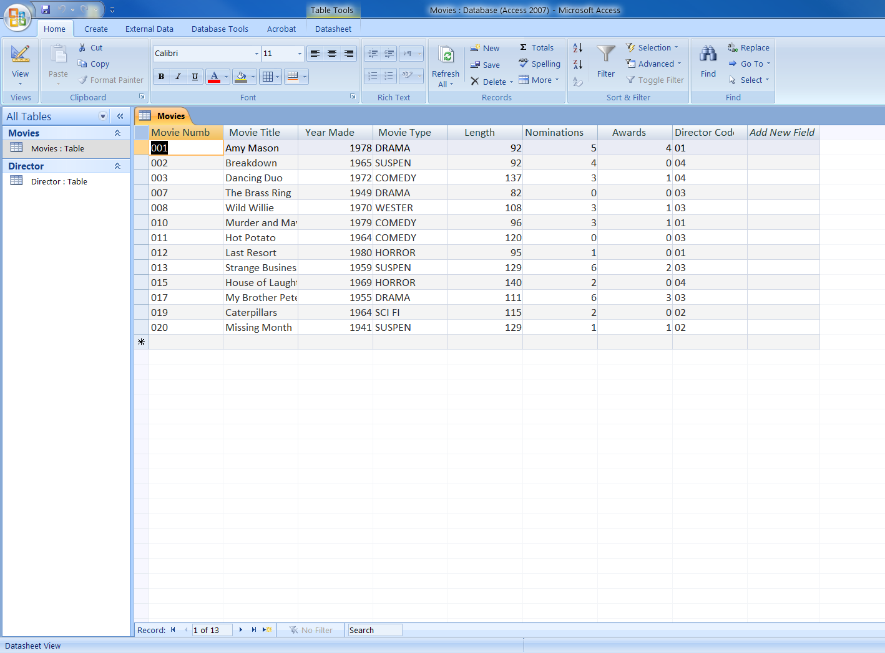

Slide 54
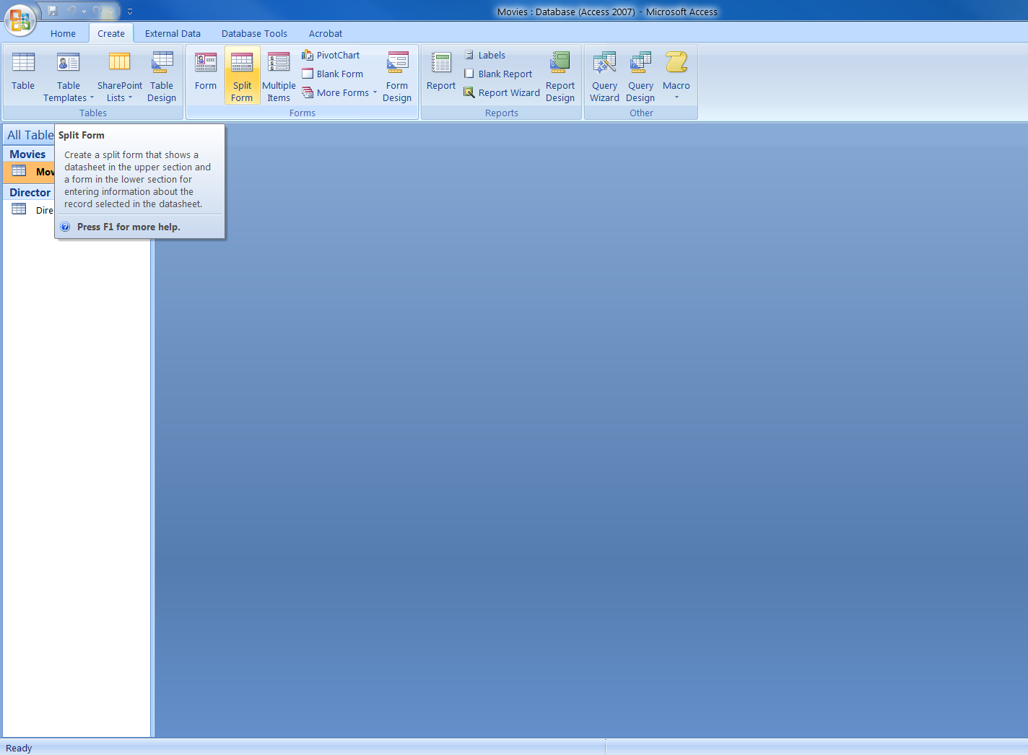

Slide 55
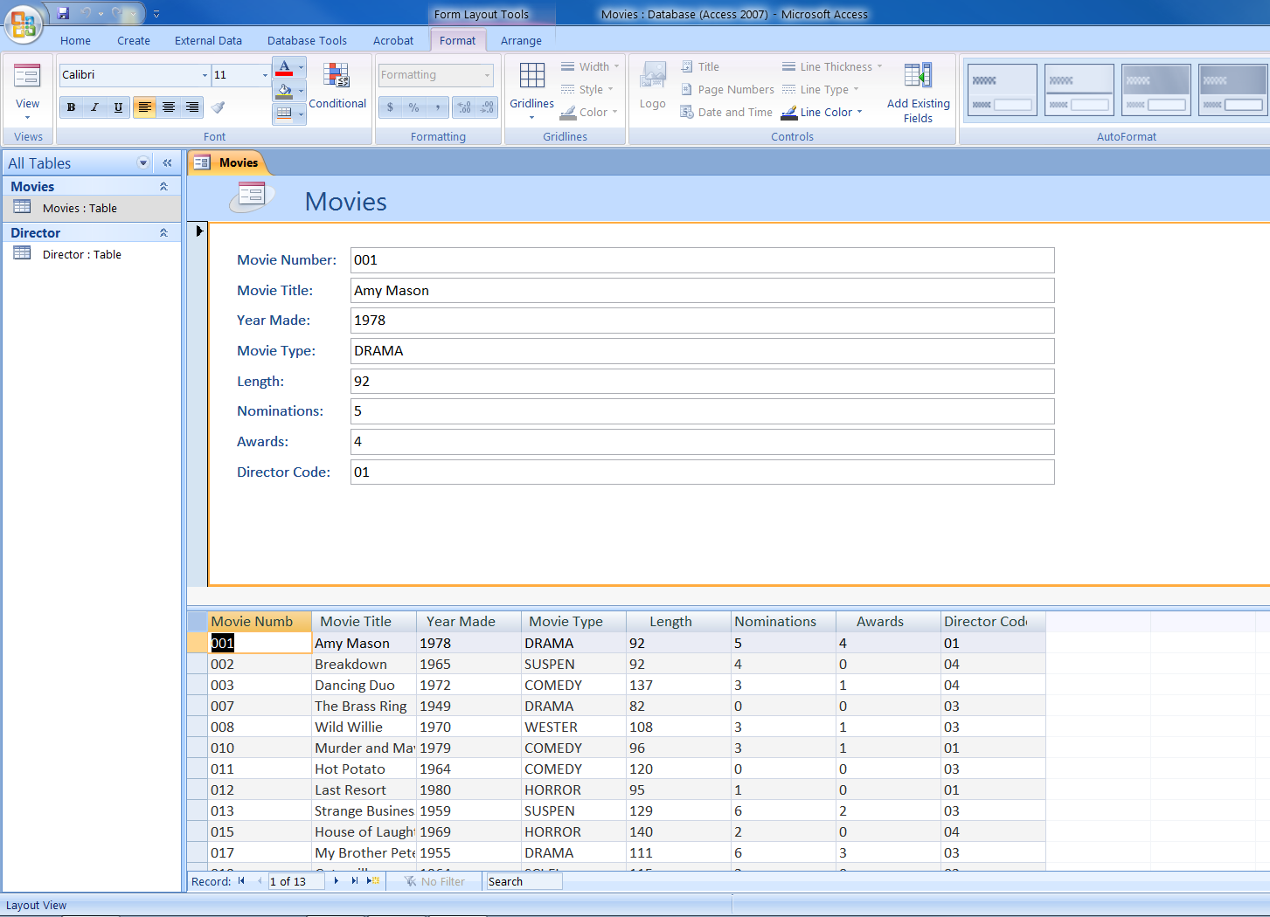
Here’s a Split
Form

Slide 56
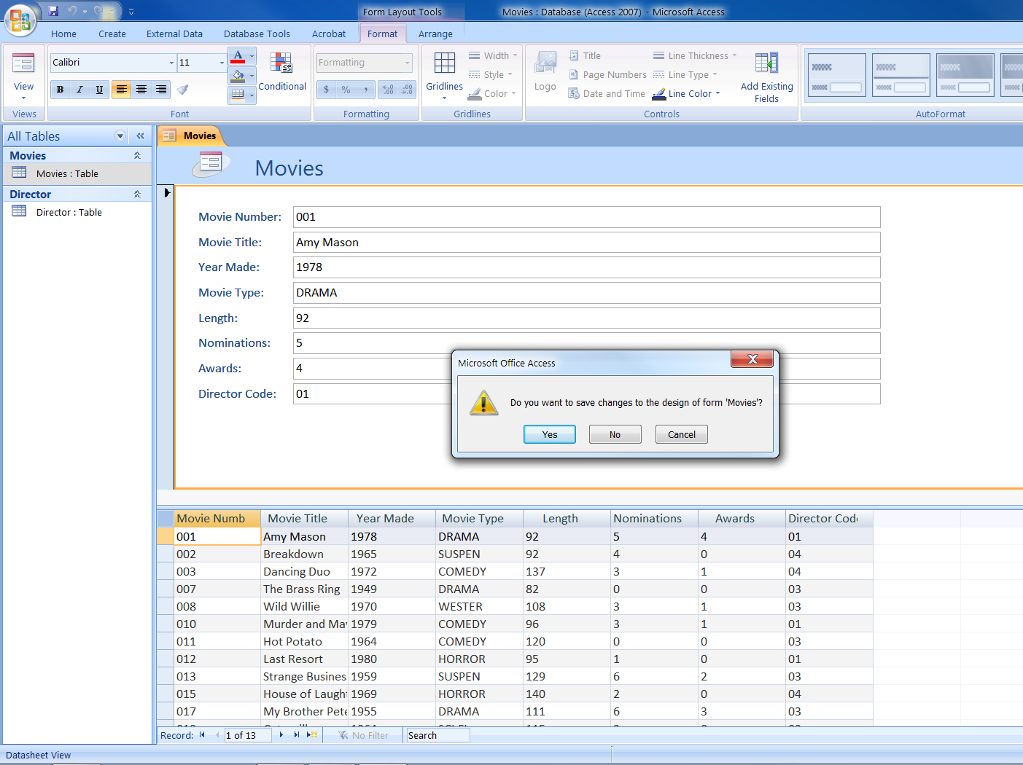

Slide 57
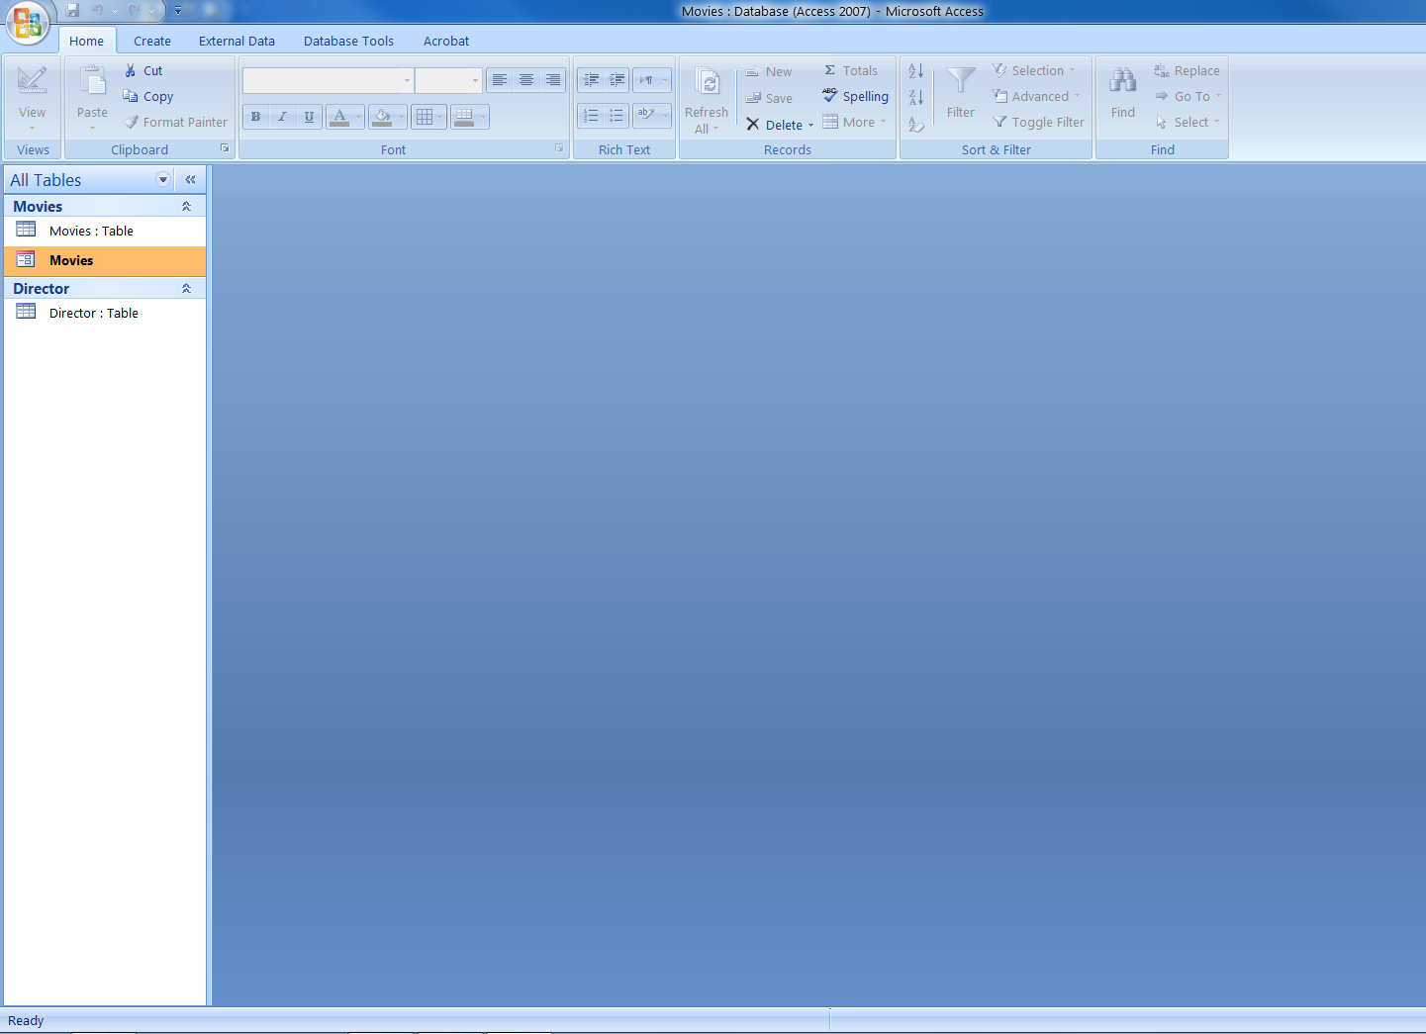
Here is the
Movies Form

Slide 58
SO Finally,
We have learnt what is a Database.
What is a Database Management System.
We have learnt that RECORDS are essentially ROWS in a table.
FIELDS are essentially COLUMNS in a table.
A PRIMARY KEY is simply a field used as the Unique Identifier.

Slide 59
Cont…
Create a Table
Save a Table
Add Records to a Table
Modify Tables in Design View
Create a Split Form

Slide 60

Krishna Raj Pandey
^{MS Access 2007}
  Advantages
  Disadvantages

Slide 61
ADVANTAGES OF MS-ACCESS
Easy to install and use — Access gives data managers a fully functional, relational database management system in minutes. Like many other Microsoft applications, Access contains Wizards that walk you through each step of the way. The user interface is intuitive; accelerating data information retrieval.
Ease to integrate – Access works well with many of the developing software programs based in Windows. It also can be used in the front-end as back-end tables with products like Microsoft SQL Server and non-Microsoft products like Oracle and Sybase.

Slide 62
Cont…
NET-friendly – Access is a go-to choice for users who plan to develop software using .NET; linking to Access database. Its graphical user interface also offers easy functionality and set up.
Widely popular — Microsoft Access is the most popular desktop database system in the world.
Saves you money — Microsoft Access is hundreds of dollars more economical than other larger systems; offering the same functions and usage.

Slide 63
Cont…
Convenient storage capacity – A Microsoft Access database can hold up to 2 GB of data.
Multi-user support – About ten users in a network can use an Access application.
Importing data — Microsoft Access makes it easy to import data.

Slide 64
DISADVANTAGES OF MS-ACCESS
Finite – Microsoft Access is useful for individual departments or small-to-medium business sectors. Any sector whose usage goes beyond 2 GB will hit a wall and discover limitations.
Structure Query Language (SQL) — SQL for MS Access is not as robust as MS SQL Server or Oracle, to just name a few.

Slide 65
Cont…
One file — All the information from your database is saved into one file. This limits options and how you choose utilize data; slowing down reports, queries, and forms. Its performance becomes slow as the user scales data size. Multimedia data can use up MS Access limited space quickly.

Slide 66
Cont…
Static-Friendly — It’s difficult to publish files a part from static files.
Multi-user limited — Technical limit is 255 concurrent users, but real world limit is 10 to 80 (depending on type of application.

Slide 67

It’s time to watch Video document

Slide 68


