Slide 1
Designing Databases Using Access

Slide 2
WHAT DO WE MEAN BY "DATABASE DESIGN?"
"DATABASE DESIGN IS A PROCESS THAT TAKES A SET OF USER REQUIREMENTS AS INPUT AND PRODUCES DATABASE STRUCTURES CAPABLE OF SUPPORTING THESE REQUIREMENTS AS OUTPUT."

Slide 3
THE 2-STEP DATABASE DESIGN PROCESS
STEP 1: INFORMATION LEVEL DESIGN
STEP 2: PHYSICAL-LEVEL DESIGN

Slide 4
FUNCTIONAL REQUIREMENTS SPECIFIED BY USERS
ALL REPORTS TO BE PRODUCED
ALL QUERIES TO BE SUPPORTED
ALL OTHER OUTPUTS TO BE SENT TO EXTERNAL DESTINATIONS
ALL RESTRICTIONS THAT THE SYSTEM MUST ENFORCE (EX.: DO NOT DELETE AN EMPLOYEE WHO HAS A PC ASSIGNED)
ALL SYNONYMS USED FOR EACH ATTRIBUTE

Slide 5
FIRST STEP
INFORMATION-LEVEL DESIGN
  USER REQUIREMENTS ARE IDENTIFIED.
  A DATABASE IS DESIGNED TO MEET THESE USER REQUIREMENTS.
  THIS STEP IS INDEPENDENT OF ANY INDIVIDUAL DBMS.

Slide 6
USERS VIEWS
A USER VIEW IS THE VIEW OF DATA NECESSARY TO SUPPORT THE OPERATIONS OF A PARTICULAR USER.
FOR EACH USER VIEW, A DATABASE STRUCTURE TO SUPPORT THE VIEW MUST BE DESIGNED, AND THEN MERGED INTO A CUMULATIVE DESIGN.

Slide 7
A DATABASE DESIGN METHODOLOGY (ADAPTED FROM C. J. DATE)
FOR EVERY USER VIEW, DO ALL OF THE FOLLOWING:
  REPRESENT THE USER VIEW AS A COLLECTION OF RELATIONS
  NORMALIZE THESE RELATIONS TO 3NF/BCNF/4NF/DKNF
  IDENTIFY ALL KEYS
  DETERMINE ANY RESTRICTIONS
  REPRESENT IN A DBDL (DATA BASE DEFINITION LANGUAGE)
  MERGE THE RESULTS OF THE PREVIOUS STEPS INTO THE DESIGN

Slide 8
ILLUSTRATION OF THE INFORMATION LEVEL DESIGN METHODOLOGY
WE ILLUSTRATE DATE'S INFORMATION LEVEL DESIGN METHODOLOGY BY BUILDING A MOVIE DATABASE SYSTEM!

Slide 9
INFORMATION-LEVEL DESIGN OF A MOVIE DATABASE - REQUIREMENTS
SUPPOSE WE HAVE THE FOLLOWING REPORTING REQUIREMENTS:
  USER VIEW (REQUIREMENT) #1 (OF 5 ):
    FOR EACH DIRECTOR, LIST HIS OR HER NUMBER, NAME, YEAR BORN, {YEAR DIED}
    ALSO MAKE DIRNAME A SECONDARY INDEX
  Our DBDL statements would be :
  DIRECTOR (DIRNUMB, DIRNAME, DIRBORN, DIRDIED)
  SK DIRNAME

Slide 10
USER VIEW (REQUIREMENT) #2
FOR EACH MOVIE, LIST NUMBER, TITLE, YEAR, AND TYPE (AND TITLE AS SECONDARY KEY)
  MOVIE (MVNUMB, MVTITLE, YEARMADE, MVTYPE)
  SK MVTITLE

Slide 11
MERGE!
RESULT OF 'MERGE WITH PREVIOUS STEPS IS':
DIRECTOR (DIRNUMB, DIRNAME, DIRBORN, DIRDIED)
    SK DIRNAME
  MOVIE (MVNUMB, MVTITLE, YEARMADE, MVTYPE)
    SK MVTITLE

Slide 12
USER VIEW (REQUIREMENT) #3
FOR EACH MOVIE, LIST NUMBER, TITLE, DIRECTOR NAME/NUM, CRITICS' RATING,MPAA RATING, NUMBER OF AWARDS NOMINATED FOR, NUMBER OF AWARDS WON:
  MOVIE ( MVNUMB, MVTITLE, DIRNUMB, DIRNAME, CRITRTNG, MPAARTNG, NUMNOMS, NUMAWRDS)
  SINCE DIRNUMB ------> DIRNAME, THIS IS NOT 3NF!
  DECOMPOSE INTO:
    DIRECTOR (DIRNUMB, DIRNAME)
    MOVIE(MVNUMB, MVTITLE, CRITRTNG, MPAARTNG, NUMNOMS, NUMAWRDS, DIRNUMB)

Slide 13
USER VIEW 3 (CONTINUED - MERGE WITH CUMULATIVE DESIGN)
RESULT OF 'MERGE WITH PREVIOUS STEPS' IS:
  DIRECTOR (DIRNUMB, DIRNAME, DIRBORN, DIRDIED)
    SK DIRNAME
  MOVIE(MVNUMB, MVTITLE, YEARMADE, MVTYPE, CRITRTNG, MPAARTNG, NUMNOMS, NUMWARDS, DIRNUMB)
    SK MVTITLE
    FK DIRNUMB ----> DIRECTOR

Slide 14
USER VIEW (REQUIREMENT) #4
FOR EACH MOVIE STAR, LIST NUMBER, NAME, BIRTHPLACE, YEAR BORN,{YEAR DIED}
  STAR ( STARNUMB, STARNAME, BRTHPLCE, STARBORN, STARDIED)

Slide 15
USER VIEW #4 CONTINUED (MERGE WITH CUMULATIVE DESIGN)
RESULT OF 'MERGE WITH PREVIOUS STEPS' IS:
  DIRECTOR (DIRNUMB, DIRNAME, DIRBORN, DIRDIED)
    SK DIRNAME
  MOVIE(MVNUMB, MVTITLE, YEARMADE, MVTYPE, CRITRTNG, MPAARTNG, NUMNOMS, NUMAWRDS, DIRNUMB)
    SK MVTITLE
    FK DIRNUMB ----> DIRECTOR
  STAR (STARNUMB, STARNAME, BRTHPLCE, STARBORN, STARDIED)

Slide 16
USER VIEW (REQUIREMENT) #5
FOR EACH MOVIE, LIST NUMBER, TITLE, NUMBER/NAME OF MOVIE STARS IN IT:
  MOVIE (MVNUMB, MVTITLE, STARNUMB,STARNAME)
    {THIS IS NOT 1NF, SO REMOVE REPEATING
    GROUP AND EXPAND THE PRIMARY KEY}
  MOVIE (MVNUMB, MVTITLE, STARNUMB,STARNAME)
    WE ALSO HAVE FD'S MVNUMB ---->MVTITLE & STARNUMB ---->STARNAME
    {NOT IN 2NF, SINCE SOME ATTRIBUTES DEPEND
    ON A PORTION OF THE PRIMARY KEY}
  MOVIE (MVNUMB, MVTITLE)
  STAR (STARNUMB, STARNAME)
  MOVSTAR (MVNUMB, STARNUMB)

Slide 17
BUT THE RELATION MOVSTAR HAS SOME FOREIGN KEYS WHICH WE MUST SPECIFY
FK MVNUMB -----> MOVIE
FK STARNUMB -----> STAR

Slide 18
RESULT OF MERGE FOR USER VIEW #5
  DIRECTOR (DIRNUMB, DIRNAME, DIRBORN, DIRDIED)
    SK DIRNAME
  MOVIE (MVNUMB, MVTITLE, YEARMADE, MVTYPE, CRITRTNG, MPAARTNG, NUMNOMS, NUMAWRDS, DIRNUMB)
    SK MVTITLE
    FK DIRNUMB ----> DIRECTOR
  STAR (STARNUMB, STARNAME, BRTHPLCE, STARBORN, STARDIED)
  MOVSTAR (MVNUMB, STARNUMB)
    FK MVNUMB ----> MOVIE
    FK STARNUMB ----> STAR

Slide 19
USER VIEW (REQUIREMENT) #6
FOR EACH MOVIE STAR, LIST NUMBER, NAME, NUMBER/NAME OF ALL MOVIES:
  WHEW! THIS IS ALREADY IN THE DATABASE!
  WE ARE FINISHED!

Slide 20
DATABASE DESIGN GOALS
TAKE USER REQUIREMENTS, PRODUCE DATABASE STRUCTURES TO SUPPORT THESE
USER (FUNCTIONAL) REQUIREMENTS INCLUDE:
  ALL REPORTS TO BE PRODUCED
  ALL INQUIRIES TO BE SUPPORTED
  ALL DETAILS ON UPDATES TO THE DATABASE
  ALL CALCULATIONS THAT MUST BE PERFORMED
  ALL DATA RESTRICTIONS TO BE ENFORCED
  ALL SYNONYMS USED FOR EACH ATTRIBUTE

Slide 21
USER VIEWS
DEF.: A USER VIEW IS THE VIEW OF THE DATABASE NECESSARY TO SUPPORT THE ACTIVITIES OF A PARTICULAR USER (OR GROUP OF USERS).
FOR EACH USER VIEW, A DATABASE STRUCTURE TO SUPPORT THE VIEW IS DESIGNED, AND THEN MERGED INTO A CUMULATIVE DESIGN.
USER VIEWS ARE SUBDIVISIONS OF THE TOTAL DATABASE REQUIREMENTS.

Slide 22
A DATABASE DESIGN METHODOLOGY (ADAPTED FROM C. J. DATE)
FOR EVERY USER VIEW, DO ALL OF THE FOLLOWING:
  REPRESENT THE USER VIEW AS A COLLECTION OF RELATIONS
  NORMALIZE THESE RELATIONS TO 3NF/BCNF/4NF/DKNF
  IDENTIFY ALL KEYS
  DETERMINE ANY RESTRICTIONS
  REPRESENT IN A DBDL (DATA BASE DEFINITION LANGUAGE)
  MERGE THE RESULTS OF THE PREVIOUS STEPS INTO THE DESIGN

Slide 23
REPRESENT EACH USER VIEW AS A COLLECTION OF RELATIONS
DETERMINE ENTITIES INVOLVED AND CREATE A SEPARATE RELATION FOR EACH
DETERMINE THE PRIMARY KEY FOR EACH RELATION
DETERMINE THE ATTRIBUTES FOR EACH OF THE RELATIONS
DETERMINE RELATIONSHIPS AMONG THE RELATIONS

Slide 24
HANDLING THE RELATIONSHIPS AMONG THE RELATIONS
ONE-TO-MANY:
  INCLUDE THE PRIMARY KEY OF THE "ONE" RELATION AS A FOREIGN KEY IN THE "MANY" RELATION.
  EX. - EACH EMPLOYEE IS ASSIGNED TO ONE DEPARTMENT - ONE DEPARTMENT CAN HAVE MANY EMPLOYEES, BUT EACH EMPLOYEE HAS ONLY ONE DEPARTMENT:
    DEPT (DEPTNUMB, DEPTNAME, DEPTLOC)
    EMPLOYEE (EMPNUMB, EMPNAME, EMPADDR, WAGERATE, DEPTNUMB)

Slide 25
HANDLING A MANY-TO-MANY RELATION
MANY-TO-MANY
  INCLUDE A NEW RELATION WHOSE PRIMARY KEY IS THE COMBINATION OF PRIMARY KEYS OF THE ORIGINAL RELATIONS
  EX. - EACH EMPLOYEE MAY BE ASSIGNED TO MULTIPLE DEPARTMENTS.
    DEPT (DEPTNUMB, DEPTNAME, DEPTLOC)
    EMPLOYEE (EMPNUMB, EMPNAME, EMPADDR, WAGERATE)
    WORKS (EMPNUMB, DEPTNUMB)

Slide 26
TYPES OF KEYS TO IDENTIFY
PRIMARY KEY
ALTERNATE KEYS
SECONDARY KEYS (ATTRIBUTES NEEDED FOR FAST RETRIEVAL)
FOREIGN KEYS (MOST IMPORTANT) –
ATTRIBUTE(S) IN RELATION X REQUIRED TO MATCH THE VALUE OF PRIMARY KEY IN SOME ROW IN RELATION Y, OR BE NULL (REFERENTIAL INTEGRITY)
  DEPT (DEPTNUMB, DEPTNAME, DEPTLOC)
  EMPLOYEE (EMPNUMB, EMPNAME, EMPADDR, WAGERATE, DEPTNUMB)

Slide 27
ISSUES INVOLVING FOREIGN KEYS
DEPT (DEPTNUMB, DEPTNAME, DEPTLOC)
EMPLOYEE (EMPNUMB, EMPNAME, EMPADDR, WAGERATE, DEPTNUMB)
ARE NULLS ALLOWED??? (USUALLY, NULLS NOT ALLOWED FOR FOREIGN KEYS)
SHOULD WE ALLOW UPDATES (CHANGES) TO THE VALUE OF A PRIMARY KEY WHICH IS REFERENCED BY A FOREIGN KEY IN ANOTHER RELATION?
  UPDATE RESTRICTED (CHANGES ARE FORBIDDEN)
  UPDATE CASCADES (CHANGE OK, BUT REFERENCED FOREIGN KEY CHANGES ALSO)
  UPDATE NULLIFIES (CHANGE OK, BUT REFERENCED FOREIGN KEY BECOMES NULL)
  <THE DEFAULT IS 'UPDATE CASCADES'>

Slide 28
SHOULD WE ALLOW DELETES OF PRIMARY KEYS REFERENCED BY FOREIGN KEYS?
DEPENDS ON POLICIES OF THE ENTERPRISE
DELETE RESTRICTED (FORBIDS A DELETE OF THE REFERENCED PRIMARY KEY)
DELETE CASCADES (DELETE OK, BUT RECORDS REFERENCING DELETED PRIMARY KEYS DELETED TOO.)
DELETE NULLIFIES (DELETE OK, BUT REFERENCING FOREIGN KEYS BECOME NULL)
<THE DEFAULT IS 'DELETE RESTRICTED'.>

Slide 29
THE DBDL (DATABASE DESIGN LANGUAGE)
Relations, attributes AND primary keys ARE REPRESENTED AS USUAL
Attributes ALLOWED TO BE NULL ARE FOLLOWED BY AN ASTERISK (*)
Alternate Keys ARE LISTED AS AK AND FOLLOWED BY THE AK'S
Secondary Keys ARE LISTED AS SK AND FOLLOWED BY THE SK'S
Foreign Keys ARE LISTED AS FK FOLLOWED BY ATTRIBUTES IN FOREIGN KEY
  FOREIGN KEY -----> {RELATION IDENTIFIED BY FOREIGN KEY}
  UPD RSTR (UPDATE RESTRICTED); UPD CSCD (DEFAULT); UPD NLF
  DLT RSTR (DEFAULT); DLT CSCD, DLT NLF

Slide 30
MERGE THE RESULTS OF PREVIOUS STEPS INTO THE DESIGN
A RELATION WHOSE PRIMARY KEY MATCHES THE PRIMARY KEY OF A RELATION IN THE CUMULATIVE DESIGN GETS MERGED WITH THAT RELATION
RESULTING RELATION CONSISTS OF
  (COMMON) PRIMARY KEY OF BOTH RELATIONS
  UNION OF ATTRIBUTES FROM BOTH RELATIONS
A RELATION WHOSE PRIMARY KEY DOES NOT MATCH THE PRIMARY KEY OF ANY OTHER RELATION IN THE CUMULATIVE DESIGN IS INCLUDED AS IS.

Slide 31
Microsoft Access
An outstanding software product.
  The leading Windows relational DBMS.
Power when you need it, with ease of use features.
On-Line Help Components
  Wizards
  Context Sensitive Help
Our goal is to use MS Access as a vehicle to illustrate some database design issues with a representative DBMS.
Several versions (creating some pedagogical problems!)
  Access 1.0, 1.1, 2.0 for Windows 3.X
  Access '95, Access '97 and Access 2000, 2002, 2003, XP and 2007

Slide 32
From Will Rogers (famous American humorist)
Which version to choose?
  "You can please some of the people all of the time,
  And you can please all of the people some of the time,
  But, you CANNOT please all of the people all of the time.“
We choose the most recent version of Access: Access 2007, for our presentations, as does our text (Appendix A).
  NJIT recommends a 2 ghz processor and 2 gig Ram
  for Office 2007
  You can probably get by for projects in IS431 with the less resource-intensive Access 2003 if you have an older pc.

Slide 33
Downloading Access 2007 from NJIT
If you do not have Access 2007 installed on your home pc, you may download it and install it
( http://tinyurl.com/y86je8p )
  If downloading from off-campus, you need to have VPN installed (from the same website)
    Instructions for installing are here:
    http://tinyurl.com/y9846ot

Slide 34
Typical Life-Cycle of Activities in Using a Database Management System
1) Design your relations (Normalization!) ****
2) Create the metadata "structure" for each relation (table)
  Define attribute (field) names
  Define physical/semantic characteristics for each attribute
3) Enter Data into a relation (table) <i.e.,"populate" the database>
  Design Validity Checks for Database Integrity
4) Modify Data in a relation (table), or the table structure(metadata
5) View a Relation on Screen, or View in Form mode
6) Design Queries for the Database
7) Perform Sorts on Tables
8) Design Reports
9) Design Customized Applications

Slide 35
Concept Mapping
Formal Concept MS Access
Relation,Entity Set <===========> Table
Attribute <==================> Field
Metadata <===============> Structure
Integrity <===============> Validation
Entity <==============> Row/Record

Slide 36
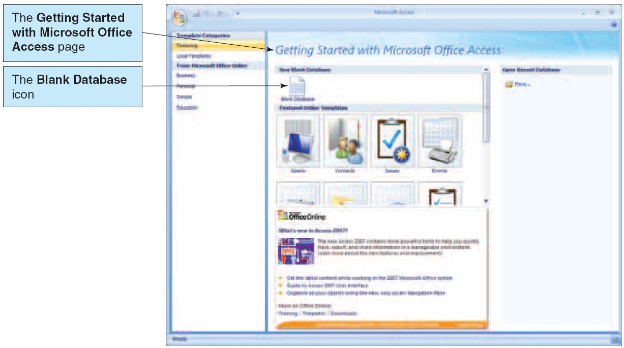
Creating a New Database in Access 2007
Click on the “Blank database” icon:

Slide 37
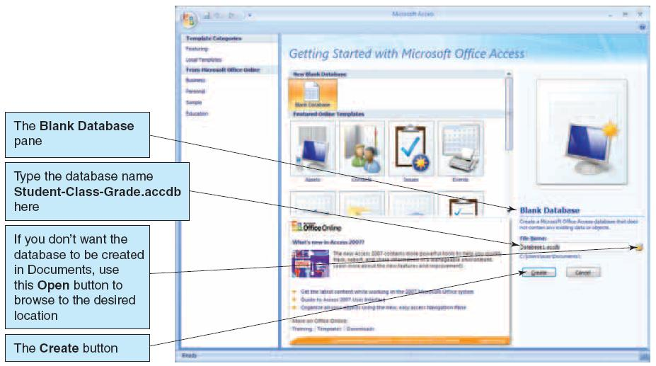
Give a Name to Your Database !

Slide 38
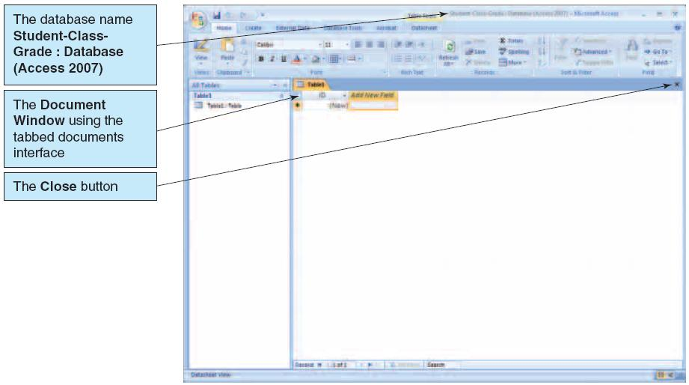
Voila: The New Access Database Has Been Created

Slide 39
We Will Implement the Following Database Schema for Students, their Classes and Their Grades
STUDENT (StudentNumber, LastName, FirstName, EmailAddress)
CLASS (ClassNumber, ClassName, Term, Section)
GRADE (StudentNumber, ClassNumber, Grade)
  In our schema, the entity set names are capitalized, the primary keys (unique identifiers) are underlined, and the foreign keys are italicized.

Slide 40
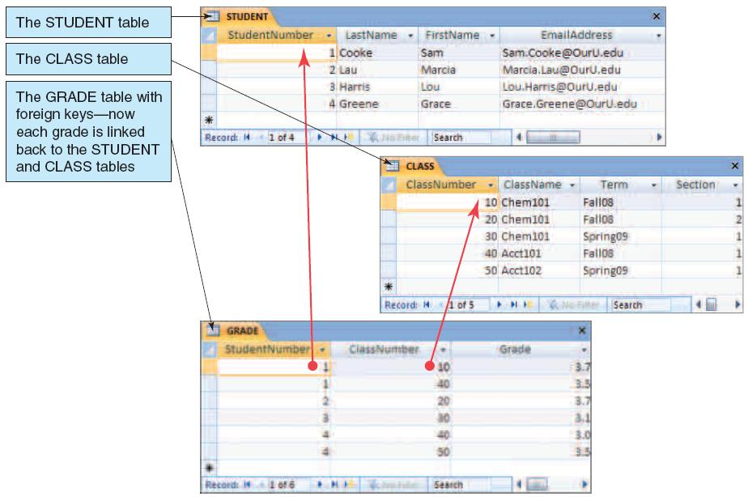
This is What The 3 Resulting Tables Might Look Like (populated with 4 students)

Slide 41
Primary Keys
Each table has a primary key
  A primary key is one (or more) attributes that uniquely identify a row.
Primary keys are underlined in our schema.
The primary key of STUDENT is StudentNumber
  Thus, a particular value of StudentNumber, say 2, identifies one and only one row in the STUDENT table.
The primary key of CLASS is ClassNumber.
But for GRADE, we will need TWO attributes to uniquely identify a row, so we have a composite primary key (StudentNumber, ClassNumber) , since there is no single attribute which will uniquely identify a row.

Slide 42
Relationships Among Tables
The StudentNumber attribute in the GRADE table, and the ClassNumber attribute in the GRADE table, create relationship links to the STUDENT and CLASS tables.
  StudentNumber and ClassNumber each are foreign keys in the GRADE table (pointing to the primary keys of other tables)
    Aside: StudentNumber and ClassNumber are also part of the composite primary key of GRADE

Slide 43
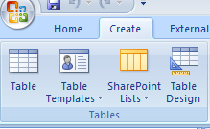
Creating Tables in Access 2007
1. Click the Create command tab to leave the Datasheet tab and display the Create command groups.
2. Click the Table Design button, as shown below, and what results is the
Table1 tabbed document window displayed in Design view (next slide)

Slide 44
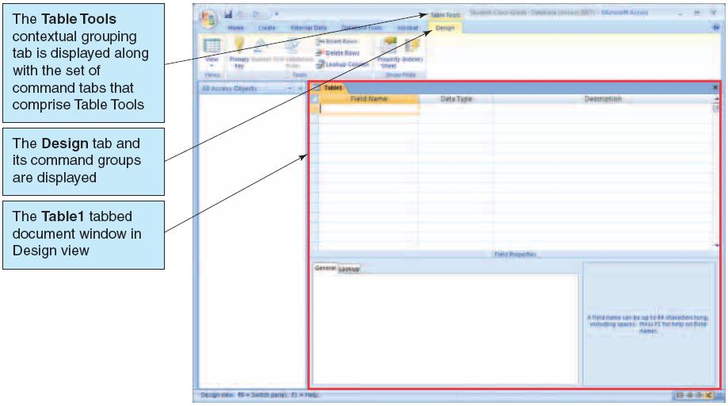
The Resulting Table1 Tabbed Document Window

Slide 45
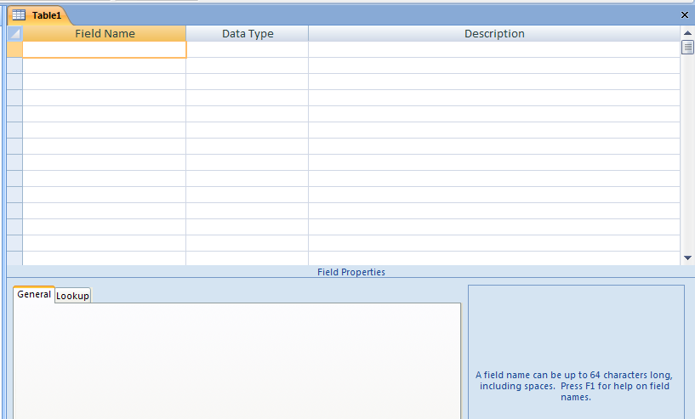
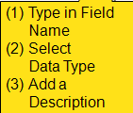
We Design A Table By Filling In Its Attributes (“Field Names”), Data Types and Descriptions

Slide 46
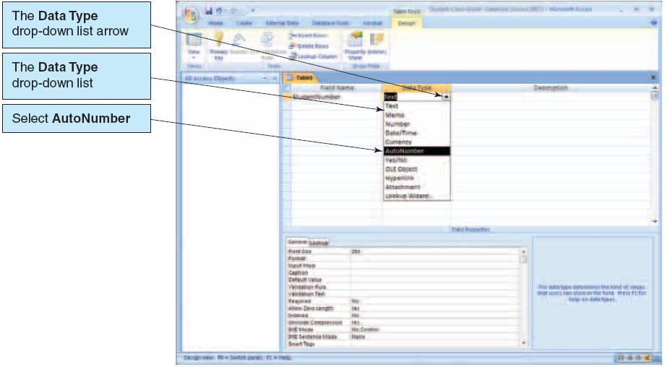
Selecting the Datatype
We select the “AutoNumber” datatype for StudentNumber, which will automatically give the next sequential integer to each new record, beginning with 1.

Slide 47
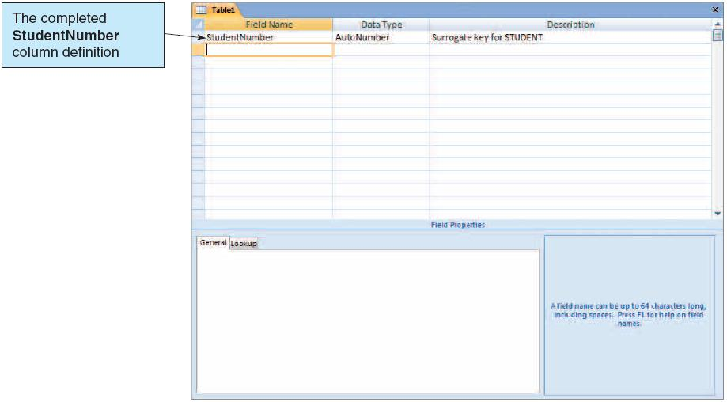
The Completed StudentNumber Attribute Definition

Slide 48
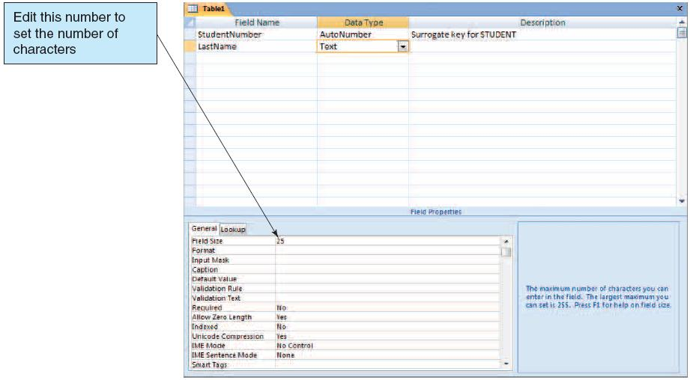
Defining the LastName Attribute and Modifying Its Size In Field Properties

Slide 49
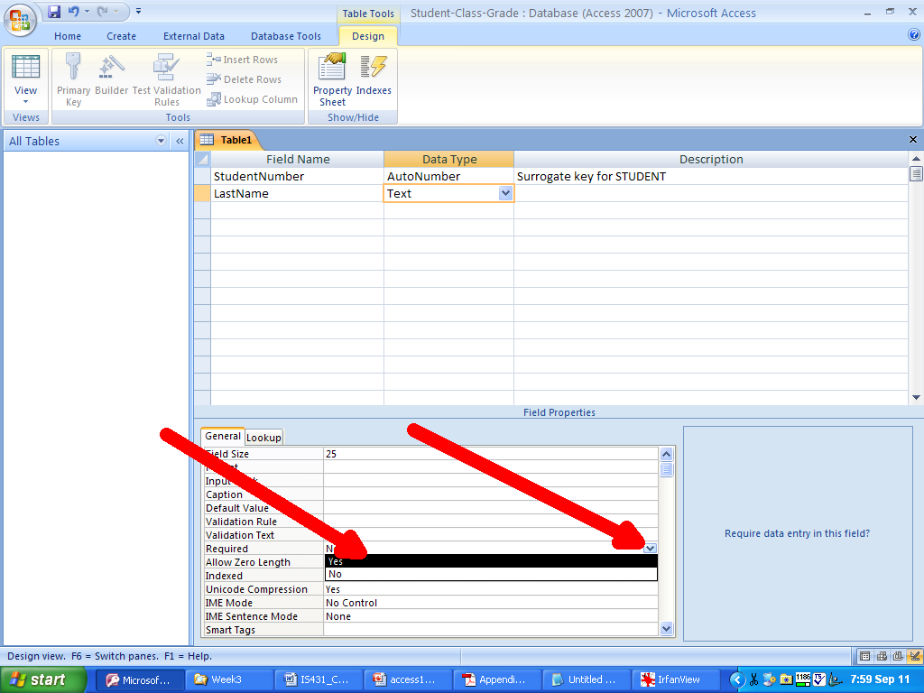
Make LastName Required By Clicking the Down Arrow and Choosing “Yes”
Choose “Yes”
The Down Arrow

Slide 50
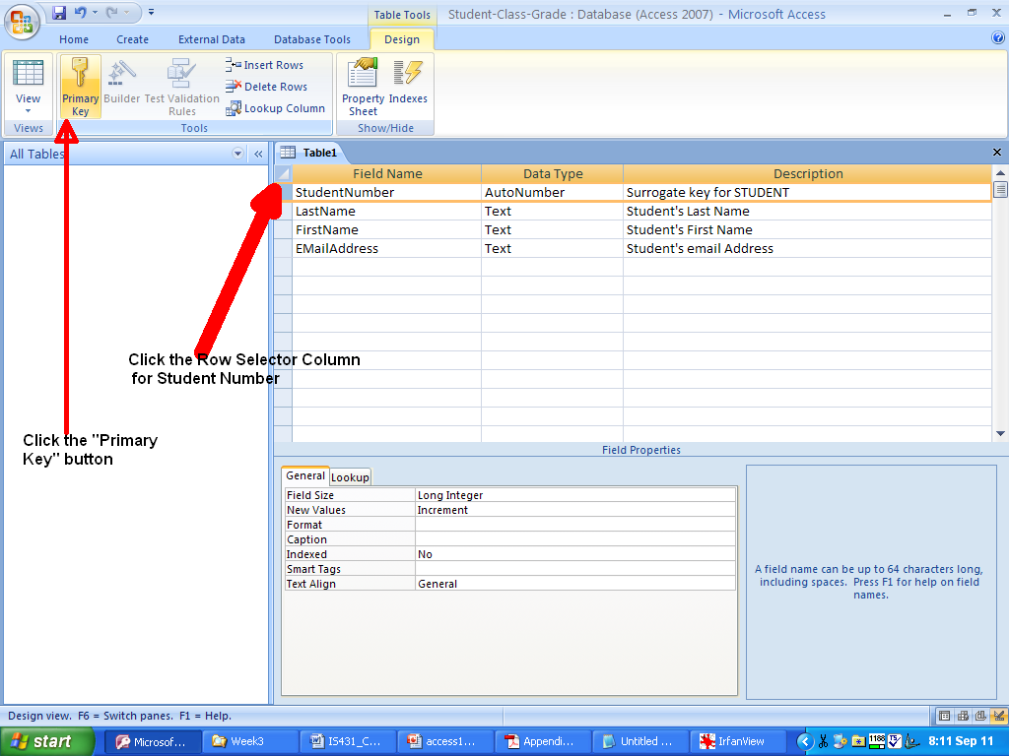
Making StudentNumber the Primary Key
First, click the Row Selector column for StudentNumber, and then click the Primary Key button in the Tools Group

Slide 51
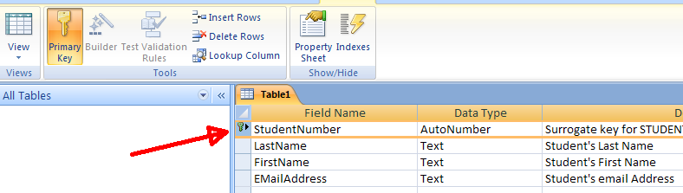
The Primary Key Symbol Indicates the Attribute is the Primary Key of the Table
(Note that, alternatively, you may right click on the attribute(s) you wish to make a primary key, and choose “Primary Key”)

Slide 52
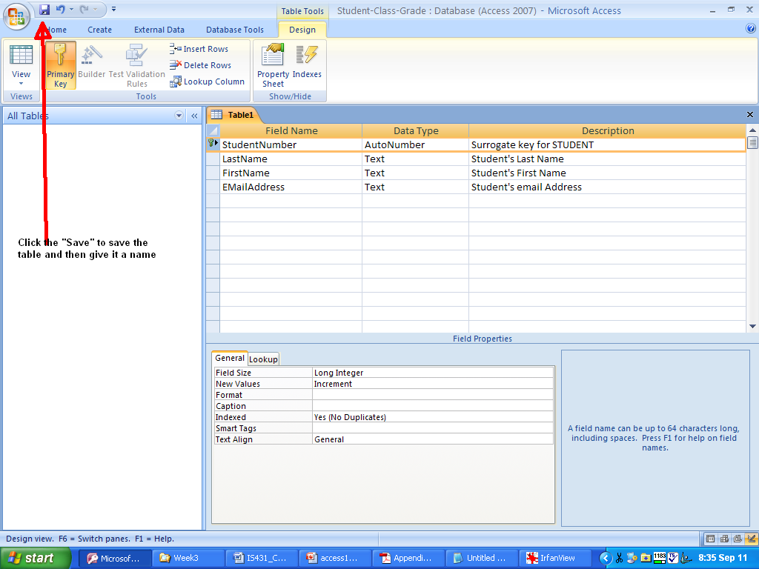
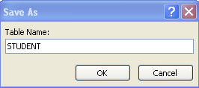
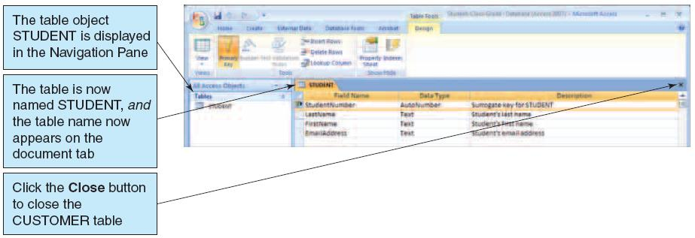
Clicking the “Save” Button in the Quick Access Toolbar, to Save the Table and Give It a Name

Slide 53
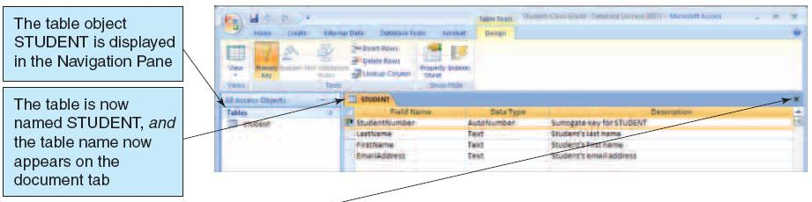
The STUDENT Table Is Official !
Click to Close The STUDENT Table

Slide 54
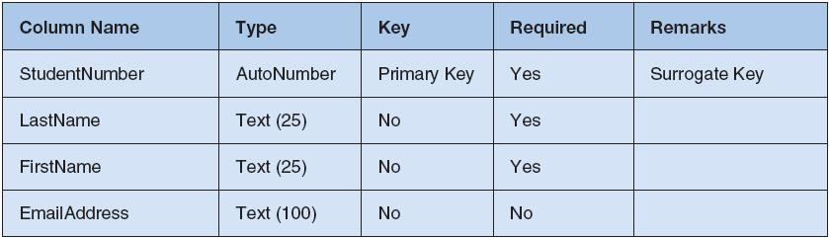
The STUDENT TABLE

Slide 55
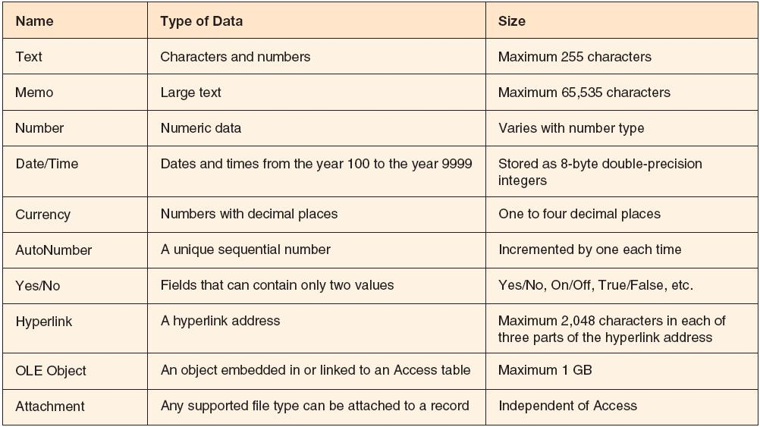
Access 2007 Datatypes

Slide 56
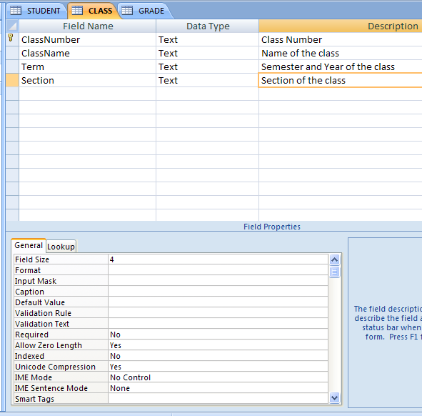
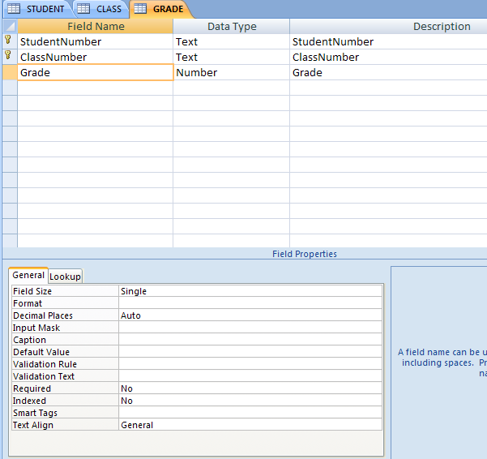
In a Similar Manner We Can Design The CLASS and GRADE Tables
Notice that there is a composite primary key (StudentNumber, ClassNumber) in the GRADE table.

Slide 57
Summary: Adding Objects to Your Database
Your database will consist of object instances (e.g., specific tables, reports, etc.) from the object categories. Your database can consists of any number of object instances from any number of object categories.
  The Object categories include:
    Tables
    Queries
    Forms
    Reports
    Macros
    Modules

Slide 58
Summary: Design View: Entering the Attribute Names
Enter the attribute name in the first column.
"Tab over" to the "Data Type" column.
  {Note that you will be in "Design View" while you are creating the structure for each relation, and you then move to "Datasheet View" where you enter and view the data according to the structure (metadata) you have defined.}
Attribute names must be
  unique in a given relation
  will consist of any combination of characters EXCEPT
    periods, exclamation marks and square brackets

Slide 59
Summary: Table Design View: Entering the Data Type and Description
In the Data Type column, the "Text" data type will be listed as the "default," with a drop down list arrow to choose from the available data types.
  Available data types, in addition to Text, include Memo, Number, Date/Time, Currency Yes/No.
  The default "field size" for Text is 255. You can change this for a particular record by entering a different field size in "Field Properties" at the bottom of your screen.
Choose your appropriate Data Type, tab over to the Description and enter your description of the attribute.
  Officially, the “Description” is optional, but in IS431, we strive for excellence in documentation, so we will require a Description for every attribute

Slide 60
Concept Mapping :
Primary Keys
CASE I : A Single Attribute Primary Key
  Select the attribute by clicking the row indicator ( to the left of the attribute name ) .
  Click the Primary Key button in Tools ( it's the button with a key in it ).
    OR Right mouse click the attribute and choose “PrimaryKey”
CASE II : A Composite Primary Key
  Click the row indicator for first attribute in composite key, and then holding the CTRL keyboard key, click row indicators for the additional attribute(s) in the composite key – this will highlight the attributes in the Primary Key
  Either click the Primary Key button in Tools, or right mouse click and choose “Primary Key”

Slide 61
Primary Keys in MS Access
A primary key is not 'officially' required by MS Access for a table, but in IS431 we WILL require it.
A Primary Key uniquely identifies each record in a table.
  MS Access will not allow a user to enter duplicate values in a primary key field.
  MS Access will not allow a user to enter a 'null value' in a primary key field.
A primary key will have a Field Property of "Indexed, no duplicates"
  So, the records in the table will be sorted by the values of the Primary Key attribute(s).

Slide 62
Choosing a Primary Key in MS Access
Under normal circumstances, you would choose an existing attribute (or set of attributes) which uniquely identifies each record, to serve as the primary key.
In some situations, you might wish to have ACCESS generate some "ID" type attribute to serve as the primary key.
  Create an attribute (for instance, AnID) and choose an Autonumber data type.
  Access automatically inserts a value in the field as each new record is created.

Slide 63
"Text" and "Number" Data Types in MS Access
TEXT (up to 255 alphanumeric characters)
NUMBER (integer or fractional values, stored in 1, 2, 4 or 8 bytes), with a default field type of "double"
  DOUBLE: 8 bytes, which implies that you can store real numbers < | 1.79769313486232 E 308 |
  SINGLE: 4 bytes, so you can store real
  numbers < |3.402823 E 38 |
  LONG INTEGER: 4 bytes (32 bits) for an integer, so range is from -2,147,483,648 to 2,147,483,647
  INTEGER: 2 bytes (16 bits) for an integer, so range is from -32,768 to 32,767
  BYTE: 1 byte for an integer, so range is from 0 to 255

Slide 64
Some Additional Data Types in MS Access
MEMO (contains alphanumerics)
CURRENCY (for monetary values, uses 8 bytes)
  Currency values are accurate to 15 digits on the LHS of decimal point, and 4 digits to the RHS of decimal point.
DATE/TIME (contains date and time values; click on Format in Field Properties and click on drop down arrow to display format choices)
AUTONUMBER (contains an automatically assigned unique numeric value - choice of display formats)
YES/NO (1 bit Boolean values - choice of display formats)

Slide 65
The Table Design is NOT “Carved in Granite”
The structure you created in "Design View" is not "carved in granite" and you may subsequently modify it by returning to "Design View" and changing whatever you wish to change.

Slide 66
Adding Data to Tables
We can add data to a table by:
  Using the datasheet view (similar to an Excel spreadsheet), and enter the data
  Using a data-entry form
  Using SQL to enter the data
In this module, we will focus on using the datasheet view to enter data into our tables

Slide 67
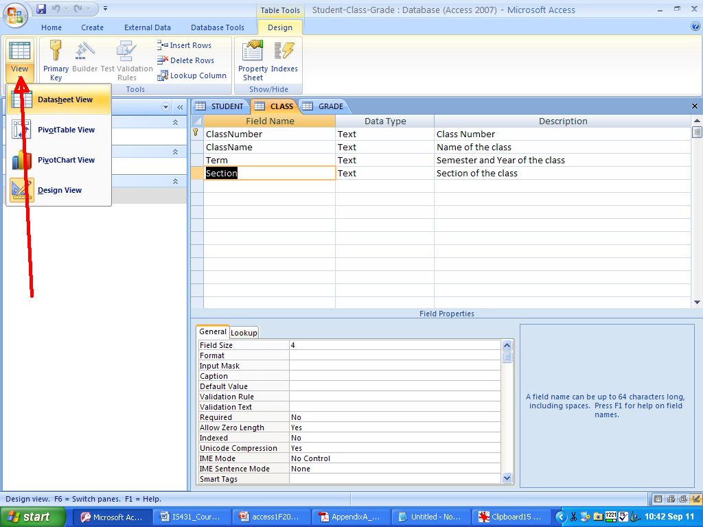
Going Into Datasheet View From Design View

Slide 68
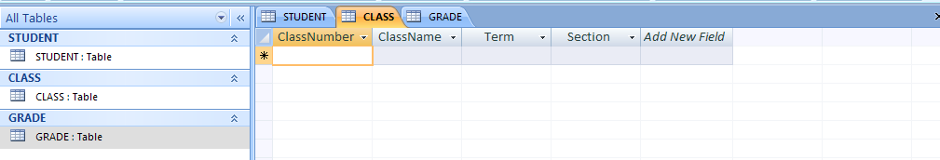
Datasheet View for the CLASS table
Now starts the data entry !

Slide 69
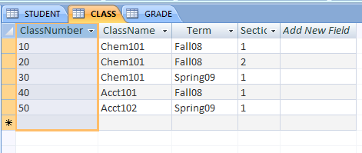
The Populated CLASS Table After Data Entry

Slide 70
Data Integrity
Data integrity refers to the accuracy of the data in the database, i.e., the data should accurately portray the "real world."
  Our goal is 100% accuracy!
Data integrity problems in databases are often a consequence of data entry errors.
Most DBMS's (such as MS Access) support the concept of Data Integrity with the following:
  Validation Rules (Designer Specified)
  Input Masks (Designer Specified)
  Implementation of the formal concept of Referential Integrity
  Field Type Checks & Indexes (usually performed by the DBMS)

Slide 71
Designing Validation Rules for Database Integrity
A Validation Rule is a rule you design into a DBMS such that the data entered by a user must precisely satisfy the rule you establish.
  The DBMS (such as MS Access), will prevent a user from entering data that does not follow your rules, and will display the validation text you prescribed for the rule the user violated.
Validation rules CANNOT guarantee 100% database integrity for data entry, but they will help correct many database entry errors.

Slide 72
Some Validation Rules Within the MS Access DBMS
Required Fields (user cannot leave this field blank)
Range of Values (value entered must be within a particular range)
Default Values (helps prevent data entry fatigue!)
Legal Values (you specify what the legal values are permitted in data entry for a particular attribute)

Slide 73
Validation Rule 1: To Specify a Required Field Which Cannot Be Left Blank on Data Entry
Concept: In Relational Database Design, the attribute(s) which is (are) the primary key should not be "null" for any entity record.
  With other (non-key) attributes, we may or may not be willing to accept "nulls" as attribute values.
Concept Mapping With Access:
  In Design View, be sure the field is "selected" (if not, click on the row indicator column ).
  In Field Properties, click on "Required."
  Click on the drop-down arrow, and select "Yes" (or, alternatively, just delete the default "No" and enter "Yes").

Slide 74
Validation Rule 2: To Specify a Valid Range of Values for an Attribute in MS Access
Select the attribute to which the validation rule will apply.
In Field Properties, click on "Validation Rule."
Enter the appropriate validation expression which expresses the acceptable values for the attribute, such as:
  >18000
  >= 0 And <=90000
  <#1/15/2010#
  <[AccountBalance]
    { Alternatively, clicking in the Validation Rule Box and then clicking the Build button ( ...) brings you into the Access Expression Builder.}

Slide 75
Validation Rule 3: Specifying a Default Value for an Attribute in MS Access
In Design View, select the desired attribute.
In Field Properties, click on the "Default Value" box, which initially is given a (sic.) default "default value" of 0 (zero).
Enter the default value you wish to have applied to the attribute if the users "skips over" this attribute.
This default value applies only to new records, and not to existing records

Slide 76
Validation Rule 4: Specifying a Collection of Legal Values for an Attribute
In Design View, select the attribute to which you wish to apply the collection of legal values.
In Field Properties, click on the "Validation Rule" box.
Enter each legal value in quotation marks , separating each legal value by the word Or, i.e.,
= "JAN" Or "FEB" Or "MAR"
Then click on "Validation Text" box, and enter the message the user should see if the value the user enters is not one of the legal values you defined.

Slide 77
Addendum to Validation Rule 4: Permitting a Null Value as a Legal Value
When you specify a collection of legal values, the input must match one of the legal values.
A null value will not normally match the collection of legal values.
If you wish to permit a null value as a legal value, add "Or is Null" (without the quotes) to the Validation Rule
  Example: "NY" Or "NJ" Or Is Null
Also note that validation rules are NOT case sensitive.

Slide 78
The "LookUp Wizard Data Type"
You can provide the user with a set of values from which to choose for entering a particular attribute.
  A means of enhancing data integrity for data input.
In the Design View drop down box for Data Type, choose "LookUp Wizard ..." for the record where you wish to present the user with a 'look-up' of allowable values.

Slide 79
The "LookUp Wizard Data Type"
The Wizard will offer you two choices:
  Enter the LookUp values on your own.
  Use an existing table for the LookUp values
  For Choice B (using data from existing tables), you will be given the tables in the current database, and must select the table which will contain the lookup values.

Slide 80
Choice A: Entering Your Own LookUp Values in the Lookup Wizard
  You provide the set of LookUp values from which the user will select one.
    The default is to just enter one column of LookUp values.
    You may also choose to enter data into two columns, and specify which one should be entered into the database (typically, you would place the LookUp value to be placed in the database in column 1, and a more detailed description in column 2).

Slide 81
The "LookUp Wizard Data Type" Continued
TIP: The Table LookUp option will aid the user in data entry by providing a list of the allowable values, BUT, it will not insure integrity for the attribute value because the user will still be able to bypass the drop-down table and enter another value.
  What to do? Use the concept specified earlier in Validation Rule 4, namely, specify a collection of Legal Values within the Field Properties of the attribute.

Slide 82
Saving the Validation Rules You Established
Don’t forget to SAVE the validation rules you created !!

Slide 83
Input Masks in Access
An input mask is a pattern for which all data entered into the attribute having the particular input mask must adhere to.
Input masks can be combined with Validation Rules and other Field Properties to ensure data integrity for data entry.
An input mask will automatically format data entered no matter how it is initially entered.
Input masks may be used for attributes like phone numbers, social security numbers, zipcodes, and to automatically capitalize names, thus ensuring format consistency between corresponding attribute instances of different entities.

Slide 84
Input Masks With Entry Required
Character
Masks For
Example
A Result
0 (zero)
Single digit,+,-
000-00-0000
234-56-9876
L
Single Letter
LL
NJ
A
Single Letter,digit
AAAAA
IS431
&
Any char or space
&&&&&&
SEARS
Access will not allow data entry for the above masks, when the input data does not have the requisite number of characters or proper character type.

Slide 85
Input Masks With Entry Not Required
Character
Masks For
Example
A Result
9
Digit or space, no + or -,
9999999
686
#
Single digit,+,-,or space
#####
-180
?
Letter
???????
Apple
a
Letter or digit
aaaaaaa
PIII850
C
Any char or space
CCCCCCCCC
WD8000 HD

Slide 86
Special Input Mask Characters
Special Char
Meaning
Example
A Result
. or , or - or /
DecPt, Comma,
Hyphen,Date Separator
000,000
360,180
<
Converts chars to right to lowercase
<CCCCCCC
tom@aol
>
Converts chars to right to uppercase
>?<?????????
Bradley

Slide 87
Some Input Mask Illustrations
>L<L???????????????? would be a mask used to take a name of no more than 18 letters entered, with at least two letters in the name, and would capitalize the first letter of the name, and make the remaining letters lower case.
(999)000-0000 would be a mask used to accept a phone number with an optional area code, but required 7-digit phone number

Slide 88
Establishing Table Relationships in MS Access
MS Access requires you to EXPLICTLY specify any relationships you wish to have between relations/tables.
  The relationships will involve tables/relations where the primary key of one table matches the foreign key in another table.
MS Access uses the database design concept of Referential Integrity, to insure that the attribute values of the foreign key in one participant will match some attribute value for the primary key in the other participant.
  The database designer must EXPLICITLY request that referential integrity be enforced.

Slide 89

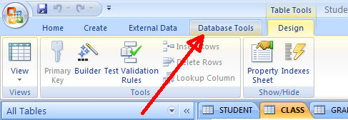
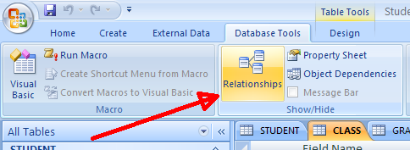
Enforcing Referential Integrity in One to Many Relationships
With referential integrity enforced between tables A and B, then if x is a foreign key attribute in A referencing a primary key y in B, then a value entered for x in data entry MUST match a value of the primary key y in table B.
To ask MS Access to enforce referential integrity between two tables, do the following:
  Choose “DatabaseTools” from the Quick Access Toolbar, and then choose “Relationships”

Slide 90
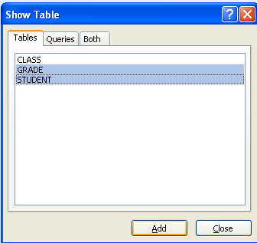
We Will Design a One To Many Relationship Between STUDENT and GRADE (one student has many grades, but each grade pertains to one student)
  In the Show Table dialog box which appears, select the tables to participate in the relationship, and click the "Add" button.
We select the STUDENT and GRADE tables, and click “Add”

Slide 91
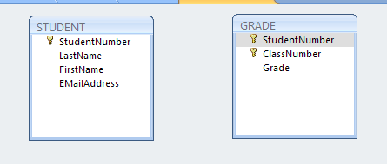
The Two Table Objects (STUDENT and GRADE) in the Relationship Window
We then create a relationship between STUDENT and GRADE tables by dragging a primary key (StudentNumber) from STUDENT and dropping it on top of the corresponding foreign key column (StudentNumber) in Grade. After so creating the relationship, Access brings up the “Edit Relationships” dialogue box.

Slide 92
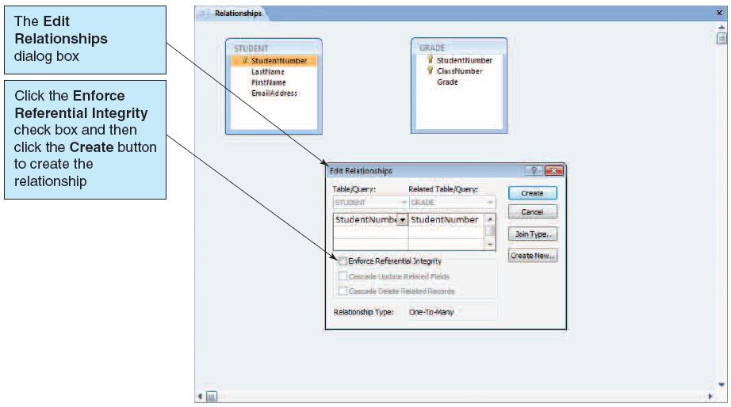
The Edit Relationships Box
We click the Enforce Referential Integrity check box, and then click the Create button to formally establish the relationship between STUDENT and GRADE.

Slide 93
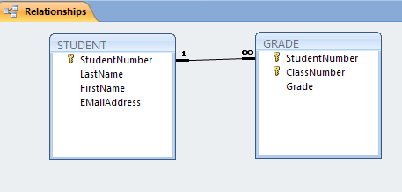
The One-To Many Relationship
Access draws a relationship line between the two participating tables, and places an infinity symbol on the line near the “many” side of the relationship, and a “1” near the 1-side of the relationship.

Slide 94
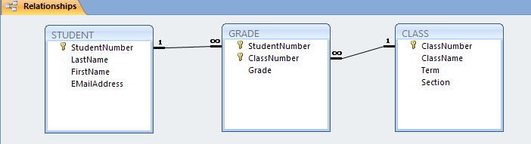
Repeating Similar Steps to Enforce Referential Integrity Between the CLASS table and the GRADE table

Slide 95
Enforcing Referential Integrity in One to Many Relationships- Continued
  Be sure the participants (relations/tables) are CLOSED!
  In the Relationships Window, select the attribute to serve as the primary key, and, with the mouse, drag it over to the foreign key attribute in the other table.
  In the subsequent Relationships Dialog Box, select "Enforce Referential Integrity" and click "Create".
  Close the Relationship Dialog Box and save your changes.

Slide 96
Viewing Hierarchical Data
Access 2000, 2002, 2003 and 2007 (but not prior Access versions) allow you to see the linked records in a Relationship, with a single mouse click!
Having established a relationship between two participating tables, open the participant having the primary key (i.e., the participant on the “one" side of the Relationship)
  i.e., if you established a relationship between Teachers and Departments, open the Department table.
You will see a column of "+" signs on the left, which, when clicked for a particular record, will provide a subdatasheet of records from the other participant, whose foreign key references the specific value of this primary key.

Slide 97
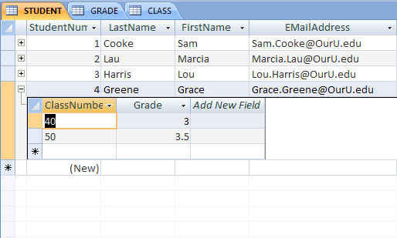
Viewing Hierarchical Data
Clicking on the “plus” in the STUDENT table, for a particular student, will yield a ‘subdatasheet’ of the courses taken by the student and the grades earned

Slide 98
Viewing Hierarchical Data
(Continued)
With the subdatasheet in view, the "+" sign has changed to a "-" sign.
  Click the "-" sign to remove the subdatasheet from the view.
Nifty, powerful feature: if you add or edit data in the subdatasheet, it will automatically be entered into the participating related table.
  So, with the STUDENT table open in Datasheet View, if you click the "+" sign for a particular STUDENT to get the associated subdatasheet of Courses for this student, you can edit or add course data directly on this subdatasheet!

Slide 99

Relational Database Queries, and Their Concept Mapping into MS Access's Query By Example (QBE)

Slide 100
First….
Be sure you have viewed the material on the Relational Algebra
And be sure you understand the concepts of “project” and “select” and “joins” and (cartesian) products
  Access QBE implements these relational algebra concepts …

Slide 101
General QBE Topics
A query is associated with a particular table or, in the case of a multi-table query, several tables.
The "workspace" where you create queries is called, in Access, the "Select Query Window.“
  The top region of the Select Query Window is where you bring in the tables(s) upon which your query will be based.
  The bottom region of the Select Query Window is called the “QBE Grid," and is where you use "Relational Algebra type " concepts to express your query.

Slide 102
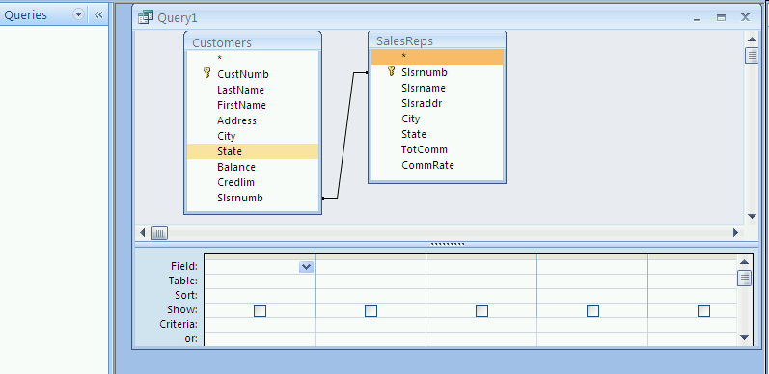
The Select Query Window
Tables selected appear in the upper region of the Select Query window, along with the attributes of the tables
Queries created will appear here – be sure “Queries” is chosen in the Navigation pane
The QBE Grid (where we specify the query

Slide 103
How to Obtain the Select Query Window: Overview
Open the database, and click the “Create” tab in the top menu
In the Ribbon, click on the Query Design button,
  Then, in the "Add Table" dialogue box, which appears, choose the table(s) which contain the attributes to be used in your query, and then click "CLOSE."

Slide 104
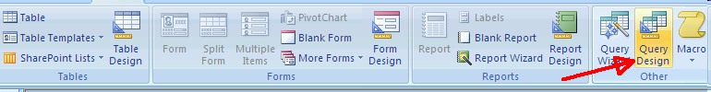
Obtaining the Select Query Windows
Open the database, and click the “Create” tab in the top menu bar, and then…
  Click “Query Design” in the Ribbon
  This brings up the “Show Tables” dialogue box, where you choose the tables that you will need in your query for the desired attributes.

Slide 105
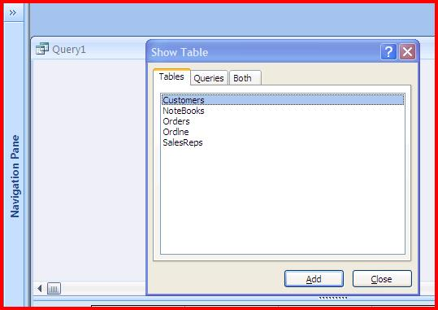
The Show Table Dialogue Box (with the Snookie database open)

Slide 106
Selecting the Tables for the Query You Are Designing
From the “Show Tables” dialogue box, select the desired tables which contain the attributes needed for your query design
  Suppose, for example, we wish to design a query giving us the customer numbers and the names of their sales representatives in Snookie – in this case, we require both the CUSTOMER table and the SALESREPS table

Slide 107
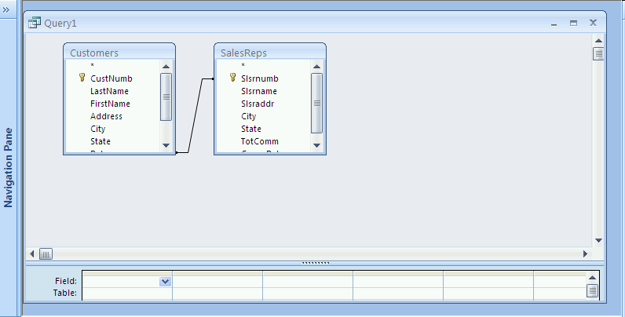
After Selecting The Requisite Tables and Closing the “Show Tables” Dialogue Box, We Have
Notice that we cannot view all of the attributes in the selected tables, so we will need to resize the table objects.
The QBE Grid is partially hidden, and needs to be resized.

Slide 108
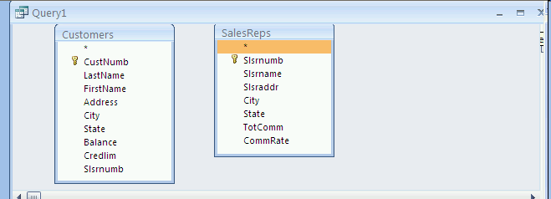
So, You May Need To Resize the Select Query Window
  You generally would want to maximize this Select Query window.
Click to maximize the Select Query window

Slide 109
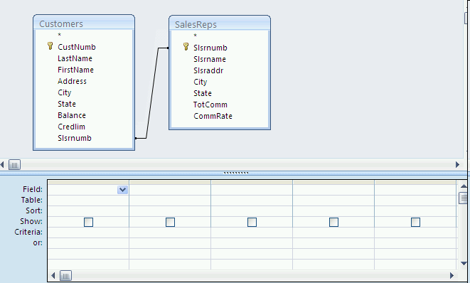
Resizing the Regions
  And you may wish to resize the regions by either enlarging the top region (accomplished by dragging down the line separating the two regions), or enlarging the bottom region (the QBE Grid)

Slide 110
Using the Select Query Window
The top region of the Select Query Window will contain the tables (& attributes) used in the query.
  At any time, additional Tables may be "added" to the top region by selecting the ShowTable button (or, alternatively, right mouse clicking in the upper region and choosing “Show Table”), then choosing the names of those additional tables which the (revised) query will refer to. When completed, “close” the dialogue box.
  .
The bottom region of the Select Query Window contains the QBE grid.

Slide 111
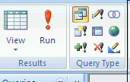
Concept Mapping: Projecting Attributes
To project an attribute, double click on the attribute name in the table in the upper region.
  The attribute name will appear in the Field row in the
  QBE grid, and the "box" in the "Show" row will be marked.
  You can also project an attribute by dragging the desired attribute from the table region into the field row.
To "run" a query, click the Run (!) button on the ribbon (LHS)

Slide 112
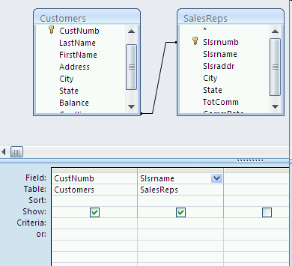
Project the Customer Numbers and Their Sales Reps

Slide 113
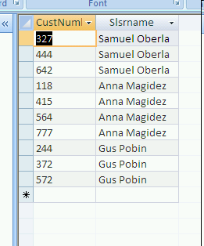
The Results of the Query (Dynaset)

Slide 114
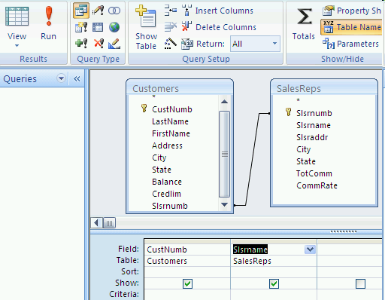
Returning to Design View
To return to the Select Query Window (Design View) after running a query, click the "Design View" button (it's the one on the extreme left of the ribbon!) and from the drop-down list, choose “Design View”

Slide 115
More Concept Mapping of Attribute Projection
To project ALL the attributes in a relation, double click on the title bar of the field list for the desired relation (this will highlight all of the attributes), and drag the group to the QBE grid.
  Note that when you "run" a query in MS Access, the result (answer) is referred to as a dynaset, which is a temporary set, not stored, consisting of records from the database which satisfy the query.

Slide 116
Saving a Query
Click the “Office Button” on the upper LHS
Choose “Save As” and then
  “Save the Current database object”
In the “Save As” dialogue box which follows, provide a meaningful name for your query (and save it as a query type)
The named query will appear in the Query objects

Slide 117
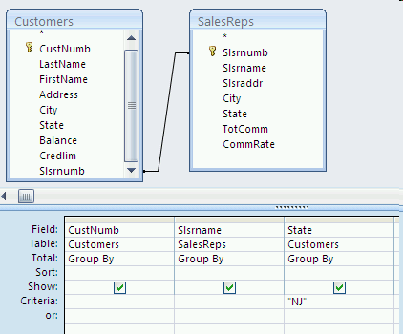
Management of the QBE Grid
To delete an attribute in the QBE Grid, highlight the attribute and click “Delete Columns” in the ribbon (or, alternatively, highlight the column and click the “Delete” key.)
The Concept Mapping for the "Select" based on a "Predicate" in the Relational Algebra, is the "Criteria" row of the QBE Grid.
Query Design to project the customers from NJ and their SalesReps

Slide 118
Select
In the Criteria cell you can create QBE expressions, using comparison operators (>, <, =, >=, <=, NOT)
If your query seeks to "select" based upon some attribute, but not to "project" that attribute, then when you double click on the attribute to get its name in the Field row, click on the Show row to disable the projection.

Slide 119
Using Compound Criteria
A compound criteria means that the query entails more than just a single simple criteria.
If all of the expressed simple criteria must be true in order for the compound criteria to be true, we have an AND criteria.
  Ex: Age > 20 AND Major = “IS”
If at least one of the expressed simple criteria must be true in order for the compound criteria to be true, we have an OR criteria.
  Ex: Class = “Senior “ OR GPA > 3.2

Slide 120
Expressing “AND” Criteria in QBE
CASE I: The simple criteria apply to different attributes.
  Procedure: In the QBE grid, place the simple criteria in the identical row, under each of the appropriate attributes.
CASE II: The simple criteria apply to the same attribute.
  Procedure: In the QBE grid, place each of the simple criteria in the same attribute column, but separate
  them by the keyword AND.

Slide 121
Expressing “OR” Criteria in QBE
CASE I: The simple criteria apply to different attributes.
  Procedure: Place each simple criteria in a different row in the QBE grid.
CASE II: The simple criteria apply to the same attribute.
  Procedure: Place each simple criteria in the same attribute column in the QBE grid, but separate each of them by an OR.
    Ex: "NJ" OR "NY"
    Can also be expressed as IN( NJ,NY)

Slide 122
Query Sorts
In a query, you might want the "answer" sorted according to either:
  A single attribute
    Example: Sort selected Employees by their last name attribute.
  Two attributes
    Example: Sort selected Customers by their State attribute, and for those customers residing in the same State, sort them by their City attribute.

Slide 123
Query Sorts on a Single Attribute
The steps are as follows:
  Complete the QBE grid to express your query.
  Click on the attribute you wish to sort on.
  In the “Sort” row of the grid, click on the down arrow which appears, and choose either Ascending or Descending.
  Run the Query.

Slide 124
Query Sorts on Two Attributes
The steps are as follows:
  Complete the QBE grid to express your query.
  Click on the row named “Sort” of the major attribute you wish to sort on.
  Click on the down arrow which appears, and choose
  either Ascending or Descending.
  Click on the minor attribute you wish to sort on.
  The leftmost attribute will be the major attribute!
  Click on the down arrow which appears, and choose either Ascending or Descending.
  Run the query.

Slide 125
Parameter Queries
For queries which are run often, we can design the query so that frequently changing criteria involving an attribute can be easily specified without having to modify the Criteria row of the QBE grid.
With a created Parameter Query, Access will prompt the user for the attribute parameters when the query is run.
  Thus, the extra steps of opening the query in Design View are eliminated.

Slide 126
Creating a Parameter Query
To design a Parameter Query, do the following:
  Create the query as usual
  In the criteria row under the attribute you wish to parameterize, enter the prompt text (the prompt which the user sees when the query is run) within square brackets, such as [Please Enter the 2-Char Statecode].
    Tip: Be careful - the prompt text can include, but should not match, the attribute name.
  Go to Datasheet View to test the Parameter Query.
  Save the Parameter Query as a regular query.

Slide 127
Using a Parameter Query
Select “Queries’ from the Navigator pane on the LHS, and double click the Parameter Query which you wish to run.
Respond to the prompt appropriately

Slide 128
Parameter Query for a Range
We might wish to create a parameter query for a range of values in an attribute.
Example: Create a parameter query to specify a consecutive range of zipcodes.
In the criteria row we would enter the following:
    Between [Enter the Beginning Zip Code] and [Enter the ending Zip Code]

Slide 129
Parameter Queries for Multiple Attributes
We might wish to prompt the user for several attributes in a parameter query.
Create a prompt ("parameter") for each attribute.
  Upon running the query, Access will prompt the user for each attribute from "Left to Right" as they appear in the QBE Grid.
  You can override this default L-R order by just dragging the attributes within the QBE grid to obtain the desired Left to Right order

Slide 130
Changing an Attribute Header Name for the Dynaset
Suppose, for the dynaset, we wish to have something more descriptive than the (perhaps shortened) attribute name originally specified in the table's "design view.“
Select the attribute, press "Home" (to bring the cursor to the front of the field), and then enter the header name you wish to appear, followed by
a colon (:).

Slide 131
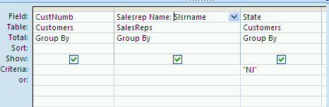
Have as a Header
“Salesrep Name”
The header “Salesrep Name”

Slide 132
Wildcard Searches and the Like Operator
We can search through records to find a string in any attribute, using the "Criteria" row for the attribute, and a "LIKE" in the cell.
There are two wildcard characters to be used with LIKE: * and ?
  * takes the place of any number of characters, letters or numbers in its position
  ? takes the place of any single character, letter or number in the same position in which the question mark is placed

Slide 133
Examples of Wildcard Searches with Like
Like */*/2010(in a date attribute)
Like 2/*/2010 (in a date attribute)
Like 2/?/2010(in a date attribute)
Like "* P*" (in a
name field with firstname, space and last name)
Like "A*" or Like "B*"
( in a Company name)
Finds all records with a 2010 date
Finds all records with any February date in 2010.
Finds all Feb. 1 to Feb. 9 records for 2010.
Finds all records beginning with a P in last name
Finds records of all company names beginning with A or B

Slide 134
Searching for Null Fields
We might wish to issue a query in order to find all records with a blank for a given attribute.
To do so, place the keywords "IS NULL" (without the quotes) in the Criteria row for the attribute you wish to check, and then run the query.
***Often used in database maintenance!***

Slide 135
Updating the Dynaset
Each time you run a query, the current contents of the specified tables are used, and a (new) dynaset is created.
CRUCIAL POINT: Any changes you edit into a dynaset will (automatically) be reflected in the base table(s).
So, if you query for "nulls," you can replace the nulls with values in the dynaset and the base table(s) will automatically be updated.

Slide 136
Queries that Require More than 1 Table
We will concept map the equivalent of a JOIN into Access.
Bring all the needed tables to the table region of the Select Query window.

Slide 137
Relationships Can Be Expressed in Access
If no relationship is present between two tables of interest, you may have Access insert a line indicating a relationship between identically named attributes in the two tables (assuming that both have the same data type ( and field length) and one of them is a primary key).
  In the top portion of the Select Query Window, point and select an attribute in one table and dragging the pointer to the related attribute in the other table.
  If desired, enforce referential integrity by going into "Relationships"

Slide 138
Multi-Table Queries - Continued
Double click on the attributes needed from both tables to express your query.
Use the Criteria row to restrict the records in the join.
Highlight TableNames in the “Show/Hide” ribbon, and you will see in the QBE grid the row called Table and the source table for each attribute
Run the query.

Slide 139
Computed Fields in Queries
A computed field is a field calculated using other attributes and arithmetic operators.
To specify a computed field in a query, do the following:
  Think of a meaningful name for your computed field.
  In an available field column in the QBE grid, enter ComputedFieldName:expression , where expression will include the names of existing fields enclosed within square brackets, plus arithmetic operators
Notes:
Use AvaiableBalance: [Credlim] - [Balance]

Slide 140
Computed Fields - Continued
Note that you generally will not have sufficient room in the Field cell to see the entire expression. Do either of the following (have cursor in Field cell):
  Go into ZOOM mode by
    right mouse click and choose ZOOM
  Go into EXPRESSION BUILDER by right mouse clicking and choosing BUILD
  Enlarge the field by dragging

Slide 141
Built-In Functions for Totals
Access has the following built-in functions, which may be used in queries:
  AVG
  MIN
  MAX
  SUM
  COUNT
  STDEV
  VAR
These functions can only be used in the Total row of the QBE grid.

Slide 142
Built-In Functions - Continued
With the cursor in an attribute column, right mouse-click and choose “Totals”
  A "Total" row will appear in the QBE grid.
    Can also enable View Totals by a click on the Totals button ( Σ ) on the ribbon in “Show/Hide”
In the "Totals" row for the desired attribute, click the down arrow and choose the built-in function you wish to apply to the attribute.
Run the query
Note that you can specify "criteria" in such a way that the function you indicated in "Totals" will be applied only to the records which satisfy the criteria.
  This is done by choosing the "Where" clause in the drop down arrow box of the attribute, and using another Column to specify a select condition in the Criteria row.
    Note: If the select condition is to also be applied to the desired attribute, you need to create an additional column in the QBE for the same attribute
Notes:
DO NOT DO ANYTHIING with this slide
WAIT UNTIL THE NEXT TWO SLIDES
BE CAREFUL NOT TO HAVE ANY ATTRIBUTES PRESENT WHICH ARE NOT PART OF THE TOTAL STATISTIC OR THE PREDICATE

Slide 143
To Calculate a Statistic Based Upon One Attribute
Clear the QBE Grid
If "Total" is not in the QBE grid, then right click the mouse and choose “Totals”
Bring into the QBE grid the attribute upon which you wish to calculate a statistic.
Click in "Total" and choose the appropriate statistic (average, sum, max, etc.)
Run the query

Slide 144
Calculating Statistics Based Upon Groups of Records
A group is a set of records which share some common attribute instance:
  Example: Students with the same major, customers having the same SalesRep, etc.
In the "Total" row for the attribute you wish to group by, select "Group By" from the Drop-Down list.
  Tip: Be certain that there are no "extra" attributes in the QBE grid; only the "group by" attribute and "statistic" attribute(s) should be present.
Complete the QBE grid with desired statistic(s) placed in the appropriate attribute(s).
Run the query.
Notes:
SUPPOSE: We wish to do a count of how many customers each salesrep has in the database.
Bring Customername and Salesrep Name into the QBE grid.
In CustomerName, in Total Row, choose Count
In SalesrepName, be sure "Group By" is checked.
Run query

Slide 145
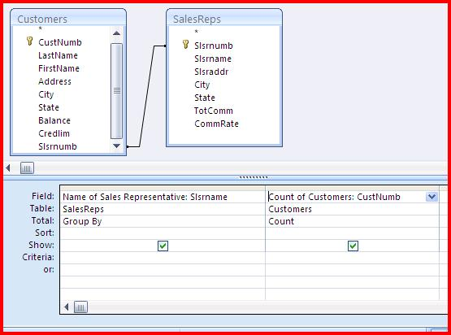
Query the Snookie Database to Obtain a Count of How Many Customers Belong to Each SalesRep

Slide 146
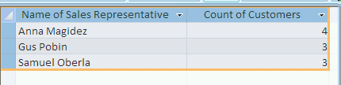
The Counts…

