Slide 1
Microsoft Access 2010
Tutorial for the CS 101 Lab

Slide 2
Outlines
Create Tables and Fields
Create Relationship
Create Queries
Create Reports

Slide 3
Microsoft Access 2010
A database is an organized collection of data—facts about people, events, things, or ideas—related to a specific topic or purpose.
•Information is data that is organized in a useful manner

Slide 4
Identify Good Database Design
Use good design techniques when creating a new database.
–Determine the information you want to keep track of to create a new database.
–Ask yourself, “What questions should this database be able to answer for me?”
–The purpose of a database is to store data in a manner that makes it easy for you to get the information you need.

Slide 5
Existing Data Base
You will deal with an existing database in this course.
You are not required to create a new database file.
You will be provided with a prepared database file.

Slide 6
Create Tables
There are several ways to create a table, the following are two ways to do that.
Create Table in Design View
Create Table in DataSheet View

Slide 7
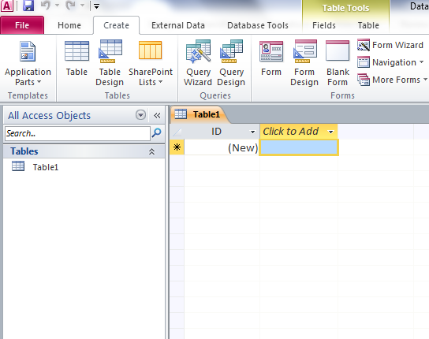
Create Tables in Design View
1
2

Slide 8
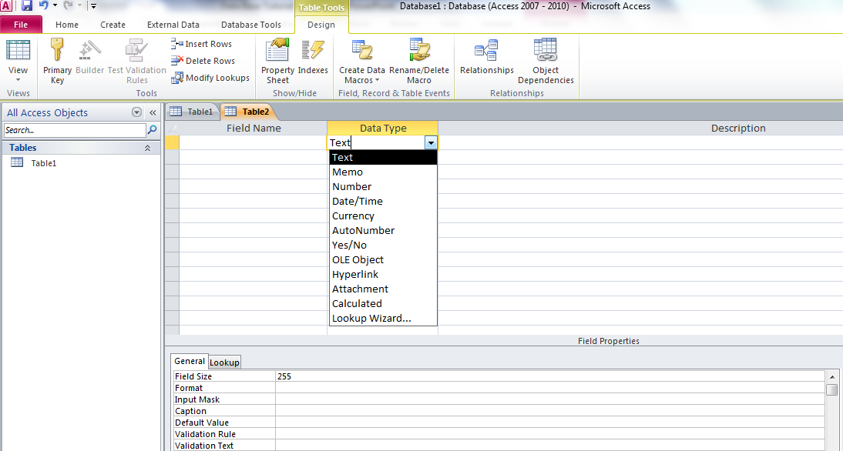
Fill Fields’ Information
Primary Key
Field’s Data Type
Field’s Name
Field’s Properties

Slide 9
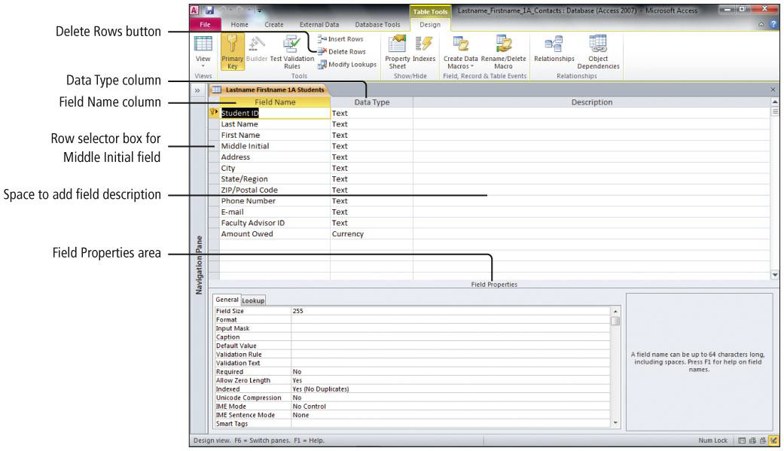
Example of Filling Fields’ Information

Slide 10
Save and Name the Table
After you fill the fields’ information, it is the time to give your table a name. Click the x in the corner
1
2

Slide 11
Create Tables in DataSheet View

Slide 12
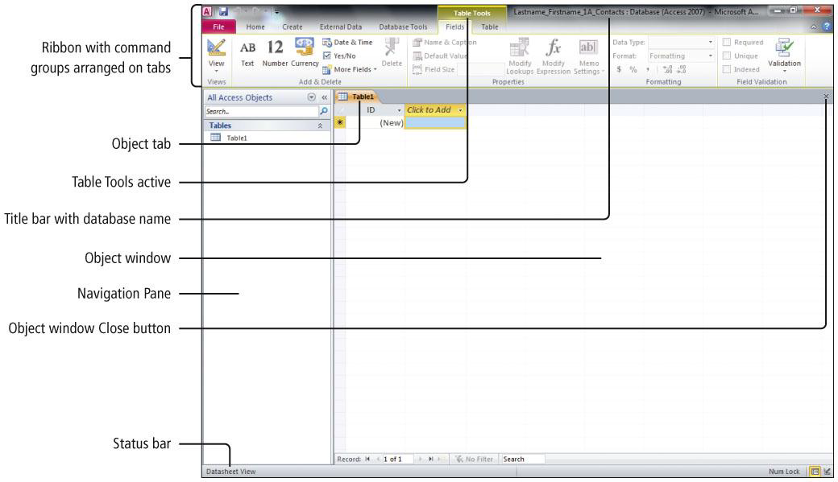
Create a Table and Define Fields in a New Blank Database

Slide 13
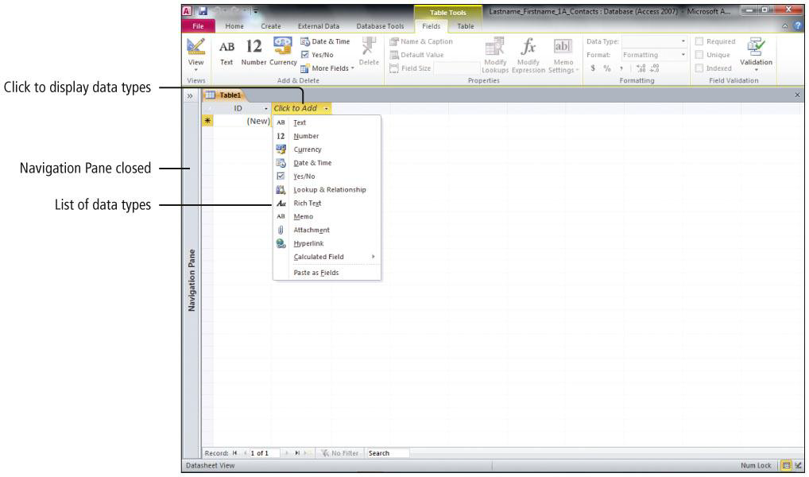
Create a Table and Define Fields in a New Blank Database

Slide 14
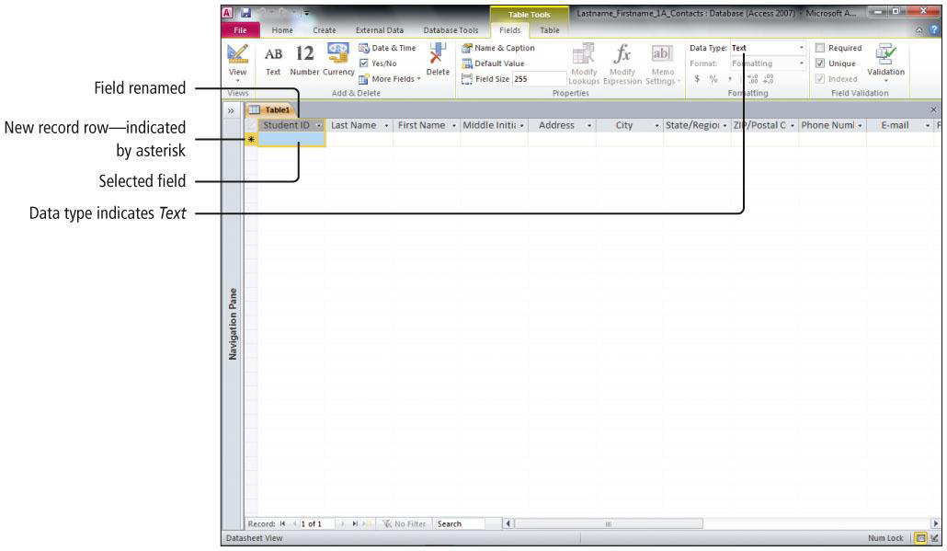
Create a Table and Define Fields in a New Blank Database
Renaming fields and changing data types

Slide 15
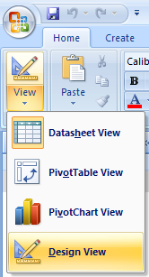
Switch Between Different Modes

Slide 16
Adding a record to a table

Slide 17
Adding a record to a table

Slide 18
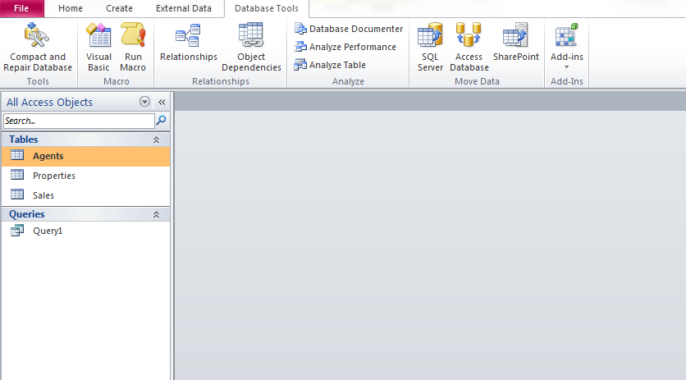
Relationship Between Tables
1
2

Slide 19
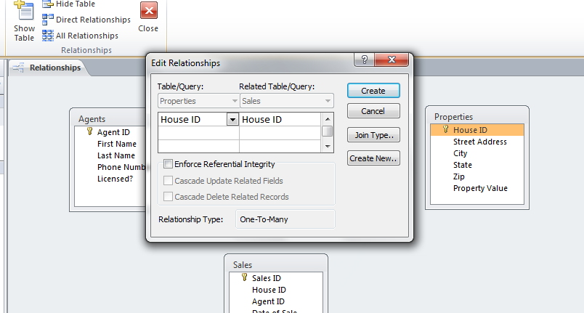
Drag and drop the Primary Key of one table into the similar field inside the second table
(2) Click the Join
(1) Make the Check

Slide 20
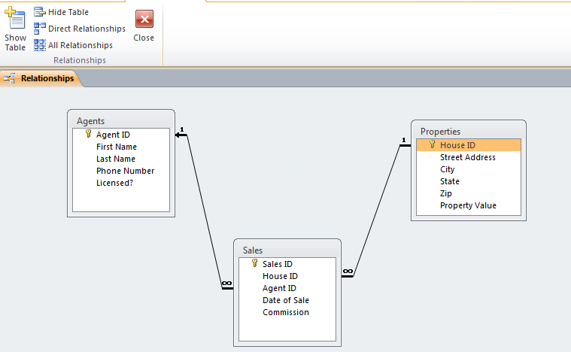
After creating the relationship
(2) Close the relationship and Save the changes
(1) Make sure that it is 1-∞ relationship

Slide 21
Queries
A query is a database object that retrieves specific data from one or more database objects—either tables of other queries.

Slide 22
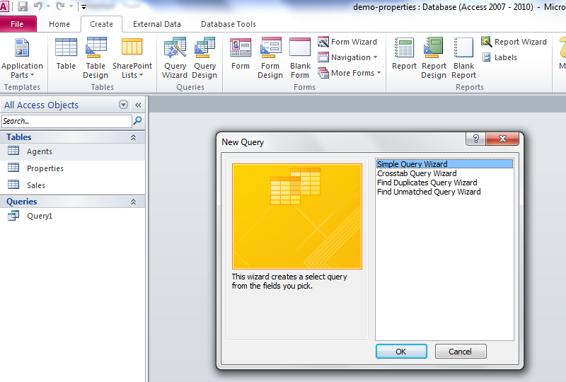
Create Queries
(1)
(3) Choose Simple Query
(2)

Slide 23
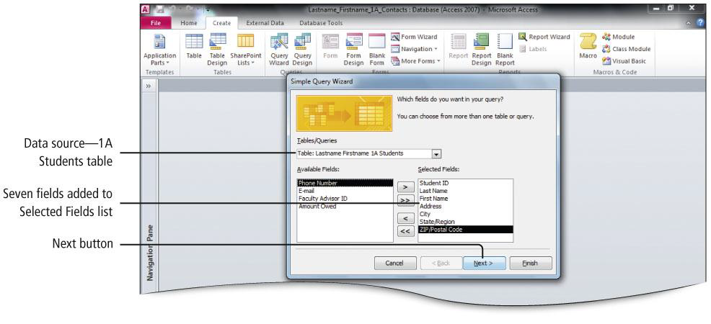
Creating a Query

Slide 24
Save and Close a Database
When you close an Access table, any changes made to the records are saved automatically.
•You will be prompted to save changes to design of the table or the layout of Datasheet view.

Slide 25
Modify Existing Tables
Data in database usually dynamic
Must be accurate, up-to-date
Locate field through Find and Replace
Looks for current field content
Once record(s) found, can delete or edit

Slide 26
Modify Existing Tables
Can navigate through table’s records using keyboard
Useful Key Combinations for Navigating a Table
Keystroke | Movement
[PageUp] | Moves the selection up one screen at a time.
[PageDown] | Moves the selection down one screen at a time.
[Ctrl]+[Home] | Moves the selection to the first field in the table or the beginning of the selected field.
[Ctrl]+[End] | Moves the selections to the last field in the table or the end of the selected field.
[Tab] | Moves the selection to the next field in the table.
[Shift]+[Tab] | Moves the selection to the previous field in the table.
Notes:
Figure 4.15

Slide 27
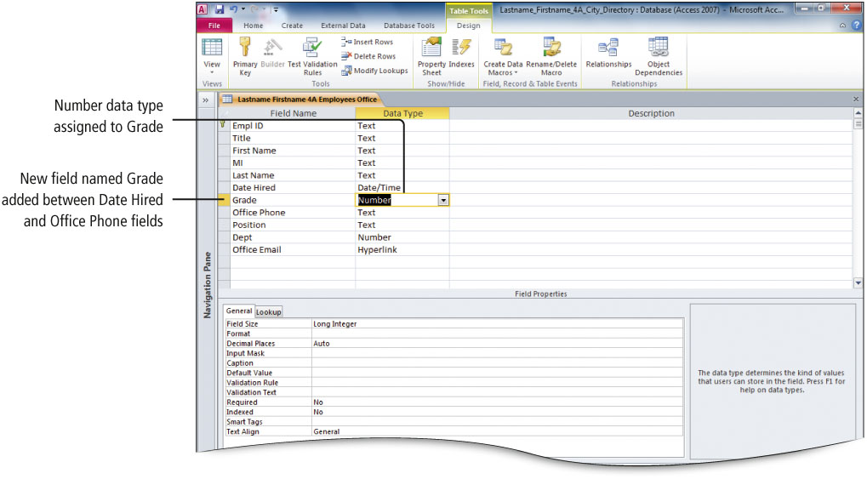
Modify Existing Tables
Advantages using Design view to add field(s)
Can insert field name and data type
Can drag to new location
Notes:
Figure 4.16

Slide 28
Create and Modify Table Relationships
Access databases are relational
Tables relate through common fields, which have values that match
Create relationships prior to creating:
Queries
Forms
Reports

Slide 29
Create and Modify Table Relationships
Referential integrity ensures validity of table data
Notes:
Figure 4.20

Slide 30
Create and Modify Table Relationships
Cascade options update table records when referential integrity is enforced
Cascade Update enables changes to a primary key field and automatically updates related table(s)
Cascade Delete permits record deletion to table and related table(s)

Slide 31
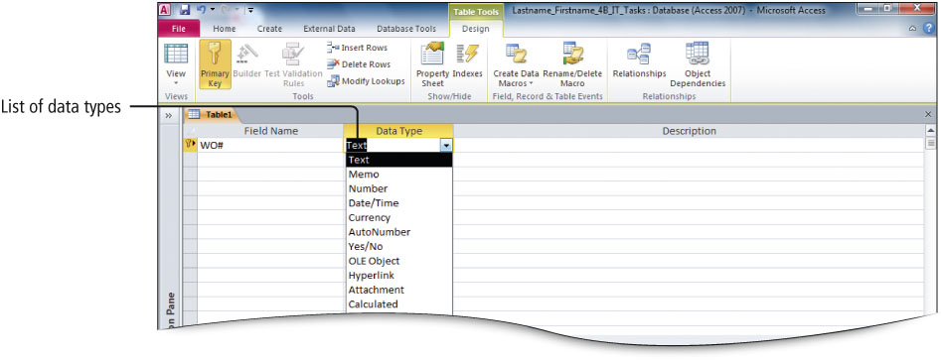
Create a Table in Design View
Gives most control over table and fields
Notes:
Figure 4.25

Slide 32
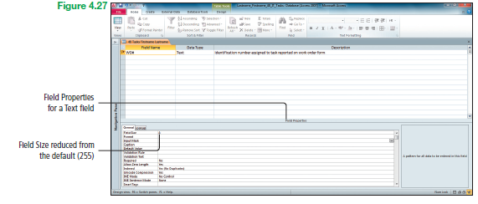
Create a Table in Design View
Field properties related to field data type
Notes:
Figure 4.27

Slide 33
Change Data Types
Decide each field’s data type before creating a table
Ensures proper data entry in fields
Determines acceptable data entry in fields
Change data type with caution on an existing field
get a warning about losing data

Slide 34
Set Field Properties
Field properties are characteristics of a field
Controls display of data
Controls input of data
Field data types determine field properties

Slide 35
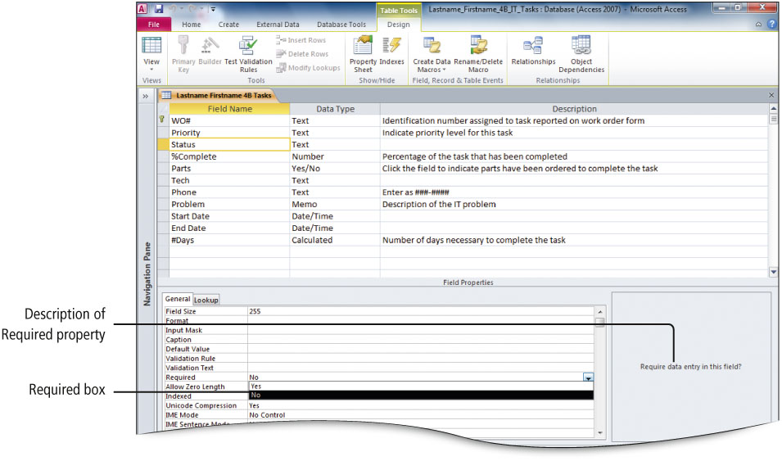
Set Field Properties
Required field property
Field entry necessary if “Yes”
Ensures field cannot be blank
Notes:
Figure 4.40

Slide 36
Set Field Properties
Default Value field property
Field content displays in new records
Can be changed by user
Increases efficient data entry
Notes:
Figure 4.42

Slide 37
All rights reserved. No part of this publication may be reproduced, stored in a retrieval system, or transmitted, in any form or by any means, electronic, mechanical, photocopying, recording, or otherwise, without the prior written permission of the publisher. Printed in the United States of America.
Copyright © 2011 Pearson Education, Inc.
Publishing as Prentice Hall
37

