Slide 1
MicroSoft Access 2007
Percy K. Parakh
Technology Training Coordinator – CDE
ChSCC

Slide 2
Introduction
What is a Database?
What is a Database Management System?
How do we use MicroSoft Access to create a simple Database.

Slide 3
Agenda
Describe databases & database management systems
Start Access
Describe the features of the Access Screen.
Create a Database.
Create a table.

Slide 4
Agenda (contd...)
Define the fields in a table.
Open a table.
Add records to an empty table.
Close a table.
Close & open a database.
Use a form to view data.
Create a graph.

Slide 5
Overview
A database is a collection of data organized in a manner that allows access, retrieval, and use of that data.
Ex. A Rolodex which keeps track of Names, Addresses, and Phone Numbers, is a simple example of a manual database.

Slide 6
Overview (contd...)
A Database Management System, allows you to use a computer to create a database.
With the computer you can (electronically) create, add, change, and delete data in the database, retrieve data using Queries, and create Forms and Reports.

Slide 7
How is it different from a Spreadsheet?
Spreadsheet Software allows users to add, subtract & perform user defined calculations on rows & columns of numbers.
Spreadsheets are more geared towards numeric data, whereas Databases work with Data that contains info. like Names, Addresses, Soc. Security #’s etc.

Slide 8
Vocabulary
Tables
Records
Fields
Primary Key

Slide 9
Definitions
A table is a collection of data about a particular subject. For Ex. a Movie table contains info. about movies like Movie No., Movie Title, Year Made, Movie Type etc.
RECORDS are simply the ROWS in the table.
FIELDS are the COLUMNS in the table.

Slide 10
Movie Table
Each COLUMN in the table
is a FIELD
Each ROW in the table
is a RECORD

Slide 11
Records
A RECORD in the MOVIE Table contains information about a specific MOVIE.
Ex. Record Number 003 contains specific information on the movie Dancing Duo.

Slide 12
Fields
A FIELD contains a specific piece of information within a RECORD.
Ex. The Movie Title field contains specific information about the Title of the Movie.

Slide 13
PRIMARY KEY
The first field in the MOVIE table is the MOVIE NUMBER. This is a code assigned by the owner to each MOVIE.
These numbers are unique; that is no two movies will be assigned the same number.
Such a field can be used as a UNIQUE IDENTIFIER. Ex. Soc-Sec-No.
This is called the PRIMARY KEY.

Slide 14
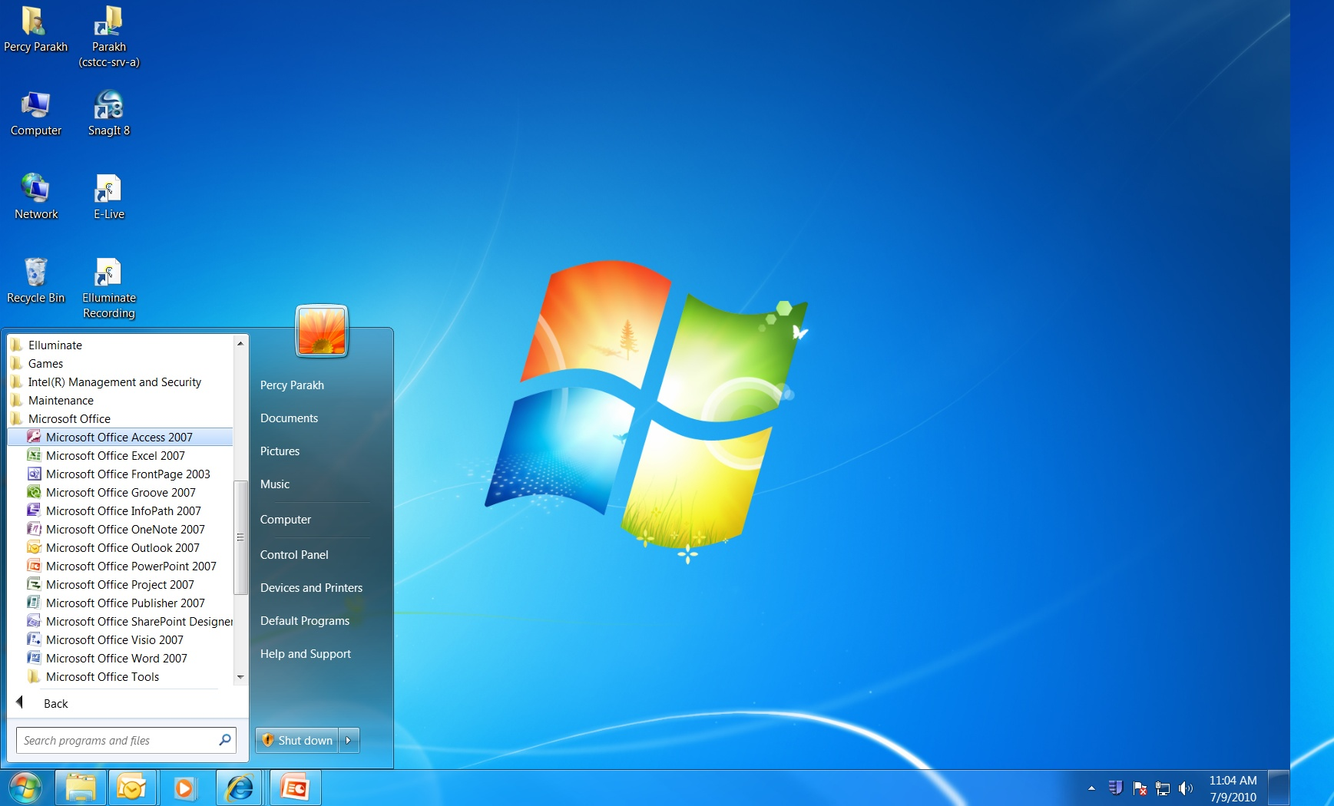
Click on Start, Programs,
Microsoft Office, Microsoft
Office Access 2007

Slide 15
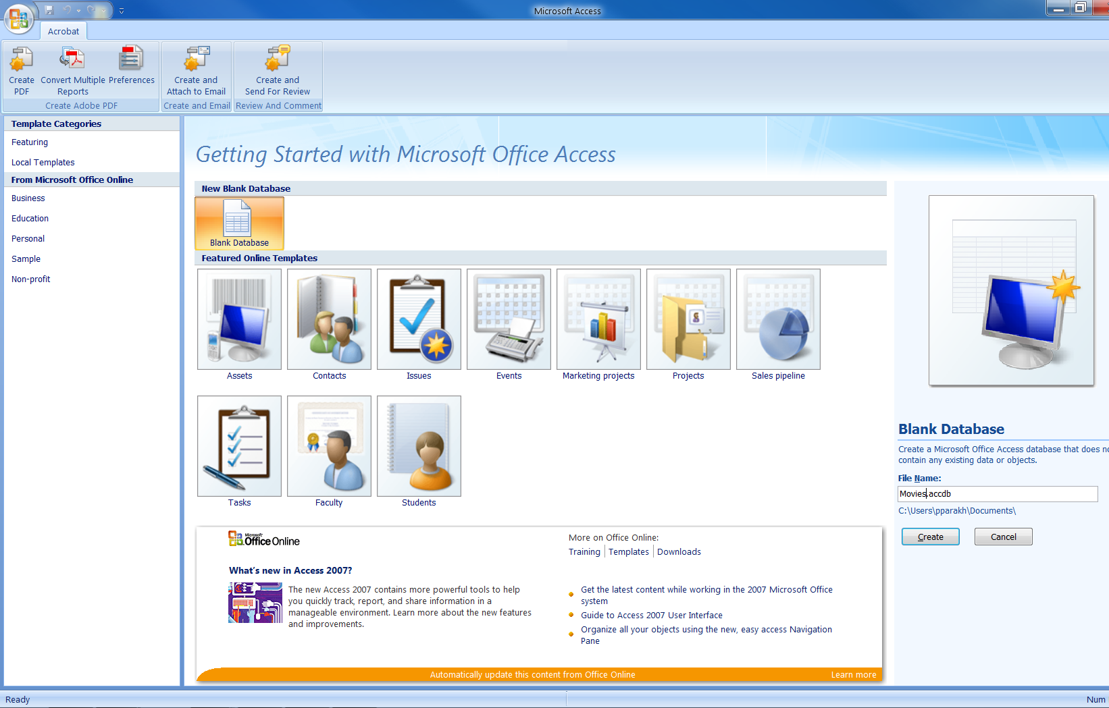
1) Click, Blank
Database
2) Name it
Movies.accdb
3) Click,
Create

Slide 16
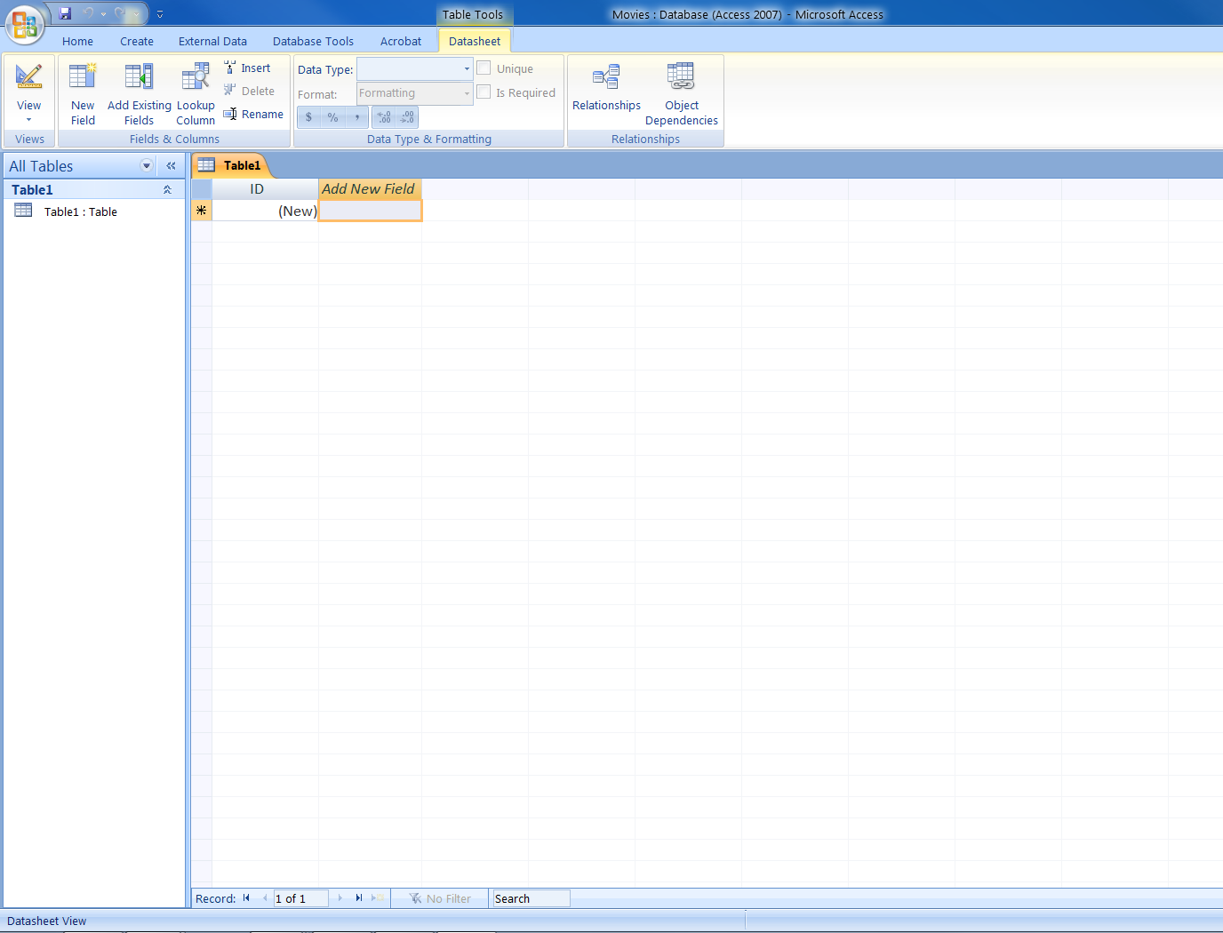

Slide 17
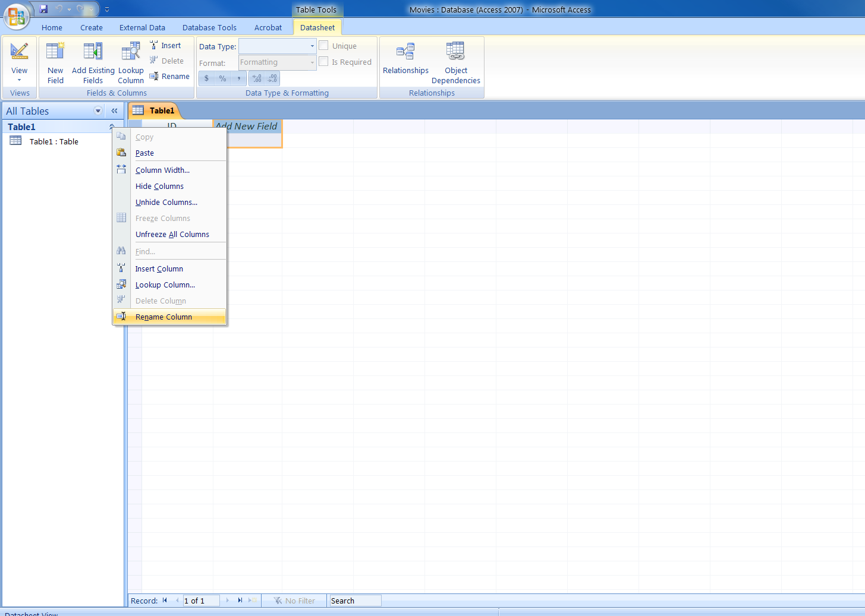
1) Right Click,
select Rename
Column

Slide 18
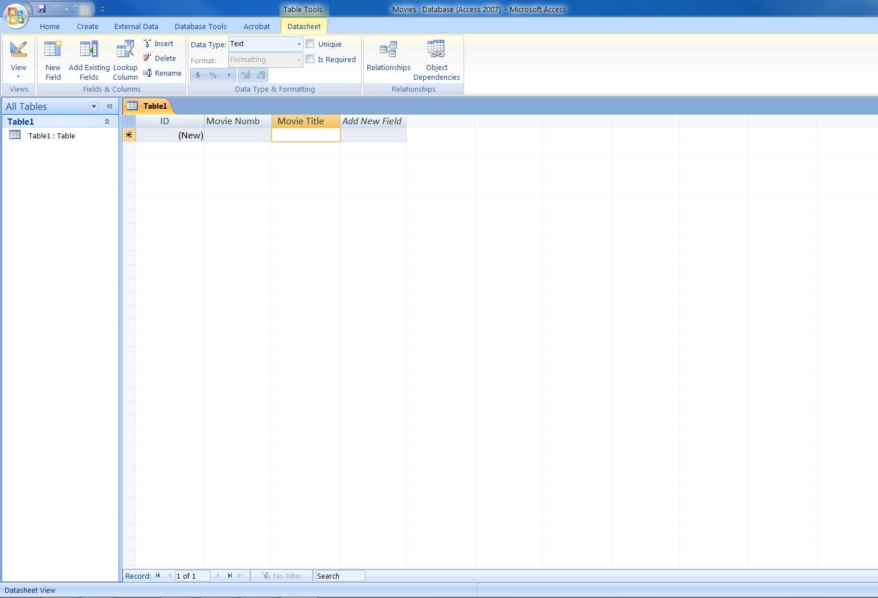
3) Data Type,
Text
4) Type in Movie
Title and so on…..
1) Rename field
as Movie Number
2) Press the
Down Arrow
key

Slide 19
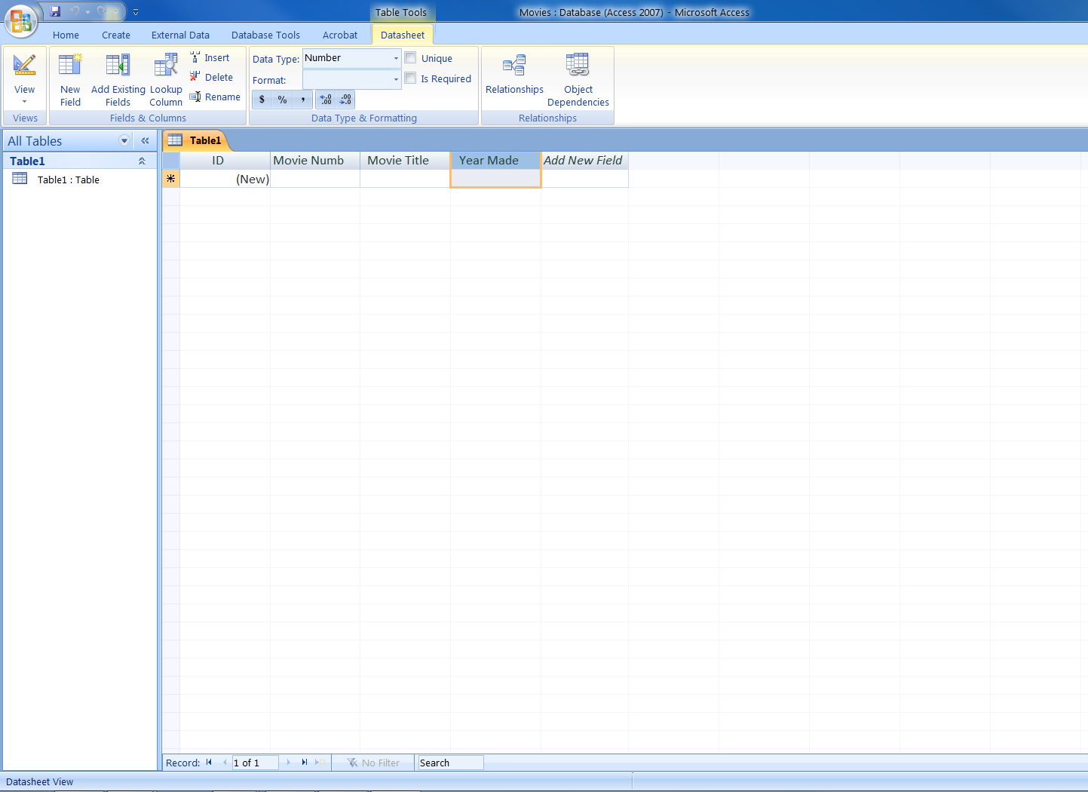
Data Type for
Year Made – Number

Slide 20
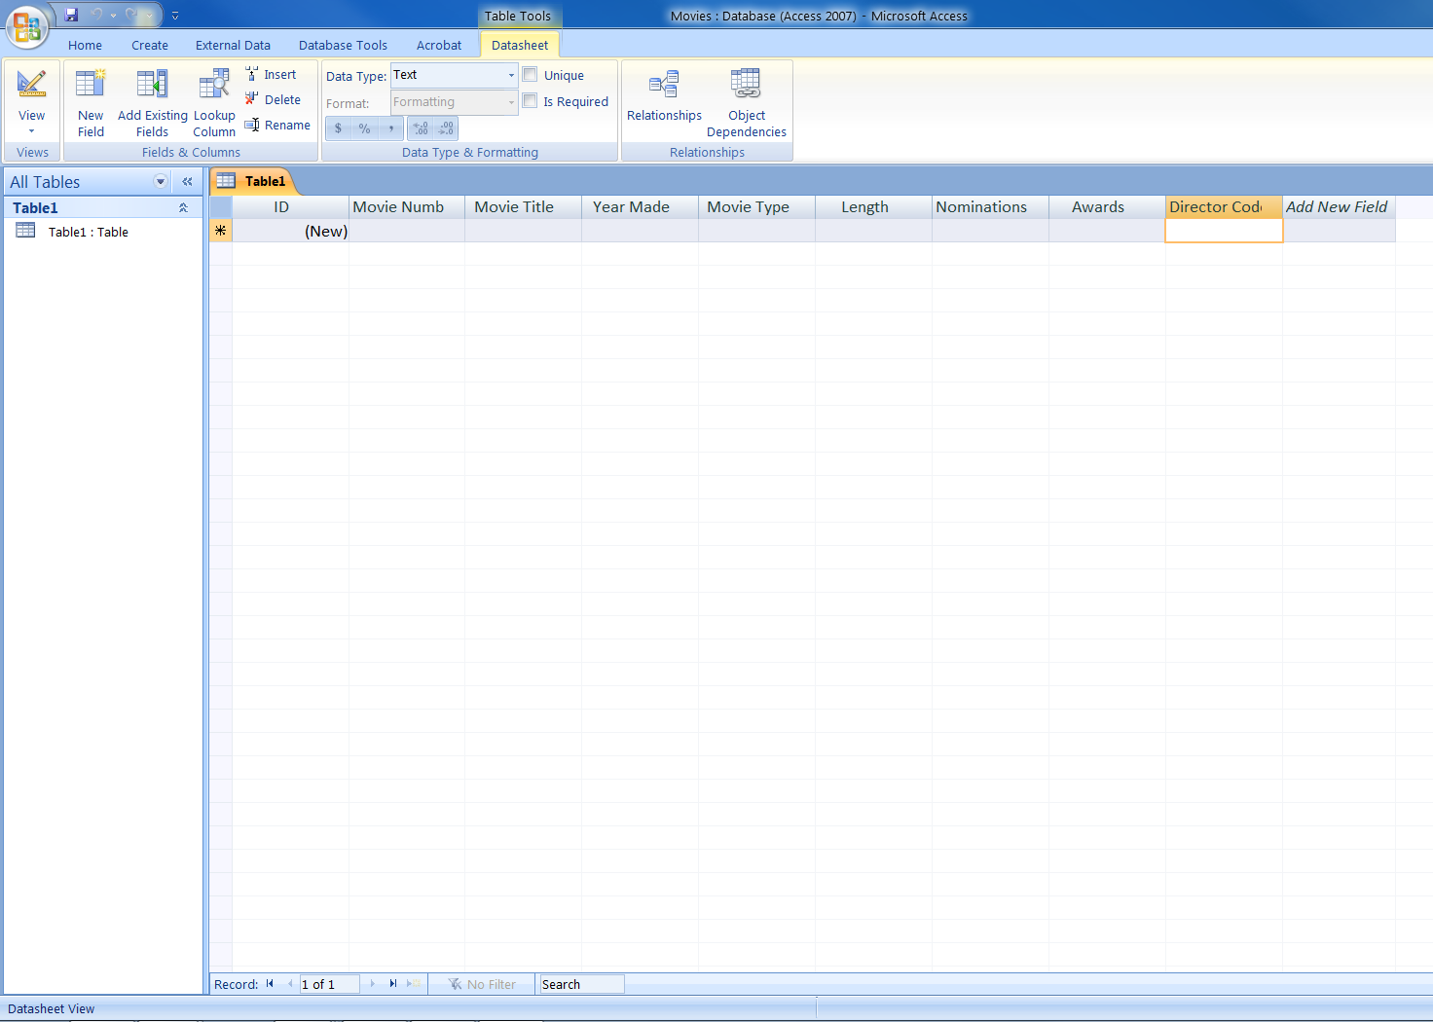
Data Type,
Number
The rest of the fields
Have a Data Type of
Text

Slide 21
Save the Table
Save the Table and call it Movies
The Movies Table will show up in the left pane

Slide 22
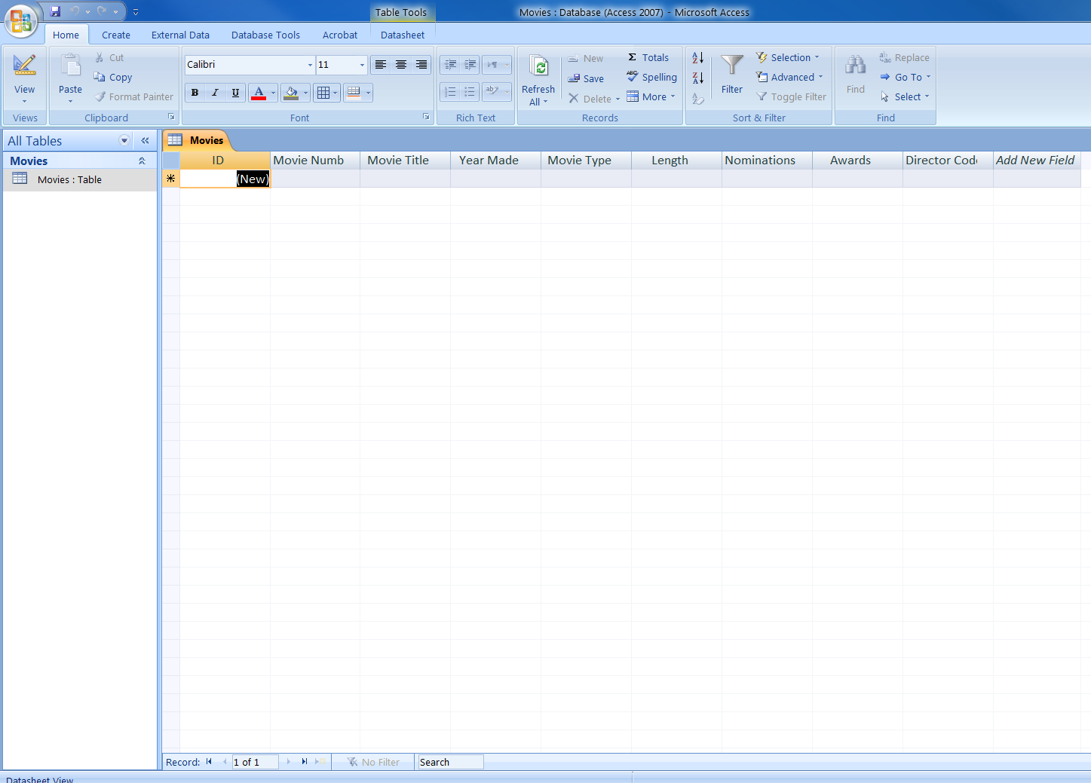
2) Click on View to
Toggle to Design
View
1) Saved as
Movies: Table

Slide 23
Creating the proper Primary Key
We will delete the bogus Primary key i.e. the ID #
We will make the Movie Number the Primary Key, by clicking on the Primary Key Button

Slide 24
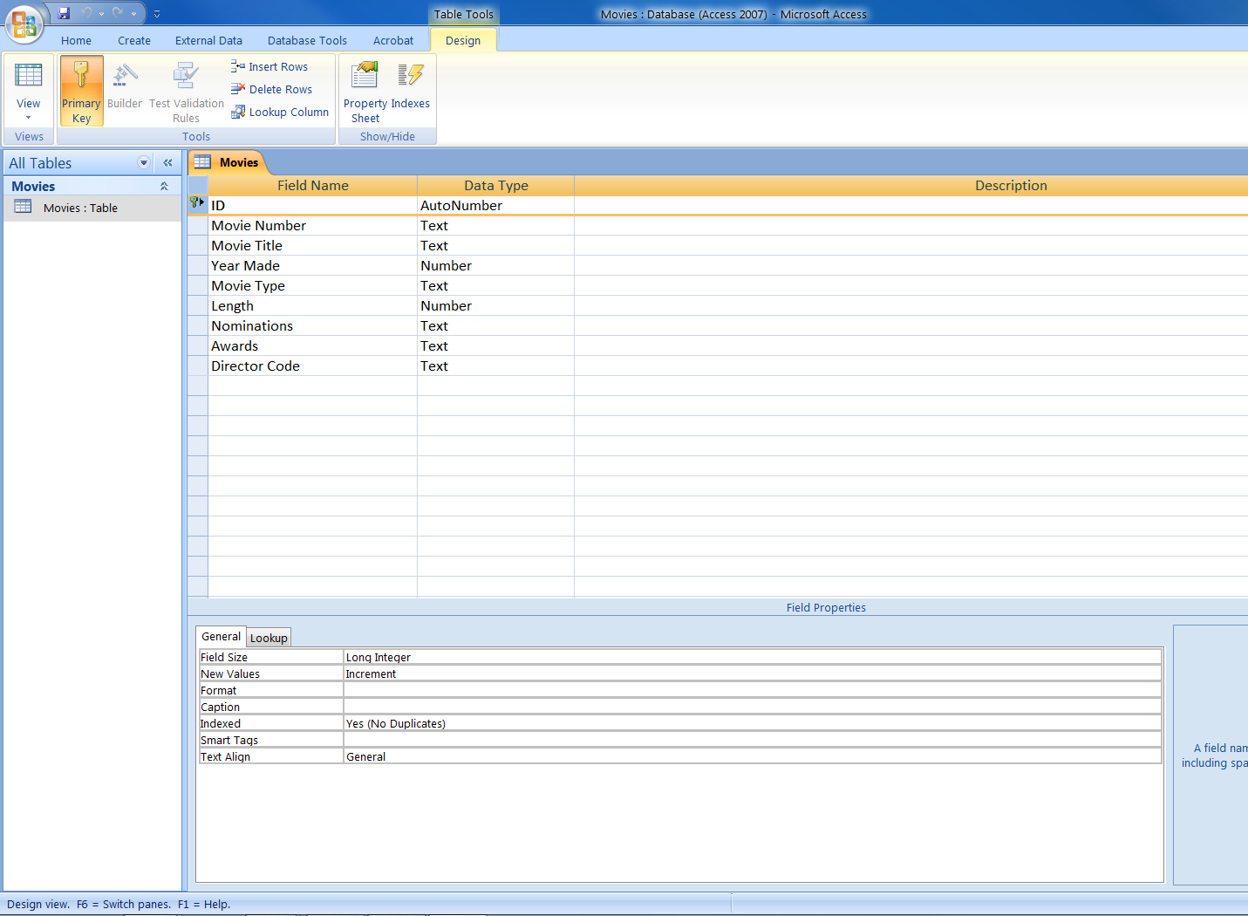
Click on the
Primary Key row,
and press Delete
on the keyboard

Slide 25
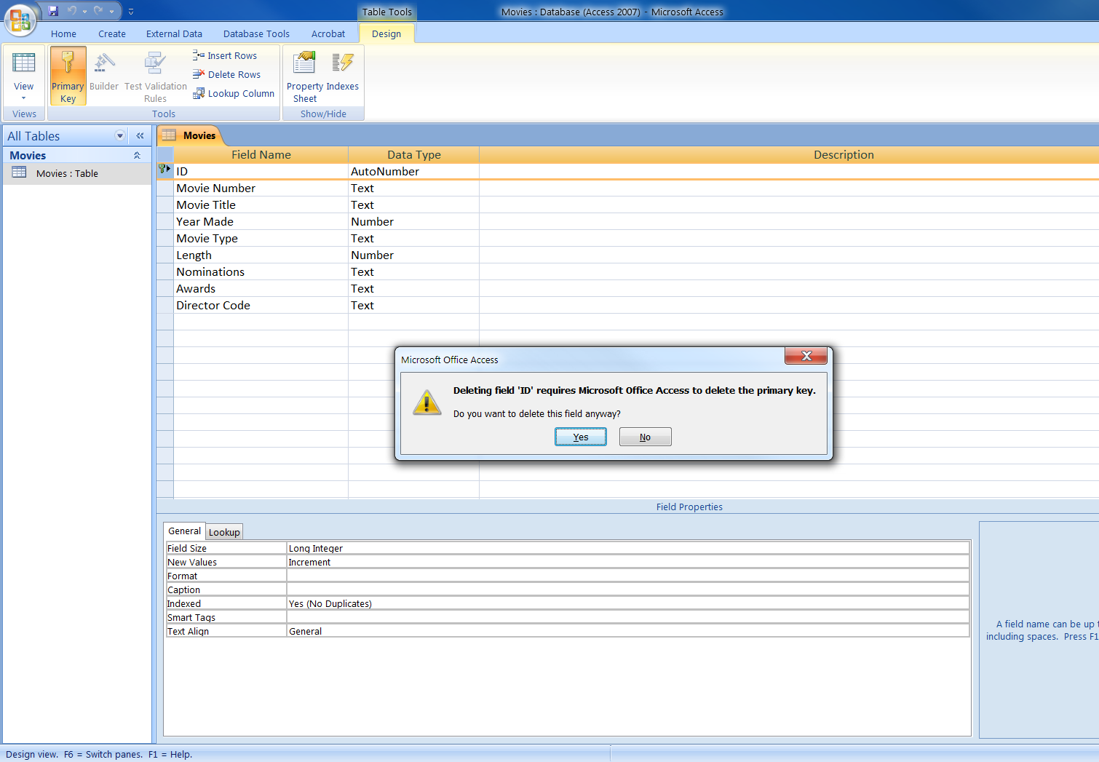
Click on
Yes

Slide 26
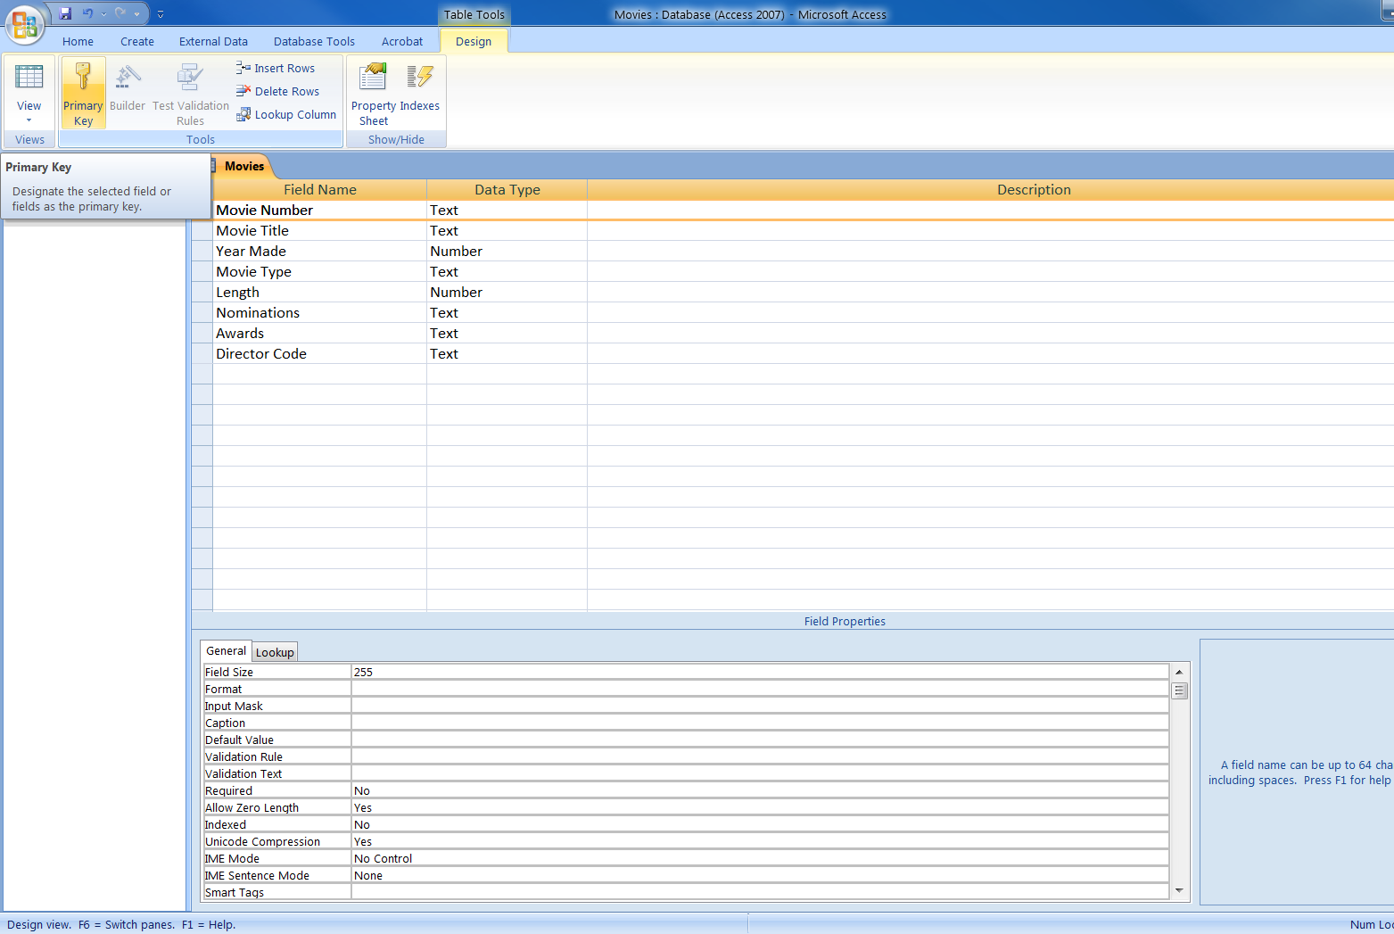
2) Click on
Primary Key
1) Click on
Movie Number
Field

Slide 27
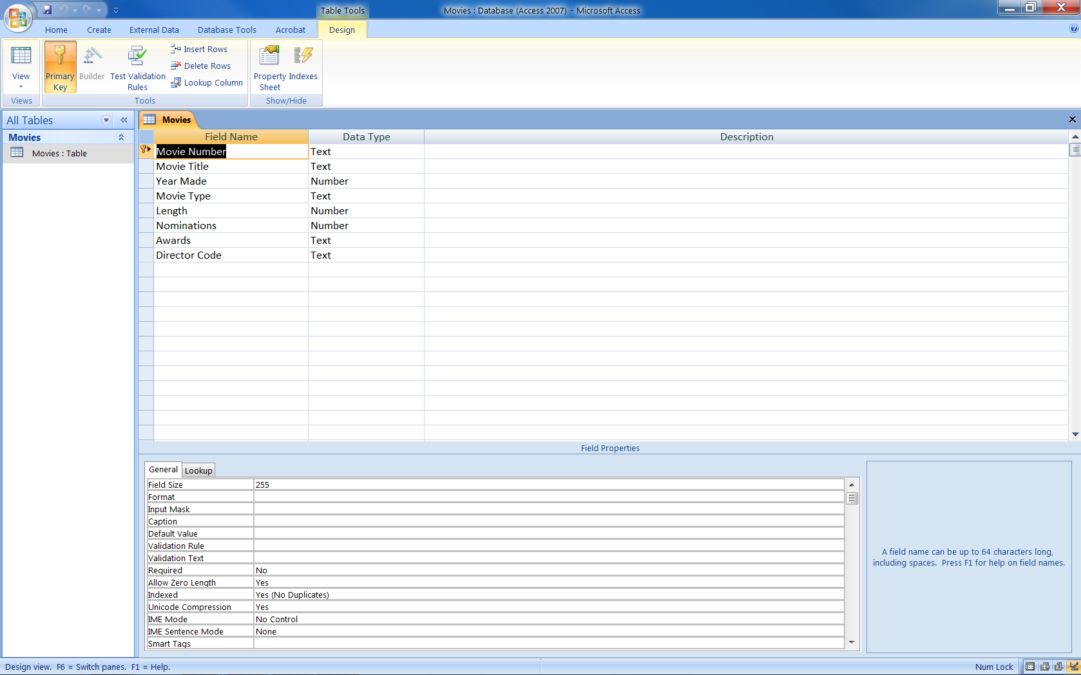
2) Close and
Save the table
1) Movie Number
is now the
Primary Key

Slide 28
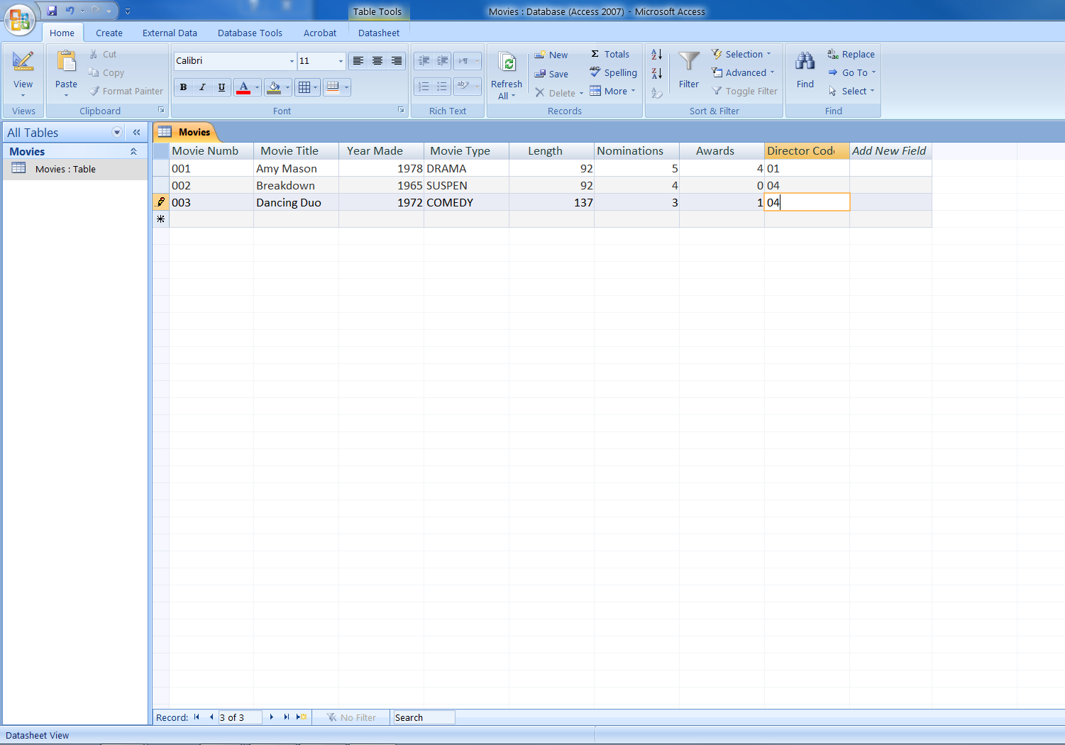
Start entering Records,
use the Tab key to move
from one field to the next,
or click in field with your
mouse and type

Slide 29
Create the Director Table
Click on the Create tab, click on Table
Create the fields in the Director Table just as before (Movie Table)
Save the Table as Director
Click on View to flip to Design View
As before delete the bogus Primary Key

Slide 30
(contd.)
Make the Director Number as the Primary Key
Change the field width to 2.
Save the Table by clicking on Close button on the table.
Type in all the records in the Director Table

Slide 31
Click on
Create Tab
2) Click on
Table ( to create a
New Table)

Slide 32
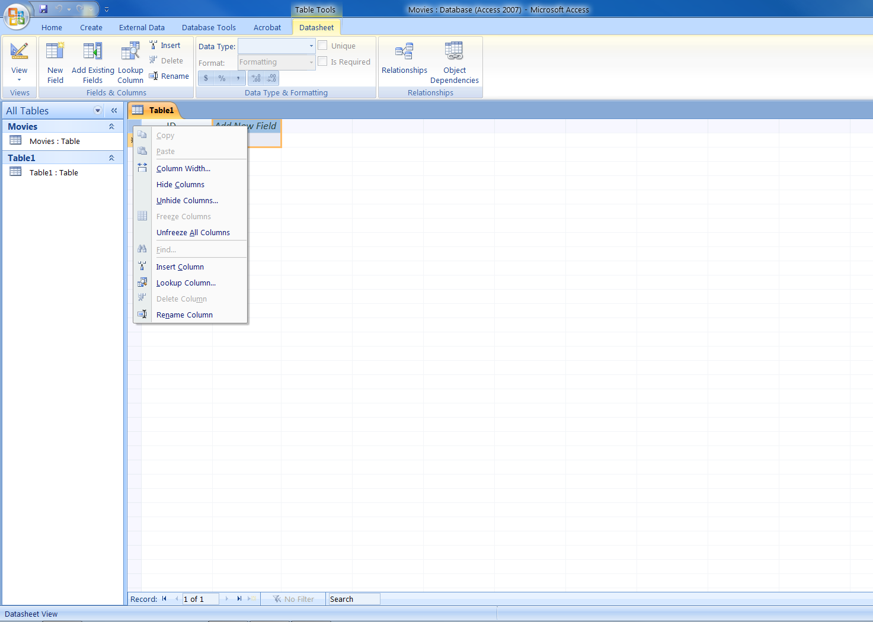
1) Right Click
On Add New
Field
2)Click on
Rename Column

Slide 33
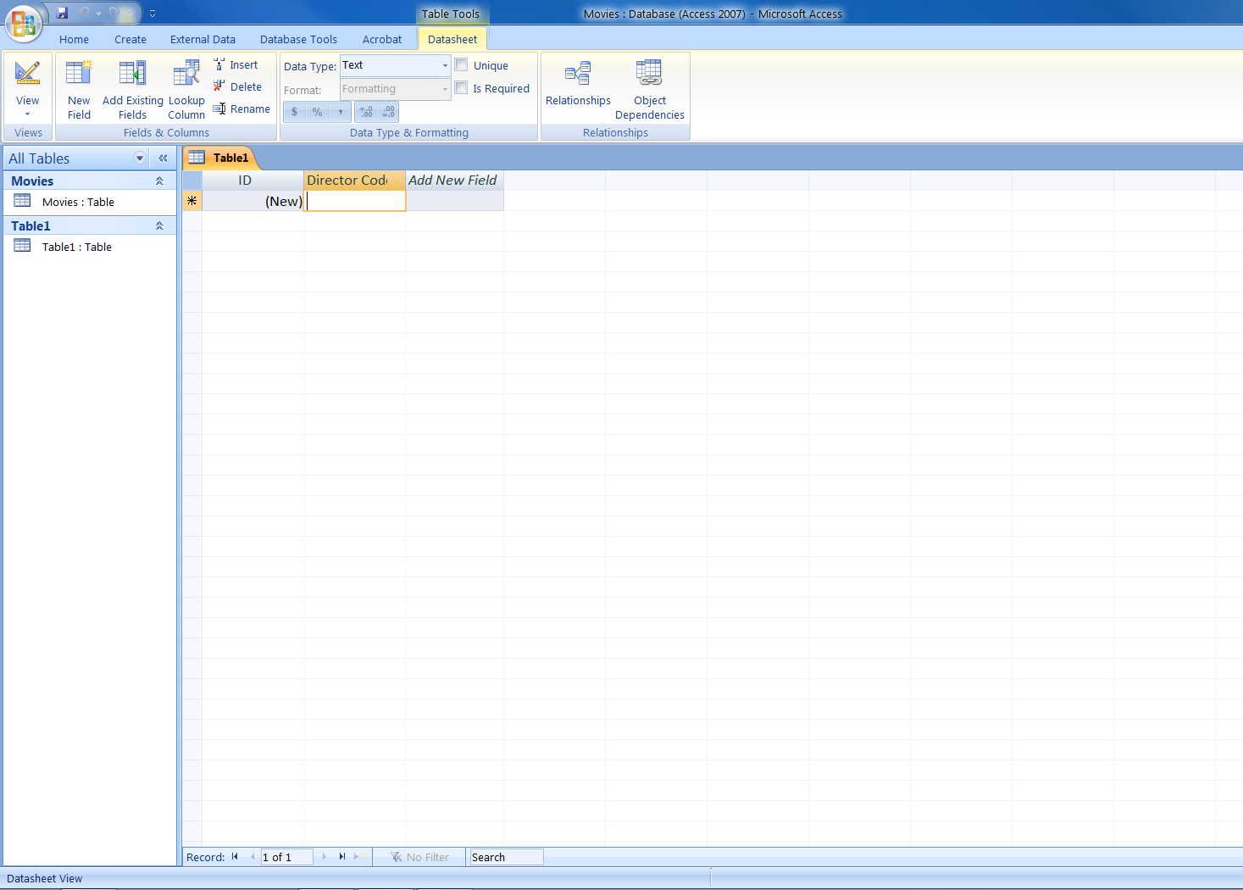
Type in
Director Code

Slide 34
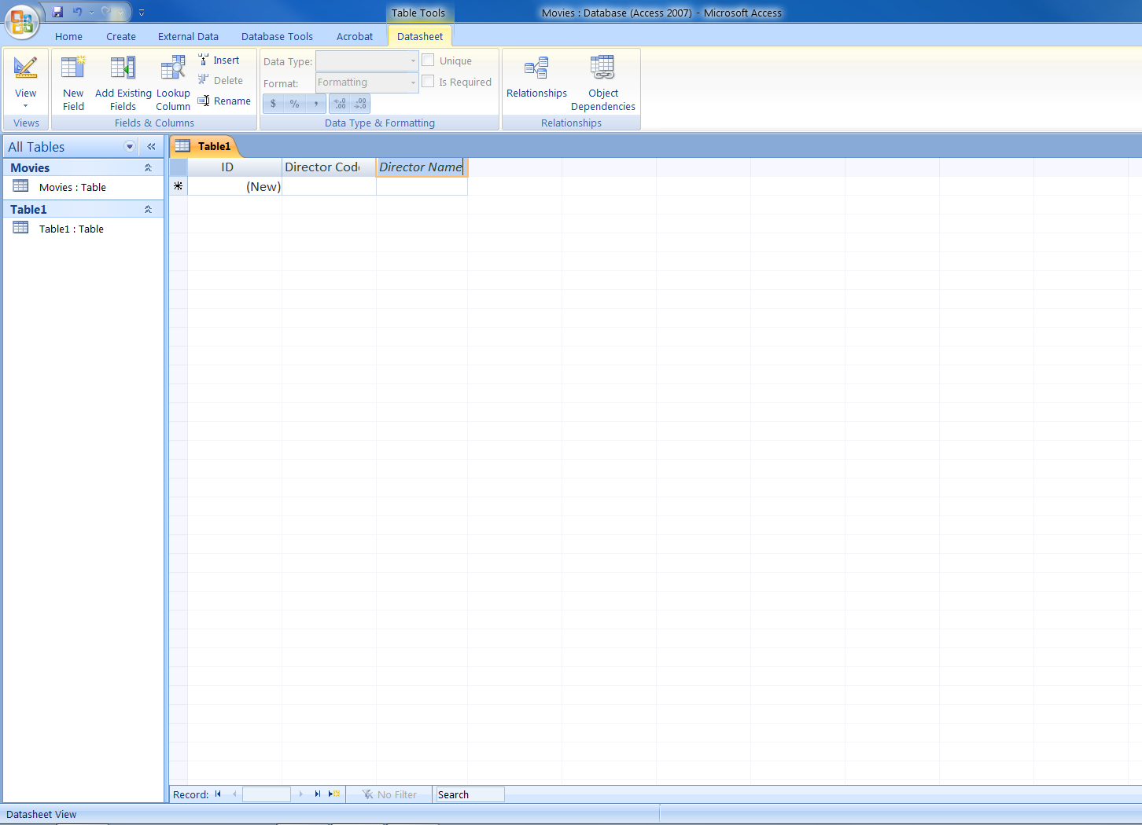

Slide 35
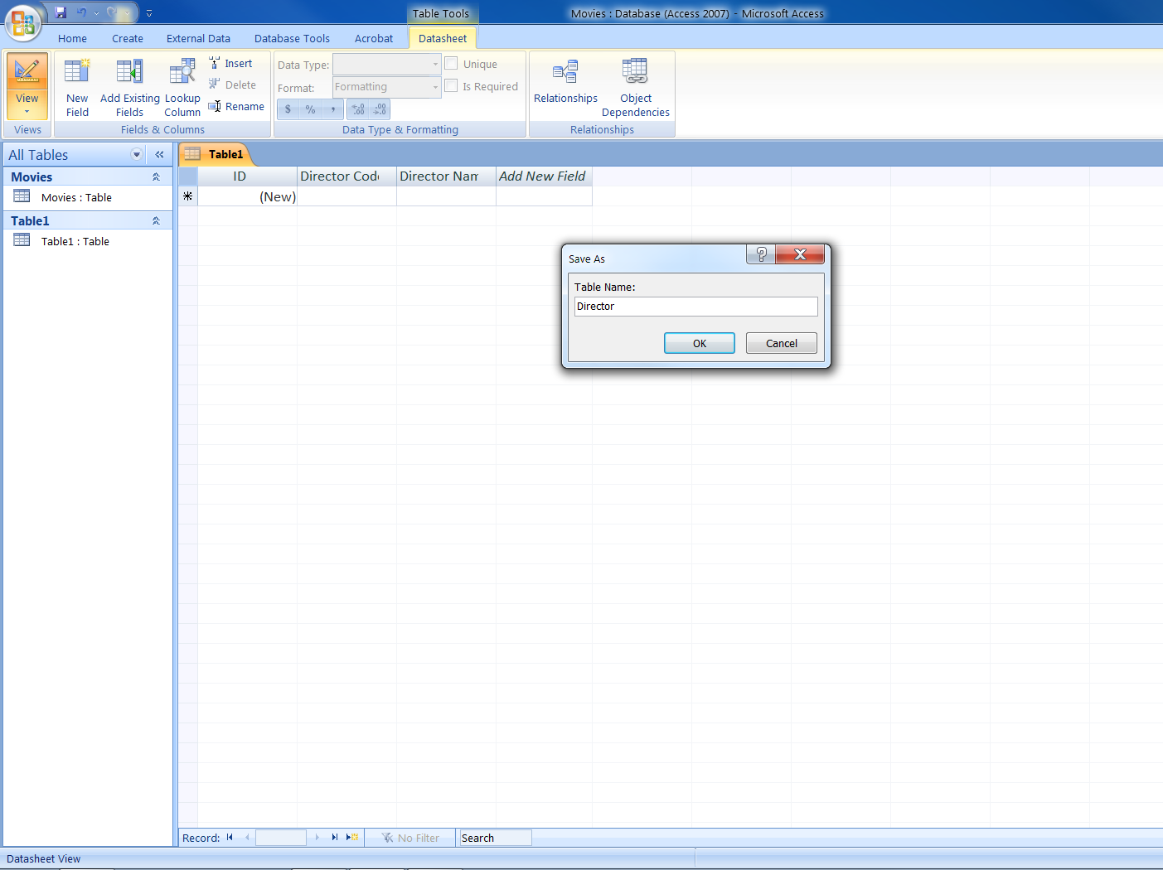
1) Save As
Director
2) Click on
View, to flip
To Design
View

Slide 36
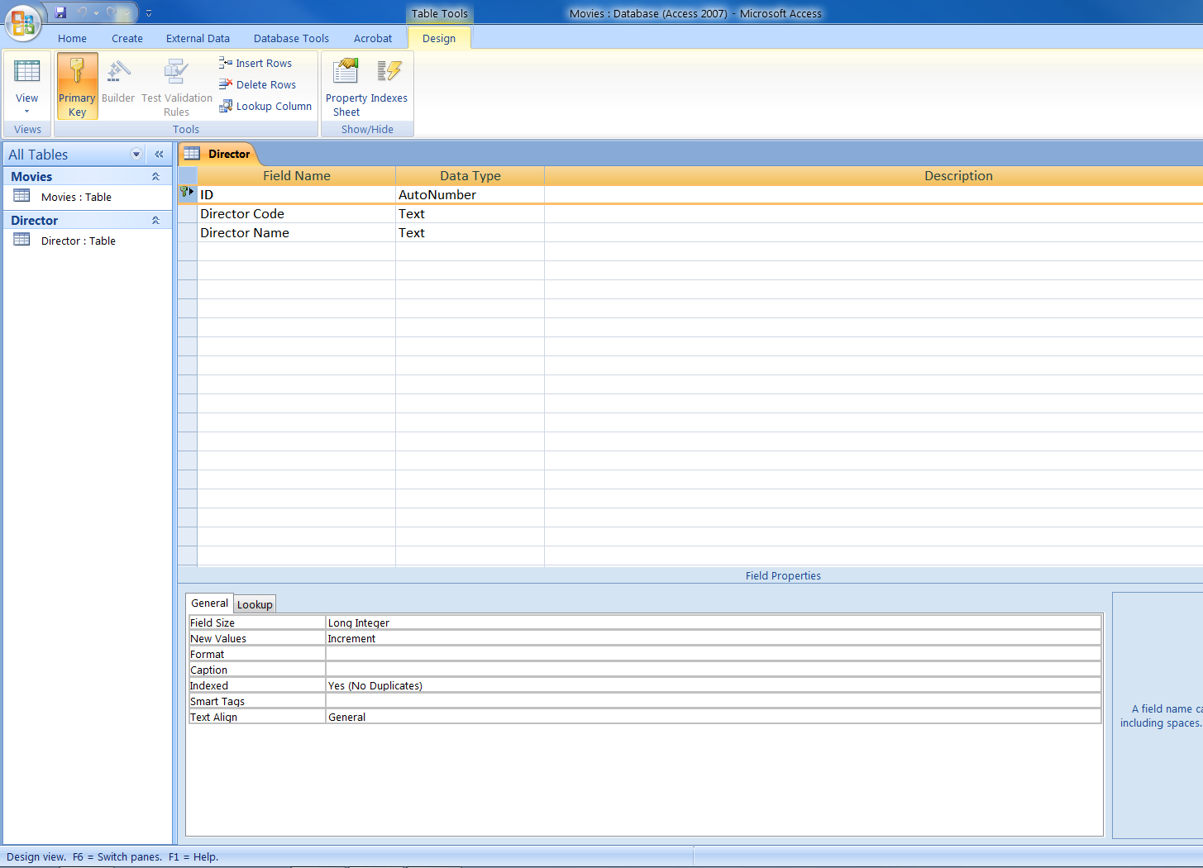
Click and
Press Delete

Slide 37
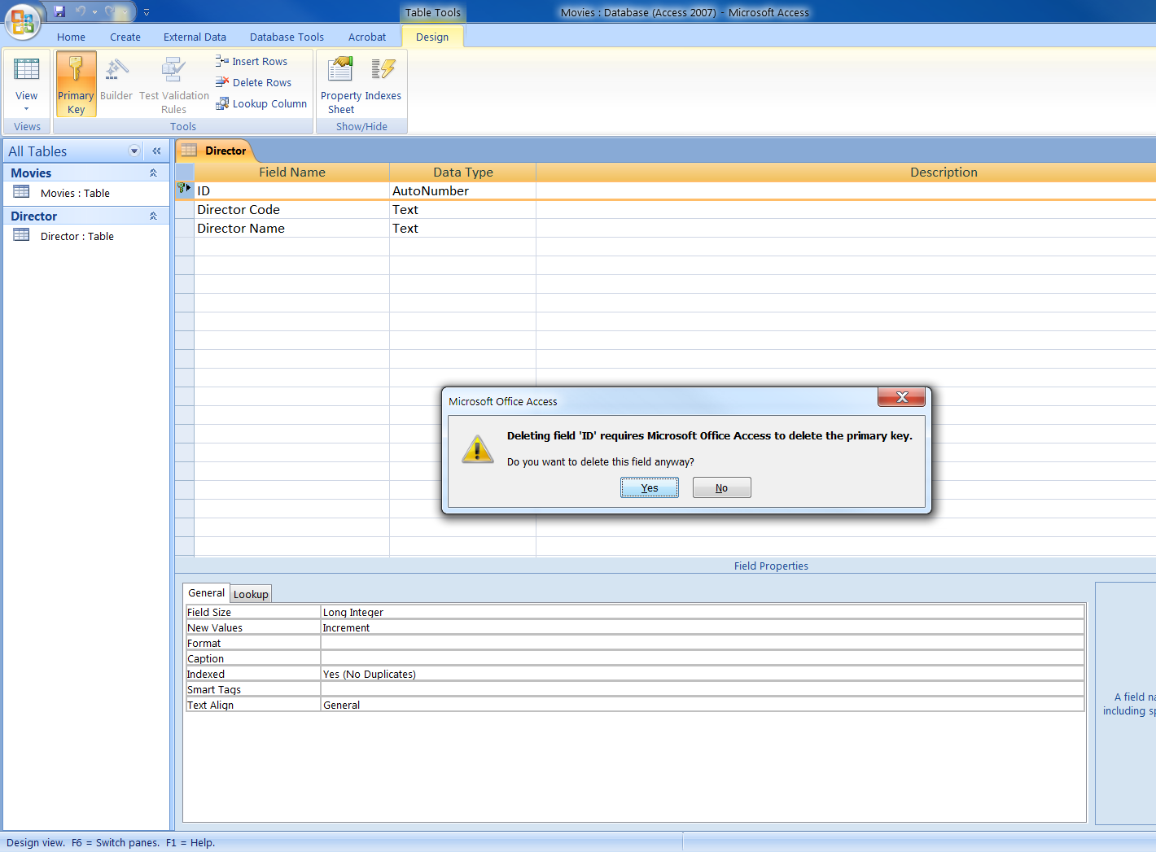

Slide 38
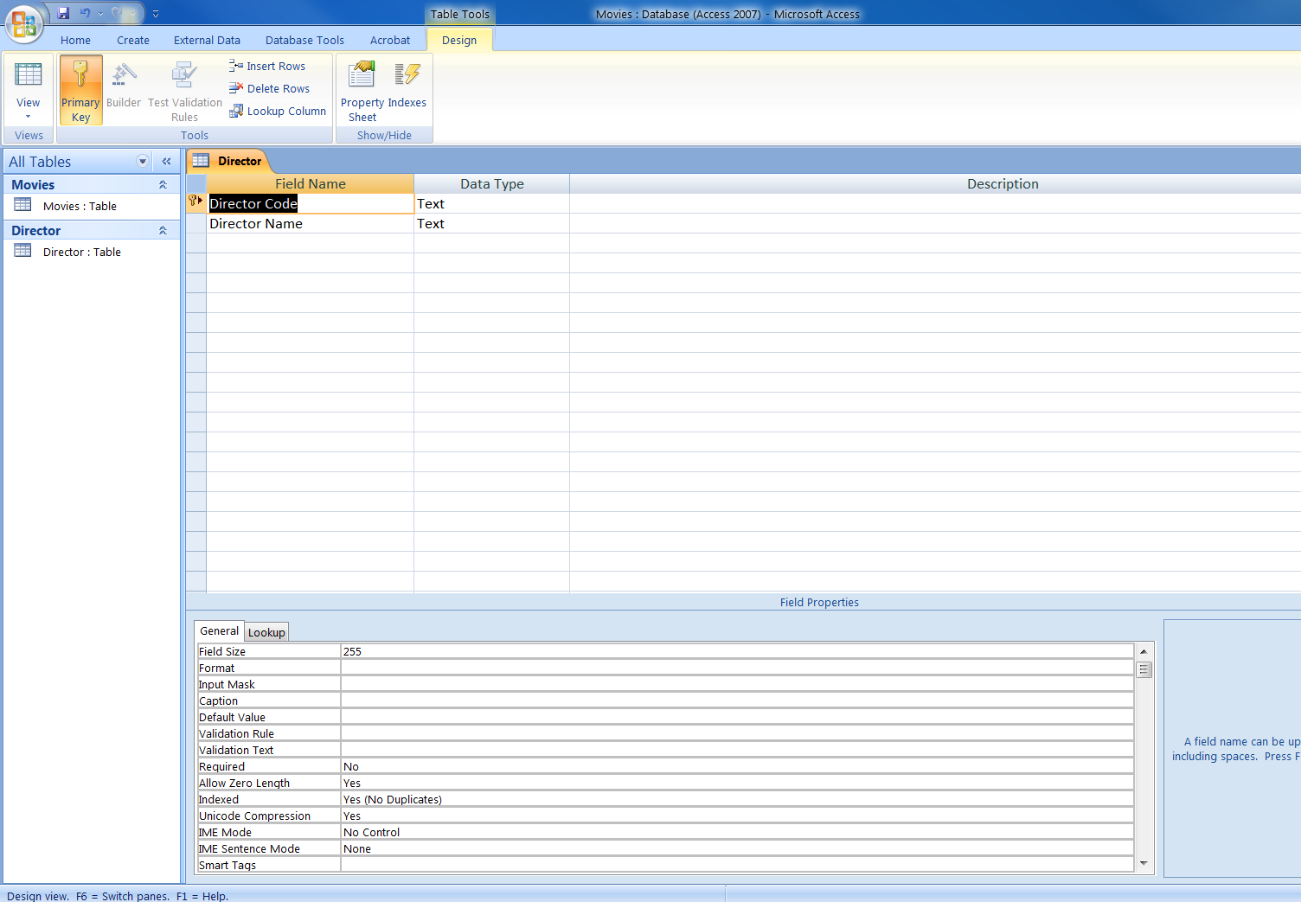
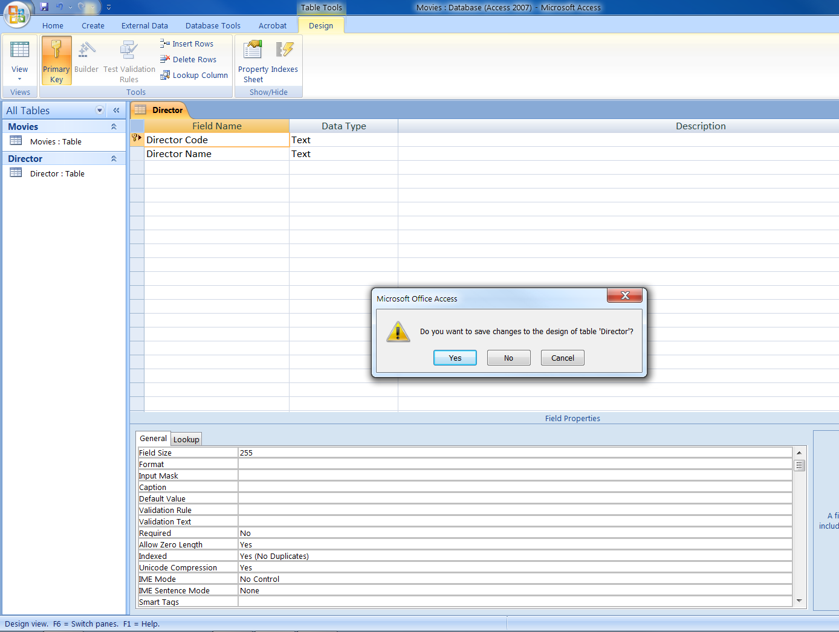
2) Click on
Primary Key
Click in
Row selector

Slide 39
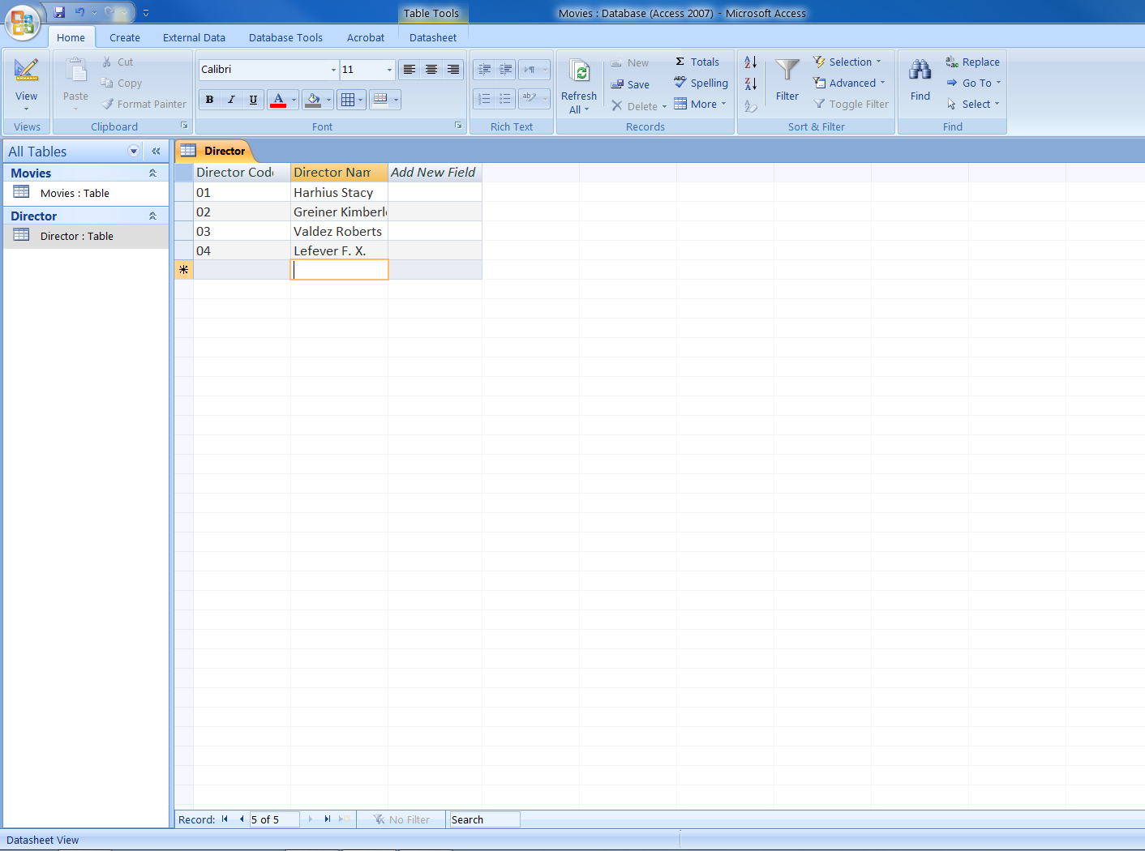
Type in
all the
records

Slide 40
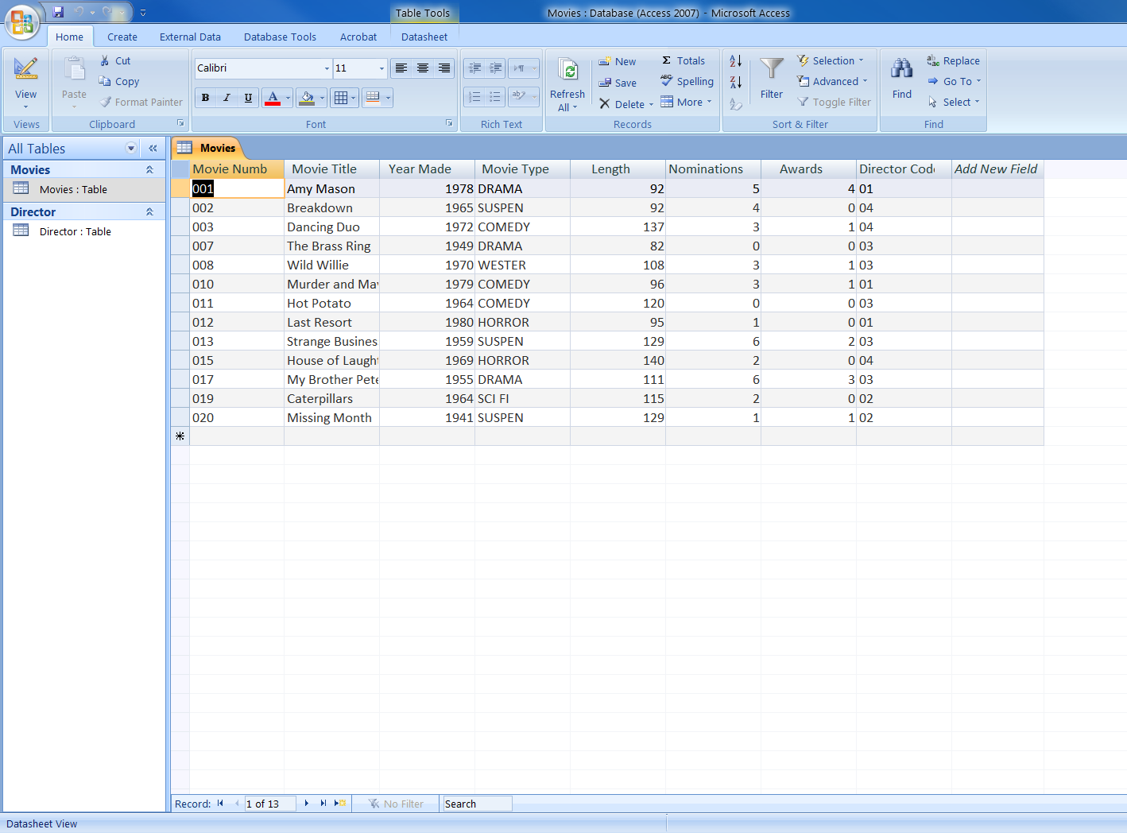

Slide 41
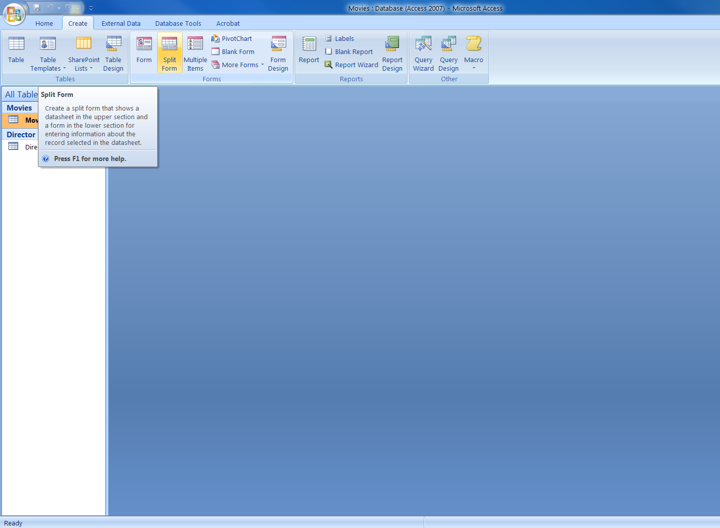

Slide 42
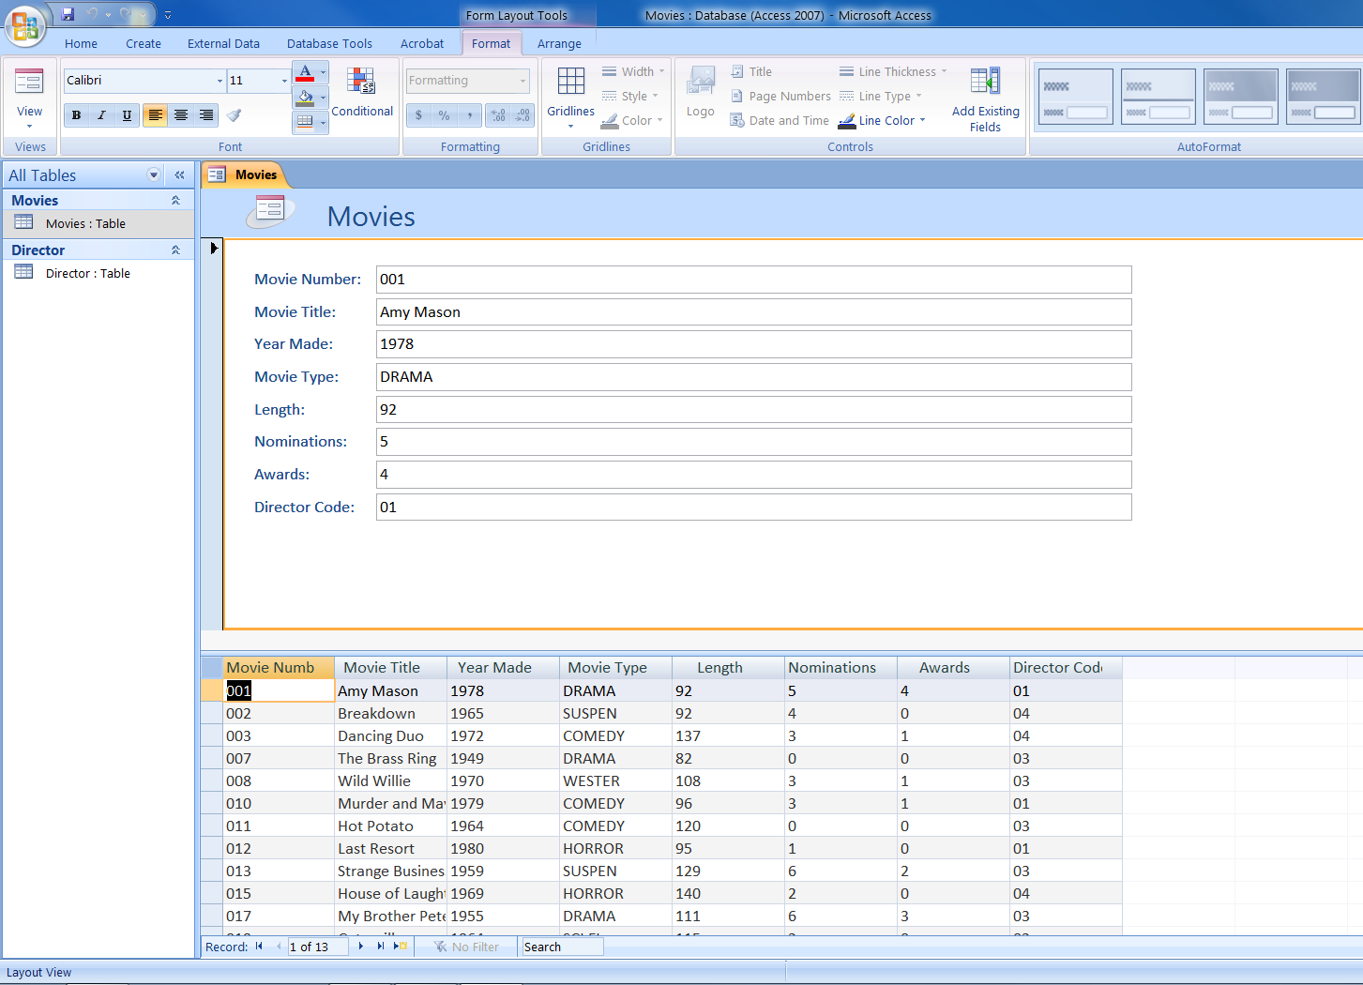
Here’s a Split
Form

Slide 43
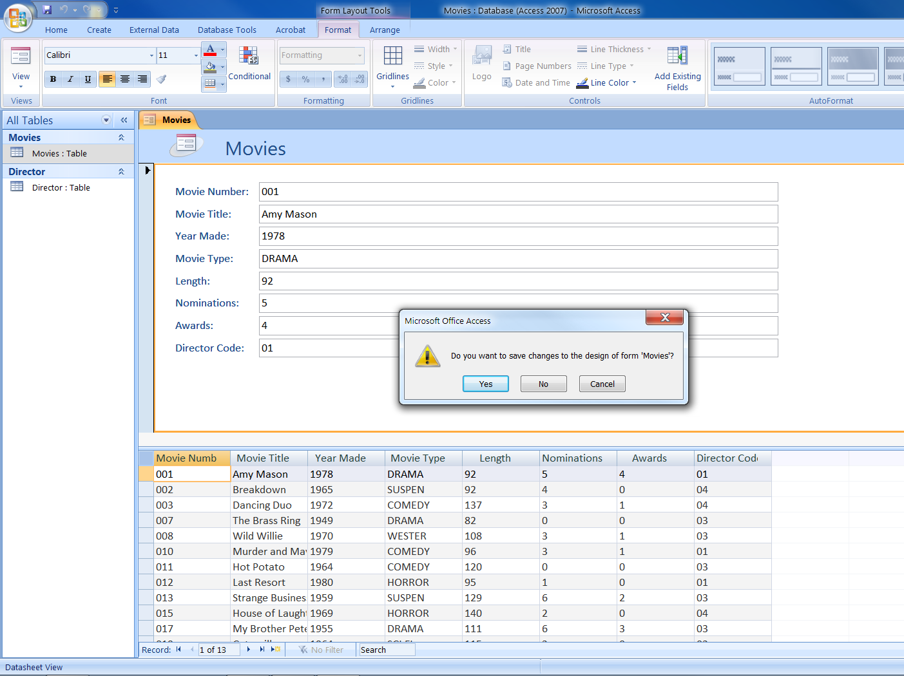

Slide 44
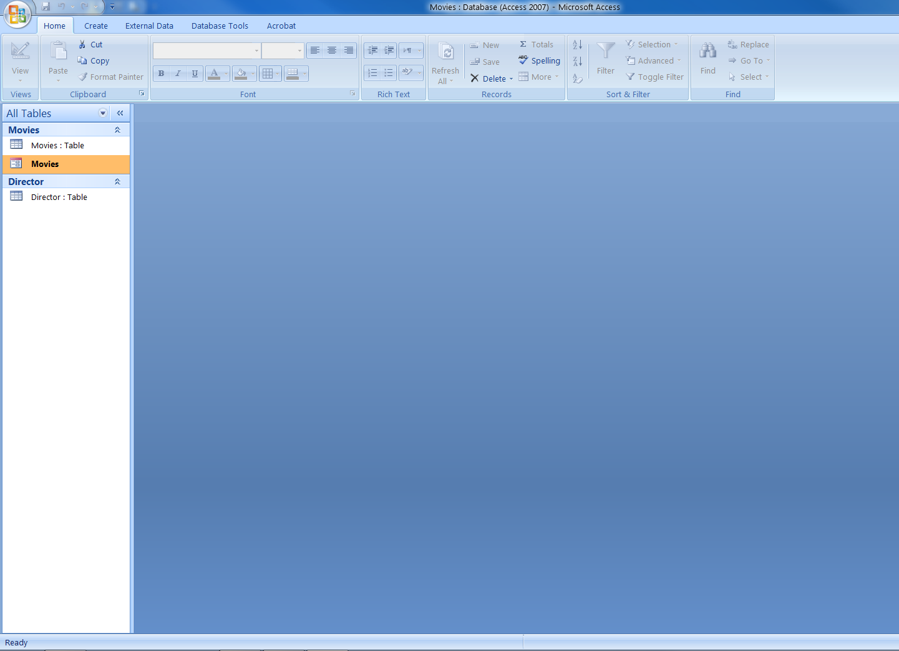
Here is the
Movies Form

Slide 45
Summary
We have learnt what is a Database.
What is a Database Management System.
We have learnt that RECORDS are essentially ROWS in a table.
And FIELDS are essentially COLUMNS in a table.
A PRIMARY KEY is simply a field used as the Unique Identifier.

Slide 46
(contd.)
Create a Table
Save a Table
Add Records to a Table
Modify Tables in Design View
Create a Split Form

