Slide 1
Access Tutorial 1
Creating a Database

Slide 2
Objectives
Learn basic database concepts and terms
Explore the Microsoft Access window and Backstage view
Create a blank database
Create and save a table in Datasheet view
Enter field names and records in a table datasheet
Open a table using the Navigation Pane

Slide 3
Objectives
Open an Access database
Copy and paste records from another Access database
Navigate a table datasheet
Create and navigate a simple query
Create and navigate a simple form
Create, preview, navigate, and print a simple report
Learn how to compact, back up, and restore a database

Slide 4
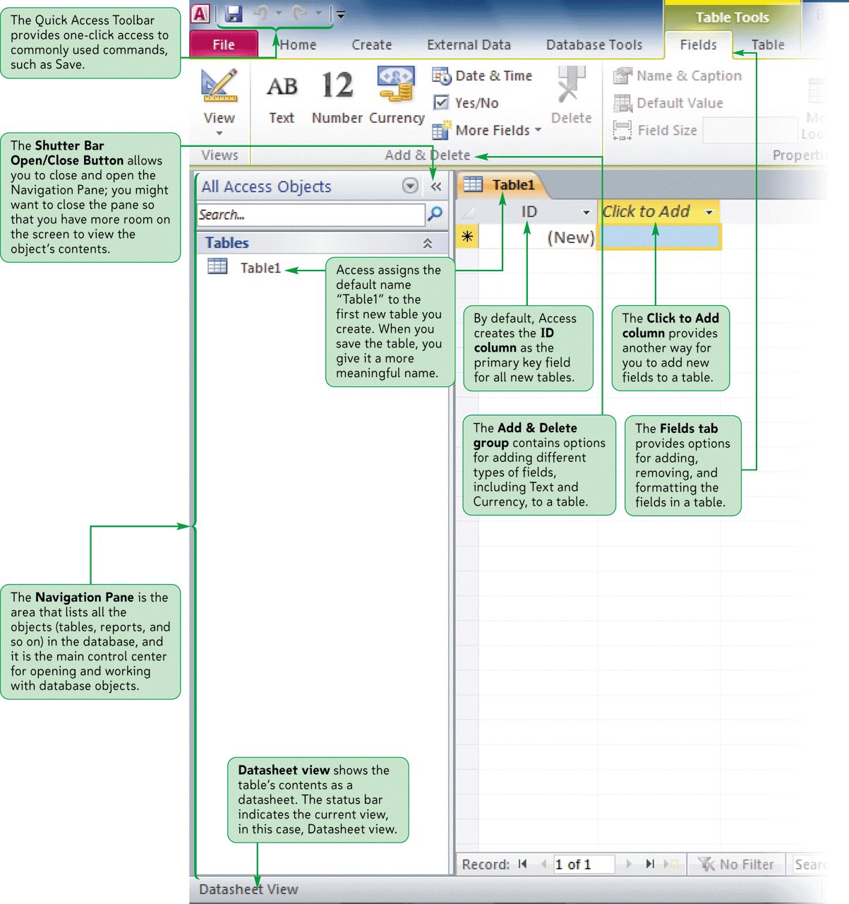
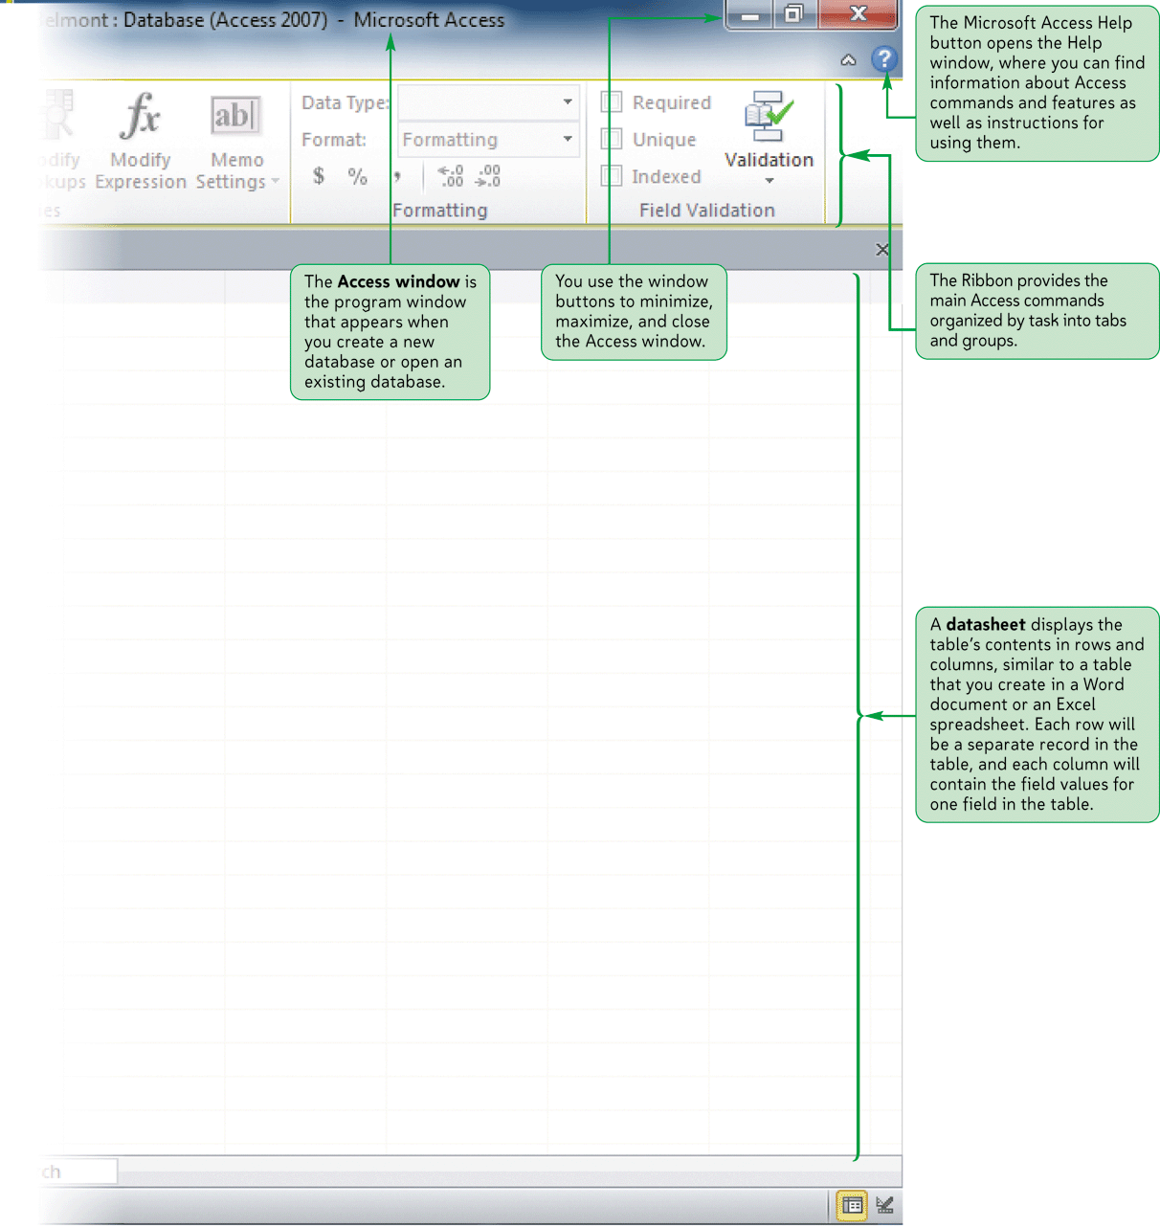
The Access Window

Slide 5
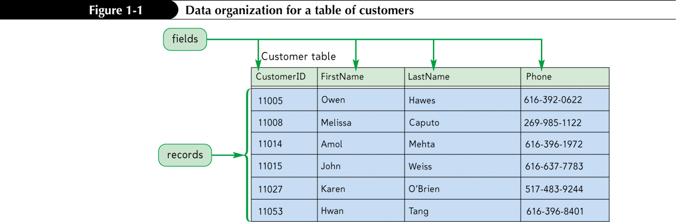
Organizing Data
Your first step in organizing data is to identify the individual fields
  The specific value, or content, of a field is called the field value
  A set of field values is called a record
Next, you group related fields together into tables

Slide 6
Databases and Relationships
A collection of related tables is called a database, or a relational database
You connect the records in the separate tables through a common field
A primary key is a field, or a collection of fields, whose values uniquely identify each record in a table
When you include the primary key from one table as a field in a second table to form a relationship between the two tables, it is called a foreign key in the second table

Slide 7
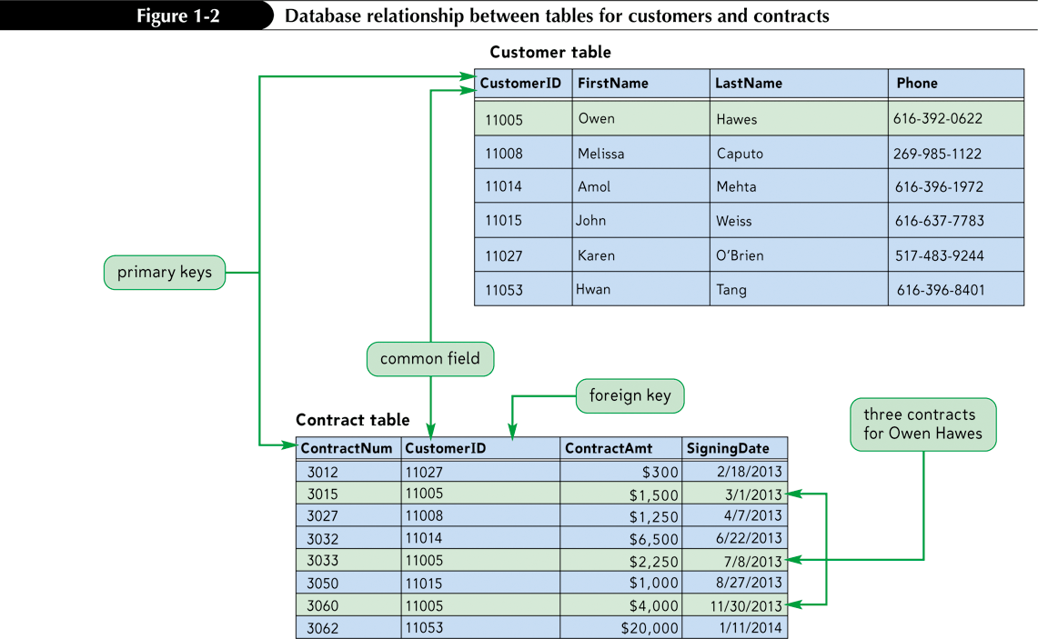
Databases and Relationships

Slide 8
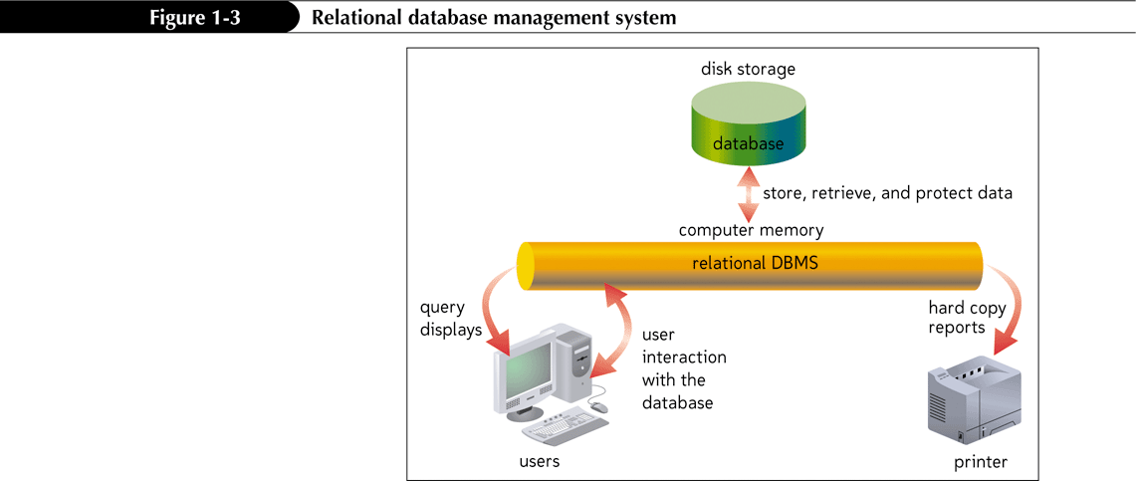
Relational Database Management Systems
A database management system (DBMS) is a software program that lets you create databases and then manipulate data in them
In a relational database management system, data is organized as a collection of tables

Slide 9
Creating a Table in Datasheet View
Click the Create tab on the Ribbon
In the Tables group, click the Table button.
Accept the default ID primary key field with the AutoNumber data type, or rename the field and change its data type, if necessary.
In the Add & Delete group on the Fields tab, click the button for the type of field you want to add to the table (for example, click the Text button), and then type the field name. Repeat this step to add all the necessary fields to the table

Slide 10
Creating a Table in Datasheet View
In the first row below the field names, enter the value for each field in the first record, pressing the tab or Enter key to move to the next field
After entering the value for the last field in the first record, press the Tab or Enter key to move to the next row, and then enter the values for the next record. Continue this process until you have entered all the records for the table
Click the Save button on the Quick Access Toolbar, enter a name for the table, and then click the OK button

Slide 11
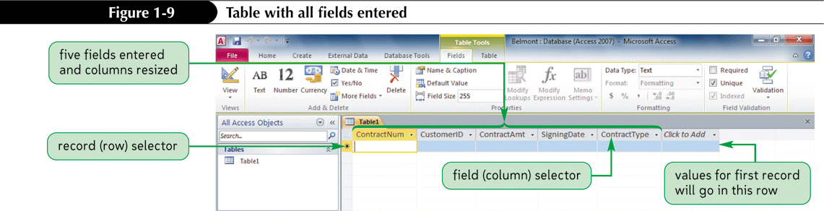
Creating a Table in Datasheet View

Slide 12
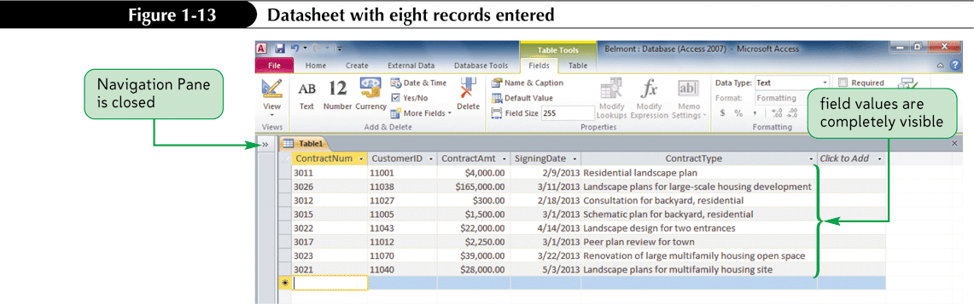
Entering Records

Slide 13
Saving a Table
Click the Save button on the Quick Access Toolbar. The Save As dialog box opens
In the Table Name text box, type the name for the table
Click the OK button

Slide 14
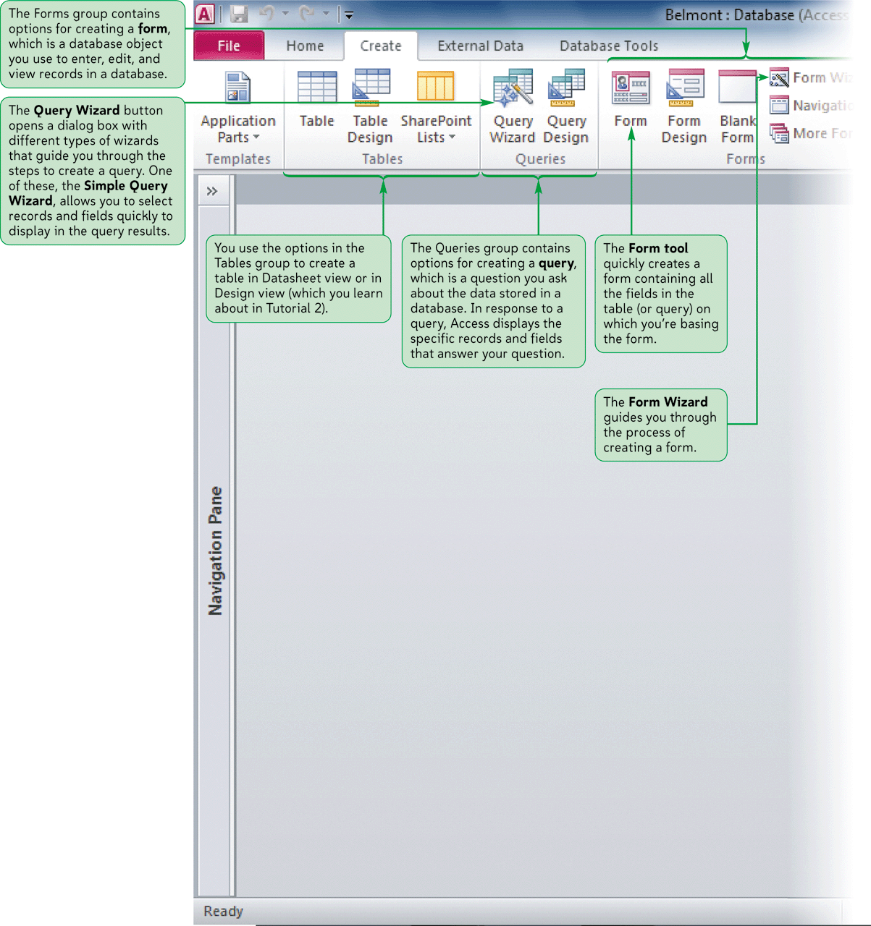
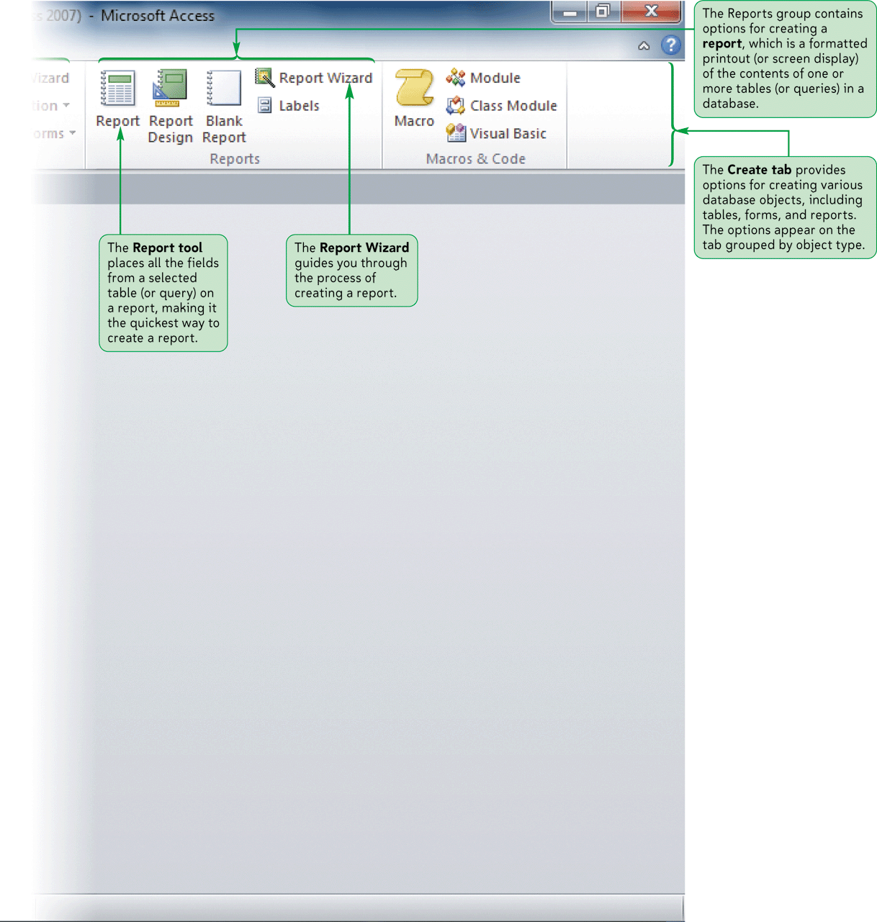
The Create Tab Options

Slide 15
Opening a Database
Start Access. If necessary, click the File tab to display Backstage view
Click the Open command in the navigation bar to display the Open dialog box
Navigate to the database file you want to open, and then click the file
Click the Open button

Slide 16
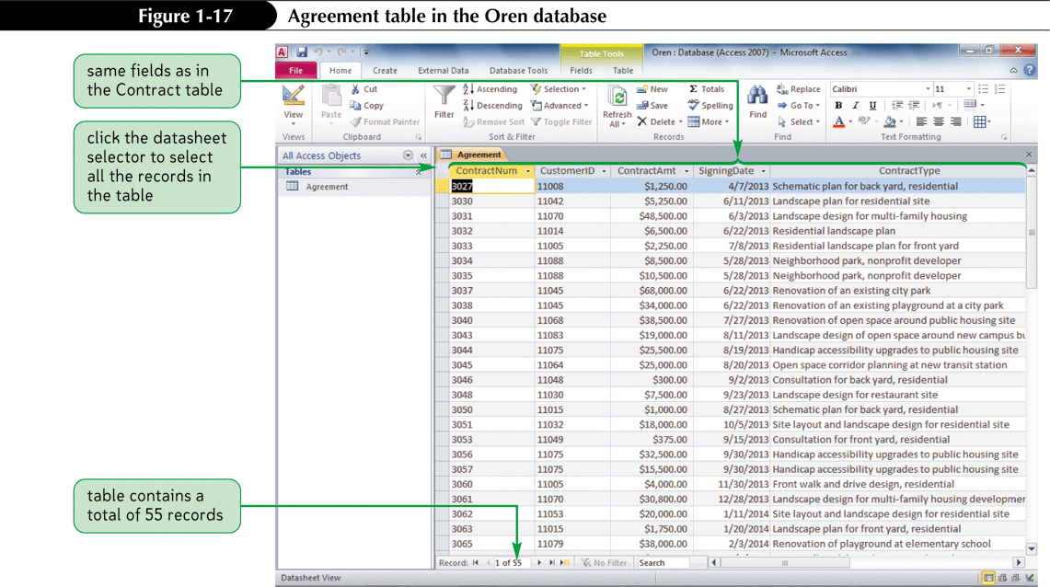
Opening a Database

Slide 17
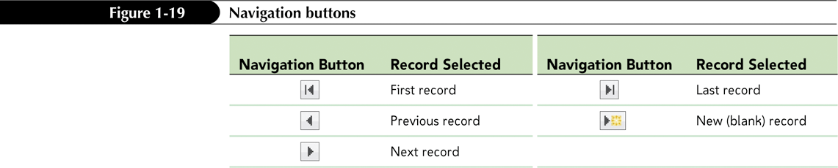
Navigating a Datasheet
The navigation buttons provide another way to move vertically through the records

Slide 18
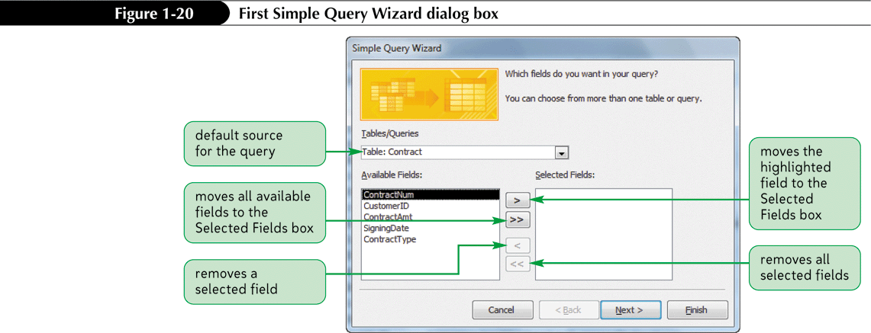
Creating a Simple Query
A query is a question you ask about the data stored in a database
The Simple Query Wizard allows you to select records and fields quickly

Slide 19
Creating a Simple Form
A form is an object you use to enter, edit, and view records in a database
You can design your own forms, use the Form Wizard, or use the Form tool to create a simple form quickly and easily

Slide 20
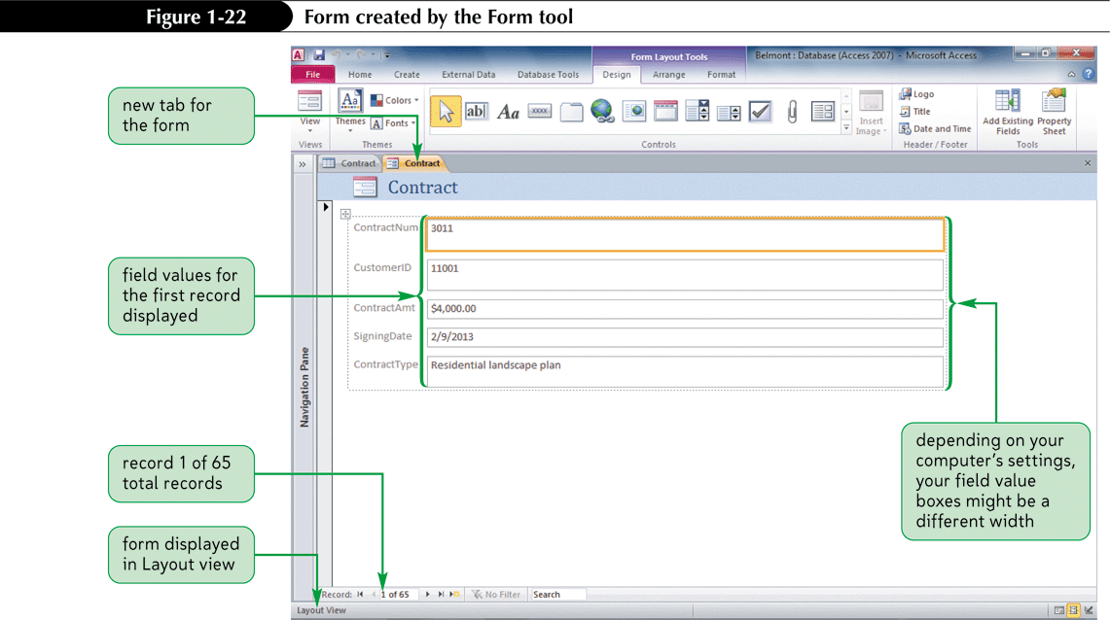
Creating a Simple Form

Slide 21
Creating a Simple Report
A report is a formatted printout (or screen display) of the contents of one or more tables in a database
The Report tool places all the fields from a selected table or query

Slide 22
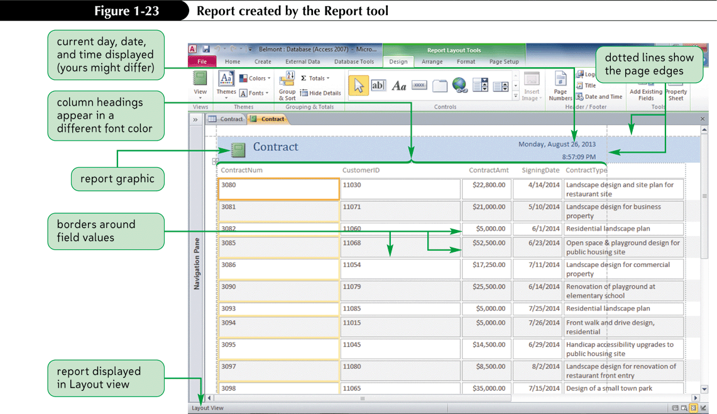
Creating a Simple Report

Slide 23
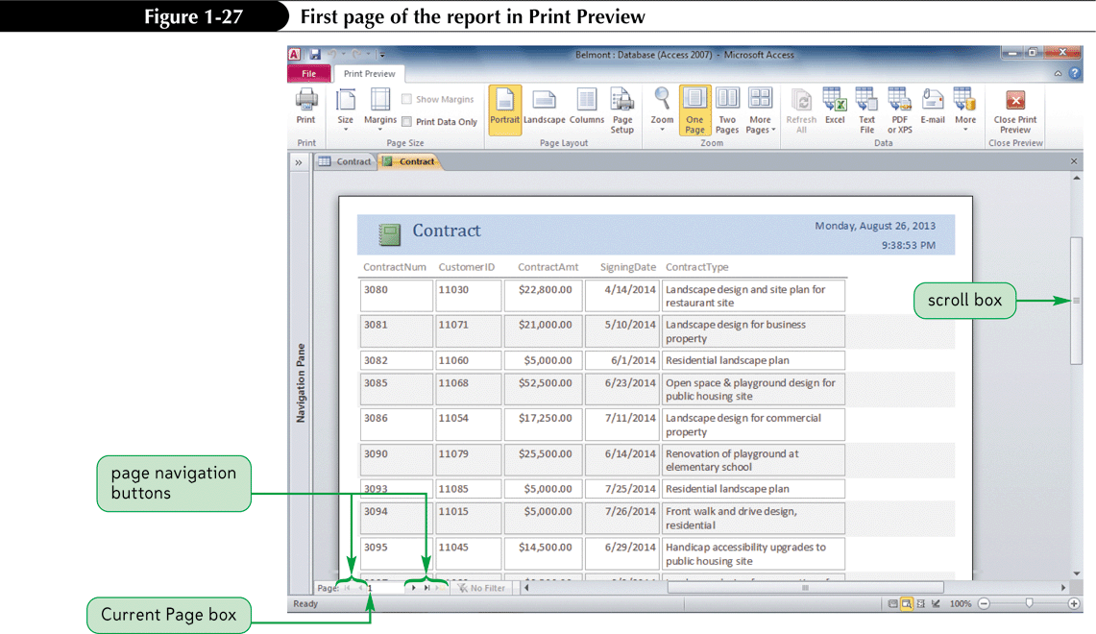
Creating a Simple Report

Slide 24
Printing a Report
Open the report in any view, or select the report in the Navigation Pane
To print the report with the default print settings, click the File tab to display Backstage view, click the Print tab, and then click Quick Print
or
To display the Print dialog box and select the options you want for printing the report, click the File tab, click the Print tab, and then click Print (or, if the report is displayed in Print Preview, click the Print button in the Print group on the Print Preview tab)

Slide 25
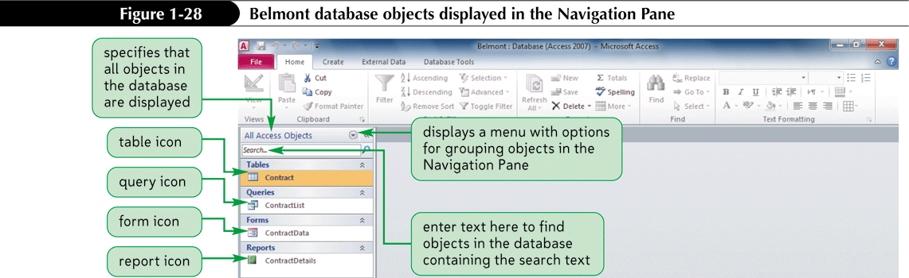
Viewing Objects in the Navigation Pane

Slide 26
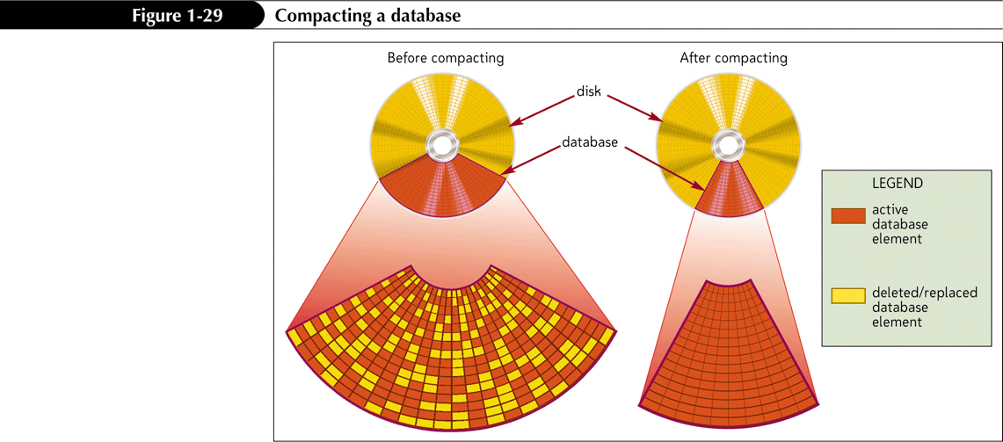
Compacting and Repairing a Database
Compacting a database rearranges the data and objects in a database to decrease its file size

Slide 27
Compacting and Repairing a Database
Make sure the database file you want to compact and repair is open
Click the File tab to display Backstage view
Make sure the Info tab is selected in the navigation bar
Click the Compact & Repair Database button

Slide 28
Backing Up and Restoring a Database
Backing up a database is the process of making a copy of the database file to protect your database against loss or damage
The Back Up Database command enables you to back up your database file from within the Access program, while you are working on your database

