Slide 1
“Saving the Planet One Tree at a Time”
ANDREW G. STEEL Chief Executive Officer THE TREEDOM GROUP
andrew.steel@thetreedomgroup.com

Slide 2
Outline
Who we are, what we do, projects, Our SUCCESS
Overview of the Treedom group
How we can help
Framework species restoration:
Multiple species, economic development, commercial options

Slide 3
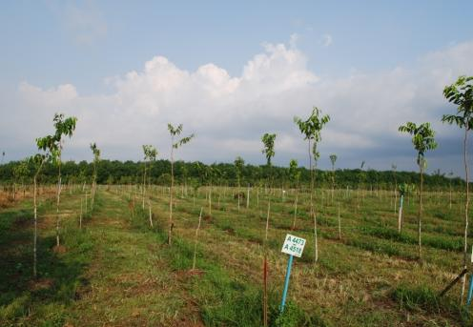
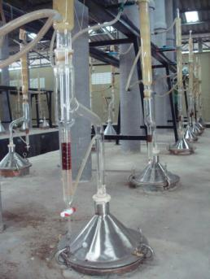
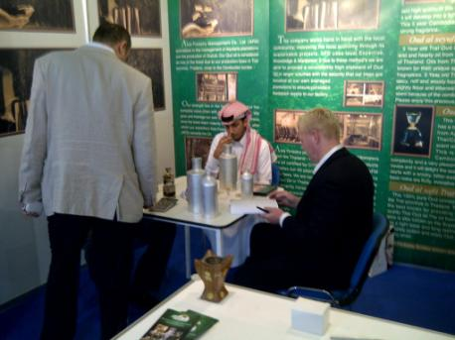
Group Overview
Asia Forestry Management - Plantation management company in South East Asia focusing on Aquilaria tree species and the production of High Grade Oud Oil at our subsidiary company, Asia Forestry Distillery based in Trat Province Thailand.
PLANTATIONS
DISTILLATION
DUBAI EXHIBITION

Slide 4
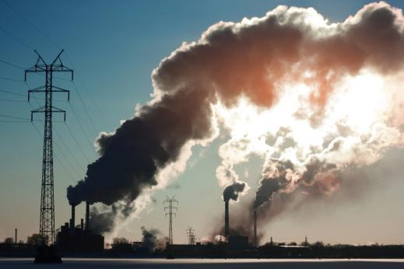
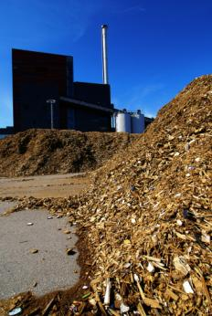
Group Overview
Equitech (Thailand) - Project Consultancy, due diligence and Management Specialists focusing on forestry , renewable resources and forest carbon.
POLLUTION
RENEWABLE ENERGY
CONSULTANCY SERVICES

Slide 5
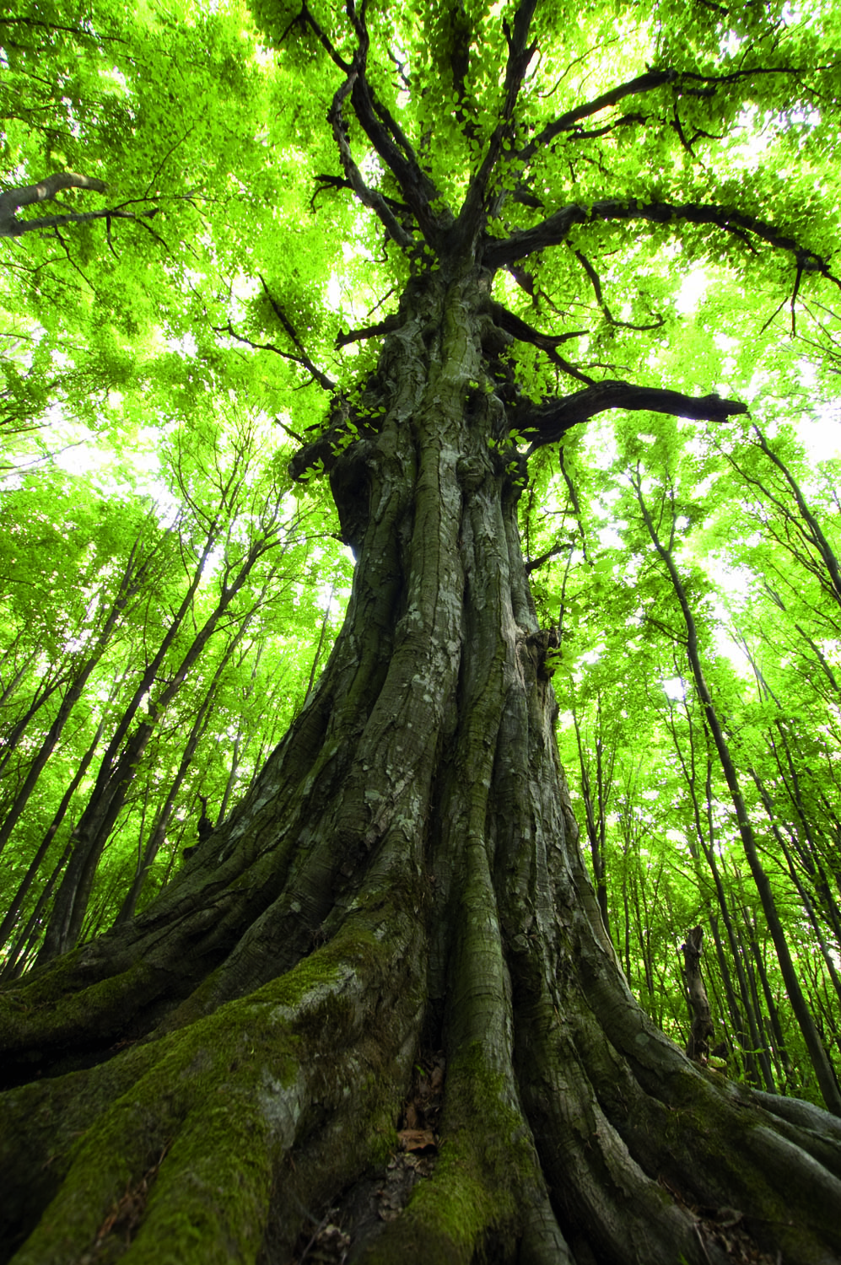
Group Overview
Treedom Investments - Investment advisor in the renewable resources sector and advisor to the Asia Renewable Resources
Fund (ARRF). The Fund is a Luxembourg domiciled and regulated SICAV SIF fund appropriate for institutions and ‘well-informed’ investors only. The Investment Objective of the fund is to provide good growth potential via a portfolio of diversified exposure to Asian forestry assets whilst protecting the interests of investors, local communities and the environment.

Slide 6
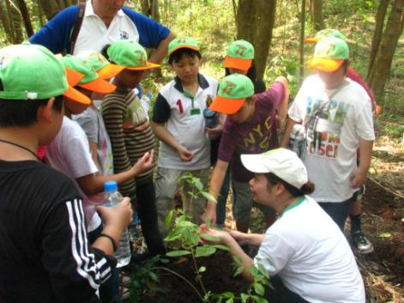
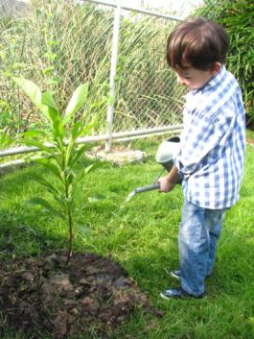
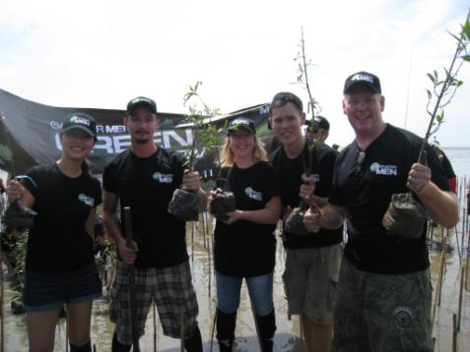
Group Overview
Plant A Tree Today Foundation (PATT) - UK Registered Charity and Thai Foundation with a projects in Thailand, Indonesia, India and South Africa. PATT works to raise awareness of global environmental issues, campaign for better environmental practices and take action against deforestation and climate change by planting trees.
ECOKIDS CAMP
SCHOOL NURSERY
PLANTING MANGROVES

Slide 7
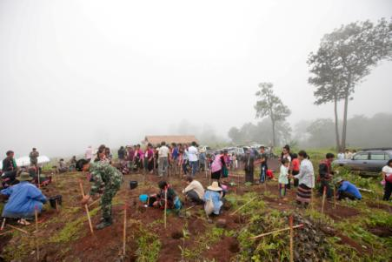
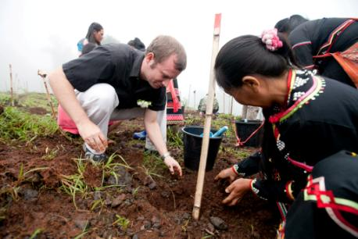
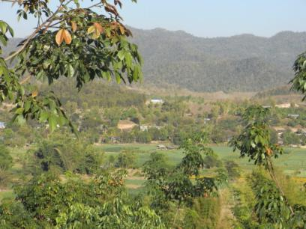
Six Senses Reforestation Project
PATT Foundation, Equitech and Six Senses Resort & Spa has engaged to implement one of Asia’s largest reforestation projects launched in August 2011.
330,000 seedlings of 30 different tree species to be planted annually
Bought from 200 different small village nurseries.
90 local villagers from three hill tribes and 200 military officers were engaged in the planting.

Slide 8
Project Objectives
Offsetting up to 180,000 tonnes of carbon emissions per year
84% of Six Senses carbon footprint is air travel
Forest restoration using framework species
Local community involvement

Slide 9
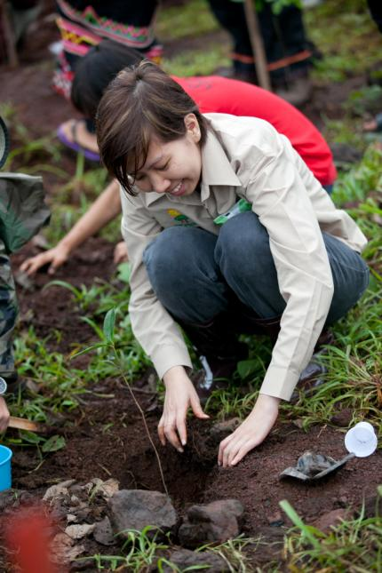
Project Highlights
5,000 Rai (800 ha) of degraded forest to be restored in Sri Lanna National Park
Doi Pa Ma first site (500 Rai – 80 ha) – ex-manganese mine
2 local hill tribe communities involved - Lahu and Musa
250 local personnel involved and 200,000 trees planted
14 indigenous tree species planted
30 species planned in total
Organic fertilizer
Polymer gel to reduce tree dehydration (dry season)
10 meter wide firebreaks and 24/7 watch
Environmental training provided and indirect forest restoration benefits outlined for local people
PRAs (Participatory Resource Assessment) conducted and collection of social, economical and land-use data

Slide 10
Economic Development
- Local employment - Support small business - Certified emission reduction credits - Creation of infrastructure - Strengthening energy sectors

Slide 11
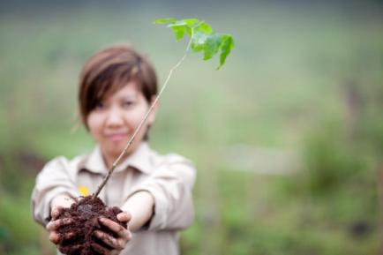
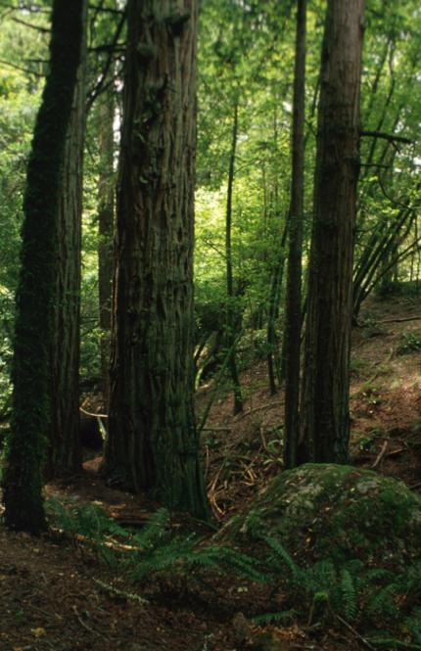
Framework Species Restoration
The framework species method of forest restoration involves planting 20-30 indigenous tree species specially selected for their ability to rapidly shade out weeds and attract seed-dispersing wildlife (FORRU, 2006). Birds and mammals, attracted to the plots, bring with them the seeds of many other forest trees and thus help to re-establish a species-rich forest tree community similar to that of the original forest. Planted trees restore forest structure, whilst the animals attracted to them restore biodiversity.
Seedlings are propagated in a nursery within close proximity to the planting site and existing forest cover. Seeds are selected from any nearby forest for germination within the nursery.

Slide 12
How the Framework Species Method Works
Framework species selection
Planting 20-30 framework species:
weeding & fertiliser application for 2 years
Weeds shaded out, site recaptured
Recovery of ecological functioning:
Litter accumulation
Nutrient cycling
Fruits and other foods
Positive Feedback
Forest structure re-established (multi-layered canopy)
Conditions for seed
germination & seedling
survival improved
Seed-dispersing wildlife attracted
Positive Feedback
Increased seed rain
Recruitment: natural re-establishment of non-planted tree species
Biodiversity recovery
Original forest restored

Slide 13
How the Framework Species Method Works
Framework species selection
Planting 20-30 framework species:
weeding & fertiliser application for 2 years
Weeds shaded out, site recaptured
Recovery of ecological functioning:
Litter accumulation
Nutrient cycling
Fruits and other foods
Positive Feedback
Forest structure re-established (multi-layered canopy)
Conditions for seed
germination & seedling
survival improved
Seed-dispersing wildlife attracted
Positive Feedback
Increased seed rain
Recruitment: natural re-establishment of non-planted tree species
Biodiversity recovery
Original forest restored

Slide 14
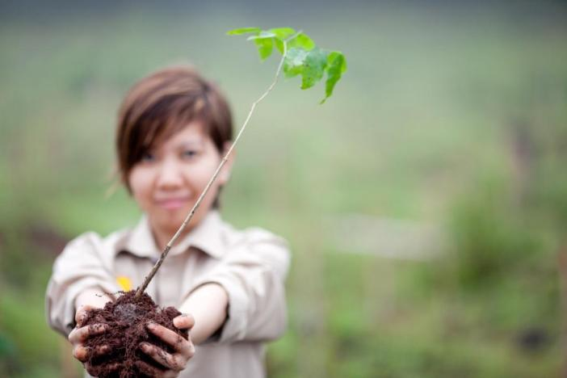
How we can help
Forestry Consultancy
Nursery Establishment & Management
Plantation Management
Forestry Asset Management
Reforestation Development
Carbon Offsetting Consultancy
Renewable Energy Projects

Slide 15
Options
Technical Assistance/Consultancy
Sub Contract Projects
Project Development
Project Management
Land/Project Options
Land availability for projects
Commercial or Reforestation
Investment into ARRF and routed back into projects in Thailand

Slide 16
THANK YOU
ANDREW G. STEEL Chief Executive Officer THE TREEDOM GROUP
andrew.steel@thetreedomgroup.com

