Slide 1
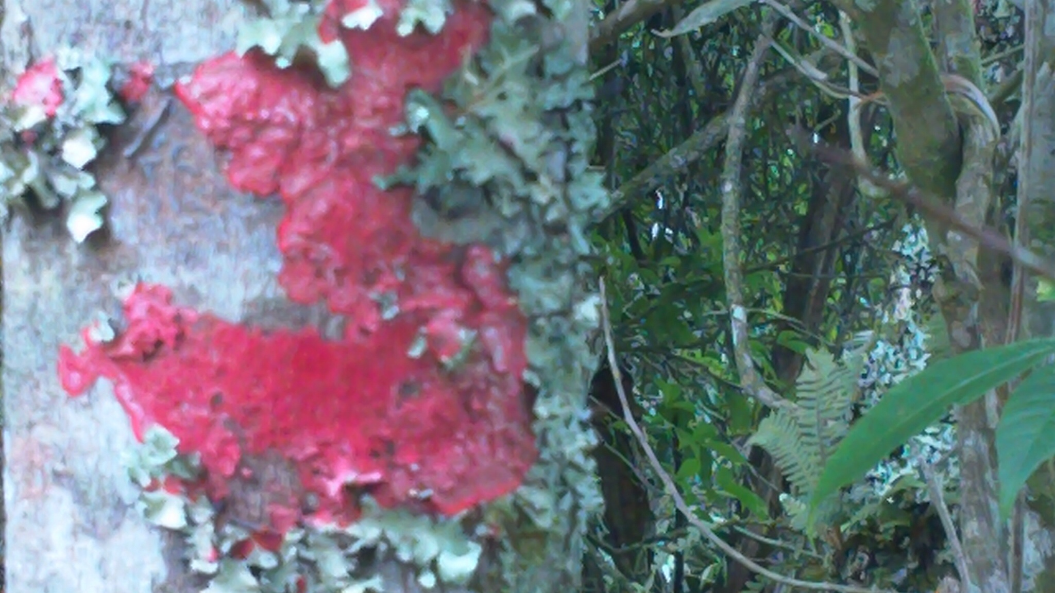
Biological Indicators
LICHENS IN RAINFORESTS

Slide 2
Introduction
Biological indicators are species :
used by observers to determine how various conditions in an environment have changed over time.
used to monitor the health of an environment or ecosystem.
That can tell us about the cumulative effects of different pollutants in the ecosystem and about how long a problem may have been present, which physical and chemical testing cannot.
A biological monitor, or biomonitor, can be defined as an organism that provides quantitative information on the quality of the environment around it. Therefore, a good biomonitor will indicate the presence of the pollutant and also attempt to provide additional information about the amount and intensity of the exposure.

Slide 3
Properties of Bioindicators
Good indicator ability
Provide measurable response (sensitive to the disturbance or stress but does not experience mortality or accummulate pollutants directly from their environment)
Response reflects the whole population/community/ecosystem response
Respond in proportion to the degree of contamination or degradation
Abundant and common
Common, including distribution within area of question
Relatively stable despite moderate climatic and environmental variability
Well-studied
Ecology and life history well understood
Taxonomically well documented and stable
Easy and cheap to survey
Economically/commercially important
Species already being harvested for other purposes
Public interest in or awareness of the species.

Slide 4
PLANTS AS BIOINDICATORS
Plants can effectively be used as cheap and naturally available monitoring systems or bioassays of the level and type of air, soil and water pollution in an area. The type and concentration of a pollutant can be reliably found out by various characteristics damage symptoms produced in the plants because such damage symptoms are pollutant specific as well as concentration specific.
For example, in young needles of Pinus, chlorois indicates SO₂pollution, necrosis indicates HF pollution, beaching indicates NO₂ pollution while chlorotic mottle indicates Cl₂ pollution in the atmosphere. These characteristic symptoms of damage in young pine needles appear only when concentration is 0.3 ppm for SO₂, 0.07 ppm for HF and 1.0 ppm for Cl₂. Similarly, browning in moss leaves due to fluoride accumulation is 5% in 65 ppm dry weight accumulation but rises to 90% in 4500 ppm dry weight accumulation. However, certain precautions have to be taken while using plants as pollution indicators.

Slide 5
Precautions in use of plants as
pollution indicators
The damage symptoms in plants should preferably be studied in the local native species. Cultivated and introduced species should be avoided.
The species sensitive to pollutants should be first identified in the local flora and then used for pollution monitoring. Tolerant species should be identified and avoided in such work.
Damage symptoms for a particular pollutant should be studied in different species sensitive to that pollutant so that presence of the pollutant in the area may be cross-checked. For example, grey necrosis in Geranium, ivory necrosis in Zinnia, brown necrosis in Chrysanthemum and reddish necrosis in Azalea indicates absolutely certain presence of SO₂ pollution in the area.
Many types of damage symptoms viz. morphological, anatomical, ultra-structural physiological, biochemical etc. should be studied in one or more sensitive plant species to ascertain the presence of a particular pollutant in the area.
Samples should be taken from as many different sites in the area as possible. From such data the extent of pollution can be determined and the possibility of symptoms being due to some pathogen is also excluded because the intensity of damage symptoms due to pollution varies in different sites according to the distance from the source of pollution while it is same in all sites in case of a pathogenic disease.
The possibility of damage symptoms in plants occurring due to some cause other than pollution e.g. due to pathogen, environmental condition or nutritional deficiency/excess should be thoroughly checked and ruled out.

Slide 6
Important characteristics of plant species used in pollution monitoring
The plant species used to monitor pollution in an area should have certain important features for the success of such programme. Most important such features are:
Species should be easy to identify in the field and easy to handle for damage analysis.
Species should have a wide range of distribution so that it can be used in different areas.
Species should be sensitive to many types of pollutants so that it can be used to monitor different types of pollutants in the area.
Species should produce highly specific damage symptoms in response to particular types and concentrations of pollutants.

Slide 7
Methods of using plants as pollution
indicators/monitors
Vegetational analysis-
Decrease in the densities of sensitive species, increase in the density of tolerant species. Absence of highly sensitive species, changes in the species composition of vegetation and distribution pattern of populations in the area are studied. Such studies indicate the type and concentration of pollutant(s) as well as the spread of the pollution problem in the area.

Slide 8
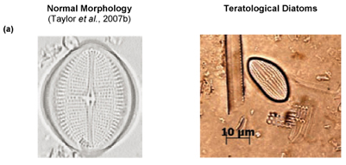
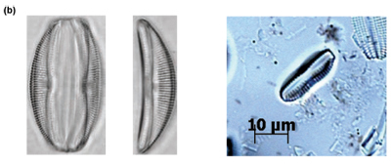
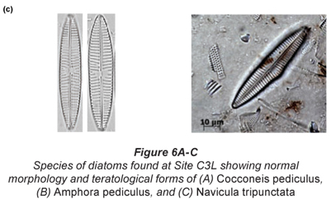
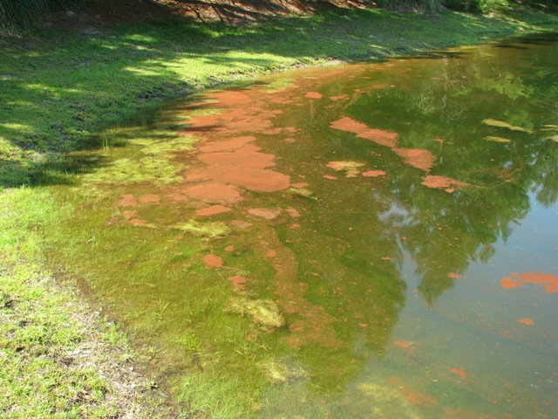
In freshwater bodies:
Changes in diatom community, decrease in plankton algae and aquatic hydrophytes and spread of Sphagnum moss indicate increased water acidity. Specific changes in the aquatic flora can indicate the pH of the water quite correctly.
Eutrophication and water blooms indicate sewage, organic matter and chemical fertilizer pollution of water.
Streams of the Kathmandu Valley had a higher percentage of pollution tolerant species than streams of the Middle Hills

Slide 9
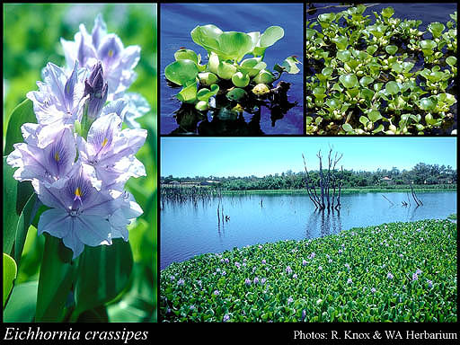
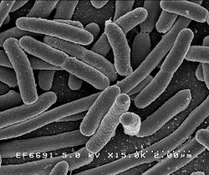
Abundance of Eichhornia indicates sewage and heavy metal pollution of water.
Increase in E. coli and aerobic decomposer bacteria indicates water pollution due to organic sewage.
E.coli

Slide 10
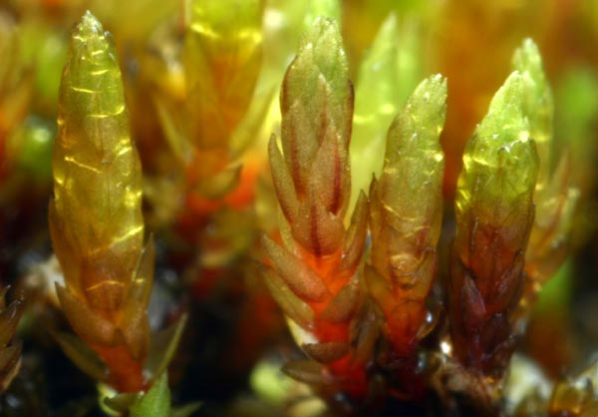
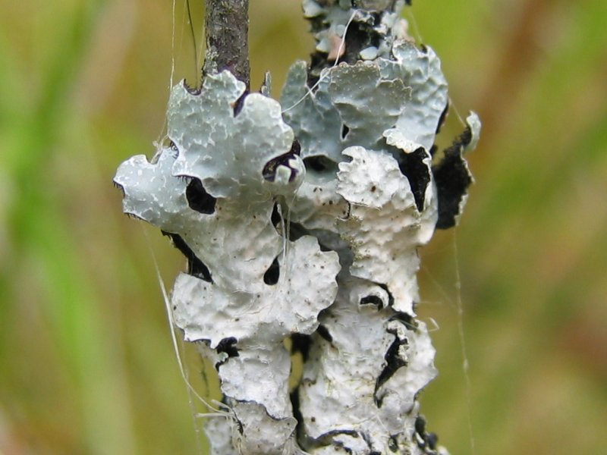
In terrestrial areas:
Decrease in the populations of mosses (Sphagnum , Bryum) and lichens (Parmelia) generally indicates air pollution by SO₂, NO₂, fluorides and HCl. Absence of most bryopytes , particularly Sphagnum and Bryum indicates atmospheric SO₂ pollution of 0.17 ppm or more. Poikilohydrous mosses are particularly useful as pollution indicators.
Changes in sensitive species of herbs and grasses occur much earlier than in shrub and tree populations. Generally, the degree of ‘Crown die-back’ and death of trees is directly related to the level of SO₂, NO₂ HF and HCl pollution of air.
Changes in soil microorganism populations indicate soil pollution. Increase in ammonifying bacteria shows NH₄ pollution, reduction in nitrate and nitrite bacteria shows NO₃ pollution, decrease in decomposer bacterial populations indicates soil acidification and pesticide pollution.
Bryum dyffrynense
Parmelia sulcata

Slide 11
Physiological and yield analysis
The rates of growth, photosynthesis, respiration, enzyme activities, percentage flowering, yield of fruits and seeds, percentage of seedling mortality in sensitive species are important characteristics that are very helpful in determining the type and level of pollution in an area because these show highly characteristic and specific changes even before other morphological or vegetational changes appear. In general, pollution is indicated by increased rate of respiration, decreased rate of photosynthesis, stimulation of the activity of catabolic enzymes, decrease or inhibition of the activities of anabolic enzymes, reduced flowering and seed output and increased seedling mortality.
Analysis of visible injury symptoms
Leaves of sensitive species generally produce highly specific and characteristic visible injury symptoms in response to pollutants. The study of such symptoms can reliably indicate the type and level of pollutant(s) present in the environment. For such analysis, leaves of same age are collected at same time of the day and at different localities in the area from plants of a particular sensitive species. Most common symptoms studied are chlorosis, necrosis, discolouration, tip-burn, bleaching, bronzing, stipples and mottles in the leaves. Characteristic colours and patterns of these symptoms in particular plant species indicate the type and level of pollutant present.
Histological analysis
In some plant species, specific pollutants cause highly characteristic damage to cells and tissues. The careful analysis of the type and degree of such cell/tissue damage in the sections of various plant parts is very useful indicator of pollution problem. For example, fluorides cause highly specific injury in the cells and tissues of pine needles.
Ultra-structural analysis
Pollution can also be monitored by study of specific injury symptoms in the cell organelles, particularly chloroplasts, mitochondria and cell membranes. For example, SO₂ pollution causes membrane damage in moss Sphagnum, chloroplast degradation and membrane damage in mosses Grimmia pulvinata andHypnum cupressiforme while Pb pollution is indicated by presence of electron-dense vesicles containing lead in the cells of moss Rhytidiadelphus squarrosus.

Slide 12
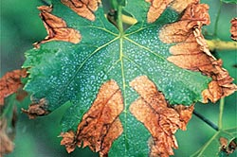
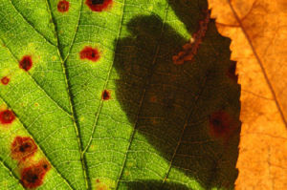
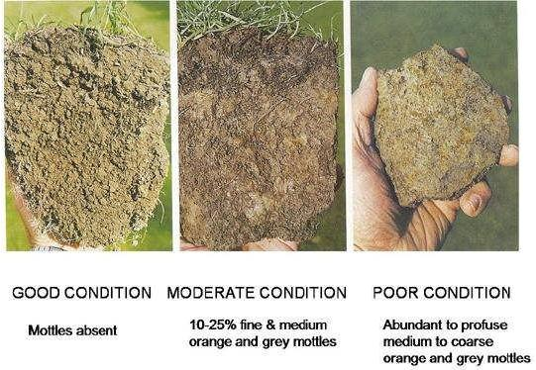
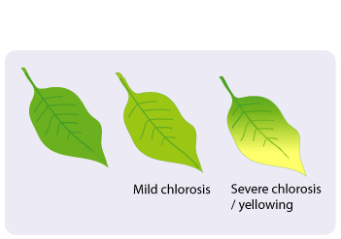

Slide 13
Chemical analysis
Accumulation of characteristic substances in different plant parts can also indicate the type and level of pollution in the environment.
S/N ratio: Sulphur is accumulated in the pollution of SO₂ and H₂S and nitrogen content is increased in NO_{x} and NH₃ pollution in the leaves and twigs of sensitive plant species. As SO₂ and NO_{x} are usually present together as air pollutants, sulphur to nitrogen ratio (S/N ratio) is a very useful indicator of their relative proportion in the atmosphere.
Amino acid content: Increase of amino acids (particularly glutamine and asparagines) in the leaves by a factor of 10 than the normal shows NH₃pollution while increase by a factor of 2 indicates NO₂ or SO₂ pollution in the atmosphere.
Pigment analysis: The presence of degradation products of certain pigments and absence of others in the leaves damaged by pollution can also indicate pollution. For example, absence of carotenes and specific zones of chlorophyll degradation products in the chromatograms indicates NO₂pollution but the presence of carotenes with chlorophyll degradation products shows SO₂ pollution.
Bark acidity: Air pollution by SO₂ an HF can usually be related with the level of bark acidity. Dicotyledonous trees are better for such analysis than coniferous trees but Scots pine has been successfully used for bark acidity analysis.

Slide 14
Metal accumulation : Many plants can absorb and accumulate different metals from their environment. Analysis of plant tissues for identifying the type and level of metal accumulated is very useful in study of metal pollution problem in the soil, air and water. For example, Willow, birch and poplar accumulate Zn and Cd, Box-elder accumulates boron and tomato accumulates sulphur from the soil. Peat mosses, particularly Sphagnum acutifolium accumulates Zn, Cd and Pb; terricolous carpet-forming mosses like Hylocomium splendens, Pleurozium schreberi and Hypnum cupressiforme accumulate Hg, Ag, Be and other common metal pollutants. Aquatic mosses like Fontinalis antipyretica, Eurhynchium ripariodes, alage like Cladophora, vascular plats like Eichhornia and Azolla are very useful in identification of water pollution by a variety of heavy metals.
Moss bag technique: This technique has been very useful in identifying atmospheric metal pollution. Ten square centimetre flat bags of nylon nets are filled with acid-washed clean Sphagnum acutifolium moss and are suspended on poles or tied to trees at specified heights. The moss absorbs various metal pollutants from the air. After specified time interval, the moss is again acid washed. The types and amounts of metals absorbed by the moss is found out indicating the metal pollution status of the air. These moss bags can be repeatedly used in such metal monitoring work. Similarly, living aquatic moss plants in perspex cylinders or wrapped in nylon nets are secured in the water body at specified depths. Analysis of the metals accumulated and the level of the decay of moss plants is used to identify water pollution by metals.

Slide 15
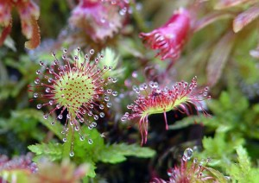
Carnivorous Plants Deeply Affected by Pollution
In a study conducted by Swedish scientists, they took several samples of the roundleaf sundew plant. The sundew is a carnivorous plant that round, fleshy leaves covered in scarlet spines.
Roundleaf sundew plants thrive in low nitrogen areas. Nitrogen is an important plant food that is usually drawn from the soil through the plant’s roots, but since the sundew lives in an environment where this element is scarce, it supplements itself with a diet of insects. The sundew is particularly useful to the environment because it helps control the local fly and midge populations.

Slide 16
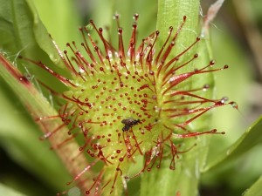
However, pollution caused by industrial processes release nitrogen into the air, which in turn gets scattered up into the troposphere. The nitrogen spreads from the industrial areas and into the wild through rain fall. This increases the amount of nitrogen found within the soil, and the once nitrogen devoid habitats of the sundew suddenly finds itself full of the pollutant.
The effect of the nitrogen rick soil on the roundleaf sundew plant is quite predictable. Since the plant is now getting sufficient nitrogen from the soil, it now has little need to supplement its diet with insects. The plants eventually catch fewer bugs.
This has a very negative effect on the environment because the insect population will have one predator less, which often leads to an excess of individuals. Not only will there be more insects, but hardier grasses and weeds that thrive in nitrogen rich soil will begin to invade the habitats of the roundleaf sundew plant and eventually displace it.
The roundleaf sundew has not evolved to compete with weeds and grasses, so it will likely be wiped out from the Swedish countryside. The insect population will increase, and common grasses and other plants would be more abundant.

Slide 17
Liverworts and mosses have been found to be good indicators of environmental conditions. The occurrence of certain aquatic mosses can be used as an indicator of calcium and nutrient content in water.
BRYOPHYTES AS INDICATORS OF POLLUTION
The suitability of liverworts & mosses as bioindicators is mainly due to their simple thalloid or one-cell thick structure, lack of cuticle or epidermis,resulting in greater absorption and accumulation of nutrients and pollutants directly from the atmosphere.
Some bryophytes grow only in a narrow and specific pH range and,therefore, their presence can be used as an indicator of soil pH.
Merceya,Mielichhoferia elongata, and M. mielichhoferia are known as copper mosses because they grow in copper rich soil. Such species can be used as indicator plants.

Slide 18
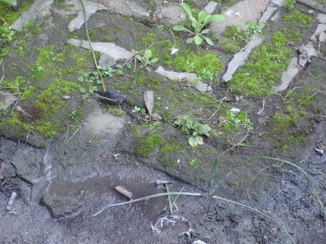
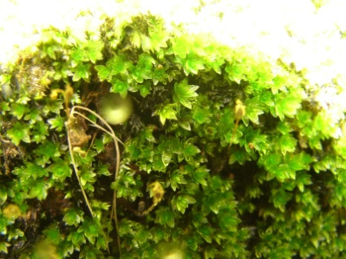
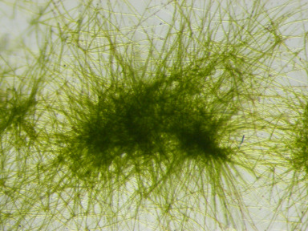
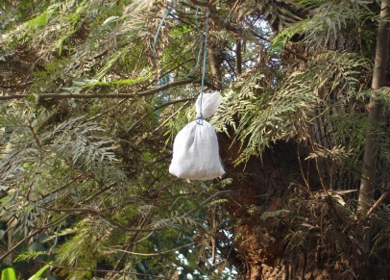
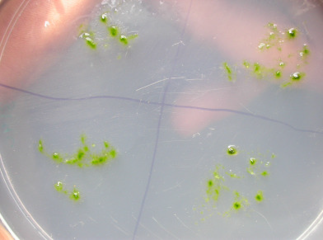
b.
a.
c.
d.
f.
e.
Figure 1. a. A tolerant species growing at a polluted site, b. Close up of a moss Hyophila showing no sporophyte production, c. Moss protonema in normal culture medium showing prominent growth, d. A moss bag in the water body to monitor metal content in water, e. A moss bag hangs on the tree to monitor the air metal contents of the site, f. Moss protonema in culture medium with heavy metals showing highly reduced growth in comparison to that of ‘c’.

Slide 19
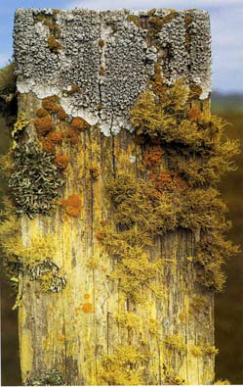
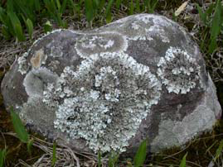
LICHENS AS ECOLOGICAL INDICATOR
Brief history of using lichens as
bioindicator of air pollution:
-Other air pollutants, NOx, O3 , heavy metals, HF, organic pollutants,caused disappearance of lichens
from cities & industrial areas.
- In 1866 it was noted that lichens disappeared from Jardin de Luxembourg near Paris.
* Smoke from burning of coal was the course.
* SO2 from burning coal damaged to lichens.
* Lichens have been used as bioindicator
of air pollution world wide

Slide 20
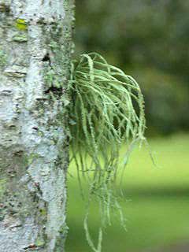
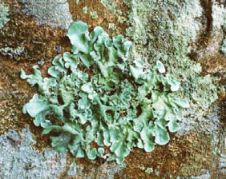
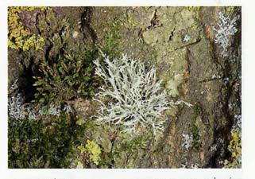
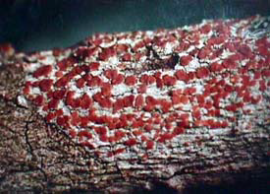
Lichens are differently sensitivity to air pollution. 1)Fruticose:
The most sensitive
2) Foliose:the second
3) Crustose:the most resistance
Ramalina farinacea

Slide 21
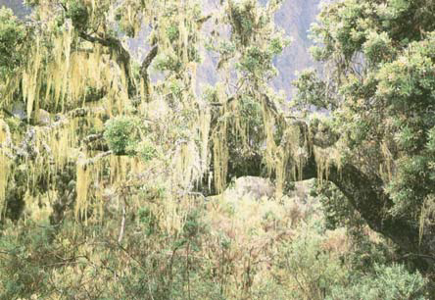
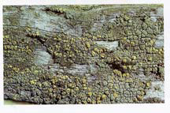
Lichens are differently sensitive to air pollution-Fruticose are the first group to disappear from polluted areas. Crustose lichens are the most resistance to air pollution
* In Bangkok : 7 species have been recorded
In Europe : Lecanora conizoides ->

Slide 22
CONCLUSION
ADVANTAGES:
Like all management tools, we must be conscious of its flaws. However, the limitations of bioindicators are clearly overshadowed by their benefits. Bioindicators can be employed at a range of scales, from the cellular to the ecosystem level, to evaluate the health of a particular ecosystem. They bring together information from the biological, physical, and chemical components of our world that manifest themselves as changes in individual fitness, population density, community composition, and ecosystem processes. From a management perspective, bioindicators inform our actions as to what is and is not biologically sustainable. Without the moss in the tundra, the cutthroat in the mountain stream, and the canary in the coal mine, we may not recognize the impact of our disturbances before it is too late to do anything to prevent them.
DISADVANTAGES:
We rely upon the sensitivity of some bioindicators to function as early-warning signals. In some instances, we cannot discriminate natural variability from changes due to human impacts, thus limiting the applicability of bioindicators in heterogeneous environments. Accordingly, populations of indicator species may be influenced by factors other than the disturbance or stress (e.g., disease, parasitism, competition, predation), complicating our picture of the causal mechanisms of change. A second criticism of the use of bioindicators is that their indicator ability is scale-dependent. bioindicator species invariably have differing habitat requirements than other species in their ecosystem. Managing an ecosystem according to the habitat requirements of a particular bioindicator may fail to protect rare species with different requirements. Finally, the overall objective of bioindicators is to use a single species, or a small group of species, to assess the quality of an environment and how it changes over time, but this can represent a gross oversimplification of a complex system.

Slide 23
THANK YOU
REQUEST:
PLEASE REMEMBER TO TAKE CARE OF THE PLANTS JUST AS WE TAKE CARE OF THE ANIMALS…THEY TOO ARE GOD’S CREATION
AND IT IS OUR DUTY TO PROTECT THEM.
PRESENTED BY- ATREYEE PARUI
SWARNALI BHATTACHARYYA
MADIHA AHMED
2ND YEAR,DEPARTMENT OF BOTANY

