Slide 1
Golden Rice and Bt crops: Unanswered safety and efficacy questions
Michael Hansen, Ph.D.
Senior Scientist
Consumers Union US
University of Philippines Los Baños
Los Baños, Philippines
August 24, 2011

Slide 2
Outline
Basics of Biotechnology
FDA safety consultation letters
Golden Rice: history, questions, alternatives
Bt crops, allergencity, immunogenicity and adverse effects on the gut of Cry1Ab, Cry1Ac
Conclusions

Slide 3
Biotechnology basics
Genetic material—DNA, RNA
Genes
Chromosomes
DNA replication
Transcription
Translation

Slide 4
cells
nucleus
chromosome
DNA
gene
A
A
C
T
C
G
T
Basepairs: A-T & C-G (nucleotides)
T
T
G
A
G
C
A
Notes:
To understand what Genetically Modified Organisms or GMOs are, let’s first review what DNA is. Within the tissues of the plant are cells. Within the cell is the nucleus. Within that are chromosomes composed of the DNA molecule, which in turn is made up of a sequence of base pairs. A simplistic description is that sequence of the genes in the DNA determine the sequence in the RNA, which then determines the sequence of the building blocks of proteins, called amino acids. These proteins can determine a particular trait or characteristic.

Slide 5
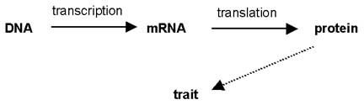
Simplified view of the Central Dogma

Slide 6
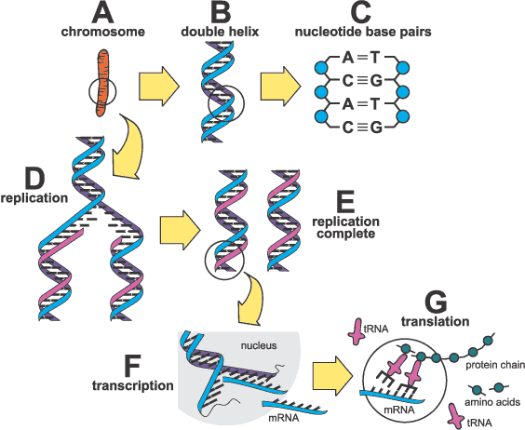
The basic structure and functions of genes and chromosomes

Slide 7
How does
Genetic Engineering work?
Isolate a gene with a
desired trait*
Change the gene so it will
work in plants*
Prepare plant cells or tissue
Transform plant cells using a gene gun
or bacteria infection method*
5. Re-grow cells to plants via tissue culture (cloning)*
* Steps that contain scientific uncertainties and risk potential
Notes:
Using genetic engineering, scientists take genes from bacteria, viruses or other sources and force them into the DNA of a plant. There are 5 steps. First they isolate the gene that they want to insert and then change it so that it works in plants. They prepare plant cells to be inserted. Insertion is often done using a gene gun, where they coat tiny particles of gold or tungsten with genes and then shoot them into a plate of cells. Alternatively, they can use bacteria to infect plants with the foreign gene. Once the gene gets into the DNA of the plant cell, the cell is cloned (using tissue culture) into a full plant. All but one of these steps contain scientific uncertainties and risks for health and the environment.

Slide 8


Gene construct
Regulatory sequence: volume switch
often CaMV 35S (virus)
e.g. Bt toxin gene from soil bacterium
Coding sequence of a gene
e.g. from pea
Regulatory sequence:
Termination signal
Plasmid backbone DNA,
superfluous genetic material
Notes:
Here is a diagram representing the gene that is inserted. It is called a transgene or gene construct. Let’ say scientists want to create a corn plant that produces its own pesticide. They typically take a gene from bacteria that produces its own pesticide. The bacteria are called Bt for Bacillus Thuringiensis and the pesticidal toxin it creates is called Bt-toxin. If you take the pesticide-producing Bt gene from the bacterium and put that inside corn by itself it wouldn’t work. Plant DNA is normally designed to turn genes on and off as needed by the cell. But there is no corn on earth that has ever had this BT gene before the advent of genetic engineering. The corn plant does not know how to turn it on. So scientists attach a promoter, usually taken from a virus, which acts as an “on” switch. It turns the gene on 24/7. This BT gene is not under the control of the DNA. It is under the control of this inserted viral promoter.
On the other side of the gene, scientists attach a stop signal or termination signal, which tells the cell, “The gene ends here. Stop reading.”
Scientists make millions of copies of the transgene, which are either shot into millions of cells or infected into the cell by bacteria. The hope is that some of the genes make it into the DNA of some of those cells. They can’t tell which of the genes make it into the DNA. So, they do the following: Before they multiply and insert the gene construct, they add an antibiotic resistant marker gene. This new gene creates a protein that protects the cell from a specific antibiotic.

Slide 9
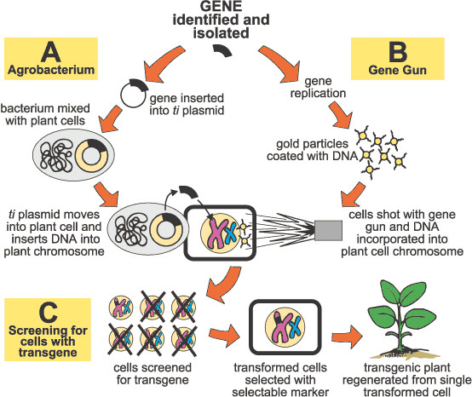
Plant transformation with Agrobacterium (Ti plasmid) and gene gun

Slide 10
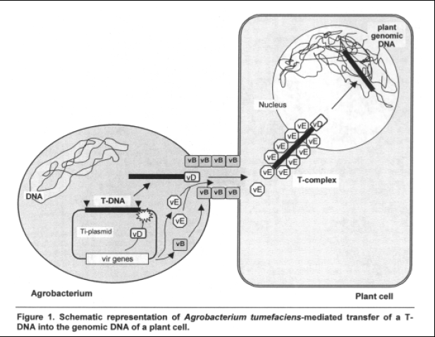

Slide 11
Key phrases in US Food and Drug Administration safety consultation letters
Letter for MON 810 (Bt corn), dated Sept. 26, 1996
“Monsanto submitted a summary assessment of corn containing transformation event MON 810 on June 6, 1996”
“Based on the safety and nutritional assessment you have conducted, it is our understanding that Monsanto has concluded that corn products derived from this new variety are not materially different in composition, safety, and other relevant parameters from corn currently on the market, and that the genetically modified corn does not raise issues that would require premarket review or approval by FDA.”
These two sentences are in all the 90+ safety consultation letters, with exception of FlavrSavr tomato
FDA does not require premarket safety assessment

Slide 12
Golden Rice
The problem: Vitamin A deficiency (VAD), which can be life-threatening
WHO: about 124 million children affected; 250,000-500,000 children go blind every year, about half die within 12 months (Enserink, M. 2008. Tough lessons from Golden Rice. Science, 230: 468-471.)
The high-tech answer: Rice engineered to produce a precursor to Vitamin A

Slide 13
Golden Rice: history
Idea first discussed at international conference at IRRI in Philippines in 1984.
1999 Team of scientists, including Ingo Potrykus, Swiss Federal Institute of Technology, successfully genetically engineer rice to produce carotenoids, precursors to Vitamin A
The hype begins: 2000 Time magazine cover story: “This rice could save a million kids a year”
May 2000: Adrian Dubock (Zeneca, now Syngenta): “One month delay = 50,000 blind children [a] month”
June 29, 2000 US special Congressional Forum, “Can Biotechnology Solve World Hunger?” Invitation stated, “ ‘golden rice’, which has been modified to include certain vitamins. . . Is already saving the sight of thousands of children in the poorest parts of Asia”

Slide 14
Golden Rice: problems
Originial Golden Rice (GR1) does not produce enough ß-carotene (Provitamin A); it produces only 1.6 μg/gm of carotenoids; a child would have to eat more than 10kg/day to get sufficient dose
2005 Sygenta introduced GR2, which contains gene from maize that produces 23 times more Provitamin A than GR1; some 37 μg/gm of carotenoids
Unexpected effect: GR1 was supposed to produce lycopene (as in tomatoes) and so be bright red; instead, it produced ß-carotene due to unexpected metabolic pathway

Slide 15
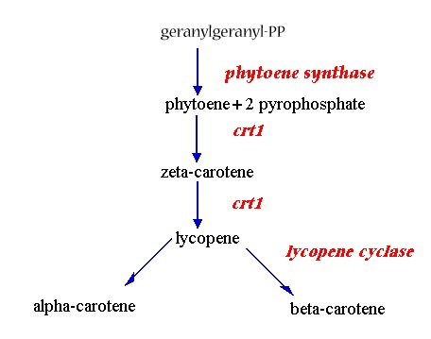
Golden Rice: Biosynthesis pathway

Slide 16
Golden Rice: problems
National Academy of Sciences advisory panel concluded that the genetic engineering of a biosynthetic pathway “raises the potential for unintended changes in the chemical composition of the resulting food” and “could lead to an increased concentration of catabolic products.” National Research Council, National Academy of Science: The Safety of Genetically Engineered Foods: Approaches to Assess- ing Unintended Health Effects. National Academies Press, Washington, DC, 2004. http://books.nap.edu/catalog/10977.htm
In gut β-carotene is cleaved in half to generate retinal, which can be reduced to retinol (Vitamin A), or oxidized to retinoic acid (RA). RA and its metabolites are toxic and teratogenic. RA can accumulate in fat and plasma.

Slide 17
Golden Rice: problems
600 naturally occurring carotenoids; at least 60 can be precursors to retinoids.
Plant enzymes involved in carotenoid metabolism have homologies to human enzymes, including the oxygenase required for the cleavage of carotenoids to retinoids in the gut. Therefore, plants have the potential to make many potentially harmful retinoid-like compounds when there are increased levels of synthetic intermediates to β-carotene as in golden rice.
It is well known that the accumulation of a biosynthetic intermediate will lead to the synthesis of new compounds by broad-specificity plant enzymes.44 While all retinoids and derivatives are likely to be teratogenic, good assays and information regarding the behavioral and teratologic activity are available for only three: retinol, RA, and retinal.

Slide 18
Golden Rice: problems
2001 sample of GR1 sent to German scientists to test for absorption of ß-carotene in intestines and utilization by body. However, the rice had less than 1% of ß-carotene levels expected. After cooking, the level declined by 50%.
Basic questions unanswered
How much ß-carotene degrades during storage? According to Golden Rice Humanitarian Boad, “Because of their chemical nature--several conjugated double bonds--carotenoids are susceptible to light and oxidation.” Studies still not published to answer this question
How much ß-carotene remains after cooking? No systematic data available. One study (Datta et al., 2003) suggested 10%

Slide 19
Golden Rice: problems
What is the bioavailability of golden Rice, i.e. how much is absorbed by the body? Study published in June 2009 found, that in healthy adults given servings of Golden Rice of 65-98 gm + 10gm butter, that conversion rate to retinol averages 3.8 + 1.7. (Tang, G. et al. 2009. Goden rice is an effective source of vitamin A. American Journal of Clinical Nutrition, 89(6): 1776-1783) No data available for children or malnourished individuals
Human feeding trials done by scientists from Tufts University in US. US National Institute of Health approved feeding trials using 72 Chinese school children, ages 6-8, that were boderline vitamin A deficient. Chinese authorities canceled feeding trial after notified by Greenpeace. Unclear whether feeding trials will take place in US
What is exact biochemical makeup of Golden Rice? Since there can be unexpected effects due to insertional mutagenesis, a complete molecular characterization is needed for each separate transformation event. No such data have been published on GR2 that was used in human feeding trial. No authority has evaluated GR2 at present

Slide 20
Golden Rice: problems
What is the potential environmental risk of Golden Rice? Unknown. Data presented at International Biosafety Workship in Beijing in September 2008 show that GE rice (e.g. Bt rice) has a very low crossing rate with other strains of cultivated non-GE rice. However, outcrossing was higher with wild rice and weedy rices. Indeed, hybrids formed from crossing of Bt rice and weedy rice varieties showed increased reproductive rates due to changes in phenology, e.g. when the plant flowers and sets seed. This increased reproductive rate could mean that the weedy rice could become even more of a problem, e.g a potential super weed
Will GR2 rice produce acceptable yields and appeal to farmers? 2008 article in Science: “there’s a long way to go. . . Both the original Golden Rice, now called GR1, and GR2 were created with Japonica cultivars that are the scientist’s favorites but fare poorly in Asian fields. Researchers are now backcrossing seven GR1 and GR2 lines with the long-grained, nonsticky Indica varieties popular among Asia’s farmers.” GR2 being crossed with 8 carefully selected Indica varieties at Indian Agricultural Research Institute, Tamil Nadu and at BRRI

Slide 21
Golden Rice: alternatives
Existing strategies to fight VAD
Supplementation A short range strategy. Liquid filled gelatin capsule or injection. UNICEF main distributor for VA (vitamin A) capsules, which cost $0.20 each. VA program costs between $1.64 and $2.20 per child. According to the Micronutrient Initiative (MI): “MI’s key contributions to global progress over the past 15 years include: providing support for supplies of Vitamin A supplements that benefit over 200 million children annually in 70 countries
Food fortification Medium range strategy. Involves adding VA to food.
  A pilot study in India with sugar and edible oils had a tremendous success (www.jsi.com/intl/omni/up_9_97.htm)
  29% of households in Indonesia already using VA fortified noodles (www.jsi.com/intl/omni/fnlrep3.htm)
  Cost of sugar fortification with VA is $0.32/person (www.jsi.com/intl/omni/sugr_pt1.htm)
  Dutch food supplement company DSM has created rice fortified with vitamins and iron that is aimed at 2 billion people worldwide who suffer vitamin ad mineral deficiencies

Slide 22
Golden Rice: alternatives
Food diversification/sustainable agriculture. Long range strategy that involves the community. Local alternatives to GR2 include red rice, mangoes (1800 ug carotene), yellow maize (450 ug carotene/100gm). Also papayas, yams, carrots, red curry peppers and greens like swamp cabbage, spinach, drumstick leaf, etc. all have high levels of β-carotene.

Slide 23
Golden Rice alternatives: Some food with high levels of β-carotene
Food Source | β-carotene Content (μg/g)
Carrots | 46-125
Leafy vegetables | 10-444
Sweet potato tuber (orange) | 200
Sweet potato leaves | 11.4
Coriander leaves | 11.6
Curry leaves | 13.3
Amaranth leaves | 2.66 - 11.6
Melon (cantaloupe) | 20.2
Mango | 4.4
Palm oil | 92.8
Liver (goat, sheep) | 66 – 100
Cod liver oil | 100 - 1,000
Dunaleilla salina (algae) | 10,000 times of carrots

Slide 24
Golden Rice: alternatives
Jules Pretty report on sustainable agriculture projects, the SAFE-World Reseach Project that looked at information on 208 cases from 52 countries.
  8.98 million farmers have adopted sustainable ag on 28.9 million ha. Most household had significant increases in household food production
  Avg. food production for 4.42 million farmers on 3.58 million ha was increased by 73%
  For 146,000 farmers on 542,000 ha that cultivated roots (sweet potatoes, potato and cassava rich in VA), the increase in food production was 17 tons per year, an improvement of 150%
According to WHO, tried and tested remedies for VAD have already “averted an estimated 1.25 million deaths since 1998 in 40 countries”

Slide 25
Bt crops
Engineered with δ-endotoxins produced by the soil bacterium Bacillus thuringiensis
δ-endotoxins are called Cry proteins and there are many of them
Bt crops on market include corn, potato, cotton, poplars; many are in testing phase, including Bt rice, Bt talong, Bt soy
Concern over allergenicity and immunological impacts on the gut, especially with Cry1Ab, Cry1Ac, which are found in Bt corn, Bt cotton, Bt talong and Bt rice

Slide 26
Zolla, L. et al. 2008. Proteomics as a Complementary Tool for Identifying Unintended Side Effects Occurring in Transgenic Maize Seeds As a Result of Genetic Modifications. Journal of Proteome Research, 7: 1850-1861.
Proteomics is the study of expressed proteins. This is good way to detect unintended effects associated with GE, particularly the disruptive effects due to the random insertion of transgene
Superior study design: GE maize (MON810) and near isoline grown side-by-side in growth chamber, to control for environmental effects

Slide 27
Zolla, L. et al. 2008. Proteomics as a Complementary Tool for Identifying Unintended Side Effects Occurring in Transgenic Maize Seeds As a Result of Genetic Modifications. Journal of Proteome Research, 7: 1850-1861.
Results: “43 proteins resulted up- or down-regulated in transgenic seeds with respect to their controls (T06 vs WT06), which could be specifically related to the insertion of a single gene into a maize genome by particle bombardment.” (pg. 1850). Of these 43 proteins, 14 were down-regulated, 13 up-regulated, 9 shut off and 7 newly expressed.
“Interestingly, a newly expressed spot (SSP 6711) corresponding to 50 kDa gamma zein, a well-known allergenic protein, has been detected. Moreover, as a major concern, a number of seed storage proteins (such as globulins and vicilin-like embryo storage proteins) exhibited truncated forms having molecular masses significantly lower than the native ones.” (pg. 1855)

Slide 28
Finamore, A et al. 2008. Intestinal and Peripheral Immune Response to MON810 Maize Ingestion in Weaning and Old Mice. Journal of Agricultural and Food Chemistry
Well designed study: MON810 and near isoline grown simultaneously in neighboring fields in Landriano, Italy, to control for environmental effects
“This study evaluated the gut and peripheral immune response to genetically modified (GM) maize in mice in vulnerable conditions. Weaning and old mice were fed a diet containing MON810 or its parental control maize . . . for 30 and 90 days. . . As compared to control maize, MON810 maize induced alterations in the percentage of T and B cells and of CD4+, CD8+, γδT, and RT subpopulations of weaning and old mice fed for 30 or 90 days, respectively, at the gut and peripheral sites. An increase of serum IL-6, IL-13, IL-12p70, and MIP-1 [cytokines involved in allergenic and inflammatory response] after MON810 feeding was also found. These results suggest the importance of the gut and peripheral immune response to GM crop ingestion as well as the age of the consumer in the GMO safety evaluation.”

Slide 29
Velirimov et al. 2008. Biological effects of transgenic maize NK603xMON810 fed in long term reproduction studies in mice.
Very carefully designed Austrian long-term feeding study. The non-GE maize control was a near isogenic line. Both control and GE maize were grown in adjacent fields in Canada in the same year (2005, 2007), to control for environmental effects. Large sample sizes were used to detect more subtle adverse effects.
Major result: statistically significant adverse reproductive effects shown in the reproductive assessment by continuous breeding (RACB) study. RACB is a feeding study whereby a pair of mice are fed GM maize for 140 days, during which time the female is bred so that she delivers 4 litters. RACB puts mice under stress making it easier to detect adverse effects.

Slide 30
Velirimov et al. 2008. Biological effects of transgenic maize NK603xMON810 fed in long term reproduction studies in mice.
“From 24 pairs assigned to the ISO and GM group, all females of the ISO group (100%) delivered 4 litters. In the GM group the number of deliveries declined with time. In the 4th litter only 20 deliveries occurred (p=0.055). The average number of pups born was always lower in the GM group but not significant before the 3rd delivery. There were significantly fewer pups born in the GM group in the 3rd (p= 0.011) and 4th (p=0.010) delivery and weaned in the 4th litter (p=0.025). Regarding all deliveries per group more pups were born in the ISO than in the GM group (1035 versus 844). Furthermore females of the GM group always had smaller litters (n < 8) as compared to females of the ISO group.”

Slide 31
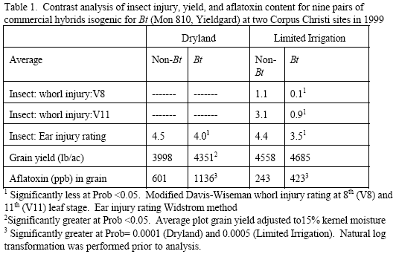

Slide 32
Vazquez-Padron, R.I., Moreno-Fierros, L., Neri-Bazan, L., de la Riva, G.A. and R. Lopez-Revilla. 1999b. Bacillus thuringiensis Cry1Ac protoxin is a potent systemic and mucosal adjuvant. Scandinavian Journal of Immunology 49: 578-584
“We conclude that Cry1Ac is a mucosal and systemic adjuvant as potent as CT [cholera toxin] which enhances mostly serum and intestinal IgG antibody responses” (Vazquez-Padron et al., 1999b: pg. 578).
Cry1Ac is potent stimulator of immune system
Cry1Ac survives digestion

Slide 33
Fares, NH & AK El-Sayed. 1998. Fine structural changes in the ileum of mice fed on delta-endotoxin-treated potatoes and transgenic potatoes. Natural Toxins 6: 219-233.
Bt-potatoes and Bt-toxin (Cry 1) caused disruption, multinucleation, swelling, increased degradation of ileal (gut) surface cells in rats. Effect worse with Bt-toxin
These effects demonstrate that Bt-toxin survives digestion in functionally and immunologically active form

Slide 34
Fares, NH & AK El-Sayed. 1998. Fine structural changes in the ileum of mice fed on delta-endotoxin-treated potatoes and transgenic potatoes. Natural Toxins 6: 219-233.
“These changes may suggest that delta-endotoxin-treated potatoes resulted in the development of hyperplastic cells in the mice ileum. Although mild changes are reported in the structural configuration of the ileum of mice fed on transgenic potatoes, nevertheless, thorough tests of these new types of genetically engineered crops must be made to avoid the risks before marketing.” (Fares and Sayed, 1998: 219)

Slide 35
Vazquez-Padron, R.I., et al. 2000b. Cry1Ac protoxin from Bacillus thuringiensis sp. kurstaki HD73 binds to surface proteins in the mouse small intestine. Biochemical and Biophysical Research Communications 271, pp. 54-58
“we demonstrated that Cry1Ac protoxin (pCry1Ac) binds to the mucosal surface of the mouse small intestine . . . six pCry1Ac-binding polypeptides present in brush border membrane vesicles isolated from the small intestine. Moreover, this protein induced in situ temporal changes in the electrophysiological properties of the mouse jejunum. The data obtained indicate a possible interaction in vivo of Cry proteins with the animal bowel which could induce changes in the physiological status of the intestine” (Vazquez-Padron et al., 2000b: 54).

Slide 36
Vazquez-Padron, R.I., et al. 2000b. Cry1Ac protoxin from Bacillus thuringiensis sp. kurstaki HD73 binds to surface proteins in the mouse small intestine. Biochemical and Biophysical Research Communications 271, pp. 54-58
“We think that previous to commercialization of food elaborated with self-insecticide transgenic plants it is necessary to perform toxicological tests to demonstrate the safety of Cry1A proteins for the mucosal tissue and for the immunological system of animals” (Vazquez-Padron et al., 2000b: 58).

Slide 37
Bernstein, et al. 1999. Immune responses in farm workers after exposure to Bacillus thuringiensis pesticides. Environmental Health Perspectives, 107(7): 575-582
Scientists did study on farm workers in onion fields in Ohio, US that were exposed to Bt sprays
“reactivity [IgE antibodies] to the Btk pro-delta-endotoxin [Cry1Ab and Cry1Ac] was encountered in 2 of 123 workers sensitized by the respiratory route . . . future clinical assessment of this possibility is now feasible because of the availability of reliable Bt skin and serologic reagents developed during the course of this investigation” (Bernstein et al., 1999: pg. 581).

Slide 38
Bernstein, et al. 2003. Clinical and laboratory investigation of allergy to genetically modified foods. Environmental Health Perspectives, 111(8): 1114-1121.
“Workers in agricultural and food preparation facilities have potential inhalation exposure to plant dusts and flours. In 1999, researchers found that migrant health workers can become sensitized to certain Bt spore extracts after exposure to Bt spraying. Thus, the potential for occupational and consumer risks needs to be assessed.”

Slide 39
Impact of Bt cotton on farmers’ health (in Barwani and Dhar District of Madhya Pradesh) –Dr. Ashish Gupta et al.
Investigation Report Oct. – Dec. 2005 www.gmwatch.org/print-archive2.asp?arcid=6265
Surveyed 5 villages, talked to people with symptoms and exposure to Bt cotton N = 23
All had skin symptoms, primarily itching (23), redness (19), or eruptions (20). The symptoms tended to occur on face (17), hands (15), feet (11)
Almost half (11) had eye symptoms—itching, redness and/or swelling
About 40% (9) had upper respiratory tract symptoms runny nose and/or excessive sneezing
Almost 90% had moderate (10) or severe symptoms (10)

Slide 40
Impact of Bt cotton on farmers’ health (in Barwani and Dhar District of Madhya Pradesh –Dr. Ashish Gupta et al.
Investigation Report Oct. – Dec. 2005 www.gmwatch.org/print-archive2.asp?arcid=6266
Symptoms overwhelmingly on exposed parts of body (face, hand, feet, neck, eyes and respiratory tract). Only 1 of 23 had symptoms only on covered parts of body (14 exposed body parts only, 8 both)
Almost 80% (18) exposed in cotton field, 4 exposed at home
Almost 74% (17) directly involved in picking cotton
People that symptoms increased in severity when they continued to work in fields and decreased when they stopped work
Symptoms started within last two years, when Bt cotton was introduced

Slide 41
Impact of Bt cotton on farmers’ health (in Barwani and Dhar District of Madhya Pradesh –Dr. Ashish Gupta et al.
Investigation Report Oct. – Dec. 2005 www.gmwatch.org/print-archive2.asp?arcid=6266
Ginning factory
Owner noted that “most of the farmers and labourers were having skin related problems due to Bt cotton”
Detailed interview with 6 workers in different ginning factories found all had itching problems on exposed parts of body (hands, legs, face), and 2 were having eruptions on body
Workers had been in factory from 2 – 7 years, but symptoms only began last year, with introduction of Bt cotton

Slide 42
Aris, A. and S. Leblanc. 2011. Maternal and fetal exposure to pesticides associated to genetically modified foods in Eastern Townships of Quebec, Canada. Reproductive Toxicology, doi:10.1016/j.reprotox.2011.02.004.
Study involved 30 pregnant, 39 nonpregnant women in Quebec, Canada.
Blood taken from women and from fetal cord blood and tested for 3 pesticides associated with GM: glyphosate, glufosinate, Cry1Ab
Results: detected metabolite of glufosinate (3-MPPA) and Cry1Ab in maternal, fetal and nonpregnant women’s blood

Slide 43
Aris, A. and S. Leblanc. 2011. Maternal and fetal exposure to pesticides associated to genetically modified foods in Eastern Townships of Quebec, Canada. Reproductive Toxicology, doi:10.1016/j.reprotox.2011.02.004.

Slide 44
Aris, A. and S. Leblanc. 2011. Maternal and fetal exposure to pesticides associated to genetically modified foods in Eastern Townships of Quebec, Canada. Reproductive Toxicology, doi:10.1016/j.reprotox.2011.02.004.

Slide 45
Aris, A. and S. Leblanc. 2011. Maternal and fetal exposure to pesticides associated to genetically modified foods in Eastern Townships of Quebec, Canada. Reproductive Toxicology, doi:10.1016/j.reprotox.2011.02.004.
“Cry1Ab toxin was detected in 93% and 80% of maternal and fetal blood samples, respectively and in 69% of tested blood samples from nonpregnant women. There are no other studies for comparison with our results. However, trace amounts of the Cry1Ab toxin were detected in the gastrointestinal contents of livestock fed on GM corn [38–40], raising concerns about this toxin in insect-resistant GM crops; (1) that these toxins may not be effectively eliminated in humans and (2) there may be a high risk of exposure through consumption of contaminated meat.”
Conclusion: “To our knowledge, this is the first study to highlight the presence of pesticides-associated genetically modified foods in maternal, fetal and nonpregnant women’s blood. 3-MPPA and Cry1Ab toxin are clearly detectable and appear to cross the placenta to the fetus. Given the potential toxicity of these environmental pollutants and the fragility of the fetus, more studies are needed, particularly those using the placental transfer approach [41].”

Slide 46
Conclusions
US FDA does not require premarket safety assessments
Unanswered questions remain of efficacy and safety remain with Golden Rice
Viable alternatives to GR exist to combat VAD
Bt crops can have unexpected adverse health effects
Unanswered safety questions, particularly regarding allergenicity, immunogenicity and adverse effects on the gut, remain with Bt crops, especially those containing Cry1Ab, Cry1Ac

Slide 47
Benbrook, C. 2004. Genetically engineered crops and pesticide use in the United States: The first nine years. At: http://www.biotech-info.net/Full_version_first_nine.pdf

Slide 48
Benbrook, C. 2004. Genetically engineered crops and pesticide use in the United States: The first nine years. At: http://www.biotech-info.net/Full_version_first_nine.pdf

Slide 49
Benbrook, C. 2009. Genetically engineered crops and pesticide use in the United States: The first thirteen years.
During first 9 years, pesticide use on genetically engineered crops was increased by a total of 122 million pounds.
Update on the Benbrook’s 2004 paper: “Bt corn and cotton has reduced insecticide use by 56 million pounds, but herbicide tolerant crops have increased pesticide use by 383 million pounds, for an overall 327 million pounds increase over the 13 years.”
So, for 1996-2004, 122 million pounds more pesticide was used on GE compared to non-GE crops. For 2005-2008, an additional 205 million extra pounds were applied.

Slide 50
Do GE crops reduce pesticide use?
“farmers have rotated RR crops, usually soya and maize, to the point that the weeds themselves are now Roundup resistant, which has resulted in much higher applications of Roundup along with a host of other chemicals.” Nathalie Moll, EuropaBio. In “GM crops: Biotech agriculture—Time to take GM seriously”, Ethical Corporation, February 7, 2008 At: www.ethicalcorp.com/content.asp?ContentID=5684

Slide 51
Wang, S., Just, D.R. and P. Pinstrup-Andersen. Tarnishing Silver Bullets: Bt technology adoption, bounded rationality and the outbreak of secondary pest infestations in China.
Paper presented at American Ag. Econ. Assoc. annual meeting, Long Beach, CA, 22-26 July, 2006
Household survey of 481 farmers, 20 villages, 5 provinces: Hebei, Shandong, Henan, Anhui, Hubei
Results for 2004:
  Average expenditure on pesticides was same ( US$101/ha) between Bt and non-BT farmers
  Bt farmers spend 46% less on bollworm pesticide, but spend 40% more on pesticides for secondary pest(s), compared to non-Bt farmers
  Main secondary pest – mirids
  GM cotton seeds cost 3 times more than non-Bt cotton, so Bt farmers make less money than non-Bt farmers
  Results markedly different from data from 1999, 2000, 2001

Slide 52
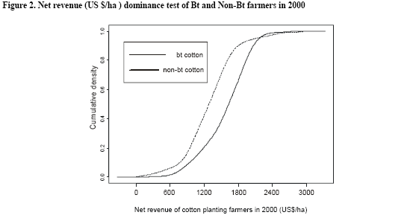
Wang, S., Just, D.R. and P. Pinstrup-Andersen. Tarnishing Silver Bullets: Bt technology adoption, bounded rationality and the outbreak of secondary pest infestations in China.
Paper presented at American Ag. Econ. Assoc. annual meeting, Long Beach, CA, 22-26 July, 2006

Slide 53
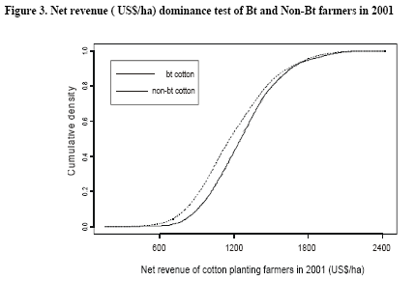
Wang, S., Just, D.R. and P. Pinstrup-Andersen. Tarnishing Silver Bullets: Bt technology adoption, bounded rationality and the outbreak of secondary pest infestations in China.
Paper presented at American Ag. Econ. Assoc. annual meeting, Long Beach, CA, 22-26 July, 2006

Slide 54
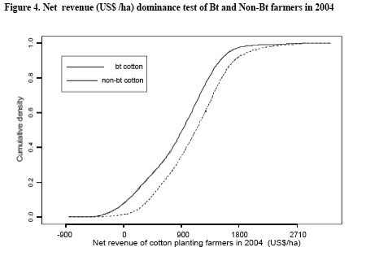
Wang, S., Just, D.R. and P. Pinstrup-Andersen. Tarnishing Silver Bullets: Bt technology adoption, bounded rationality and the outbreak of secondary pest infestations in China.
Paper presented at American Ag. Econ. Assoc. annual meeting, Long Beach, CA, 22-26 July, 2006

