Slide 1
New Technologies (GMOs), Administrative Agencies, and Public Interest Groups
Why good people fear good technology – and what to do about it
Professor Jay P. Kesan, Ph.D., J.D.
University at Illinois at Urbana-Champaign

Slide 2
Outline
How we perceive risk differently as individuals and societies
GMOs are good science and provide societal benefits
Why people distrust GMOs in spite of prevailing scientific opinions
What the private sector can do to combat misunderstanding: explain added value, show payoff to the public, fund communication campaigns
What the public sector can do: scientific activism, defeating labeling laws, highlighting benefits of GMO foods

Slide 3
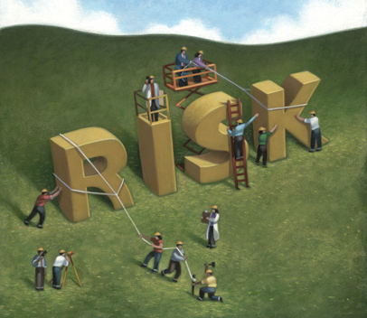
Risk Assessment
Traditionally, risk has been defined by the statistical probability of injury.
Nowadays, social scientists argue that risk is inherently subjective.
The importance of the unknown -different people evaluate food risks differently - the science is new, and the presence of GMOs themselves is not obvious. There are gaps between scientific and social rationality.
This explains why the same issue, like GMOs, can have vastly different risk assessments by different people.

Slide 4
GMOs are Good Science
In reality, GMOs have been scientifically tested and are safe.
Pose no harm not found in conventional or organic foods.
"There is broad scientiﬁc consensus that genetically engineered crops currently on the market are safe to eat. After 14 years of cultivation and a cumulative total of 2 billion acres planted, no adverse health or environmental effects have resulted from commercialization of genetically engineered crops.” – Pamela Ronald, UC Davis plant geneticist

Slide 5
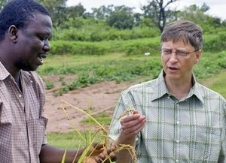
GMOs can be a Great Solution
GMOs can help solve world hunger – Bill Gates

Slide 6
GMOs have Potential Environmental Benefits
1. Reducing crop production cost and increasing yield
2. Reducing toxic chemicals in the environment by reducing need for pesticides
3. Environmental monitoring and remediation
4. Plant-based biopharmaceuticals
Source: Om V. Singh et al., Genetically Modified Crops: Success, Safety Assessment, and Public Concern, 71 Appl. Microbiology & Biotechnology 598-607 (Apr. 2006).
Notes:
Source: Om V. Singh et al., Genetically Modified Crops: Success, Safety Assessment, and Public Concern, 71 Appl. Microbiology & Biotechnology 598-607 (Apr. 2006).

Slide 7
Yet, People Still Fear GMOs

Slide 8
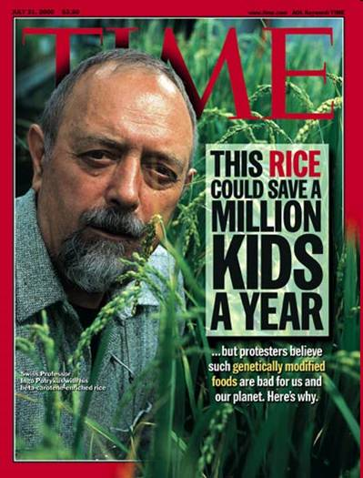
Golden Rice is an Example of Irrational Fear Causing Harm
2.5 million children die every year from Vitamin A deficiency
Golden rice uses technology that scientists are offering for free which is proven to be safe and adds Vitamin A to rice
Despite this rice being able to save many lives, it is banned from commercial production

Slide 9
Golden Rice, contd.
Former Greenpeace president takes the blame, admitting Greenpeace is partly responsible for having spread a campaign of misinformation about golden rice. And kids are dying as a result.

Slide 10
People Perceive GMOs as
Unnatural
Dangerous

Slide 11
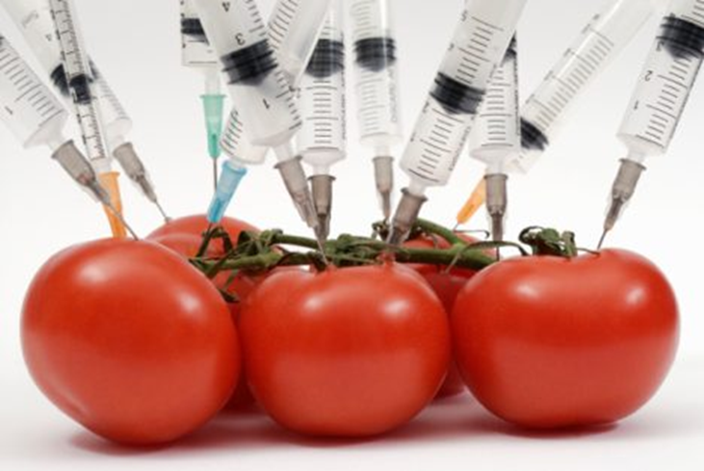
Why the Fear?
People perceive anything involving human manipulation as being highly unnatural.

Slide 12
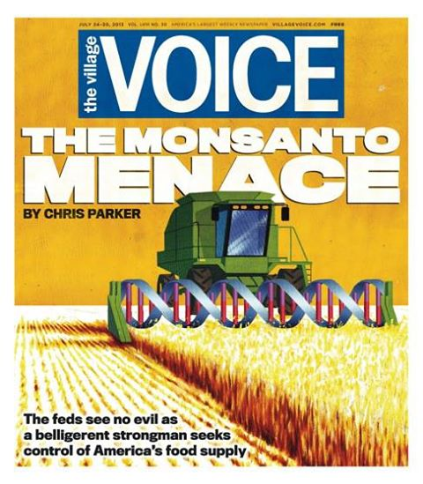
Why the Fear? contd.
2. Hysteria in popular journalism. Popular media links GMOs to the archetypical “evil corporation”.
“There’s so much misinformation floating around about G.M.O.’s that is taken as fact by people,” said Michael D. Purugganan, a professor of genomics and biology and the dean for science at New York University

Slide 13
Why the Fear? contd.
3. Cultural differences.
European societies view GMOs as much more dangerous than American societies do. France, for example, is trying to reassert traditional food and eating habits in the wake of the American fast food invasion.

Slide 14
Why the Fear? contd.
4. Need better access to scientific education. Scientific literacy correlates with acceptance of GMOs.
Notes:
Replaced original statement about IQ being positively correlated with acceptance of GMOs. This should be more PC – framing it more in terms of equality of access than genetic superiority. The test specifically focuses on IQs which as we know is part nature and part nature. By phrasing it in terms of access we can avoid offending anyone.

Slide 15
Why the Fear? contd.
5. Socioeconomic differences. Studies have shown that wealthier individuals with more decision-making power are more likely to approve of GMOs.

Slide 16
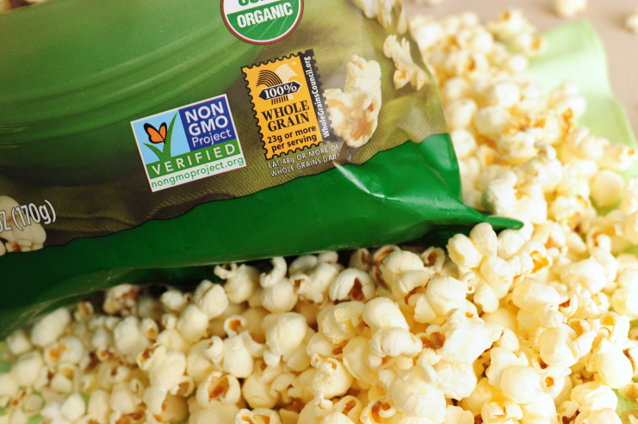
Why the Fear? contd.
6. Special interest groups.
You will see this logo on some popular foods like Kettle Chips. The Non-GMO Project is a non-profit organization that began as an initiative of independent natural foods retailers in the US and Canada. It is self-evident that they have a financial stake in how GMO foods are received.

Slide 17
Special Interest Groups, contd.
“I’ve found that ears are stoked by prominent environmental groups, supposed food-safety watchdogs, and influential food columnists; that dodgy science is laundered by well-respected scholars and propaganda is treated credulously by legendary journalists; and that progressive media outlets, which often decry the scurrilous rhetoric that warps the climate debate, serve up a comparable agitprop when it comes to GMOs.” – Keith Kloor, Slate

Slide 18
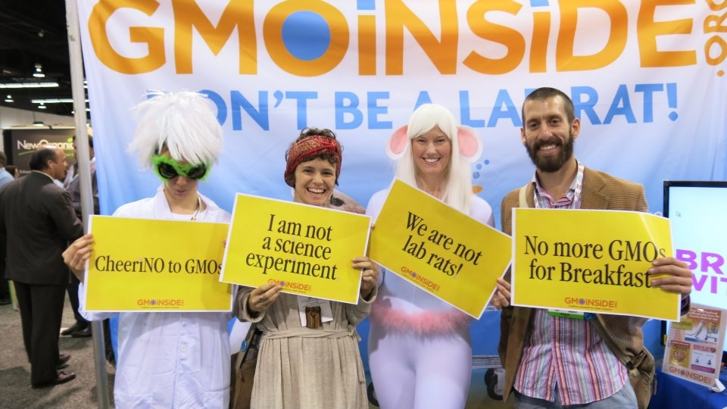
Special Interest Groups, contd.
GMO Inside (a Green America campaign)
Green America is a nonprofit group that promotes “ethical consumerism”
It is a poorly ranked non-profit (1/4 stars on Charity Navigator)
Formerly known as Co-Op America, it runs a business network and a publicized list of approved businesses and products

Slide 19
Special Interest Groups, contd.
Organic Consumers Association (OCA)
Represents many members, including several thousand natural and organic foods businesses
U.S. and international policy board made of many individuals including organic farmers (who, naturally, have a business interest in banning GMOs)

Slide 20
Why the Fear? contd.
7. Personal perceptions
Public views about corporations
many individuals view corporations as inherently amoral or immoral
Trust in government
Certain individuals are predisposed to mistrust the government. Therefore, FDA approval and the like are disregarded by certain people.
Source: Ferdaus Hossain et al., Public Approval of Genetically Modified Foods, 27 Intl. Journal of Consumer Studies 353-65 (Nov. 2003).
Notes:
Source: Ferdaus Hossain et al., Public Approval of Genetically Modified Foods, 27 Intl. Journal of Consumer Studies 353-65 (Nov. 2003).

Slide 21
What can the Private Sector do?
Continue scientific testing of GMOs.
Would allay some public fears.
But significant testing has already been done. The scientific community is already convinced.
More testing would be a serious financial burden on private companies.

Slide 22
Producers: Focus on Added Value
Studies have shown that public approval for GMOs is considerably higher when it is used to bring tangible benefits to society compared to when it does not bring any such benefit
Only 49% approve if GMOs have no added benefits.
Source: Ferdaus Hossain et al., Public Approval of Genetically Modified Foods, 27 Intl. Journal of Consumer Studies 353-65 (Nov. 2003).
Notes:
Source: Ferdaus Hossain et al., Public Approval of Genetically Modified Foods, 27 Intl. Journal of Consumer Studies 353-65 (Nov. 2003).

Slide 23
Show Payoff to the Public
Statistics have shown people are more likely to accept GMOs if they:
Make food taste better (71% approve)
Increase shelf life of food (62% approve)
Lower prices (74% approve)
Remember, this is up from acceptance rates of 49% without any improvements!
Notes:
Only 49% approve if GMOs have no added benefits.

Slide 24
Communication Campaigns
Three key points:
Inform consumers about not only the risks but also the benefits in an objective manner.
Consumers must obtain their information from trusted organizations.
Provide information in a credible and persuasive matter.
Simply providing information on the risks and benefits of GMOs is not enough.
Also, consider adding contact information to food labels. This appears to increase public trust and confidence.
Source: Montserrat Costa-Font et al., Consumer acceptance, valuation of and attitudes towards genetically modified food: Review and implications for food policy, 33 Food Policy 99-111 (2008).
Notes:
M. Consta-Font et al. 1 Food Policy 99-111 (2008).

Slide 25
GMOAnswers.com
Current communication campaign funded by Monsanto and others
Openly answers questions submitted by internet users in its public forums.
States that it respects people and farmers around their world and their right to choose products and seeds that are best for them
Successful because it uses outside, credible statistics and presents information in a clear, respectful manner
Problem: Getting people to visit the website and trust the website. As we will see, individuals do not always trust corporate sources.

Slide 26
What the Public Sector can do
Trust is directly related to public acceptance of new technologies.
Many studies have revealed that for GMO technology, consumers consider consumer organizations, environmental groups, and scientists to be more trustworthy than the biotech industry
Consumers also distrust government. Government should take a role in policy making, but not in changing public perception
Source: Montserrat Costa-Font et al., Consumer acceptance, valuation of and attitudes towards genetically modified food: Review and implications for food policy, 33 Food Policy 99-111 (2008).
Notes:
M. Consta-Font et al. 1 Food Policy 99-111 (2008).

Slide 27
Public Interest Groups and Social Media
Interested parties can use social media to their benefit
Websites like Change.org allow users to circulate petitions with written descriptions that serve a dual purpose: disseminating information and appealing to those individuals who distrust authorities like the government
A petition on Change.org to legalize golden rice appears to be gaining steam

Slide 28
Counter-Protesting
Certain pro-GMO groups have begun to protest at anti-GMO protests, offering another side to a one-sided conversation
Handing out educational brochures and carrying banners that explain the scientific facts
Scientist activism? Some people believe that research scientists should be impartial in regards to the relation of science to public policy. But others say scientists should be involved in educating the public and policymakers.
“It is long past time for scientists to stand up and shout, ‘No more lies — no more fear-mongering.’ ” - Nina V. Fedoroff, a professor at the King Abdullah University of Science and Technology in Saudi Arabia and a former science adviser to the American secretary of state

Slide 29
Engage the Government and Defeat Labeling Laws
Labeling laws can mislead and
falsely alarm consumers –
American Association for the
Advancement of Science
Labeling laws are failing at the
federal level

Slide 30
States and Labeling Laws
Labeling laws are now becoming a state issue
Private groups should lobby and educate at the state level
While Washington mulls over labeling law:
Washington State Academy of Sciences reports that the consequences would include increased food costs and that no significant health effects from GMOs have ever been documented.

Slide 31
Public Education
Use education to change public perception of GMOs
Include these topics in our public school science classes
Increase overall scientific literacy and combat misinformation
Promote and fund separate groups who can disseminate information without carrying the stigma of government-source information

Slide 32
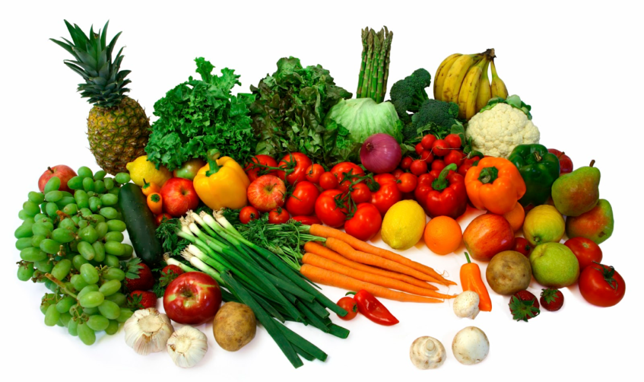
Differentiating GMO Foods
Administrative agencies like the FDA should consider differentiating GMO foods based on beneficial characteristics like nutritional value
Focus on ways to communicate value and benefits in a way that outweighs the risks in the public’s mind

Slide 33
Conclusion
Before any new technology, not just GMOs, can prevail, consumers must accept it. No matter how good the science is, the product will only survive if the public wants it to survive.
“Public sentiment is everything. With public sentiment, nothing can fail. Without it, nothing can succeed.” – Abraham Lincoln.

