Slide 1
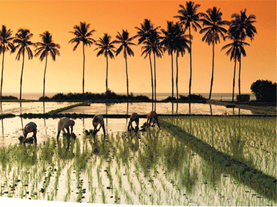
Golden Rice: A magical solution to a global problem or a wasted investment?

Slide 2
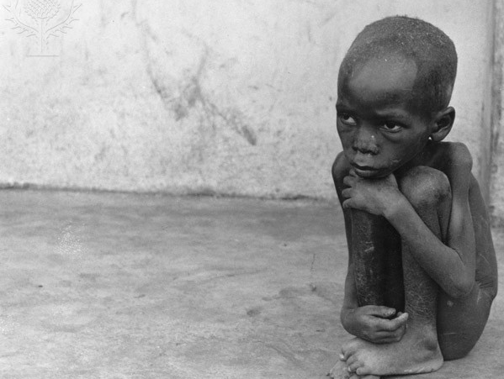
The Food and Agriculture Organization estimates that about 850 million people go hungry every day and another billion are living on less than one dollar (Cummings, 2008).
As a result of such extreme poverty there is no other choice for these billion plus people but to survive on staples such as rice (Beyer, 2010).

Slide 3
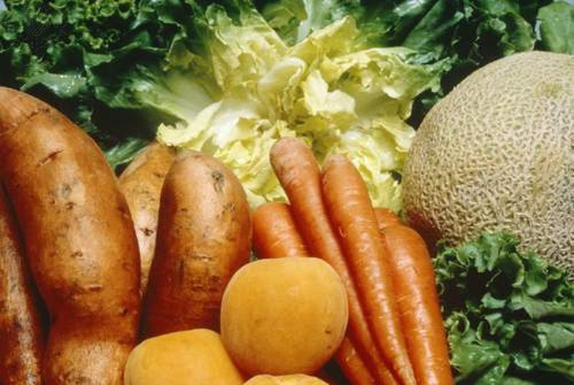
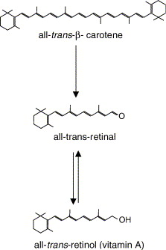
Humans must obtain vitamin A from diet as a preformed vitamin or provitamin carotenoid like beta-carotene.
The intestine converts beta-carotene to retinal and retinal is reduced to vitamin A.
Proteins & fats in the diet enhance absorption.
Infant requires at least 400 чg and a lactating mother requires at least 1,200 чg
Vegetables rich in beta-carotene include- carrots, sweet potatoes, pumpkin, kale, spinach, collards, & squash (5-10 mg retinal per 100 g)
(Harrison, 2012)
Vitamin A
Notes:
Humans must obtain vitamin A from diet as a preformed vitamin or provitamin carotenoid like beta-carotene. The intestine converts beta-carotene to retinal and retinal is reduced to vitamin A. Proteins & fats in the diet enhance aborption

Slide 4
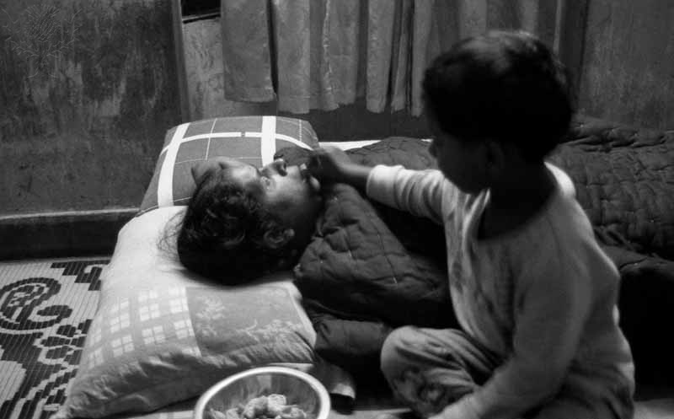
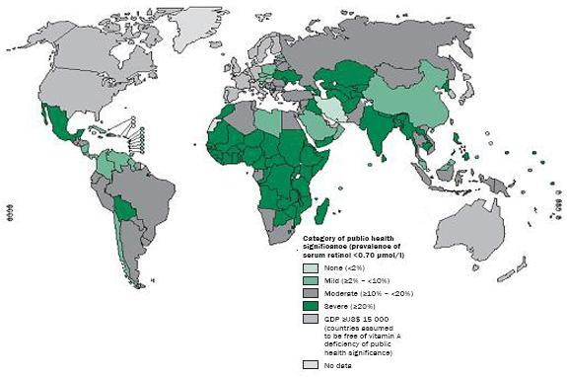
Malnutrition & Vitamin A Deficiency
VAD affects 140 million pre-school children and 7 million pregnant women worldwide (Stein & Sachdev, 2008)
250,000 to 500,000 children becoming blind every year, half of whom die within 12 months after losing their sight (Beyer, 2010).
Vitamin A deficiency affects public health, economic productivity, and individual well-being as it leads to night blindness, corneal scars, blindness, measles, and death (Stein & Sachdev, 2008
Supplementation and fortification of food to treat (Beyer, 2010).
(WHO, 2012)

Slide 5
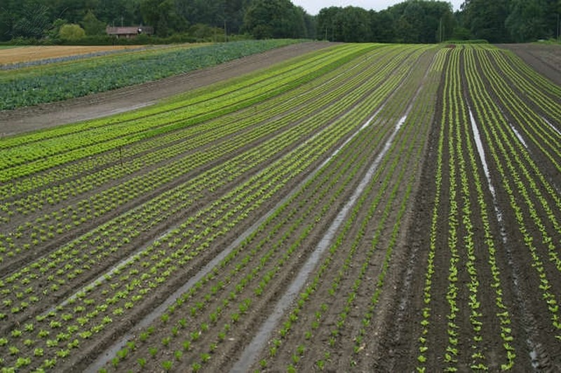
History
Agricultural practices have existed for 12,000 years (Holdrege & Talbott, 2008).
Alteration to crops was accomplished through selection of traits by farmers (Holdrege & Talbott, 2008).
2500 B.C. Rice first came on the scene for human consumption(“History of Rice”).
300 B.C. Alexander the Great’s army brought rice to West Asia and Greece (“History of Rice”).
The Nazis in the 1930s brought an emphasis on eugenics, the idea that genes determine traits (Cummings, 2008).
After World War II, chemicals that were used in the war as explosives, defoliants, and nerve gas were converted into fertilizers, herbicides, and pesticides (Cummings, 2008).
1940-1970s Green Revolution, led by Norman Borlaug Promised an end to world hunger though cross breeding, high yielding varieties, irrigation, pesticide use, monocultures of grains, and use of nitrogen fertilizer (Frison, 2008).
Pre 1950 Primative understanding of nutrition (Keusch, 2003).
Last 30 yrs plant diversity has been accomplished mainly through biotechnology (Holdrege & Talbott, 2008).

Slide 6
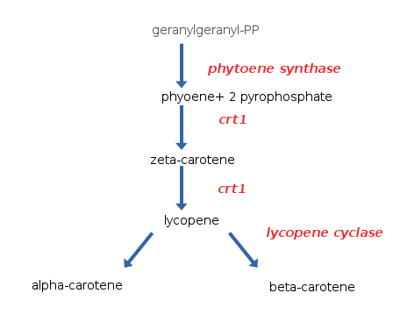
Golden Rice
1984 Concept was birthed (Esernick, 2008)
Early 1970 DNA recombinant technology was developed (Yin-liang, 2006)
1992 Decided that there would be a reintroduction of the biochemical pathway that leads to beta-carotene would be introduced into the endosperm of rice via a promoter (Esernick, 2008).
Peter Beyer & Ingo Potrykus led the development (Cummings, 2008)
Pathway engineering of four genes from Narcissus pseudonarcissus & Erwinia uredovora allows the plant to synthesize beta-carotene in the endosperm (Beyer, 2010).
http://www.youtube.com/watch?v=L7qnY_GqytM&feature=related

Slide 7
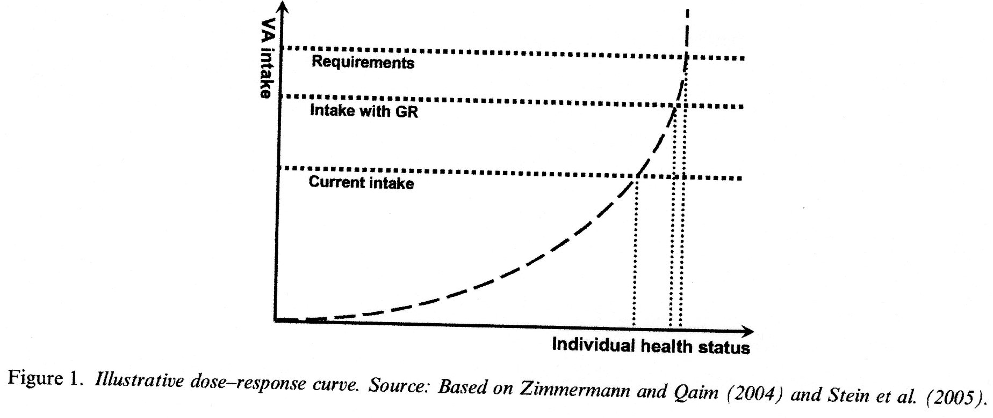
Golden Rice’s
Short Comings
It has been widely criticized that the engineered rice contains far less than the required amount of beta-carotene, only 1.6 чg per gram of endosperm (Enserink, 2012).
Levels fall short of the required amount of vitamin A (Stein & Sachdev, 2008)
3.7 kilos of dry rice or about 9 kilos of cooked rice, which is about 20 pounds to get the daily needs of vitamin A (Pence, 2002).
A normal diet would consist of only 300 grams of rice which would lead to only 8% of vitamin A (Pence, 2002).
(Stein, et. al., 2008, p.147)

Slide 8

Culture & Religion
“Come eat rice with me” is known as the most gracious greeting in Chinese hospitality (Holdrege & Talbott, 2008).
Not only is rice central in Asian food but is a sensory symbolism of pure whiteness connecting to the religious aspects of the culture (Cummings, 2008).
The type of rice a person eats shows a level of class and only the beggars are given brown rice (Cummings, 2008).
Highly unlikely that golden rice will replace white rice, which for millennia has played a variety of nutritional, culinary, and ceremonial roles (Altieri, 2004).

Slide 9
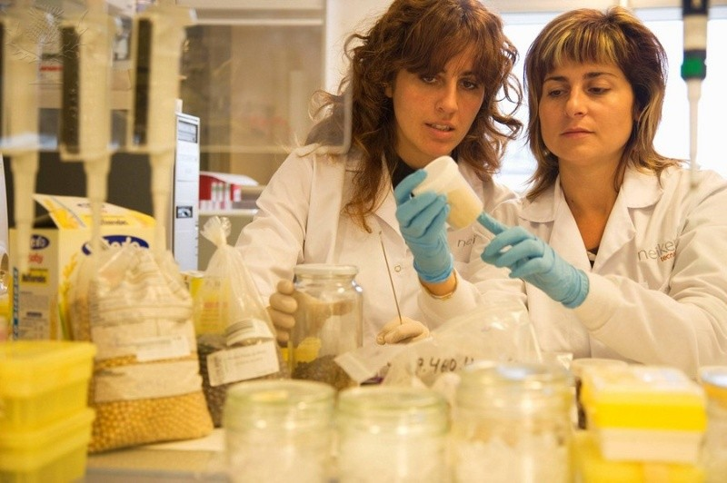
Government & Politics
The government has great influence on what is sold in shops catered for the poor and the content of school meals (Stein & Sachdev, 2008).
No guarantees that the golden rice will eventually be approved in the target countries. India and China as regulatory agencies have shielded away from approving insect-resistant GM rice, Thailand decided to steer clear of golden rice altogether (Ensernick, 2012).
Hunger is caused by poverty. And since poverty is a political problem, it cannot be cured by commercial technology-or any technology for that matter,” states Cummings, enforcing her great doubts of the success of golden rice (Cummings, 2008).
Law
Must be approved by the National Food Safety and Biosafety authorities before distribution to local rice farmers and consumers (Stein & Sachdev, 2008).
Scientific evidence will need to be provide to assure that the rice is safe and nutritionally adequate, does not pose unacceptable risks to the environment, and will provide the human health benefits (Dobson, 2000).

Slide 10
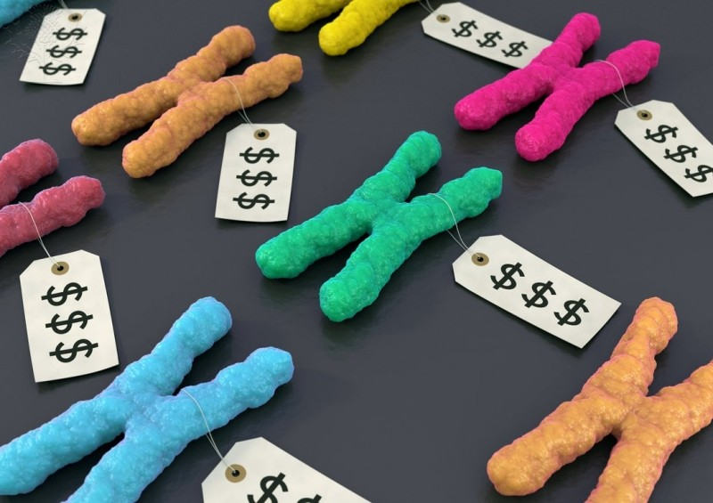
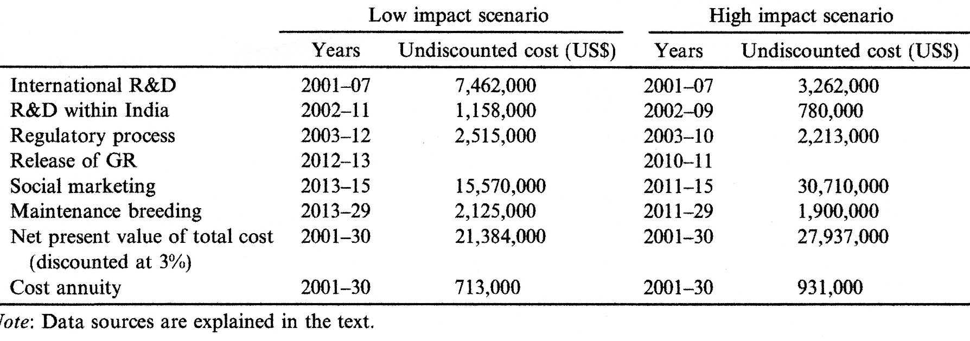
Economic
70 patents from 32 different companies (Cummings, 2008)
Companies will donate to farmers that do not earn more than $10,000 annually ( (Holdrege & Talbott, 2008).
If farmers make more than $10,000 annually they will then begin paying royalty fees, which is undefined (Holdrege & Talbott, 2008
Farmers will not be allowed to export the rice (Potrykus, 2010).
Rice will cost the same as rice purchased today (Beyer, 2010).
Farmers may grow this new rice given free access to the seeds, but the poor living on less than a dollar a day still need to purchase the rice to receive any benefits (Holdrege & Talbott, 2008).
Figure 3 Cost comparisons of projected costs to bring golden rice to market successfully using India as an example (Stein & Sachdev, 2008)

Slide 11
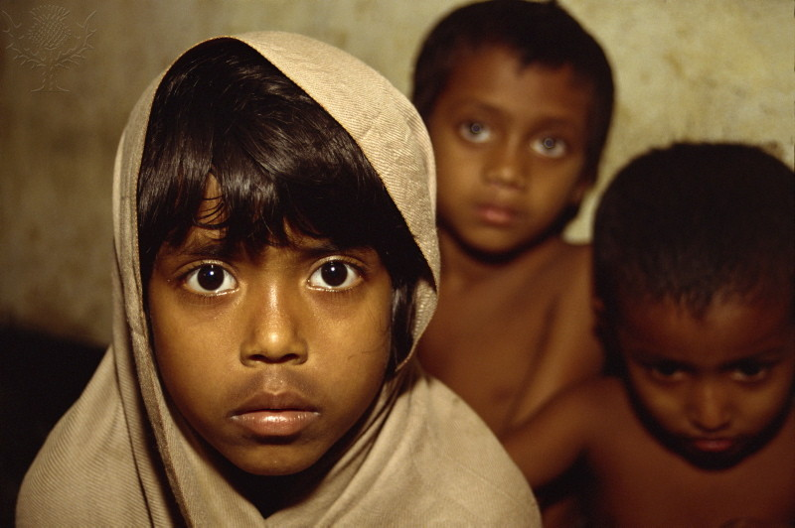
Future Implications
Even if golden rice is successful we have done nothing to address serious issues such as world hunger, poverty, and malnutrition (Cummings, 2008).
Small scale projects are much more promising and have the potential to address more than vitamin A deficiency alone (Cummings, 2008).
Raising fish in rice patties, grow own vitamin-rich veggies such as beans and pumpkin, and nutritional education focused on how to combine foods (Cummings, 2008).
We are throwing our money at a highly in effective approach with golden rice (Cummings, 2008).
Future Implications

Slide 12
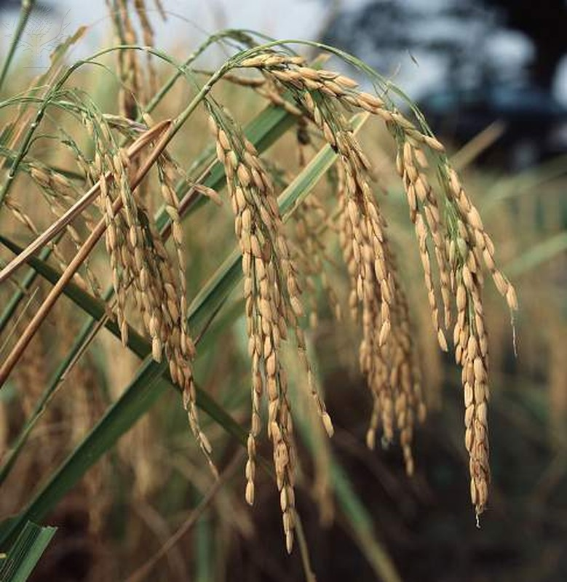
Works Cited
Altieri, M. A. (2004). Genetic engineering in agriculture: The myths, environmental risks, and
alternatives. Oakland, Calif: Food First Books/Institute for Food and Development Policy.
Beyer, P. 2010. Golden Rice and ‘Golden’ crops for human nutrition, New Biotechnology, 27(5), 478-481. Cummings, C. H. (2008). Uncertain peril: Genetic engineering and the future of seeds. Boston, Mass:
Beacon Press.
Enserink, M. (2008). Tough Lessons from Golden Rice. Science, 320 (5875), 468-471.
Global Prevalence of Vitamin A Deficiency in Population at Risk. (2009). WHO global database on vitamin A deficiency. Retrieved on October 5, 2012 from http://www.childinfo.org/vitamina.html.
History of Rice. http://www.duke.edu/web/soc142/team3/Group%20Rice/History.htm Retrieved September 27, 2012.
Holdrege, C., & Talbott, S. (2008). Beyond biotechnology: The barren promise of genetic engineering. Lexington, KY: University Press of Kentucky.
Keusch, G. T., (2003). The History of Nutrition: Malnutrition, Infection, and Immunity. Journal of Nutrition, 133(1), 336S-340S.
Pence, G. E. (2002). The ethics of food: A reader for the twenty-first century. Lanham: Rowman & Littlefield.
Potrykus, I. (2010). Lessons from the ‘Humanitarian Golden Rice’ project: regulation prevents development of public good genetically engineered crop products. New Biotechnology, 27 (5), 466-472.
Stein, A. J., Sachdev, H.P.S., Qaim, M. (2008). Genetic Engineering for the Poor: Golden Rice and Public Health in India. 36 (1), 144-158.
Yin-liang LIU, Exploration of the Biopolitics of GMOs: Using Golden Rice as an Analytical Model, Agricultural Sciences in China, Volume 5, Issue 12, December 2006, Pages 885-894, ISSN 1671-2927, 10.1016/S1671-2927(07)60001-7.

