Slide 1
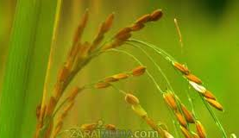

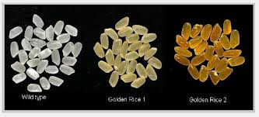
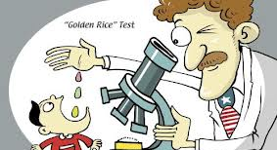
Golden Rice: A boon or bane?

Slide 2
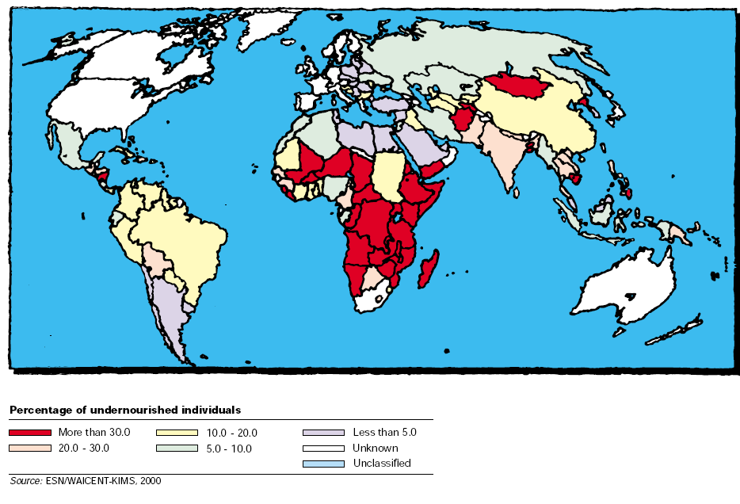
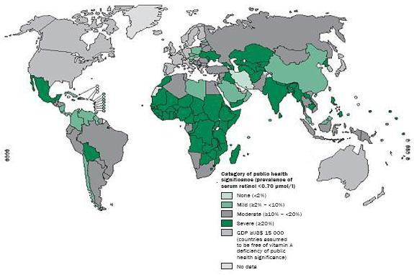
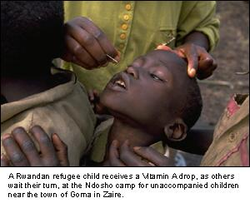
Malnutrition and VAD

Slide 3
β-Carotene Pathway Problem in Plants
IPP
IPP
Geranylgeranyl diphosphate
Geranylgeranyl diphosphate
Phytoene synthase
Daffodil gene
Phytoene synthase
Phytoene
Phytoene
Rice lacks
these enzymes
Phytoene desaturase
Complete Vitamin A Pathway
Phytoene desaturase
Single bacterial gene;
performs both functions
ξ-carotene desaturase
ξ-carotene desaturase
Lycopene
Lycopene
Lycopene-beta-cyclase
Daffodil gene
Lycopene-beta-cyclase
β -carotene
(vitamin A precursor)
β -carotene
(vitamin A precursor)

Slide 4
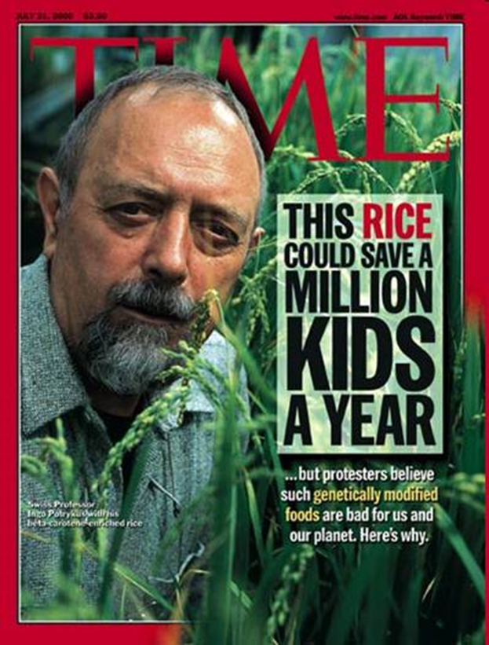
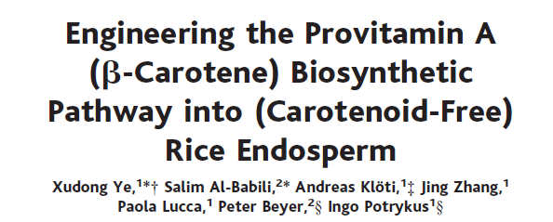
Production of Golden rice 1

Slide 5
Production of Golden rice 1
Single tranformation
Co-tranformation

Slide 6
Confirmation of transformation by Northern and Western Blots

Slide 7
HPLC analysis of the carotenoid extracts

Slide 8
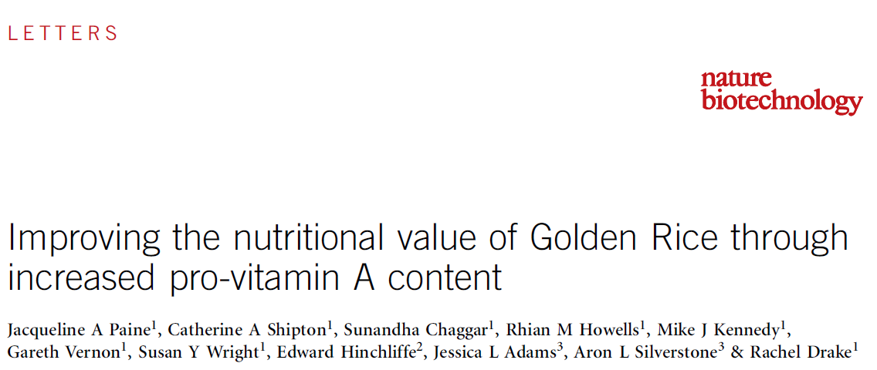
Golden rice 2

Slide 9
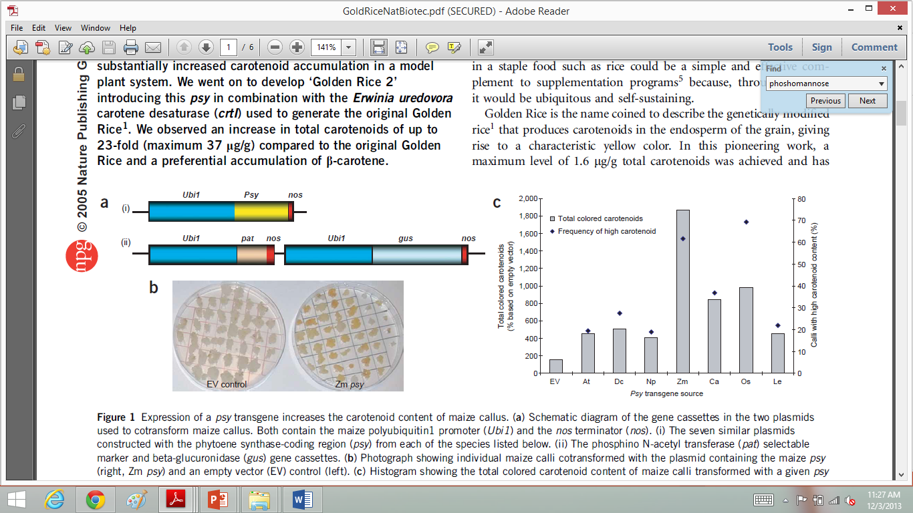
Carotenoid enhancement in rice by introduction of psy orthologues and crtl

Slide 10
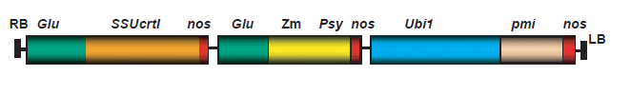
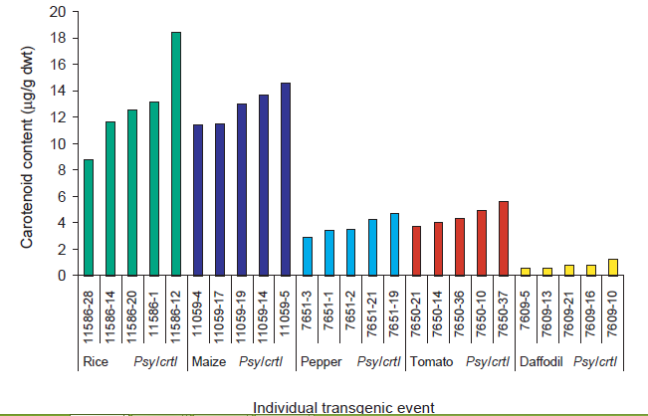
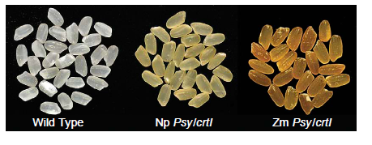
Carotenoid enhancement in rice by introduction of psy orthologues and crtl

Slide 11
Differences between Golden rice 1 and 2
35 μg of carotinoids per gram of dry Golden rice 2 instead of 1.6 μg of carotinoids per gram of dry Golden rice 1.
More efficient phy gene introduced.
Removal of CaMV 35S by polyubiquitin gene.
Incorporation of phosphomannose-isomerase sugar-based selection system instead of antibiotic selection system.

Slide 12
Human trials
Golden Rice 2 plants were grown hydroponically with heavy water (deuterium oxide) to generate deuterium-labeled [²H]β-carotene in the rice grains.
Golden Rice servings of 65–98 g (130–200 g cooked rice) containing 0.99–1.53 mg β -carotene were fed to 5 healthy adult volunteers (3 women and 2 men) with 10 g butter.
A reference dose of [¹³C10]retinyl acetate (0.4–1.0 mg) in oil was given to each volunteer 1 week before ingestion of the Golden Rice dose.
Blood samples were collected over 36 d.

Slide 13
Results
Human trial resulted in a speculation that 50 g uncooked Golden Rice, which is a reasonable serving size for children aged 4–8 y in rice eating regions, who eat ~130–200 g rice/d , would be able
to provide >90% of vitamin A estimated average requirement (EAR) (275 μg retinol/d) or >60% of the Recommended Dietary Allowance (RDA) which is 400 μg retinol/d.

Slide 14
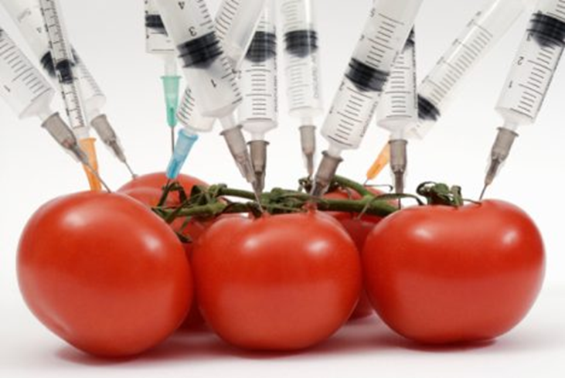
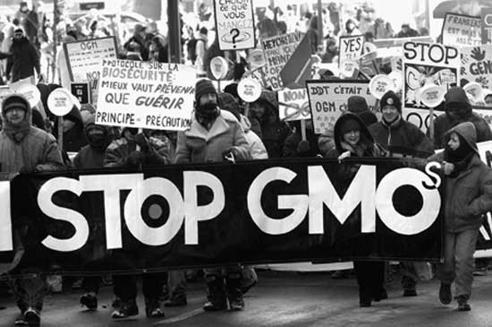
Opposition and delay
People perceive anything involving human manipulation as being highly unnatural.

Slide 15
Issues surrounding commercialization of Golden rice
Social
Political
Environmental

Slide 16
Major concerns
Eat several kilograms of it to get their daily requirement.
Will change the food habit of the developing countries
Small farmers will lose their land and income for being unable to compete with the corporate industries

Slide 17
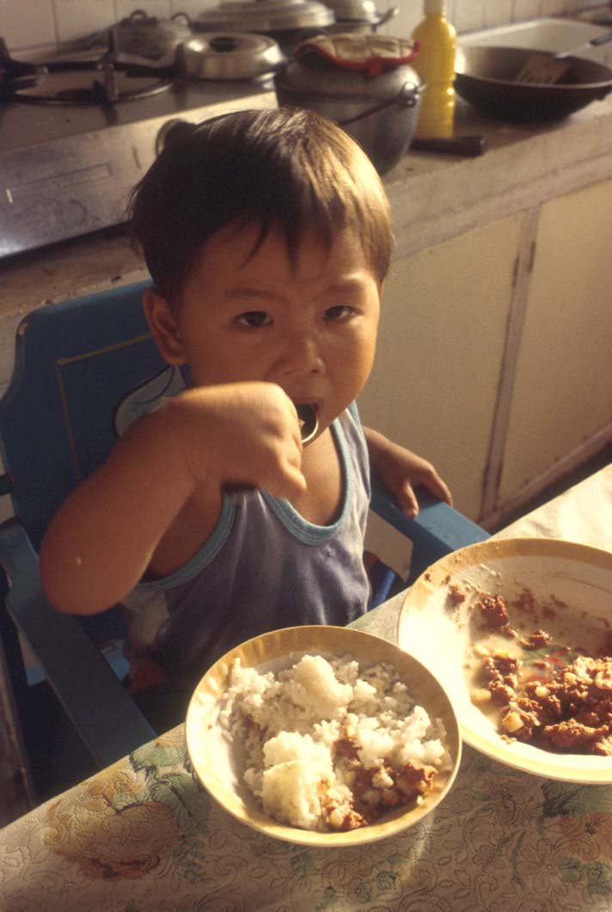

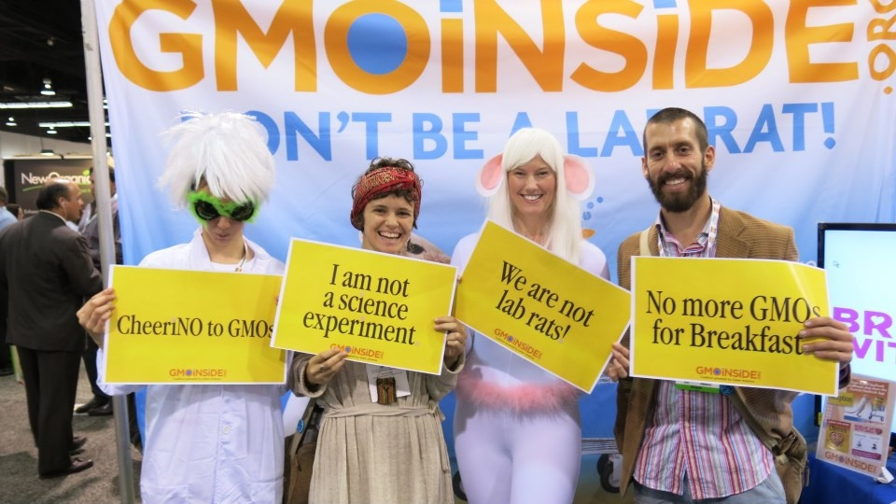
Conclusion
“Public sentiment is everything. With public sentiment, nothing can fail. Without it, nothing can succeed.” – Abraham Lincoln.

