Slide 1
Intro to Biotechnology
By C. Kohn, Waterford WI

Slide 2
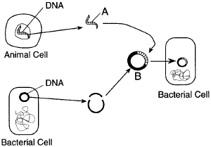
Recombinant DNA
The mapping of the genomes of different species was made possible as a result of recombinant DNA
Recombinant DNA: when genes from two different species are combined and introduced into a cell
Sections of DNA were introduced into E. coli bacteria which then reproduced and copied the genes.
However, recombinant DNA can be used to create much more than a sequenced genome.

Slide 3
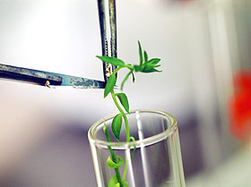
Biotechnology
Recombinant DNA has made the science of biotechnology possible.
Biotechnology: the manipulation of the genetics of organisms to make useful products
Biotechnology is not necessarily a new science
Selective breeding of livestock and the use of microbes to make wine are ancient examples of biotechnology
However, with the use of recombinant DNA and other technologies, biotechnology has changed modern life.

Slide 4
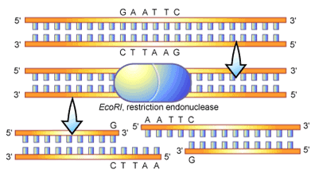
Making Recombinant DNA
The production of recombinant DNA from multiple sources is relatively the same whether you intend to sequence a genome or produce Bt corn.
First, a gene must be cut using a restriction enzyme (a chemical scissors for DNA that always cuts at the same sequence of bases)
Copies of DNA always yield the same restriction fragments when exposed to a restriction enzyme (meaning DNA copies are always cut in a predictable way).

Slide 5
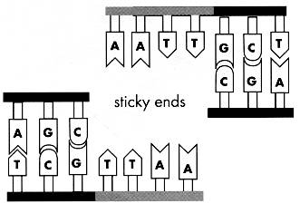
Making Recombinant DNA
If a restriction enzyme cuts DNA in such a way that a single-stranded portion remains, this is called a “sticky end”
Sticky ends are important because they allow the addition of new genes so long as they have the complementary sequence to the sticky ends
E.g. a new gene would have to have a TTAA sticky end to ‘fit’ inside these restriction fragments.

Slide 6
Creation of Recombinant DNA
1. A restriction enzyme cuts DNA
2. Restriction fragments are created
3. A new gene with complementary sticky ends is inserted.
4. DNA ligase (an enzyme) permanently seals the new gene into the genome.
Restriction Enzyme
DNA Ligase

Slide 7
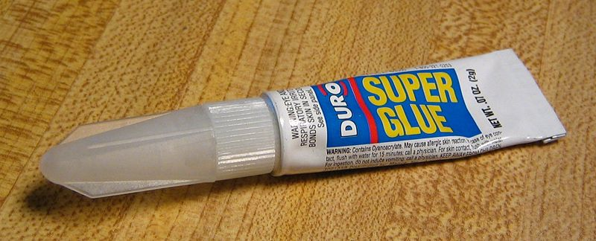
DNA Ligase
Even if a new gene has complementary sticky ends, a DNA ligase enzyme is necessary to “cement” the new gene into the genome.
Without DNA ligase, the bond is only temporary.
DNA Ligase is the “super glue” that makes a bond permanent
Once DNA ligase has formed a permanent bond with the new gene and the original genome (the “vector), we have recombinant DNA.
A cloning vector is the DNA that carries the inserted gene
DNA Ligase

Slide 8
Creating Clone Libraries
If you recall, recombinant DNA was used to sequence the human genome.
Sections of human DNA were inserted into E. coli chromosomes to replicate the human DNA.
By cutting the bacterial genome and inserting the human DNA, we were creating recombinant DNA.
Each time the bacteria divided, they reproduced the same human gene.
Later, the human gene could be removed using the same restriction enzyme to cut the bond created by DNA ligase.
The DNA, now copied, could be better studied and sequenced using the Sanger method.

Slide 9
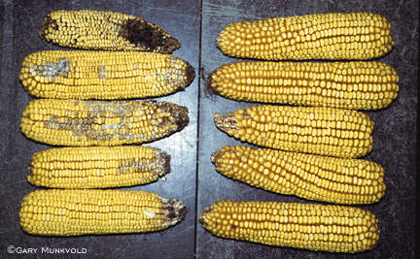
Uses of Recombinant DNA
Recombinant DNA provides many uses beyond sequencing a genome.
One of the industries most affected by biotechnology and the use of recombinant DNA is agriculture.
Bt Corn is perhaps the most famous examples of a genetically modified organism (GMO).
GMO: a plant or animal that has been genetically modified through the addition of a small amount of genetic material from other organisms.
Right: control vs. Bt corn

Slide 10
Bt Corn
In a GMO, genetic material from another organism is inserted into the plant or animal genome. These genes can come from any living source, including bacteria, fungi, and other organisms.
In the case of Bt Corn, an inserted gene for a natural insecticide came from Bacillus thuringiensis, a bacterium found naturally in the soil.
B. thuringiensis bacteria naturally produce a toxin (the Bt delta toxin) which kills specific predatory insects during the larval stage.
It does not other insects in the way broad-spectrum insecticides do, making it an ideal replacement to synthetic chemical pesticides.
Bt was actually available as a separate pesticide since 1960 and has an excellent safety record, making it an ideal choice as a GMO.

Slide 11
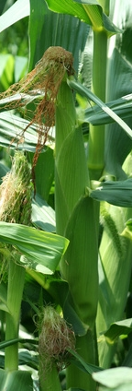
Production of Bt Corn
Production of Bt Corn was relatively straightforward:
The gene for the Bt toxin was sequenced and identified.
The gene was removed from the B. thuringiensis genome using a restriction enzyme.
The genome of corn was spliced using the same restriction enzyme.
The gene was inserted and made permanent using DNA ligase.
The modified corn genome was inserted into a corn cell nucleus.
The corn cell, when it divided, produced the Bt gene along with the rest of the corn’s genome.

Slide 12
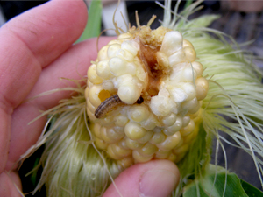
Bt in action.
Because Bt corn has the gene for the Bt toxin, it produces this protein just like any other protein in a corn cell.
When an insect ingests the Bt toxin protein produced by the corn, the Bt toxin binds to the stomach wall of the insect.
Within hours the stomach wall is broken down by the toxin.

Slide 13
Is It Safe?
Bt corn was approved by the USDA for human consumption in 1995. Is it safe?
This might be a good question, given the Bt toxin kills insects by destroying their intestinal tracts
“Delta endotoxins and VIPs produced by the currently available events all are rapidly broken down in the stomach and thus are not potential food allergens.” – Colorado State University
i.e. your own stomach will rapidly break down the toxins before they can affect you
Bt corn is considered generally safe a not a threat to consumers.
It is regulated by both the EPA and FDA for human and environmental safety.
It has been used for over 15 years with no record of serious issue.
Does this mean it is safe?

Slide 14
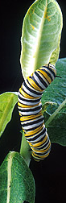
Bt & Monarchs
Concern has also been raised about the impact of Bt corn on monarch butterflies.
Research by the USDA’s Agricultural Research Service has shown that other than an early version of Bt Corn (which has since been replaced), the impact on monarchs is negligible and insignificant.
Plus, the alternative to Bt corn is the use of chemical pesticides, which are far more harmful to butterflies.

Slide 15
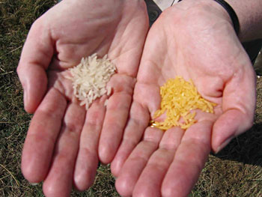
Golden Rice
Rice is one of the most widely consumed grains in the world.
However, rice is not a rich source of many vitamins, including Vitamin A
Vitamin A deficiency is a major problem in many countries, leading to blindness and other health disorders.
Golden rice was an early attempt to use GMOs to solve a major nutritional problem in developing nations.

Slide 16
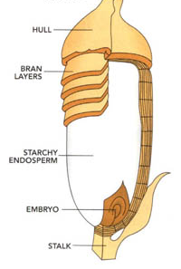
Golden Rice
Some plants naturally produce β-carotene, which our own bodies use to produce Vitamin A
Golden rice is a genetically modified version of rice that helps the body produce Vitamin A through increased levels of β-carotene
Rice endosperm (the white starchy inside) does not naturally produce β-carotene
Selective breeding therefore would not have worked to produce a breed of rice that makes β-carotene

Slide 17
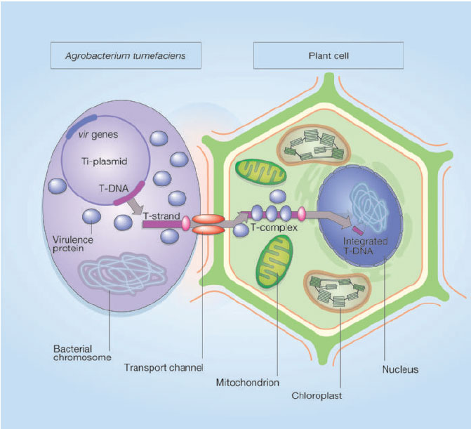
Producing Golden Rice
Agronomy researchers identified the pathway necessary for a plant to produce β-carotene as well as the enzyme proteins that fulfilled this role.
A special kind of bacterium, called Agrobacterium tumafaciens, was used to insert β-carotene genes from daffodils into the rice genome.
Agrobacterium can transfer DNA between itself and plants
Galls (stem growths) on plants are naturally caused by Agrobacterium

Slide 18
Golden Rice
Using Agrobacterium, the genes for the entire β-carotene protein pathway were inserted into the rice genome.
The β-carotene genes also turned the white endosperm of the rice into a rich yellow.
This is why it is now called “Golden Rice”

Slide 19
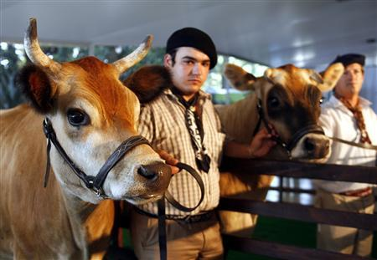
“Pharm” Animals
Current research is aiming to create farm animals that are engineered to be pharmaceutical “factories”
In other words, these GM animals would produce medical substances in their bodies the same way they produce any other kind of protein.
Most of this kind of research focuses on milk-production as a source of the production of medical pharmaceuticals.
For example, these Argentinean cows were engineered to produce insulin in their milk (along with all other milk proteins)
Ideally, diabetic patients would not need to take insulin shots – they’d only need to drink a glass of milk!

Slide 20
Environmental Uses
Genetically Modified Organisms have also been sought for their potential benefit to the environment.
One major area of research is the use of GMOs to clean up toxic waste sites and oil spills.
Some bacterial strains have been developed that can degrade some compounds found in oil spills into a more neutral and less harmful substance
Other microbes are being engineered to break down wastes that are not currently biodegradable (such as plastics), or extract toxic heavy metals such as copper, lead, and nickel.

Slide 21
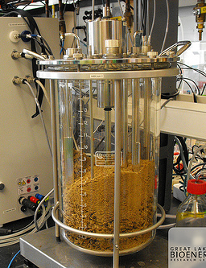
Biofuels
GM organisms are currently being developed to convert cellulose (in plant cell walls) into a easily-convertible form for the greater production of environmentally sustainable biofuels (such as ethanol and biodiesel).
Cellulose is the most widely abundant organic molecule on the planet and absorbs CO2 from the atmosphere.
If a microbe could be developed to efficiently convert cellulose into a source of fuel, we could eliminate our dependence of fossil fuels and other non-renewable sources of energy.
At the same time, the effects of climate change could be minimized by removing CO2 from the atmosphere.

