Slide 1
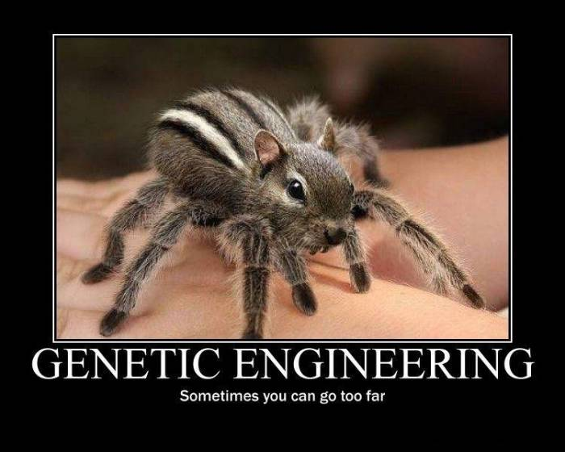
Biotechnology Unit: Genetic Engineering Techniques
Notes:
This is just meant to be a funny introduction.
“Chipmuntula”

Slide 2
What is Biotechnology?
Biotechnology is the manipulation of natural biological processes in order to serve societal needs.
Notes:
Briefly go over what biotechnology is and a brief overview of some of the “products” that we have been able to produce.

Slide 3
Types of Biotechnology
4 MAIN AREAS OF BIOTECHNOLOGY
Transgenic Biotechnology | Mixing genetic material from multiple sources (species)
Reproductive cloning | Techniques used to clone certain species (mammals)
Reprogramming of Cells | Reprogramming differentiated cells or using stem cells to become needed tissues in patients with diseases or physical harm
Forensic Biotechnology | Use of restriction enzymes and electrophoresis to distinguish one person from another
Notes:
Briefly describe the four main areas of biotechnology.

Slide 4
Where is your line?
As we go through the following slides, you will be presented with different techniques and examples of how biotechnology is being used in our global society.
It is your job to decide…how far is too far? Where is your ethical line and what factors dictate when your line is crossed?
Remember, if your line is different from somebody else’s that is perfectly fine. Are you ready?
HERE WE GO!
Notes:
What we want to do is engage the students in a conversation/discussion over where their line is regarding bioethics and biotechnology. We use this method to give them a reason to learn more about the content in this unit. They need to know that decisions that are made regarding biotechnology are shaping the global marketplace even as they are learning this material. Give them the opportunity to speak their opinion as long as there is no judgment. The ultimate goal here is to have students think about their own opinion, listen to the opinions of others, and hopefully…decide whether their “line” has moved by the end of the lesson.

Slide 5
Transgenic Biotechnology
Where is your line?

Slide 6
HGH Deficiencies
The pituitary gland produces a crucial hormone called the human growth hormone.
This peptide hormone (protein) provides for normal growth and development.
If the pituitary gland is defective then growth is severely stunted.
For many years HGH had to be extracted from the pituitary glands of deceased humans which meant that there was a shortage of available HGH.
Notes:
You could probably review the pituitary gland, the hormones it produces, and their effects by asking what other issues a defective pituitary gland might have.
Posterior pituitary
Oxytocin – stimulates growth and metabolic functions
Antidiuretic hormone – promotes water retention in the kidneys
Anterior pituitary
Growth hormone – stimulates growth and metabolic functions
Prolactin – stimulates milk production
Follicle stimulating hormone – stimulates production of ova and sperm
Luteinizing hormone – simulates ovaries and testes
Thyroid-stimulating hormone – stimulates the thyroid gland
Adrenocorticotropic hormone – stimulates the adrenal cortex to secrete glucocorticoids

Slide 7
Starting in the mid-1980’s…
Now, we have all we need! How?
The HGH gene was cut out of the human genome and inserted into a plasmid, which is now now called recombinant DNA because it contains DNA from multiple sources.
The plasmid is then taken up via transformation by a bacterium.
The bacterium reproduces many times and when the the bacterium undergoes transcription and translation (protein synthesis), it makes all of the HGH that we could possibly need!
Notes:
This slide shows the students how transgenic bacteria are made. Go through the process with them and make sure that they fully understand the following concepts before going on:
Recombinant DNA and how it is made
Where does the plasmid come from?
What is transformation and what role is it playing in this process?
We can make “proteins” with this method as the bacteria are undergoing the same process that our cells do, i.e. transcription, translation, etc.
You might stop here and ask, “Does this cross anyone’s line?”
Remember that the students do NOT have to memorize or learn each individual step. The main thing they need to know for the AP Biology Exam is to be able to use this as an illustrative example of genetic engineering techniques that can be used to manipulate the heritable information of DNA, and in some cases, RNA.

Slide 8
Wait, what is a plasmid?
A plasmid is a small, circular piece of DNA that not only is separate from the chromosome, but can also replicate independently.

Slide 9
How do they cut out a gene?
How do they cut the gene of interest out of the genome?
Restriction Enzymes!!
Notes:
Go over the process with the students.
Make sure that you point out how “sticky ends” are made and what makes them “sticky”, i.e. their ends are complementary to other strands that have been cut with the same restriction enzyme.
Remember that the students do NOT have to memorize or learn each individual step. The main thing they need to know for the AP Biology Exam is to be able to use this as an illustrative example of genetic engineering techniques that can be used to manipulate the heritable information of DNA, and in some cases, RNA.

Slide 10
How does a fragment then get spliced in?
Notes:
Go over the process with them and explain how fragments without “sticky ends” are not able to be spliced in.
Go back over DNA ligase. Where have they seen that before? (DNA replication)
Remember that the students do NOT have to memorize or learn each individual step. The main thing they need to know for the AP Biology Exam is to be able to use this as an illustrative example of genetic engineering techniques that can be used to manipulate the heritable information of DNA, and in some cases, RNA.

Slide 11
Insulin
The pancreas, among other functions, produces a crucial hormone called insulin.
This peptide hormone (protein) ensures that glucose is taken up by the cells for cellular respiration.
If the pancreas is defective then the blood sugar levels get dangerously high causing many physiological effects (Diabetes mellitus).
Using very similar technique as HGH production previously mentioned, scientists were able to use E. coli to bioengineer synthetic insulin in 1977.
Other transgenic organisms used to produce insulin today are yeast (Saccharomyces cerevisiae) and a plant called safflower (Carthamus tinctorius).
Notes:
Go over what insulin does, where its made, and what diabetes is. Engage them in a discussion of the different ways in which it can be made synthetically.
Make sure that you engage the students in a brief discussion of “Does this cross your line?” Again, this could be done by a show of hands and anyone raising their hands can give a brief explanation of why.

Slide 12
Golden Rice
The World Heath Organization estimates that between 1 and 2 million children die each year from vitamin A deficiency.
Golden rice is a genetically modified food that is fortified with beta carotene, which the human body converts into vitamin A.
This transgenic organism is the result of mixing genes from a bacterium and from daffodils into the rice genome.
It is not currently used due to regulatory issues.
Do you think we should be able to use it?
Notes:
Go over what golden rice is, how its made, and what possible good it might could do. Make sure they know that because of issue with regulation, it is not “currently” being used. Much like several other GMF (Franken foods) available today.
Make sure that you engage the students in a brief discussion of “Does this cross your line?” Again, this could be done by a show of hands and anyone raising their hands can give a brief explanation of why.

Slide 13
Reproductive Cloning
Where is your line?

Slide 14
Reproductive Cloning
What is a clone?
It is an exact genetic replica of another cell or organism.
What have we cloned so far?
DNA (Polymerase Chain Reaction)
Cells (creating tissue cultures or stem cell lines)
Whole organisms
Notes:
You might start by asking what the students “think” cloning is and what they feel about it.

Slide 15
Organismal Cloning
What has been cloned thus far?
Plants have been cloned for thousands of years!
Bananas, potatoes, grape vines (grafting), etc.
Many trees, shrubs, and vines are just clonal colonies.
Animals
Parthenogenesis – asexual reproduction that occurs naturally where offspring is born with sexual reproduction (sharks, anteaters, some insects, etc.)
Some animals have undergone somatic cell nuclear transfer such as: sheep, rats, cats, goats, dogs, camels, and many others.

Slide 16
Somatic Cell Nuclear Transfer (SCNT)
Notes:
Go over the process of cloning outlined by the figure. Engage the students in discussion by asking the following questions:
Is a male needed for this process? Why or why not?
Why is an egg cell used?
What is the difference between the DNA in the egg and the DNA in the somatic cell?
Make sure that you engage the students in a brief discussion of “Does this cross your line?” Again, this could be done by a show of hands and anyone raising their hands can give a brief explanation of why.
Remember that the students do NOT have to memorize or learn each individual step. The main thing they need to know for the AP Biology Exam is to be able to use this as an illustrative example of genetic engineering techniques that can be used to manipulate the heritable information of DNA, and in some cases, RNA.

Slide 17
So, what if we…
So, what if we….
What if we manipulate animal embryos and use recombinant technology to give these animals some beneficial characteristics…to us? That is what some scientists have been able to do. Some animals, like this goat, have been bred to produce certain peptide hormones needed by humans when they express milk. These proteins can easily be separated from the milk for human use!
Notes:
Make sure that you engage the students in a brief discussion of “Does this cross your line?” Again, this could be done by a show of hands and anyone raising their hands can give a brief explanation of why.

Slide 18
Reprogramming cells
Where is your line?

Slide 19
What can stem cell research do for us?
Stem cells could help us in many medical applications such as:
Organ and tissue regeneration
Fighting the following diseases:
Cardiovascular disease
Brain diseases like Parkinson’s and Alzheimer's
Blood diseases like leukemia and sickle-cell anemia
So…what’s all the fuss about?
The stems cells that work the best come from embryos.

Slide 20
Plant cells are totipotent!
Notes:
Explain how a plant, such as this carrot, can be fragmented and then used to produce a whole carrot again. Ask the students if they have ever heard of the word totipotent and ask them what they think it means.

Slide 21
Stem Cells
What are they?
Stem cells are undifferentiated, meaning that they haven’t become a “type” of cell yet.
When a sperm meets an egg, the resulting zygote is totipotent. The inner cell mass, the source of “embryonic stem” cells, are pluripotent.
Totipotent cells have the ability to create a whole organism, or at least all different types of tissues.
Pluripotent cells can only give rise to most types of tissues, and definitely NOT a whole organism.
Notes:
Make sure the students understand the difference between a pluripotent cell and a totipotent cell.

Slide 22
iPS cells
In 2007, the induced pluripotent stem (iPS) cells were developed.
Reprogramming genes are spliced into normal human somatic cells.
This tricks the cell into changing from a differentiated cell into a pluripotent cell.
The cell can then develop into a desired, differentiated cell of another type!
THIS COULD ELIMINATE THE NEED FOR EMBRYONIC STEM CELLS!
Notes:
Really engage the students and ask if iPS cells were used instead of embryonic stem cells…would they be for their use to help cure/fight diseases?
Remember that the students do NOT have to memorize or learn each individual step. The main thing they need to know for the AP Biology Exam is to be able to use this as an illustrative example of genetic engineering techniques that can be used to manipulate the heritable information of DNA, and in some cases, RNA.

Slide 23
John Gurdon Shinya Yamanaka
The 2012 Nobel Prize in Physiology and Medicine
They received the 2012 Nobel Prize (Physiology and Medicine) for their work with the development of iPS cells.
Notes:
This slides stresses that the concepts and technologies discussed in this lesson are changing rapidly everyday.

Slide 24
Forensic Biotechnology
Where is your line?

Slide 25
Forensic Biotechnology
Forensic Biotechnology is used to determine the identity of certain individuals:
Criminals
Disaster victims
Biological parents

Slide 26
Electrophoresis
Notes:
Engage the students in a discussion of this process by asking them the following questions:
Why is the DNA being placed on the negative side?
Why does it travel toward the positive side?
Explain that the gel is like a matrix of tunnels, some large and some small. Ask: Why are the large molecules closer to the start than the smaller ones? How can we use this to identify certain fragments.
One way to analyze a sample of DNA via electrophoresis involves cutting the sample with restriction enzymes. This requires a large sample of DNA, such as from a test tube of blood. Cutting with the enzymes will produce fragments of DNA. The length of those fragments will differ between individuals. Those differences are called restriction fragment length polymorphisms (RFLP). The illustration in this slide and the next could be RFLPs. How can this be used to do paternity tests or crime scene analysis? (compare banding patterns between samples)
Make sure that you engage the students in a brief discussion of “Does this cross your line?” Again, this could be done by a show of hands and anyone raising his or her hands can give a brief explanation of why.
Remember that the students do NOT have to memorize or learn each individual step. The main thing they need to know for the AP Biology Exam is to be able to use this as an illustrative example of genetic engineering techniques that can be used to manipulate the heritable information of DNA, and in some cases, RNA.

Slide 27
Electrophoresis

Slide 28
Polymerase Chain Reaction
Usually there is only a small amount of DNA to work with at a crime scene.
Investigators and forensic scientists use the polymerase chain reaction to make thousands of copies of key regions of the original DNA strand.
Notes:
The small amount of sample available at most crime scenes makes RFLP analysis impossible. Another option is to use PCR to produce products to analyze in other ways, as described in the following slides. Note that no restriction enzymes are used in analyzing PCR products, so we do not refer to RFLPs when discussing PCR analysis of DNA. If large samples of DNA are present, then both techniques could be used.

Slide 29
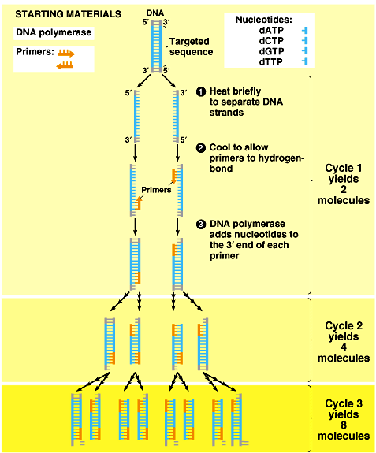
PCR!
Notes:
For a great animations showing how PCR works, see http://www.dnalc.org/view/15924-Making-many-copies-of-DNA.html and http://www.dnalc.org/view/15475-The-cycles-of-the-polymerase-chain-reaction-PCR-3D-animation-with-no-audio.html (the first is in 2D and the second is in 3D)
Take some time going over this figure and the animation(s). It is important to realize that only a relatively short (up to 20,000 base pairs, but typically much shorter than that) “target sequence” is being amplified. The area between the two primers is the target sequence. In the image on the slide, point out that the chromosome goes on for a very long distance both above and below the stretch being shown in the illustration. PCR can not be used to copy an entire chromosome. Make sure the student understands what is going on here by prompting them to explain the following:
What is a primer used for?
How is DNA polymerase used in this process?
What else must be in the test tube for the process to work? (template DNA; nucleotides – A,C,G,T)
What does heating up the test tube mixture do?
What does cooling the test tube mixture do?
Remember that the students do NOT have to memorize or learn each individual step. The main thing they need to know for the AP Biology Exam is to be able to use this as an illustrative example of genetic engineering techniques that can be used to manipulate the heritable information of DNA, and in some cases, RNA.
Make sure that you engage the students in a brief discussion of “Does this cross your line?” Again, this could be done by a show of hands and anyone raising his or her hands can give a brief explanation of why.

Slide 30
Electrophoresis
The PCR products (DNA strands) are analyzed via electrophoresis for STR’s (short tandem repeats).
Every person has their own individual pattern of these STRs.
For a single set of primers, a person will have 2 PCR products if they inherited different numbers of STRs from each parent. This results in 2 bands on their gel.
Notes:
Each PCR reaction typically amplifies a single locus (there are some researchers using multiple primers in a single mixture, but that is not important for our level of discussion). Since we all have two copies of each locus (thanks to our maternal and paternal homologous chromosomes), we will get two separate products from a single PCR reaction. If the region between the primers on our paternal chromosome differs in length from the region between those same primers on our maternal chromosome then we get products of different sizes which then show up as two separate bands on a gel. If the products happen to be the same length, then only one band results. One of the most common regions for pcr analysis are those containing short repeated segments of DNA between the primer sites. These are called STRs. One might have 15 repeats of that sequence between the primer sites on the paternal chromosome and 18 repeats of that same sequence between the same primer sites on the maternal chromosome. This would then result in two bands on a gel when these PCR products are analyzed. By using multiple sets of primers, one can get numerous bands to compare between samples.
Numerous other differences could be analyzed other than STRs, such as SNPs (single nucleotide polymorphisms), etc. but students do not need to know every possible method of analyzing DNA differences. They DO need to know that differences exist and why they exist.

Slide 31
Short Tandem Repeats
Notes:
Earl Washington, Jr. was sentenced in 1982 for rape and murder. In 1994, DNA from the crime scene was tested and in the analysis of the DNA on the victim and the two suspect, it was found that Mr. Washington was NOT guilty. Shortly before his execution the governor of Virginia gave him clemency and commuted his sentence to life in prison. Years later he was given a full pardon and released from prison…after 17 years.
In the table, the numbers refer to the number of repeats at each locus. For instance, at locus 1 (STR marker 1), Earl had 16 repeats on one of his chromosomes and 18 on the other. The evidence DNA had 17 and 19 repeats, meaning it could not have come from Earl. But it did match Kenneth Tinsley. Note that STR marker 1 was enough to eliminate Earl as a suspect, but that single site would not be conclusive as to it coming from Kenneth. Numerous sites were used and all matched Kenneth Tinsley.

Slide 32
DNA Analysis
We have the ability to “sequence DNA.” This means that if we know the gene we are looking for we can analyze someone’s DNA for a specific sequence, i.e. allele.
Therefore, we could tell you definitively if you have a disorder like Huntington’s, an autosomal dominant disorder, or not.
Huntington’s Disorder is a degenerative brain disorder that “usually” starts causing telltale symptoms around age 35. There is no cure for Huntington’s and it is eventually fatal.
Would you want to know?
Notes:
Make sure that you engage the students in a brief discussion of “Does this cross your line?” Again, this could be done by a show of hands and anyone raising his or her hands can give a brief explanation of why.
Remember that the students do NOT have to memorize or learn each individual step. The main thing they need to know for the AP Biology Exam is to be able to use this as an illustrative example of genetic engineering techniques that can be used to manipulate the heritable information of DNA, and in some cases, RNA.

Slide 33
Where is your line?
Other than the ones already mentioned, here are some other “real-life” examples of biotechnology. Do any of these cross your line?
Injecting human brain cells into monkey brains
for brain disease research
Xenotransplantation
using animal “parts” for our parts (for instance using a pig valve to replace a defective heart valve in a human)
Adding human stem cells to sheep fetuses
to produce sheep with livers made of mostly human tissue
Bt crops
these crops contain genes from the bacterium Bacillus thuringiensis which produces proteins toxic to pest insects
Roundup Ready crops
contain genes that protect them from Roundup (herbicide)
Notes:
Again, the goal is to get students to find their “line” and ask themselves why their line is where it is and most importantly…what circumstances could make my line change.

Slide 34
Created by:
Jason Walker
Science Coordinator
National Math + Science Initiative
Dallas, TX

