Slide 1
What is Allelopathy?
The word allelopathy derives from two separate words.
They are allelon which means "of each other", and pathos which means "to suffer".
Allelopathy refers to the chemical inhibition of one species by another. The "inhibitory" chemical is released into the environment where it affects the development and growth of neighboring plants.
Allelopathic chemicals can be present in any part of the plant.
They can be found in leaves, flowers, roots, fruits, or stems. They can also be found in the surrounding soil.

Slide 2
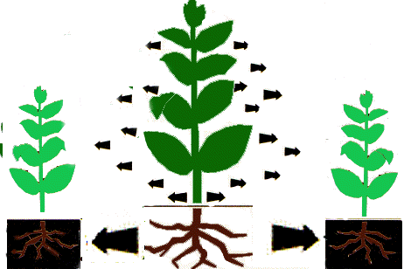
Target species are affected by these toxins in many different ways. The toxic chemicals may inhibit shoot/root growth, they may inhibit nutrient uptake, or they may attack a naturally occurring symbiotic relationship thereby destroying the plant's usable source of a nutrient.

Slide 3
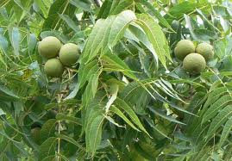
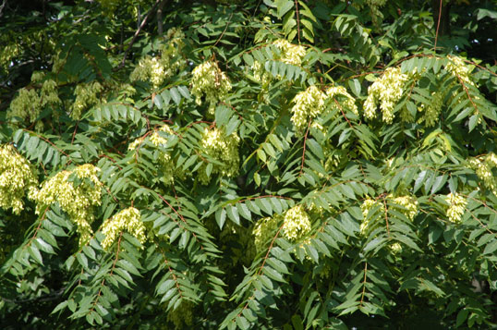
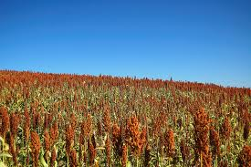
Chemical Warfare in the Plant Kingdom
Black Walnut-The chemical responsible for the toxicity in Black Walnut is Juglone and is a respiration inhibitor.
Tree-Of-Heaven-Ailanthone, an allelotoxin extracted from the root bark of Ailanthus.
Sorghum- Sorgolene is found in the root and disrupts mitochondrial functions and inhibits photosynthesis.

Slide 4
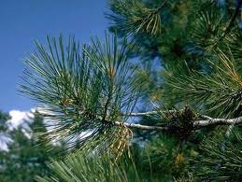
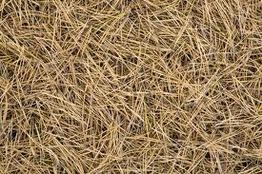
Have you noticed allelopathy or allelopathic-like influences in your neighborhood? Elsewhere?
Why is studying allelopathy important?
What are some beneficial implications of allelopathy? How can these be used for the betterment of the planet?

