Slide 1
PLANT ALLELOPATHY
PRESENTED BY:
N. ROMEN SINGH
M.Sc.(hons.)final year,2011-2012
ROLL NO:15

Slide 2
CONTENTS
1.INTRODUCTION
2.HISTORY
3.PLANT ALLELOCHEMICALS
4.ALGAL ALLELOPATHY
5.ALLELOPATHY OF BRYOPHYTES
6.ALLELOPATHY OF PTERIDOPHYTES
7.ALLELOPATHY OF GYMNOSPRMS
8.MODE OF ALLELOCHEMICAL INDUCTION
9.ALLELOPATHIC INTERACTION AMONG PLANTS
10. MODE OF ACTION OF PLANT INHIBITION
11.ROLES OF ALLELOPATHY IN NATURE
12.ADVANTAGES OF ALLELOCHEMICALS
13.CONCLUSION

Slide 3
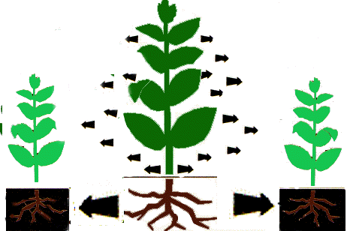
WHAT IS PLANT ALLELOPATHY?
The term Allelopathy, from the Greek-derived compounds allelo- and -pathy (meaning "mutual harm" or "suffering"), was first used in 1937 by the Austrian professor Hans Molisch in the book Der Einfluss einer Pflanze auf die andere - Allelopathie (The Effect of Plants on Each Other) published in German.
Allelopathy refers to the beneficial or harmful effects of one plant on another plant, both crop and weed species, by the release of chemicals from plant parts .

Slide 4
HISTORY OF PLANT ALLELOPATHY
Theophrastus (ca. 300 B.C.E.), a student and successor to Aristotle, wrote about allelopathic reactions in his botanical works. He has been called the "father of Botany", and wrote of how chickpea "exhausts" the soil and destroys weeds.
In 1 C.E., Gaius Plinius Secundus, also known as Pliny the Elder, a roman scholar and naturalist, wrote about how chick pea and barley "scorch up" cornland. He also mentioned that Walnut trees are toxic to other plants.
Augustin Pyramus De Candolle, a botanist and naturalist, in 1832, suggested that soil sickness was caused by chemicals released by the crop.

Slide 5
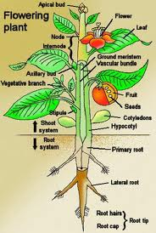
ALLELOCHEMICALS AND THEIR OCCURRENCE
. Allelochemicals are a subset of secondary metabolites,[which are not required for metabolism (i.e. growth, development and reproduction) of the allelopathic organism. Allelochemicals with negative allelopathic effects are an important part of plant defense against herbivory
Allelopathic chemicals can be present in any part of the plant. They can be found in roots, rhizomes,leaves,stems, flowers ,pollens, fruits, or seeds.
They can also be found in the surrounding soil. Target species are affected by these toxins in many different ways.

Slide 6
continued
These allelochemicals may be conveniently grouped as follows: GLUCOSIDES SAPONINS TANNINS
ISOTHIOCYANATES
GLUCOSINOLATES ALKALOIDS PHENOLIC COMPOUNDS ESSENTIAL OILS(sesquiterpenes ,terpenes,coumarins etc.) ORGANIC ACIDS and
OTHERS.
Their occurrence is sporadic but may be specific for FAMILIES,SUB FAMILIES and GENERA and sometimes even for SPECIES or SUB SPECIES

Slide 7
Chemical structure of some ALKALOIDS
Alkaloids include literally thousands of bitter, nitrogenous compounds found throughout the plant kingdom. They often contain one or more rings of carbon atoms, with a nitrogen atom in the ring.

Slide 8
Chemical structure of FLAVONOIDS

Slide 9
Chemical structure of TANNIC ACIDS

Slide 10
Chemical structure of some ORGANIC ACIDS
Organic acids Organic compounds having functional group –COOH behave like acids and hence they are known as organic acids. For example:

Slide 11
SYNTHESIS OF SOME ALLELOCHEMICALS
All phenylpropanoids are derived from cinnamic acid, which is formed from phenylalanine by the catalytic action of phenylalanine ammonia-lyase (PAL), the branch point enzyme between primary (shikimate pathway) and secondary (phenylpropanoid) metabolism (Figure 2). It is known that many phenolic compounds not only have a physiologically functional ability, but also plant allelopathic potential.
Figure.1. Scheme of phenylpropanoid pathway

Slide 12
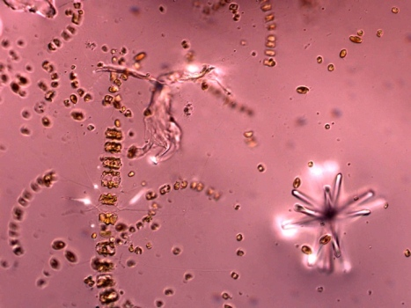
Algal Allelopathy
Freshwater cyanobacteria produce several bioactive secondary metabolites with diverse chemical structure, which may achieve high concentrations in the aquatic medium when cyanobacterial blooms occur. Some of the compounds released by cyanobacteria have allelopathic properties, influencing the biological processes of other phytoplankton or aquatic plants.
Fig: algal allelochemical affecting bacterial biodiversity

Slide 13
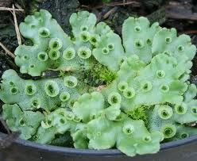
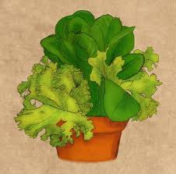
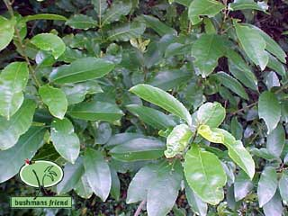
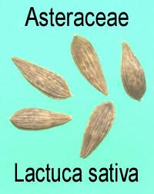
BRYOPHYTIC ALLELOPATHY
Mahoe whitey wood. Melicytus ramiflorus
Water-soluble leachates (1%, 5%, 10% concentration) derived from 18 species of bryophytes (mosses 11 species; liverworts 7 species) were tested on the germination and seedling growth of Lactuca sativa and two common trees Melicytus ramiflorus (Violaceae) and Fuchsia excorticata(Onagraceae

Slide 14
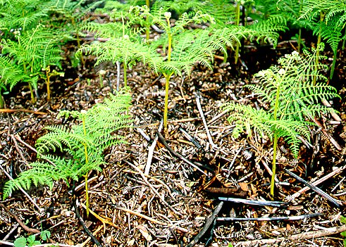
Pteridophytic Allelopathy
Recent advances in fern allelopathy were introduced, including studies on the autotoxicity of ferns and of allelopathic interactions occurring in 2 ways (sporophytes acting on gametophytes and gametophytes acting on gametophytes). Fern autotoxicity is a type of intraspecific allelopathy, whereby a fern species inhibits the growth of its own kind through the release of toxic chemicals into the environment

Slide 15
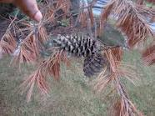
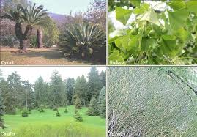
Gymnospermic Allelopathy
Most of the studies pertaining to the sparse and reduced vegetations under the Conifers are due to the phytotoxins/allelochemical,released by fallen litter layer(which forms the humus layer on the forest floor.

Slide 16
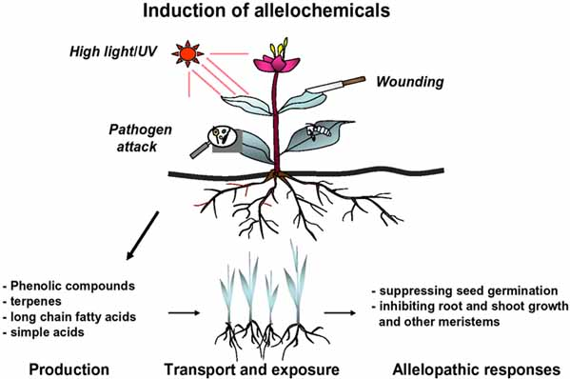
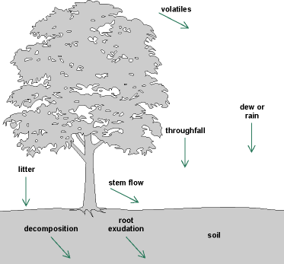
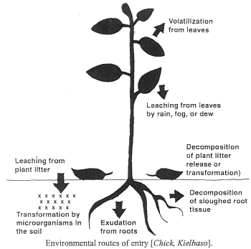
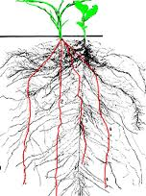
Mode of allelochemical release
These molecules can be released by
raindrops or condensing fog
from the aerial parts of the emitter of the plant (this being very effective if the molecules are water soluble)
WOUNDING, ATTACK BY PATHOGENS AND HERBIVORES
or can be released into a hot dry atmosphere if metabolites are volatile (as with many terpenoids)
In some plants, these molecules are released directly through excretion from the roots

Slide 17
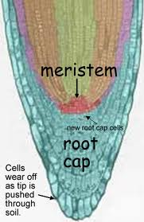
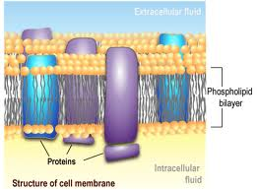
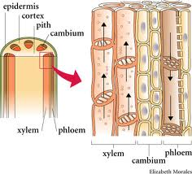
Mode of action of Allelochemicals
1.Inhibition of cell division in Root meristem
2.Inhibition of oxidation of plant hormones
3.Alteration of membrane permeability
4.Reduced stomatal aperture leading to the impaired photosynthesis
5.Interference with mitochondrial function .
6.Reduced protein synthesis
7.Clogging of the xylem strand leading to the impaired water balance.

Slide 18
Plants-Microbes Communication
Figure. Plants give off a variety of allelochemicals that can directly inhibit or stimulate the growth of other plants (allelopathy) and/or influence microorganisms in their own root zone (rhizosphere), in the bulk soil, or in other plants' rhizospheres.
Similarly, soil and root zone microorganisms give off substances that can either support or hinder nutrient uptake and growth of plants. As a result, crops, weeds, and soil microbes are linked through a web of chemical and microbiological communications that can be quite species-specific

Slide 19
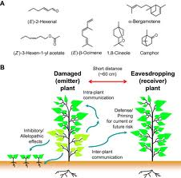
PLANT –PLANT NEGATIVE INTERACTION
Chemical-mediated plant-plant
interference, or allelopathy
is one
mechanism by which plants may gain an
advantage over their competitors. Plants that
produce and release potent phytotoxins can
reduce the establishment, growth, or survival
of susceptible plant neighbors, thus reducing
competition and increasing resource
availability.
(

Slide 20
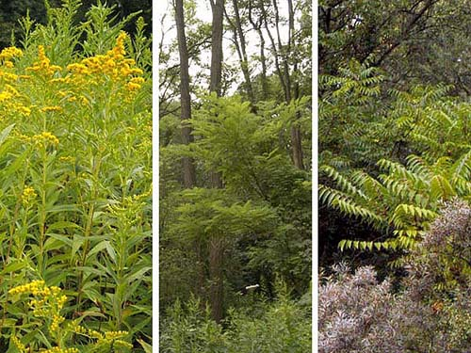
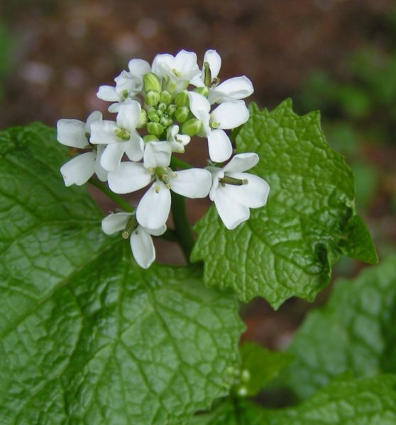
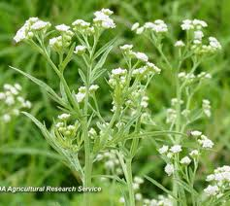
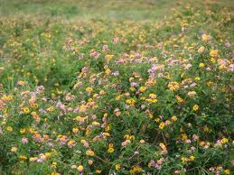
POSITIVE ROLES OF PLANT ALLELOPATHY 1.IN WEED CONTROL
Plants that cause deleterious effects to another plant that is intentionally grown, or crop, are called weeds.
1.Golden rod 2.Black Locust, 3.Tree of Heaven, 4Garlic mustard
.
Allelopathic crops can be used to control weeds by:
1)Use of crop cultivars with allelopathic properties
2) Application of residues and straw of allelopathic crops as
Mulches
3) Use of an allelopathic crop in a rotational sequence where the
allelopathic crop can function as a smother crop or where
residues are left to interfere with the weed population of the next
crop

Slide 21
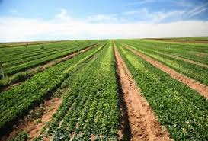
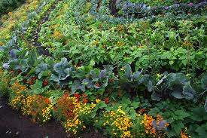
Application of Plant allelopathy in 2.FARMING :
From the agronomic point of view, the research in allelopathy
provides perspectives of a reduced reliance on traditional herbicides
if weed control can be achieved by the release of allelochemicals from
the crops.
Also, in cropping systems where herbicides are not used,
for example in organic farming, crop cultivars with enhanced
allelopathic activity could be part of the weed management strategy.
Weed control mediated by allelopathy - either as natural herbicides
or through the release of allelopathic compounds from a living crop
cultivar or from plant residues - is often assumed to be advantageous
for the environment compared to traditional herbicides

Slide 22
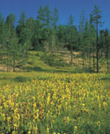
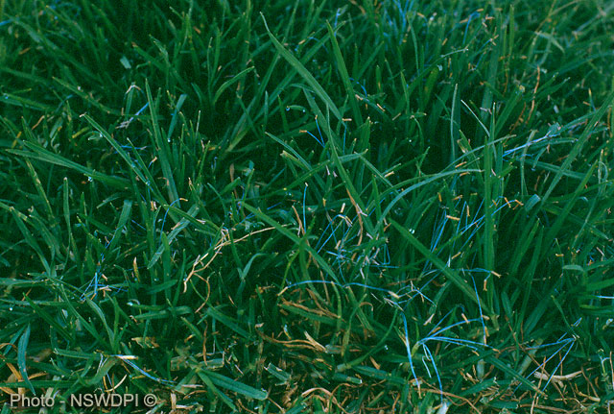
Roles of Allelopathy in 3.Plant Biodiversity and Sustainable Agriculture
The allelochemicals are involved in the environmental complex of managed or natural ecosystems.
Allelopathic compounds have been shown to play important roles in the determination of plant diversity, dominance, succession, and climax of natural vegetation and in the plant productivity of agroecosystems.
The incorporation of allelopathic substances into agricultural management may reduce the use of synthetic herbicides, fungicides, and insecticides and lessen environmental deterioration.
After the deforestation of coniferous or hardwood forests, a pasture grass, kikuyu grass (Pennisetum clandestinum), was transplanted onto the land. Significant suppression of weed growth by the kikuyu grass was found; however, the growth of coniferous or hardwood plants was not suppressed but stimulated.

Slide 23
Physiological effects of plant allelopathy
Abiotic agents:
soil fertility,light intensity (22°C and27°C),atmospheric humidity,water and abiotic stress and precipitation etc.
Biotic agents:
Attack by pathogens and herbivores,
over populations etc.

Slide 24
Conclusion and future directions
The science of plant allelopathy exhibits complexities of biochemical interaction among plants including microbes. This plays an important role in agro-ecosystem leading to the healthy natural resources.These natural products (allelochemicals) are environmental friendly and target oriented.These biochemical products are originally plant secondary metabolites.

Slide 25
REFERENCES AND SOURCES
Allelopathy in Agroecosystems ,BY R.K. Kohli,Batish,Daizy
Plant-Plant Allelopathic interaction ,BY Springer
Plant Ecology BY Michael .J.Crawling
^ ª ^{b} Stamp, Nancy (March 2003), "Out of the quagmire of plant defense hypotheses", The Quarterly Review of Biology 78 (1): 23–55,
Kruse, M. M. Strandberg and B. Strandberg. 2000. Ecological Effects of Allelopathic Plants - A Review. National Environmental Research Institute - NERI Technical Report No. 315. Silkeborg, Denmark.
Rizvi, S. J. H., M. Tahir, V. Rizvi, R. K. Kohli, and A. Ansari. 1999. Allelopathic Interactions in Agroforestry Systems. Critical Reviews in Plant Sciences 18: 773-779.
Altieri, M. 1993. Crop protection strategies for subsistence farmers. Westview Press,
Achhireddy N.R. and Singh M. 1984. Allelopathic effects of lantana
(Lantana camara) on milkweedvine (Morrenia odorata). Weed Sci. 32, 757–
761.
Blum U. 1998. Effects of microbial utilization of phenolic acids and their
phenolic acid breakdown products on allelopathic interactions. J. Chem.
Ecol. 24, 685–708.
www.organicweeds.org.uk

