Slide 1
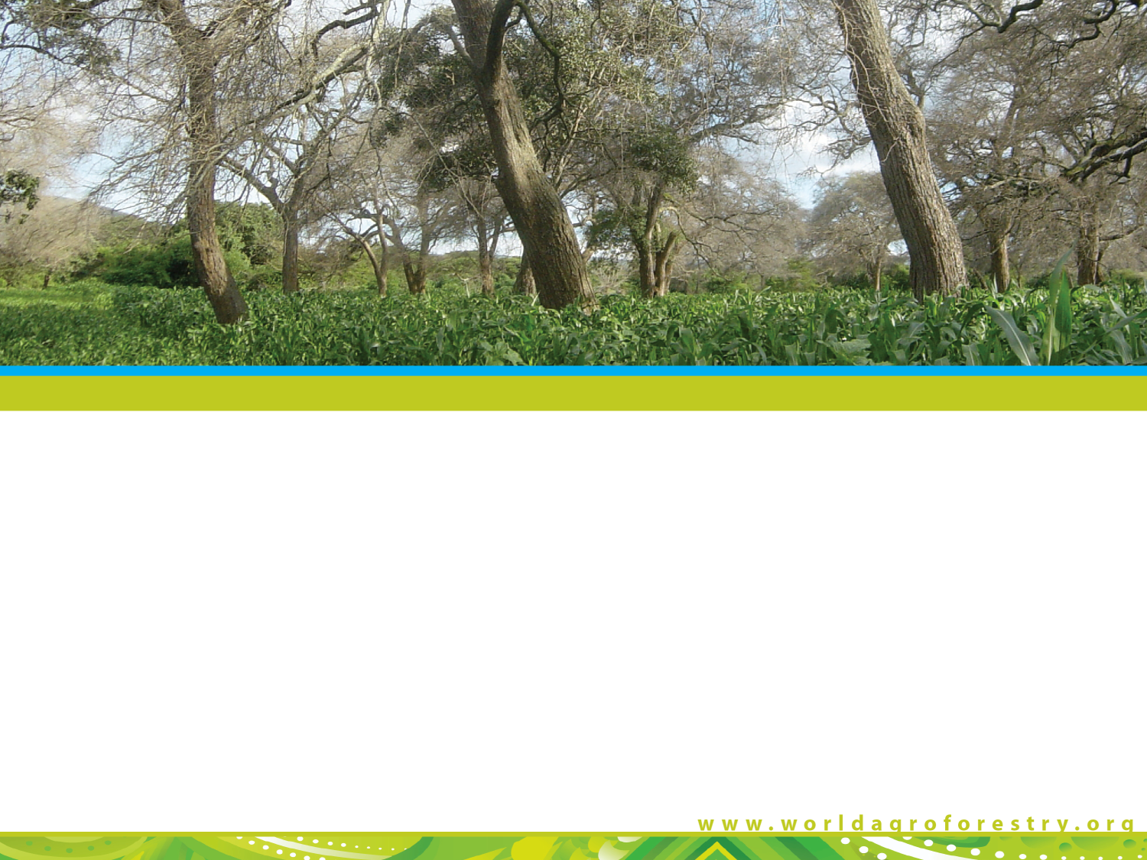

Agroforestry: a tool for sustainable nutrition?

Slide 2

About the World Agroforestry Centre
(aka ICRAF)
2

Slide 3
Who are we?
We are one of the 15 global reasearch centres of the Consultative Group on International Agricultural Research (CGIAR)
We are dedicated to generating and applying the best available knowledge to stimulate agricultural growth in developing countries, raise farmers’ incomes, and protect the environment.
  Our Vision: a rural transformation in the developing world as smallholder households increase their use of trees in agricultural landscapes to improve their food security, nutrition, income, health, shelter, energy resources and environmental sustainability.
  Our mission: generate science-based knowledge about the diverse roles that trees play in agricultural landscapes, and use this research to advance policies and practices that benefit the poor and the environment.
3

Slide 4
Our research priorities
Domestication, utilization and conservation of superior agroforestry germplasm.
Maximizing on-farm productivity of trees and agroforestry systems.
Improving tree product marketing and extension for smallholders.
Reducing land health risks and targeting agroforestry interventions to enhance land productivity and food availability.
Improving the ability of farmers, ecosystems, and governments to cope with climate change.
Developing policies and incentives for multi-functional landscapes with trees that provide environmental services.
4

Slide 5
Our participation in the CGIAR Research Programmes (CRPs)
CRP 1 Integrated Agricultural Systems
CRP 2 Policy research
CRP 4 Health and Nutrition
CRP 5 Land and Water
CRP 6 Forests, Trees and Agroforestry
CRP 7 Climate Change and Agriculture
5

Slide 6
Cereal yields by region
5000
4500
4000
East Asia
3500
3000
Latin America
2500
Kg per Hectare
2000
South Asia
1500
1000
Sub-Saharan Africa
500
0
1960
1965
1970
1975
1980
1985
1990
1995
2000
2005
World Bank World Development Indicators

Slide 7
Fruit & veg consumption
Modified after: Msangi and Rosegrant 2011. Feeding the Future’s Changing Diets.

Slide 8
African facts
Population growth has rendered fallowing impossible in many communities
Land overuse is depleting soil organic matter, soil carbon and soil microbiology
Consequently, across drylands Africa, soil fertility is dropping by 10-15% a year (Bunch, 2011)
Deep poverty and logistical bottlenecks makes fertiliser unaffordable for most
Funding for fertiliser subsidies is scarce and fickle
Where will soil fertility, soil organic matter and extreme weather resilience come from ?
11

Slide 9
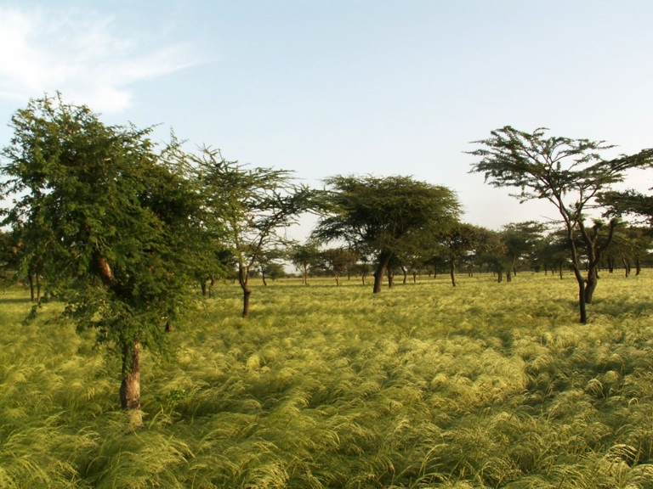
From trees.
Faidherbia Albida in teff crop system in Ethiopia

Slide 10
Impact of fertilizer trees on maize yield under farmer management
_______________________________________
maize yield (t/ha)
Maize only 1.30
Maize + fertilizer trees 3.05
____________________________________________________________
2011 Survey of farms in six districts (Mzimba, Lilongwe, Mulanje, Salima, Thyolo and Machinga)

Slide 11
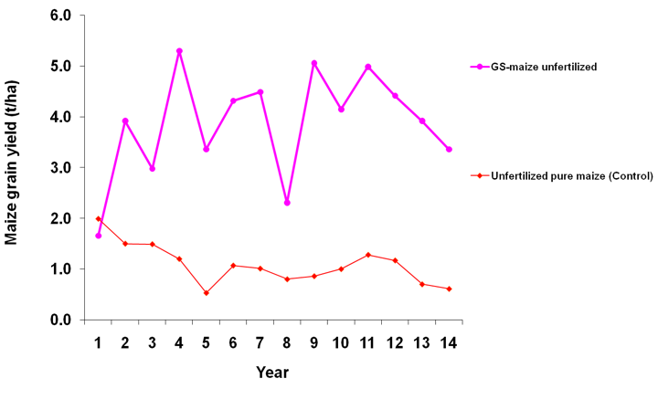
Long-term maize yield without fertilizer
in a Gliricidia system
P addition
resumed
Flood
Drought
Drought
P stopped

Slide 12

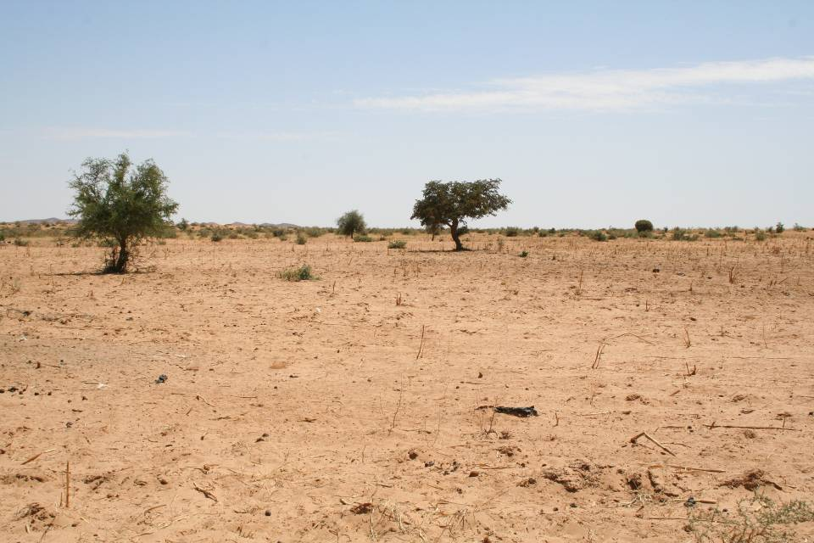
Farmer-Managed Natural Regeneration
Zinder, southern Niger in the 1980s
In FMNR, farmers will select the best shoots from trees regrowing naturally from stumps and eliminate the rest. This promotes the growth of vigorous new trees adapted to local conditions.

Slide 13
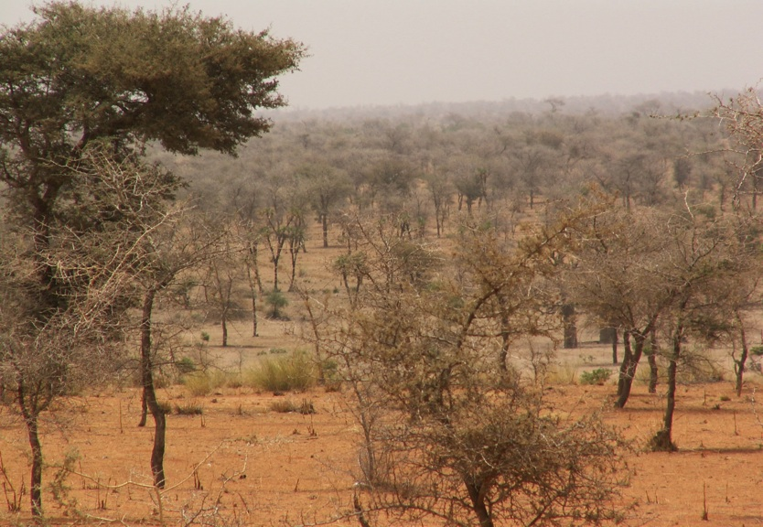
Today, there are 5 million hectares of millet production in Faidherbia parklands in Niger, producing 500,000 tons of extra grain a year !

Slide 14
Kantché district, Zinder, Niger
District of 350,000 people, with high tree on-field densities. Rainfall averages ca. 350 mm per year, typical of Sahel drylands.
Annual district-wide grain surplus:
2007 21,230 tons
2008 36,838 tons
2009 28,122 tons
2010 64,208 tons
2011 13,818 tons
Kantché produces grain surpluses even in drought years. This is mostly exported to northern Nigeria, providing cash revenue.
Yamba & Sambo, 2012
23

Slide 15
Where will Africa’s nutrition come from?
Modified after: Msangi and Rosegrant 2011. Feeding the Future’s Changing Diets.

Slide 16
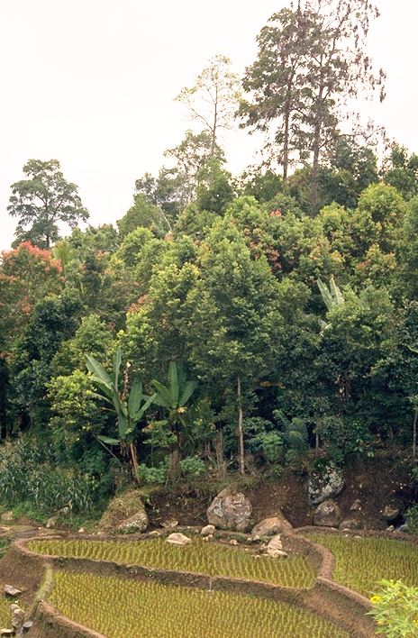
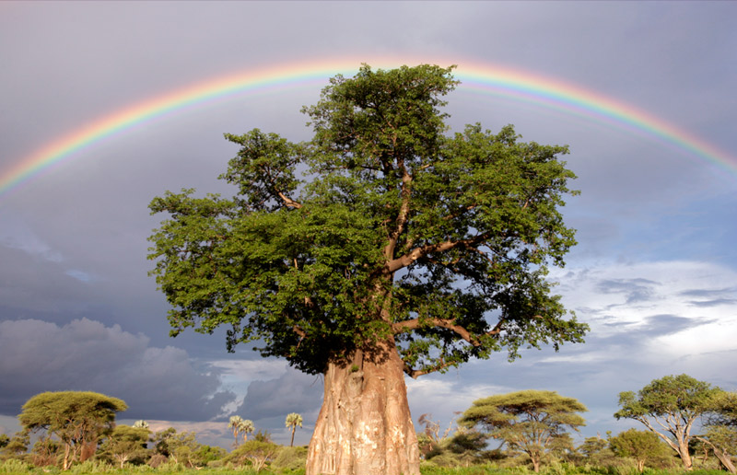

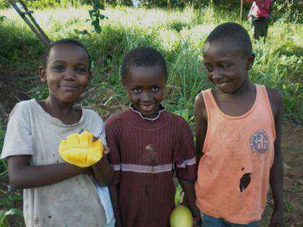

From
trees.

Slide 17
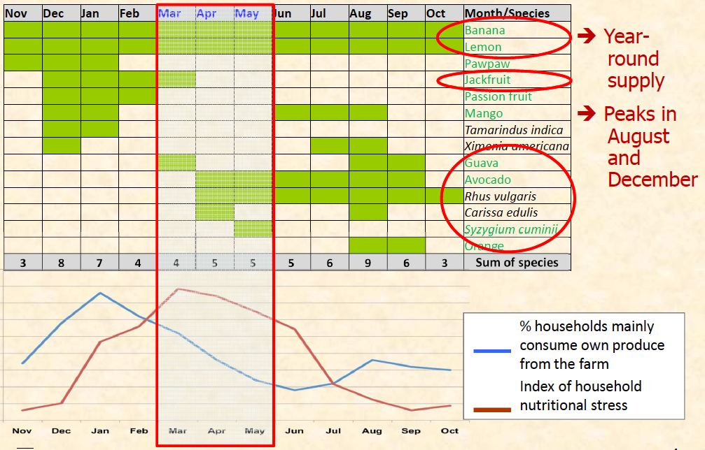
Harvest seasons
Example from western Kenya

Slide 18
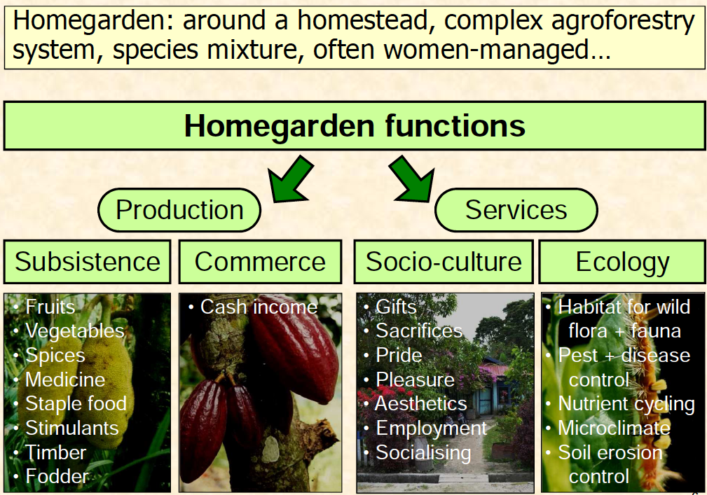
Homegardens and their function

Slide 19
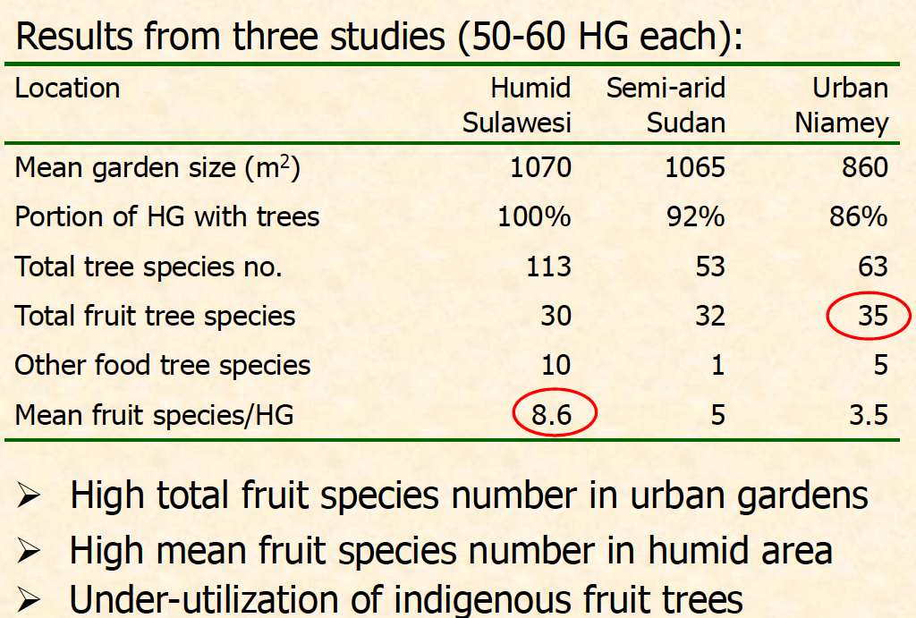
Trees in homegardens

Slide 20
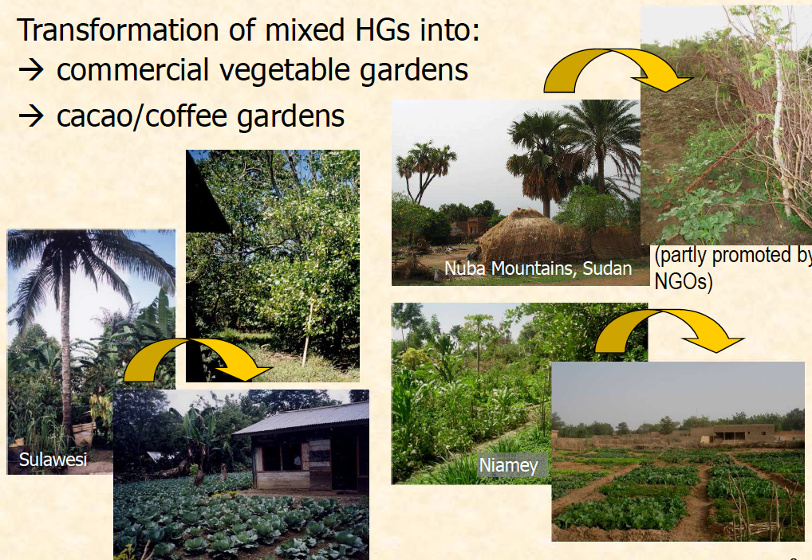
Beware of ignorance!

Slide 21
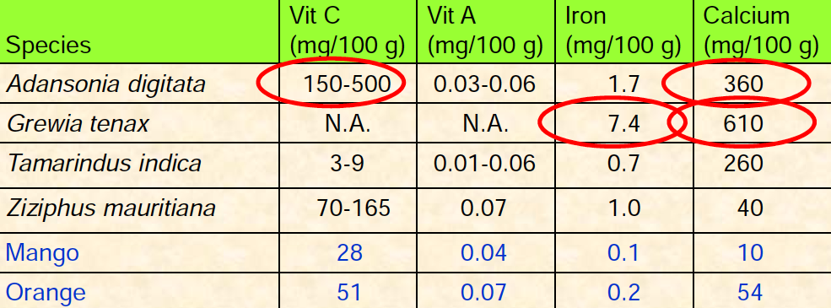
Vit A & C: indigenous beat exotics
Sources: Freedman (1998) Famine foods.
http://www.hort.purdue.edu/newcrop/FamineFoods; Fruits
for the Future Series, ICUC; Fineli (http://www.fineli.fi/), etc.

Slide 22
Domestication of Agroforestry Trees producing food and non-food products
Tree-to-tree variation within a village population
Simple and appropriate propagation technology
Creation of early fruiting, low stature, productive cultivars with high quality and uniformity
Cultivar meeting market specifications
Fruiting cultivar

Slide 23
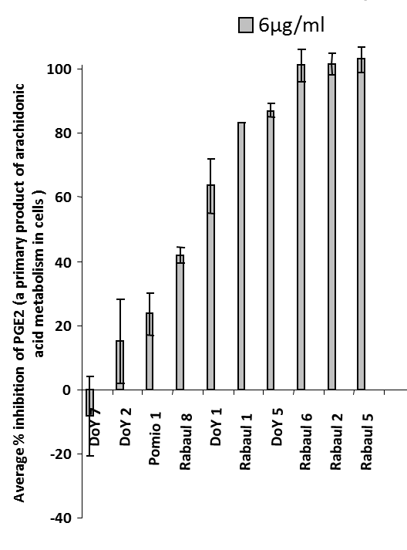
Quantification of Important Traits
Medicinal properties
Fruit morphology
Elite trees
for selection
Essential oils
Edible oils and fatty acids
Techniques allow multiple trait selection for different markets

Slide 24
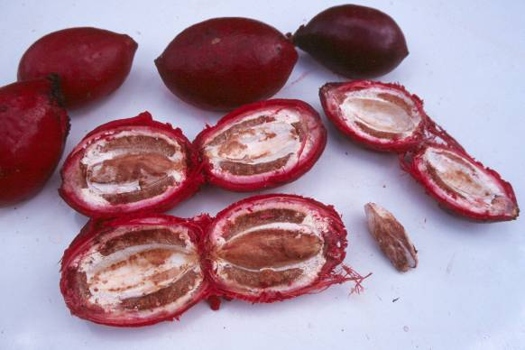
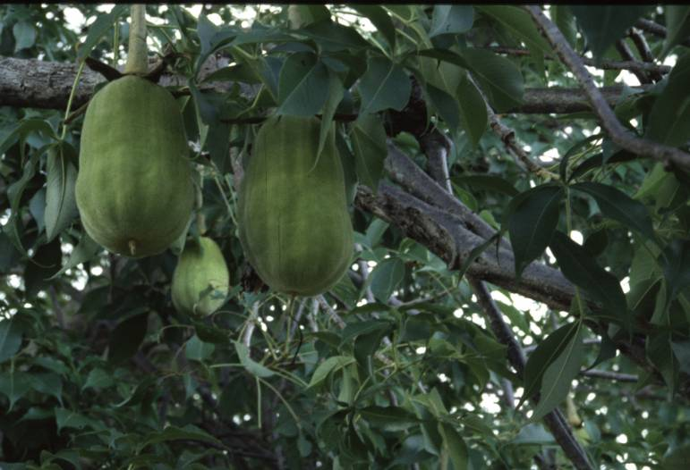
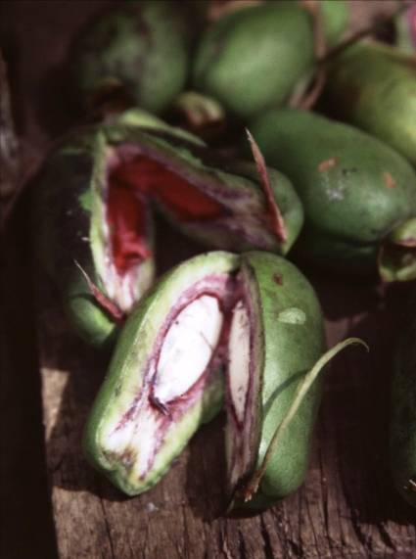
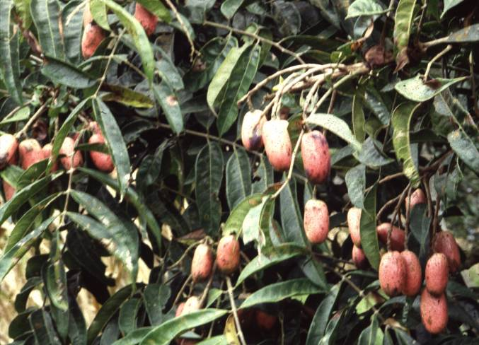
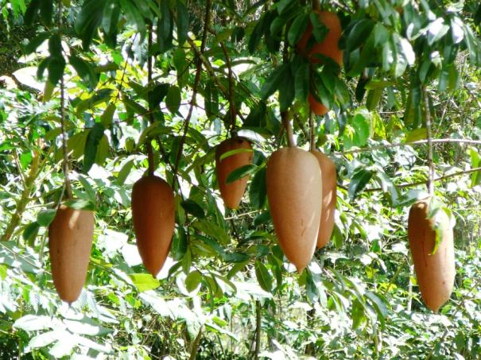
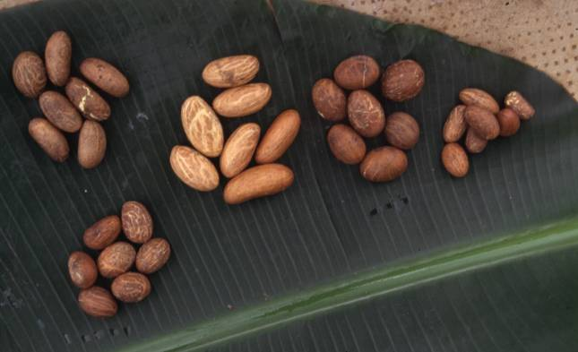
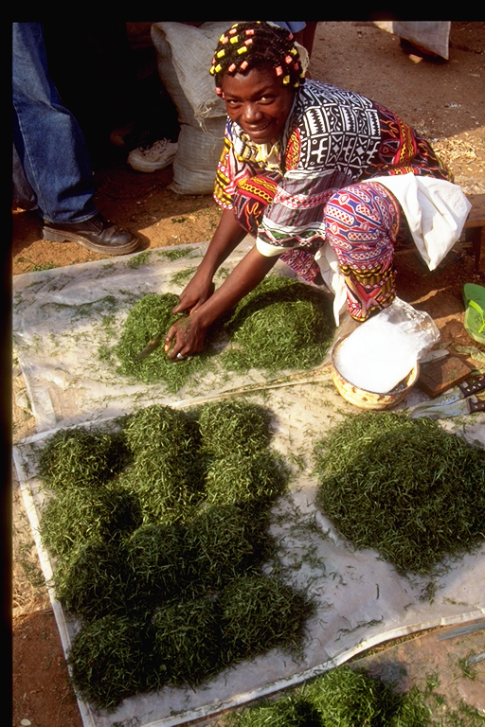
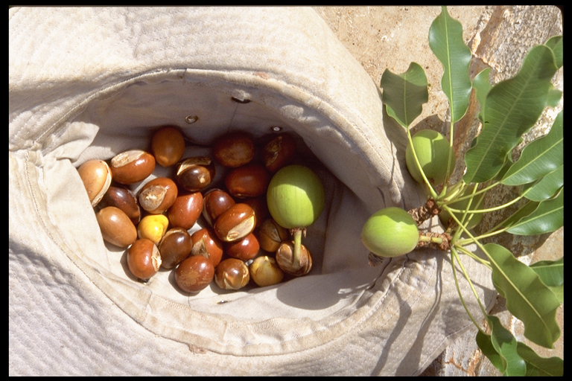
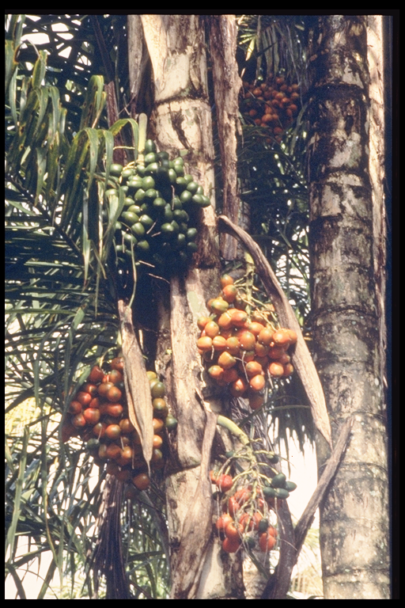
50+ species under Domestication
*
*
*Some of these have been approved by EU Food Regulations

Slide 25
Participatory Tree Domestication (PTD)
Put simply PTD refers to:
the means communities select, propagate and manage high-value indigenous fruit trees and medicinal plants and integrate them in the various farming systems,
Species for domestication are mainly selected encompassing indigenous knowledge and genetic selection based on scientific principles
A strong partnership is developed with scientists, civic authorities and private companies.
PTD is a farmer driven and market lead process. It focuses on species farmers consume best with high potentials for local, regional and international markets

Slide 26
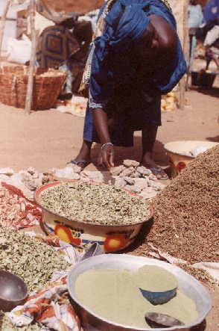
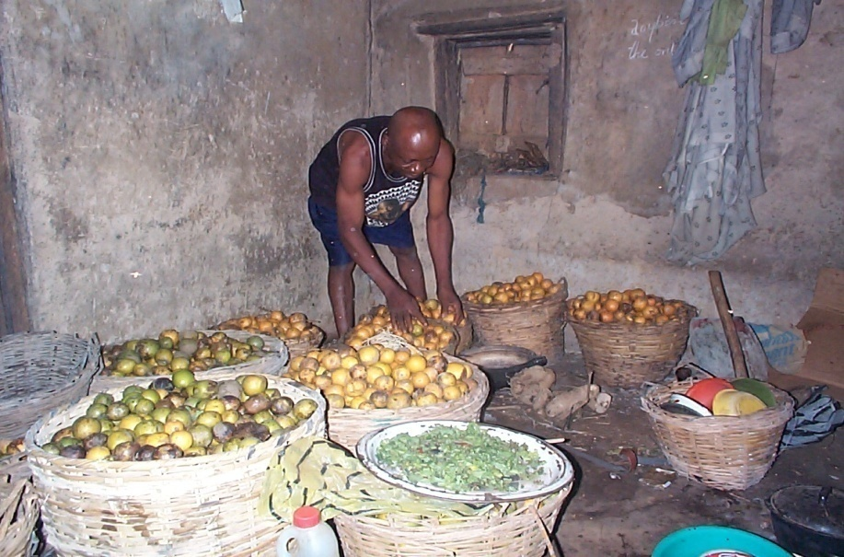
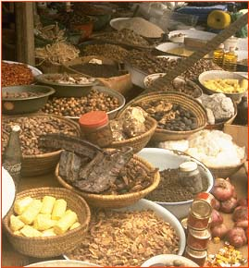
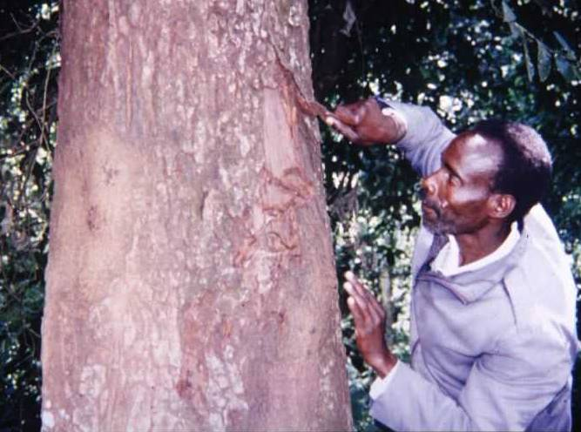
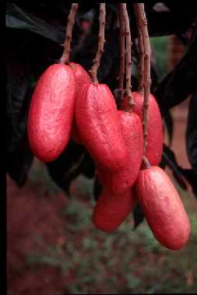
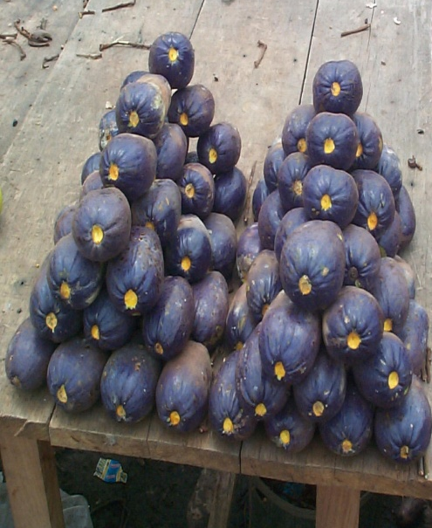
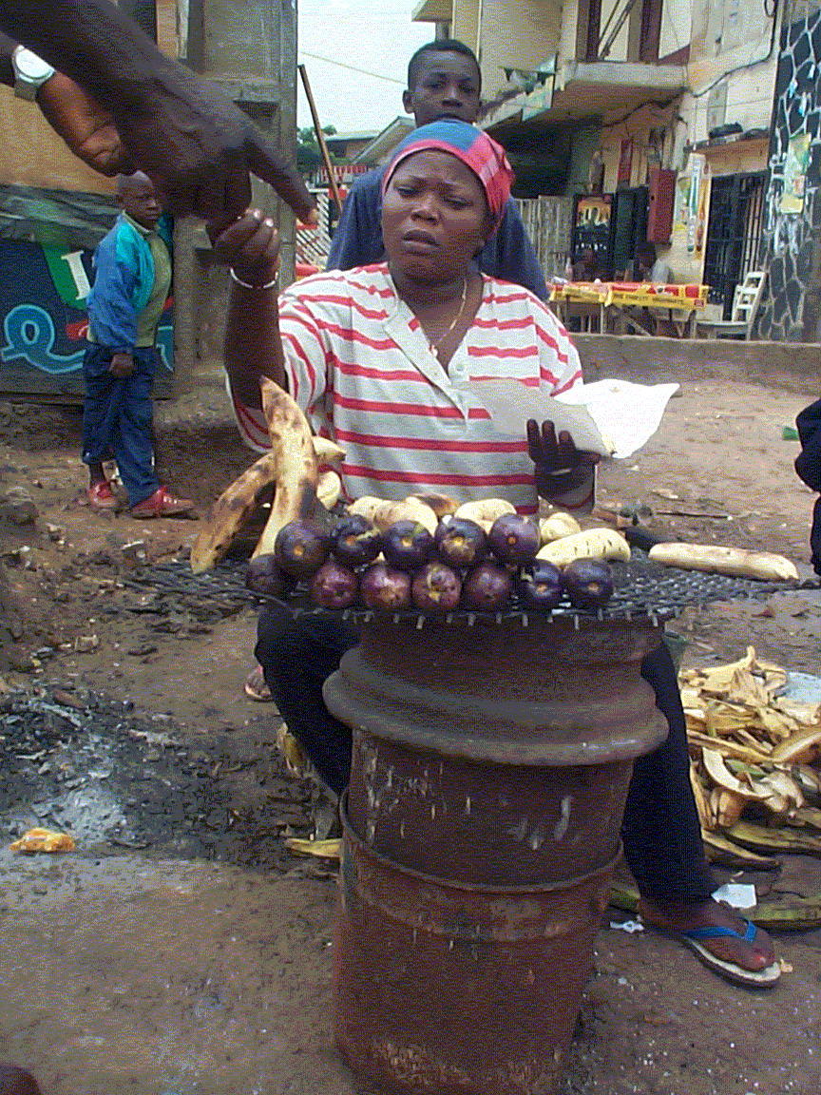
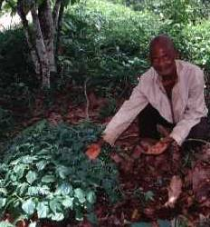
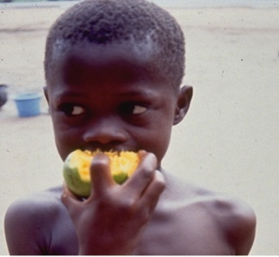
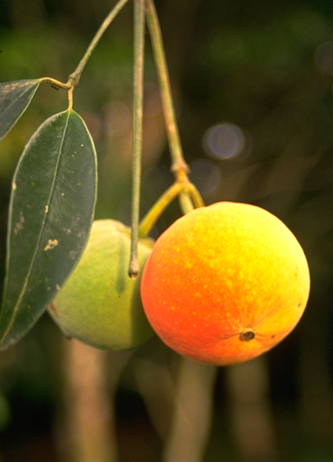
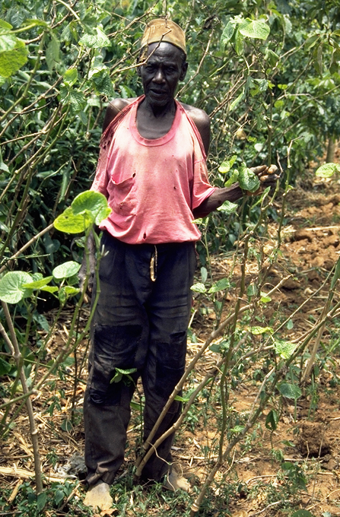
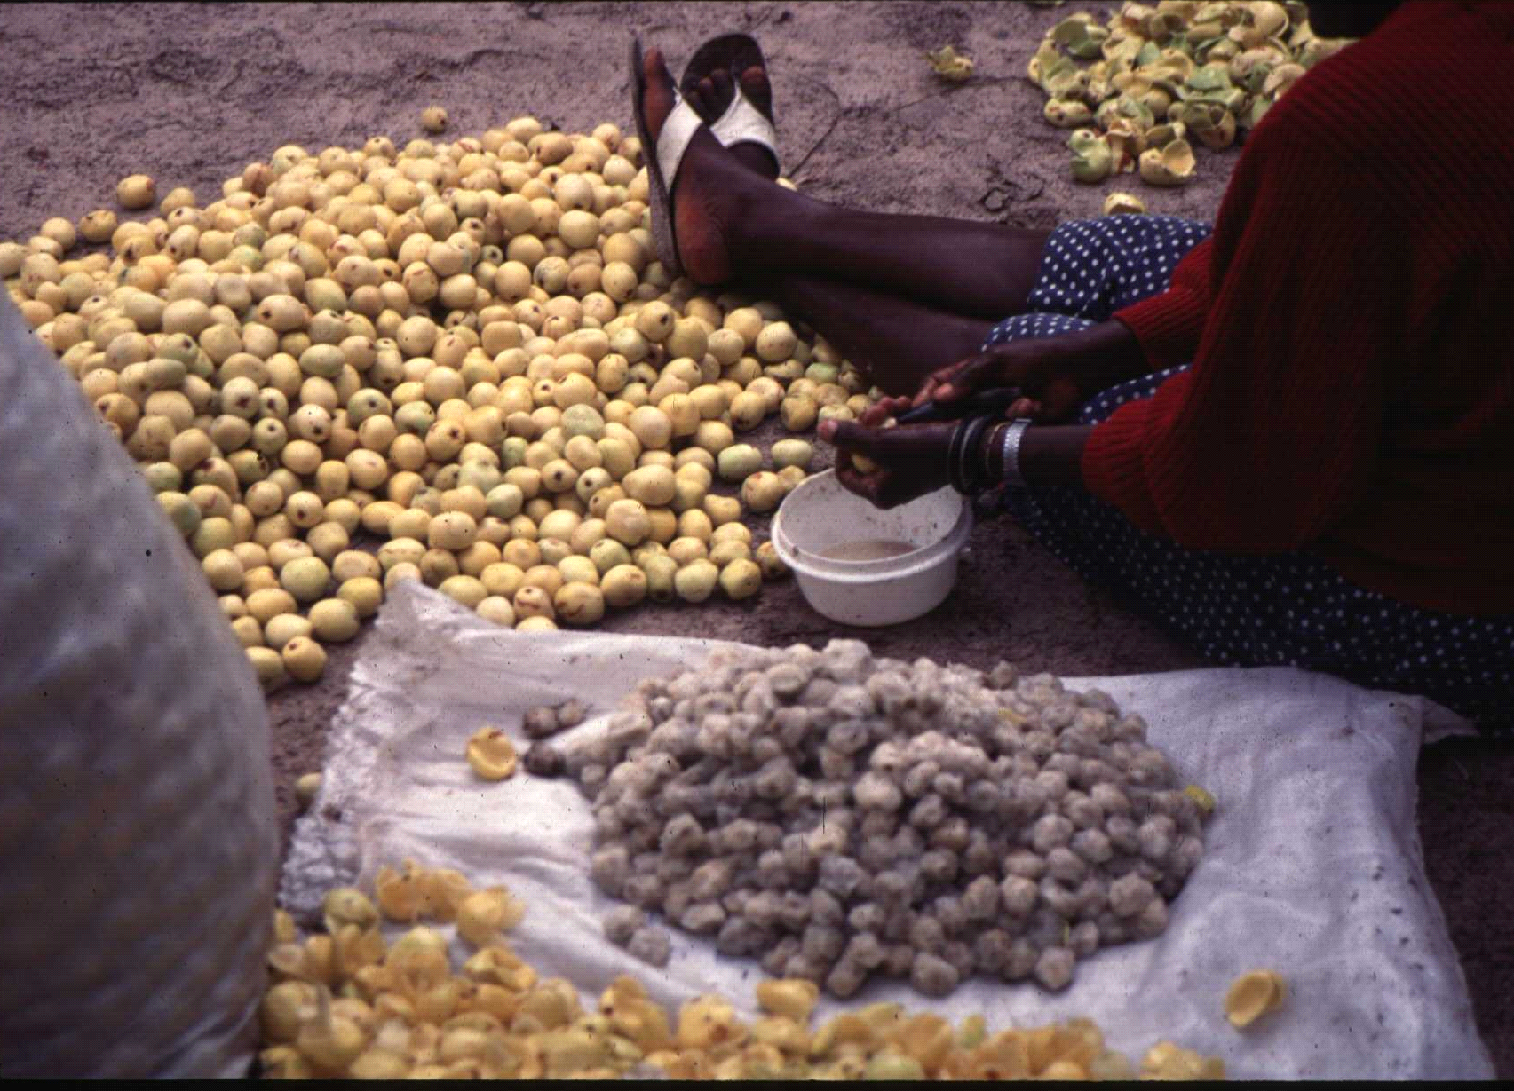
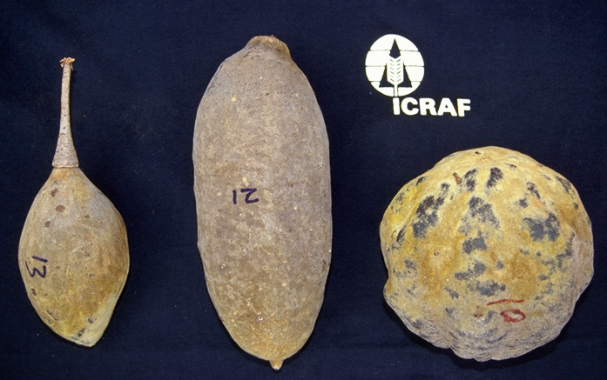
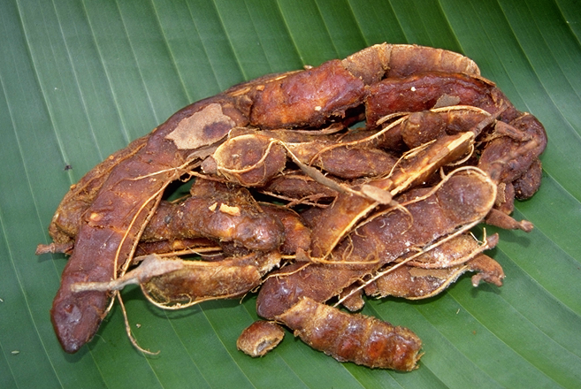

Slide 27
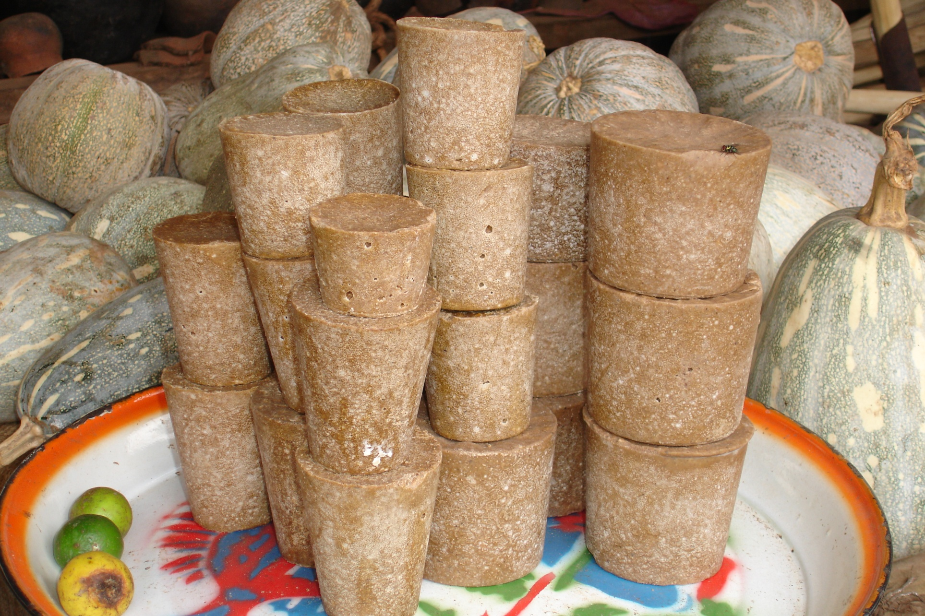
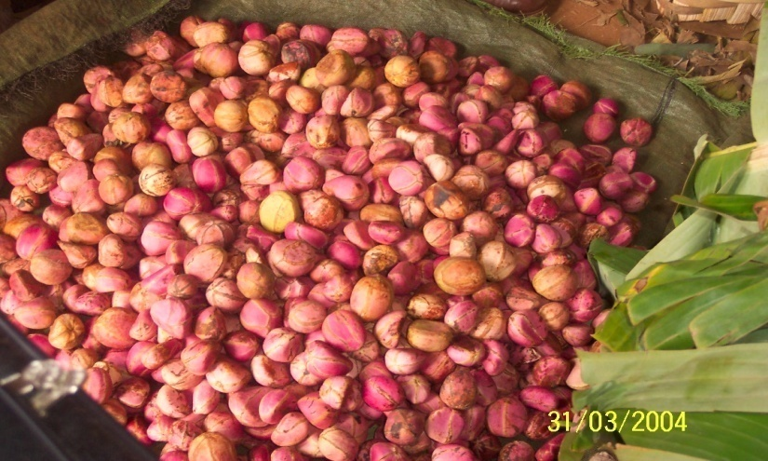
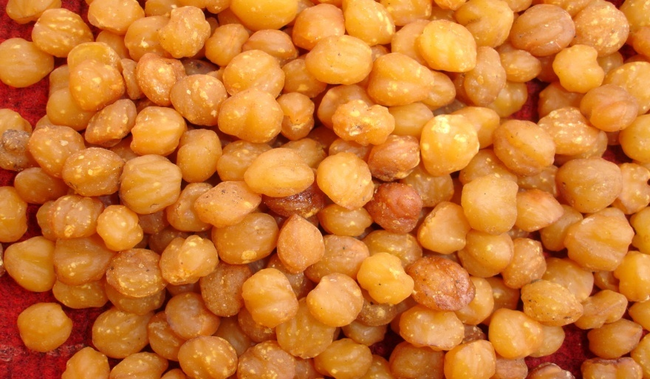
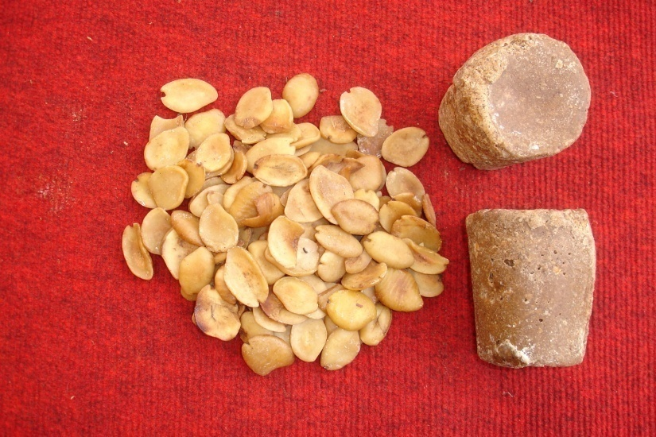
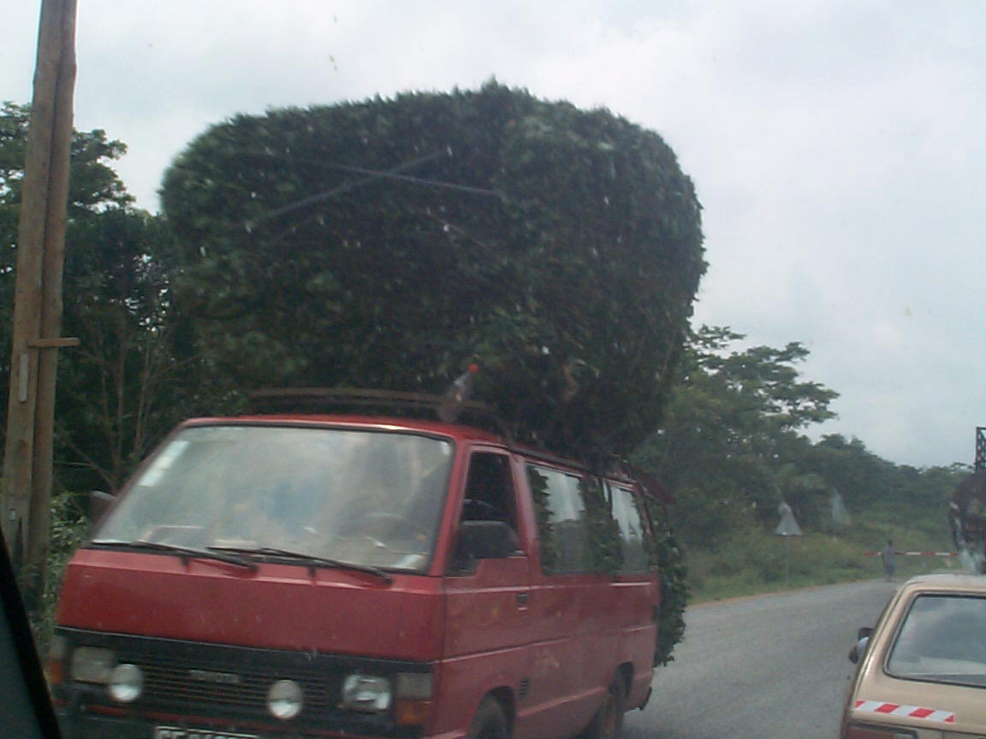
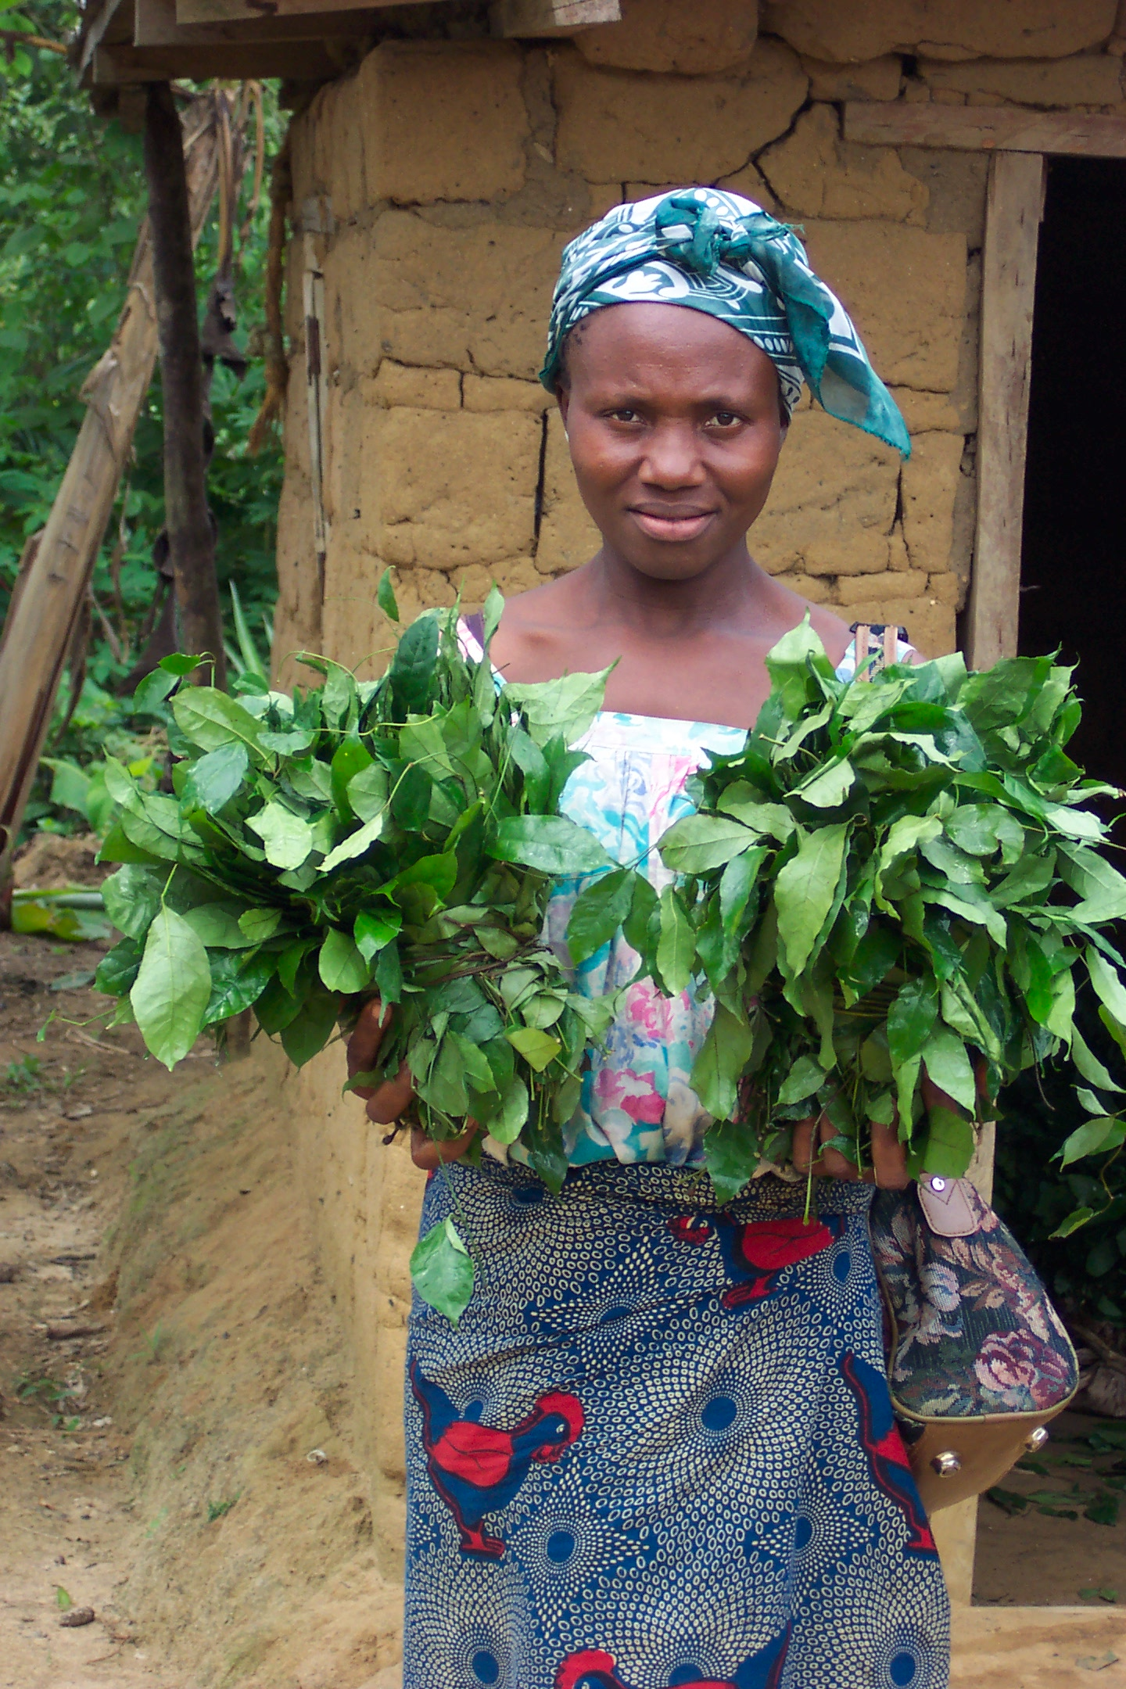
SPECIES UNDER DOMESTICATION
Kola nitida
Ricinodendron heudelotii
Irvingia gabonensis
Gnetum africanum

Slide 28
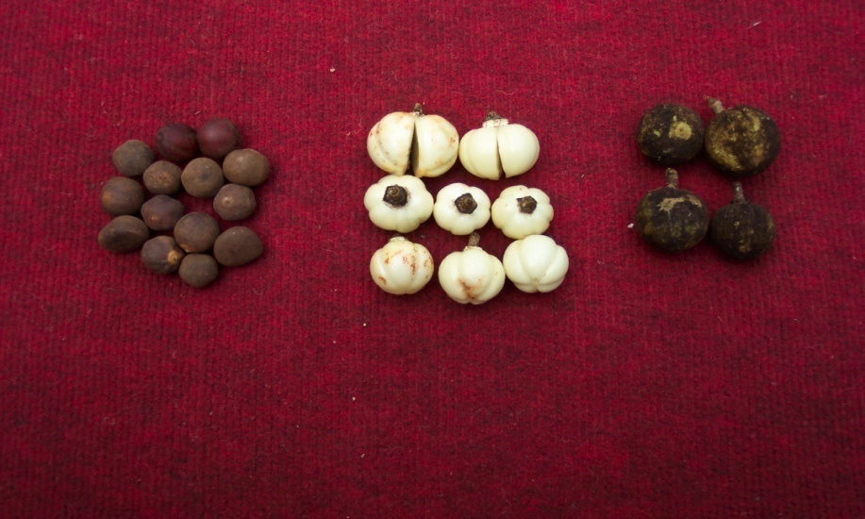
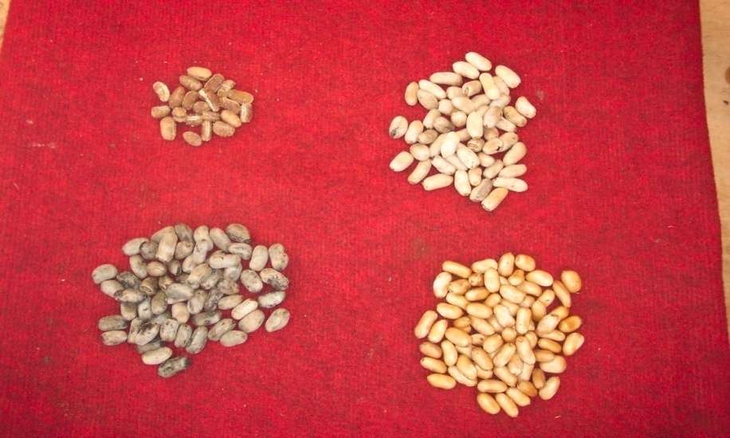
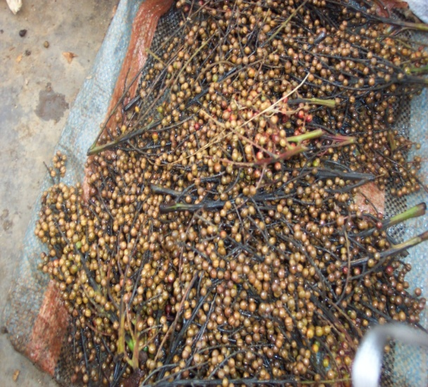
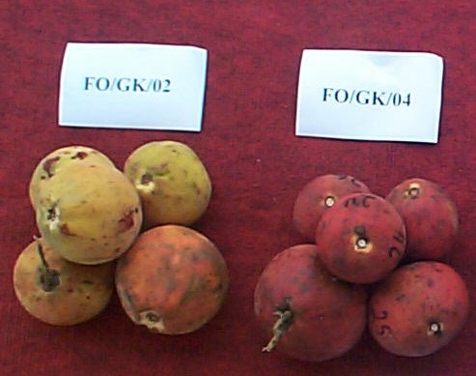
Afrotyrax lepidophyllus
Monodora myristica
Zanthoxylum macrophylla
Garcinia cola (Bitter kola)

Slide 29
Nutritional benefits of indigenous fruits
Species | Dacroydes edulis fruit (88% dm) | Irvingia gabonensis kernels (88% dm) | Maize grain (86% dm) | Rice grain | Cassava tuber (30-35%dm)
Carbohydrates | 14 | 26-39 | 66-76 | 46-59 | 24-31
Fats/oils | 32 | 51-72 | 2-6 | 1-2 | <1
Protein | 26 | 7.4 | 5-14 | 4-8 | 1
Fibre | 18 | 1 | 1-3 | 1-4 | 1-2
Data on micronutrients, fatty acids, etc.
in Leakey 1999, Food Chemistry 64, 1-14.

Slide 30
Harvest periods of selected priority indigenous fruit/nut species of West and Central Africa.

Slide 31
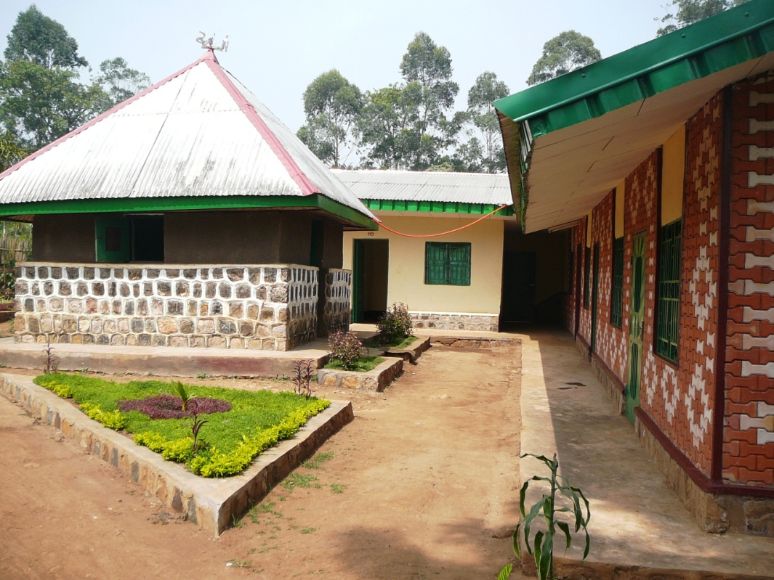
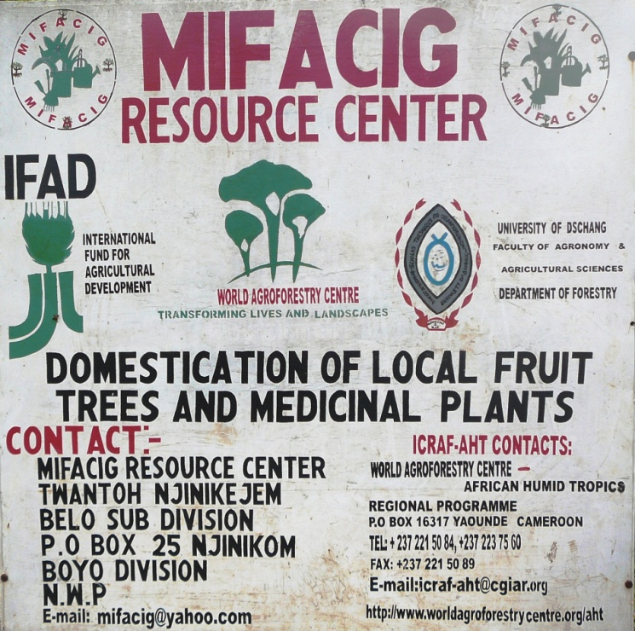
RURAL RESOURCE CENTERS
Innovative approach helping farmers to be exposed to updated technologies in domestication and agroforestry.
Demonstration plots helping farmers to acquire skills in producing NTFPs and marketing knowledge
.

Slide 32
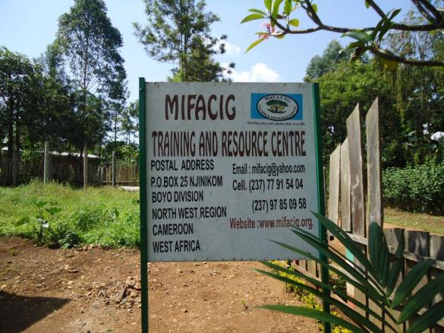


The concept of Rural Resource Centres

Slide 33
Differences with the classical agricultural extension approach
More scope for joint research, adaptation, training, sharing and diffusion of good practices and technologies
Better partnership between research, civil society organisations and farmers
More flexibility in activities, room for testing and adaptation
Gradual development
Efforts to be self-sustaining

Slide 34




Infrastructure
Tree nursery
training hall and offices
Small library
Agroforestry demonstration plots

Slide 35



Activities
Learning from each other during study visits
Exchanging planting material between resource centres
Experimenting together with farmers vegetative propagation techniques on species prioritised by communities

Slide 36
Why agroforestry?
Agroforestry lets farmers grow more food, fodder and fuel while managing agricultural landscapes for critical ecosystem services - sustainably.
Agroforestry helps curb greenhouse gas emissions by slowing the conversion of forest to farmland and by sequestering more carbon on farms (in trees and the soil).
Agroforestry can involve hundreds of highly nutritious species, many of which are still relatively unknown.
6

Slide 37

Malawi National Agroforestry Food Security Programme
Malawi is one of African 16 countries (April 2012) that are implementing or setting up National Evergreen Agriculture Action Plans, and the seat of the World Agroforestry Centre’s Southern Africa hub.

Slide 38

Gliricidia, a leguminous coppice tree, interplanted with maize. The leaves are cut and turned over into the topmost soil layer, providing nitrogen and other nutrients

Slide 39




Fertilizer tree options: from the short to the long term
Relay Fallow
intercropping
(grain yield: 2-3 tons)
Improved Fallows
(grain yield: 3-4 tons)
Gliricidia / Maize
intercropping
(grain yield 3-5 tons)
Faidherbia/ Maize
intercropping
(grain yield 3-5+ tons)
1 year
2 years
3 years
5+ years
Waiting period before benefit accrues

Slide 40
What trees give to farms:
Increased crop nutrient availability in rainfed food crop systems
Improved microclimate and soil water relations conveying greater adaptation to climate change
Increased and more stable food crop productivity
Increased food micronutrient availability (fruits)
Enhanced dry season fodder availability
Dramatically increased carbon accumulation in food crop systems: 6-10 tons of CO₂ per hectare per year are common
Enhanced biodiversity
Reduced deforestation due to on-farm fuelwood and timber production

Slide 41
Because it works, agroforestry is spreading across Africa, both from the grassroots and through government programmes.
Because the defining feature of these agroforestry fields is that they carry living vegetation all year around, we call this "evergreen agriculture".
This spread must be hugely speeded up to meet the needs of tens of millions of smallholder farmers.

Slide 42
The evergreen agriculture vision:
EverGreen Agriculture is emerging as an affordable and accessible science-based solution to regenerate the land on small-scale farms and increase family food production and cash income.
EverGreen Agriculture is a form of more intensive farming that integrates trees with annual crops. The vision of EverGreen Agriculture is to sustain a green cover on the land throughout the year, increasing food and fodder production sustainably.
EverGreen farming systems feature both perennial and annual species (trees and food crops). The overall indicator of their effectiveness is building a healthy soil and environment, while increasing the resilience of the farm enterprise to a variety of risks. They deliver extended growing seasons, increased productivity, better water utilization efficiency, and drought resilience.
Millions of women and men farmers in Zambia, Malawi, Niger, Burkina Faso, and other countries are already practicing EverGreen Agriculture, successfully restoring exhausted soils with richer sources of organic nutrients, and dramatically increasing both their crop yields and incomes.
More countries are joining the Evergreen Partnership almost monthly: see http://evergreenagriculture.net for details and regular updates.

Slide 43

Governments: 16 countries are now engaged in EverGreen Agriculture
30

Slide 44

Government example: in December 2011, the Ethiopian PM announces national plan to raise 100 million Faidherbia trees in farmers’ fields

Slide 45
What must be done?
32

Slide 46

Grassroots: agroforestry in West Africa is expanding too slowly

Slide 47

Existing systems are not recognised for what they are (ex:Faidherbia agroforest in Senegal)
What’s wrong with this picture?
All the trees are old and risk declining soon. These lands are not being managed for replacement tree growth.

Slide 48
Growing Evergreen Agriculture on farms
Offer support to countries launching evergreen agriculture programmes:
  Help establish the right policies
  Technical support to define and establish best systems
  Boost extension services reach and quality
Research, develop and support the implementation of scaling up and scaling out to many millions of smallholders
  Support to pioneer farmers, to national extension services, to NGOs and INGOs
Encourage more partnerships between research, development, and private sector institutions
Help spread the idea of “trees on farms” further at national and international levels
33

Slide 49
Building the science of Evergreen Agriculture
Grow the science by encouraging research partnerships across the region to tackle key questions:
  Develop systems adapted to as many agroecological regions as are encountered
  Resolving complex policy issues
  Enhancing targeting & scaling-up
  Ensure quality tree genetics and plentiful tree seed supplies
  Enhance tree propagation and establishment
  Adapt to integrated production systems
  Estimate potentials for climate change adaptation
  …
34

Slide 50
Conclusion
Agroforestry and EverGreen Agriculture are
fresh, low-cost approaches to land regeneration and food security that have their roots in Africa and are spreading across the tropics and that are
being adopted by millions of smallholders.
Poor households should be targeted over large areas to end hunger on small farms; working in the
many nations that are creating the policy and institutional environments to favor adoption.
Research is critical to underpin the acceleration of more widespread adoption

Slide 51
For more information
Patrick Worms, World Agroforestry Centre
Email:p.worms@cgiar.org
Tel: +32 495 24 46 11
www.worldagroforestrycentre.org
www.worldagroforestrycentre.org/evergreen_agriculture
http://evergreenagriculture.net/about-evergreen-agriculture
36

