Slide 1
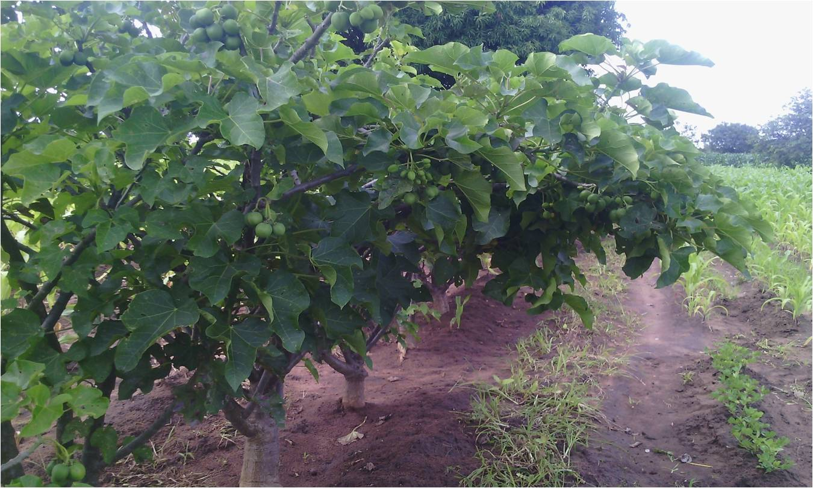
BERL-Concern Worldwide Partnership

Slide 2
Background
Berl was founded in 2006 to establishing a national scale bio fuel business in Malawi.
Between 2008 and 2012 BERL has planted 6.6 million Jatropha trees
These trees were planted by smallholder farmers as a boundary crop
2015 BERL got a certificate to start selling Jatropha oil for blend with diesel.

Slide 3
BERL-CWW partnership Background
Partnership between Bio-Energy Resources Ltd (BERL), & Concern Worldwide started in Sept 2012
Introduced Jatropha Curcas for Commercial Use
CWW supported BERL field staff to operate in the target areas.
Project Goals:
Provide additional income cash crop to smallholder farmers
Mitigate climate change - carbon sync; multiple benefits of trees including soil conservation

Slide 4
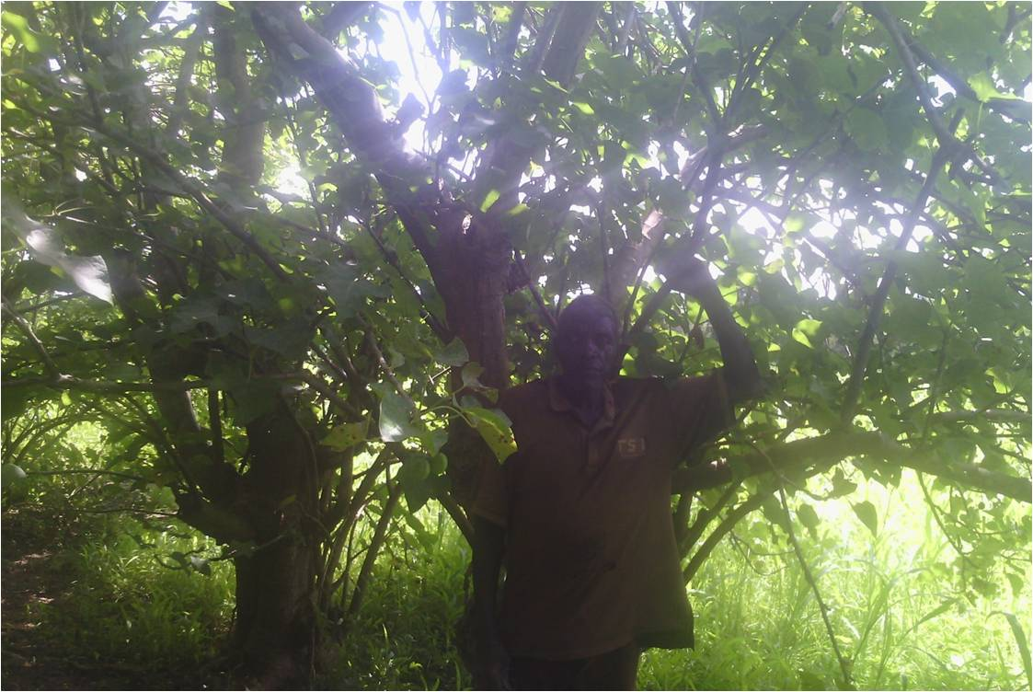
JaTROPHA trees are perennial and the tree can remain productive for 40 years or more. .

Slide 5
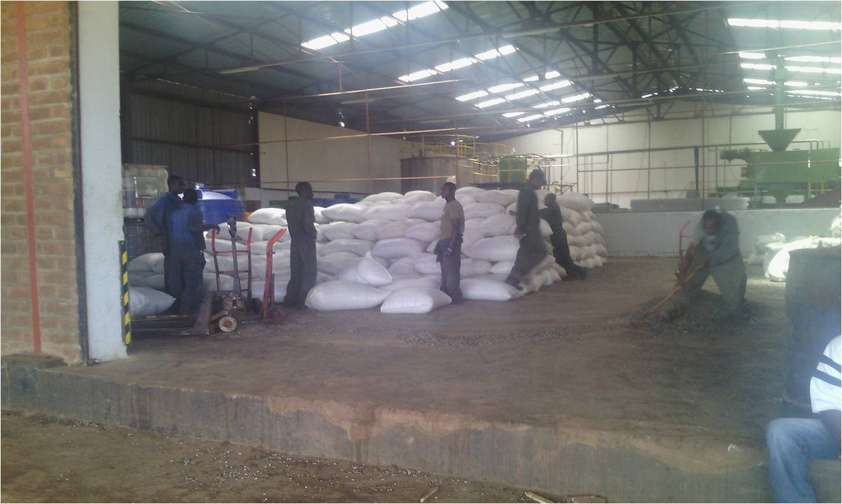
Jatropha seeds are feed stock for producing bio diesel and Jatropha-Diesel blend.

Slide 6
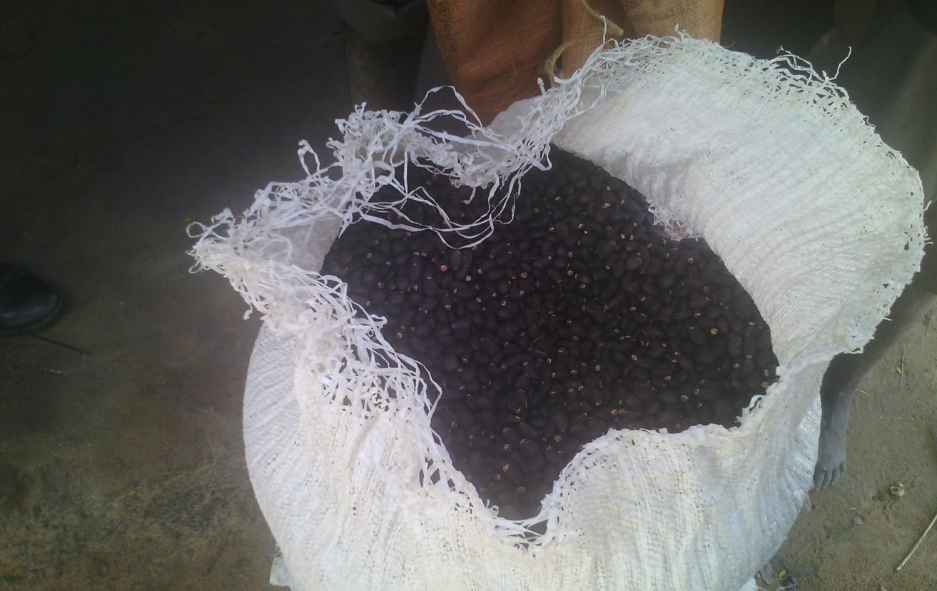
Average yield from one tree varies from 1.5kgs in the fourth year to 4kg for fully matured trees (6-10yrs & above)

Slide 7
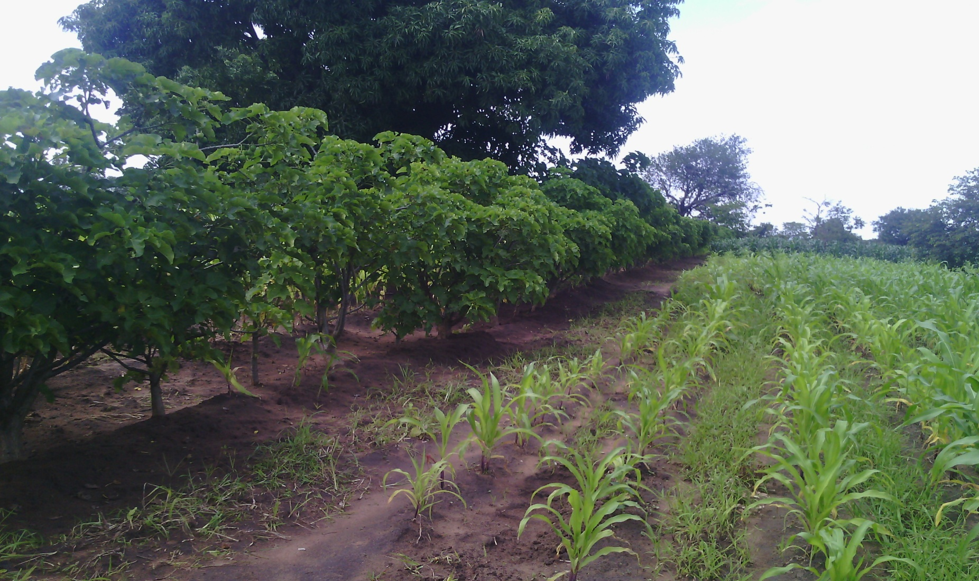
The trees are planted as ‘hedges’ around farmers fields

Slide 8
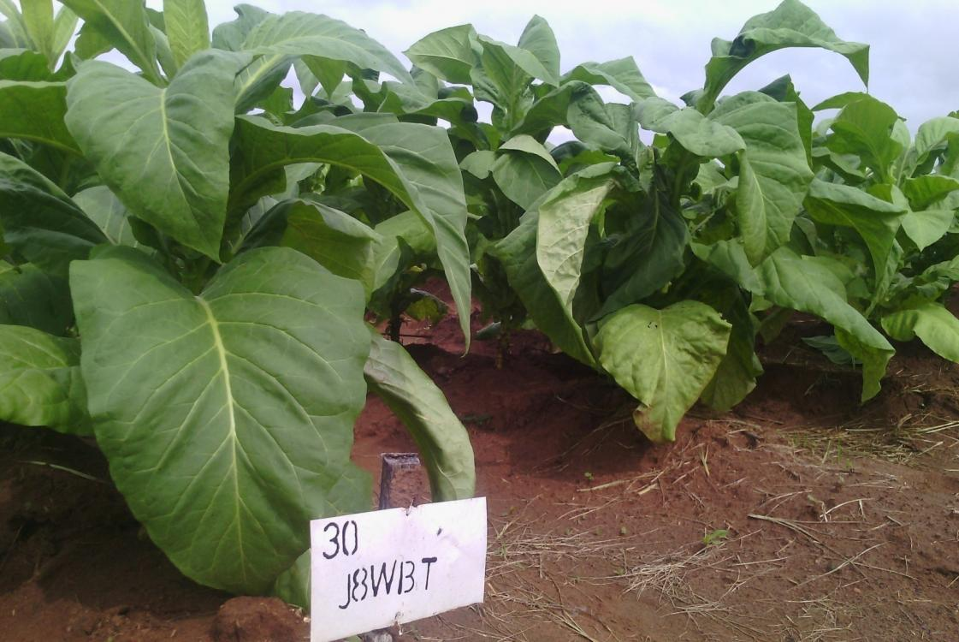
Jatropha Seedcake
Seed cake has proved to be a viable bio fertilizer in tobacco.
Seedcake also suppresses nematodes in tobacco.
Jatropha cake applied 8 wks before transplanting

Slide 9
Partnership Achievements in the past two years
1,741 farmers trained in Jatropha production
294,570 Jatropha trees planted
212 clubs received contracts
With these numbers currently a potential market of about $260,000 per annum (assumes 4kgs/tree)
MWK 65,000 per farmer per year from otherwise unused land.

Slide 10
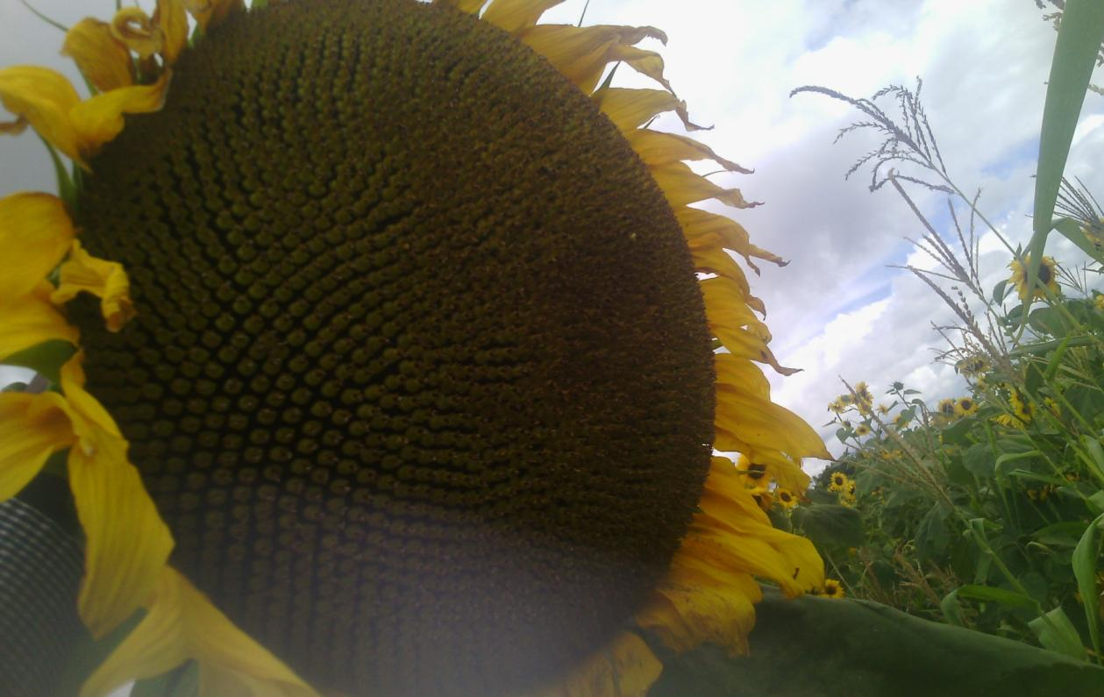
Sunflower – Instant benefit to farmers

Slide 11
BERL-CWW initiatives on CSA
BERL extension agents started selling sunflower seed to farmers in 2013
In 2014 the partnership introduced CA to the production of sunflower
Started small:
Close to 50 hectares of land have been planted this season
450 farmers involved

Slide 12
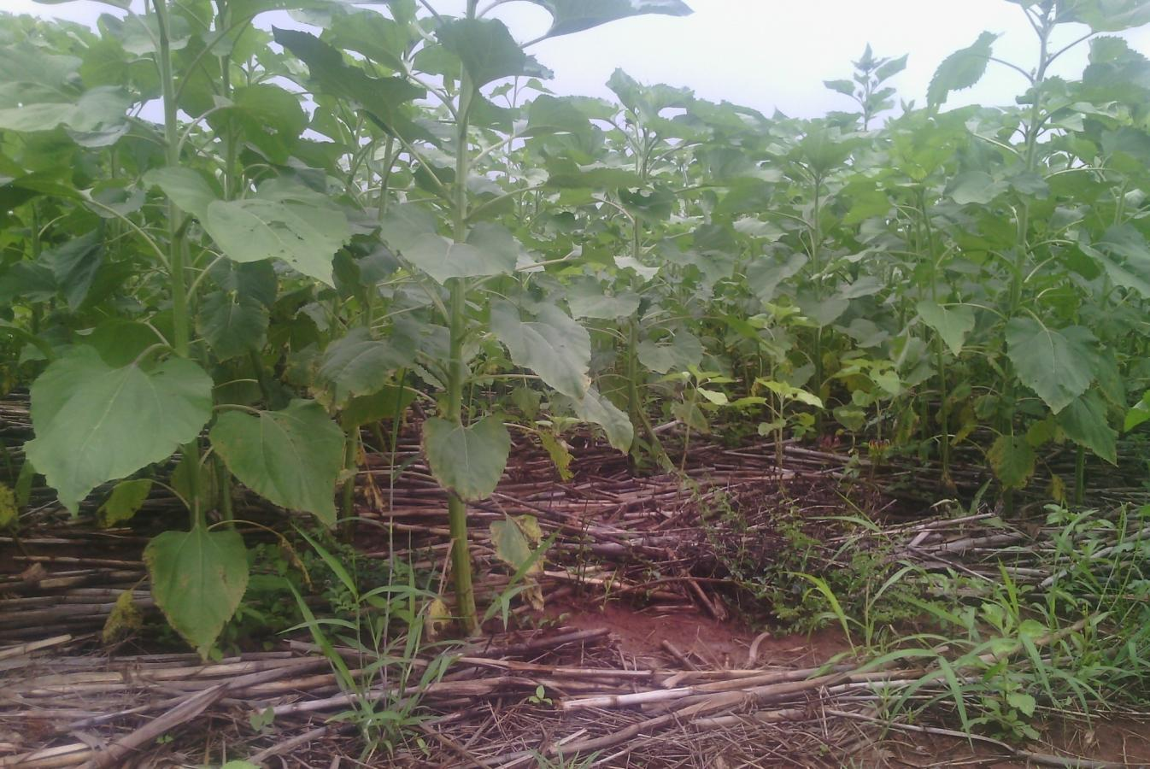
Sunflower under CA

Slide 13
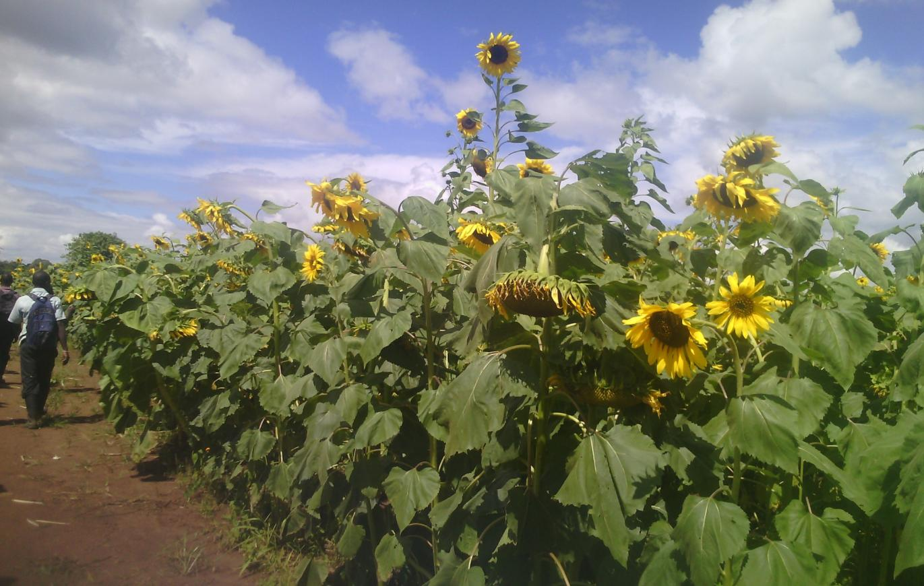

Slide 14
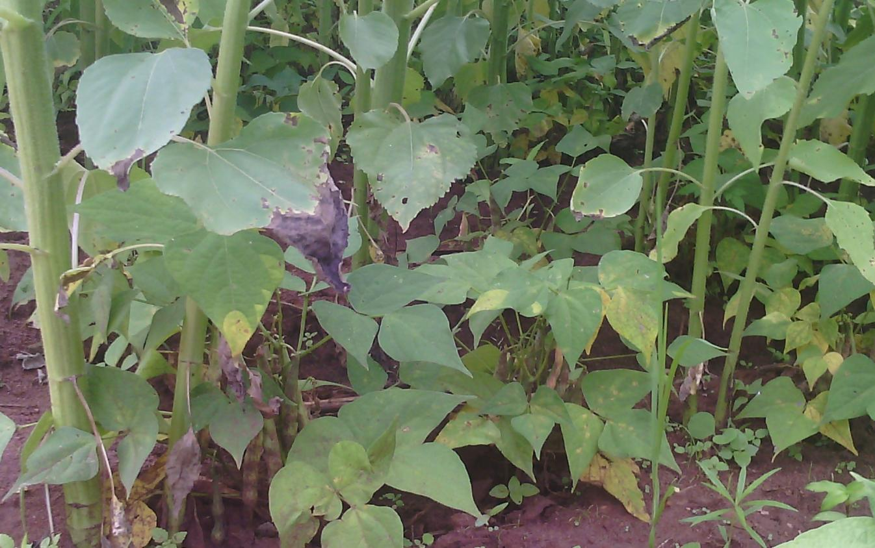
Sunflower under CA intercropped with climbing beans

Slide 15
Challenges
Pests and diseases in Jatropha particularly red beetles and elegant grasshoppers
Farmers expectations and adoption of Jatropha production
Limited short term benefits

Slide 16
Challenges
Getting Jatropha Oil approved by the Malawi Bureau of Standards
Ground cover for CA
Demand is greater than what our resources allow us to reach

Slide 17
Opportunities
Plan to link up with MOST on community spray technicians as service providers and test this model.
Access new higher yielding sunflower seed
More than 25,000 farmers are registered with BERL across Malawi
BERL has 7 years experience in planting Jatropha, 4 years of planting sunflower, if given support smallholder farmers and the nation would benefit.

Slide 18
Conclusion
In order to maximize adoption of CSA technologies, there is need for collaborative efforts between government, NGOs and the private sector in the agricultural sector.
BERL is looking forward to partner with NGOs in order to effectively reach out to the existing farmer network that is currently not fully reached due to lack of resources for maintaining field staff.

Slide 19
Thank You

