Slide 1

How do the challenges of Climate Change, Food and Nutrition Security and Health affect each other and what, in this context, is the role of R&D in providing sustainable and appropriate solutions?

Slide 2

Small farms are the bedrock of development.
“Asia’s post-war miracle economies emerged by following a recipe with just three ingredients: land reform; export-led, state-backed manufacturing; and financial repression.
The process began with the ousting of the landlords. Feudal estates were broken up and divided among small farmers, who also received cheap credit and valuable advice.
Smallholder farming requires “grotesque” amounts of labour. But that is a good thing, because countries as poor as Taiwan or South Korea were in the 1950s have labour—and only labour—in abundance."
-- The Economist, July 2013
The same applies to today's LDCs.
Notes:
Small farms are more efficient than large farms, as evidenced by an impressive body of empirical studies showing an inverse relationship between farm size and land productivity across Asia and Africa (Larson et al. 2014; Eastwood et al. 2010; Binswanger-Mkhize and McCalla 2010). Moreover, small farms typically achieve their higher land productivity using labor-intensive methods rather than capital- intensive machines. These are important efficiency advantages in poor countries where land and capital are scarce relative to labor.
In poor, labor-abundant economies, not only are small farms more efficient, but because they also account for large shares of the rural poor, small farm development can be a “win-win” proposition for growth and poverty reduction. Asia’s green revolution demonstrated how agricultural growth that reaches large numbers of small farms can transform rural economies and raise enormous numbers of people out of poverty (Rosegrant and Hazell 2000). Recent studies also show that a more egalitarian distribution of land not only leads to higher economic growth but also helps ensure that the growth that is achieved is more beneficial to the poor (World Bank 2007).
Small farms also contribute to greater food security, both through feeding their own families and by supplying local markets with foods that may be less costly and less risky than alternative supplies, particularly in regions facing high transport costs. Because they produce more output per hectare than large farms, they also contribute to greater national food self-sufficiency in land scarce countries.
Small farm households with cash incomes also have more favorable expenditure patterns than large farms for promoting growth of the local nonfarm economy, including rural towns. They spend higher shares of their incremental income on locally produced goods and services, many of which are labor intensive (Mellor 1976; Hazell and Roell 1983). These demand patterns generate additional income and jobs in the local nonfarm economy, which can be beneficial to the poor.

Slide 3
Who are we?
One of the 15 CGIAR research centres
employing about 500 scientists and other staff.
We generate knowledge about the diverse roles that trees play in agricultural landscapes
We use this research to advance policies and practices that benefit the poor and the environment.
2

Slide 4
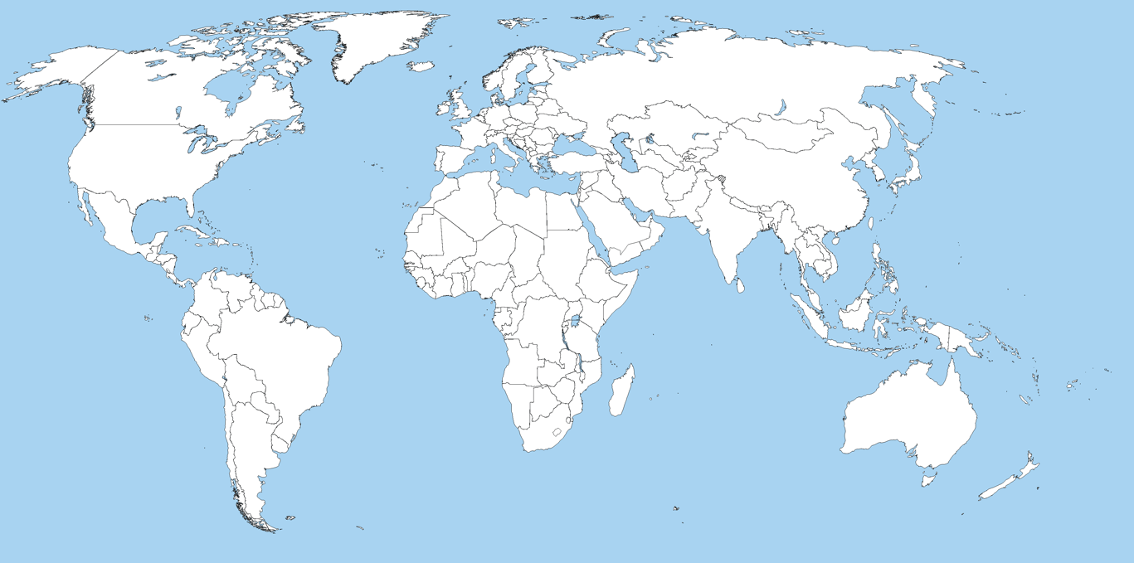
Our HQ & regional research nodes

Slide 5


Slide 6
We seek answers to this challenge:
“by 2050, we need to…
Double world food production on ~ the same amount of land
Make farms, fields and landscapes more resistant to extreme weather, while…
… massively reducing GHG emissions.”
3

Slide 7
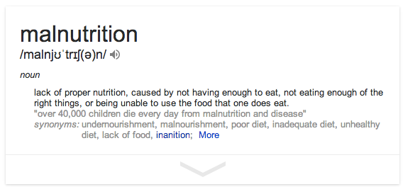
Our core business

Slide 8
Malnutrition means not enough calories…
5000
Cereal yields by region, 1960-2005
4500
4000
East Asia
3500
3000
Latin America
2500
Kg per Hectare
2000
South Asia
1500
1000
Sub-Saharan Africa
500
0
World Bank World Development Indicators
1960
1965
1970
1975
1980
1985
1990
1995
2000
2005

Slide 9
… and a lack of micronutrients.
Fruit & veg consumption
Modified after: Msangi and Rosegrant 2011. Feeding the Future’s Changing Diets.

Slide 10
So here’s a first answer.

Slide 11
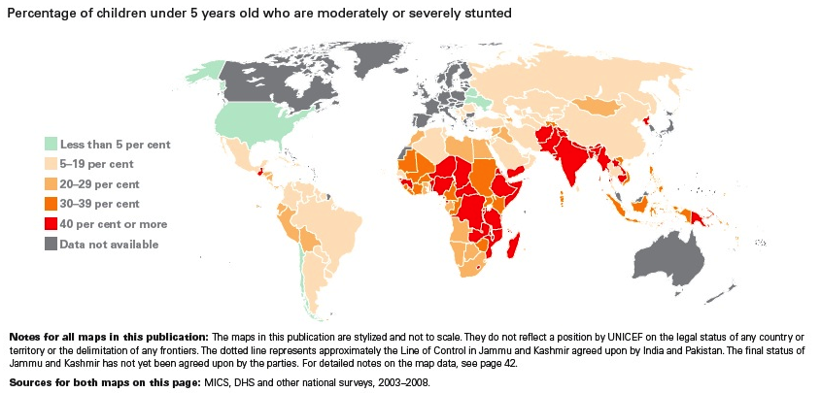
Malnutrion begets stunting…

Slide 12
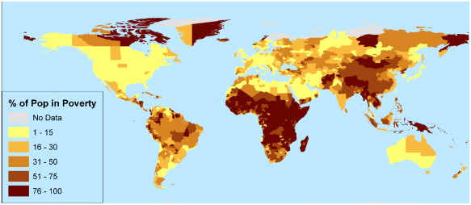
… which (co-)begets poverty.
Poverty rates by administrative region

Slide 13
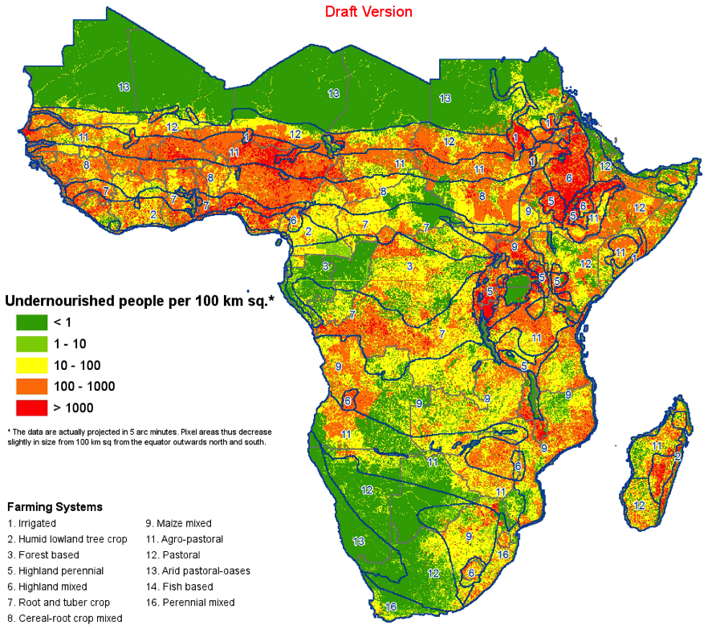
That brings undernourishment, which...

Slide 14
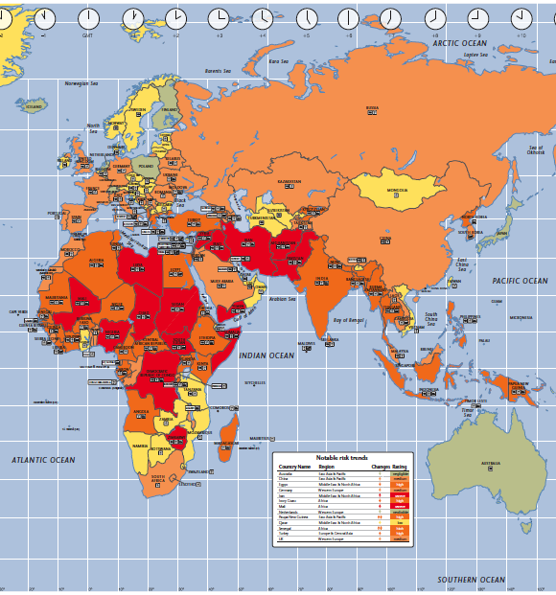

… begets instability, deepening…
Notes:
What are the data points we want to highlight
Build up – demographics, political, productivity, future resilience
D – start with political (in the news – terrorism, instability) – what’s undelying this – productivity

Slide 15
… poverty.

Slide 16
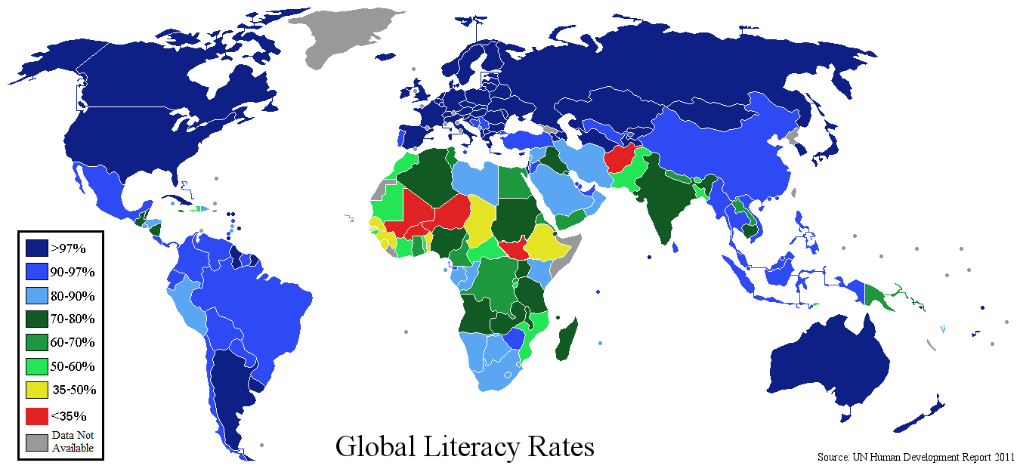
Poverty brings low literacy…

Slide 17
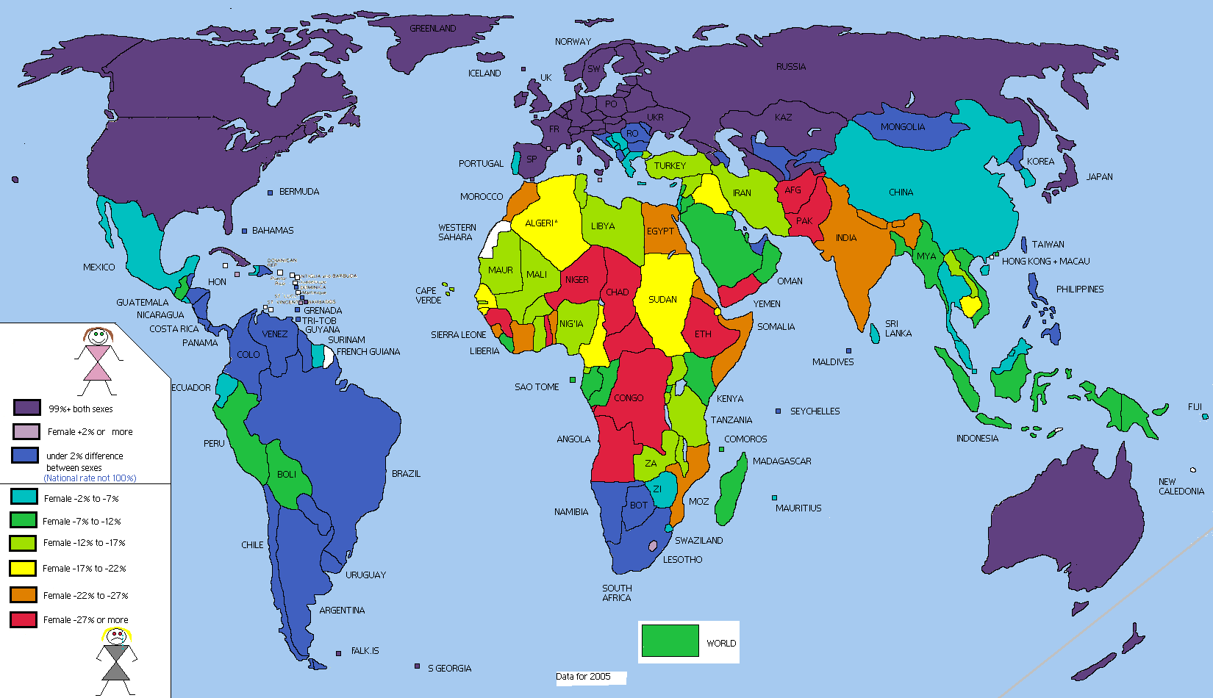
… which especially afflicts women.
Fooddeserts.org

Slide 18
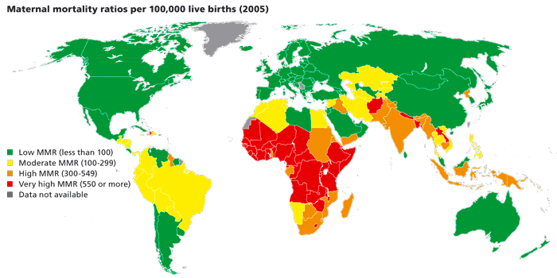
Both bring high maternal mortality…

Slide 19
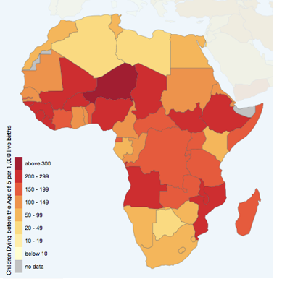
… and high child mortality.

Slide 20
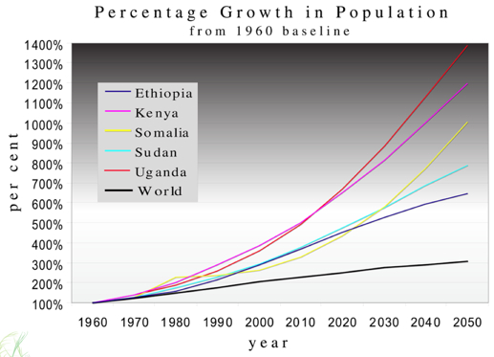
Families react by having lots of children….
8

Slide 21
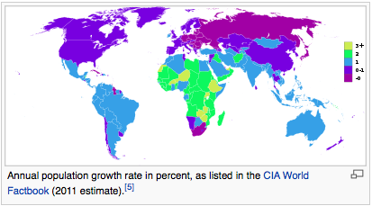
…bringing huge pop growth rates.

Slide 22
…exacerbating low literacy, which...

Slide 23
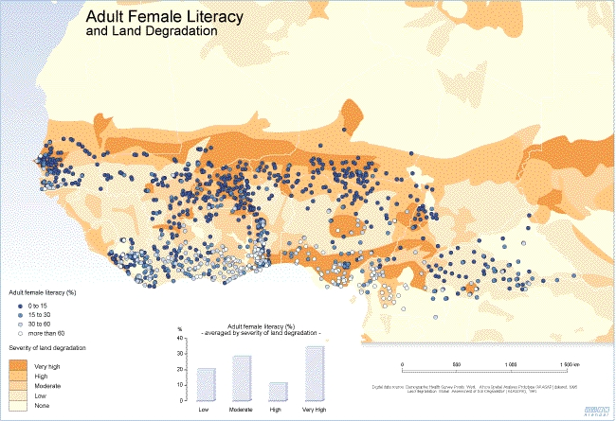
… encourages poor agronomic practices…

Slide 24
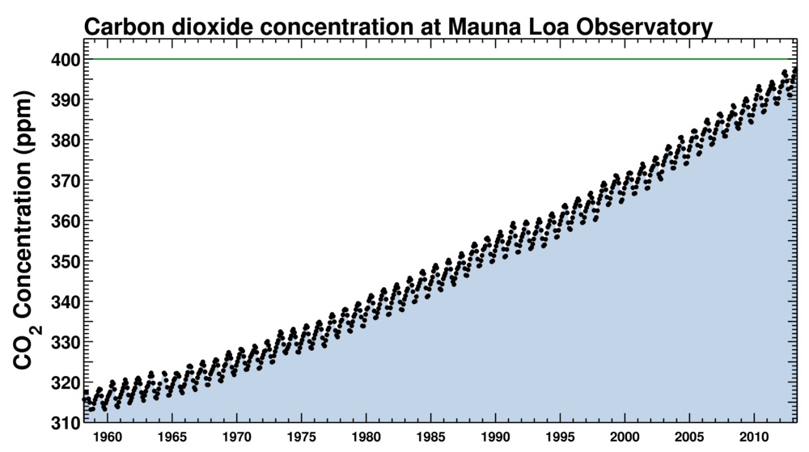
…of a kind needlessly sensitive to changing local climates…

Slide 25
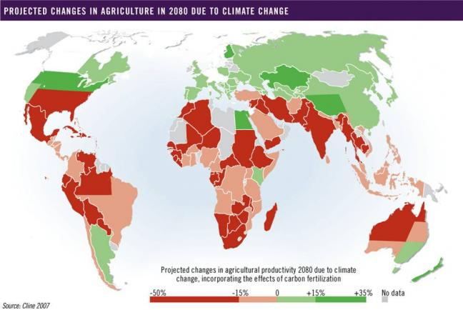
… that will affect Africa more than most.

Slide 26
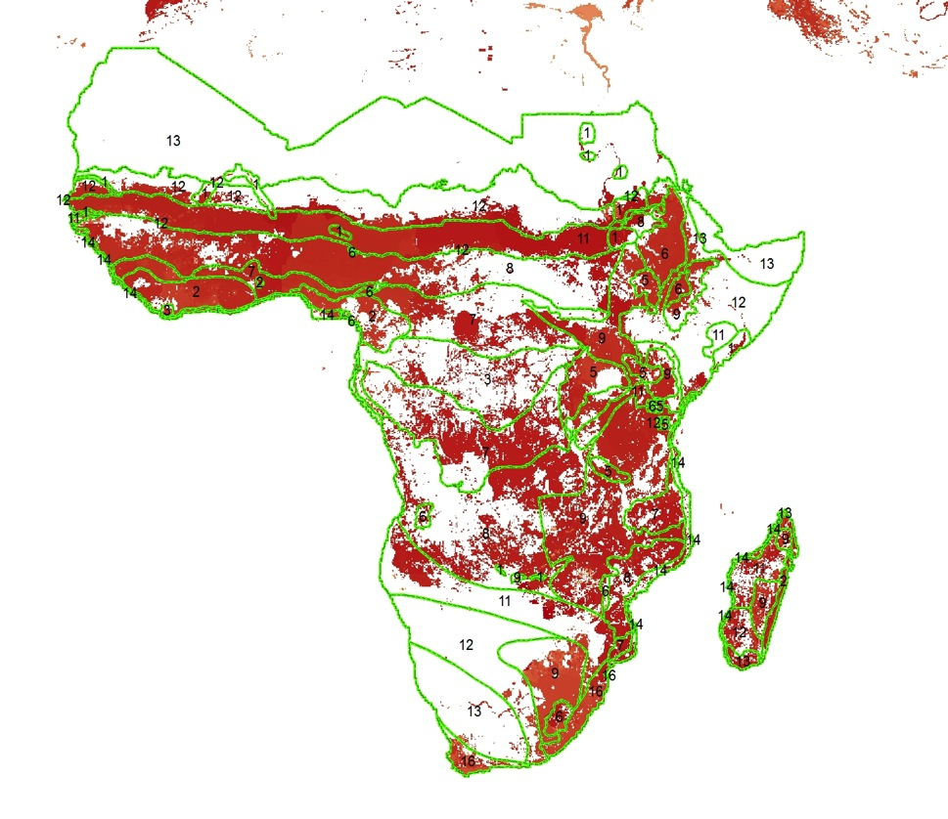

That will exacerbate huge yield gaps…

Slide 27
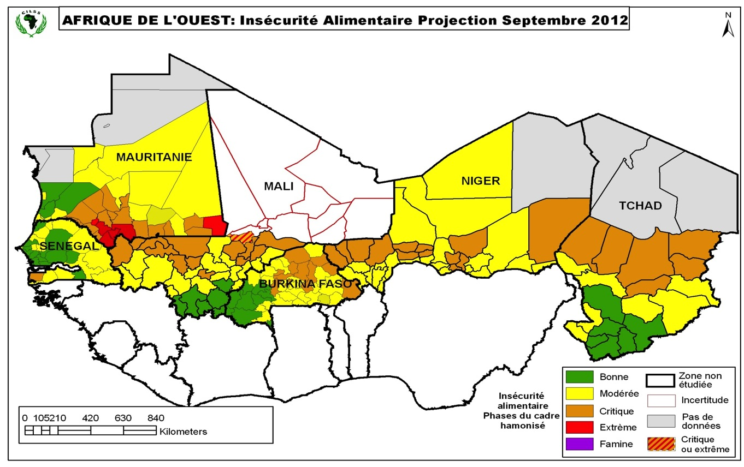
… and thus bring more hunger…

Slide 28
… and more instability.
Notes:
What are the data points we want to highlight
Build up – demographics, political, productivity, future resilience
D – start with political (in the news – terrorism, instability) – what’s undelying this – productivity

Slide 29

It’s the mother of all vicious circles.

Slide 30
Oh, and lest we forget...

Slide 31
Africa is huge.

Slide 32
But… is it really ?
But…

Slide 33
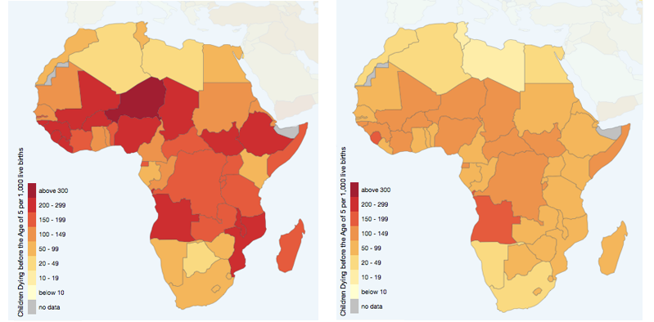
Child mortality over time
Under-5 deaths/ 1,000 live births
1990
2012
UNICEF (2013), Rosen (2014)

Slide 34
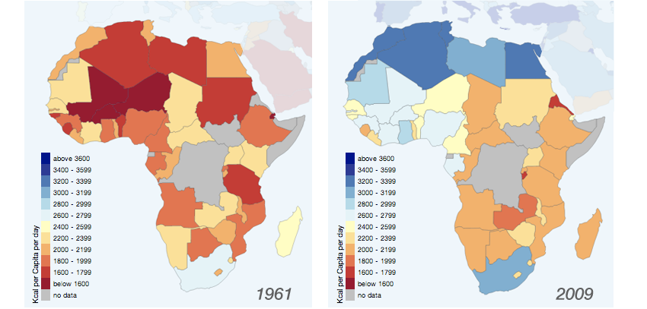
Food supply over time
kCal/capita
1961
2009
FAOSTAT, Rosen (2014)

Slide 35
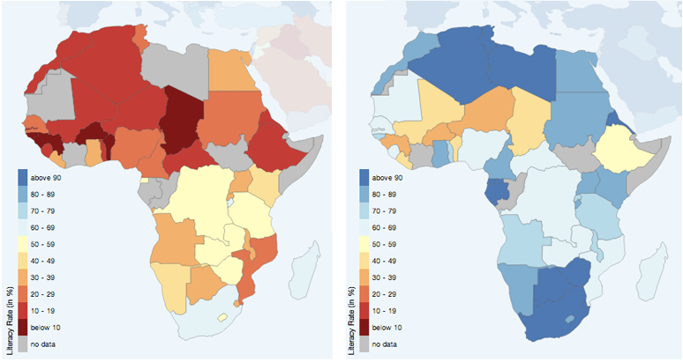
Literacy rate
Literacy rate per age cohort, latest data (2000-2012)
Age 65+
Age 15-24
UNESCO, Rosen (2014)

Slide 36

So, nothing to worry about?

Slide 37
Sadly, yes. Here’s why.

Slide 38
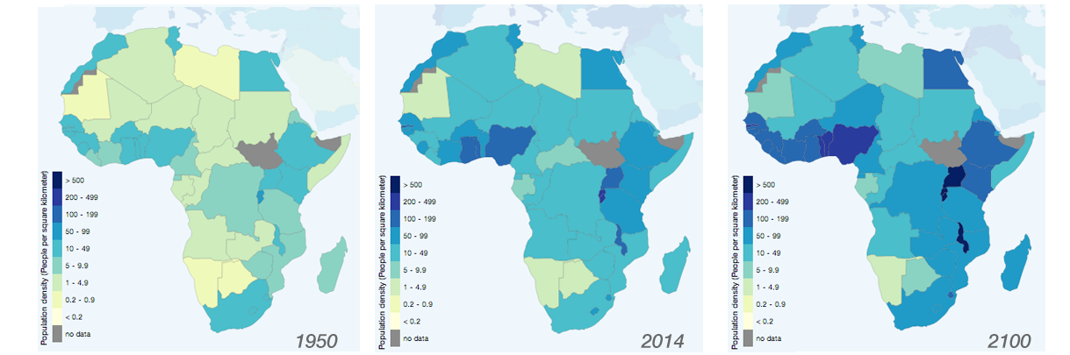
Populations keep rising.
Population densities
1950
2014
2100
UNESCO, Rosen (2014)

Slide 39
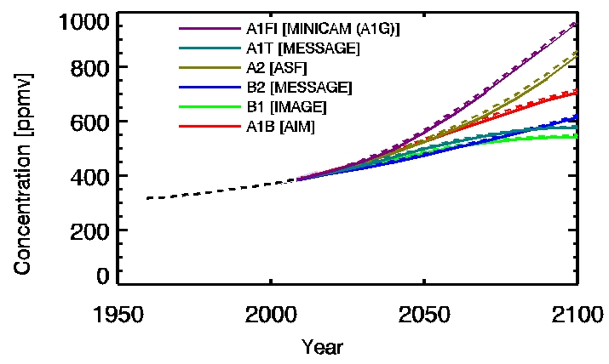
So do GHG emissions.
IPCC

Slide 40
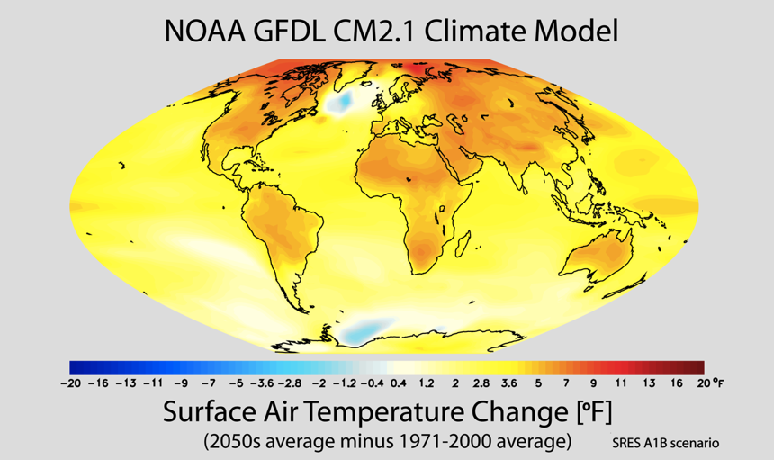
And that will have an impact.

Slide 41
So what can R&D do?

Slide 42
Help define terms.

Slide 43
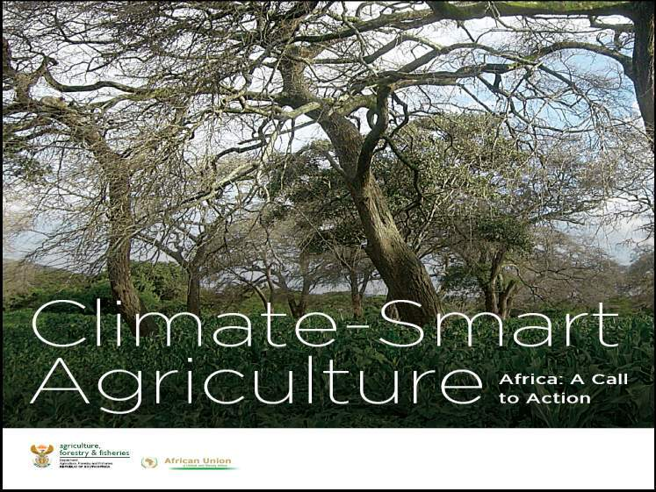

Notes:
43

Slide 45

Does this work?

Slide 46
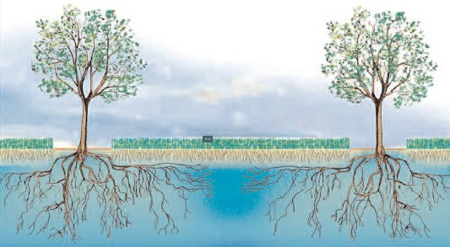
(Hint: not terribly well)
Trees crowns buffer crops from storms, droughts
Crop roots force tree roots deeper, helping shield trees from droughts
Trees roots help prevent waterlogging

Slide 47
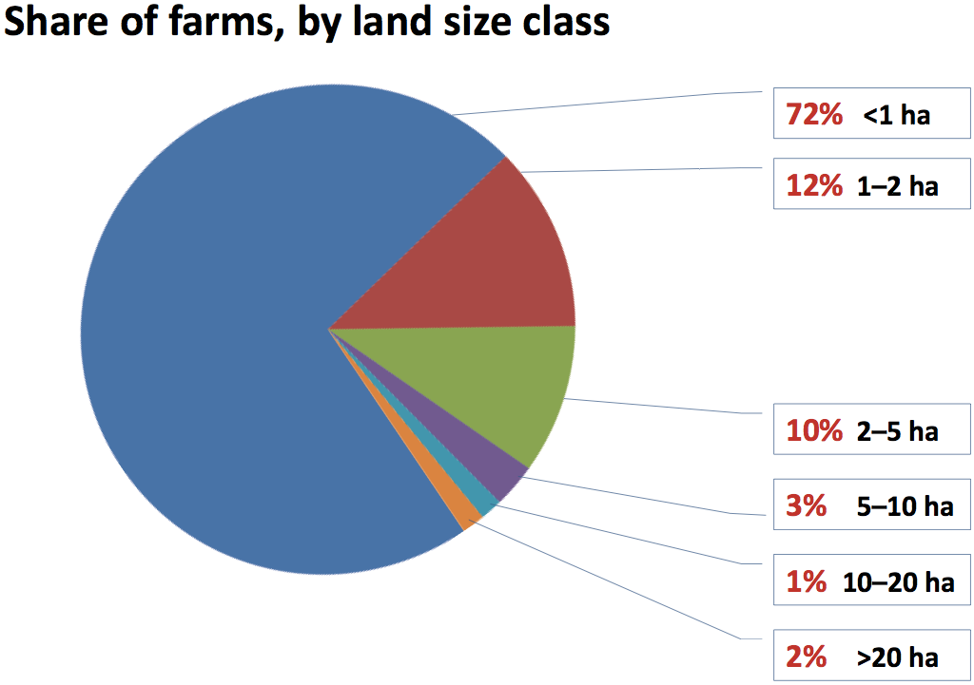
Small farms are the rule…
FAO, State of Food and Agriculture 2014

Slide 48
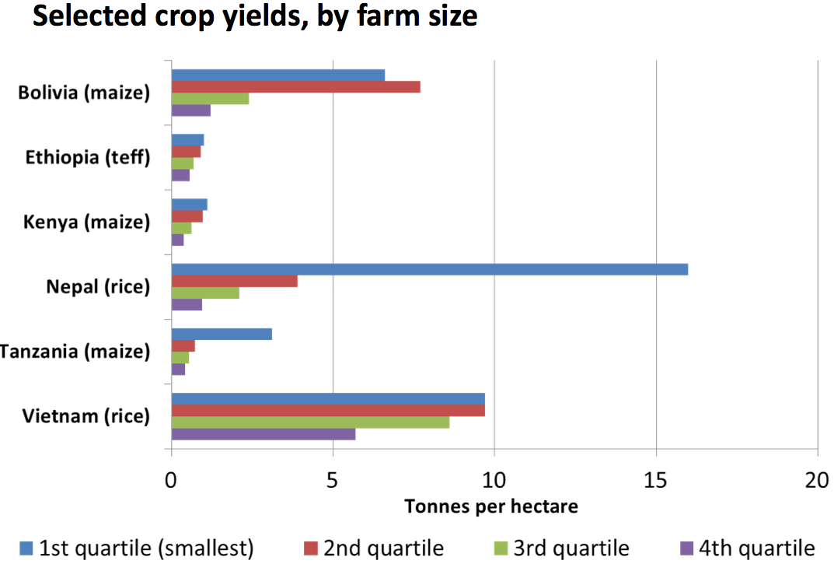
… and they outperform large ones...
FAO, State of Food and Agriculture 2014

Slide 49
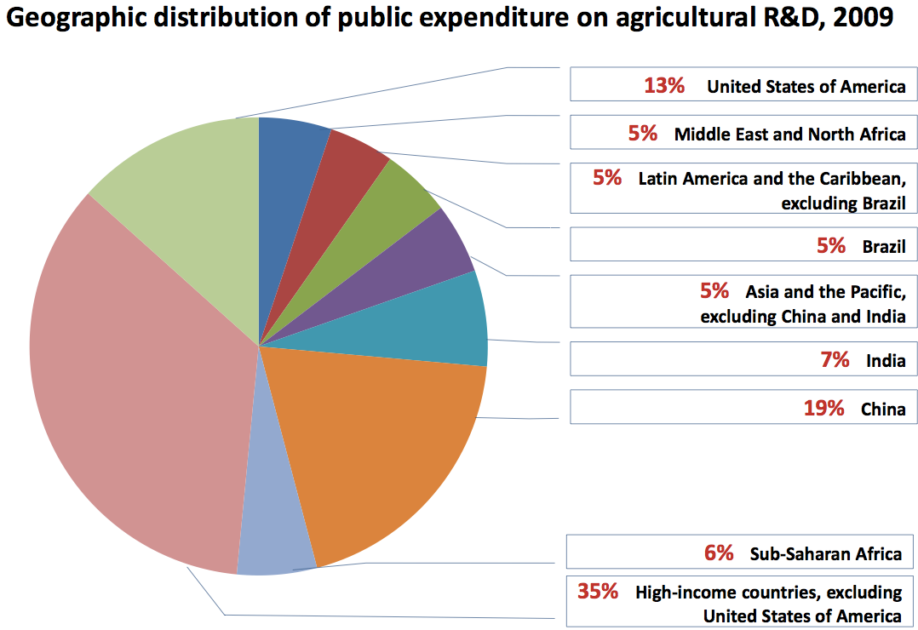
Only 6% of R&D funding spent in Africa!
FAO, State of Food and Agriculture 2014

Slide 50
Example: agroforestry

Slide 51
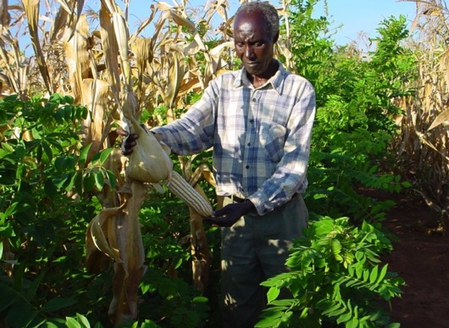
Semi arid tropics: Malawi
yield (t/ha)
Maize only 1.30
Maize + fertilizer trees 3.05
Survey of >200 farms in six districts in 2011
(Mzimba, Lilongwe, Mulanje, Salima, Thyolo and Machinga)
Gliricidia, a leguminous coppice tree, interplanted with maize. The leaves are cut and turned over into the topmost soil layer, providing nitrogen and other nutrients.

Slide 52
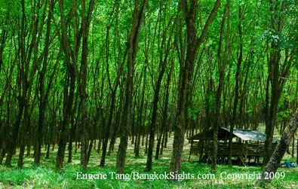
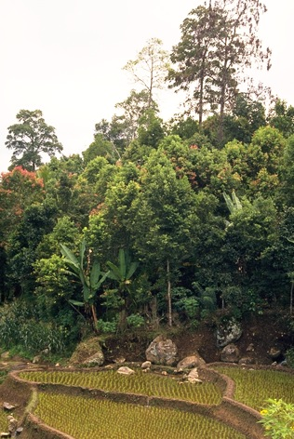
Humid tropic: Sumatra (Indonesia)
 | Rubber plantation | Improved germplasm jungle rubber garden
Farm/plantation size | 1,000 – 15,000 Ha | 3 – 5 Ha
Income after costs Ha⁻¹ Yr ⁻¹ (USD) | ~ 800 | ~ 3,000
N° of value chains | 1 | > 10
Biodiversity ratio (compared to biodiversity of undisturbed local land) | ~ 2% | ~ 60%
Phytosanitation use | High | Low to nil
Social costs | Medium to high | Low to nil
Environmental costs | Very high | Low
Leakey, 2012

Slide 53
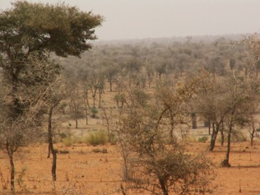
Sahel drylands: Kantché, Zinder (Niger)
350,000 people, rainfall ca. 350 mm / year, typical of Sahel drylands.
Annual district-wide grain surplus:
2007 21,230 tons drought year !
2008 36,838 tons
2009 28,122 tons
2010 64,208 tons
2011 13,818 tons drought year !
Why? More soil organic carbon, less erosion, windbreak effects, nitrogen (leguminous trees), deep soil nutrients transferred to crops through roots and leaf litter, distributed shade against heat shock, groundwater pump through taproot, better rainwater percolation, microclimatic effects…
Yamba & Sambo, 2012
23

Slide 54
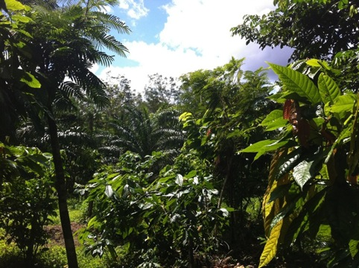
Commodity: oil palm agroforestry
Annual crops 3-4 years (cassava, maize, short-cycle legumes)
Fruit trees : cacao, açaí (euterpe oleracea), banana
Timber, fertilizer trees
Intense management, slash-and-mulch
3 x 6 ha plots
Planted in early 2008
Plot 1 (81 plants/ha) | Plot 2 (99 pl/ha) | Plot 3 (99 pl/ha) | Moncrop (143 pl/ha)
8 tons ha⁻¹ yr⁻¹ | 6.4 tons ha⁻¹ yr⁻¹ | 8.7 tons ha⁻¹ yr⁻¹ | 5 tons ha⁻¹ yr⁻¹

Slide 55
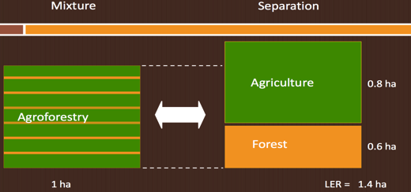
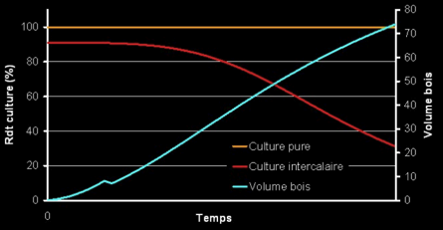
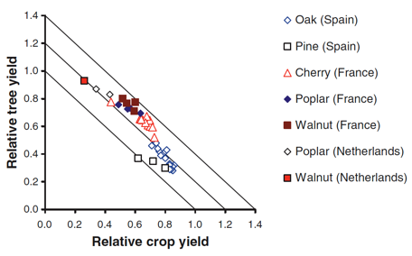
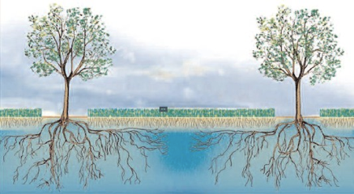
Key agroforestry metric: the Land Equivalency Ratio
Mead & Willeay (19080)
Graves et al. (2007b)

Slide 56
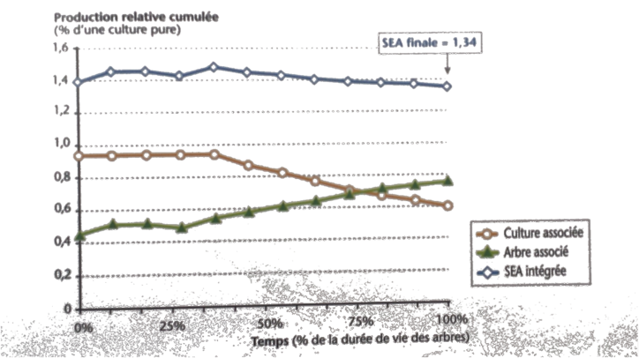
Poplar-winter wheat, France
Cumulative yields
(% of monocrop plots)
Final LER: 1.34
Combined yield
Tree component
Wheat component
Time (% of tree lifetime)
Source: C. Dupraz, F. Liagre, AGROOF

Slide 57
Environmental LERs, too.
Agriculture
Agroforestry
Value of ecosystem services from crop, grass and livestock components
Agriculture
+ Forestry
Forestry
Value of ecosystem services from tree and shrub component
Source: C. Dupraz, F. Liagre, AGROOF

Slide 58
African farm facts
Population growth has rendered fallowing impossible in many communities
Land overuse is depleting soil organic matter, soil carbon and soil microbiology
Consequently, across drylands Africa, soil fertility is dropping by 10-15% a year (Bunch, 2011)
Deep poverty and logistical bottlenecks makes fertiliser unaffordable for most
Funding for fertiliser subsidies is scarce and fickle
Where will soil fertility, soil organic matter and extreme weather resilience come from ?
11

Slide 59
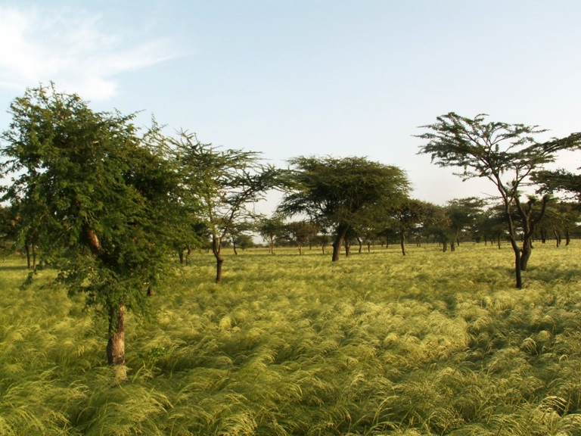
From trees.
Faidherbia Albida in teff crop system in Ethiopia

Slide 60
Fertilizer trees can outperform NPK.
2009/2010 season; data from 6 Malawian districts
Farmer plot management | Sampling Frequency | Mean (Kg/Ha) | Standard error
Maize without fertiliser | 36 | 1322 | 220.33
Maize with fertiliser | 213 | 1736 | 118.95
Maize with fertiliser trees | 72 | 3053 | 359.8
Maize with fertiliser trees & fertiliser | 135 | 3071 | 264.31
Mwalwanda, A.B., O. Ajayi, F.K. Akinnifesi, T. Beedy, Sileshi G, and G. Chiundu 2010
13

Slide 61
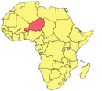

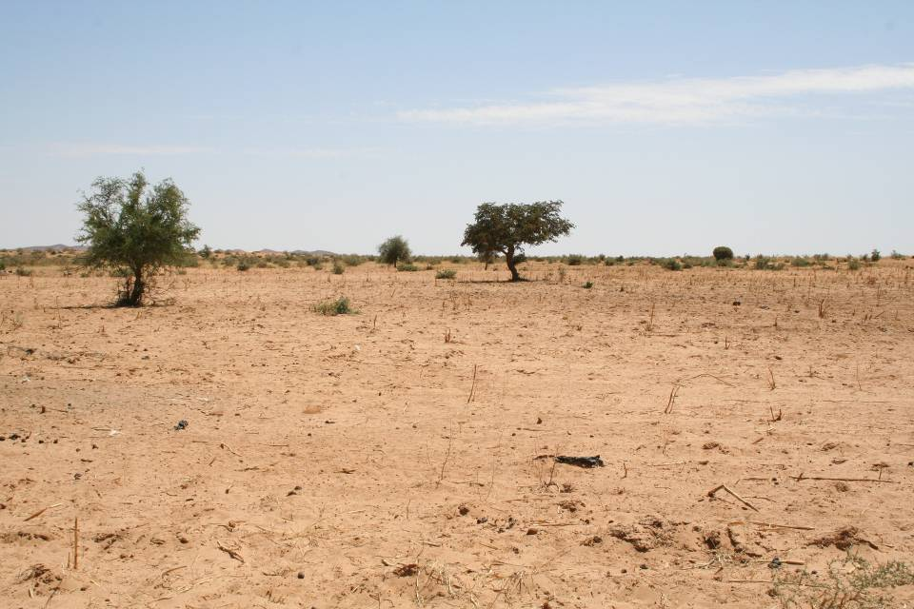
Trees can reclaim barren lands.
Then...
Zinder, Niger, 1980s

Slide 62

... and now.
Zinder, Niger, today.
These 5 million hectares of new agroforest parklands are yielding
500,000 tonnes
more than before.
(Reij, 2012)
Farmer-managed naturally regenerated leguminous tree parklands in millet/sorghum systems.

Slide 63
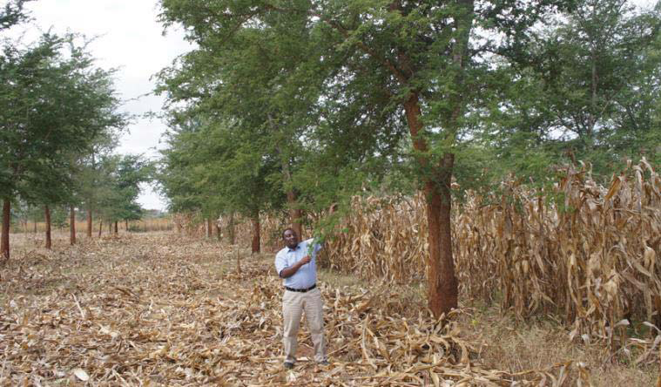
Zambia: conservation agriculture with Faidherbia

Slide 64
Faidherbia Trial Results in Zambia
Maize yield - zero fertiliser (tons/ha)
2008 2009 2010
With Faidherbia 4.1 5.1 5.6
Without Faidherbia 1.3 2.6 2.6
Number of trials 15 40 40
Conservation Farming Unit, Zambia

Slide 65
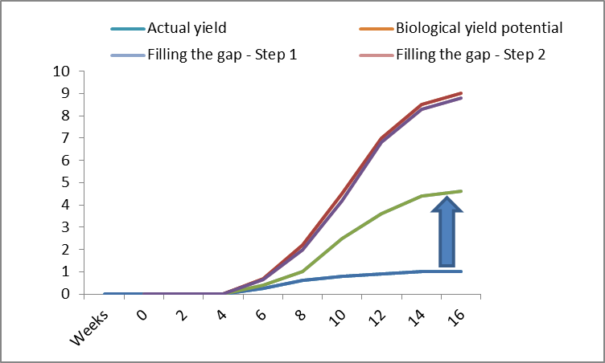
The yield gap lesson
Typical African yield
Typical EU yield
Simple AF yield
Advanced variety yield
GMOs…
Crop yield
(tonnes per hectare)
Advanced
Agroecology &
intrants
Simple
agroforestry

Slide 66
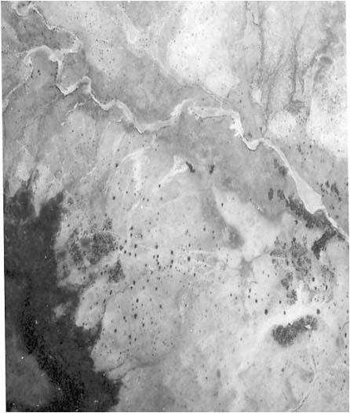
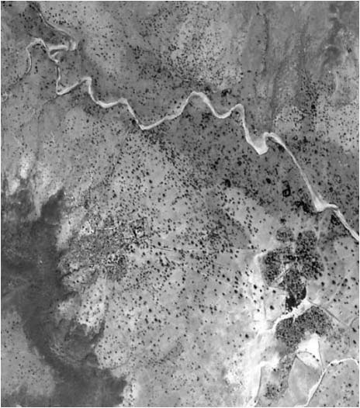
Impact of Policy Changes
Restrictive forest codes in the Sahel were beginning to be relaxed in Niger so that trees planted or managed on farmers’ fields could remain the property of the farmer and not revert to the government.
Galma, Niger 1975 2003
Source: World Vision Australia

Slide 67
Nutrition issue. Where will micronutrients come from?
Modified after: Msangi and Rosegrant 2011. Feeding the Future’s Changing Diets.

Slide 68
CGIAR system level objectives | Competing Theories of Change
Goal 3. Improve nutrition security to eliminate malnutrition and enhance healthy and nutritious diets. Healthy nutrition requires more than calories provided by staple foods, especially for young children. As dietary choices change, new health issues emerge. | A. Genetically modified staple food crops with enhanced micronutrients and vitamins. B. Enhanced diversity of food sources in an agrodiversity approach

Slide 69
Daily nutrient requirement
→ Adult female, 31-50 years old, not pregnant or lactating, sedentary lifestyle
Macronutrients | 5
Carbohydrate | 130 | g
Dietary Fiber | 25 | g
Linoleic Acid | 12000 | mg
Alpha-Linolenic Acid | 1100 | mg
Protein | 47 | g
Vitamins |  | 14
Vitamin A | 500 | µg RE
Vitamin C | 50 | mg
Vitamin D | 200 | IU
Vitamin E | 15 | mg
Vitamin K | 90 | µg
Thiamin | 1.1 | mg
Riboflavin | 1.1 | mg
Niacin | 14 | mg
Vitamin B6 | 1.3 | mg
Folate | 400 | µg
Vitamin B12 | 2.4 | µg
Pantothenic Acid | 5 | mg
Biotin | 30 | µg
Choline | 425 | mg
Minerals | 12
Calcium | 1000 | mg
Chromium | 25 | µg
Copper | 0.9 | mg
Flouride | 3 | mg
Iodine | 150 | µg
Iron | 18 | mg
Magnesium | 320 | mg
Manganese | 1.8 | mg
Molybdenum | 45 | µg
Phosphorus | 700 | mg
Selenium | 55 | µg
Zinc | 8 | mg
➔ 31 nutrients to be covered

Slide 70
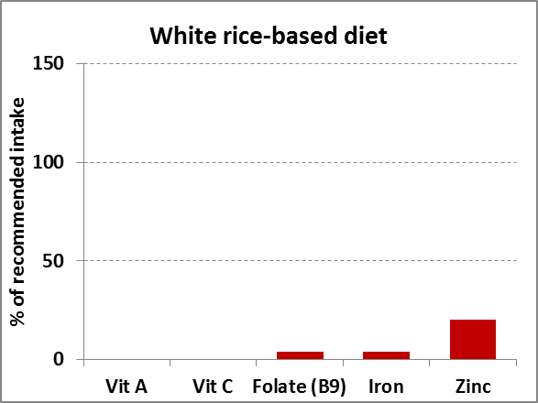
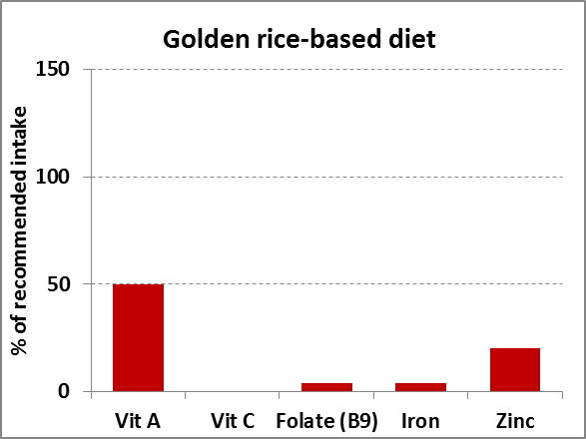
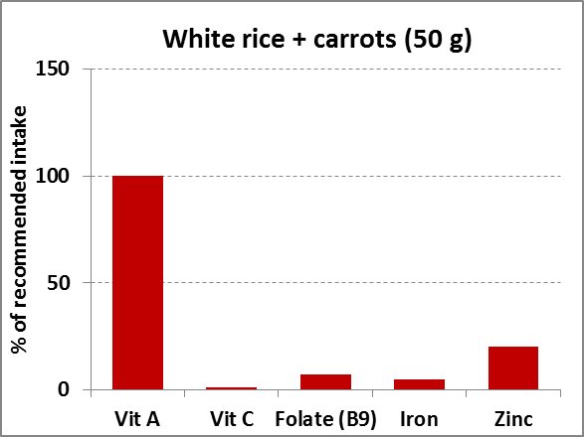
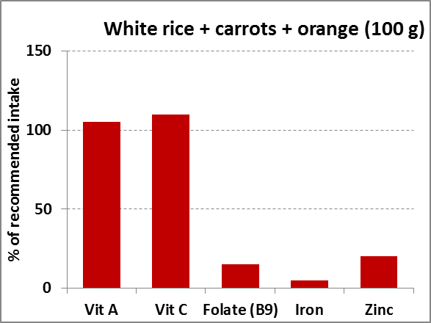
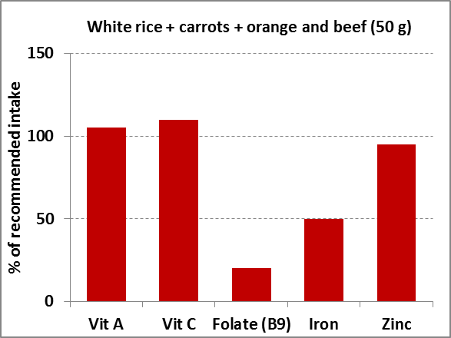

Agro-biodiversity for balanced diets
or 50 g cassava leaves
or 70 g moringa leaves
or 9 g red palm oil
or 90 g butternut
or 125 g mango (orange)
or 20 g guava
or 20 g baobab pulp
or 30 g moringa leaves
or 80 g mango
or 60 g sesame seeds
or 70 g Grewia tenax fruits
➔ High agro-biodiversity = diverse, balanced diets

Slide 71

Fruit tree portfolio for vitamin supply
➔ Vitamin A and C supply possible year-round
➔ Cultivation of 8-13 fruit tree species
Hunger gap
Species name | Jan | Feb | Mar | April | May | Jun | Jul | Aug | Sep | Oct | Nov | Dec |  | Vit C | Vit A
Lantana camara
Carica papaya |  |  |  |  |  |  |  |  |  |  |  |  |  | + | +++
Mangifera indica |  |  |  |  |  |  |  |  |  |  |  |  |  | + | +++
Musa x paradisiaca
Eriobotrya japonica |  |  |  |  |  |  |  |  |  |  |  |  |  |  | +++
Morus alba |  |  |  |  |  |  |  |  |  |  |  |  |  | (+)
Tamarindus indica
Syzygium spp. |  |  |  |  |  |  |  |  |  |  |  |  |  |  | +++
Annona reticulata |  |  |  |  |  |  |  |  |  |  |  |  |  | (+)
Psidium guajava |  |  |  |  |  |  |  |  |  |  |  |  |  | +++ | +
Punica granatum
Casimiroa edulis |  |  |  |  |  |  |  |  |  |  |  |  |  | (+)
Vangueria madagascariensis
Citrus limon |  |  |  |  |  |  |  |  |  |  |  |  |  | +
Citrus sinensis |  |  |  |  |  |  |  |  |  |  |  |  |  | +
Vitex payos |  |  |  |  |  |  |  |  |  |  |  |  |  |  | +++
Persea americana
Passiflora edulis |  |  |  |  |  |  |  |  |  |  |  |  |  |  | +
Pappea capensis
Balanites aegyptiaca |  |  |  |  |  |  |  |  |  |  |  |  |  | (+)
Carissa edulis
Available species | 2 | 4 | 6 | 4 | 4 | 5 | 4 | 2 | 3 | 1 | 2 | 2
ICRAF, Machakos baseline data (2014, EC Fruit Project)

Slide 73


Slide 74

Obvious mitigation need.

Slide 75

Obvious mitigation potential

Slide 76

Mitigation potential of various AF systems
Aertsens et al.’s estimate of
mean European AF performance
Mbow (2012)
Notes:
High input carbon practices: Improved crop varieties, crop rotation, use cover crop, conservation agriculture, better use of manure
Integrated nutrient management: reduction of leaching, improved N use, improved use of fertilizers
Increase availability of water: water management, water harvesting
Improved tillage: less soil disturbance, incorporating crop residues and soil organic matter
Agroforestry: increase above ground biomass and fuel wood, reduce soil erosion, set-aside,

Slide 77


Mapping soil organic carbon
Mapping SOC Stocks using high resolution (QuickBird) satellite image
A landscape level SOC stocks mapping can be made using medium resolution satellite imagery such as ASTER and Landsat
SOC stocks in the mid Yala, western Kenya. The effect of cloud is masked as no data
Notes:
The slide is an output of the Land Health Surveillance Framework and shows C-stocks in the Yala watershed, western Kenya. Accurate SOC measurements allow tracking C-stock changes over time and can hence be used for monitoring, reporting and verification (MRV). This is a requirement for C-markets to function.

Slide 78



95% correlation between sat and lab

Slide 79
Arbitrary mitigation/adaptation distinction.
Improved carbon
sink management
[M]
Improved adaptive
capacity of the society
[A]
Minimized
deforestation and
forest degradation
[M]
Improved
livelihood [A]
Diminished release
of GHG to the
Atmosphere [M]
Improved
agricultural
productivity [A]
Sustainable
forest
management [M]
Better landscape
management [M] [A]
Enhanced ecosystem
services and goods
availability [A]
Soil and water
conservation [A]
Reduced loss of
soil carbon stock
[M]
Agroforestry
[M] [A]
Biodiversity
conservation [A]
Enhances carbon
sinks [M]
Afforestation and
reforestation [M]

Slide 80

Wanted: heat buffering
C3/C4 plant productivity vs. T°
Wheat
Maize
T° (C)

Slide 81

Microclimatic effect of canopy shade
Lower T° extends the crops’ grain-filling period.
Source: CIMMYT

Slide 82
Maize-mixed: Aggregated Assessment

Slide 83

Soil biota density under crops compared with agroforestry
Number per m² (Barrios et al 2012)

Slide 84

Soil biota density under crops compared with agroforestry
Number per m² (Barrios et al 2012)
Notes:
Mark the build up of termites due to the large volume of cereals

Slide 85
Local water buffering
Trees crowns buffer crops from storms, droughts
Crop roots force tree roots deeper, helping shield trees from droughts
Trees roots help prevent waterlogging

Slide 86
Water buffering and woody biomass
The lower tree roots in the AF system explain why woody biomass is higher than in pure forests: the trees are less exposed to water stress.

Slide 87
Other adaptation effects
Better use of light and water resources: land equivalency ratios > 1
Crop yields: more soil organic matter, better plant nutrient availability
Livestock farming: more on-land fodder, shelter
Extreme weather resilience: roots pump water, trees can shade crops from excess heat, windbreaks
Insurance function (old age…): timber sales offer one-off cash income
Income diversification: crops, biomass, fodder, timber, fruits, nuts, C credits…
Higher biodiversity: fewer niches for pests, more niches for pest predators
Soil restoration: more SOC, richer soil microbiology, enhanced percolation, less erosion, less degradation
Water capture: better water retention and percolation, less runoff
More rainfall? evapotranspiration is the source for most rainfall in the Sahel, other regions.

Slide 88


Much rain does not originate from the seas.
As plants prefer one of the naturally available isotopes of oxygen, it’s easy to measure if rain evaporated from the oceans or from plants.
P = precipitation
P from Et = P from evapotranspiration
E = evaporation
P_{from Et}/P
van der Ent RJ, Savenije HHG, Schaefli B, Steele‐ Dunne SC, 2010. Origin and fate of atmospheric moisture over continents. Water Resources Research 46, W09525,
E/P

Slide 89


Global water management

Slide 90

Deforesting Myanmar will reduce rainfall in China

Slide 91
Some things trees give to the land
Soil restoration:
  more SOC, richer soil microbiology, enhanced percolation, less erosion, less degradation
Soil fertility:
  more SOC, more N if legumes, nutrient pump
Increased carbon accumulation
  6-10 tons of CO_{2-eq.} per hectare per year are common
Higher biodiversity:
  fewer niches for pests, more niches for pest predators
Lower input requirements:
  fewer pesticides, fewer fertilisers
Higher productivity:
  better use of water, nutrients, light
Better, crop yields:
  more soil organic matter, better plant nutrient availability, protective microclimate
Better nutrition:
  fruits, fodder, multi-crop system support
Livestock farming:
  more dry season fodder availability
Weather resilience:
  roots pump water, trees offer shade and windbreaks
Insurance:
  in hard times, farmers can sell timber
Income diversification:
  crops, fuel, fodder, timber, fruits
Health:
  nutrition, medicinal barks and leaves
Energy resources:
  fuelwood, charcoal
Reduced deforestation:
  more tree products sourced off-forest

Slide 92
The sustainability transition
Net income
Capital (except land), inputs
Resilience, sustainability
risk proofing, micronutrients,
biodiversity, mitigation,
adaptation, water availability…
Yield range
Expertise,
knowledge, Skills
Neg. externalities: GHG, land
degradation, biodiversity loss,
autonomy loss, nutrient
deficiency, weather risks,
water stress, debt…
Intensive agriculture
Agroecological systems

Slide 93
How do we get there?

Slide 94

Crop
Land
1.5 billion ha
Pasture &
Rangelands
3.4 billion ha
Planted
forests
Natural
Forest
4.1 billion ha
Deserts
1.9 billion ha
Wetlands
1.3 billion ha

Slide 95

                Is this the best way to achieve..
                Productivity/Income ?
                Sequestration/Mitigation ?
                Reduced emissions ?
                Resilience/Adaptation ?
Agriculture
Forestry
Environment
CSA
REDD+
PES

Slide 96
Integrate Segregate
⬅agroforestation
Open field agriculture
⬅re- and afforestation
Fields,fallow, forest mosaic
Plantations
deforestation➔
Fields, Forests & Parks
Agroforests
⬅forest modification
Natural forest

Slide 97
Old Impact Pathway Paradigm
Development
(application of knowledge)
Research
(building of knowledge)
Time (years)

Slide 98
New Impact Pathway Paradigm
Development
(proof of application &
application of knowledge)
Research
(building of knowledge)
Time (years)

Slide 99
The African Union’s 2nd Drylands Declaration
"RECOMMEND AND PROPOSE that the drylands development community, through the African Union, and all collaborating and supporting organizations, commit seriously to achieving the goal of enabling EVERY farm family and EVERY village across the drylands of Africa to be practicing Farmer-Managed Natural Regeneration and Assisted Natural Regeneration by the year 2025."

Slide 100

African Union Strategy to End Hunger by 2025
Targeting to scale-up Fertilizer Tree Technologies to tens of millions of farmers during the coming decade. This could enable 7 billion “fertilizer plants” on farmers’ fields during the next decade.

Slide 101
The Malabo Declaration of African Heads of State - June 2014
«We commit to...ensure that by 2025, at least 30% of our farm households in Africa are resilient to climate-related risks.»

Slide 102
EU policy changes
2013 Common Agricultural Policy:
  1305/2013 Article 23 pillar 2: Establishment of agroforestry systems.
Climate Change 2030 Policy Framework Communication:
  4.2 Agriculture and land use:
  “For example, emissions are associated with livestock production and fertilizer use while grassland management or agro-forestry measures can remove CO2 from the atmosphere.”

Slide 103

If this is the
future…

Slide 104

… then why this?
Investment in agroforestry
Investment in
conventional agriculture

Slide 105
Well, to some this list….
Soil restoration:
  more SOC, richer soil microbiology, enhanced percolation, less erosion, less degradation
Soil fertility:
  more SOC, more N if legumes, nutrient pump
Increased carbon accumulation
  2-10 tons of CO_{2-eq.} per hectare per year are common
Higher biodiversity:
  More niches for pest predators
Lower input requirements:
  fewer pesticides, fewer fertilisers
Higher productivity:
  better use of water, nutrients, light
Better, crop yields:
  more soil organic matter, better plant nutrient availability, protective microclimate
Better nutrition:
  fruits, fodder, multi-crop system support
Livestock farming:
  fodder , shelter
Weather resilience:
  roots pump water, trees offer shade and windbreaks
Insurance & savings:
  One off timber sales
Income diversification:
  crops, fuel, fodder, timber, fruits
Reduced deforestation:
  more tree products sourced off-forest
Flood control & water recharge:
  Marketable environmental service

Slide 106

… sounds too good to be true.

Slide 107


Slide 108


Slide 109
For more information
p.worms@cgiar.org
Mobile +32 495 24 46 11
Land +32 2 351 6829
www.worldagroforestrycentre.org
53

