Slide 1
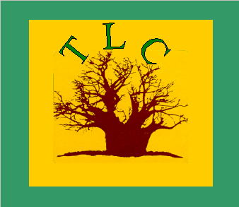
      FMNR IN SOUTHERN AFRICA:
      FACT0RS MOTIVATING FARMERS
      WITH ACTIONS AND STRATEGIES FOR SCALING UP
      TOTAL LANDCARE
      Thematic Session on FMNR
      CONFERENCE ON BEATING FAMINE
      APRIL 14-17, 2015

Slide 2
STRUCTURE OF PRESENTATION
Faidherbia albida in Malawi highlighting its value and impact on crops in areas where the tree is naturally found in Malawi.
FMNR with other trees outside the “Faidherbia belt”, with a focus on the diversity, density & management of trees in the central upland region of Malawi.
Factors motivating farmers for FMNR and its management.
Actions and strategies for upscaling

Slide 3
FMNR IN SOUTHERN AFRICA
As a farmer driven practice borne out of experience and necessity, FM natural regeneration is the most widespread and most successful agroforestry system in Southern Africa and perhaps in other regions of the continent.
Despite this fact and its increasing popularity among farmers, few organizations know of or support this practice.

Slide 4
KEY ACTIONS
FMNR needs far greater attention, research, exposure and publicity to attract the support of Governments, Donors, NGOs and the Private Sector to realize its massive potential to improve the lives and livelihoods of smallholder farmers and their environment.

Slide 5
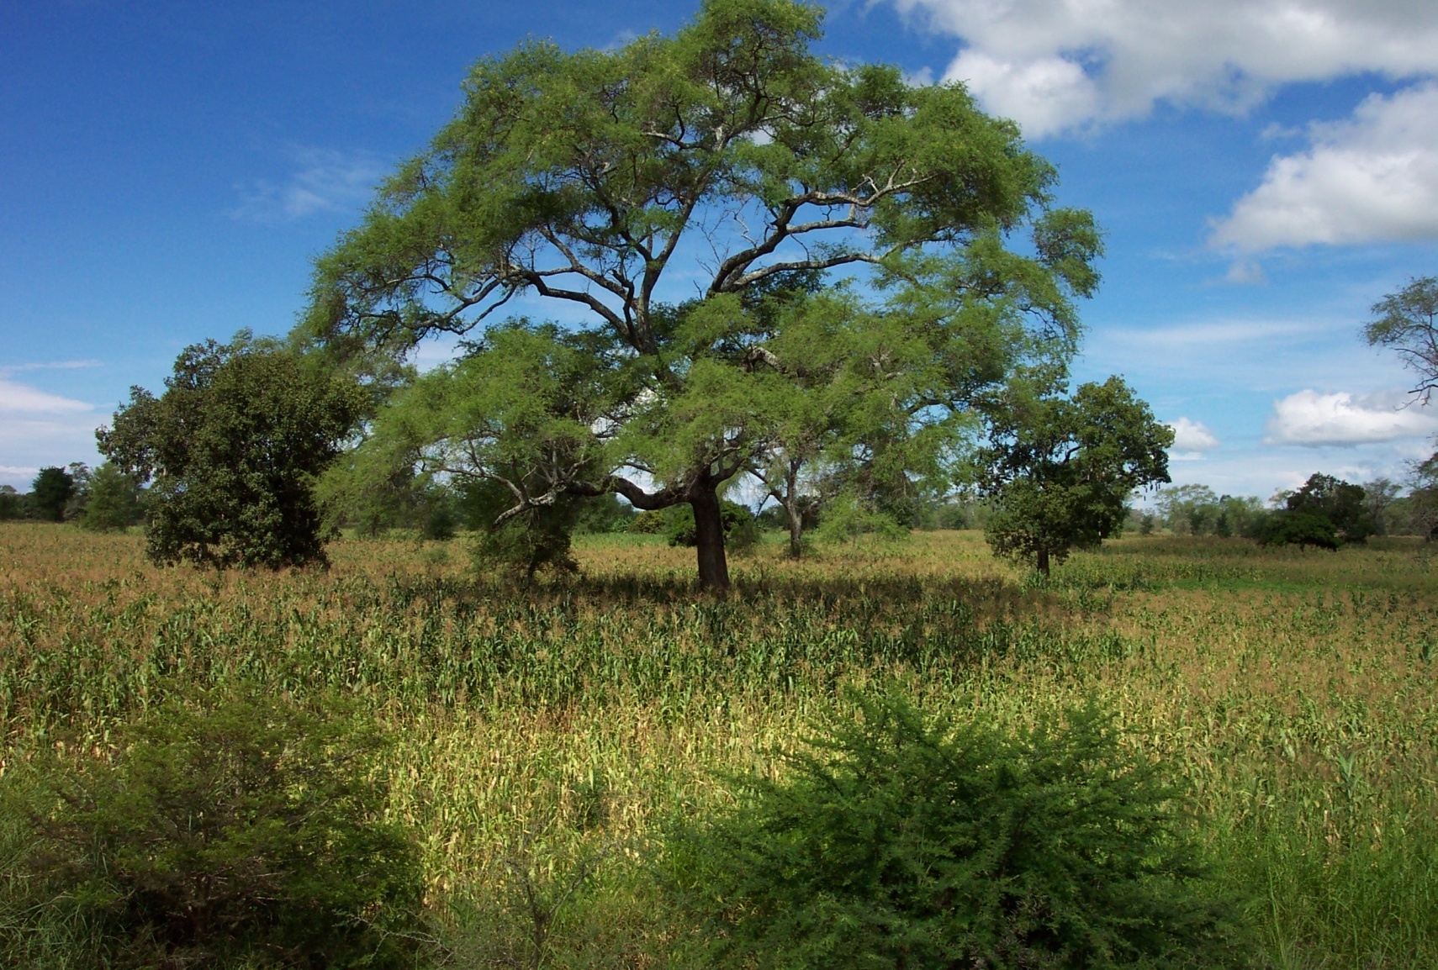
Faidherbia albida
Increases productivity with lower input costs and risks from erratic rainfall

Slide 6

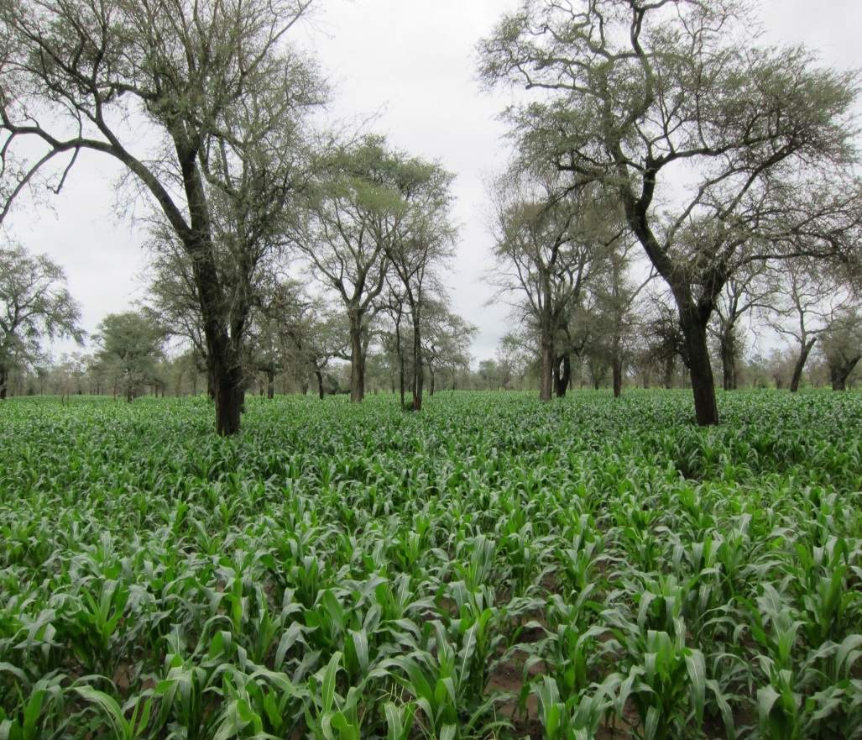
Increases maize yields by 50-200% due to improvements in soil fertility and the micro-environment with greater resilience to climate change

Slide 7
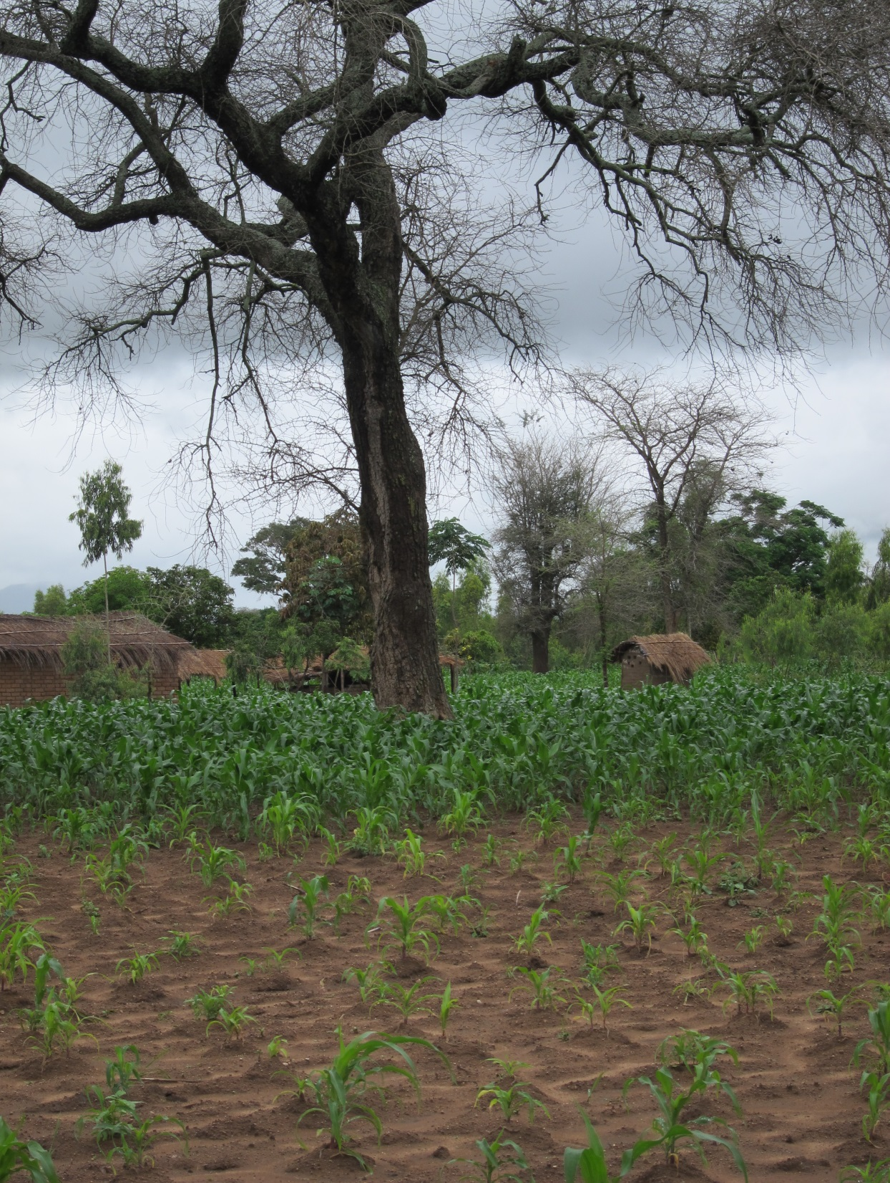
Crop resilience to drought and dry spells:
Healthy maize under Faidherbia vs. stressed crop outside

Slide 8
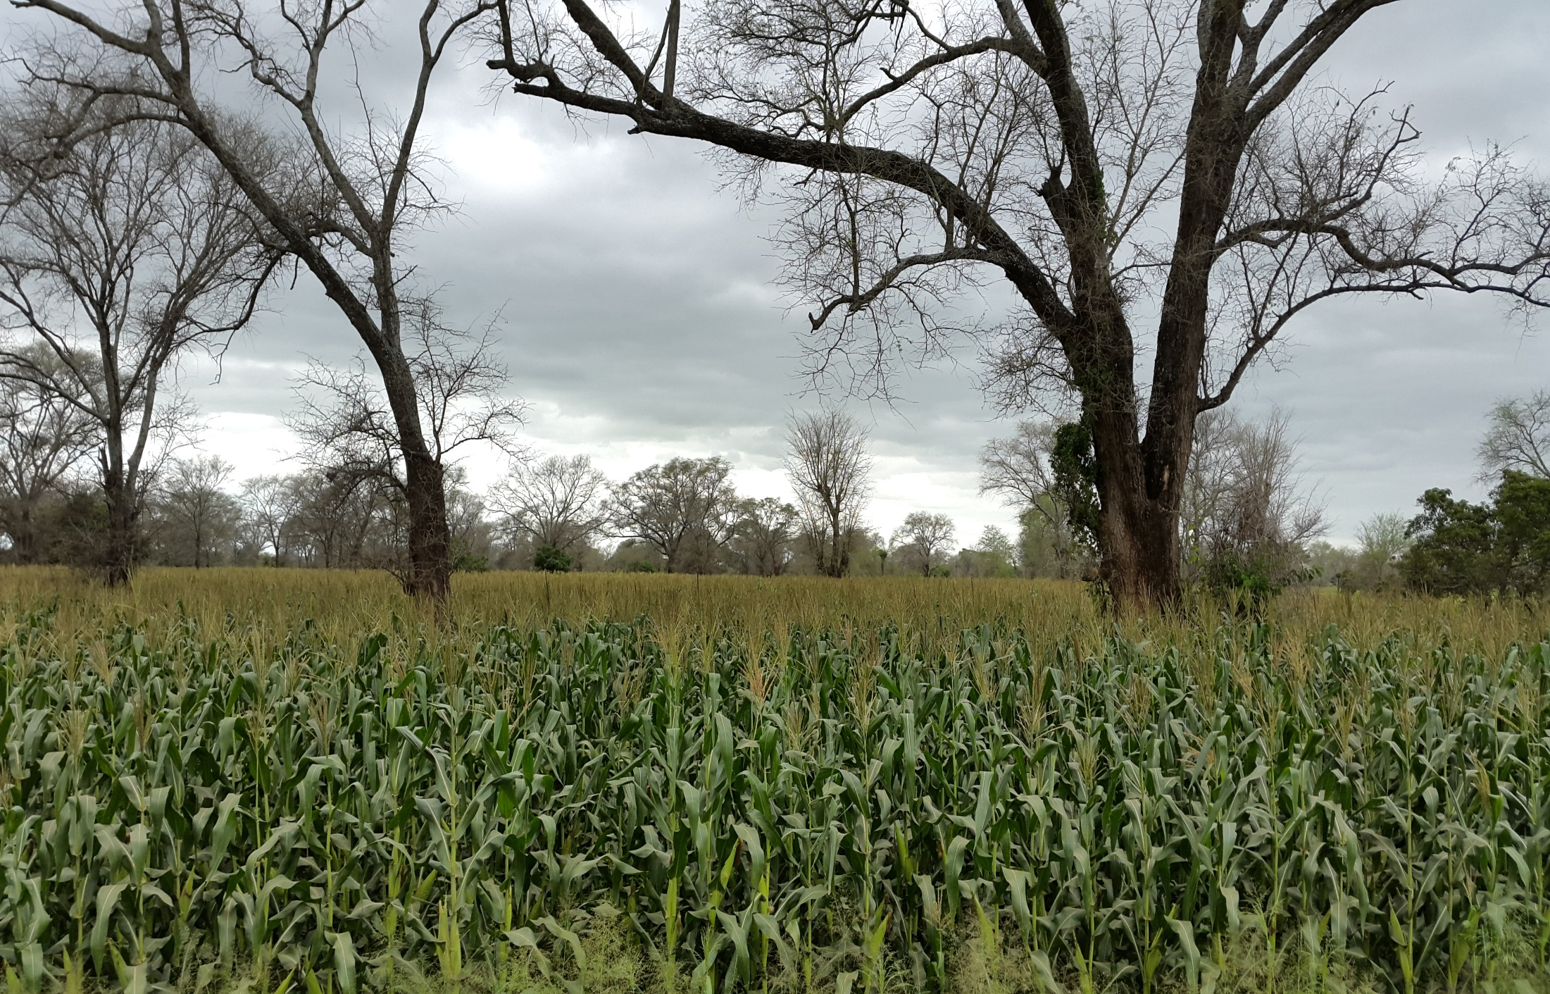
Maize Crop under Faidherbia in 2014/15

Slide 9
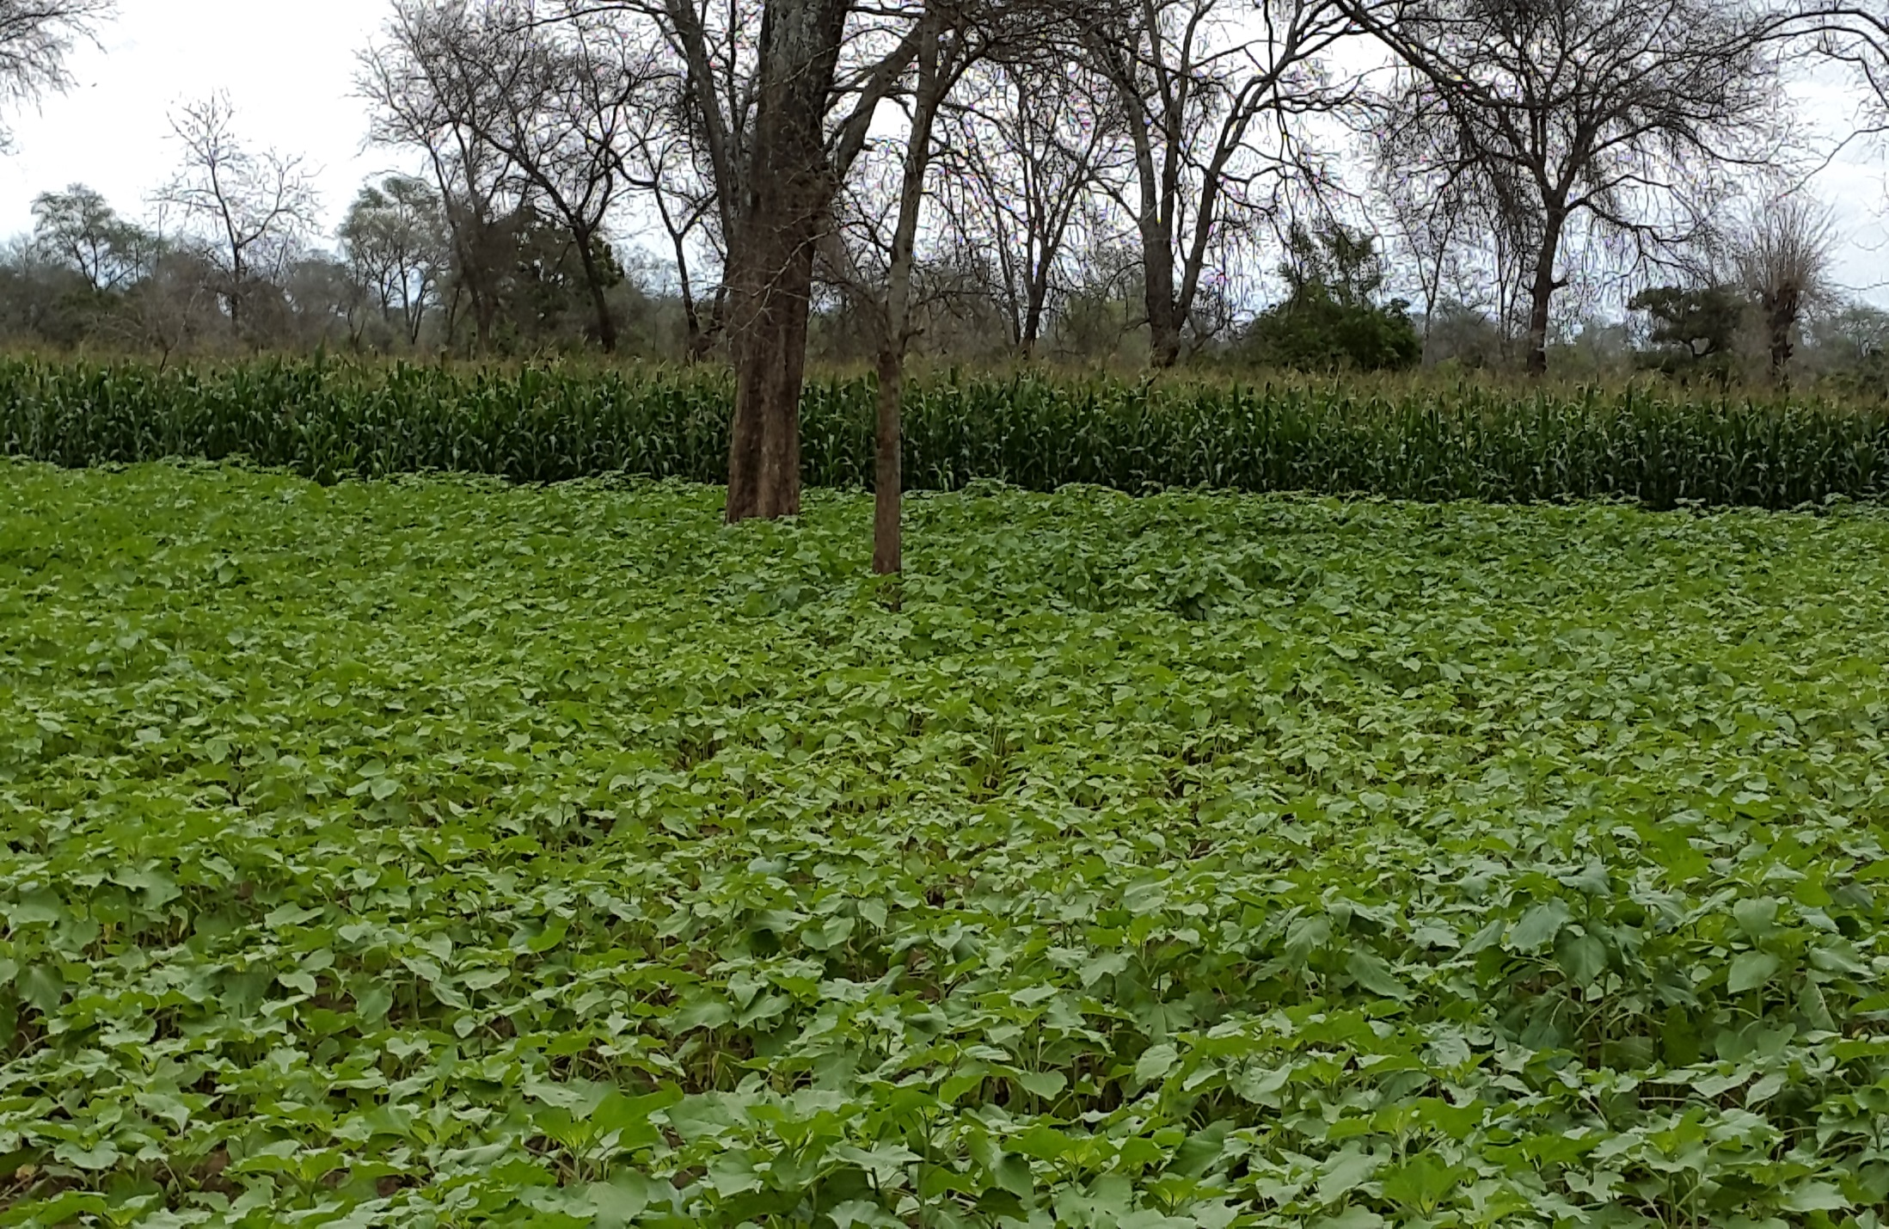
Sunflower Crop under Faidherbia in 2014/15

Slide 10
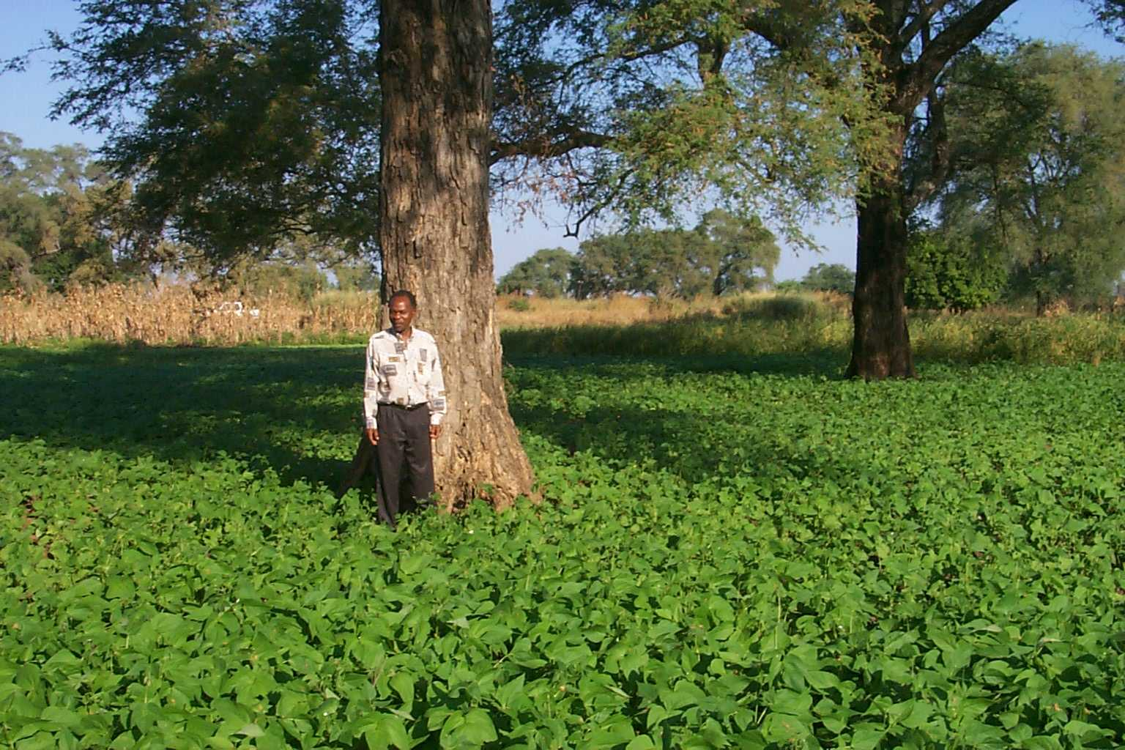
Winter Beans under Faidherbia after maize harvest

Slide 11
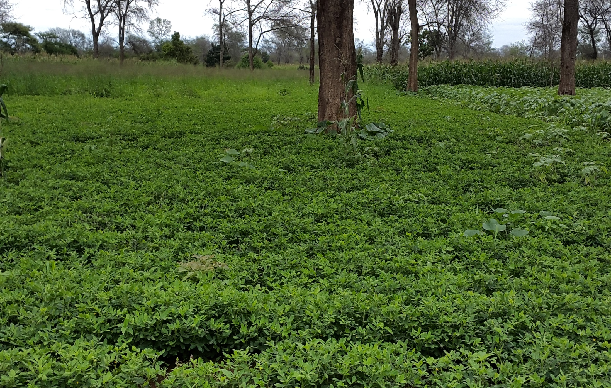
Groundnut Crop under Faidherbia in 2014/15

Slide 12
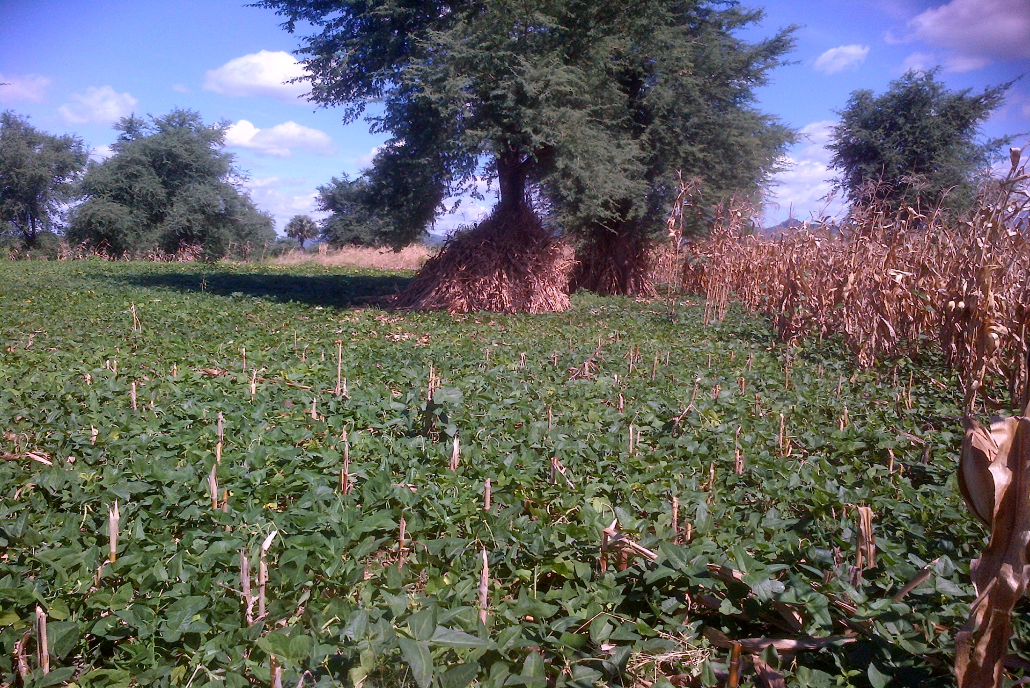
Cowpea Relay Crop under Faidherbia after maize harvest

Slide 13
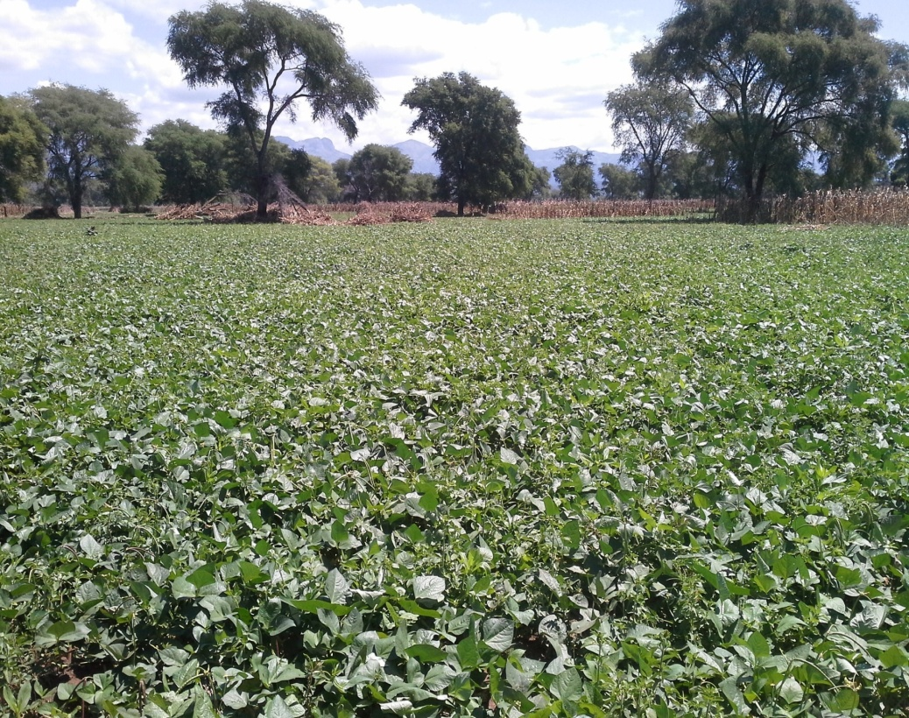
Cowpea Relay Crop under Faidherbia after maize harvest

Slide 14
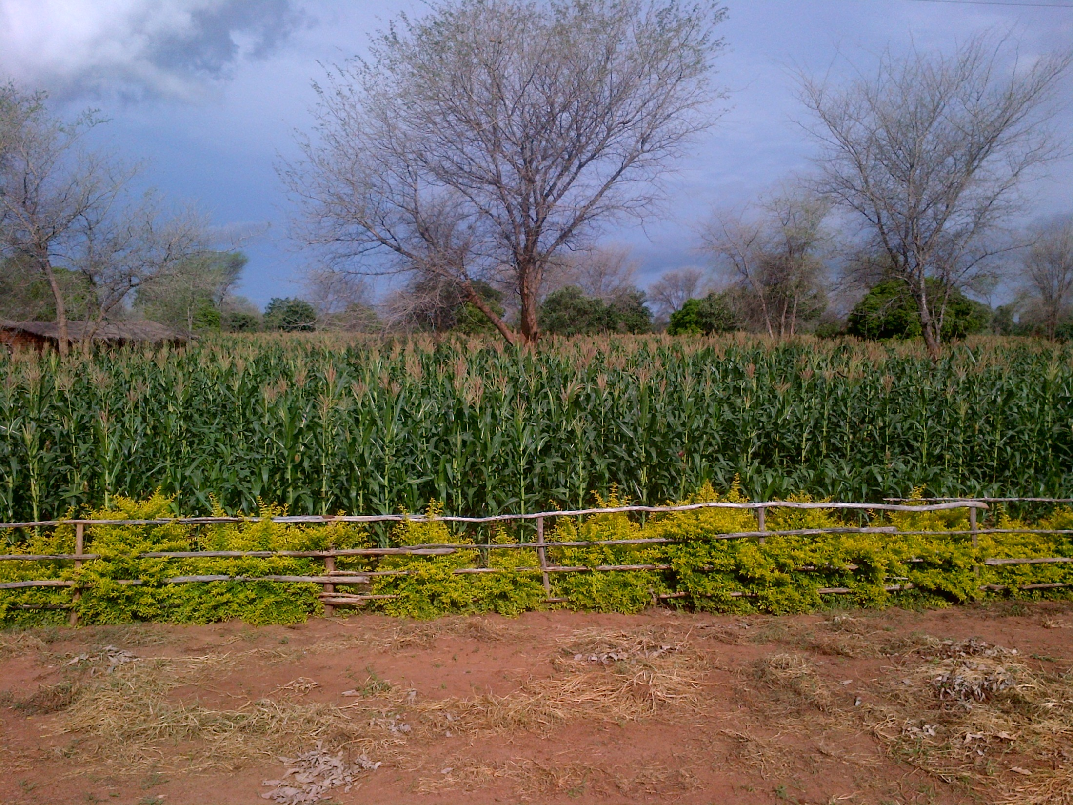
Healthy Maize with 10 year old Faidherbia

Slide 15
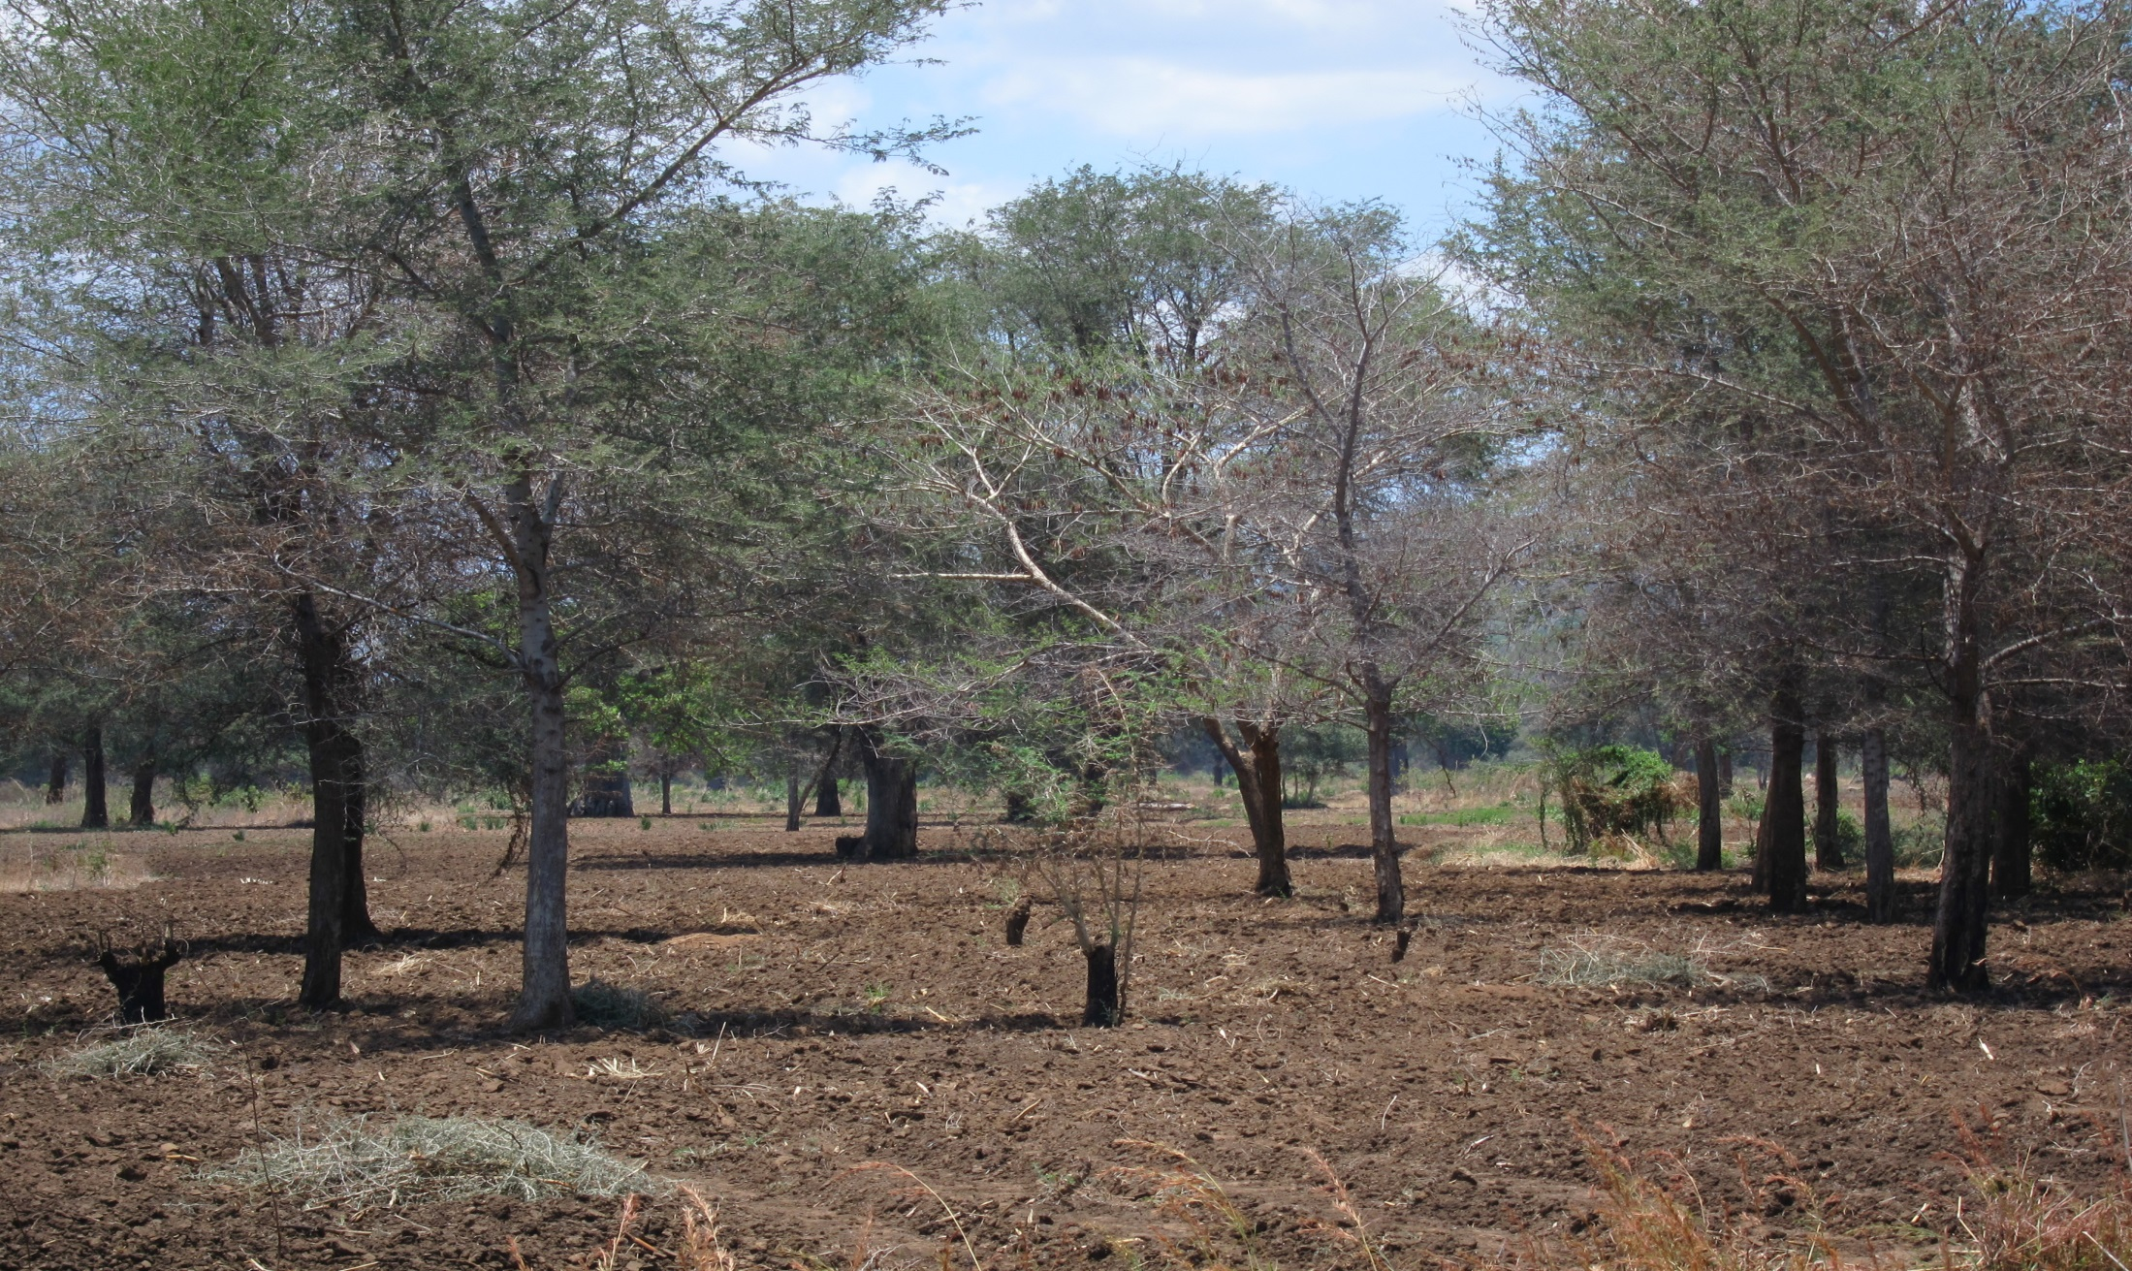
Land ready for planting with natural regenerating Faidherbia

Slide 16
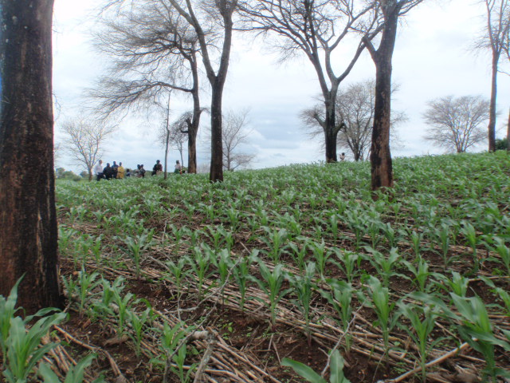
Young Maize Crop under CA with Faidherbia

Slide 17
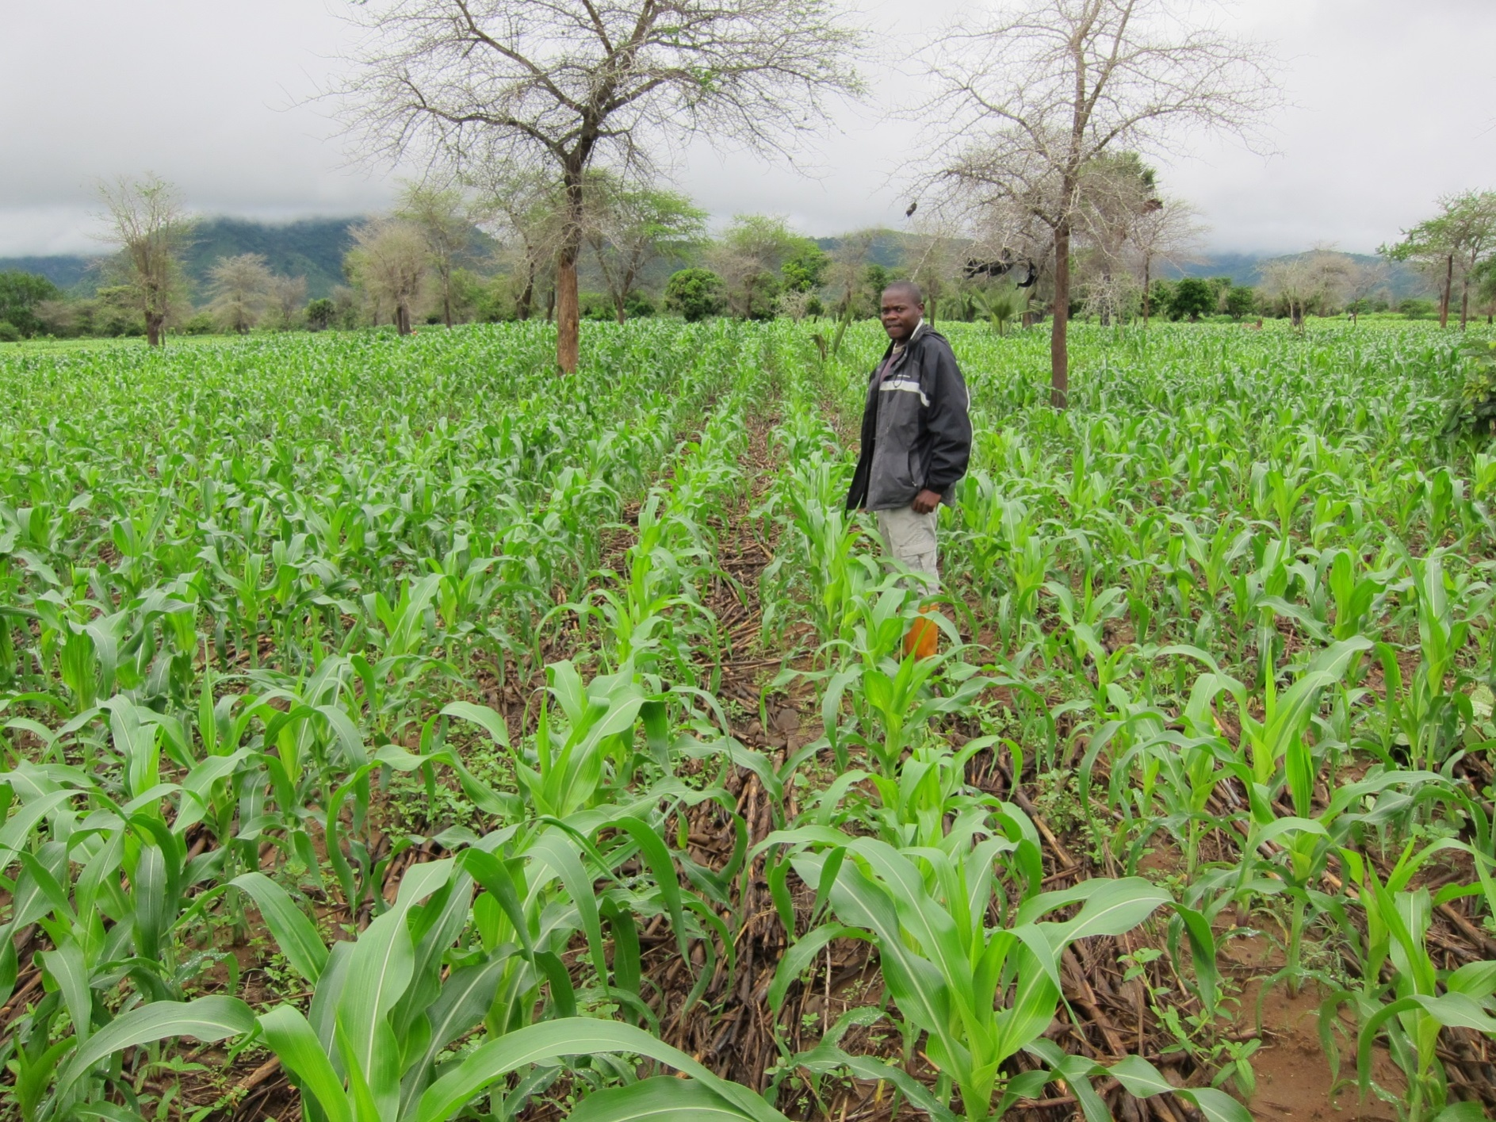
CA with 10 year-old Faidherbia trees

Slide 18
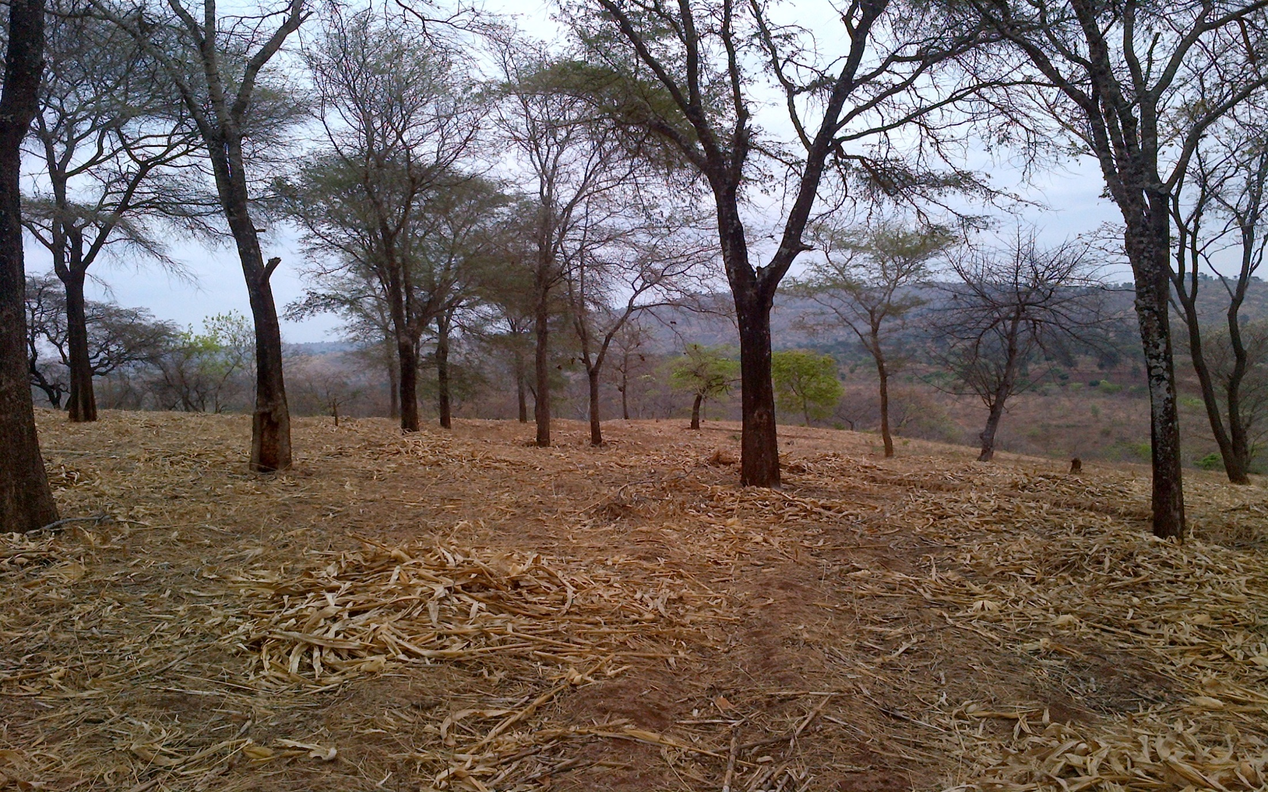
Farm land under CA with Faidherbia after the maize harvest leaving Crop Residues on the Soil Surface

Slide 19
Effects of Faidherbia on Farmer Maize Yields (kg/ha) in Malawi under CA vs. Ridge Tillage, 2010/11 (all plots used the same type & amount of fertilizer at modest rates)
38% Increase in Yield

Slide 20
Effects of Faidherbia on Maize Yields under CA vs Ridge Tillage, 2013/14 (different letters are significant at p < 0.001)

Slide 21
Maize Yields with CA Under and Away from Faidherbia from 40 farmer fields in Zambia – Average Yield Increase was 220% (Source: CFU Zambia)

Slide 22
Farmer Motivation for FMNR
Limited Options for tree planting – opportunities for planting trees are limited by lack of knowledge and inputs (and their timely provision) coupled by labor demands for farming and small land holdings
Low Cost, Easy and Flexible to do – Farmer driven practice; most work is done in the dry season which minimizes labor conflicts with farming; avoids the huge expense and effort to raise, transport, out-plant, manage, and protect seedlings produced in nurseries.
Adaptability - Natural trees have well established root systems and are well adapted to the local ecology with strong tolerance to drought, fire, browsing, pests and diseases.

Slide 23
Farmer Motivation for FMNR
Diverse products – FMNR helps to restore the biodiversity of the natural landscape and provides multiple products and uses in the local context - not possible from planting a limited range of species.
Impact on soils and crops – Many trees benefit soils and crops by replenishing nutrients, maximizing rainfall capture & infiltration, and minimizing effects of dry spells by conserving moisture and reducing evaporation. Results reduce or complement use of fertilizers
Bottom line – protection from fire and cutting by people ensures good survival and growth

Slide 24
NATURAL REGENERATION OF OTHER TREES ON SMALLHOLDER FARMS
EXAMPLES FROM LILONGWE DISTRICT

Slide 25
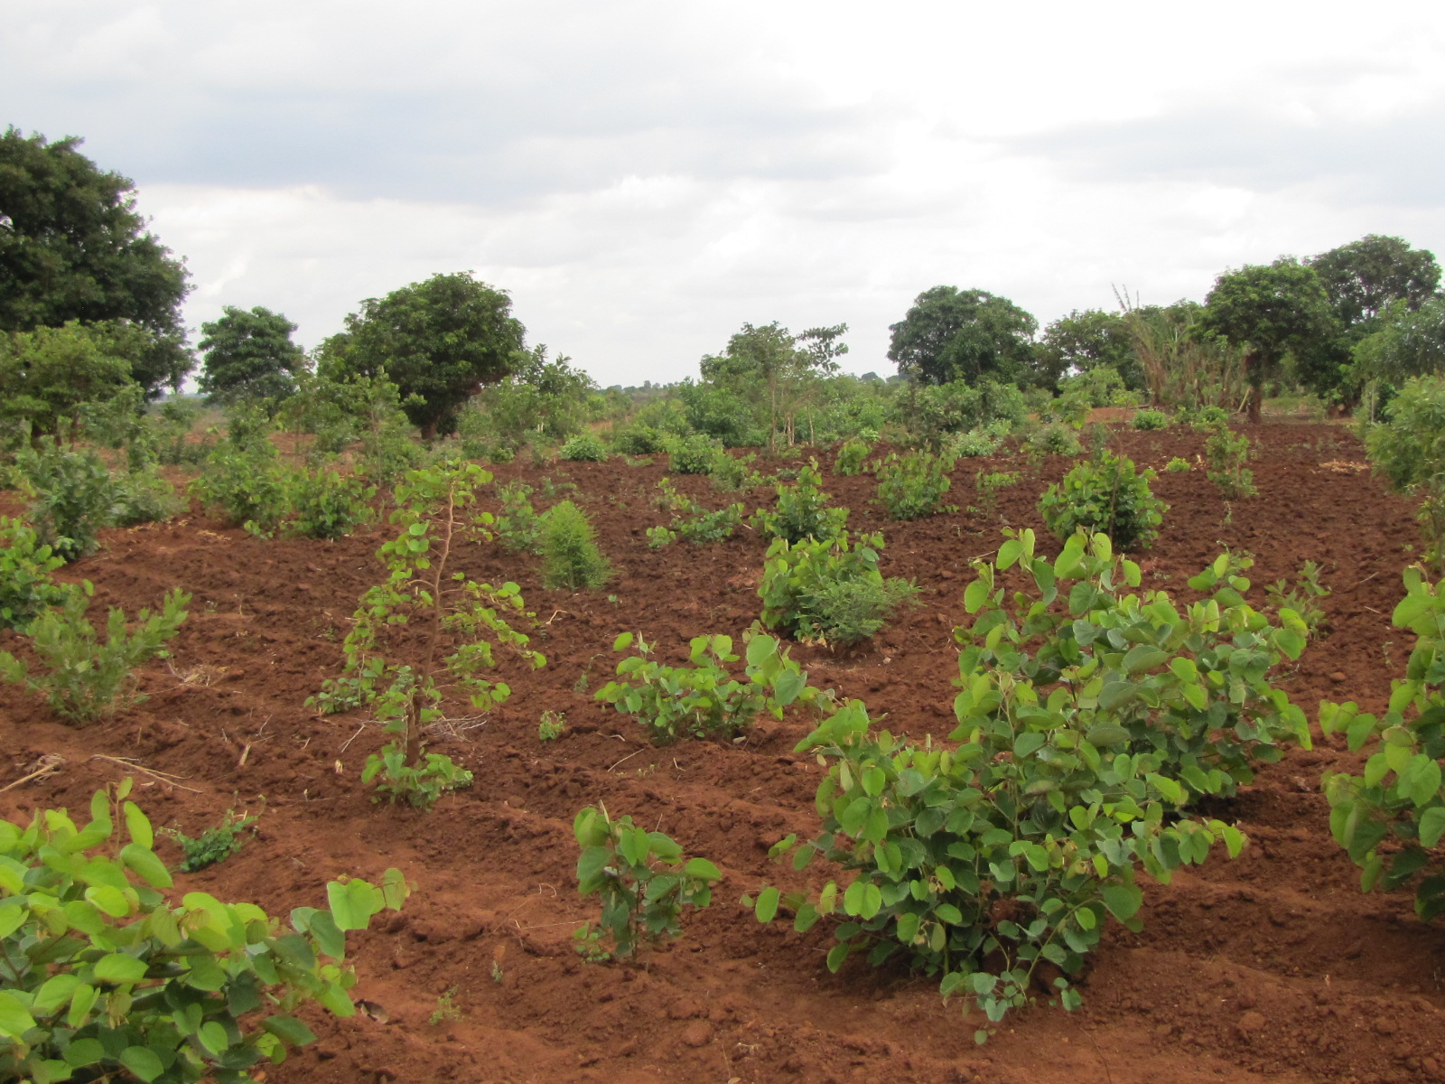
With protection from fire & cutting, most farm land in Malawi has inherent ability to regenerate

Slide 26
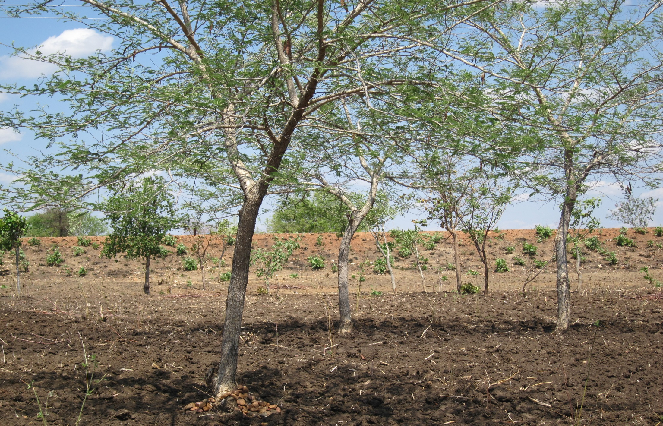
Management of young Acacia polyacantha in the dry season

Slide 27
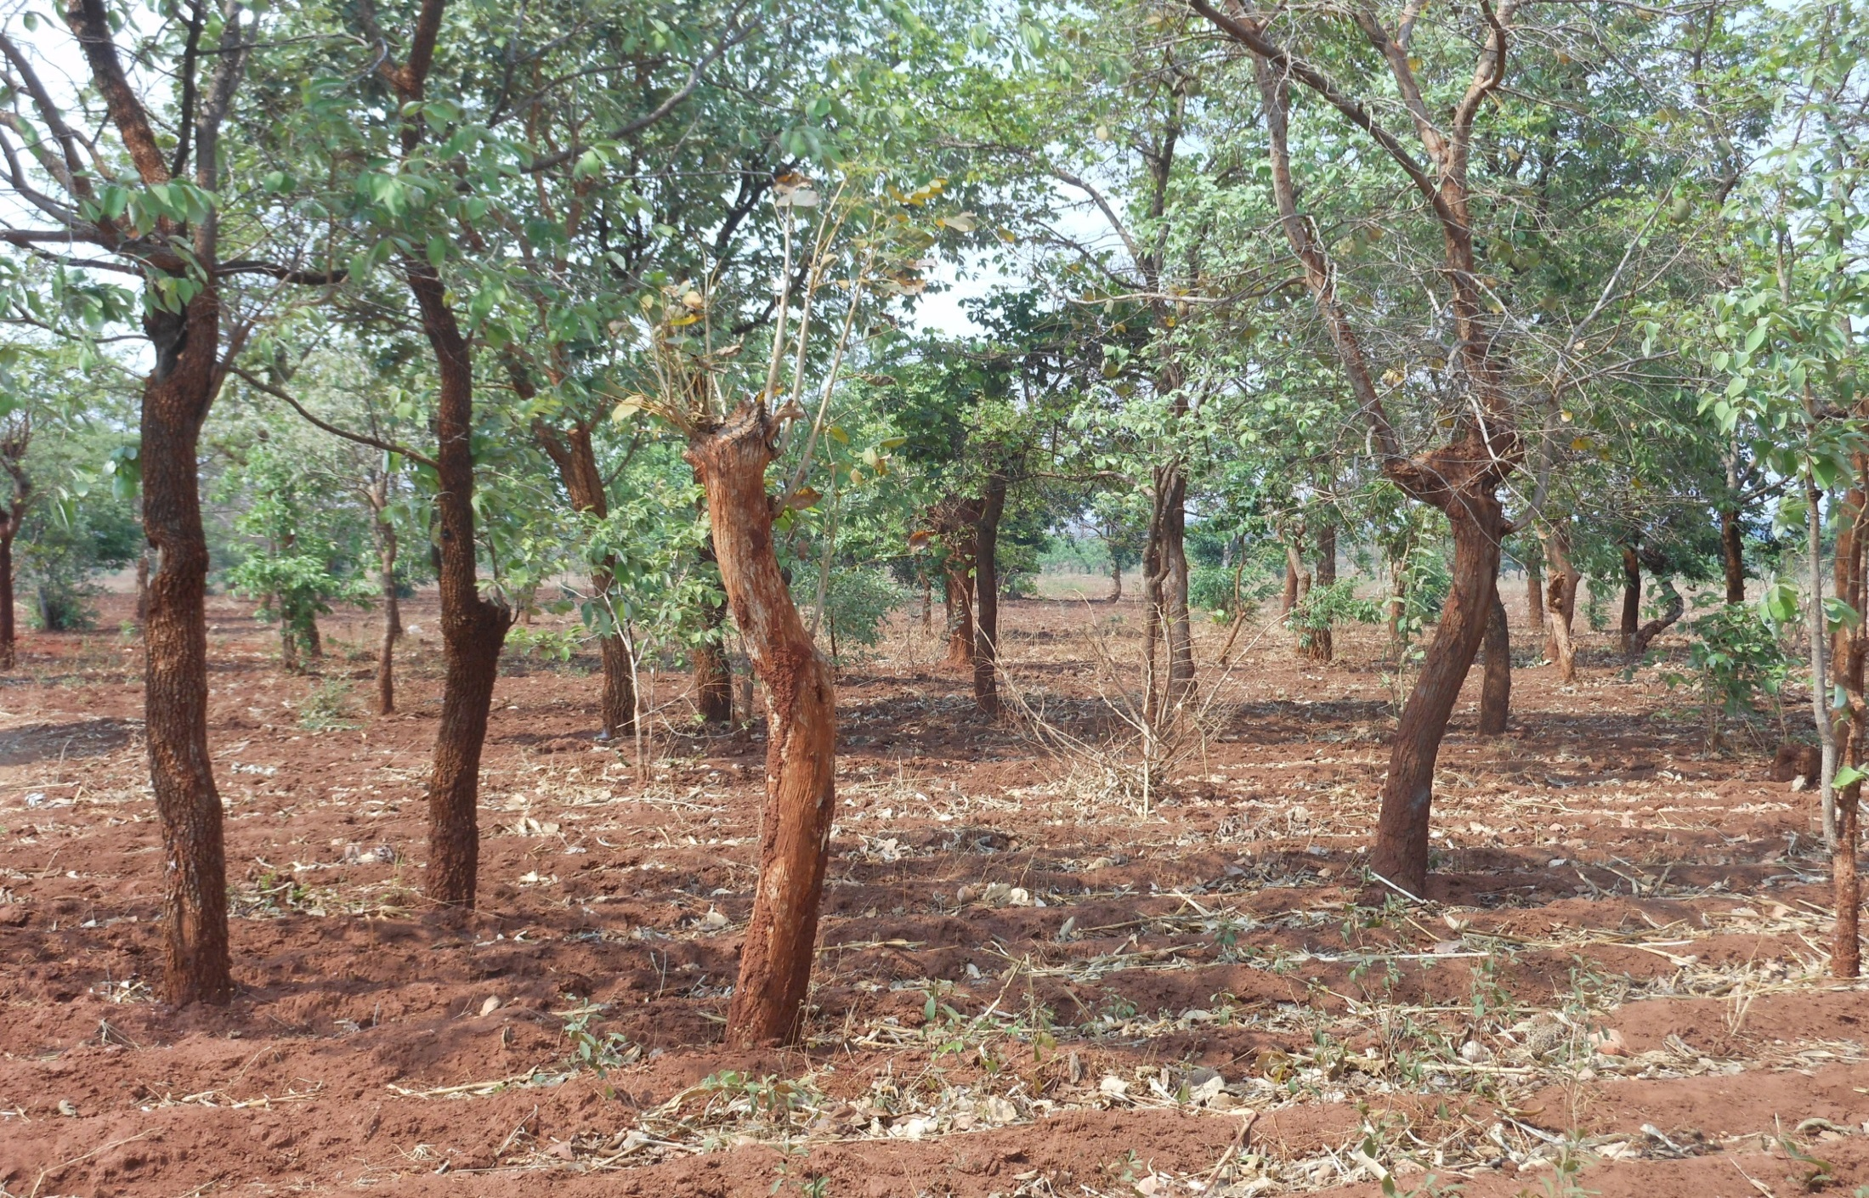
Management & Trimming of Natural Trees in the dry season before the Rains

Slide 28
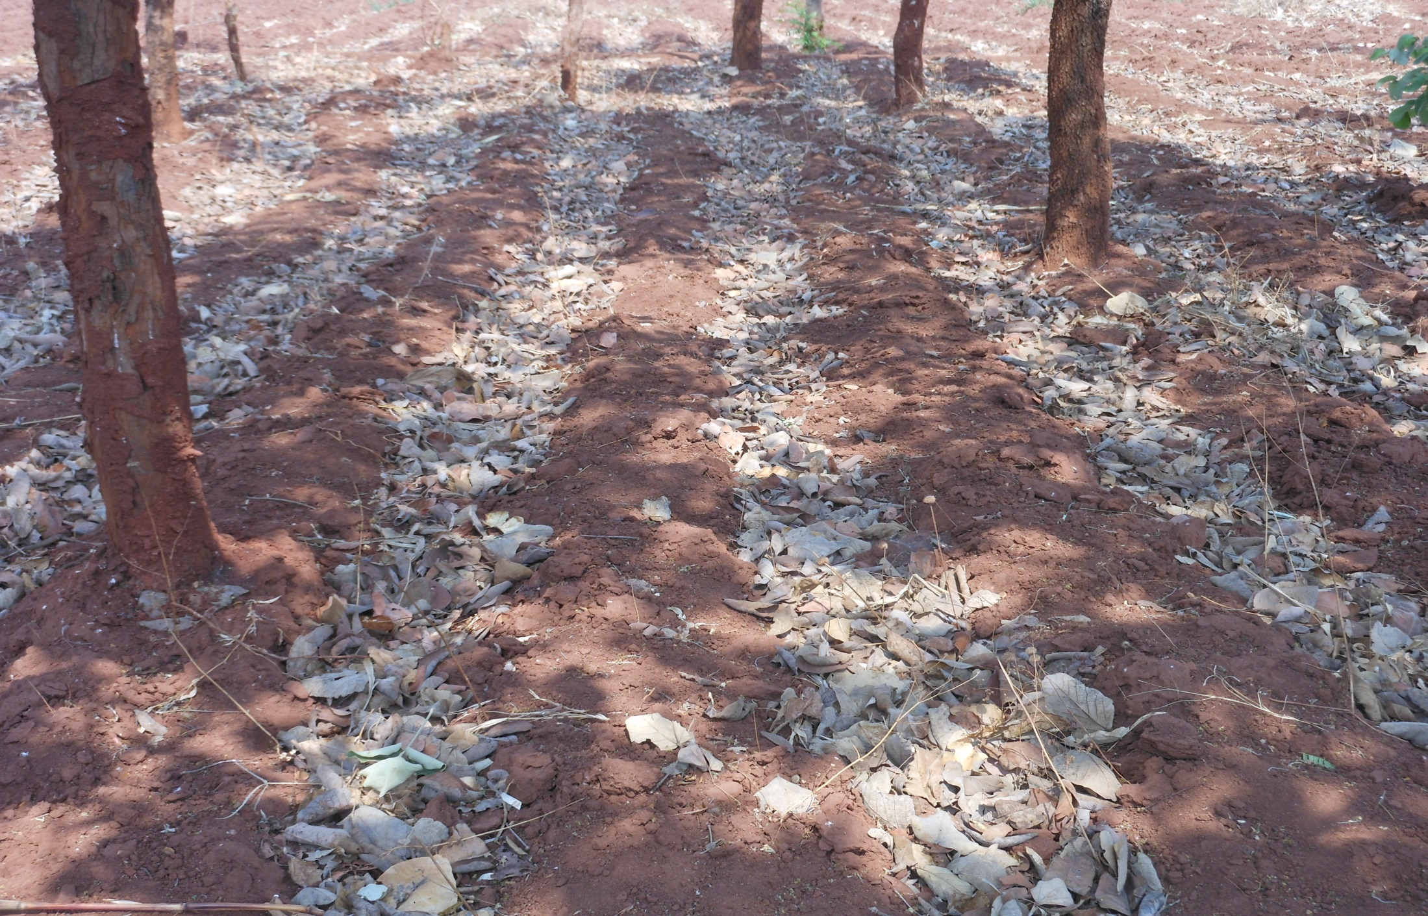
Leaf litter from trees are an important source of nutrients/organic matter for good crop growth

Slide 29
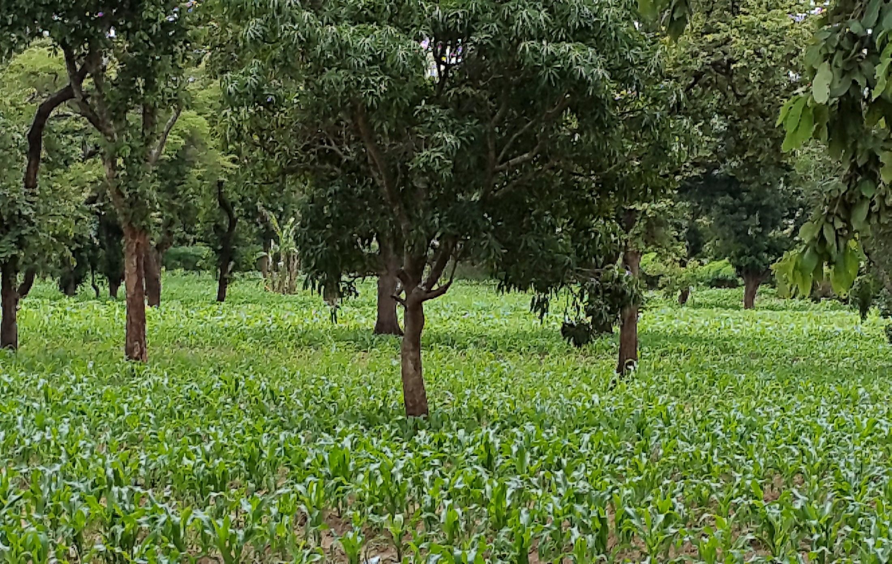
Natural Tree Regeneration with Maize

Slide 30
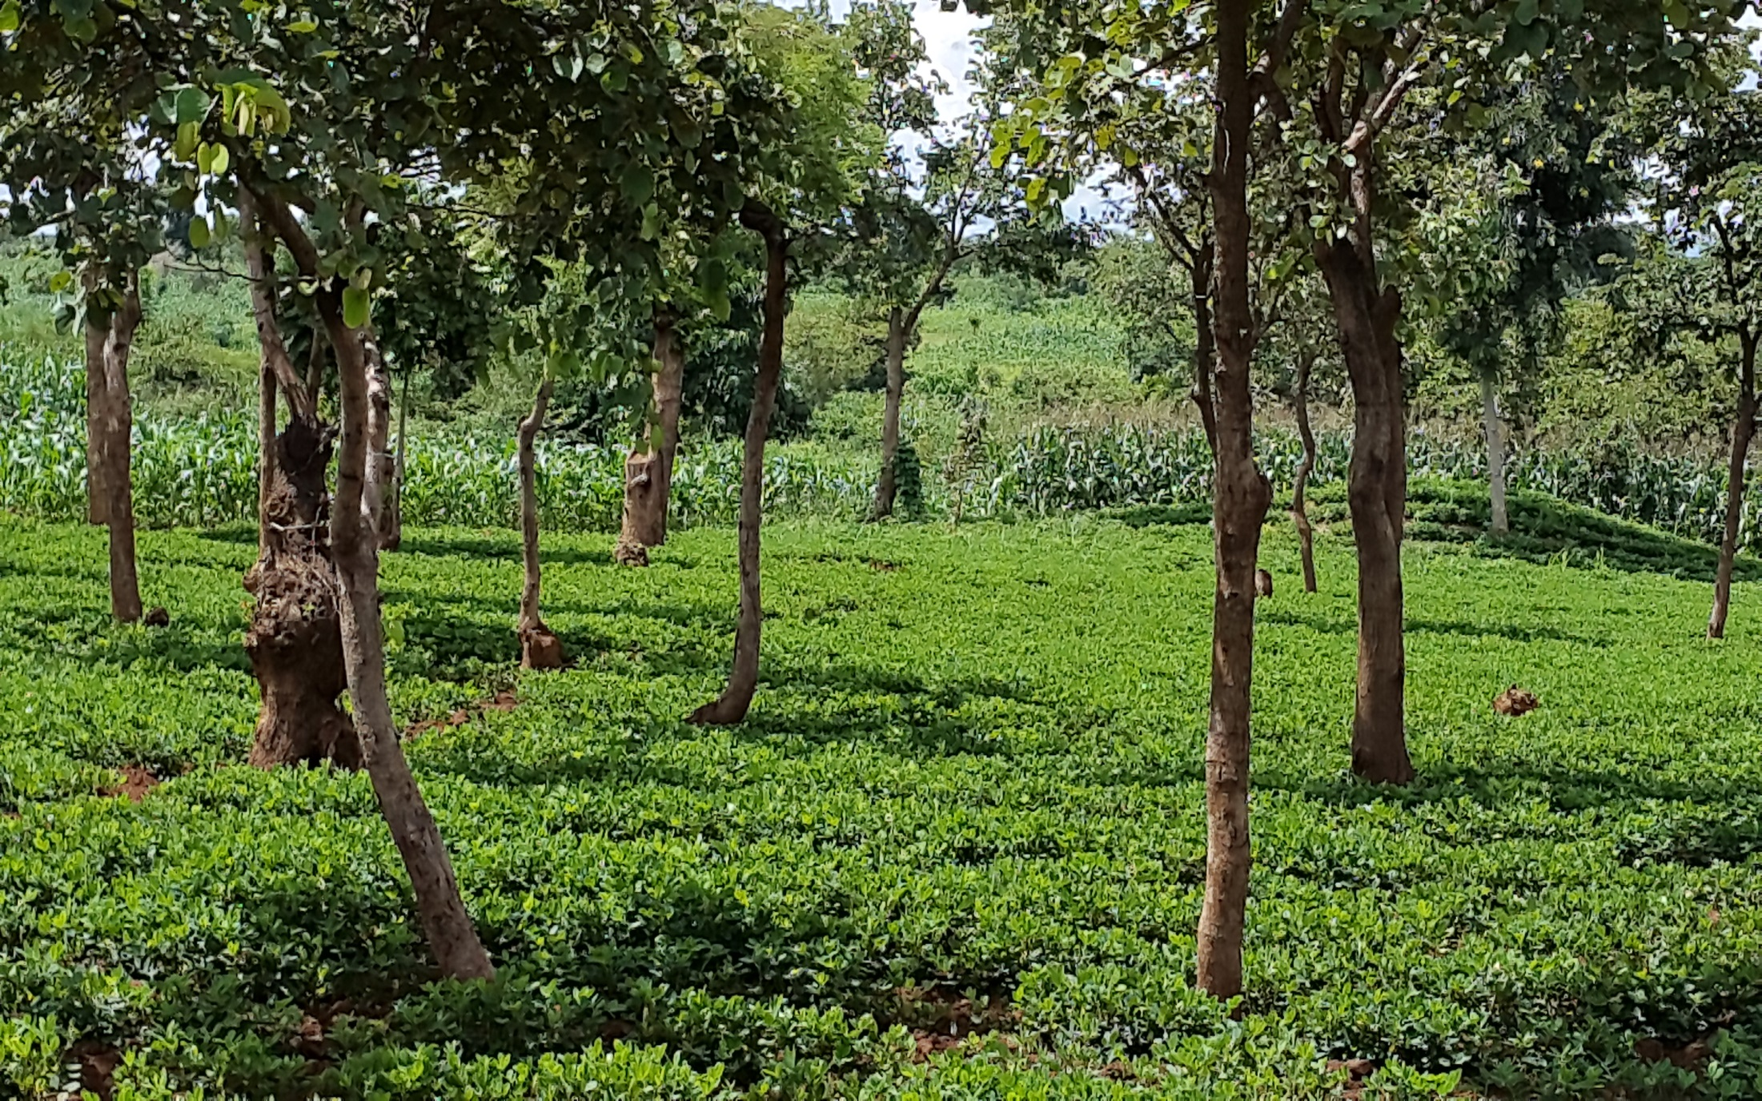
Well Managed Natural Regeneration with Groundnuts

Slide 31
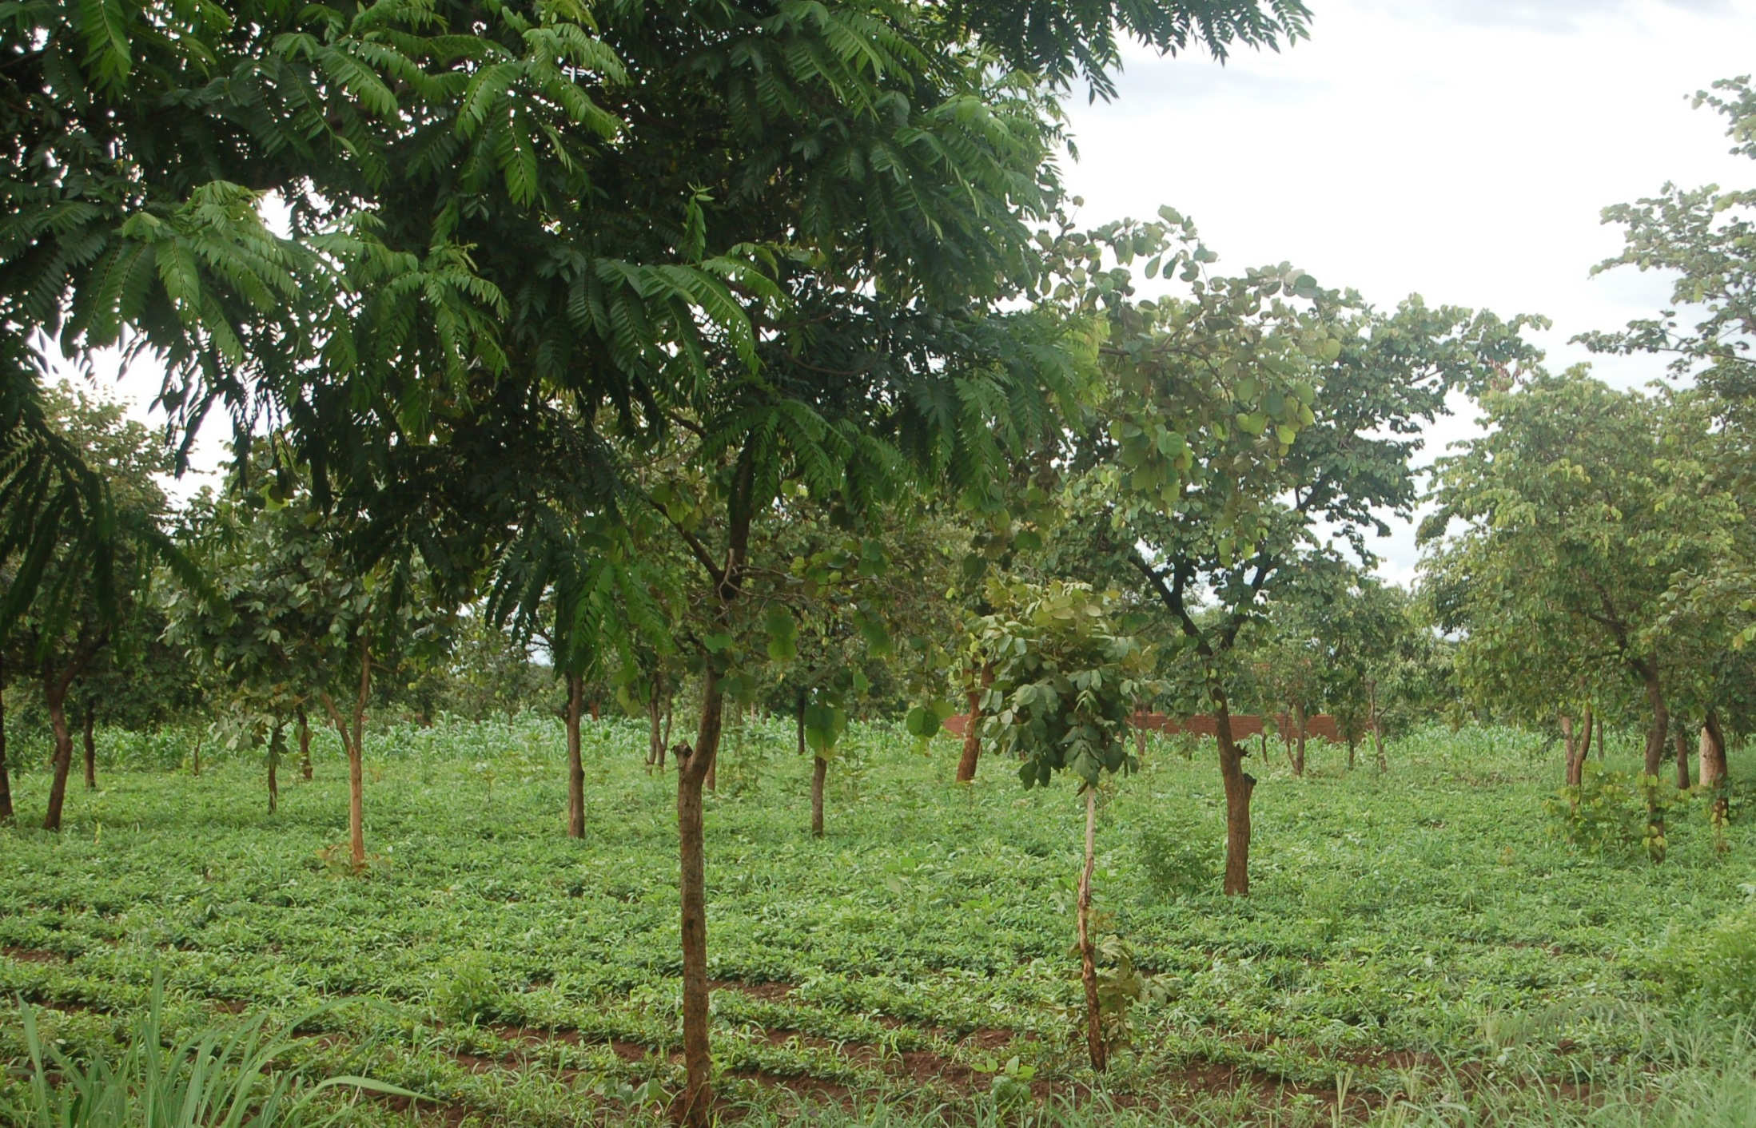
Farmer Managed Natural Trees with Groundnuts

Slide 32
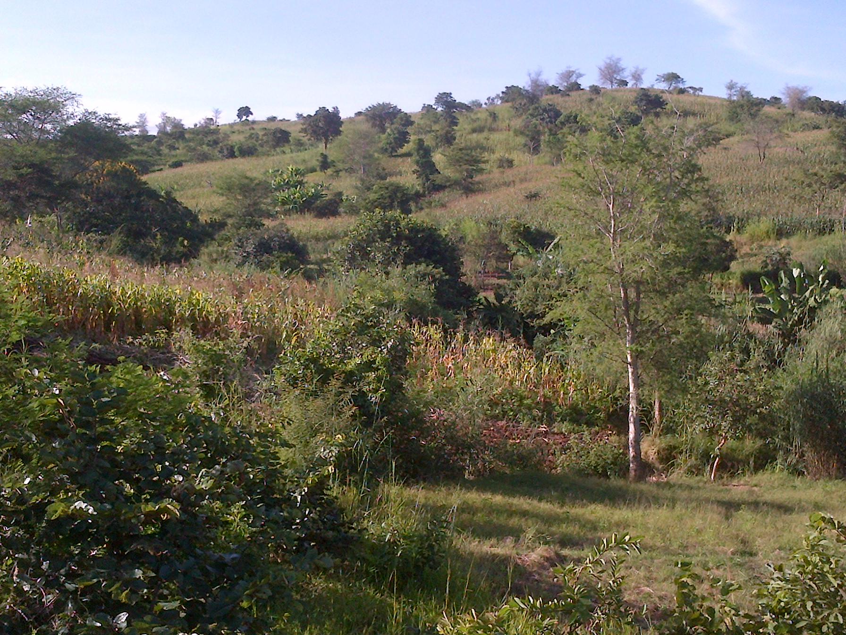
Agricultural Landscape with Natural Regeneration

Slide 33
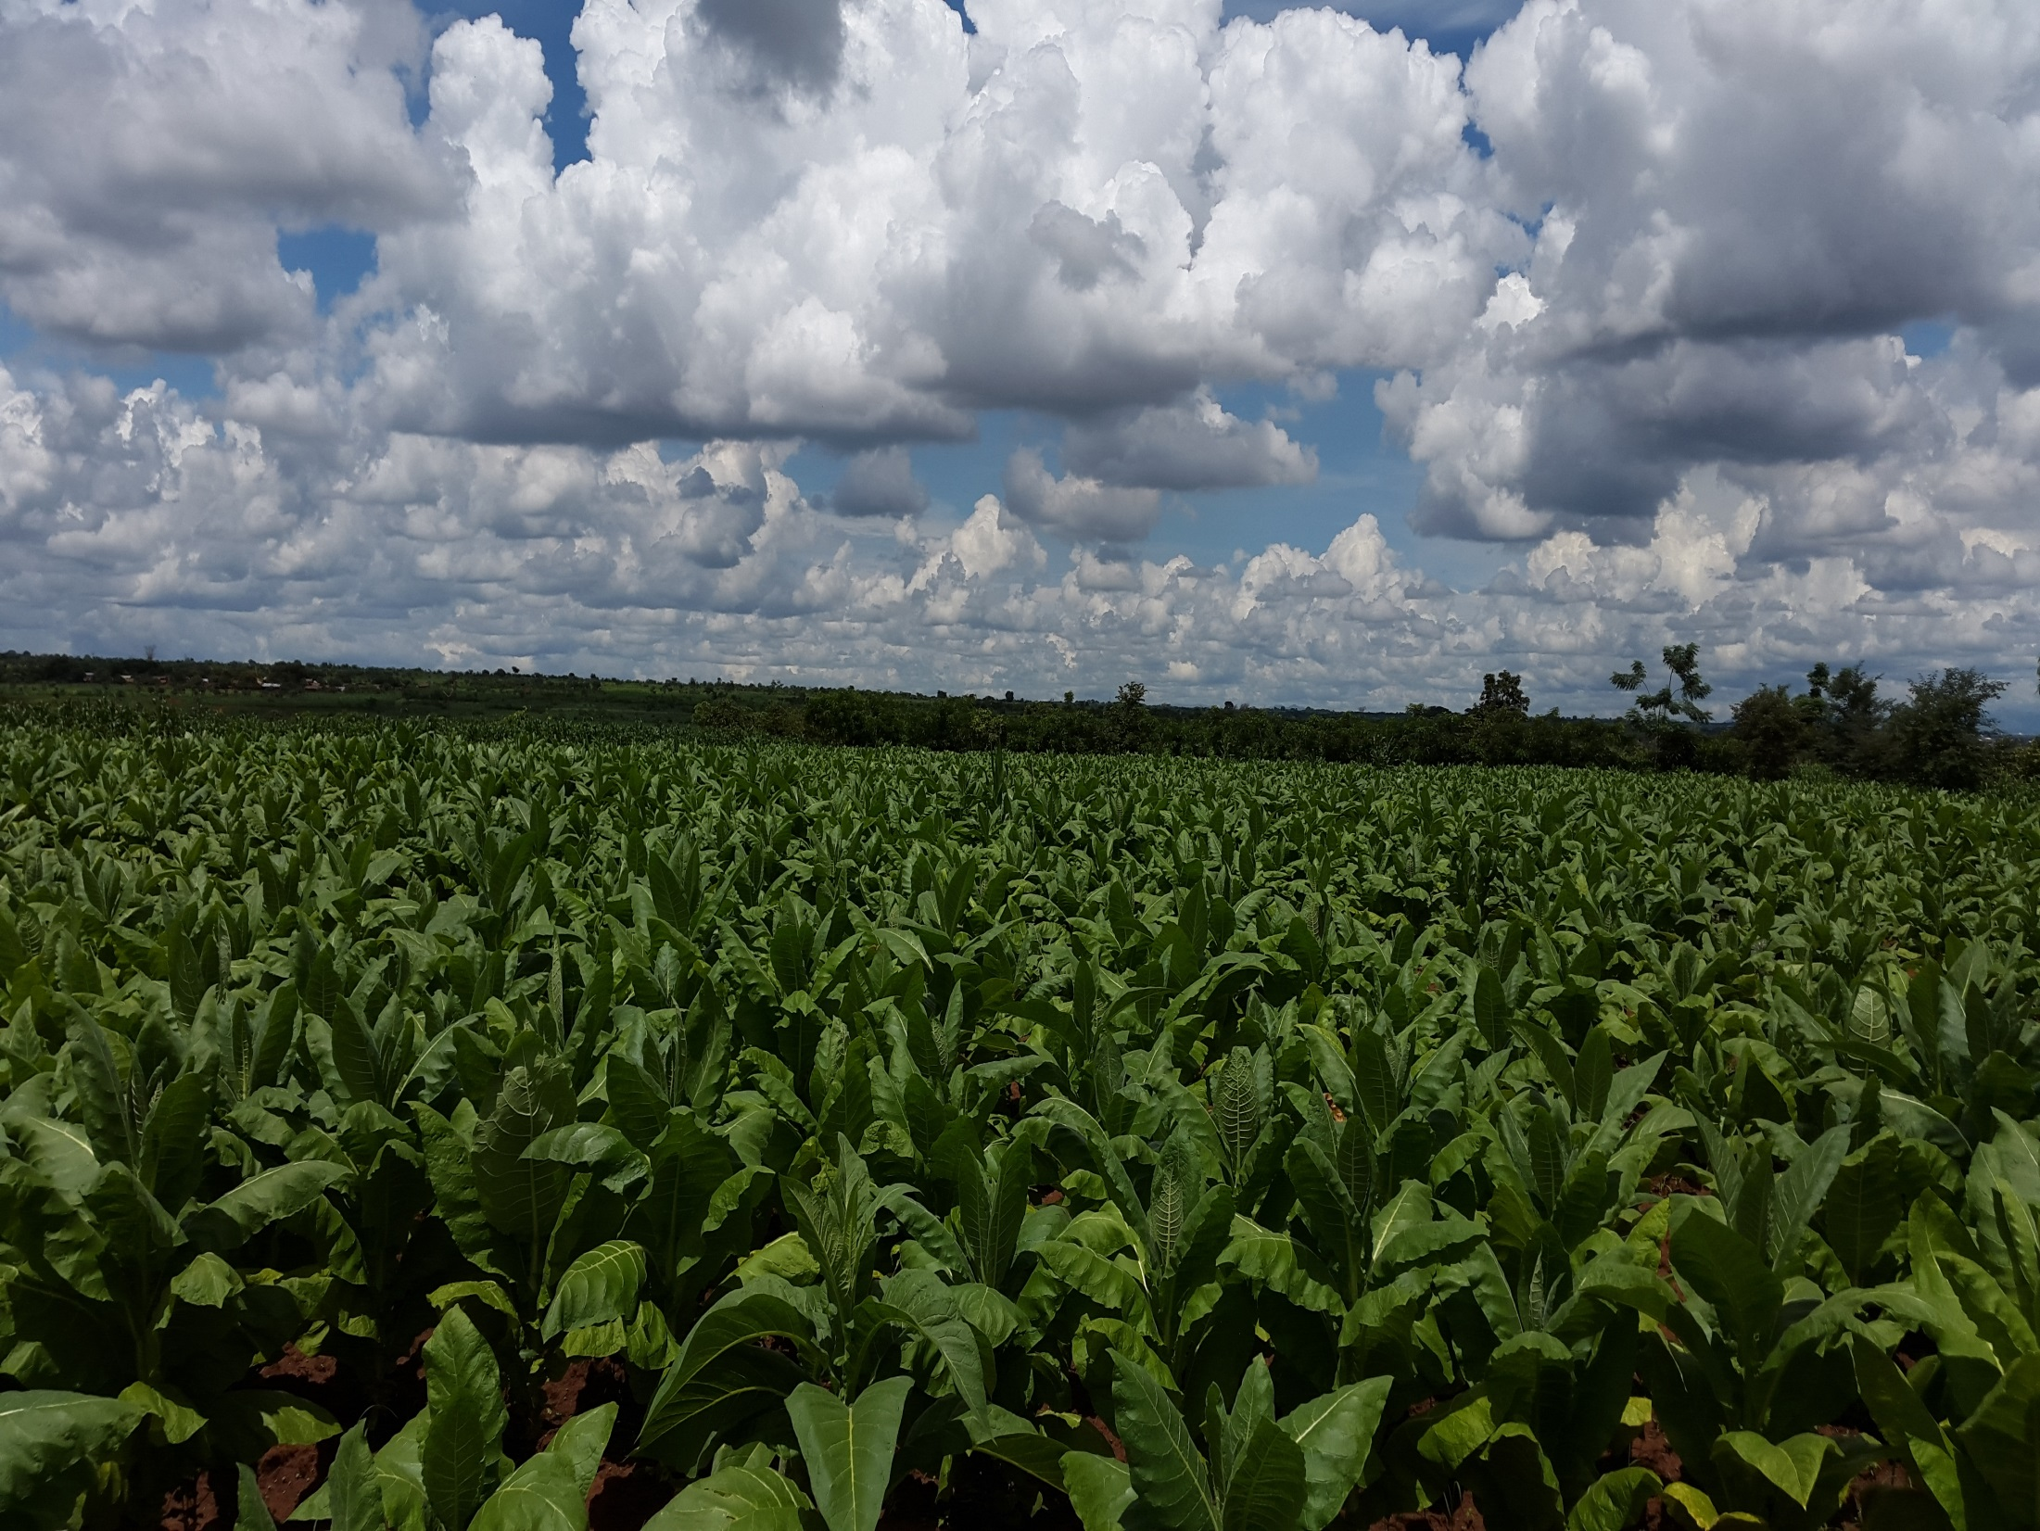
Commercial support for commercial crops like Tobacco and Cotton normally insist of removing all trees

Slide 34
Density & Composition of NR Trees on Farms in Lilongwe District
UKWE EPA, LILONGWE DISTRICT WEST |  |  |  | CHIWAMBA EPA, LILONGWE DISTRICT EAST |  |  |  | CHIVALA EPA, LILONGWE DISTRICT NORTH
Top 15 Species | Density /ha | % Comp |  | Top 15 Species | Density /ha | % Comp |  | Top 15 Species | Density /ha | % Comp
Piliostigma thonningii | 83.75 | 49.1% |  | Piliostigma thonningii | 35.34 | 26.1% |  | Combretum molle | 23.70 | 20.0%
Combretum collinum | 37.59 | 22.0% |  | Combretum colllinum | 26.32 | 19.4% |  | Markhamia obtusifolia | 19.71 | 16.7%
Acacia polyacantha | 7.49 | 4.4% |  | Combretum zeyheri | 17.74 | 13.1% |  | Brachystegia spiciformis | 16.01 | 13.5%
Lonchocarpus capassa | 6.47 | 3.8% |  | Markhamia obtusifolia | 11.52 | 8.5% |  | Piliostigma thonningii | 13.55 | 11.5%
Rauvolfia caffra | 5.50 | 3.2% |  | Acacia polyacantha | 4.56 | 3.4% |  | Erythrina abyssinica | 8.41 | 7.1%
Markhamia obtusifolia | 4.73 | 2.8% |  | Albizia harveyi | 4.42 | 3.3% |  | Azanza garkeana | 5.29 | 4.5%
Faidherbia albida | 2.86 | 1.7% |  | Faidherbia albida | 4.41 | 3.3% |  | Strychnos spinosa | 3.69 | 3.1%
Kigelia africana | 2.65 | 1.6% |  | Entada abyssinica | 3.88 | 2.9% |  | Acacia polyacantha | 3.28 | 2.8%
Azanza garkeana | 2.45 | 1.4% |  | Lonchocarpus capassa | 3.74 | 2.8% |  | Combretum collinum | 2.68 | 2.3%
Combretum molle | 2.02 | 1.2% |  | Combretum molle | 3.11 | 2.3% |  | Combretum zeyheri | 2.28 | 1.9%
Combretum zeyheri | 1.56 | 0.9% |  | Albizia amara | 1.99 | 1.5% |  | Faidherbia albida | 1.90 | 1.6%
Vitex payos | 1.36 | 0.8% |  | Strychnos spinosa | 1.97 | 1.5% |  | Vangueria infausta | 1.68 | 1.4%
Erythrina abyssinica | 1.29 | 0.8% |  | Cussonia arborea | 1.95 | 1.4% |  | Combretum psidioides | 1.59 | 1.3%
Entada abyssinica | 1.23 | 0.7% |  | Vangueria infausta | 1.95 | 1.4% |  | Croton macrostachys | 1.16 | 1.0%
Maytenus senegalensis | 1.23 | 0.7% |  | Azanza garkeana | 1.83 | 1.4% |  | Entada abyssinica | 1.16 | 1.0%
14 Other Species | 8.40 | 4.9% |  | 16 Other Species | 10.74 | 7.9% |  | 24 Other species | 12.21 | 10.3%
Tree Density / ha | 170.59 | 100.0% |  | Tree Density / ha | 135.47 | 100.0% |  | Tree Density / ha | 118.32 | 100%
Mean DBH (cm) | 6.96 |  |  | Mean DBH (cm) | 9.24 |  |  | Mean DBH (cm) | 10.23
Mean Height (m) | 3.31 |  |  | Mean Height (m) | 4.15 |  |  | Mean Height (m) | 4.27
# Species in Transects | 29 |  |  | # Species in Transects | 31 |  |  | # Species in Transects | 39
Diversity Index | 3.38 |  |  | Diversity Index | 8.22 |  |  | Diversity Index | 11.23
# Trees in Transects | 320 |  |  | # Trees in Transects | 320 |  |  | # Trees in Transects | 320

Slide 35
Density & Composition of NR Trees on Farms in Lilongwe District
UKWE EPA, LILONGWE WEST |  |  | CHIWAMBA EPA, LILONGWE EAST |  | CHIVALA EPA, LILONGWE NORTH
Tree Density / ha | 170.59 |  | 135.47 |  | 118.32
Mean DBH (cm) | 6.96 |  | 9.24 |  | 10.23
Mean Height (m) | 3.31 |  | 4.15 |  | 4.27
Total # Species Recorded | 29 |  | 31 |  | 39
Diversity Index | 3.38 |  | 8.22 |  | 11.23
# Total Trees | 320 |  | 320 |  | 320

Slide 36
Trees On-Farm - How to Manage the Trees
Trees have a natural propensity to regenerate on farmland. They just need some management and protection.
Farmers select and protect regenerating trees of their choice and density based on their interests - no prescribed arrangement, but densities range from 25 to 250 or more/ha
Thin shoots to 1 or 2 dominant stems to promote vertical growth - avoids scrubby bush which takes land away from crops and produces low quantities of wood.
Manage the canopy before & during the cropping season by trimming branches to minimize excessive shade on the crop
Collect thinned shoots & trimmings for fuel or other uses.
Other products may be collected as needed such as fruits, fodder and various parts of trees for medicinal or other uses.

Slide 37
Actions and Strategies for Upscaling
FMNR is currently driven by farmers with little support except by a few organizations.
Given its multiple benefits, low cost, popularity with farmers and ease of adoption, greater and more intensive efforts are needed to promote this practice across the region.
Increase awareness & exposure to FMNR and its multiple benefits with different crops and agro-ecologies through various media, meetings, field days, exchange visits involving farmers, Govt agencies, Donors, NGOs, Projects, and the Private Sector

Slide 38
Actions and Strategies for Upscaling….
Institute community led initiatives to publicize, promote and encourage FMNR as a simple, low cost practice adaptable to the specific circumstances of farmers in different agro-ecologies (e.g., TLC support to the Msangu Belt Initiative involving Traditional Chiefs across 5 Districts in the Faidherbia Belt along the lake shore)
Institute initiatives to leverage resources from Government, donors, NGOs and the private sector to expand support and out-reach efforts

Slide 39
Actions and Strategies for Upscaling….
Document and publicize the multiple benefits of FMNR from the perspective of farmers as well as its impacts soils, crops, biodiversity and conservation
Produce and provide quality training / extension materials & services to field staff and farmers
Maximize adoption and impacts by combining it with CA, tree planting and improved stoves to alleviate pressures on natural regeneration

Slide 40



ACKNOWLEDGEMENTS
Information in this presentation was produced by Total LandCare with support and collaboration from the Government of Malawi, USAID, the Royal Norwegian Embassy, and the British Government through DFID.
Christian Thierfelder from CIMMYT deserves recognition for collaboration on CA.
TOTAL LANDCARE
P.O. Box 2440
Area 14, Plot 100
Lilongwe, Malawi
Tel: +265 1 770 904 / 905; Fax: +265 1 770 919
Email: total.landcare.mw@gmail.com
Website: www.totallandcare.org

