Slide 1
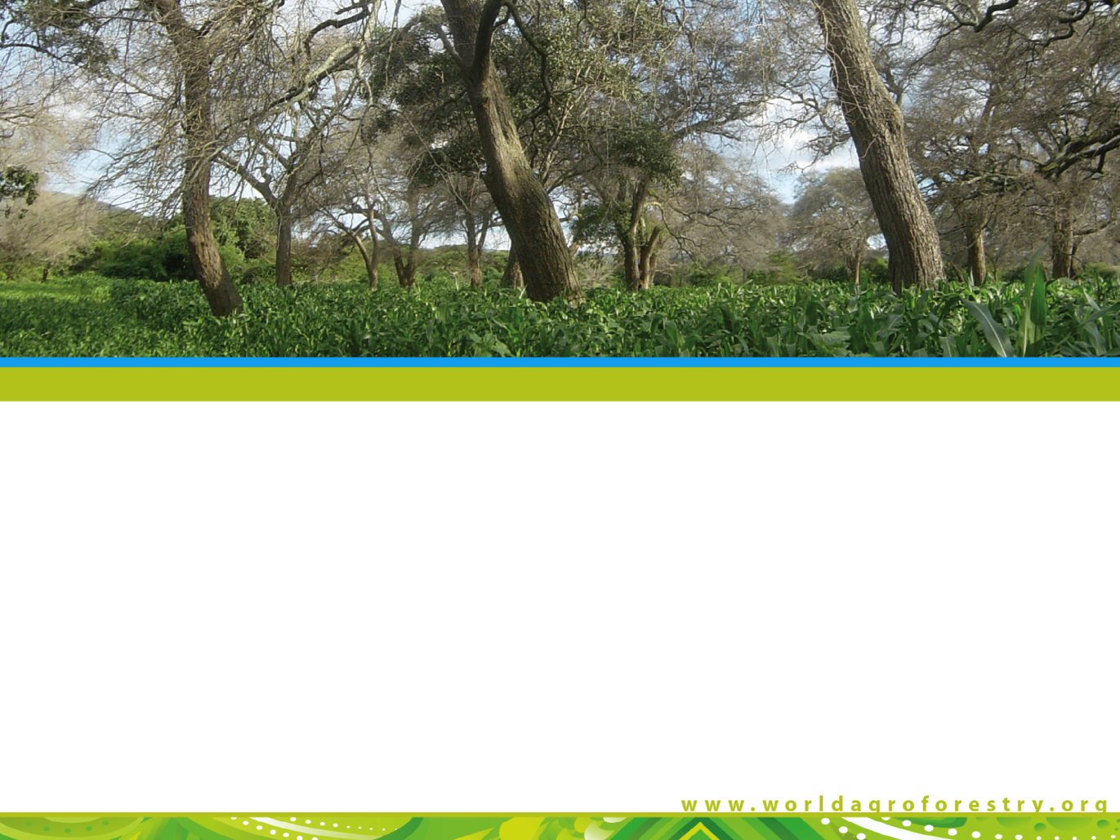

Agroforestry: an essential climate resilience tool
Patrick Worms, ICRAF
2013

Slide 2

Who are we?
One of the 15 CGIAR research centres
employing about 500 scientists and other staff.
We generate knowledge about the diverse roles that trees play in agricultural landscapes
We use this research to advance policies and practices that benefit the poor and the environment.
2

Slide 3
By 2050, we need to…
Produce 60% more food on ~ the same amount of land
Make farms, fields and landscapes more resistant to climate change
Massively reduce GHG emissions from land use.
3

Slide 4
The context

Slide 5

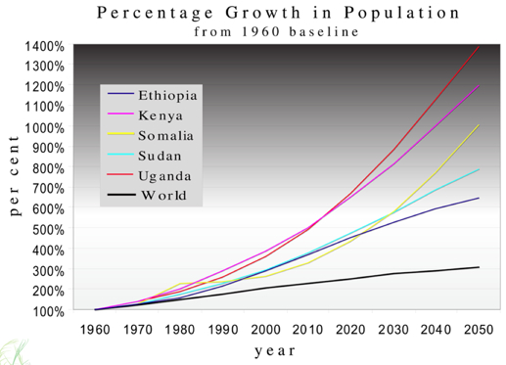
Population growth
8

Slide 6
Cereal yields by region
5000
4500
4000
East Asia
3500
3000
Latin America
2500
Kg per Hectare
2000
South Asia
1500
1000
Sub-Saharan Africa
500
0
1960
1965
1970
1975
1980
1985
1990
1995
2000
2005
World Bank World Development Indicators

Slide 7
Fertiliser use by region
2500
East
Asia
2000
1500
100 grams per Hectare
South Asia
1000
Latin America
500
Sub-Saharan Africa
0
1960
1965
1970
1975
1980
1985
1990
1995
2000
2005
World Bank World Development Indicators

Slide 8
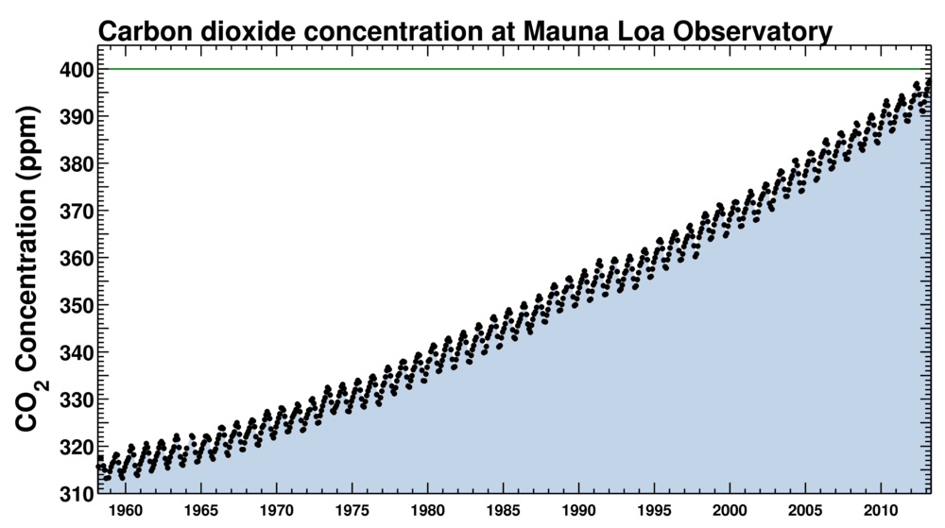
And, of course...

Slide 9
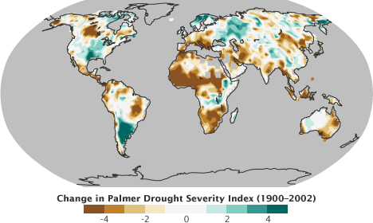
Which, depressingly, leads to...
IPCC 4th assessement report

Slide 10
The result?

Slide 11

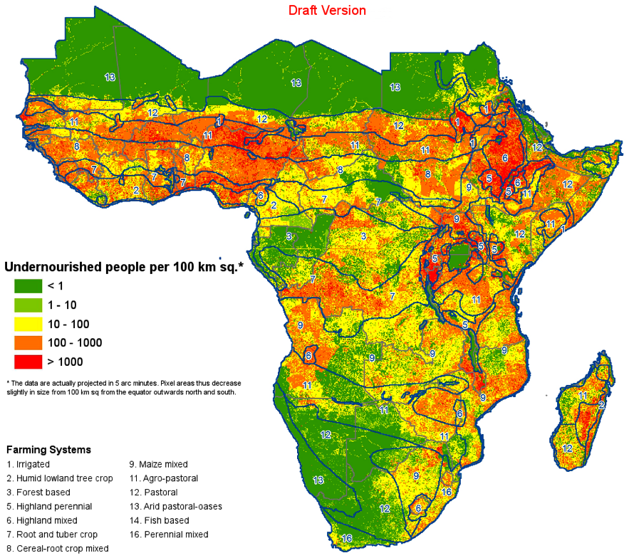
Undernourishment, which...

Slide 12
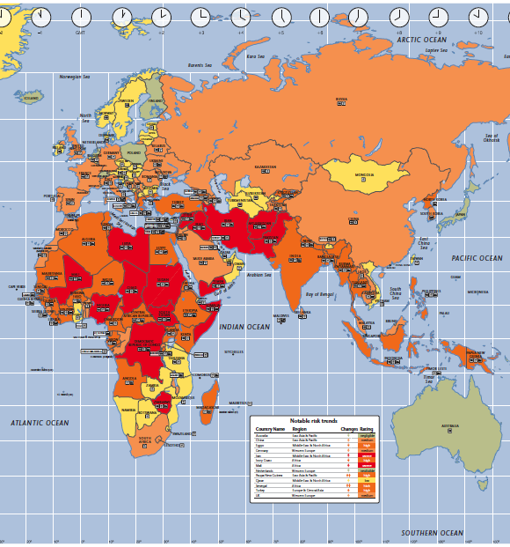

… brings instability,...
Notes:
What are the data points we want to highlight
Build up – demographics, political, productivity, future resilience
D – start with political (in the news – terrorism, instability) – what’s undelying this – productivity

Slide 13
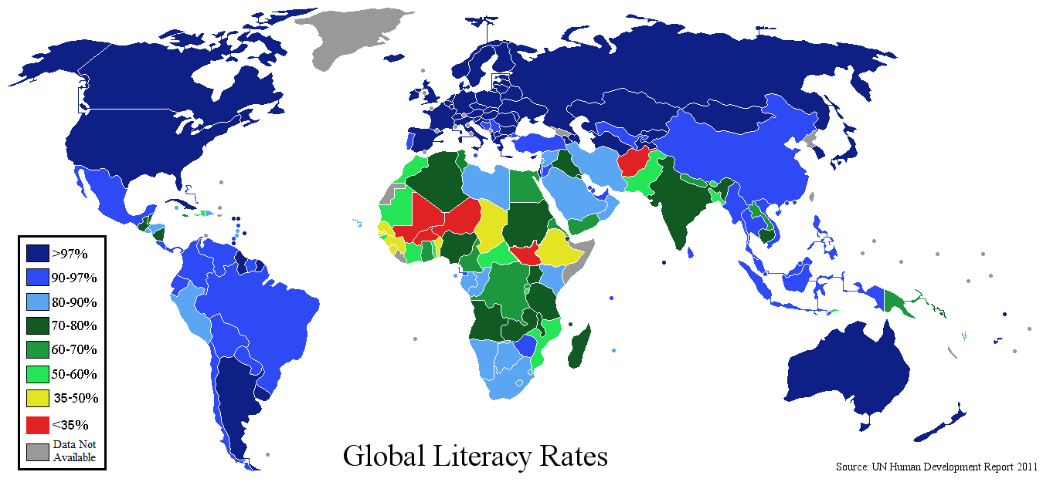
…low literacy...

Slide 14
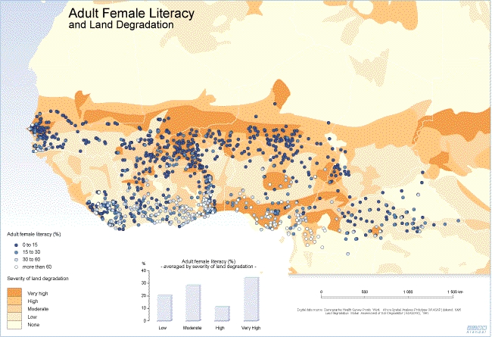
…especially among women...

Slide 15
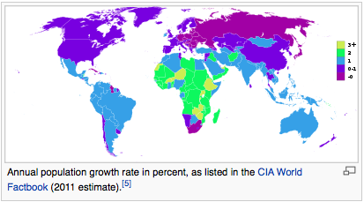
…thus huge population growth rates...

Slide 16
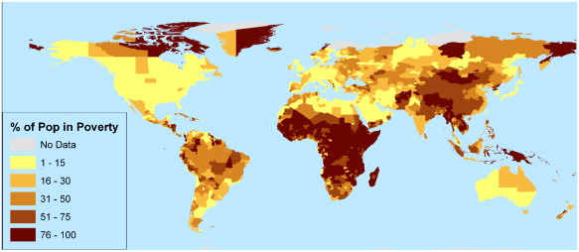
… deep poverty ...

Slide 17
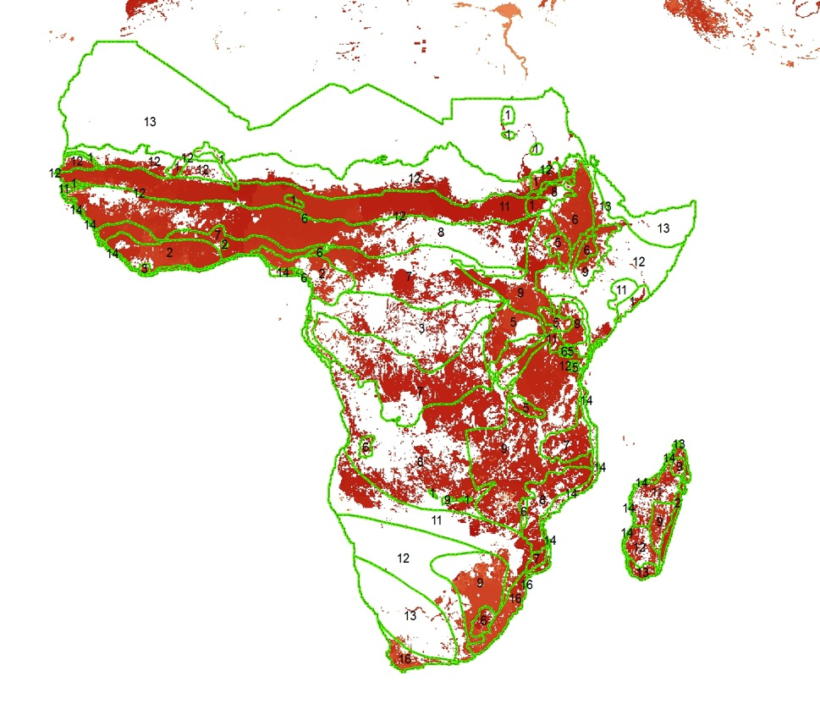

… hence huge yield gaps…

Slide 18
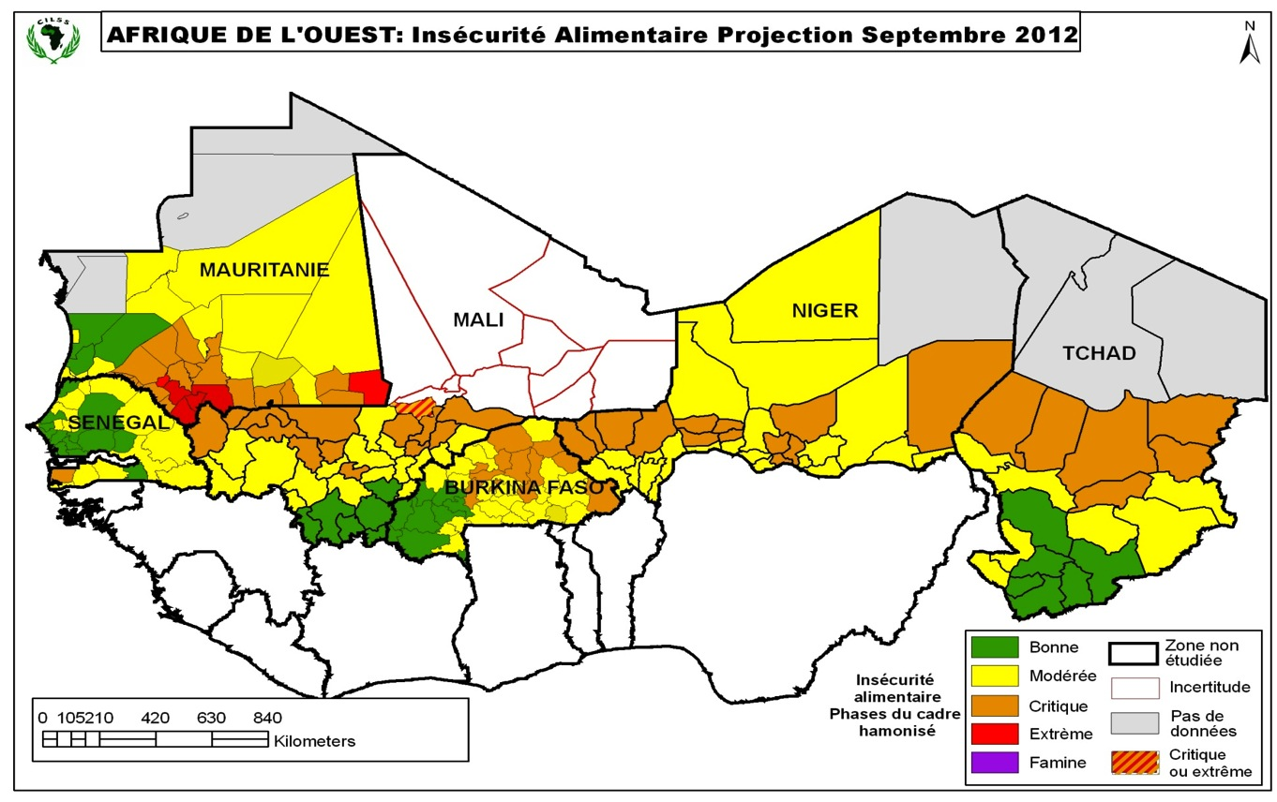
… and thus hunger.

Slide 19
Oh, and lest we forget...

Slide 20

Africa is enormous.

Slide 21
The result?

Slide 22
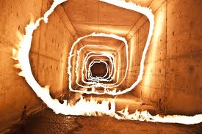
A hellish spiral.

Slide 23
Or, less emotionally:
Population growth has rendered fallowing impossible in many communities
Land overuse is depleting soil organic matter, soil carbon and soil microbiology
Soil fertility is dropping by 10-15% a year (Bunch, 2011)
Poverty and logistics makes fertiliser unaffordable for most smallholders
Funding for fertiliser subsidies is scarce and fickle
7

Slide 24
So… is that 2050 to-do list doable?
Produce 60% more food on ~ the same amount of land
Make farms, fields and landscapes more resistant to climate change
Massively reduce GHG emissions from land use.
3

Slide 25
Where will soil fertility and climate resilience come from ?
7

Slide 26
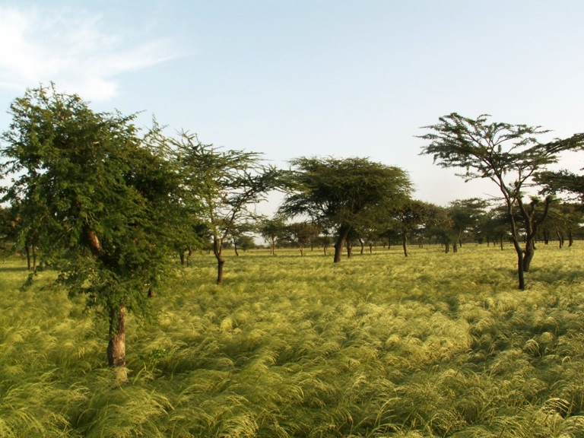
From trees.
Faidherbia Albida in teff crop system in Ethiopia

Slide 27
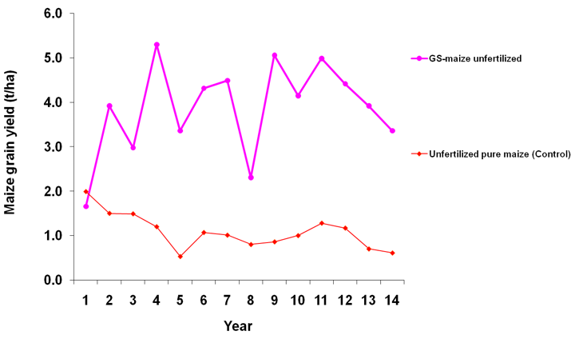
Maize yields with and without fertiliser trees
Gliricidia Spp.

Slide 28
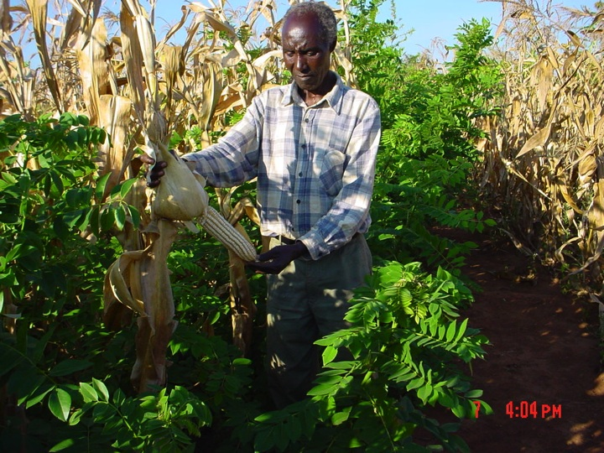
Notes:
Gliricidia is a a leguminous coppice tree interplanted with maize in this photo. The leaves are cut and turned over into the topmost soil layer, providing nitrogen and other nutrients to this season’s crop. The coppiced trees then grow back below the maturing maize.

Slide 29
Agroforestry brings massive yield increases in trials…
Faidherbia Albida
Maize yield, no fertiliser – tonnes per hectare
2008 2009 2010
Number of trials 15 40 40
With fertiliser trees 4.1 5.1 5.6
Without trees 1.3 2.6 2.6
________________________________________________________________________________________________________________________________________________________________________________________________
With trees and no fertiliser, yields exceed the average yield observed in East Asia
Notes:
With Faidherbia tree and no fertiliser, yields exceed the average yield observed in East Asia

Slide 30
… and on farmer’s fields.
maize yield (t/ha)
Maize only 1.30
Maize + fertilizer trees 3.05 __________________________________________________________
2011 Survey of farms in six Malawi districts (Mzimba, Lilongwe, Mulanje, Salima, Thyolo and Machinga)

Slide 31
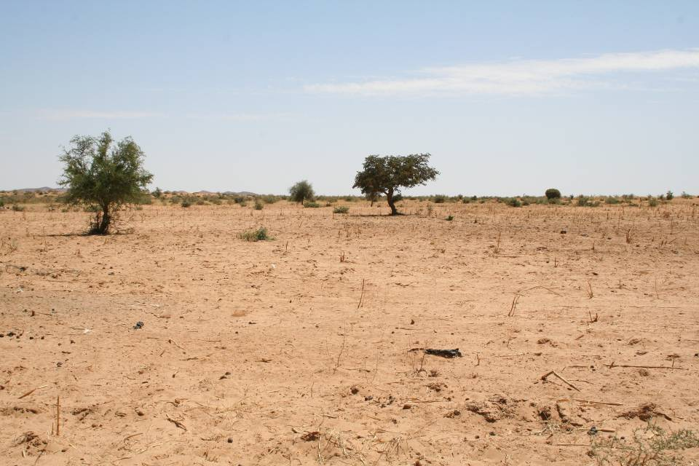
Then...
Zinder, Niger, 1980s

Slide 32
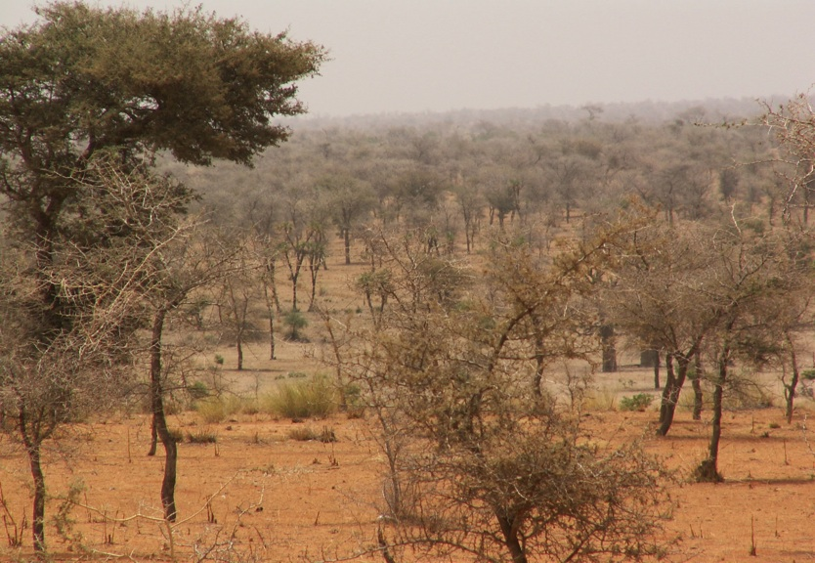
... and now.
Zinder, Niger, today.
These 5 million hectares of new agroforest parklands are yielding
500,000 tonnes
more than before.
(Reij, 2012)

Slide 33
Kantché district, Zinder, Niger
350,000 people, rainfall ca. 350 mm / year, typical of Sahel drylands.
Annual district-wide grain surplus:
2007 21,230 tons drought year !
2008 36,838 tons
2009 28,122 tons
2010 64,208 tons
2011 13,818 tons drought year !
.
Yamba & Sambo, 2012
23

Slide 34
Fertilizer trees can perform better than NPK.
2009/2010 season; data from 6 Malawian districts
Plot management | Sampling Frequency | Mean (Kg/Ha) | Standard error
Maize without fertiliser | 36 | 1322 | 220.33
Maize with fertiliser | 213 | 1736 | 118.95
Maize with fertiliser trees | 72 | 3053 | 359.8
Maize with fertiliser trees & fertiliser | 135 | 3071 | 264.31
Mwalwanda, A.B., O. Ajayi, F.K. Akinnifesi, T. Beedy, Sileshi G, and G. Chiundu 2010
13

Slide 35
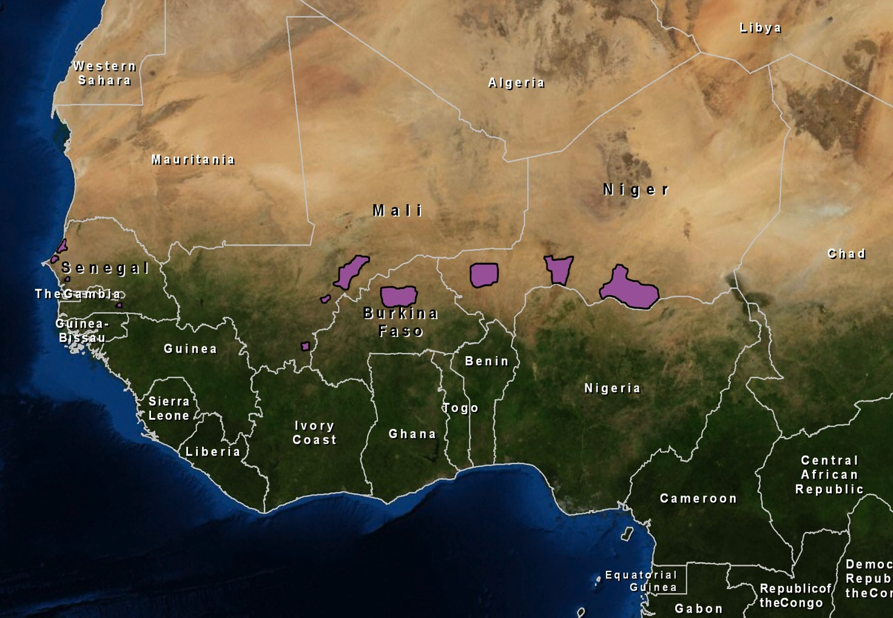
Expansion of agroforests
in some of the world’s most arid farmlands

Slide 36
Fertiliser trees are just one of many kinds of agroforestry.

Slide 37
Agroforests: combinations of perennial species on arable land
Home gardens with perennials
Woodlots or farm forests
Trees on field and farm boundaries
Sylvopastoral systems: Trees in pastures
EverGreen Agriculture: Trees intercropped with field crops
Productive landscape systems

Slide 38
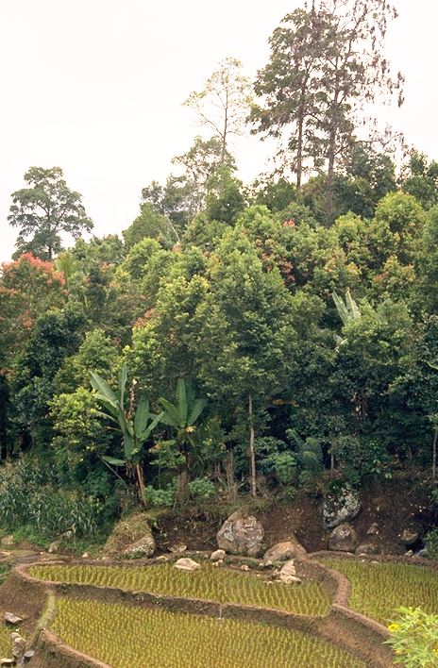
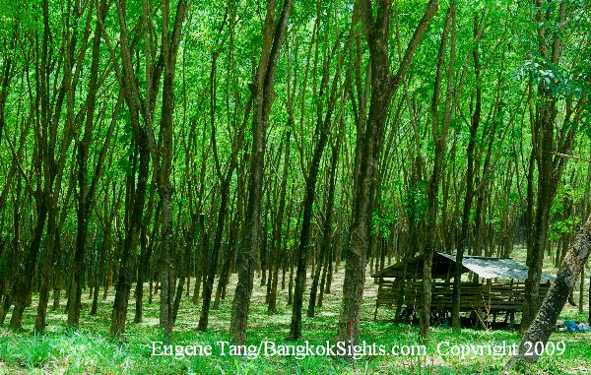
800 $ / Ha / year
High social costs
High environmental costs
3,000 $ / Ha / year
No social costs
Low environmental costs
Leakey, 2012

Slide 39
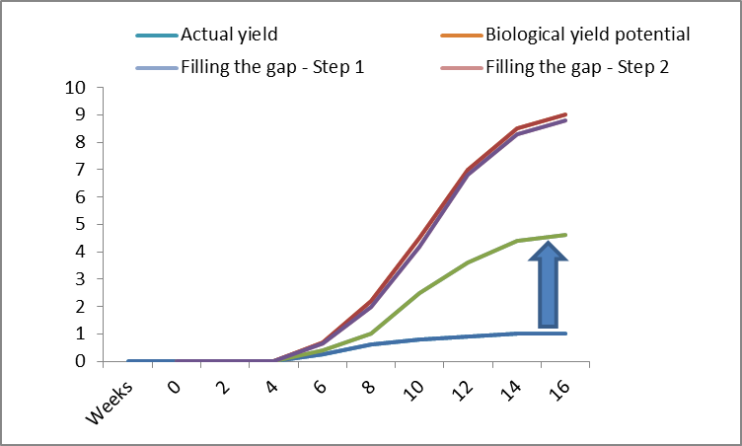
Trees help fill the yield gap
Crop yield
(tonnes per hectare)
GMOs
Advanced
Agroecology &
intrants
Simple
agroecology

Slide 40
The 2050 to-do list…
Produce 60% more food on ~ the same amount of land
Make farms, fields and landscapes more resistant to climate change
Massively reduce GHG emissions from land use.
√
3

Slide 41
Produce 60% more food on ~ the same amount of land
Make farms, fields and landscapes more resistant to climate change
Massively reduce GHG emissions from land use.
3

Slide 42
Adaptation through trees 1
Increased crop nutrient availability in rainfed food crop systems
Improved microclimate and weather buffering offering greater adaptation to climate change
Increased soil water retention and farmwater availability
Mesoclimatic effects are being documented for large AF parklands
Increased, and more stable, food crop productivity

Slide 43
Adaptation through trees 2
Increased food micronutrient availability (fruits)
Enhanced dry season fodder availability
Non-food products for own use or cash income: firewood, timber, medicinals...
Dramatically increased carbon accumulation in food crop systems: 6-10 tons of CO₂ per hectare per year are common
Enhanced biodiversity
Reduced deforestation due to on-farm fuelwood and timber production

Slide 44
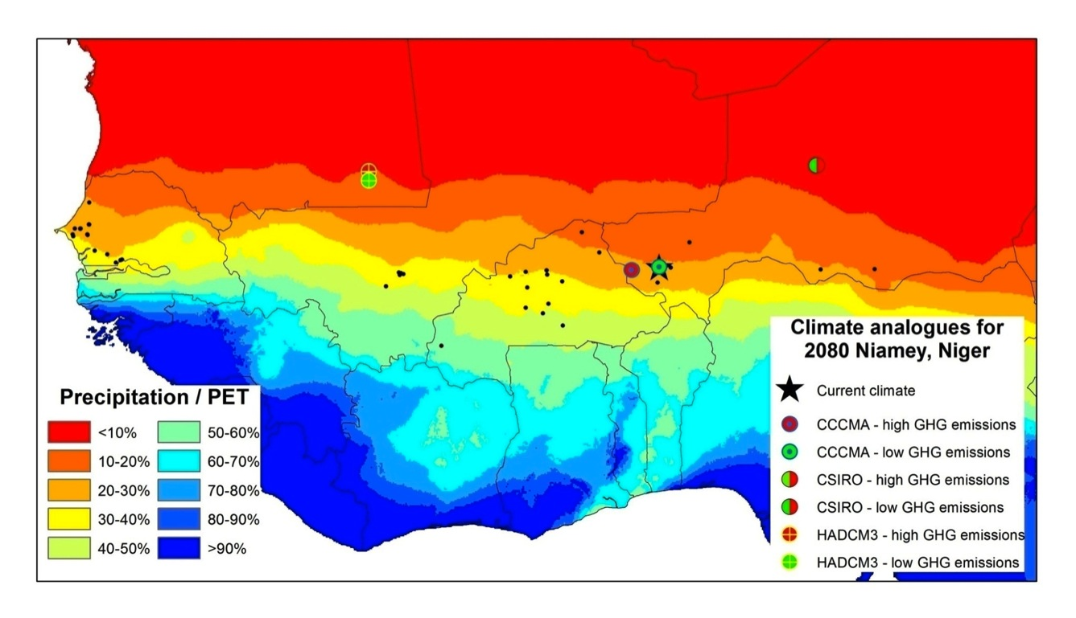
Development of climate analogues

Slide 45
The 2050 to do list
Produce 60% more food on ~ the same amount of land
Make farms, fields and landscapes more resistant to climate change
Massively reduce GHG emissions from land use.
√
√
3

Slide 46
Produce 60% more food on ~ the same amount of land
Make farms, fields and landscapes more resistant to climate change
Massively reduce GHG emissions from land use.
3

Slide 47
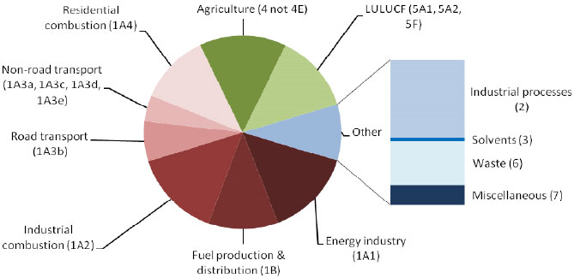
Sectoral shares of global GHG emissions: land use and ag > 30% !

Slide 48
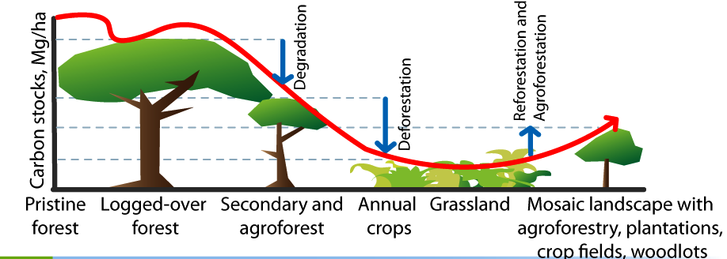
Trees lock up C above and below ground

Slide 49
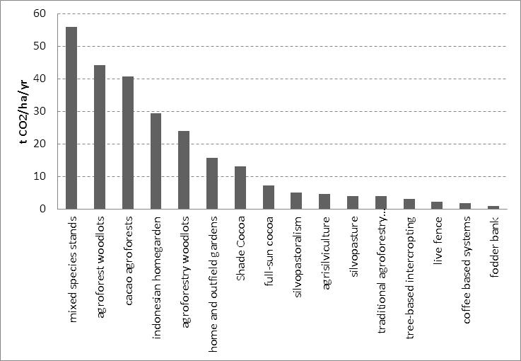
Mitigation through trees
Carbon potential in various AF systems
Mbow personal communication (2012)
Notes:
High input carbon practices: Improved crop varieties, crop rotation, use cover crop, conservation agriculture, better use of manure
Integrated nutrient management: reduction of leaching, improved N use, improved use of fertilizers
Increase availability of water: water management, water harvesting
Improved tillage: less soil disturbance, incorporating crop residues and soil organic matter
Agroforestry: increase above ground biomass and fuel wood, reduce soil erosion, set-aside,

Slide 50
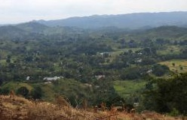
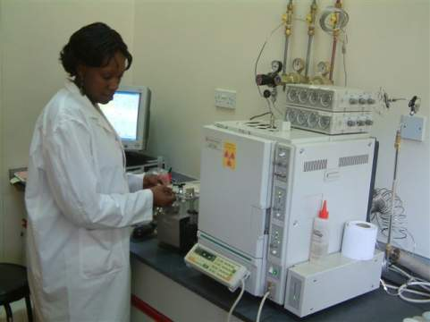
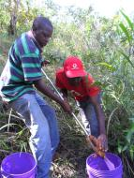

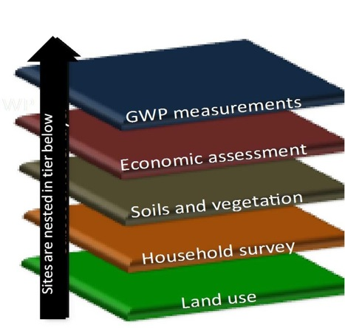
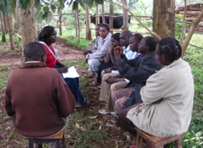
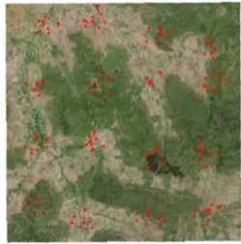
How do we know that?
Quantifying the potential of CSA.
Landscape
Monitoring GHGs
Multi-scale, randomized sampling design
Physical environment
Surveys & focus groups
Remote sensing & ground truthing
Standard Assessment of Mitigation Potential and Livelihoods in Smallholder Systems (SAMPLES)
Notes:
Building the evidence base on CSA requires the co-location of research. That is because the effectiveness of any given practice or technology to achieve any of the 3 CSA goals tend to be site specific, constrained by environment and human decision making
Thus though people have made broad generalization about proposed CSA practices, they may or may not be substantiated in the same place.
ICRAF in combination with a consortium of CG (ILRI, IRRI, and otehrs) and non CG partners is implementing a program called SAMPLES. Trying to build consensus for standard methods to assess mitigation and livelihoods. Here the methods have to We are also trying to figure out how best to integrate and scale out the information provided to provide actionable information at the level of decision making: households (intervention level), communities, and regions..
This is the preliminary approach we are using where we nest and co-locate the sampling sites (biophyical and socioeconomic). We are using and experimenting with a range of high and low tech methods. We specifically are designing this program is specific designed to optimize the relationship among scale, cost, and accuracy of measurement
“Sampling sites nested in tier below” means that the sampling points in the tier higher are a subset of those sites sample in that below.
NOTE: MICCA will implement the methodology designed in SAMPLES in Year 2 &3.
SAMPLES explictly only examine 2 aspects of CSA. However, the mitigation options (e.g., agroforestry in Nyando) examined in GWP measurement and economic assessment are considered if they are adaptive as well. There is thefore an implict consideration of adaptive capacity.
About the pictures:
Landscape: Kolero Tanzania, mixed staples-maize, cassava, rice (upland and paddy)
Monitoring GHG: gas chromatography in lab in Nairbi, inset is the base of a chamber
Physical environment: Soil sampling
Surveys…: Focal group meeting to discuss socially acceptable CSA in Kaptumo
Remote sensing: LDSF figure put here simply illustrate the point.

Slide 51
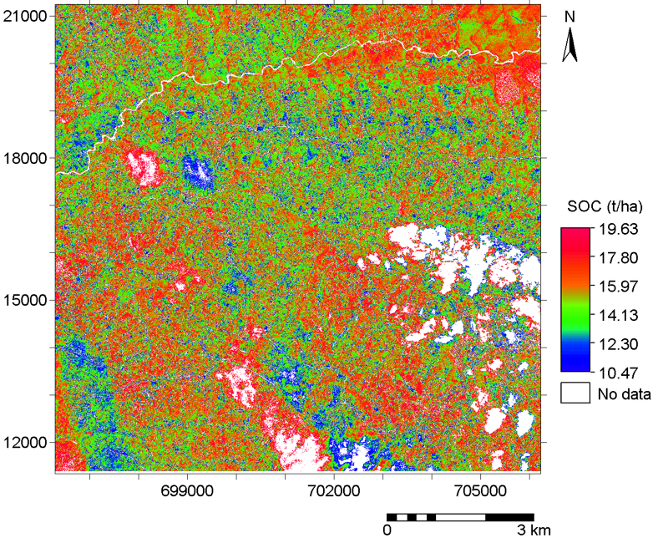

Mapping soil organic carbon
Mapping SOC Stocks using high resolution (QuickBird) satellite image
A landscape level SOC stocks mapping can be made using medium resolution satellite imagery such as ASTER and Landsat
SOC stocks in the mid Yala, western Kenya. The effect of cloud is masked as no data
Notes:
The slide is an output of the Land Health Surveillance Framework and shows C-stocks in the Yala watershed, western Kenya. Accurate SOC measurements allow tracking C-stock changes over time and can hence be used for monitoring, reporting and verification (MRV). This is a requirement for C-markets to function.

Slide 52
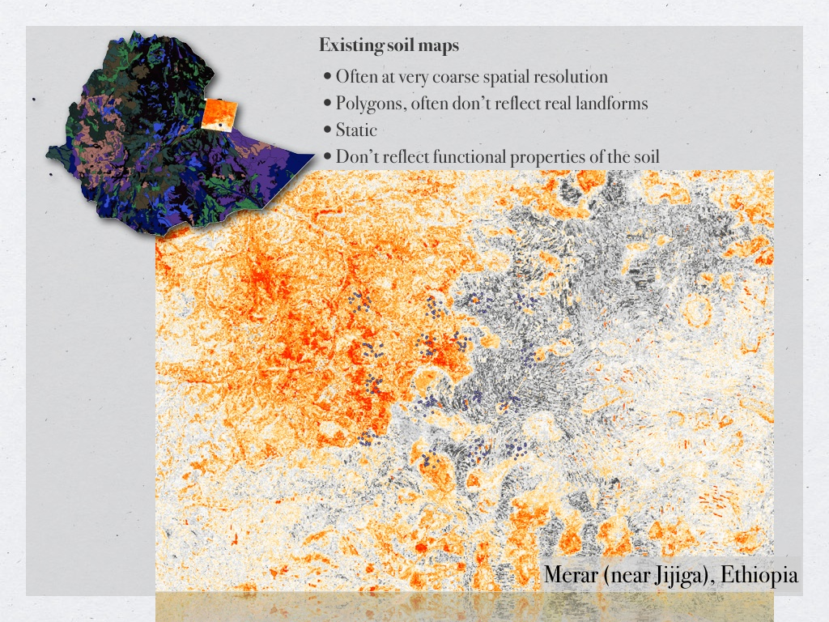

Mapping of soil erosion

Slide 53
The 2050 to-do list
Produce 60% more food on ~ the same amount of land
Make farms, fields and landscapes more resistant to extreme weather
Massively reduce GHG emissions from land use.
√
√
√
3

Slide 54
To get there:
Integrate, don’t segregate.

Slide 55
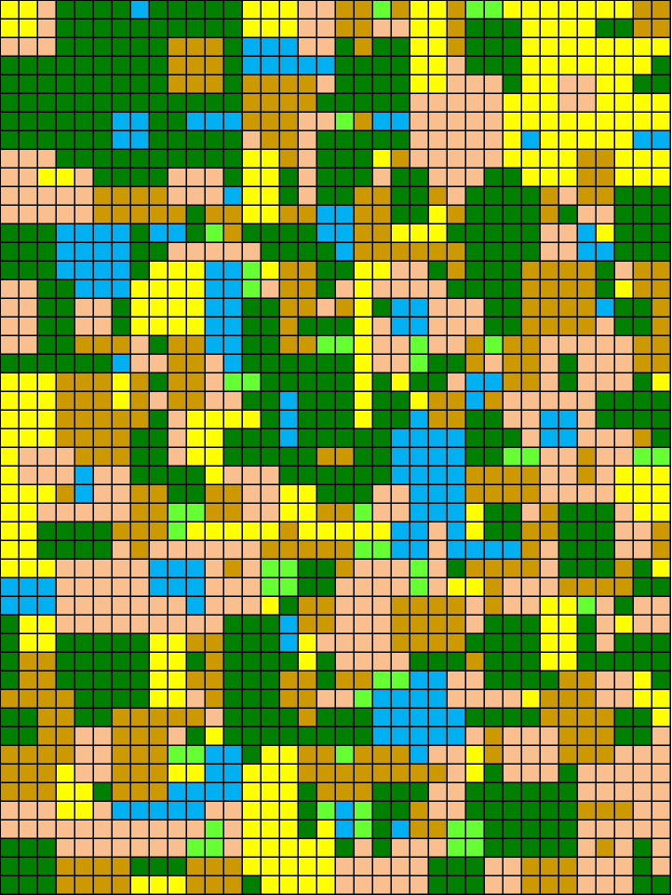
How we manage
the landscape…
… and what it looks like
in the real world.
Crop
Land
1.5 billion ha
Pasture &
Rangelands
3.4 billion ha
Natural
Forest
4.1 billion ha
Deserts
1.9 billion ha
Wetlands
1.3 billion ha

Slide 56
Integrate Segregate
⬅agroforestation
Open field agriculture
⬅re- and afforestation
Fields,fallow, forest mosaic
Plantations
deforestation➔
Fields, Forests & Parks
Agroforests
⬅forest modification
Natural forest

Slide 57
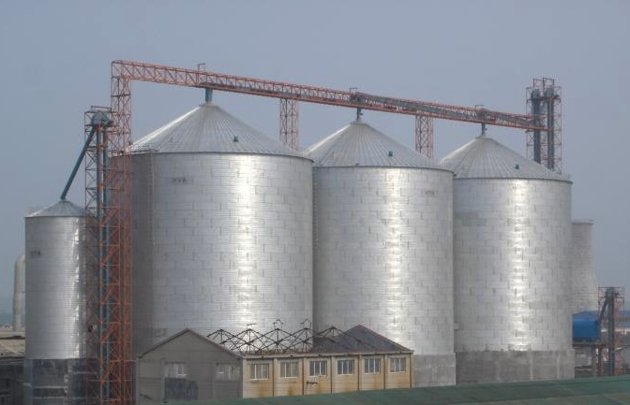
                Is this the best way to achieve..
                Productivity/Income ?
                Sequestration/Mitigation ?
                Reduced emissions ?
                Resilience/Adaptation ?
Agriculture
Forestry
Environment
CSA
REDD+
PES

Slide 58
Old Impact Pathway Paradigm
Development
(application of knowledge)
Research
(building of knowledge)
Time (years)

Slide 59
New Impact Pathway Paradigm
Development
(proof of application &
application of knowledge)
Research
(building of knowledge)
Time (years)

Slide 60
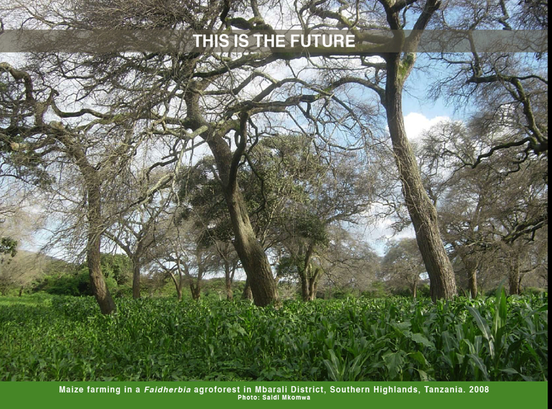

Slide 61
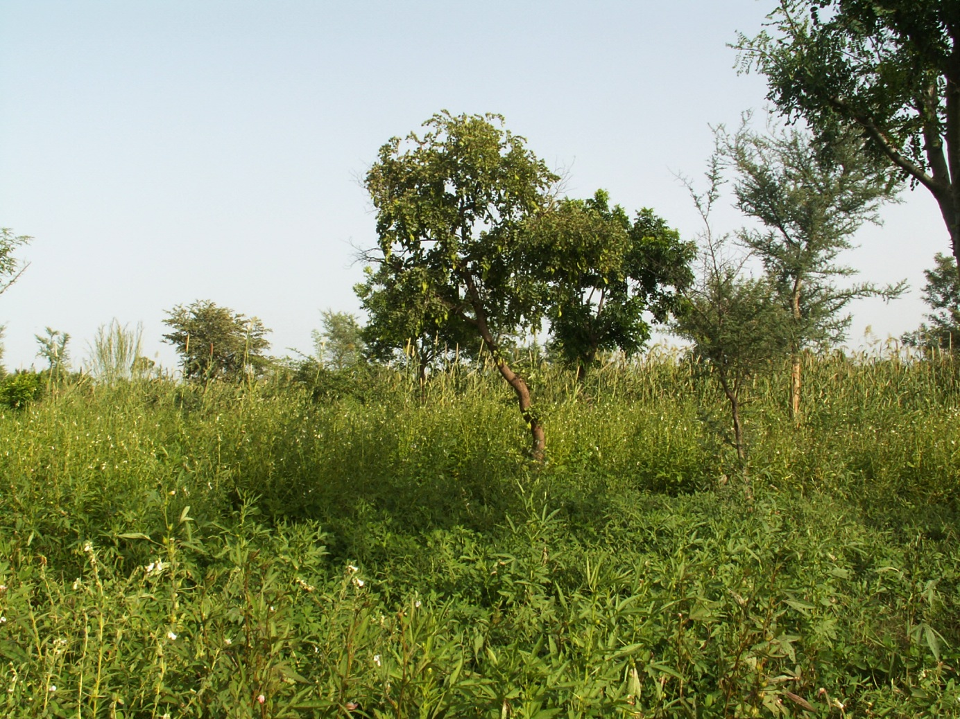
15 years ago, this was barren land
(yield: 0 kg/ha)
Thank you !

Slide 62
For more information
Patrick Worms, World Agroforestry Centre
Email:p.worms@cgiar.org
Tel: +32 495 24 46 11
www.worldagroforestrycentre.org
53

