Slide 1
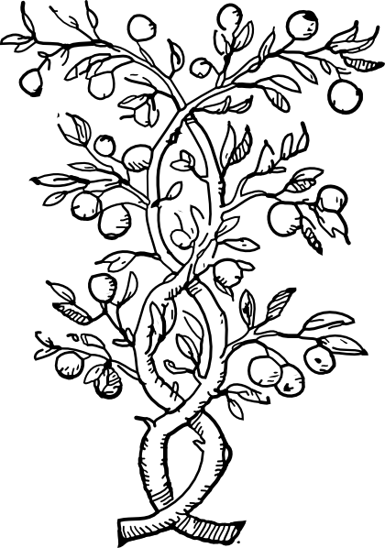
AGROFORESTERIE
Par Venant Nahayo et
Jonathan Guaya
Notes:
*

Slide 2
DEFINITION
L'agroforesterie est un mode de production agricole intégré et intensif dans lequel les plantes ligneuses (arbres, arbustes et arbrisseaux, lianes ligneuses et bambous, etc.) jouent un rôle essentiel pour atteindre des objectifs environnementaux, économiques et sociaux.
Notes:
*

Slide 3
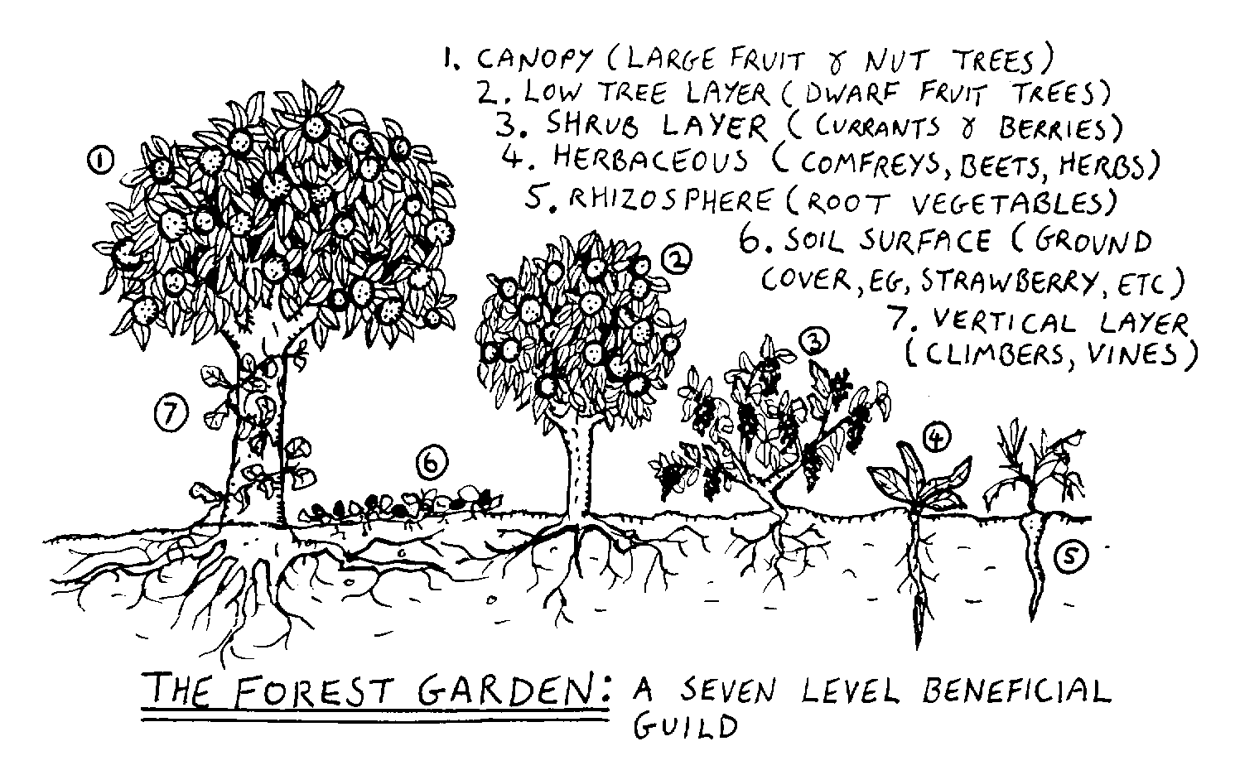

Slide 4
ORIGINE ET EVOLUTION
Agriculture et foresterie concurrents ?
vue de l’espace
gestion des terres et gouvernance
En Afrique, déforestation due à la pression démographique
(nécessité de cultiver, de manger, de chauffer, pâture, etc.)
Le paysan pratique l'agroforesterie depuis longtemps
Notes:
*

Slide 5
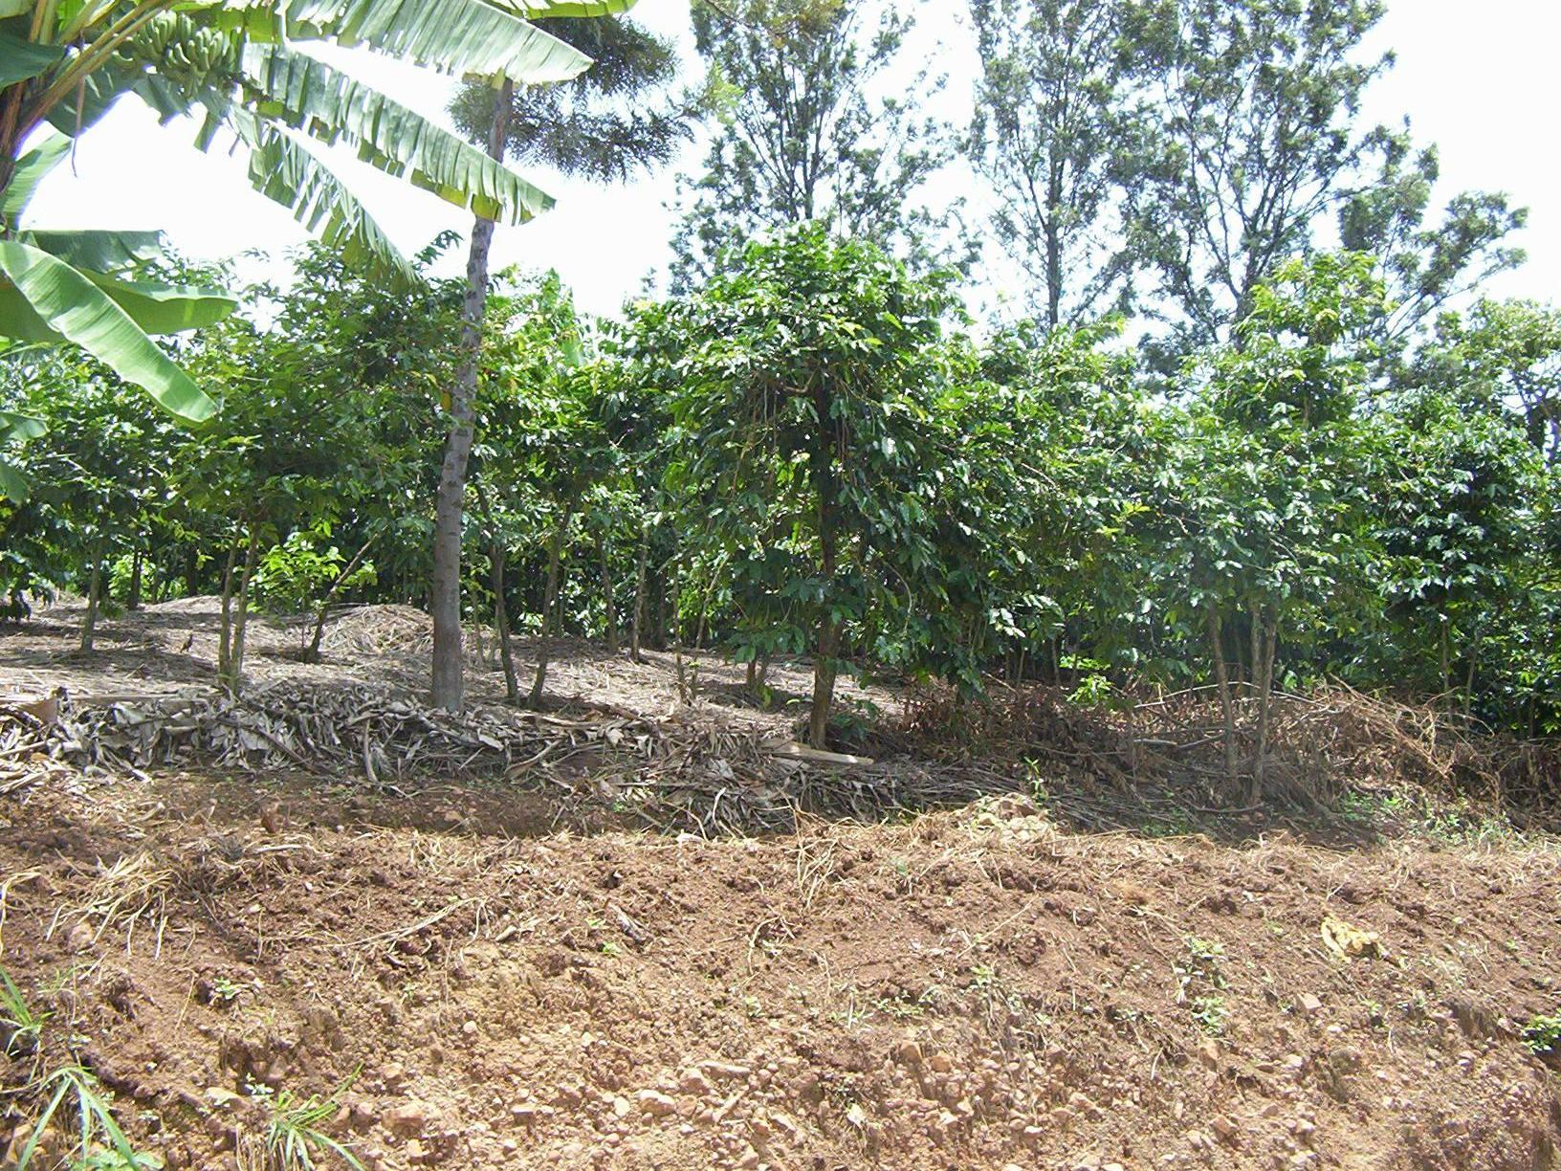
Photo NV: En commune Murwi au Burundi.
Le caféier associé au grevillea et quelques bananiers.
Notes:
*

Slide 6
ORIGINE ET EVOLUTION
suite...
Agroforesterie : “nouvelle discipline” ou pratiques anciennes ?
En Afrique, dans les années 70 que l’intérêt est né à cause de la crise du bois de feu et de la sécheresse au Sahel.
Affirmation en 1980, agroforesterie comme approche intégrée et systémique
Notes:
*

Slide 7
« Plus qu'un réservoir de 2 par 4 ... »
A. Produits de valeur économique, médicale
Bois- énergie;
Bois de service et d’oeuvre;
Produits non ligneux;
Gomme arabique du Soudan pour l’alimentation
les peintures, les colles
les champignons et plantes ornementales;
Feuillage, écorces, fleurs, sève, etc.
Notes:
*

Slide 8
B. Services rendus par les arbres
Préserver la matière organique des sols (Roose, 1994) et améliorer leur fertilité.
Lutter contre l’ érosion éolienne et hydrique.
Faciliter l’infiltration des eaux de pluie et assurer les productions agricoles.
Réguler le climat en séquestrant le carbone
Amélioration du climat en ville.
Notes:
*

Slide 9
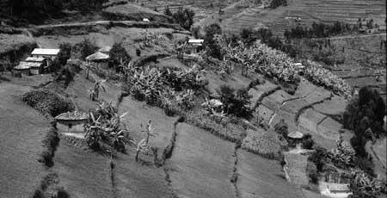
Cultures en terrasses dans la région de Byumba, Rwanda.
Notes:
Bananiers et quelques arbres épars dans les concessions. (© Odoul/FAO)
*

Slide 10
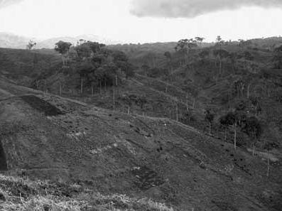
Déforestation à Rwegura (Burundi)
Les plantations de thé ont remplacé la foret.
Notes:
*

Slide 11
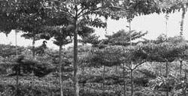
Production de café sous ombrage, Costa Rica. (© Harmand/Cirad)
Notes:
La culture du caf éier sous couvert et/ou en association avec des cultures annuelles n’est pas admise au Burundi et au Rwanda. Le colonisateur voulait maximiser la production en imposant le caf éier en monoculture. Le paillis est vol é aux autres cultures et est mis dans les caf éiers.
*

Slide 12
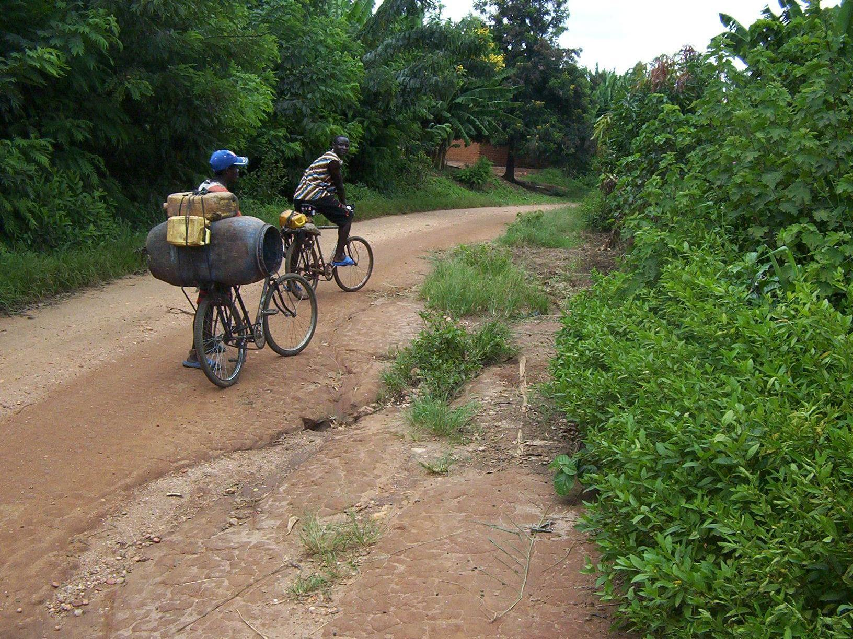
Photo NV: Commune Murwi au Burundi
Agroforesterie sur les routes et autour des cases
Notes:
*

Slide 13
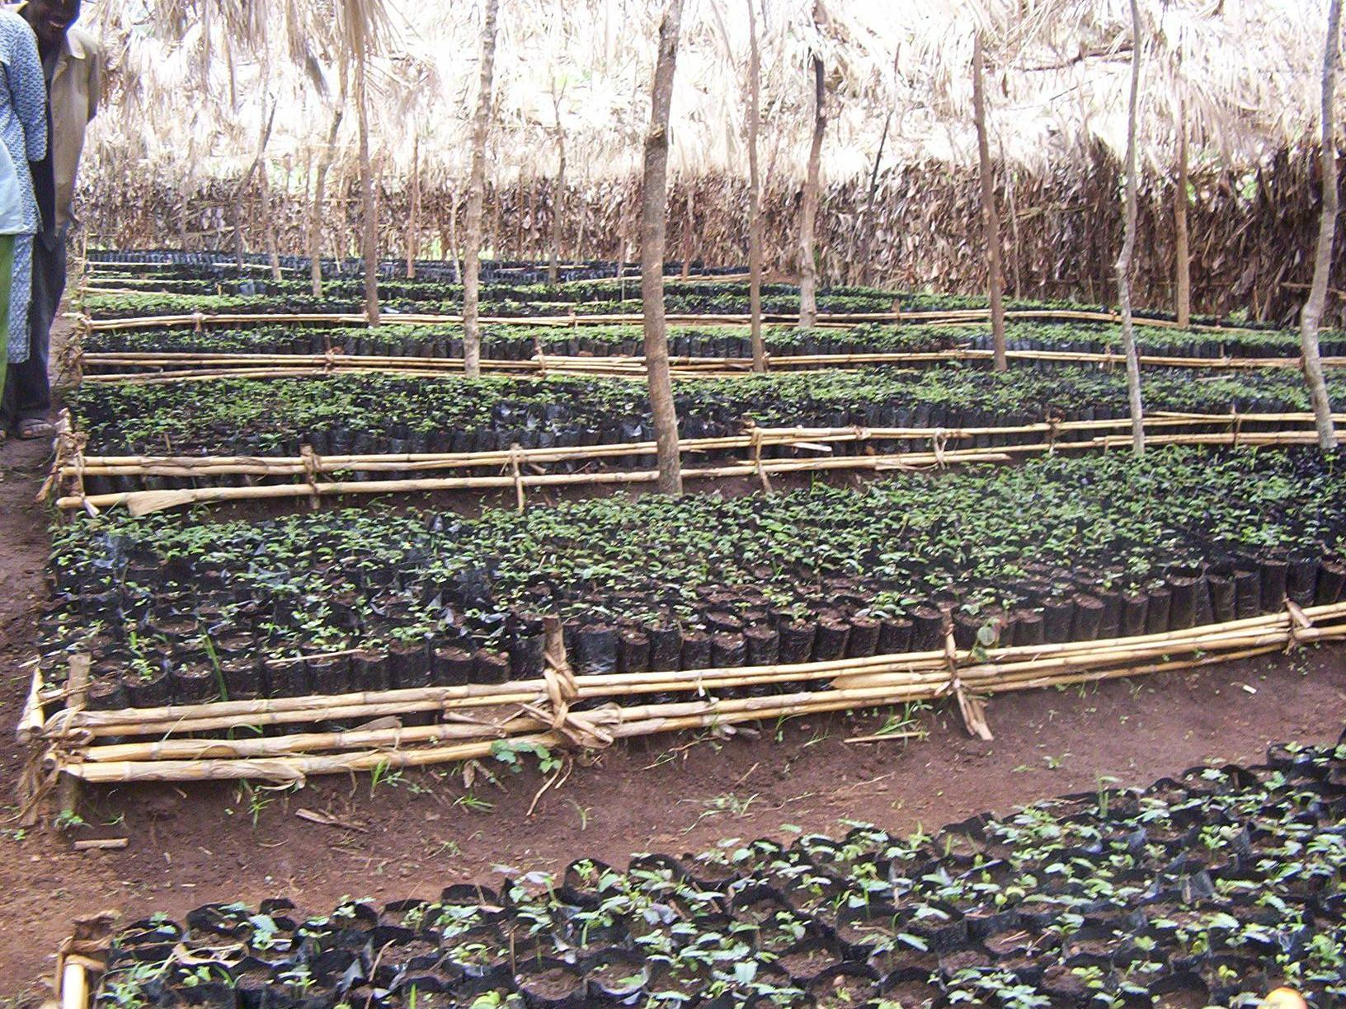
Photo NV prise le 11/1/2004
Une pépiniere d’arbres et arbustes agroforestiers dans la province de Makamba au Burundi entretenue par la population
Notes:
*

Slide 14
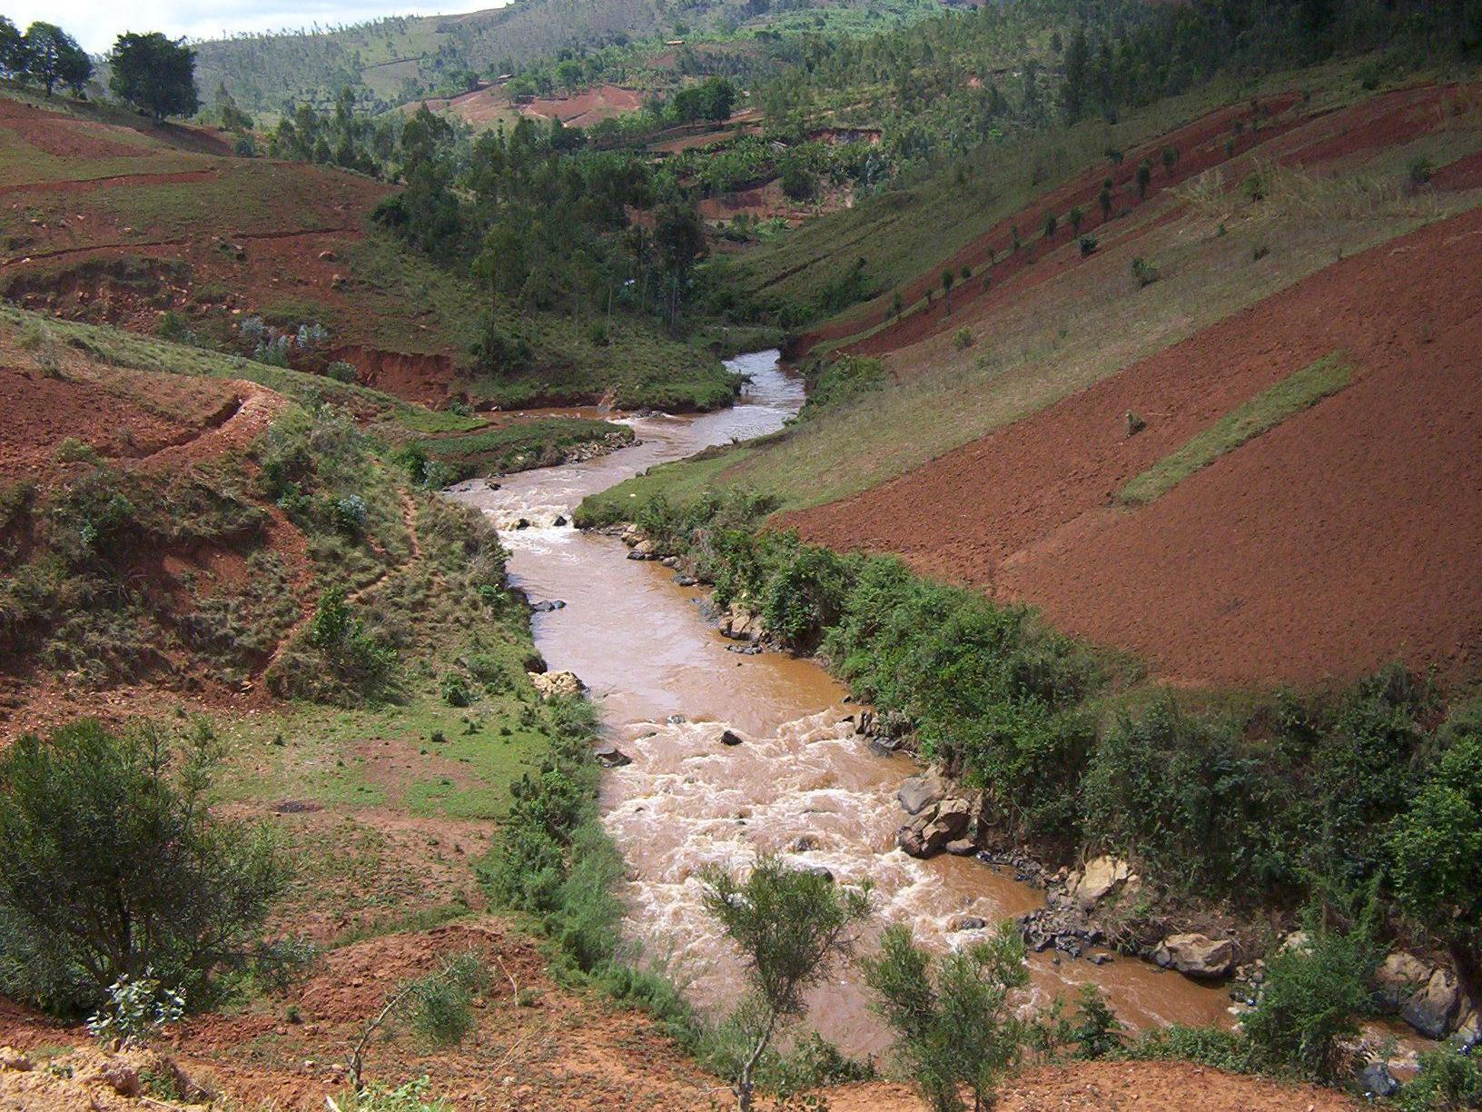
Photo NV: Riviere Mubarazi en commune Muramvya au Burundi
Pas de lutte anti-érosive, la zone tampon entre la rivière et le début de la pente base de la colline n’est pas boisée
Notes:
*

Slide 15
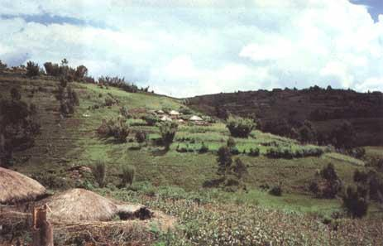
Exploitations pratiquant l’agroforesterie
Notes:
*

Slide 16
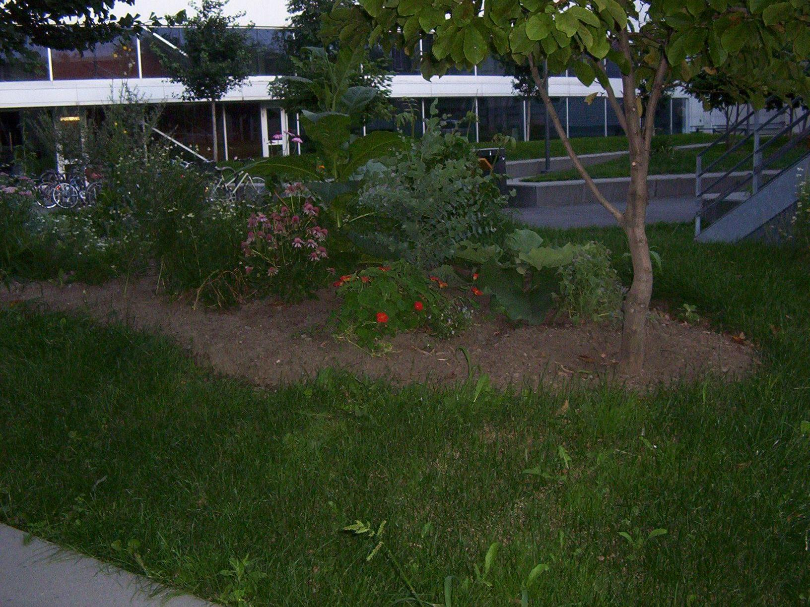
UQAM fait l’agroforesterie en ville : Montréal
C’est un modele à suivre, même la ville a besoin d’arbres et d’arbustes associés aux plantes annuelles comme les légumes, les plantes médicinales et les fleurs
Notes:
*

Slide 17
UQAM fait l’agroforesterie en ville : Montréal
C’est un modele à suivre, même la ville a besoin d’arbres et d’arbustes associés aux plantes annuelles comme les légumes, les plantes médicinales et les fleurs
Notes:
*

Slide 18
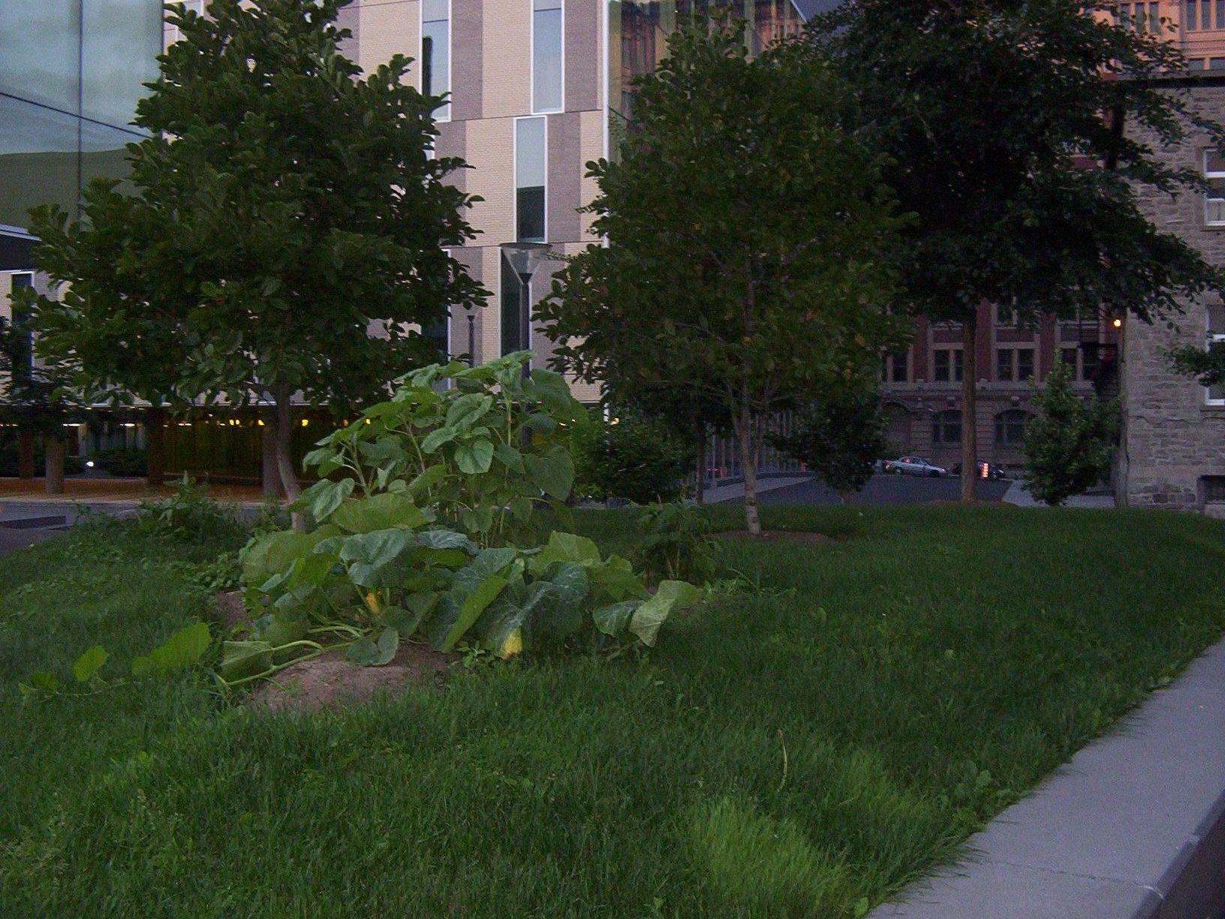
Arbres avec cultures annuelles et gazon en ville
Bon paysage et apport de fraicheur et d’oxygène !
Notes:
*

Slide 19
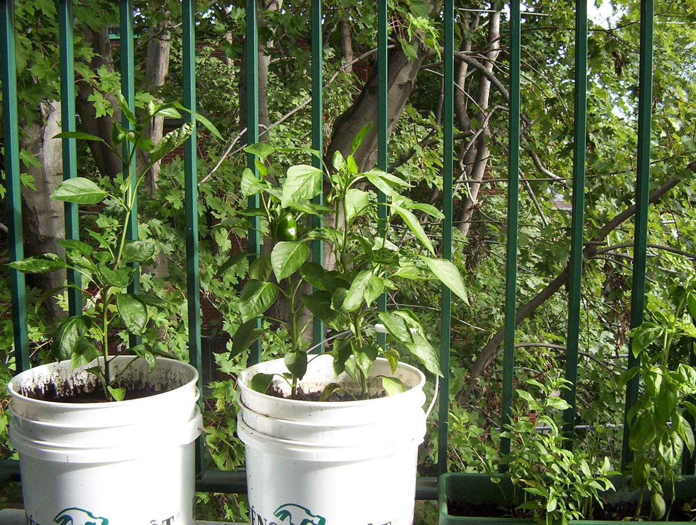
Culture de légume sur balcon et sous ombrage
Notes:
Sur ce balcon, il y a fraicheur, oxygène et dans quelques temps je n’acheterai pas de poivron.
*

Slide 20
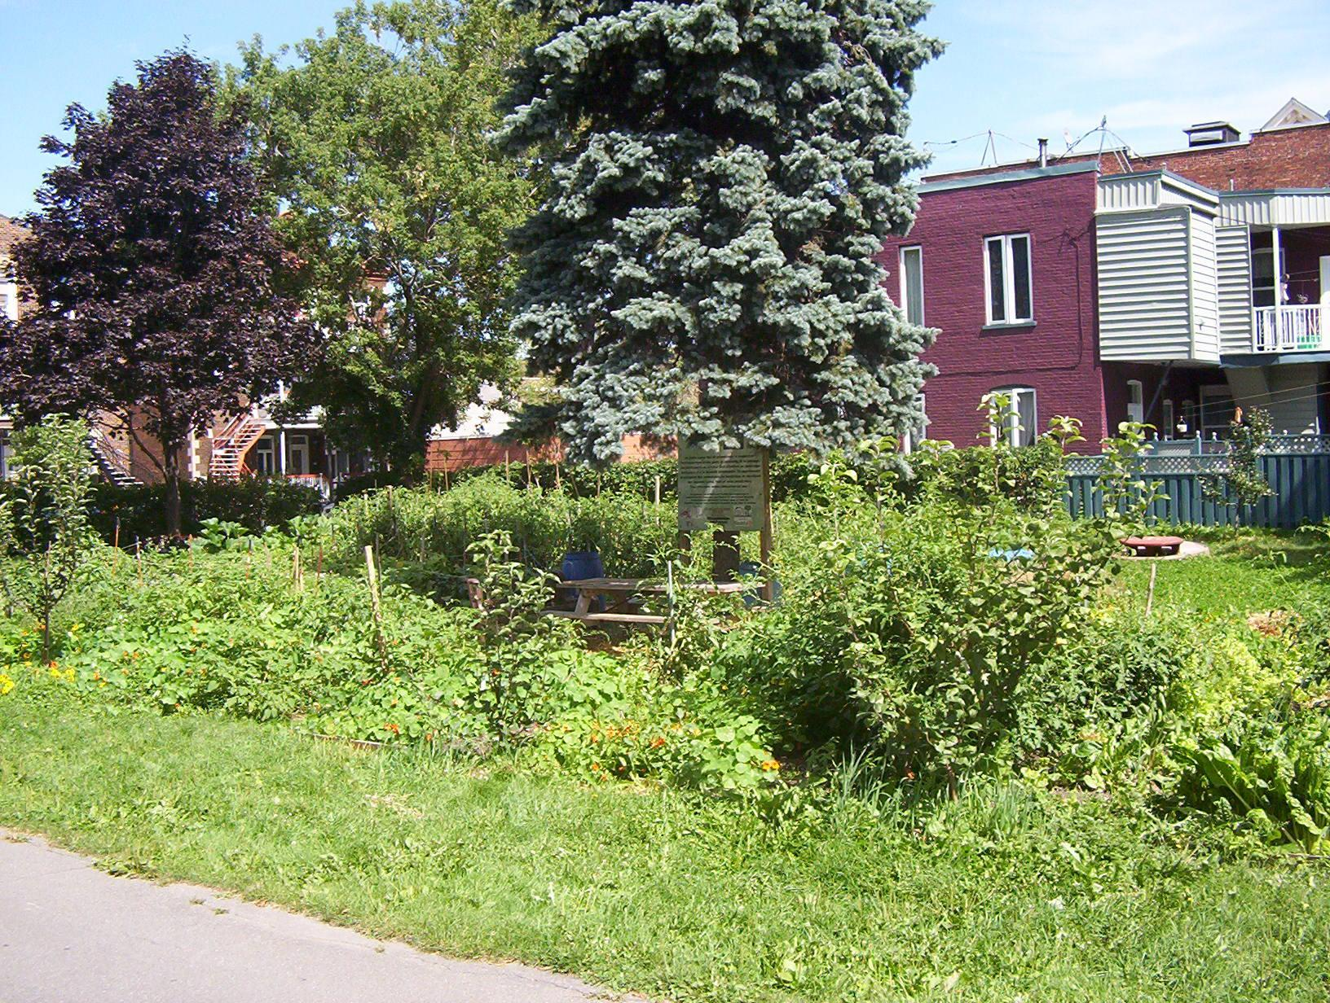
Jardin collectif de Verdun avec arbres
Notes:
*

Slide 21
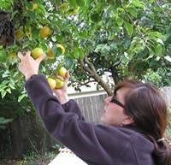
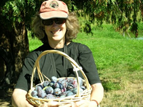
Portland Fruit Tree Project
Portland Fruit Tree Project provides a community-based solution to a critical and growing need in Portland and beyond – access to healthy food.
By empowering neighbors to share in the harvest and care of urban fruit trees, we are preventing waste, building community knowledge and resources, and creating sustainable, cost-free ways to obtain healthy, locally-grown food.
Because money doesn’t grow on trees… but fruit does!
We organize people to gather fruit before it falls, and make it available to those who need it most.
We register fruit and nut trees throughout the city, bring people together to harvest and distribute thousands of pounds of fresh fruit each year, and teach tree care and food preservation in hands-on workshops.
Notes:
*

Slide 22
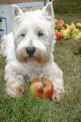
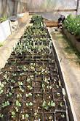
LifeCycles Fruit Tree Project
Lifecycles is a non-profit, community-based organization dedicated to cultivating awareness of and initiating action around food, health and urban sustainability in the Greater Victoria community. This predominantly youth driven organization is geared towards education and building community connections through hands-on projects that work towards creating better local and global food security.
LifeCycles' roots begin in 1994 in the soil of an international youth exchange. The focus of the exchange was on comparatively examining home environments and developing joint projects to enhance the quality of urban community life.
Addressing the shortage of community gardens in Victoria, beginning with mapping needs and supplies for each.
Creating model gardens promoting organic methods.
Coordinating a sharing backyard program to link landowners with individuals who were landless but desired to garden.
Organizing conferences, community workshops to raise awareness about food issues and to encourage activism.
Notes:
*

Slide 23
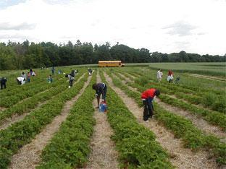
North York Harvest Foodbank
Making Connections addresses the need for food bank clients to have access
to fresh produce. The project’s goal is to improve consumption and knowledge
of fresh and locally-grown vegetables and fruit.
We connect food program clients to fresh local produce. We link local farms to
non-profit organizations and clients, and ultimately this provides a re-connection
with both land and our food sources for all involved.
Making Connections works with ‘at-risk’ individuals in the north Toronto area
including those with a low income, seniors, children, and newcomers.
How Making Connections helps link hungry families to local produce
Farm Support. Local produces are picked up by North York Harvest Food Bank and distributed to food bank users in the northern Toronto area. Over 13,000 lbs of fresh produce were donated in 2008.
Gleaning is the picking of fruits and vegetables that a farmer will not harvest. It is free of charge and helps reduce food wastage at the same time as providing community members and food bank clients with access to wonderful seasonal produce. Making Connections arranges gleaning trips to participating farms and for many participants this is their first visit to a farm.
Educational Workshops. Many people in Toronto have limited knowledge of local produce and its preparation. What do you do with a rutabaga? Making Connections offers cooking workshops in community kitchens which cover topics such as food safety, nutrition and preservation techniques. Participants make jams, baby food and sauces that can be stored through to winter.
Public support and education
Notes:
*

Slide 24
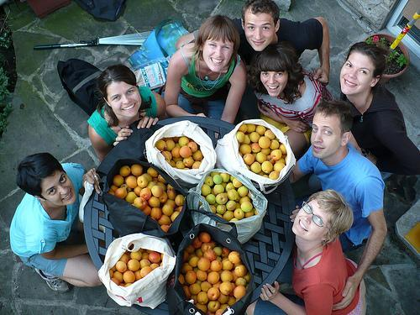
Not Far From the Tree
The core of our programming is our residential fruit-picking program, where we pick fruit from trees that would otherwise go to waste. We help fruit tree owners make use of the abundance of fruit that their trees offer by dispatching teams of volunteers to harvest it for them. One third goes to the fruit tree owners, another third goes to the volunteers for their labour, and the final third is distributed (by bicycle or cart) to community organizations in the neighbourhood who can make good use of the fresh fruit.
In 2008, our first full season, we picked over 3,000 lbs of fruit in Toronto. As we expand, we are creating a network of neighbourhood-based fruit tree hubs around the city.
In partnership with Growing for Green, we’re helping to support Toronto’s first community orchard in a public park.
In partnership with a gardening group based in Toronto, we offer educational workshops, garden tours, volunteer gardening opportunities and social networking to local gardeners.
In 2009 the group’s members founded Toronto’s first community orchard. Located in Ben Nobleman Park near Eglinton West subway station, it includes 9 fruit trees including pears, plums and cherries.
The group is working to help apartment-dwelling Torontonians link up with with homeowners who have garden space to spare so they can plant vegetable gardens through the Sharing Backyard program.
Notes:
*

Slide 25
Pour en savoir plus...
ALEXANDER, Christopher et Al. A Pattern Language. Oxford Press. 1977.
GOLDSMITH, Edward. The Way : An Ecological Worldview. Green Books. 1997.
HEMENWAY, Toby. Gaia's Garden. Chelsea Green Publishing Compagny. 2000.
MOLLISON, Bill. Permaculture : A Designer's Manual. Tagari Publications. 1988.
http://portlandfruit.org/
http://lifecyclesproject.ca
http://www.northyorkharvest.com
http://www.notfarfromthetree.org/
http://pousses.blogspot.com/
Notes:
*

